Slide 1
Therapy of Diabetes Mellitus
Yacoub Irshaid MD, PhD, ABCP
Department of Pharmacology

Slide 2
Therapy of Diabetes Mellitus
Diabetes mellitus (DM) is a heterogeneous group of metabolic disorders characterized by hyperglycemia.
It is associated with abnormalities in carbohydrate, fat, and protein metabolism.
It may result in chronic complications including microvascular, macrovascular, and neuropathic disorders.

Slide 3
Therapy of Diabetes Mellitus
DM is the leading cause of blindness and end-stage renal disease.
It may result in lower extremity amputations, and cardiovascular events.

Slide 4
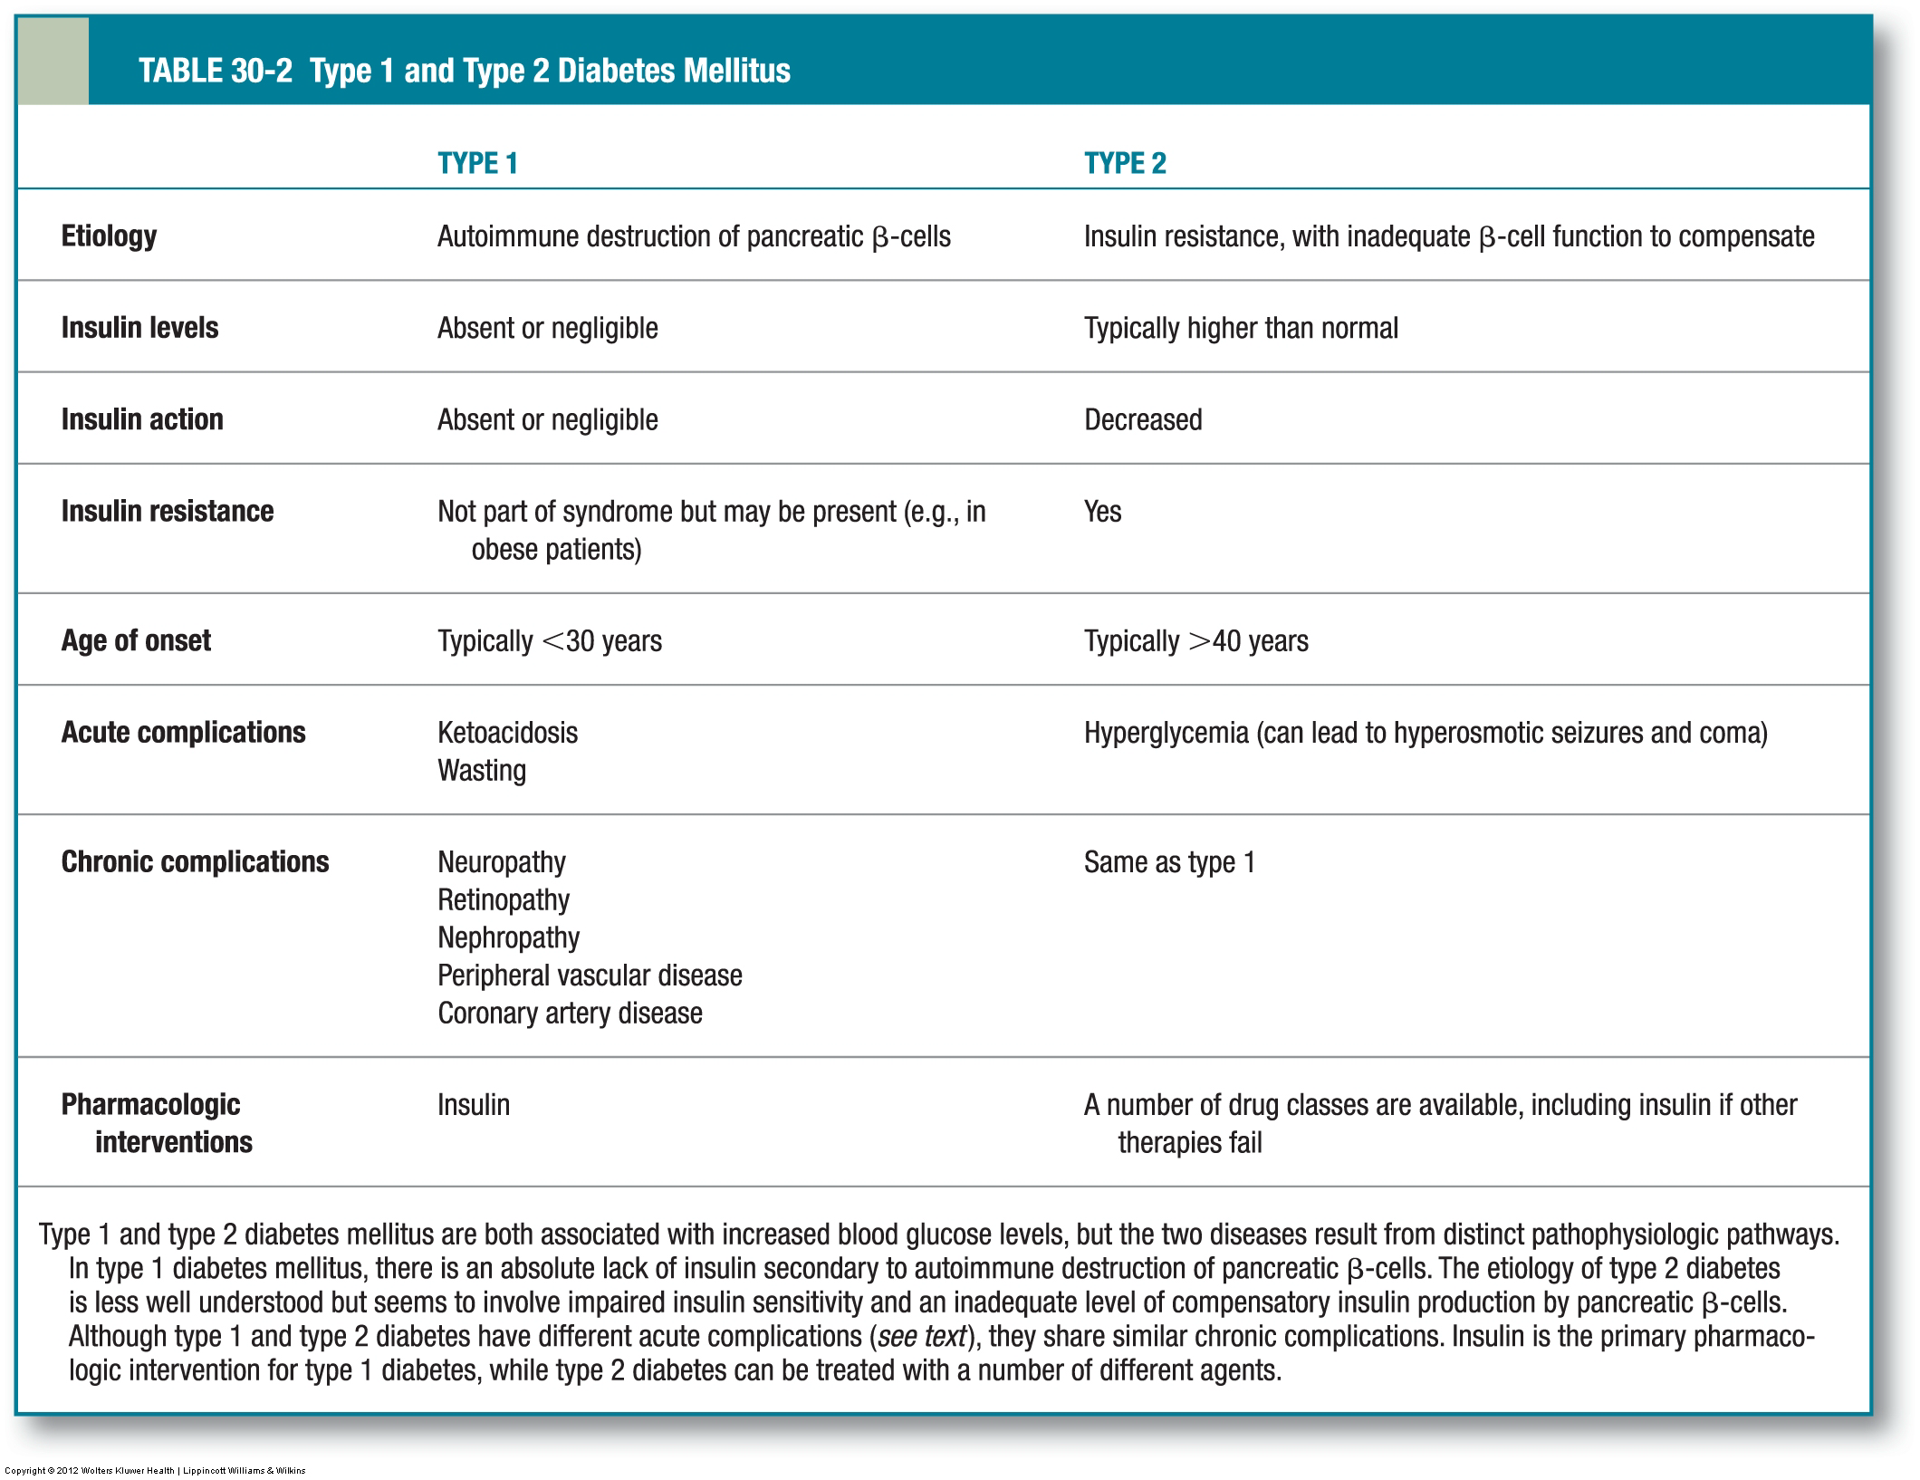

Slide 5
Drug-induced Diabetes Mellitus
Pyriminil (vacor) (rodenticide) – loss of pancreatic β-cells.
Pentamidine – cytotoxic effect on pancreatic β-cells (type 1).
Nicotinic acid – impairment of insulin action.
Glucocorticoids – Metabolic effects and insulin antagonism.
Thyroid hormones – increase hepatic glucose production.
Growth hormone - reduces insulin sensitivity resulting in mild hyperinsulinemia, and increased blood glucose levels
Diazoxide: inhibition of insulin secretion.

Slide 6
Drug-induced Diabetes Mellitus
β-adrenergic agonists – glycogenolysis, and gluconeogenesis.
Thiazide – hypokalemia-induced inhibition of insulin release.
Phenytoin – induces insulin insensitivity.
Interferone – β-cell destruction (type 1)
Chronic alcohol - insulin resistance and pancreatic β-cell dysfunction.
Cyclosporin – suppresses insulin production and release.

Slide 7
Drug-induced Diabetes Mellitus
HIV protease inhibitors - peripheral insulin resistance with insulin deficiency relative to hyperglucagonemia.
Atypical antipsychotics (clozapine and olanzapine) – weight gain and insulin resistance.
Megestrol acetate – insulin resistance.
Others

Slide 8
Therapy of Diabetes Mellitus
Desired Outcome:
The primary goals of DM management are:
To reduce the risk for microvascular and macrovascular disease complications.
To ameliorate symptoms.
To reduce mortality.
To improve quality of life.
To minimize weight gain and hypoglycemia.

Slide 9
Therapy of Diabetes Mellitus
Early diagnosis and treatment to near-normal glycemia reduces the risk of developing microvascular (retinopathy, nephropathy, and neuropathy ) disease complications.
Aggressive management of cardiovascular risk factors including smoking cessation, treatment of dyslipidemia, intensive blood pressure control, and antiplatelet therapy are needed to reduce the risk of developing macrovascular disease (ischemic heart disease, peripheral vascular disease, and cerebrovascular disease).

Slide 10
Therapy of Diabetes Mellitus
Hyperglycemia also contributes to poor wound healing by compromising white blood cell function and altering capillary function.
DKA and hyperosmolar hyperglycemic state (HHS) are severe manifestations of poor diabetes control, always requiring hospitalization.

Slide 11
Nonpharmacologic Therapy
Screening.
Monitoring:
blood glucose, HbA_{1c}, fasting lipid profile, urinary albumin (urine albumin-to-creatinine ratio [UACR]) and estimated glomerular filtration rate (eGFR), diabetic peripheral neuropathy, and dilated eye examination.

Slide 12
Nonpharmacologic Therapy
Glycemic goals:
HbA_{1c} goal for nonpregnant adults of <7%, or of <6.5% without significant hypoglycemia.
Hospital: Critically ill glucose: 140-180 mg/dL, or more stringent guidelines down to 110-140 mg/dL (if without hypoglycemia).

Slide 13
Nonpharmacologic Therapy
5. Medical nutrition therapy:
Weight loss is recommended for all insulin-resistant /overweight or obese individuals. Either low-carbohydrate, low-fat calorie restricted diets, or Mediterranean diets. (healthier eating behaviors leading to sustained weight loss over time is more important than a specific diet).

Slide 14
Nonpharmacologic Therapy
In individuals with type 2 diabetes, ingested protein appears to increase insulin response without increasing plasma glucose concentrations. Therefore, carbohydrate sources high in protein should not be used to treat or prevent hypoglycemia.
Saturated fat should be <7% of total calories.

Slide 15
Nonpharmacologic Therapy
A Mediterranean-style eating pattern, rich in monounsaturated fatty acids (olive oil), may benefit glycemic control and CVD risk factors and can therefore be recommended as an effective alternative to a lower-fat, higher-carbohydrate eating pattern.
Consider financial and cultural food issues.
Discourage bedtime and between-meal snacks, set realistic goals.

Slide 16
Nonpharmacologic Therapy
A diet lower in fat is recommended for patients with CVD and avoiding a high protein diet in patients with nephropathy may be appropriate.
Supplements with all of the essential vitamins and minerals if needed.

Slide 17
Nonpharmacologic Therapy
6. Physical Activity:
Aerobic exercise improves insulin sensitivity, modestly improves glycemic control, reduces cardiovascular risk, contributes to weight loss or maintenance, and improves well-being.
Physical activity goals include at least 150 min/wk of moderate (50%-70% maximal heart rate) intensity exercise spread over at least 3 days a week with no more than 2 days between activities.

Slide 18
Nonpharmacologic Therapy
Resistance/Strength training is recommended at least 2 times a week in patients without proliferative diabetic retinopathy.

Slide 19
Nonpharmacologic Therapy
7. Patient Education:
It is not appropriate to give patients with DM brief instructions and a few pamphlets.
Diabetes education, at initial diagnosis and at ongoing intervals over a lifetime, is critical.
The behaviors include healthy eating, being active, monitoring, taking medication, problem solving, reducing risk, and healthy coping.

Slide 20
Nonpharmacologic Therapy
The patient must be involved in the decision-making process with knowledge of the disease and associated complications.
Emphasize that complications can be prevented or minimized with good glycemic control and managing risk factors for CVD.
Motivational interviewing techniques to encourage patients to identify barriers that hinder achieving health goals, and then work to solve them.

Slide 21
Other Recommendations
A. Blood pressure:
Systolic/diastolic blood pressure should be treated to <140/<90 mm Hg.
Lower goals systolic blood pressure <130 mm Hg and/or diastolic blood pressure <80 mm Hg may be appropriate for younger patients.
Lifestyle intervention such as weight loss, and diet including reducing sodium and increasing potassium.
Initial drug therapy should be with an ACEi or ARB; if intolerant to one, the other should be tried.

Slide 22
Other Recommendations
B. Dyslipidemia:
Lifestyle modification focusing on the reduction of saturated fat, and cholesterol intake; increase omega-3 acids, viscous fiber, and plant sterols; weight loss, and increase physical activity should be recommended.
Consider the use of statins according to risks.

Slide 23
Other Recommendations
C. Antiplatelet Therapy:
Use aspirin (75-162 mg daily) for secondary cardioprotection.
D. Hospitalized Patients:
Critically ill: By IV insulin protocol; Noncritically ill: scheduled subcutaneous insulin with basal, nutritional, and correction coverage.
E. Psychosocial:
Assess the patient’s psychological and social situation as an ongoing part of the medical management of diabetes.

Slide 24
Prevention of Diabetes Mellitus
Efforts to prevent type 1 were all unsuccessful.
Prevention of type 2 diabetes:
The “4 lifestyle pillars” for the prevention of type 2 diabetes are to decrease weight, increase aerobic exercise, increase fiber, and decrease fat intake.

Slide 25
Prevention of Diabetes Mellitus
2. Drugs:
Metformin therapy reduces the risk of developing type 2 DM, especially in obese, <60-year-old patients, and women with prior GDM.
Rosiglitazone reduces the incidence of type 2 diabetes.
Acarbose and liraglutide decrease progression to type 2 DM.

Slide 26
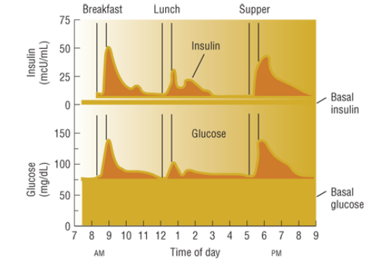
Pharmacologic Therapy (Type 1 DM)
All patients with type 1 DM require insulin.
Relationship between insulin and glucose over the course of a day

Slide 27
Pharmacologic Therapy (Type 1 DM)
Attemp to mimic normal secretion of insulin.
One or two injections daily of any one insulin formulation will in no way mimic normal physiology, and therefore is unacceptable.
The timing of insulin onset, peak, and duration of effect must match meal patterns and exercise schedules to achieve adequate blood glucose control throughout the day.

Slide 28
Insulin

Slide 29
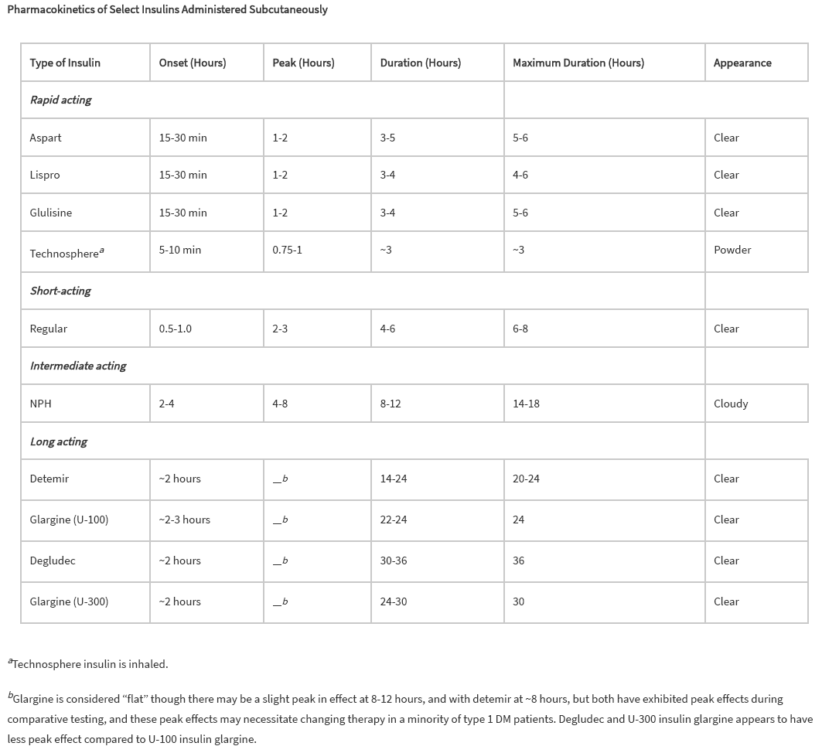

Slide 30
Intensive Insulin Regimen
A, aspart; CS-II, continuous subcutaneous insulin infusion; D, detemir or degludec; G, glargine; GLU, glulisine; L, lispro; N, NPH; P, pramlintide; R, regular.
 | 7 am meal | 11 am meal | 5 pm meal | Bed time
2 doses (R or rapid acting) + N | R, L, A, Glu + N |  | R, L, A, Glu + N
3 doses (R or rapid acting) + N | R, L, A, Glu + N | R, L, A, Glu | R, L, A, Glu + N
4 doses (R or rapid acting) + N | R, L, A, Glu | R, L, A, Glu | R, L, A, Glu | N
4 doses (R or rapid acting) + N | R, L, A, Glu + N | R, L, A, Glu | R, L, A, Glu | N
4 doses (R or rapid acting) + long acting | R, L, A, Glu | R, L, A, Glu | R, L, A, Glu | G or D
CS-II pump | Adjusted basal + Bolus | Adjusted basal + Bolus | Adjusted basal + Bolus
3 prandial doses | P added to previous regimens | P added to previous regimens | P added to previous regimens

Slide 31
Pharmacologic Therapy (Type 1 DM)
The simplest regimens that can approximate physiologic insulin release use “split-mixed” injections consisting of a morning dose of an intermediate acting insulin such as NPH and a “bolus” rapid-acting insulin or regular insulin prior to the morning and evening meals.
The morning intermediate-acting insulin dose provides basal insulin during the day and provides “prandial” coverage for the midday meal.

Slide 32
Pharmacologic Therapy (Type 1 DM)
The evening intermediate-acting insulin dose provides basal insulin throughout the evening and overnight.
That is acceptable when patients have fixed timing of meals and carbohydrate intake.
However, That regimen may not achieve good glycemic control overnight without causing nocturnal hypoglycemia.
Moving the evening NPH dose to bedtime may improve glycemic control and reduce the risk of nocturnal hypoglycemia.

Slide 33
Pharmacologic Therapy (Type 1 DM)
“Basal-bolus” regimens using multiple daily injections (MDI) may mimic normal insulin physiology, with a combination of intermediate- or long-acting insulin to provide the basal component, and a rapid-acting insulin to provide prandial coverage.
Long-acting insulins include insulin detemir, glargine, or degludec.

Slide 34
Pharmacologic Therapy (Type 1 DM)
Bolus or prandial insulin can be provided by either regular insulin or rapid-acting insulin analogs: lispro, aspart, or glulisine.
The rapid onset and short duration of action of the rapid-acting insulin analogs more closely replicate normal physiology than does regular insulin.

Slide 35
Pharmacologic Therapy (Type 1 DM)
Approximately 50% of total daily insulin replacement should be in the form of basal insulin and the other 50% in the form of bolus insulin, divided between meals.
In new patients, the initial total daily dose is usually between 0.5 and 0.6 units/kg/day.

Slide 36
Pharmacologic Therapy (Type 1 DM)
Continuous subcutaneous insulin infusion (CS-II) or insulin pumps using a rapid-acting insulin analog is the most sophisticated and precise method for insulin delivery. In highly motivated patients, it achieves excellent glycemic control more than MDI.
Insulin pump therapy may also be paired to continuous glucose monitoring (CGM), which allows calculation of a correct insulin dose, as well as alert the patient to hypoglycemia and hyperglycemia.

Slide 37
Pharmacologic Therapy (Type 1 DM)
Insulin pumps require greater attention to detail and more frequent self-monitored blood glucose (SMBG) than does a basal-bolus MDI regimen.
Patients need extensive training on how to use and maintain their pump.

Slide 38
Pharmacologic Therapy (Type 1 DM)
All patients treated with insulin should be instructed how to recognize and treat hypoglycemia.
At each visit, patients with type 1 DM should be evaluated for hypoglycemia including the frequency and severity of hypoglycemic episodes.
Hypoglycemic unawareness may result from autonomic neuropathy or from frequent episodes of hypoglycemia.
The loss of warning signs of hypoglycemia is a relative contraindication to continued intensive therapy.

Slide 39
Pharmacologic Therapy (Type 1 DM)
Patients who have erratic postprandial glycemic control despite proper insulin dose may benefit from addition of the amylino-mimetic pramlintide.
Amylin suppresses endogenous production of glucose in the liver.
Pramlintide taken prior to each meal can improve postprandial blood glucose control.
It is not a substitute for bolus insulin.

Slide 40
Pharmacologic Therapy (Type 1 DM)
Pramlintide can NOT be mixed with insulin requiring the patient to take an additional injection at each meal.
When pramlintide is initiated, the dose of prandial insulin should be reduced by 30% to 50%, to prevent hypoglycemia.

Slide 41
Pharmacologic Therapy (Type 1 DM)
Pramlintide:
Slow gastric emptying – vagally mediated.
Reduce glucagon secretion.
Promote satiety or reduce appetite - centrally.
Produces moderate weight loss.
Main adverse effects include Hypoglycemia and GIT disturbances: nausea, vomiting, anorexia.

Slide 42
Pharmacologic Therapy (Type 2 DM)
Symptomatic patients may initially require treatment with insulin or combination therapy.
All patients are treated with therapeutic lifestyle modification.
Patients with HbA_{1c} of 7.5% or less are usually treated with metformin (which is unlikely to cause hypoglycemia).
Those with HbA_{1c} more than 7.5% but less than 8.5% could be initially treated with a single agent, or combination therapy.

Slide 43
Pharmacologic Therapy (Type 2 DM)
Patients with higher initial HbA_{1c} will require two agents or insulin.
All therapeutic decisions should consider the needs and preferences of the patient, if medically possible.
Obese patients without contraindications are often started on metformin which is titrated to 2,000 mg/day.
Non-obese patients are more likely to be insulinopenic, necessitating medications that may increase insulin secretion.

Slide 44
Pharmacologic Therapy (Type 2 DM)
An insulin secretagogue, such as a sulfonylurea, is often added second.
Sulfonylureas have several potential drawbacks including weight gain and hypoglycemia; they do not produce a durable glycemic response.
Better choices include DPP-4 inhibitors and GLP-1 receptor agonist but they have therapeutic and safety limitations.
TZDs produce a more durable glycemic response and are unlikely to cause hypoglycemia, but weight gain, fluid retention and the risk of new onset heart failure have limited their use.

Slide 46
Drug & class | Dose ( mg) | Duration of action (hours) | Drug | Dose ( mg) | Duration of action (hours)
Sulfonylureas
Glimepiride | 1-8 | 24 | Glipizide | 2.5-40 | 12-24
Glyburide | 1.25-20 | 12-24 | Glipizide extended release | 5-20 | 24
Micronized glyburide | 1-12 | 24
Non-sulfonyureas secretagogues
Rapaglinide | 0.5-4 | 2-3 | Nateglinide | 60-120 | 2-4
Biguanides
Metformin | 500-2500 | 6-12 | Metformin extended release | 1500-2000 | 24
Thiazolidinediones
Rosiglitazone | 4-8 | Poorly correlated with half-life. Max effect ~ 4 weeks | Poiglitazone | 15-45 | Poorly correlated with half-life. Max effect ~ 4 weeks
α-glucosidae inhibitors
Acarbose | 25-50 | Affects absorption of carbohydrates in a single meal | Miglitol | 25-100 | Affects absorption of carbohydrates in a single meal
GLP-1 receptor agonists / Incretin mimetics
Exenatide | 5-10 mcg | 10 | Liraglutide | 0.6-1.8 | 24
DPP-4 inhibitors
Sitagliptin | 100 | 24 | Saxagliptin | 2.5-5 | 24
Linagliptin | 5 | 24
Amylin mimetics
Pramlintide | 15-60 (type 1 DM) 60 or 120 (type 2 DM) | C_{max} 20 min
Bile acid sequestrants
Colesevelam | 3750 | N/A

Slide 47
Pharmacologic Therapy (Type 2 DM)
Treatment selection should be based on multiple
factors:
If the patient has had diabetes for several years, due to progressive failure of β-cell function, he is more likely to require insulin therapy.
If the patient has multiple co-morbidities (CVD, dementia, depression, osteoporosis, heart failure, recurrent genitourinary (GU) infections, some medications may be poor choices based on their potential adverse effects.

Slide 48
Pharmacologic Therapy (Type 2 DM)
If the patient’s postprandial blood glucose readings are the primary reason for poor control, pick a medication that addresses postprandial blood glucose excursions.
If the patient’s fasting blood glucose readings are consistently elevated, a medication that addresses fasting blood glucose would be a better choice.
Adverse effect profile, contraindications, hypoglycemia potential, and tolerability by the patient, should be considered when selecting therapy.

Slide 49
Pharmacologic Therapy (Type 2 DM)
Motivation, resources, and potential difficulties with adherence should also influence treatment selection.
If the patient is an older adult, the risk of hypoglycemia and other adverse effects increases and life expectancy diminishes. These factors should influence medication choices and HbA1c goals.
Non-glycemic effects (CVD reduction with medications, lipid effects, blood pressure effects, weight, and durability of HbA_{1c} reduction) may all influence the decision.

Slide 50
Pharmacologic Therapy (Type 2 DM)
It is unlikely that any one drug class will arrest β-cell failure, necessitating combination therapy.
The combination of a TZD and GLP-1 receptor agonist is a good one:
TZDs reduce apoptosis of β-cells
GLP-1 receptor agonists augment pancreatic function.
Metformin, pioglitazone, and exenatide are promising.

Slide 51
Glucagon-like peptide-1 (GLP-1) from the GIT
It enhances insulin release in response to an ingested meal.
It suppresses glucagon secretion.
It delays gastric emptying.
It decreases appetite.
It is degraded by dipeptidyl peptidase-4 (DPP-4).

Slide 52
Pharmacologic Therapy (Type 2 DM)
Exenatide:
It is a long-acting analogue of GLP-1, Acts as agonist at GLP-1 receptors.
Used as adjunctive therapy in persons with type 2 diabetes treated with metformin or metformin plus sulfonylureas who still have suboptimal glycemic control.
Delays gastric emptying.
Suppresses postprandial glucagon release.

Slide 53
Pharmacologic Therapy (Type 2 DM)
It increases insulin secretion in a glucose-dependent manner. The increased insulin secretion is speculated to be due in part to an increase in beta-cell mass, from decreased beta-cell apoptosis, increased beta-cell formation, or both. (Noticed in culture)
Suppresses appetite.
Associated with weight loss.

Slide 54
Exenatide
Adverse effects:
Nausea, vomiting, diarrhea: major adverse effect is nausea (45%), which is dose dependent and declines with time.
Acute pancreatitis.
Renal impairment and acute renal injury.
Not associated with hypoglycemia unless used in combination.

Slide 55
Pharmacologic Therapy (Type 2 DM)
With time some patients with type 2 DM become relatively insulinopenic necessitating insulin therapy.
In these patients use insulin injections at bedtime (intermediate- or long-acting basal insulin) while continuing to use oral agents or GLP-1 receptor agonists for control during the day.
This strategy is associated with less weight gain, equal efficacy, and lower risk of hypoglycemia when compared to starting prandial insulin or split-mix twice daily insulin regimens.

Slide 56
Pharmacologic Therapy (Type 2 DM)
Any modification of this strategy should depend on fasting and posprandial glucose monitoring, HbA_{1c} monitoring, and time of development of hypoglycemia.

Slide 57
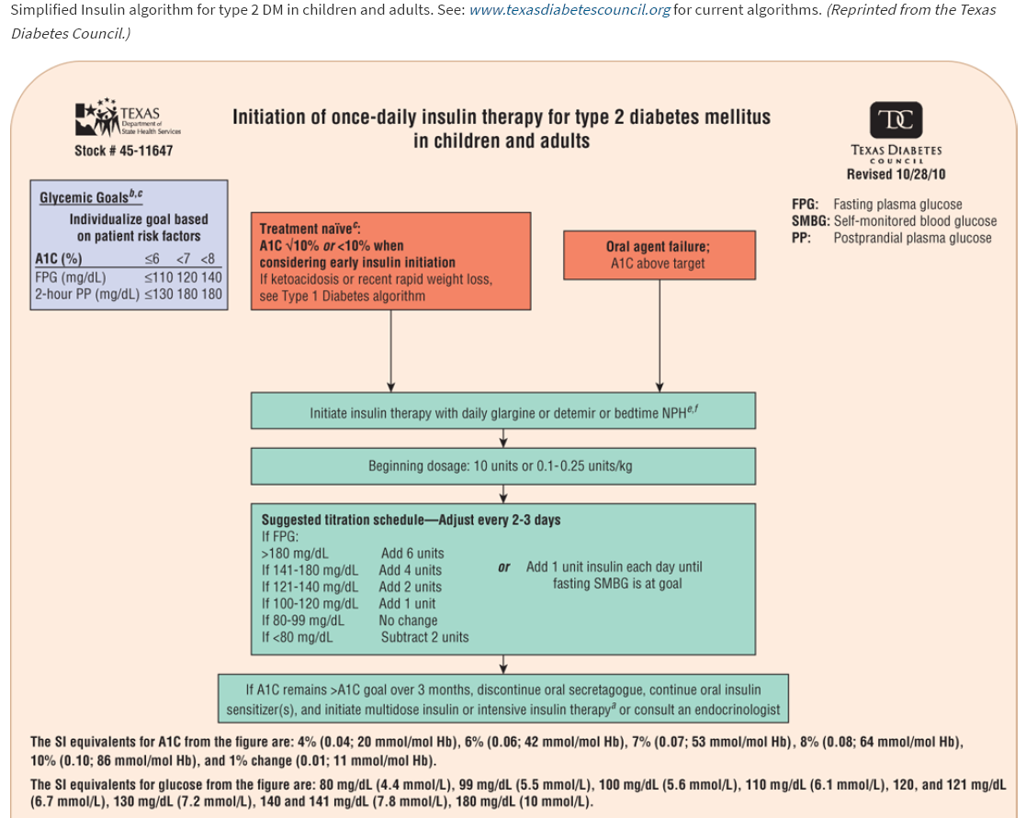

Slide 58
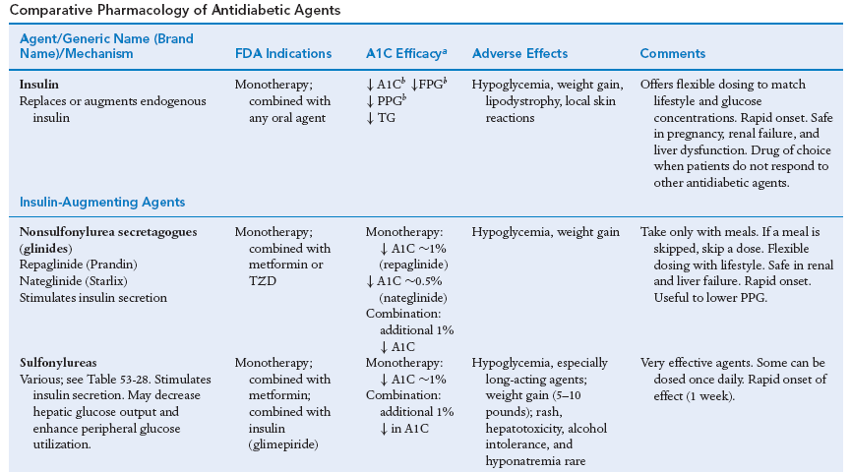

Slide 59
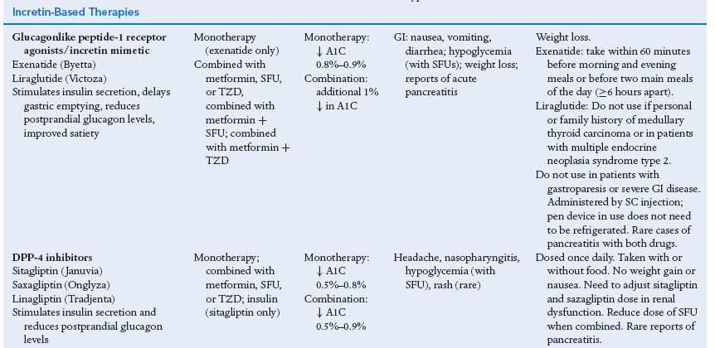

Slide 62
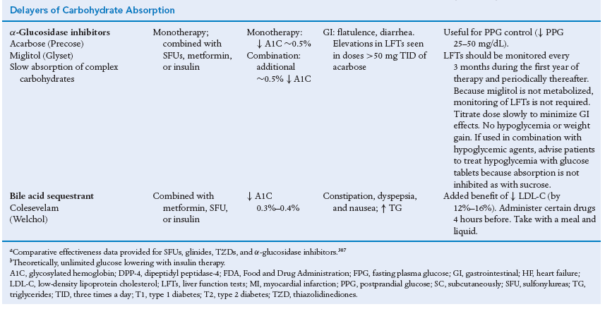

Slide 63
Effect of Some Antidiabetics on Body Weight

Slide 64
Special Populations (Children and Adolescents with Type 2 DM)
Type 2 DM is increasing in adolescence probably caused by obesity and physical inactivity.
Need extraordinary efforts on lifestyle modification measures.
If failed, use metformin, sulfonylureas (or TZDs) or any combination of these may improve glycemic control.
Insulin therapy is the standard of care when glycemic goals cannot be achieved or maintained with metformin and sulfonylurea.

Slide 65
Special Populations (Elderly patients with Type 2 DM)
Consideration of the risks of hypoglycemia, the extent of co-morbidities, self-care, nutritional status, social support, falls risk, mental status, and life expectancy should all influence glycemic goals and treatment selection.
Avoidance of both hypo- and hyperglycemia is extremely important.
Elderly patients may have an altered presentation of hypoglycemia because of loss of autonomic nerve function with age.

Slide 66
Special Populations (Elderly patients with Type 2 DM)
DPP-4 inhibitors, shorter-acting insulin secretagogues, low-dose sulfonylureas, or α-glucosidase inhibitors may be used.
DPP-4 inhibitors or α-glucosidase have low risk of hypoglycemia.
Metformin may be used at low doses if Cl_{cr} is > 30 mL/min/1.73 m².
Simple insulin regimens with daily basal insulin may be appropriate.

Slide 67
Dipeptidyl peptidase-4 (DPP-4) inhibitors (Sitagliptin)
Inhibit DPP-4, the enzyme that degrades incretin hormones.
Prolong the half-life of endogenous GLP-1.
Decrease postprandial glucose levels.
Decrease glucagon concentration.
Increase circulating GLP-1 and glucose-dependent insulinotropic polypeptide (GIP) and thus, insulin concentrations in a glucose-dependent manner.

Slide 68
Sitagliptin
Most commonly used in combination with a TZD or metformin, or sulfonylureas.
May be used as monotherapy.
Used for type 2 DM orally, peaks within 1–4 hours, and has a half-life of approximately 12 hours.
Dosage should be reduced in patients with impaired renal function
Weight neutral.

Slide 69
Sitagliptin
Adverse effects:
Nasopharyngitis, upper respiratory infections, headaches
Hypoglycemia when the drug is combined with insulin secretagogues or insulin. Not associated with hypoglycemia when used alone.
Acute pancreatitis which may be fatal.
Allergic reactions.

Slide 70
Diabetic Ketoacidosis and Hyperosmolar Hyperglycemic State
These are true emergencies.
Insulin given by continuous IV infusion to restore the patient’s metabolic status are the cornerstones of therapy.
Pay attention to volume deficits, electrolyte disturbances, and acidosis.
Treat the precipitating problem.

Slide 71
Hospitalization for Intercurrent Medical Illness
Patients on oral agents may need transient therapy with insulin to achieve adequate glycemic control during a hospitalization.
It is important to stop metformin in all patients who arrive in acute care settings as contraindications to metformin are prevalent in hospitalized patients (renal dysfunction, hypoxia..).

Slide 72
Perioperative Management
Patients who require surgery may experience worsening of glycemia similar to those admitted to hospital for a medical illness.
Acute stress increases counter-regulatory hormones.
Therapy should be individualized based on the type of DM, nature of the surgical procedure, previous therapy, and metabolic control prior to the procedure.

Slide 73
Perioperative Management
Patients on oral agents may need to be transiently switched to insulin to control blood glucose, preferably as continuous insulin infusions.
Metformin should be discontinued temporarily after any major surgery until it is clear that the patient is hemodynamically stable and normal renal function is documented.

