Slide 1
SHOCK
Marzouq Amarin. MD
Plastic and Reconstructive Surgeon
University of Jordan

Slide 2
Shock
A state of cellular and tissue hypoxia due to reduced oxygen delivery and/or increased oxygen consumption or inadequate oxygen utilization.
This most commonly occurs when there is circulatory failure manifested as hypotension / reduced tissue perfusion
.
The initial cellular injury that occurs is reversible; however, the injury will become irreversible if tissue perfusion is prolonged or severe enough such that, at the cellular level, compensation is no longer possible.
"Undifferentiated shock" refers to the situation where shock is recognized but the cause is unclear.

Slide 3
The specific responses will differ based on the etiology of shock, as certain physiologic responses may be limited by the inciting pathology

Slide 4
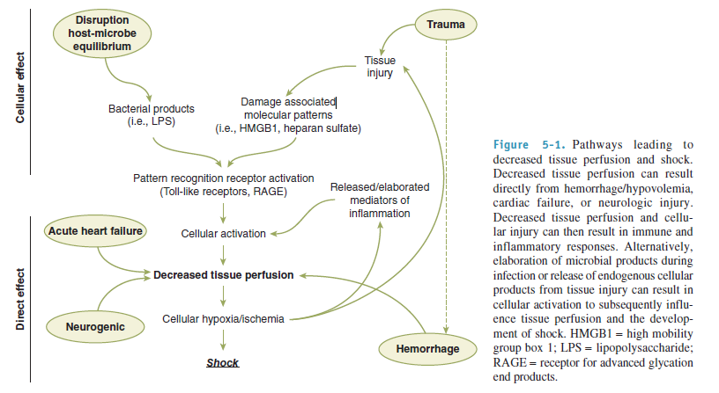

Slide 5
Neuroendocrine and Organ-Specific Responses
The goal of the neuroendocrine response to shock is to maintain perfusion to the heart and the brain, even at the expense of other organ systems. Peripheral vasoconstriction occurs, and fluid excretion is inhibited.
The mechanisms include autonomic control of peripheral vascular tone and cardiac contractility, hormonal response to stress and volume depletion, and local microcirculatory mechanisms that are organ specific and regulate regional blood flow.

Slide 6
Afferent Signals
Afferent impulses transmitted from the periphery are processed within the central nervous system (CNS) and activate the reflexive effector responses or efferent impulses. These effector responses are designed to expand plasma volume, maintain peripheral perfusion and tissue O2 delivery, and restore homeostasis.
The afferent impulses that initiate the body’s intrinsic adaptive responses and converge in the CNS originate from a variety of sources.

Slide 7
The initial inciting event usually is loss of circulating blood volume. Other stimuli that can produce the neuroendocrine response include pain, hypoxemia, hypercarbia, acidosis, infection, change in temperature, emotional arousal, or hypoglycemia.
The sensation of pain from injured tissue is transmitted via the spinothalamic tracts, resulting in activation of the hypothalamic-pituitary-adrenal axis, as well as activation of the autonomic nervous system (ANS) to induce direct sympathetic stimulation of the adrenal medulla to release catecholamines.

Slide 8
Baroreceptors also are an important afferent pathway in initiation of adaptive responses to shock. Volume receptors, sensitive to changes in both chamber pressure and wall stretch, are present within the atria of the heart. They become activated with low volume hemorrhage or mild reductions in right atrial pressure.

Slide 9
These receptors normally inhibit induction of the ANS. When activated, these baroreceptors diminish their output, thus disinhibiting the effect of the ANS.
The ANS then increases its output, principally via sympathetic activation at the vasomotor centers of the brain stem, producing centrally mediated constriction of peripheral vessels.

Slide 10
Chemoreceptors in the aorta and carotid bodies are sensitive to changes in O2 tension, H+ ion concentration, and carbon dioxide (CO2) levels. Stimulation of the chemoreceptors results in vasodilation of the coronary arteries, slowing of the heart rate, and vasoconstriction of the splanchnic and skeletal circulation.

Slide 11
Efferent Signals
Cardiovascular Response.
Changes in cardiovascular function are a result of the neuroendocrine response and ANS response to shock, and constitute a prominent feature of both the body’s adaptive response mechanism and the clinical signs and symptoms of the patient in shock. Hemorrhage results in diminished venous return to the heart and decreased cardiac output. This is compensated by increased cardiac heart rate and contractility, as well as venous and arterial vasoconstriction.

Slide 12
Stimulation of sympathetic fibers innervating the heart leads to activation of β1-adrenergic receptors that increase heart rate and contractility in an attempt to increase cardiac output.
Increased myocardial O2 consumption occurs as a result of the increased workload

Slide 13
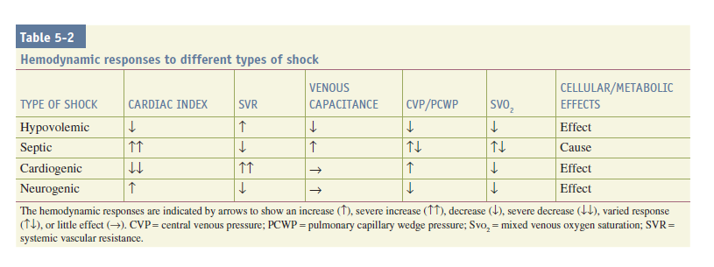

Slide 14
Direct sympathetic stimulation of the peripheral circulation via the activation of α1-adrenergic receptors on arterioles induces vasoconstriction and causes a compensatory increase in systemic vascular resistance and blood pressure
Selective perfusion to tissues occurs due to regional variations in arteriolar resistance, with blood shunted away from less essential organ beds such as the intestine, kidney, and skin.

Slide 15
the brain and heart have autoregulatory mechanisms that attempt to preserve their blood flow despite a global decrease in cardiac output.
Direct sympathetic stimulation also induces constriction of venous vessels, decreasing the capacitance of the circulatory system and accelerating blood return to the central circulation.

Slide 16
Increased sympathetic output induces catecholamine release from the adrenal medulla.
Catecholamine levels peak within 24 to 48 hours of injury and then return to baseline. Persistent elevation of catecholamine levels beyond this time suggests ongoing noxious afferent stimuli.

Slide 17
Catecholamine effects on peripheral tissues include
stimulation of hepatic glycogenolysis and gluconeogenesis to increase circulating glucose availability to peripheral tissues,
an increase in skeletal muscle glycogenolysis,
suppression of insulin release,
increased glucagon release.

Slide 18
Hormonal Response.
The stress response includes activation of the ANS, as well as activation of the hypothalamic-pituitary-adrenal axis.
Shock stimulates the hypothalamus to release corticotropinreleasing hormone, which results in the release of adrenocorticotropic hormone (ACTH) by the pituitary.

Slide 19
ACTH subsequently stimulates the adrenal cortex to release cortisol. Cortisol acts synergistically with epinephrine and glucagon to induce a catabolic state.
Cortisol stimulates gluconeogenesis and insulin resistance, resulting in hyperglycemia as well as muscle cell protein breakdown and lipolysis to provide substrates for hepatic gluconeogenesis.
Cortisol causes retention of sodium and water by the nephrons of the kidney.

Slide 20
The renin-angiotensin system is activated in shock.
Decreased renal artery perfusion, β-adrenergic stimulation, and increased renal tubular sodium concentration cause the release of renin from the juxtaglomerular cells.
Renin catalyzes the conversion of angiotensinogen (produced by the liver) to angiotensin I, which is then converted to angiotensin II by angiotensin-converting enzyme (ACE) produced in the lung.
Angiotensin II is a potent vasoconstrictor of both splanchnic and peripheral vascular beds, and also stimulates the secretion of aldosterone, ACTH, and antidiuretic hormone (ADH).

Slide 21
The pituitary also releases vasopressin or ADH in response to hypovolemia, changes in circulating blood volume sensed by baroreceptors and left atrial stretch receptors, and increased plasma osmolality detected by hypothalamic osmoreceptors.

Slide 22
Epinephrine, angiotensin II, pain, and hyperglycemia increase production of ADH. ADH levels remain elevated for about 1 week after the initial insult, depending on the severity and persistence of the hemodynamic abnormalities.
ADH acts on the distal tubule and collecting duct of the nephron to increase water permeability, decrease water and sodium losses, and preserve intravascular volume. Also known as arginine vasopressin, ADH acts as a potent mesenteric vasoconstrictor, shunting circulating blood away from the splanchnic organs during hypovolemia.
This may contribute to intestinal ischemia and predispose to intestinal mucosal barrier dysfunction in shock states.

Slide 23
METABOLIC EFFECTS
Cellular metabolism is based primarily on the hydrolysis of adenosine triphosphate (ATP). The splitting of the phosphoanhydride bond of the terminal γ-phosphate from ATP is the source of energy for most processes within the cell under normal conditions.

Slide 24
The majority of ATP is generated in our bodies through aerobic metabolism in the process of oxidative phosphorylation in the mitochondria. This process is dependent on the availability of O2 as a final electron acceptor in the electron transport chain. As O2 tension within a cell decreases, there is a decrease in oxidative phosphorylation, and the generation of ATP slows. When O2 delivery is so severely impaired such that oxidative phosphorylation cannot be sustained, the state is termed dysoxia.

Slide 25
When oxidative phosphorylation is insufficient, the cells shift to anaerobic metabolism and glycolysis to generate ATP.
This occurs via the breakdown of cellular glycogen stores to pyruvate. Although glycolysis is a rapid process, it is not efficient, allowing for the production of only 2 mol of ATP from 1 mol of glucose. This is compared to complete oxidation of 1 mol of glucose that produces 38 mol of ATP.
Additionally, under hypoxic conditions in anaerobic metabolism, pyruvate is converted into lactate, leading to an intracellular metabolic acidosis.

Slide 26
There are numerous consequences secondary to these metabolic changes
The depletion of ATP potentially influences all ATP-dependent cellular processes.
Decreased intracellular pH also influences vital cellular functions
changes in gene expression within the cell.
acidosis leads to changes in calcium metabolism and calcium signaling.
irreversible cell injury and death.

Slide 27
Epinephrine and norepinephrine have a profound impact on cellular metabolism. Hepatic glycogenolysis, gluconeogenesis, ketogenesis, skeletal muscle protein breakdown, and adipose tissue lipolysis are increased by catecholamines.
Cortisol, glucagon, and ADH also contribute to the catabolism during shock. Epinephrine induces further release of glucagon, while inhibiting the pancreatic β-cell release of insulin.
The result is a catabolic state with glucose mobilization, hyperglycemia, protein breakdown, negative nitrogen balance, lipolysis, and insulin resistance during shock and injury.
The relative underuse of glucose by peripheral tissues preserves it for the glucose-dependent organs such as the heart and brain.

Slide 28
Cellular Hypoperfusion
The O2 debt is the deficit in tissue oxygenation over time that occurs during shock. When O2 delivery is limited, O2 consumption can be inadequate to match the metabolic needs of cellular respiration, creating a deficit in O2 requirements at the cellular level.
The measurement of O2 deficit uses calculation of the difference between the estimated O2 demand and the actual value obtained for O2 consumption. Under normal circumstances, cells can “repay” the O2 debt during reperfusion. The magnitude of the O2 debt correlates with the severity and duration of hypoperfusion.

Slide 29
Cellular gene expression
The DNA binding activity of a number of nuclear transcription factors is altered by hypoxia and the production of O2 radicals or nitrogen radicals that are produced at the cellular level by shock.
Expression of other gene products such as heat shock proteins, vascular endothelial growth factor, inducible nitric oxide synthase (iNOS), heme oxygenase-1, and cytokines also are clearly increased by shock.
subsequently alter gene expression in specific target cells and tissues.
The involvement of multiple pathways emphasizes the complex, integrated, and overlapping nature of the response to shock

Slide 30
Hypovolemic Shock
Marzouq Amarin. MD
Plastic and Reconstructive Surgeon
University of Jordan

Slide 31
Hypovolemic/Hemorrhagic
The most common cause of shock in the surgical or trauma patient is loss of circulating volume from hemorrhage.

Slide 32
Hypovolemia induces sympathetic stimulation, leading to epinephrine and norepinephrine release, activation of the renin-angiotensin cascade, and increased vasopressin release.
Peripheral vasoconstriction is prominent, while lack of sympathetic effects on cerebral and coronary vessels and local autoregulation promote maintenance of cardiac and CNS blood flow.

Slide 33
Diagnosis
Treatment of shock is initially empiric. A secure airway must be confirmed or established and volume infusion initiated while the search for the cause of the hypotension is pursued.
Shock in a trauma patient or postoperative patient should be presumed to be due to hemorrhage until proven otherwise.

Slide 34
The clinical signs of shock may be evidenced by agitation, cool clammy extremities, tachycardia, weak or absent peripheral pulses, and hypotension.
Such apparent clinical shock results from at least 25% to 30% loss of the blood volume. However, substantial volumes of blood may be lost before the classic clinical manifestations of shock are evident.
when a patient is significantly tachycardic or hypotensive, this represents both significant blood loss and physiologic decompensation.

Slide 35
The clinical and physiologic response to hemorrhage has been classified according to the magnitude of volume loss.
Loss of up to 15% of the circulating volume (700–750 mL for a 70-kg patient) may produce little in terms of obvious symptoms, while loss of up to 30% of the circulating volume (1.5 L) may result in mild tachycardia, tachypnea, and anxiety.
Hypotension, marked tachycardia (i.e., pulse greater than 110–120 beats per minute[bpm]), and confusion may not be evident until more than 30% of the blood volume has been lost; loss of 40% of circulating volume (2 L) is immediately life threatening and generally requires operative control of bleeding.

Slide 36
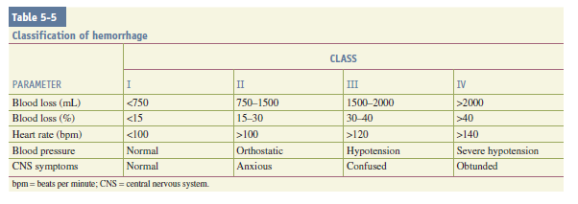

Slide 37
Young healthy patients with vigorous compensatory mechanisms may tolerate larger volumes of blood loss while manifesting fewer clinical signs despite the presence of significant peripheral hypoperfusion. These patients may maintain a near-normal blood pressure until a precipitous cardiovascular collapse occurs.

Slide 38
Elderly patients may be taking medications that either promote bleeding (e.g., warfarin or aspirin) or mask the compensatory responses to bleeding (e.g., β-blockers). In addition, atherosclerotic vascular disease, diminishing cardiac compliance with age, inability to elevate heart rate or cardiac contractility in response to hemorrhage, and overall decline in physiologic reserve,
Decrease the elderly patient’s ability to tolerate hemorrhage.

Slide 39
Recent data in trauma patients suggest that a systolic blood pressure (SBP) of less than 110 mmHg is a clinically relevant definition of hypotension and hypoperfusion based on an increasing rate of mortality below this pressure

Slide 40
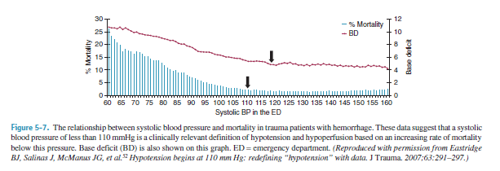

Slide 41
In addressing the sensitivity of vital signs , A more recent study corroborated that tachycardia was not a reliable sign of hemorrhage following trauma and was present in only 65% of hypotensive patients.

Slide 42
Serum lactate and base deficit are measurements that are helpful to both estimate and monitor the extent of bleeding and shock. The amount of lactate that is produced by anaerobic respiration is an indirect marker of tissue hypoperfusion, cellular O2 debt, and the severity of hemorrhagic shock.
Several studies have demonstrated that the initial serum lactate and serial lactate levels are reliable predictors of morbidity and mortality with hemorrhage following trauma .

Slide 43
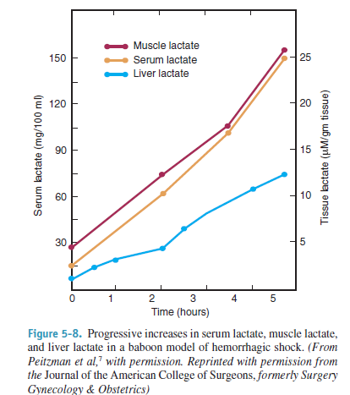

Slide 44
Similarly, base deficit values derived from arterial blood gas analysis provide clinicians with an indirect estimation of tissue acidosis from hypoperfusion.
Davis and colleagues stratified the extent of base deficit into
Mild (–3 to –5 mmol/L),
Moderate (–6 to –9 mmol/L),
Severe (less than –10 mmol/L),
from this established a correlation between base deficit upon admission and transfusion requirements, the development of multiple organ failure, and death.

Slide 45
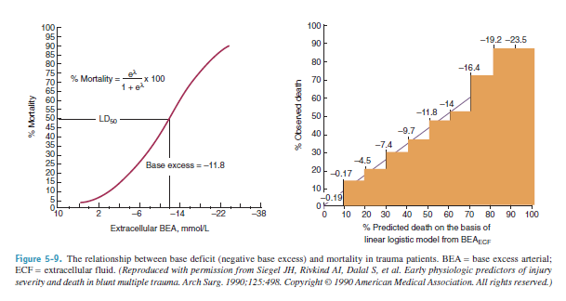

Slide 46
Both base deficit and lactate correlate with the extent of shock and patient outcome, but interestingly do not firmly correlate with each other. Evaluation of both values may be useful in trauma patients with hemorrhage.

Slide 47
Although hematocrit changes may not rapidly reflect the total volume of blood loss, admission hematocrit has been shown to be associated with 24-hour fluid and transfusion requirements and more strongly associated with packed red blood cell transfusion than tachycardia, hypotension, or acidosis.
It must be noted that lack of a depression in the initial hematocrit does not rule out substantial blood loss or ongoing bleeding.

Slide 48
In management of trauma patients, understanding the patterns of injury of the patient in shock will help direct the evaluation and management.
Identifying the sources of blood loss in patients with penetrating wounds is relatively simple because potential bleeding sources will be located along the known or suspected path of the wounding object.

Slide 49
Patients with penetrating injuries who are in shock usually require operative intervention.
Patients who suffer multisystem injuries from blunt trauma have multiple sources of potential hemorrhage.
Blood loss sufficient to cause shock is generally of a large volume, and there are a limited number of sites that can harbor sufficient extravascular blood volume to induce hypotension (e.g., external, intrathoracic, intra-abdominal, retroperitoneal, and long bone fractures).
In the nontrauma patient, the GI tract must always be considered as a site for blood loss.

Slide 50
Substantial blood loss externally may be suspected from prehospital medical reports documenting a substantial blood loss at the scene of an accident, history of massive blood loss from wounds, visible brisk bleeding, or presence of a large hematoma adjacent to an open wound.
Injuries to major arteries or veins with associated open wounds may cause massive blood loss rapidly. Direct pressure must be applied and sustained to minimize ongoing blood loss. Persistent bleeding from uncontrolled smaller vessels can, over time, precipitate shock if inadequately treated.

Slide 51
When major blood loss is not immediately visible in the setting of trauma, internal (intracavitary) blood loss should be suspected.
Each pleural cavity can hold 2 to 3 L of blood and can therefore be a site of significant blood loss. Diagnostic and therapeutic tube thoracostomy may be indicated in unstable patients based on clinical findings and clinical suspicion.
In a more stable patient, a chest radiograph may be obtained to look for evidence of hemothorax.
Major retroperitoneal hemorrhage typically occurs in association with pelvic fractures, which is confirmed by pelvic radiography in the resuscitation bay.
Intraperitoneal hemorrhage is probably the most common source of blood loss inducing shock.

Slide 52
`The physical exam for detection of substantial blood loss or injury is insensitive and unreliable; large volumes of intraperitoneal blood may be present before physical examination findings are apparent.
Findings with intra-abdominal hemorrhage include abdominal distension, abdominal tenderness, or visible abdominal wounds.
Hemodynamic abnormalities generally stimulate a search for blood loss before the appearance of obvious abdominal findings.

Slide 53
Adjunctive tests are essential in the diagnosis of intraperitoneal bleeding; intraperitoneal blood may be rapidly identified by
diagnostic ultrasound
diagnostic peritoneal lavage.
Furthermore, patients who have sustained high-energy blunt trauma who are hemodynamically stable or who have normalized their vital signs in response to initial volume resuscitation should undergo computed tomography scans to assess for head, chest, and/or abdominal bleeding.

Slide 54
Treatment
Control of ongoing hemorrhage is an essential component of the resuscitation of the patient in shock.
treatment of hemorrhagic shock is instituted concurrently with diagnostic evaluation to identify a source.
Patients who fail to respond to initial resuscitative efforts should be assumed to have ongoing active hemorrhage from large vessels and require prompt operative intervention.
Based on trauma literature, patients with ongoing hemorrhage demonstrate increased survival if the elapsed time between the injury and control of bleeding is decreased.
Although there are no randomized controlled trials, retrospective studies provide compelling evidence in this regard.

Slide 55
To this end, Clarke and colleagues. demonstrated that trauma patients with major injuries isolated to the abdomen requiring emergency laparotomy had an increased probability of death with increasing length of time in the emergency department for patients who were in the emergency department for 90 minutes or less.
This probability increased approximately 1% for each 3 minutes in the emergency department.

Slide 56
The appropriate priorities in these patients are
(a) Secure the airway.
(b) Control the source of blood loss.
(c) Intravenous (IV) volume resuscitation.

Slide 57
In trauma, identifying the body cavity harboring active hemorrhage will help focus operative efforts; however, because time is of the essence, rapid treatment is essential and diagnostic laparotomy or thoracotomy may be indicated.
The actively bleeding patient cannot be resuscitated until control of ongoing hemorrhage is achieved.

Slide 58
Our current understanding has led to the management strategy known as damage control resuscitation.
This strategy begins in the emergency department and continues into the operating room and into the intensive care unit (ICU).
Initial resuscitation is limited to keep SBP around 80 to 90 mmHg.
This prevents renewed bleeding from recently clotted vessels.

Slide 59
Resuscitation and intravascular volume resuscitation are accomplished with blood products and limited crystalloids.
Too little volume allowing persistent severe hypotension and hypoperfusion is dangerous, yet too vigorous of a volume resuscitation may be just as deleterious.
Control of hemorrhage is achieved in the operating room, and efforts to warm patients and to prevent coagulopathy using multiple blood products and pharmacologic agents are used in both the operating room and ICU.

Slide 60
Cannon and colleagues first made the observation that attempts to increase blood pressure in soldiers with uncontrolled sources of hemorrhage is counterproductive, with increased bleeding and higher mortality.
This work was the foundation for the “hypotensive resuscitation” strategies.
Several laboratory studies confirmed the observation that attempts to restore normal blood pressure with fluid infusion or vasopressors were rarely successful and resulted in more bleeding and higher mortality.

Slide 61
A prospective, randomized clinical study compared delayed fluid resuscitation (upon arrival in the operating room) with standard fluid resuscitation (with arrival by the paramedics) in hypotensive patients with penetrating torso injury.
The authors reported that delayed fluid resuscitation resulted in lower patient mortality.

Slide 62
Further laboratory studies demonstrated that fluid restriction in the setting of profound hypotension resulted in early deaths from severe hypoperfusion.
These studies also showed that aggressive crystalloid resuscitation attempting to normalize blood pressure resulted in marked hemodilution, with hematocrits of 5%.

Slide 63
Reasonable conclusions in the setting of uncontrolled hemorrhage include:
Any delay in surgery for control of hemorrhage increases mortality;
With uncontrolled hemorrhage attempting to achieve normal blood pressure may increase mortality, particularly with penetrating injuries and short transport times, a goal of SBP of 80 to 90 mmHg may be adequate in the patient with penetrating injury;
Profound hemodilution should be avoided by early transfusion of red blood cells.

Slide 64
For the patient with blunt injury, where the major cause of death is a closed head injury, the increase in mortality with hypotension in the setting of brain injury must be avoided.
In this setting, an SBP of 110 mmHg would seem to be more appropriate.
Patients who respond to initial resuscitative effort but then deteriorate hemodynamically frequently have injuries that require operative intervention.

Slide 65
The magnitude and duration of their response will dictate whether diagnostic maneuvers can be performed to identify the site of bleeding. However, hemodynamic deterioration generally denotes ongoing bleeding for which some form of intervention (i.e., operation or interventional radiology) is required.
Patients who have lost significant intravascular volume, but whose hemorrhage is controlled or has abated, often will respond to resuscitative efforts if the depth and duration of shock have been limited.

Slide 66
A subset of patients exists who fail to respond to resuscitative efforts despite adequate control of ongoing hemorrhage.
These patients have ongoing fluid requirements despite adequate control of hemorrhage, have persistent hypotension despite restoration of intravascular volume necessitating vasopressor support, and may exhibit a futile cycle of uncorrectable hypoperfusion, acidosis, and coagulopathy that cannot be interrupted despite maximum therapy.

Slide 67
These patients have deteriorated to decompensated or irreversible shock with peripheral vasodilation and resistance to vasopressor infusion.
Mortality is inevitable once the patient manifests shock in its terminal stages.
Unfortunately, this is often diagnosed in retrospect.

Slide 68
Fluid resuscitation is a major adjunct to physically controlling hemorrhage in patients with shock. The ideal type of fluid to be used continues to be debated; however, crystalloids continue to be the mainstay of fluid choice.
Several studies have demonstrated increased risk of death in bleeding trauma patients treated with colloid compared to patients treated with crystalloid.

Slide 69
In patients with severe hemorrhage, restoration of intravascular volume should be achieved with blood products
Ongoing studies continue to evaluate the use of hypertonic saline as a resuscitative adjunct in bleeding patients.

Slide 70
The benefit of hypertonic saline solutions may be immunomodulatory. Specifically, these effects have been attributed to pharmacologic effects resulting in decreased reperfusion-mediated injury with decreased O2 radical formation, less impairment of immune function compared to standard crystalloid solution, and less brain swelling in the multi-injured patient.
The reduction of total volume used for resuscitation makes this approach appealing as a resuscitation agent for combat injuries and may contribute to a decrease in the incidence of ARDS and multiple organ failure.

Slide 71
Transfusion of packed red blood cells and other blood products is essential in the treatment of patients in hemorrhagic shock.
Current recommendations in stable ICU patients aim for a target hemoglobin of 7 to 9 g/dL.
However, no prospective randomized trials have compared restrictive and liberal transfusion regimens in trauma patients with hemorrhagic shock.

Slide 72
The current standard in severely injured patients is termed damage control resuscitation and consists of transfusion with red blood cells, fresh frozen plasma (FFP), and platelet units given in equal number.
Civilian and military trauma data show that the development of coagulopathy of trauma is predictive of mortality.

Slide 73
Similarly, platelet transfusion is important. Studies have demonstrated that low platelet counts in trauma patients were associated with increased mortality, and that increased platelet use appears to improve outcome.
The benefit of platelet transfusion may be most pronounced in trauma patients with brain injury.
Platelets should be transfused in the bleeding patient to maintain counts above 50 .

Slide 74
There is a potential role for other coagulation factor-based products, such as fibrinogen concentrates and prothrombin complex concentrates. Use of these agents may be guided by a drop in fibrinogen levels to less than 1 g/L or, less specifically, by thromboelastogram findings to suggest hyperfibrinolysis.

Slide 75
Data also support the use of antifibrinolytic agents in bleeding trauma patients, specifically tranexamic acid (a synthetic lysine analogue that acts as a competitive inhibitor of plasmin and plasminogen).
The multinational Clinical Randomization of an Antifibrinolytic in Significant Haemorrhage 2 (CRASH-2) trial suggested that early use of tranexamic acid limits rebleeding and reduces mortality.

Slide 76
In the past, coagulopathy associated with the bleeding patient was presumed to be due solely to dilution and depletion of clotting factors and platelets.
We now understand that an acute coagulopathy of trauma occurs as an immediate consequence of injury, with abnormal admission coagulation as a predictor of high mortality.

Slide 77
Traditional measurement of platelets, international normalized ratio, and partial thromboplastin time may not reflect the coagulopathy of trauma or response to therapy effectively.
Recently, thromboelastography (TEG) has been used as a quicker, more comprehensive determination of coagulopathy and fibrinolysis in the injured patient.
Holcomb and colleagues recently reported that TEG predicted patients with substantial bleeding and red cell transfusion better than conventional coagulopathy tests, need for platelet transfusion better than platelet count, and need for plasma transfusion better than fibrinogen levels.

Slide 78
Additional resuscitative adjuncts in patients with hemorrhagic shock include minimization of heat loss and maintaining normothermia.
The development of hypothermia in the bleeding patient is associated with acidosis, hypotension, and coagulopathy

Slide 79
Hypothermia in bleeding trauma patients is an independent risk factor for bleeding and death. This likely is secondary to impaired platelet function and impairments in the coagulation cascade.
Several studies have investigated the induction of controlled hypothermia in patients with severe shock based on the hypothesis of limiting metabolic activity and energy requirements, creating a state of “suspended animation.” These studies are promising and continue to be evaluated in large trials.

Slide 80
THANK YOU

