Slide 1
Lower Respiratory Tract Infections
--lines of treatment
Maisa Mansour , MD
Faculty of Medicine
Jordan University

Slide 2
Objectives
1- Impact of respiratory tract infections .
2- Quick review of basic anatomy and physiology.
3- Definitions and classifications.
4- Treatment of Bronchitis and Pneumonia according to the latest guidelines.

Slide 3
Why is this important?
The respiratory system is the most commonly infected system in our body.
Health care providers will see more respiratory infections than any other type.
Most of the time these infections are preventable and treatable.
High cost.
Mortality and morbidity ???

Slide 4
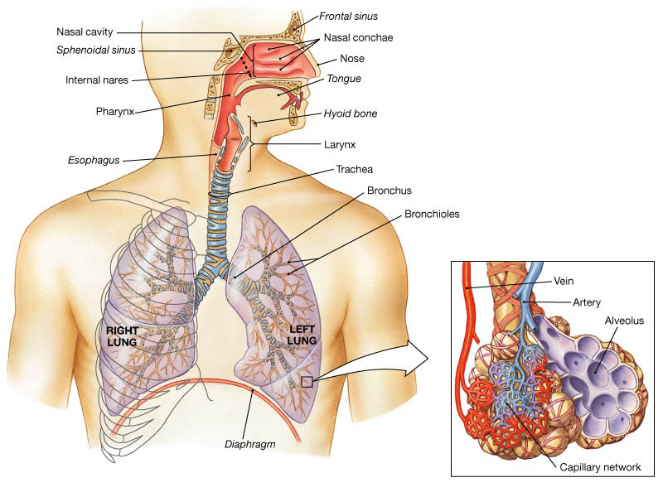

Slide 5
Respiratory System Functions
Gas exchange.
Filters inspired air.
Sound production.
Contains receptors for smell.
Rids the body of some excess water and heat.
Helps regulate blood pH.

Slide 6
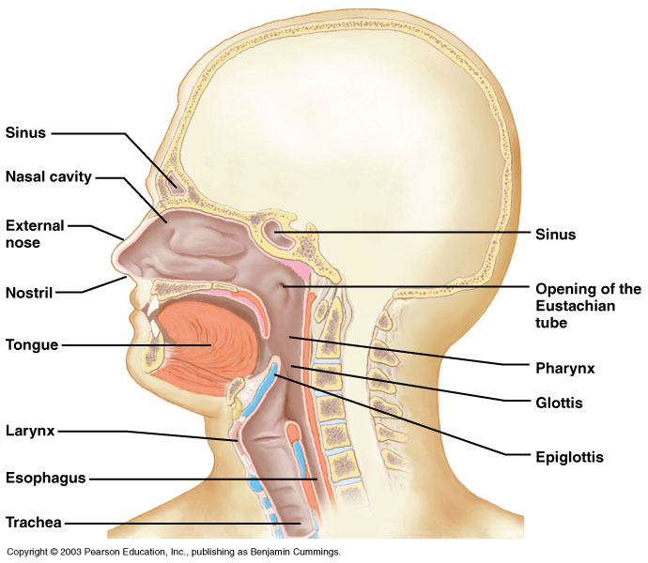
Upper respiratory tract

Slide 7
Upper Respiratory Tract
Composed of the nose and nasal cavity, paranasal sinuses, pharynx (throat), larynx.
All part of the conducting portion of the respiratory system.

Slide 8
Lower Respiratory Tract
Conducting airways (trachea, bronchi, up to terminal bronchioles).
Respiratory portion of the respiratory system (respiratory bronchioles, alveolar ducts, and alveoli).

Slide 9
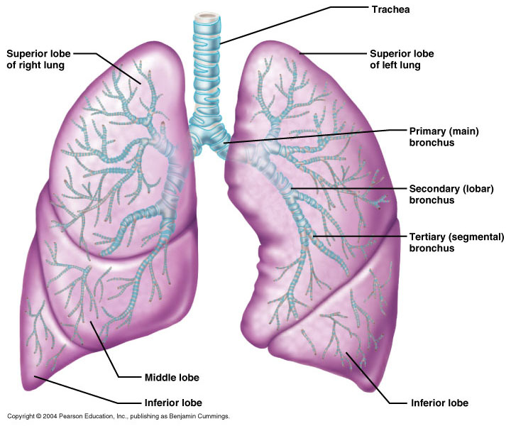
Conducting zone of lower respiratory tract

Slide 10
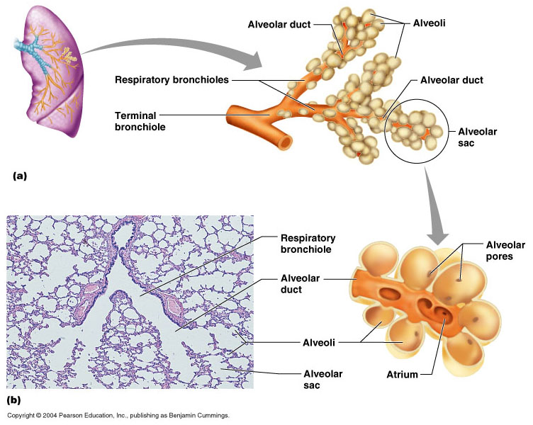
Respiratory Zone of Lower Respiratory Tract

Slide 11
Respiratory defense mechanism
Cough reflex.
Mucociliary clearance mechanisms.
Mucosal immune system.
Phagocytosis
Alveolar macrophages
Humoral and cellular immunity
IgA
Interferons

Slide 12
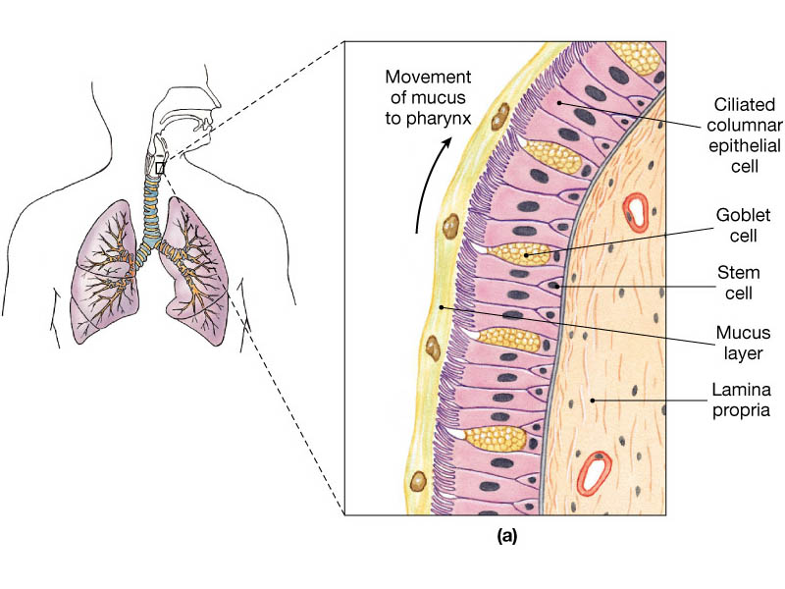

Slide 13
Upper respiratory tract infection
Acute tonsillitis
Acute pharyngitis
Acute otitis media
Acute sinusitis
Common cold
Acute laryngitis
Otitis externa
Acute epiglotitis

Slide 14
URT infections
Upper respiratory tract infection (URI) represents the most common acute illness evaluated in the outpatient setting.
Most common cause of sick leaves.
Short incubation period.
Most of the time symptomatic treatment
Secondary bacterial infection may occurred.

Slide 15
URT infections
Rhinitis - Inflammation of the nasal mucosa
Rhinosinusitis or sinusitis - Inflammation of the nares and paranasal sinuses, including frontal, ethmoid, maxillary, and sphenoid
Pharyngitis - Inflammation of the pharynx, hypopharynx, uvula, and tonsils

Slide 16
URT infections
Epiglottitis (supraglottitis) - Inflammation of the superior portion of the larynx and supraglottic area.
Laryngitis - Inflammation of the larynx
Laryngotracheitis - Inflammation of the larynx, trachea, and subglottic area.
Tracheitis - Inflammation of the trachea and subglottic area.

Slide 17
LRTI
Bronchitis acute Vs chronic???
Pneumonia
Bronchiectasis

Slide 18
Acute bronchitis
Generally viral in origin.
Only lasts for a few days to weeks.
Rhinovirus, Parainfluenza, RSV, Influenza viruses.
Expectorating cough, dyspnea, wheezing, chest pain, fever, and fatigue.
In addition, bronchitis caused by Adenovirus may cause systemic and gastrointestinal symptoms.
The cough due to bronchitis can continue for up to three weeks or more even after all other symptoms have subsided.

Slide 19
Acute Bronchitis
Only about 5-10 % of Bronchitis are caused by bacterial infection.
Secondary bacterial infections can occur.
The commonest pathogens are :
- H. influenza
- S. pneumoniae
- S. aureus.

Slide 20
Acute bronchitis
Diagnosis is mostly clinical(signs and symptoms).
No radiologic changes on chest X-Ray.
Usually no need for antibiotics treatment.
Antibiotics only for secondary bacterial infections proved by microbiology, or in patient with chronic lung disease(COPD exacerbations, bronchiactesis).

Slide 21
Chronic Bronchitis
In the setting of COPD
Smoking related lung disease.
With two phenotypes : Emphysema and Chronic Bronchitis.

Slide 22

COPD Definition
Chronic Obstructive Pulmonary Disease (COPD) is a common, preventable and treatable disease that is characterized by persistent respiratory symptoms and airflow limitation that is due to airway and/or alveolar abnormalities usually caused by significant exposure to noxious particles or gases.
© 2017 Global Initiative for Chronic Obstructive Lung Disease

Slide 23
Exacerbations of COPD
COPD exacerbations are defined as an acute worsening of respiratory symptoms that result in additional therapy.
They are classified as:
  Mild (treated with short acting bronchodilators only, SABDs)
  Moderate (treated with SABDs plus antibiotics and/or oral corticosteroids) or
  Severe (patient requires hospitalization ). Severe exacerbations may also be associated with acute respiratory failure.
© 2017 Global Initiative for Chronic Obstructive Lung Disease

Slide 24
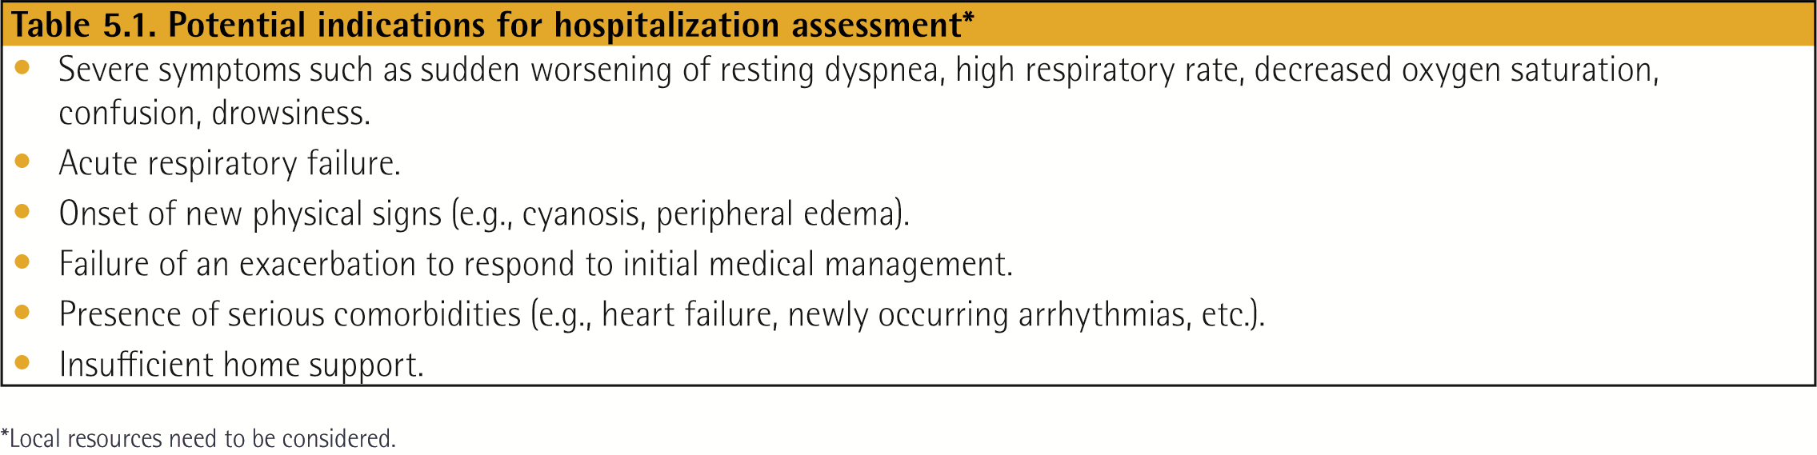
Management of Exacerbations
© 2017 Global Initiative for Chronic Obstructive Lung Disease

Slide 25
Management of Exacerbations
Classification of hospitalized patients
No respiratory failure:
Respiratory rate: 20-30 breaths per minute; no use of accessory respiratory muscles; no changes in mental status; hypoxemia improved with supplemental oxygen given via Venturi mask 28-35% inspired oxygen (FiO₂); no increase in PaCO₂.
© 2017 Global Initiative for Chronic Obstructive Lung Disease

Slide 26
Management of Exacerbations
Classification of hospitalized patients
Acute respiratory failure — non-life-threatening: Respiratory rate: > 30 breaths per minute; using accessory respiratory muscles; no change in mental status; hypoxemia improved with supplemental oxygen via Venturi mask 25-30% FiO₂; hypercarbia i.e., PaCO₂ increased compared with baseline or elevated 50-60 mmHg.
© 2017 Global Initiative for Chronic Obstructive Lung Disease

Slide 27
Management of Exacerbations
Classification of hospitalized patients
Acute respiratory failure — life-threatening:
Respiratory rate: > 30 breaths per minute; using accessory respiratory muscles; acute changes in mental status; hypoxemia not improved with supplemental oxygen via Venturi mask or requiring FiO₂ > 40%; hypercarbia i.e., PaCO₂ increased compared with baseline or elevated > 60 mmHg or the presence of acidosis (pH < 7.25).
© 2017 Global Initiative for Chronic Obstructive Lung Disease

Slide 28
Management of Exacerbations
Exacerbations of COPD can be precipitated by several factors. The most common causes are respiratory tract infections.
The goal for treatment of COPD exacerbations is to minimize the negative impact of the current exacerbation and to prevent subsequent events.
Short-acting inhaled beta₂-agonists, with or without short-acting anticholinergics, are recommended as the initial bronchodilators to treat an acute exacerbation.
© 2017 Global Initiative for Chronic Obstructive Lung Disease

Slide 29
Management of Exacerbations
Pharmacologic treatment
The three classes of medications most commonly used for COPD exacerbations are:
Bronchodilators
  Although there is no high-quality evidence from RCTs, it is recommended that short-acting inhaled beta₂-agonists, with or without short-acting anticholinergics, are the initial bronchodilators for acute treatment of a COPD exacerbation.
Corticosteroids
  Data from studies indicate that systemic glucocorticoids in COPD exacerbations shorten recovery time and improve lung function (FEV1). They also improve oxygenation, the risk of early relapse, treatment failure, and the length of hospitalization.
Antibiotics
© 2017 Global Initiative for Chronic Obstructive Lung Disease

Slide 30
Management of Exacerbations
Maintenance therapy with long-acting bronchodilators should be initiated as soon as possible before hospital discharge.
Systemic corticosteroids can improve lung function (FEV₁), oxygenation and shorten recovery time and hospitalization duration. Duration of therapy should not be more than 5-7 days.
Antibiotics, when indicated, can shorten recovery time, reduce the risk of early relapse, treatment failure, and hospitalization duration. Duration of therapy should be 5-7 days.
Methylxanthines are not recommended due to increased side effect profiles.
© 2017 Global Initiative for Chronic Obstructive Lung Disease

Slide 31
Management of Exacerbations
Non-invasive mechanical ventilation should be the first mode of ventilation used in COPD patients with acute respiratory failure who have no absolute contraindication because it improves gas exchange, reduces work of breathing and the need for intubation, decreases hospitalization duration and improves survival.
Following an exacerbation, appropriate measures for exacerbation prevention should be initiated .
© 2017 Global Initiative for Chronic Obstructive Lung Disease

Slide 32
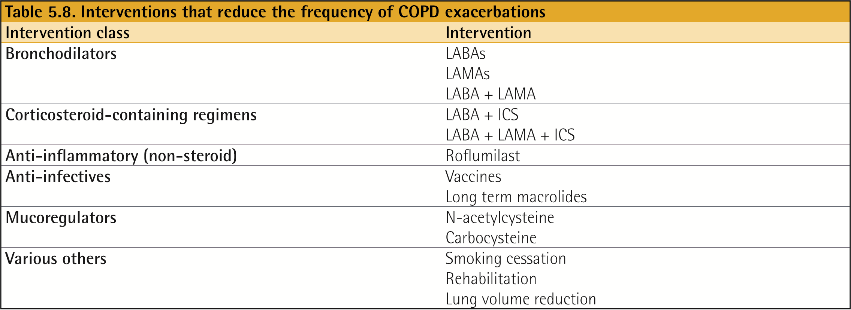
Management of Exacerbations
© 2017 Global Initiative for Chronic Obstructive Lung Disease

Slide 33
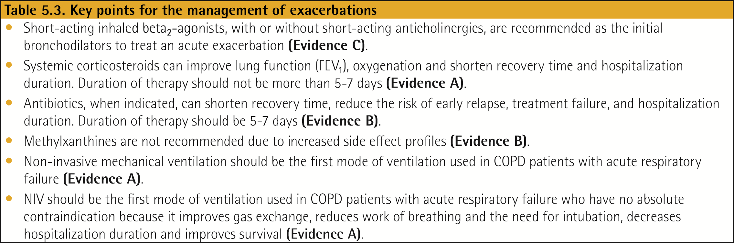
Management of Exacerbations
- Summary
© 2017 Global Initiative for Chronic Obstructive Lung Disease

Slide 34
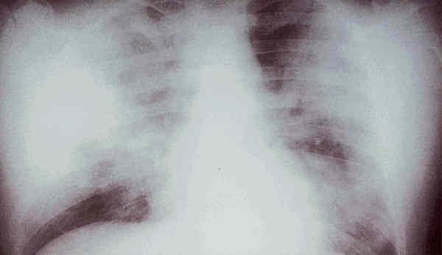
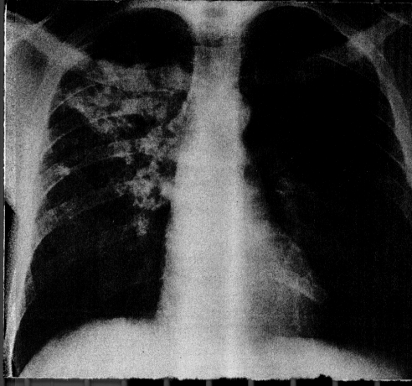
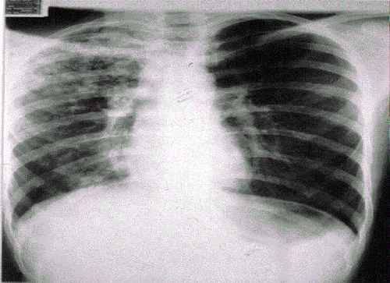
Pneumonia
S.pneumo
Legionella
TB
Plague
Tularemia
RICIN toxin
Staphylococcal Enterotoxin B
SARS

Slide 35
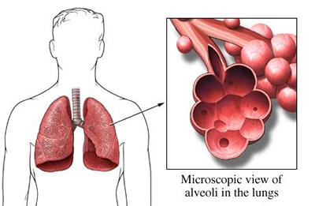
pneumonia
Definition
Pneumonia is an acute infection of the
parenchyma of the lung, caused by
bacteria, fungi, virus, parasite .
• Pneumonia may also be caused by
other factors
including X-ray, chemicals, allergens.

Slide 36
Pneumonia
Inhalation, aspiration and hematogenous spread are the 3 main mechanisms by which bacteria reaches the lungs.

Slide 37
Epidemiology
  - 8th leading causes of death in the USA .
  Mortality rate: 1-5% out-Pt, 12% In-Pt, 40% ICU
  Death rates increase with comorbidities and age.
  Affects race and sex equally

Slide 38
Pneumonia
Diagnosis :
New respiratory symptoms plus new infiltration on CXR.

Slide 39
Classification
Classification of anatomy
Classification of pathogen
Classification of acquired environment

Slide 40
Classification
Ⅰ.Classification by pathogen
Pathogen classification is the most useful
to treat the patients by choosing effective
antimicrobial agents.
Streptococcus pneumonia is the commonest organism.

Slide 41
Bacterial pneumonia
(1) Aerobic Gram-positive bacteria ,such
as streptococcus pneumoniae, staphy
lococcus aureus, Group A hemolytic
streptococci
(2) Aerobic Gram-negative bacteria, such
as klebsiella pneumoniae, Hemophilus
influenzae, Escherichia coli
(3) Anaerobic bacteria

Slide 42
Atypical pneumonia
Including Legionnella pneumonia ,
Mycoplasmal pneumonia ,chlamydia pneumonia.

Slide 43
Fungal pneumonia
Fungal pneumonia is commonly caused by Candida, and aspergilosis.

Slide 44
Viral pneumonia
Viral pneumonia may be caused by adenoviruses, respiratory syncytial
virus, influenza, cytomegalovirus,
herpes simplex virus.

Slide 45
Other pathogens
Pneumonia caused by
other pathogen
Rickettsias (a fever rickettsia).
parasites
protozoa

Slide 46
Ⅱ.Classification by anatomy
1. Lobar: Involvement of an entire lobe
2. Lobular: Involvement of parts of the lobe only, segmental or of alveoli contiguous to bronchi (bronchopneumonia).
3. Interstitial

Slide 47

Lobar pneumonia

Slide 48

Lobular pneumonia

Slide 49
Classification by acquired environment
Community acquired pneumonia，CAP
Hospital acquired pneumonia，HAP
Health care associated pneumonia ,HCAP
Immunocompromised host pneumonia.

Slide 50
CAP
CAP refers to pneumonia acquired outside of hospitals or extended-care facilities .
Streptococcus pneumoniae remains the most commonly identified pathogen.
Other pathogens include Haemophilus influenzae, mycoplasma pneumoniae, Chlamydophilia pneumoniae, Moraxella catarrhalis

Slide 51
CAP
Smokers are at increased risk for invasive pneumococcal infections even if they do not have structural lung disease.

Slide 52
CAP
CAP affects 5.6 million adults in USA annually .
It accounts for 1.7 million hospitalizations per year .
Pneumonia is the 8th leading cause of death in the USA , > 60,000 deaths annually .
It is the cause of 46% of all deaths from infectious diseases .

Slide 53
Organisms associated with CAP
Outpatient
1- S. pneumonia.
2- M. pneumonia.
3- H. infleunza.
4- C. pneumonia.
5- Respiratory viruses.

Slide 54
Organisms associated with CAP
Inpatient (non-ICU ):
1- S. pneumonia
2- M. pneumonia
3- C. pneumonia
4- H. infleunza
5-Legionella spp
6- aspiration.

Slide 55
Organisms associated with CAP
Inpatients ( ICU ):
1- S. pneumonia
2- S . aureus
3- Legionella spp
4- Gram negative bacilli
5- H. infleunza

Slide 56
CAP:
Risk Factors
Altered Mental Status
Smoking
Alcohol consumption
Malnutrition
Immunosuppression
Underlying lung disease
Age ≥65 years

Slide 57
CAP:
Clinical Presentation
Symptoms:
  Cough (typically productive)
  Fever with chills and sweats
  Shortness of breath
  Chest pain
Signs:
  Fever, tachycardia, tachypnea
  Crackles/rhonchi on lung exam
  Leukocytosis

Slide 58
CAP: Diagnosis –
Imaging
Infiltrate on Cxray (or other imaging) required for the diagnosis of pneumonia
If clinically suspect CAP, but negative Cxray consider:
  Chest CT
  Empiric treatment and repeat Cxray in 24-48 hrs

Slide 59
Sputum Gram Stain & Culture
Neither sensitive nor specific
30% of patients can’t produce sputum
With grading—only 25%-40% good quality
At best 28% are good samples
Can’t detect atypicals
Prior antibiotics affect results

Slide 60
Limitations of Sputum Culture
Overdiagnosis
- Contamination with upper respiratory tract flora
- Chronic colonization of the lower respiratory tract with pathogens
Underdiagnosis
- Sampling errors
- Atypical bacterial pathogens

Slide 61
Blood Cultures
Outpatient – < 1%
Ward patients – 6.6%-17.6%
ICU patients – 27%
Recommended for hospitalized patients
It has a low sensitivity but high specificity

Slide 62
CAP:
Diagnosis – Special Tests
Urinary Legionella Antigen
  Serotype 1 only
  Accounts for 88% of USA isolates
  Sensitivity: 70%; specificity: >90%
Urinary Pneumococcal Antigen
  Sensitivity: 60-90%, specificity: 100%
  Recent study found 10% of specimens from pts with non-pneumococcal pneumonia were positive

Slide 63
CAP:
Poor Prognostic Factors
Age > 65 years
Nursing home resident (HCAP)
Presence of chronic lung disease
High APACHE score
Need for mechanical ventilation

Slide 64
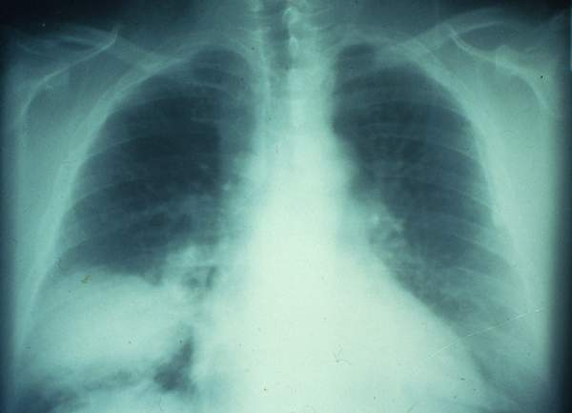
CAP:
Treatment Guidelines
Where to treat:
  Many can be treated as an outpatient
  Must consider illness severity, comorbidities, home support, adherence to therapy

Slide 65
CAP:
Treatment Guidelines
Pneumonia Severity Index (PSI)
  Prediction rule to stratify risk of death from CAP
  Assists in determining location of Rx for CAP
  Should not supercede clinical judgment
Notes:
Pneumonia Patient Outcomes Research Team

Slide 66
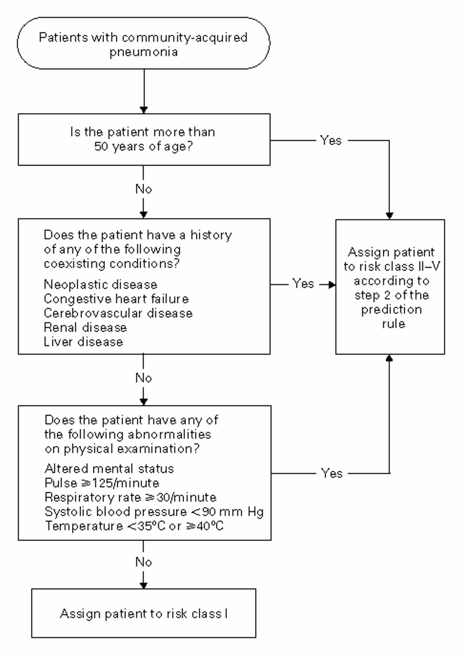
CAP:
PSI
Fine, M. J. et al. N Engl J Med 1997;336:243-250

Slide 67
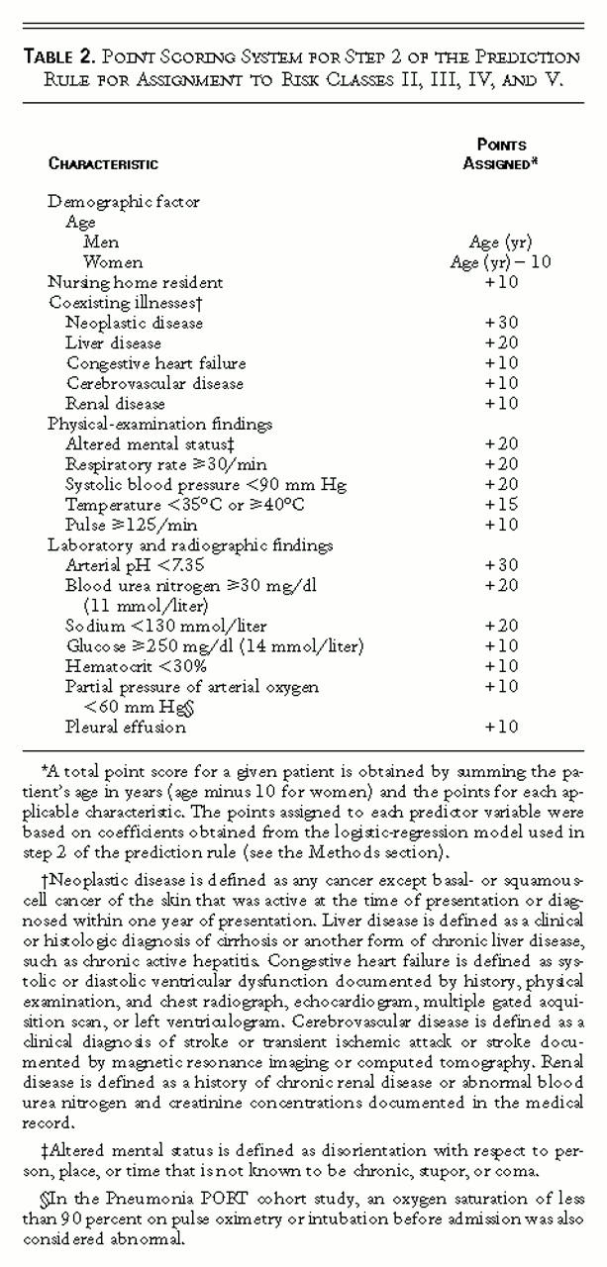
Then, add up their risk points:
Risk | Score
II | < 70
III | 71-90
IV | 91-130
V | > 130

Slide 68
CAP:
PSI
PSI Index | Mortality Rate
I | 0.1-0.5%
II | 0.4-0.9%
III | 0-2.8%
IV | 8.2-12.5%
V | 27-31%
Consider Outpt Tx
Needs Inpt Tx
Fine, M. J. et al. N Engl J Med 1997;336:243-250

Slide 69
CAP:
CURB-65
CURB-65 criteria
  Confusion
  Uremia (BUN >20)
  Respiratory rate (RR >30)
  Blood pressure (SBP <90 or DBP < 60)
  Age 65 years or greater

Slide 70
CAP:
CURB-65
CURB-65 Score | Mortality Rate | Tx Location
0 | 0.7% | Outpatient
1 | 2.1% | Outpatient
2 | 9.2% | Inpatient
3 | 14.5% | Inpatient - ?ICU
4 | 40.0% | ICU
5 | 57.0% | ICU

Slide 71
CAP:
Treatment
Abx initiated in the emergency dept, ideally within 4 hrs
Quick administration has been associated with reduced mortality
Use of empiric guidelines have reduced costs, mortality, LOS
Based upon severity of illness and host immune status
Target regimen based upon culture results

Slide 72
CAP:
IDSA-ATS Treatment Guidelines
Stratify empiric outpatient treatment based on
  Drug-resistant Strep pneumo risk
    > 25% resistance rate (e.g. Nashville, TN)
  Presence of co-morbidities
    Alcoholism/Aspiration risk
    Bronchiectasis/COPD
    IVDA
    Post-influenza
  Prior abx use in the preceding 3 months

Slide 73
CAP:
IDSA-ATS Treatment Guidelines
Empiric Treatment – Outpatient:
  No confounding factors:
  macrolide (azithromycin 500mg x 1 day then 250mg Qday or clarithromycin 500mg po Q12hrs or clarithro-ER 1000mg Qday)
  or
  doxycycline 100mg Q12hrs

Slide 74
CAP:
IDSA-ATS Treatment Guidelines
Empiric Treatment – Outpatient:
  Confounding factors present:
  respiratory quinolone (levofloxacin 750mg Qday, moxifloxacin 400mg Qday)
  or
  beta-lactam (amoxicillin 1g Q8hrs, amox-clav-ER 2gm Q12hrs, cefpodoxime 200mg Q12hrs, cefdinir 300mg Q12hrs, etc) + macrolide
  or
  beta-lactam + doxycycline

Slide 75
CAP:
IDSA-ATS Treatment Guidelines
Empiric Treatment – Hospitalized, non-ICU:
  Beta-lactam (ceftriaxone, cefotaxime, ampicillin, or ertapenem) + macrolide or doxycycline
  or
  Respiratory quinolone alone
  (levofloxacin, moxifloxacin, gemifloxacin)

Slide 76
CAP:
IDSA-ATS Treatment Guidelines
Empiric Treatment – Hospitalized, ICU:
  Beta-lactam (ceftriaxone, cefotaxime, or ampicillin/sulbactam) + macrolide or respiratory quinolone
  PCN-allergic = resp quinolone + aztreonam

Slide 77
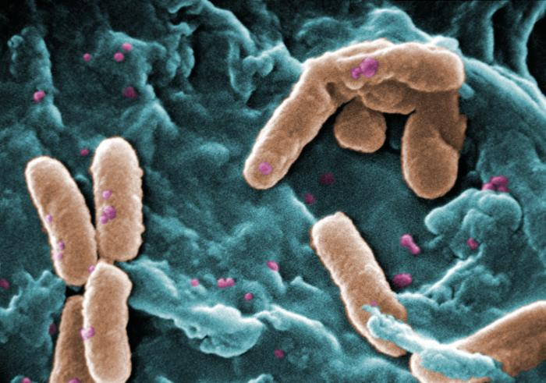
CAP:
Risk Factors for Pseudomonas
Structural lung diseases, such as bronchiectasis
Repeated exacerbations of severe COPD leading to frequent steroid and/or antibiotic use
Health-Care Associated Pneumonia (HCAP)

Slide 78
CAP:
Pseudomonas Coverage
Beta-lactam (piperacillin-tazobactam, cefepime, imipenem, or meropenem) + ciprofloxacin or levofloxacin or
Beta-lactam + aminoglycoside + azithromycin or
Beta-lactam + aminoglycoside + respiratory quinolone
PCN-allergic = substitute aztreonam for the beta-lactam

Slide 79
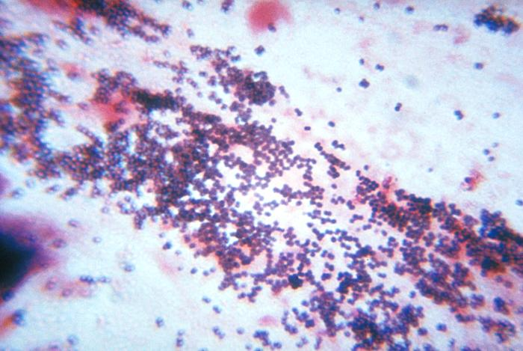
CAP:
MRSA
Consider empiric coverage of MRSA if:
  HCAP
  Necrotizing pneumonia
  Post-influenza pneumonia
  History of MRSA or recurrent skin abscesses
Treat with vancomycin or linezolid

Slide 80
CAP:
MRSA – Vancomycin vs. Linezolid
Retrospective analysis of data from two separate, prospective trials (n = 1,019)
Patients with nosocomial pneumonia
Aztreonam + vancomycin or linezolid
No difference in survival except in MRSA pneumonia subgroup (63.5% vs. 80%, p=0.03)
Linezolid is an alternative to vancomycin in new IDSA/ATS guidelines
Wunderink, et al. Chest 2003

Slide 81
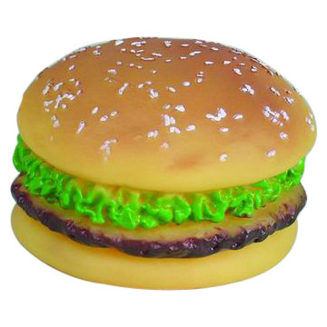
CAP:
Oral Abx Therapy
Switch to po abx when…
  Hemodynamically stable
  Clinically improving
  Able to tolerate po
  Have normal GI tract fxn

Slide 82
CAP:
Length of Therapy
Rx for a minimum of 5 days
Before discontinuation of therapy:
  Pt should be afebrile for 48–72 hrs
  Pt should have no more than one CAP-associated sign of clinical instability
Longer duration usually indicated with Legionella, Chlamydia, MRSA

Slide 83
CAP:
Criteria for Clinical Stability
Temperature <37.8°C
Heart rate <100 beats/min
Respiratory rate <24 breaths/min
Systolic blood pressure >90 mm Hg
Arterial oxygen saturation > 90% or pO₂ > 60 mm Hg on room air
Ability to maintain oral intake
Normal mental status

Slide 84
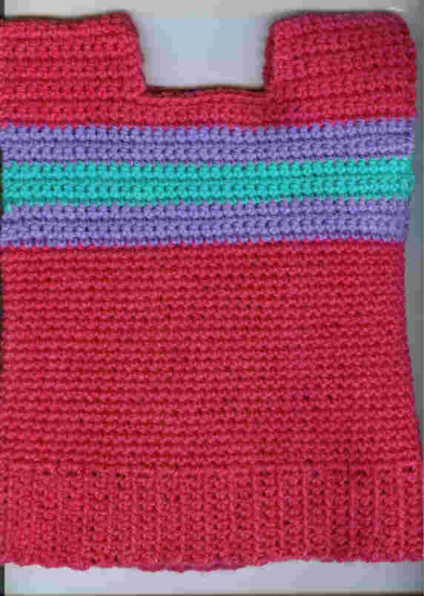
CAP:
Prevention
Marked reduction in 30 day mortality in hospitalized pt with CAP from 1987 to 2005 due to greater use of pneumococcal and infleunza vaccines and use of guidelines for antibiotics.
Vaccinations
  (I hope you all took the Flu shot this season ! )

Slide 85
HAP
“Nosocomial” Pneumonia
Hospital-acquired pneumonia (HAP)
  Occurs 48 hours or more after admission, which was not incubating at the time of admission
Ventilator-associated pneumonia (VAP)
  Arises more than 48-72 hours after endotracheal intubation

Slide 86
HAP
The pathogen of HAP
Gram-negative bacteria (GNB) account for 55% to 85% of HAP infections
gram-positive cocci account for 20% to 30% and some other pathogens.

Slide 87
HAP
Enteric Gram-negative organisms, S. aureus, Pneudomonas aeruginosa.

Slide 88
HAP
EPIDEMIOLOGY
General risk factors for developing HAP include age more than 70 years, serious comorbidities, malnutrition, impaired consciousness, prolonged hospitalization, and chronic obstructive pulmonary diseases.

Slide 89
VAP
VAP is the most common infection occurring in patients requiring care in an intensive care unit (ICU), with incidence rates ranging from 6% up to
52%, much higher than the 0.5% to 2% incidence reported for hospitalized patients as a whole.
This increased incidence is due to the fact that patients located in an ICU often require mechanical ventilation, and mechanically ventilated patients are 6 to 21 times more likely to develop HAP than are nonventilated patients.

Slide 90
HCAP
Healthcare-associated pneumonia (HCAP)
  Patients who were hospitalized in an acute care hospital for two or more days within 90 days of the infection; resided in a nursing home or LC facility; received recent IV abx, chemotherapy, or wound care within the past 30 days of the current infection; or attended a hospital or hemodialysis clinic.

Slide 91
HCAP:
Definition
Hospitalized in acute care hospital two or more days within 90 days prior to infection
Reside in long-term care facility
Received IV abx, chemotx, or wound care in last 30 days
Dialysis

Slide 92
Streptococcus pneumonia
Most common cause of CAP
Gram positive diplococci
“Typical” symptoms (e.g. malaise, shaking chills, fever, rusty sputum, pleuritic chest pain, cough)
Lobar infiltrate on CXR
Suppressed host
25% bacteremic.

Slide 93
Atypical pneumonia
#2 cause (especially in younger population)
Commonly associated with milder Sx’s: subacute onset, non-productive cough, no focal infiltrate on CXR
Mycoplasma: younger Pts, extra-pulm Sx’s (anemia, rashes), headache, sore throat
Chlamydia: year round, URI Sx, sore throat
Legionella: higher mortality rate, water-borne outbreaks, hyponatremia, diarrhea

Slide 94
Diagnosis
Give a definite diagnosis of pneumonia
To evaluate the degree of the pneumonia
To definite the pathogen of the pneumonia

Slide 95
ICU admission decision.
Direct admission to an ICU is required for patients with septic shock requiring vasopressors or with acute respiratory failure requiring intubation and mechanical ventilation.
(Strong recommendation; level II evidence.)
Direct admission to an ICU or high-level monitoring unit is recommended for patients with 3 of the minor criteria for severe CAP listed in next table .
(Moderate recommendation; level II evidence.)

Slide 96
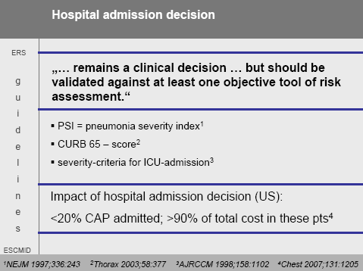
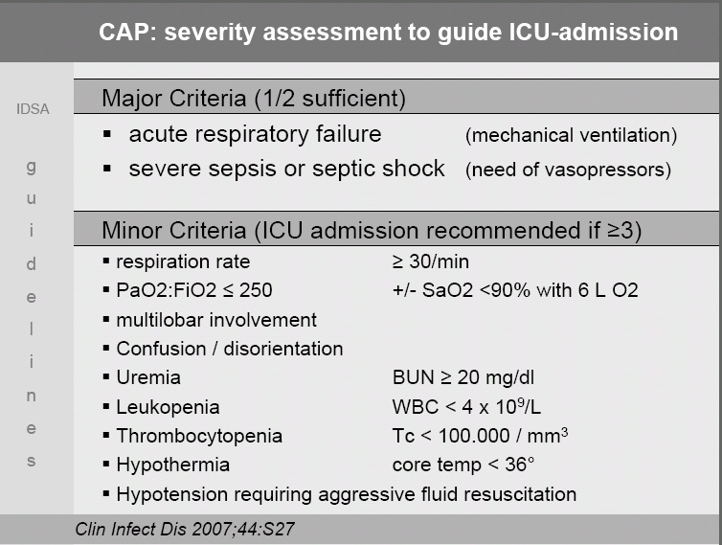

Slide 97
THANK YOU

