Slide 1
Limbic system

Slide 2
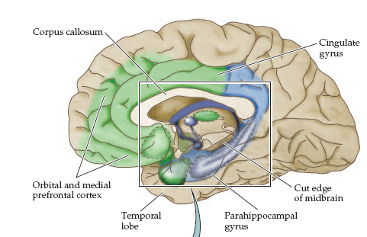
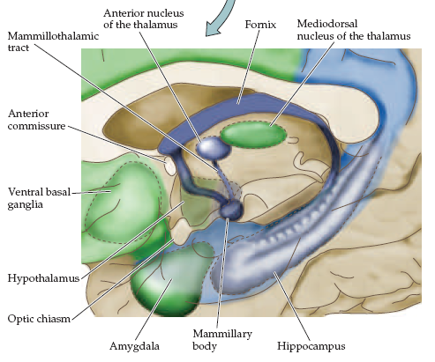

Slide 3
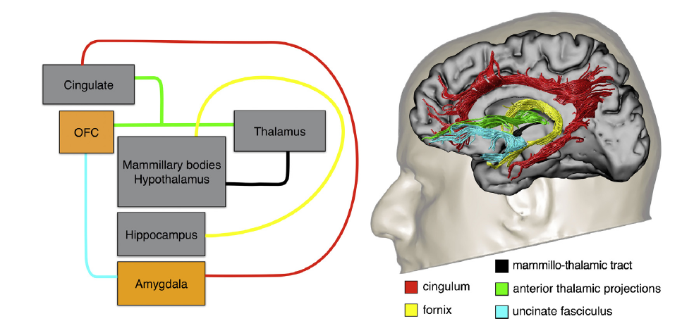

Slide 4
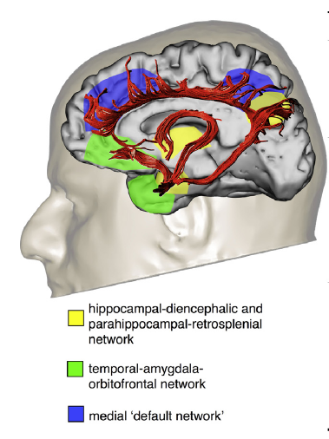

Slide 5
Limbic system functions
Memory
Spatial orientation
Multimodal sensory integration
Emotion processing
Motivation and behavioral selection
Self knowledge
Default network

Slide 6
Limbic system functions
Memory
Spatial orientation
Hippocampal-dienchphalic-parahippocampal- retrospinal network
Multimodal sensory integration
Emotion processing
Motivation and behavioral selection
Self knowledge
Default network

Slide 7
Hippocampal-dienchphalic-parahippocampal-retrospinal network
Alzheimer's disease
Amnesias
Korsakoff syndrome

Slide 9
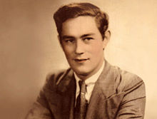
Henry Gustav Molaison (H.M.)
Surgical removal of left and right medial temporal lobes (hippocampus, parahippocampal gyrus)
Anterograde amnesia

Slide 10
Korsakoff Syndrome
Neuronal degeneration in the mammillary body, dorsomedial thalamic n. & hippocampus.
Often seen in chronic alcoholics: due to thiamine deficiency.
Both short- and long-term memory loss.
Confabulation.
Wernicke-Korsakoff syndrome: profound memory loss & learning difficulties.

Slide 11
Limbic system functions
Multimodal sensory integration
Emotion processing
Motivation and behavioral selection
Temporal-amygdala-orbitofrontal
Self knowledge
Default network

Slide 12
Temporal-amygdala-orbitofrontal
semantic deficits (semantic dementia)
language difficulties
personality changes and other behavioral symptoms (e.g. aggression, disinhibition)
Kluver-bucy syndrome
Psychopathy
Bipolar affective disorders

Slide 13
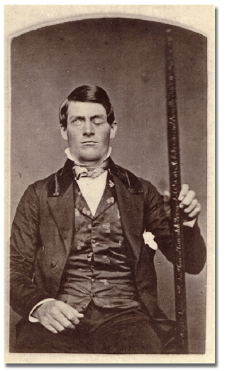
Temporal-amygdala-orbitofrontal
semantic deficits (semantic dementia)
language difficulties
personality changes and other behavioral symptoms (e.g. aggression, disinhibition)
Kluver-bucy syndrome
Psychopathy
Bipolar affective disorders

Slide 14
Ablation of the amygdala bilaterally
Klüver-Bucy Syndrome
Hyperphagia
Hyperorality
Hypersexuality
Hypermetamorphosis
Agnosia: visual, tactile & auditory
Dementia

Slide 15
Limbic system functions
Self knowledge & Autobiographical information
Moral reasoning & action monitoring
Emotions of other & social evaluations
Dorsomedial Default network
Posterior cingulate cortex & precuneus
Medial prefrontal cortex
Angular gyrus

