Slide 1
INFLAMMATION LECTURE
DR HEYAM AWAD, FRCPATH

Slide 3
INFLAMMATORY REACTION
RECOGNITION.
RECRUITMENT.
REMOVAL OF THE AGENT.
REGULATION.
RESOLUTION/ REPAIR.

Slide 4
RECOGNITION

Slide 5
RECEPTORS

Slide 6
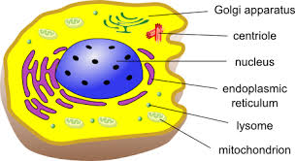

Slide 7
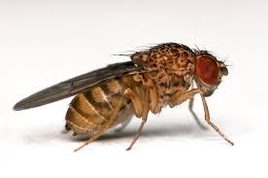
CELULAR RECEPTORS FOR MICROBES
TOLL-LIKE RECEPTORS (TLRs).

Slide 8
WHICH CELLS?
EPITHELIAL.
DENDRITIC CELLS.
MACROPHAGES.
WBCs.

Slide 9
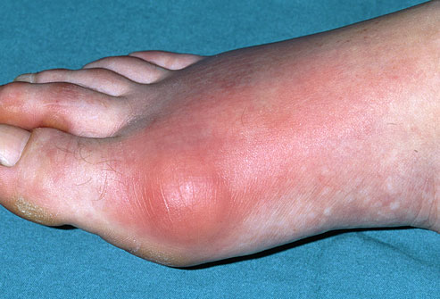
SENSORS OF CELL DAMAGE.

Slide 10
SENSORS OF CELL DAMAGE

Slide 11
SENSORS OF CELL DAMAGE

Slide 12
SENSORS OF CELL DAMAGE

Slide 13
SENSORS OF CELL DAMAGE ACTIVATE A PROTEIN CYTOSOLIC COMPLEX CALLES INFLAMMASOME.
INFLAMMASOME INDUCES PRODUCTION OF IL-1.
IL-1 RECRUITS LEUKOCYTES.

Slide 14
WHICH CELLS?
WHERE IN THE CELLS?

Slide 15
OTHER CELLULAR RECEPTORS
WBCs EXPRESS RECEPTORS FOR Fc TAIL OF ANTIBODIES AND COMPLEMENT...............SO THEY RECOGNISE MICROBES COATED WITH ANTIBODIES AND COMPLEMENT

Slide 16
CIRCULATING PROTEINS
COMPLEMENT SYSTEM REACTS AGAINST MICROBES.
MANNOSE- BINDING LECTIN RECOGNISES MICROBIAL SUGARS.
COLLECTINS BIND MICROBES.

Slide 17
RECRUITMENT

Slide 18
MARGINATION
NORMALLY RBCs ARE CONFINED TO A CENTRAL COLUMN DISPLACING WBCs TO THE PERIPHERY.
STASIS CAUSES DECREASE WALL SHEAR STRESS SO MORE WBCs TAKE A PERIPHERAL POSITION.

Slide 19
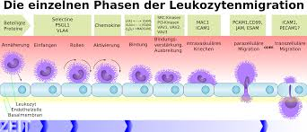
ROLLING

Slide 20
ROLLING IS FOLLOWED BY ADHESION.

Slide 21
ROLLING AND ADHESION ARE CAUSED BY COMLEMENTARY ADHESION MOLECULES IN BOTH WBC AND ENDOTHELIAL CELLS.
ADHESION MOLECULES: SELECTINS AND INTEGRINS.....A LONG STORY!!!

Slide 22
SELECTINS CAUSE ROLLING....WEAK ADHESION.
ROLLING SLAWS DOWN WBCs....CHANCE FOR FIRM ADHESION.
FIRM ADHESION BY INTEGRING...VCAM AND ICAM

Slide 23
MIGRATION
TRANSMIGRATION OR DIAPEDESIS.
OCCURS MAINLY IN POSTCAPILLARY VENULES.
ADHESION MOLECULES...PECAM (PLATELET ENDOTHELIAL CELL ASHESION MOLECULE).
THROUGH THE BASEMENT MEMBRANE? COLLAGENASE.

Slide 25
CHEMOTAXIS
CHEMOATTRACTANTS:
BACTERIAL PRODUCTS; PEPTIDES AND LIPIDS.
CYTOKINES, ESPECIALLY CHEMOKINES( IL8 ).
COMPLEMENT C5a.
ARACHIDONIC ACID METABOLITES, LEUKOTRIENE B4.

Slide 26
REMOVAL OF INSULT
PHAGOCYTOSIS AND INTRACELLULAR KILLING.
THREE STEPS : RECOGNITION AND ATTACHMENT, ENGULFMENT, KILLING OR DERGRADATION.

Slide 27
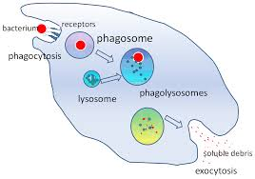

Slide 28
RECEPTORS FOR RECOGNITION
MANNOSE RECEPTORS.
RECOGNISE MANNOSE AND FUCOSE ON GLYCOPROTEINS AND GLYCOLIPIDS .

Slide 29
RECEPTORS
SCAVENGER RECEPTOR.
RECOGNISE MODIFIED LDL....OXIDISED OR ACETYLATED.

Slide 30
RECEPTORS
RECEPTORS FOR OPSONINS.
OPSONINS ARE PROTEINS THAT BIND MICROBES.
OPSONINS: IgG, C3b, LECTINS.

Slide 31
ENGULFMENT

Slide 32
INTRACELLULAR DESTRUCTION
LYSOSOMAL ENZYMES.
REACTIVE OXYGEN SPECIES.
REACTIVE NITROGEN SPECIES.

Slide 33
LYSOSOMAL ENZYMES
WHICH CELLS?

Slide 34
NEUTROPHIL GRANULES
1. PRIMARY, LARGE, AZUROPHIL GRANULES.
MYLOPEROXIDASE, BACTERIOCIDAL FACTORS, HYDROLASES.
2. SECONDARY, SMALL, SPECIFIC GRANULES.
LYSOZYME, COLLAGENASE, GELATINASE, ALKALINE PHOSPHATASE, HISTAMINASE.

Slide 35
PROTEASES.
ACID PROTEASES....DEGRADE ACIDIFIED DEBRIS .
NEUTRAL PROTEASES... CAN DEGRADE COLLAGEN, ELASTIN, FIBRIN, CARTILAGE, BASEMENT MEMBRANE
NEUTRAL PROTEASES CAN CAUSE TISSUE DESTRUCTION.

Slide 36
MACROPHAGES
CONTAIN: HYDROLASES, COLLAGENASE, ELASTASE, PHOSPHOLIPASE.

Slide 37
ANTIPROTEASES
LYSOSOMAL PROTEASES ARE HARMFUL TO OUR TISSUE.
CONTROLLED BY ANTIPROTEASES.
ALPHA 1 ANTITRYPSIN INHIBITS NEUTROPHIL ELASTASE.

Slide 38
REACTIVE OXYGEN SPECIES
OXIDASES CAN PRODUCE ROS, e.g: SUPEROXIDE ANION.
OXIDASE CONSISTS OF 7 PROTEINS!!
COMPONENTS IN PLASMA MEMBRANE AND CYTOPLASM.
ROS PRODUCED IN PHAGOLYSOSOMES.

Slide 40
SUPEROXIDE IS CONVERTED TO HYDROGEN PEROXIDE (H2O2)
H2O2 CONVERTED BY MYELOPEROXIDASE TO HYPOCHLORITE (OCL2-)
HYPOCHLORITE DESTROYS MICROBES BY HALOGENATION OR OXIDATION.

Slide 41
NITROGEN RADICALS
NITRIC OXIDE (NO) PRODUCED BY NITRIC OXIDE SYNTHASE (NOS)
NOS...eNOS, nNOS,iNOS.
NO RECTS WITH SUPEROXIDE TO FORM PEROXINITRITE(ONOO-)

