Slide 1
Brainstem and Corticonuclear Projections

Slide 3
CN I
-Anosomia
-ageusia, hypogeusia
CN II
-blindness
-hemianopia
-mydriasis
-quadrantanopia
CN III, IV, VI
-diplopia
-ptosis
-paralysis of extraocular muscles
-mydriasis
CN. V
-trigeminal neuralgia (tic douloureux)
-paralyis of masticatory muscles
-jaw jerk reflex (afferent limb/efferent limb)
-lateral medullary syndrome
CN. VII
-Bell palsy
-central seven
-paralysis of muscles of facial expression
-corneal reflex
-hemifacial spasms
CN. VIII
-deafness
-vestibular schwannoma
-tinnitus
CN. IX
-glossopharyngeal neuralgia
-gag reflex
-jugular foramen syndromes
CN. X
-dysarthria
-dysphagia
-dyspnea
-jugular foramen syndromes (see Text p. 218)
CN. XI
-jugular foramen syndromes (see Text p. 218)
-paralysis of trapezius and sternocleidomastoid muscles
CN. XII
-lateral deviation on protrusion
-medial medullary syndrome

Slide 4
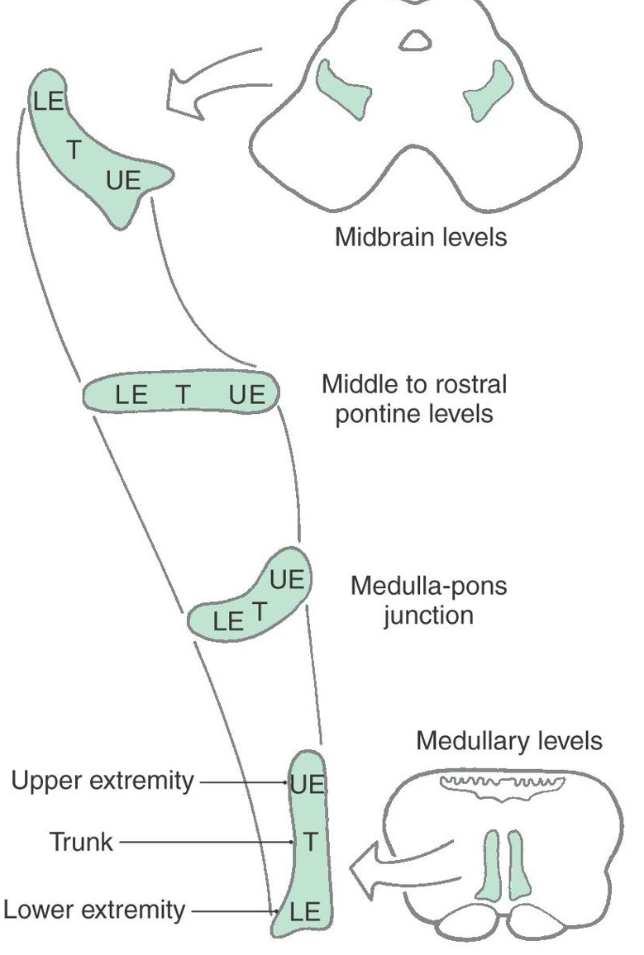

Slide 6
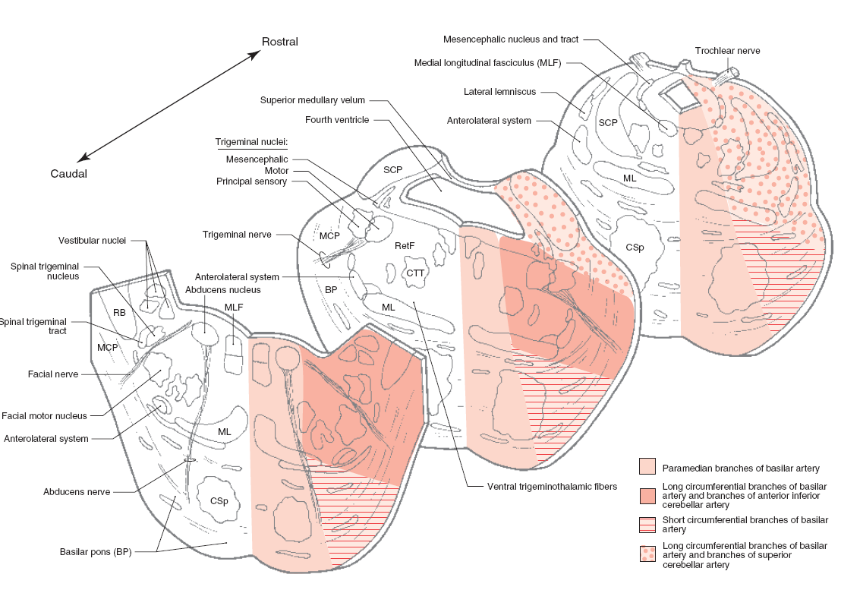

Slide 7
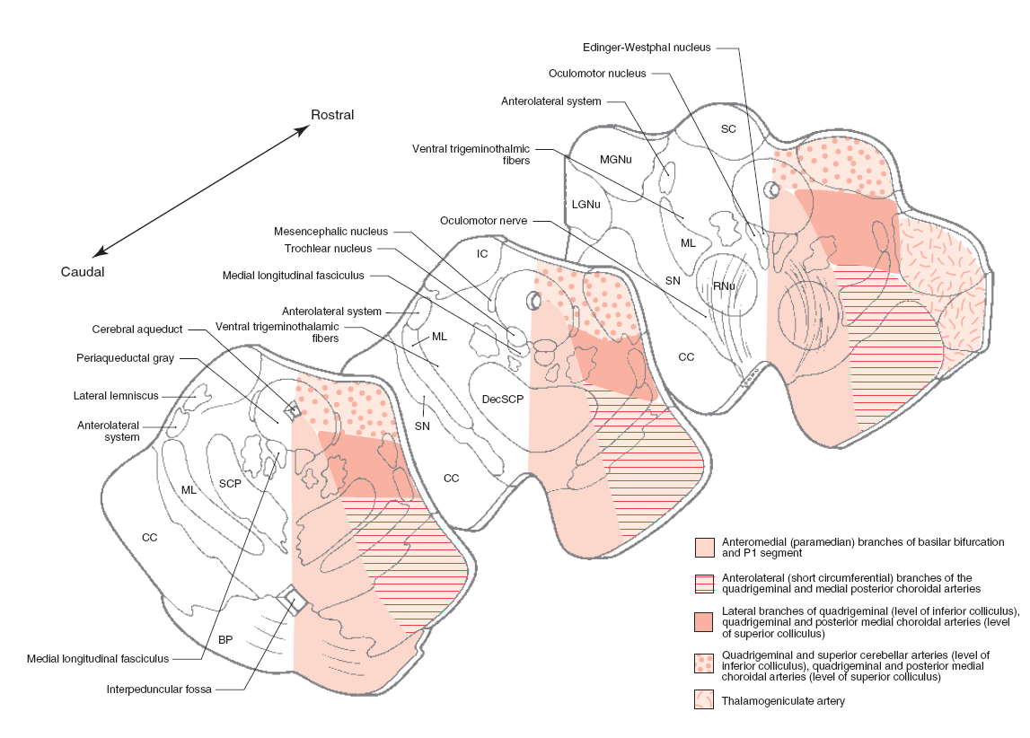

Slide 8
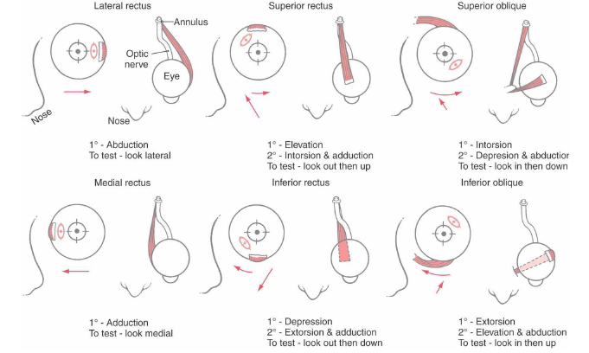

Slide 9
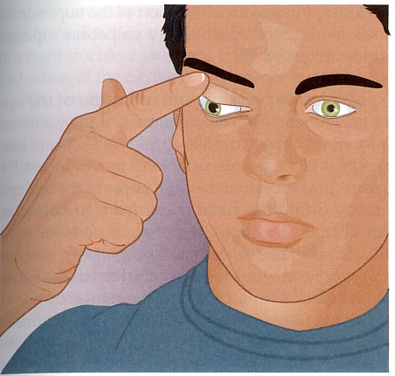
Third Nerve Palsy
Eye “down and out”

Slide 10
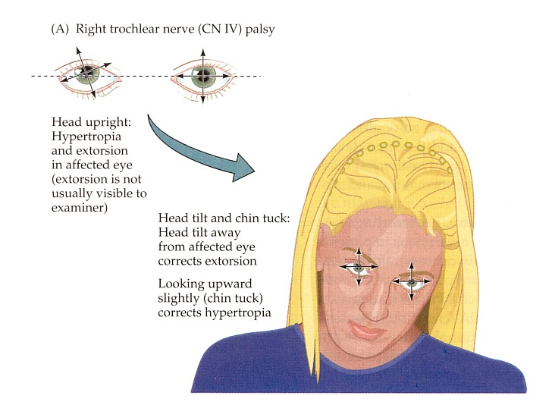
Trochlear Nerve Palsy
Note: Right eye
Instead of intorsion and depression
action of superior oblique
See extorsion and elevation
Observe how the axes over
the right eye shift when patient
generates a compensatory head
movement
Attempted Correction:
Patient tilts head to her left
Tucks chin to foveate on object
Left eye will align accordingly

Slide 11
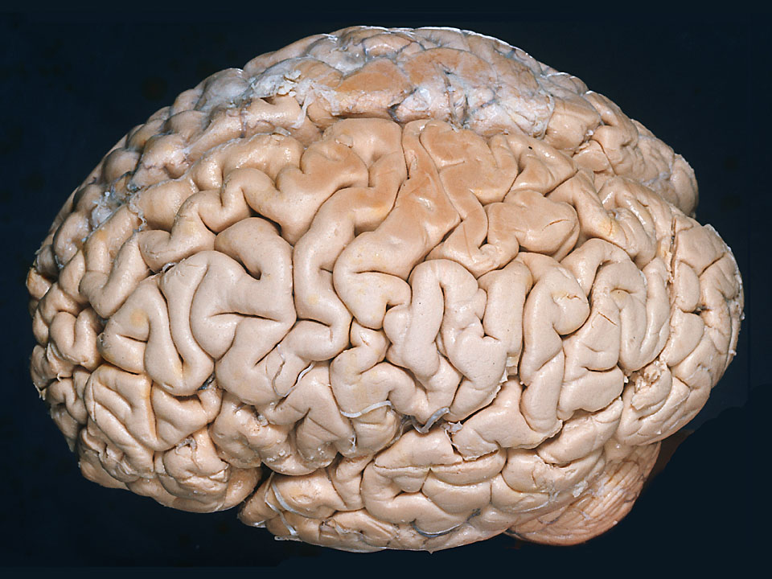
Face Area of Somatomotor Cortex and Frontal Eye Field
F
See Atlas Fig. 2-11

Slide 12
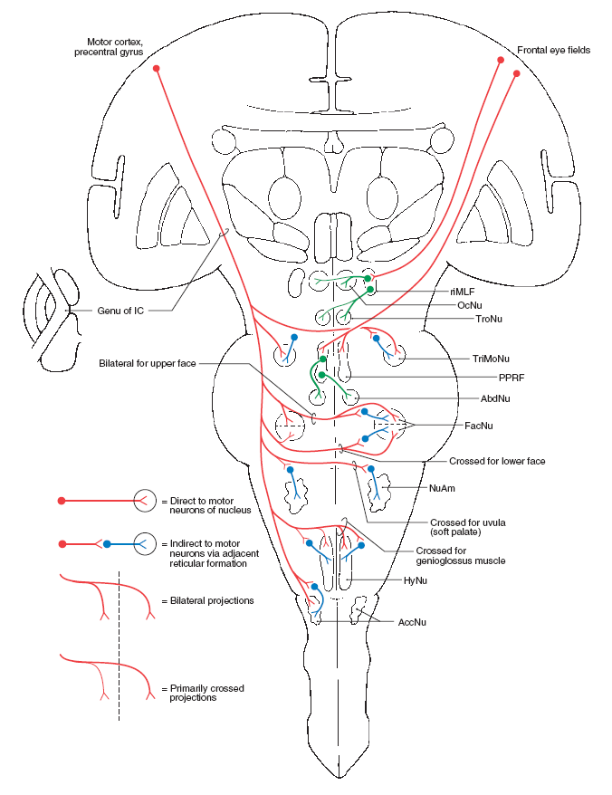
Corticonuclear Fibers
*
*
*
*
*
*

Slide 13
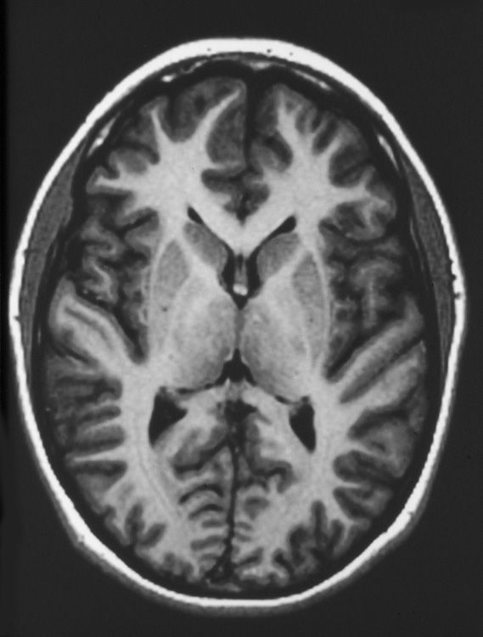
Internal Capsule in MRI
Internal Capsule
Atlas Fig. 5-12

Slide 14
Corticonuclear Fibers
*
*
*
*
*
*

Slide 15
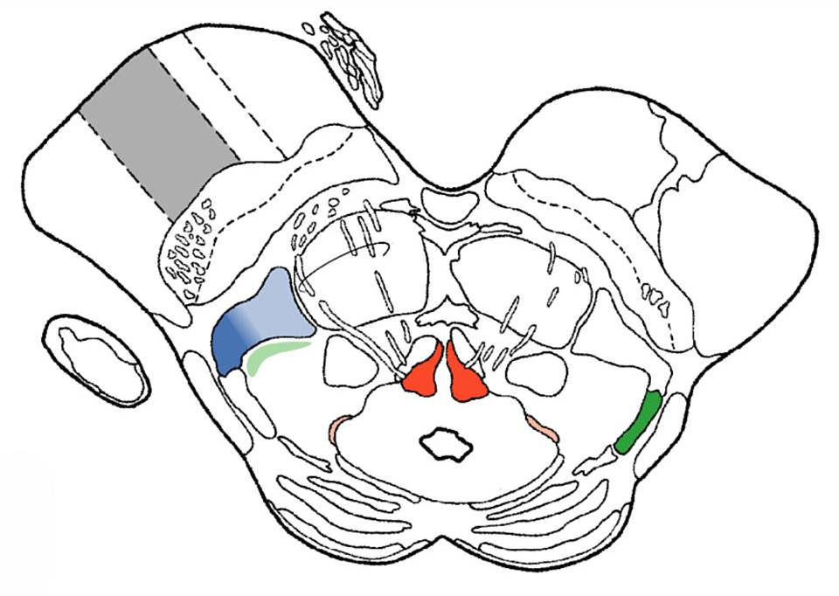
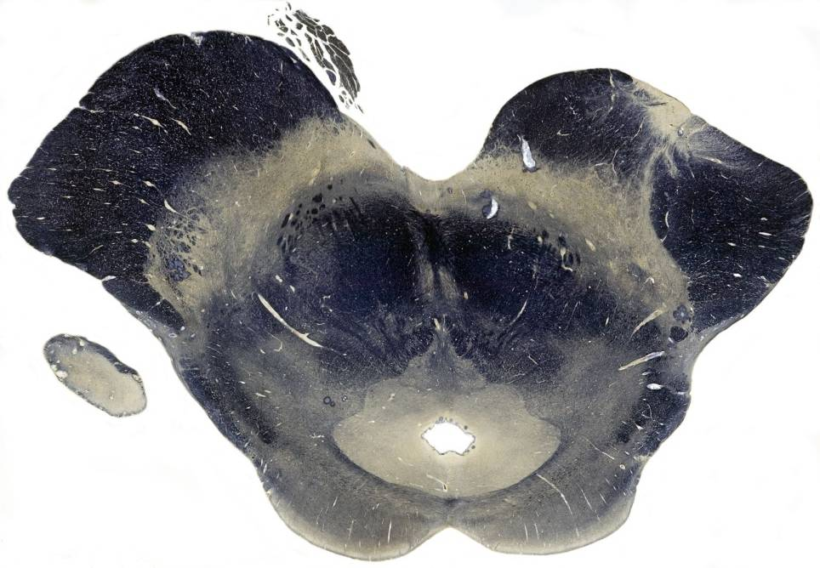
Corticonuclear Fibers in the Crus Cerebri
FP fibers
Face
UE
LE
POT fibers

Slide 16
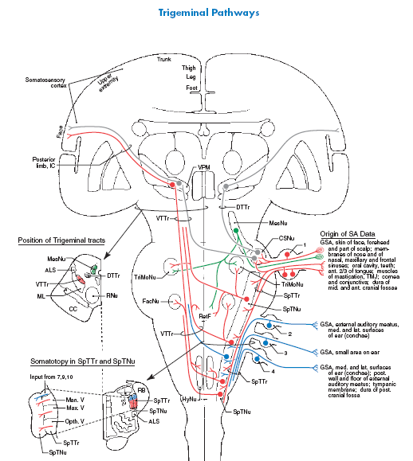

Slide 17
Trigeminal Nerve: CN V
*
*
*
*
*
*

Slide 18
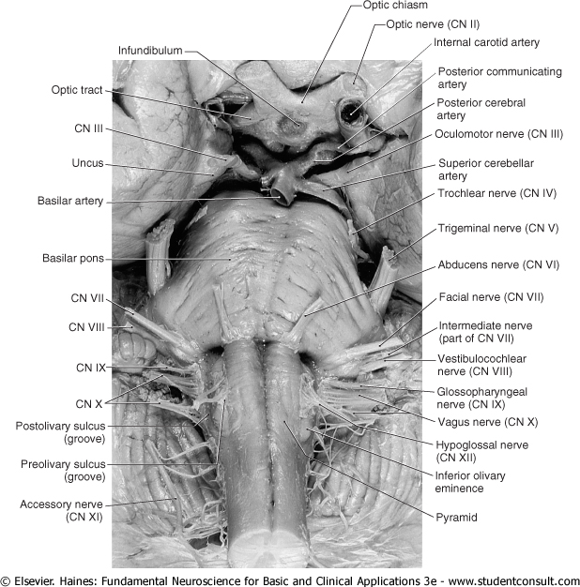
Facial Nerve: CN VII

Slide 19
Facial Nerve: CN VII
*
*
*
*
*
*

Slide 20
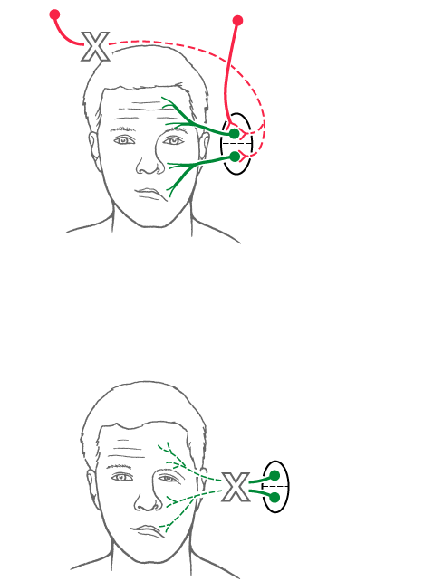
The Facial Nerve
Central Seven
Bell Palsy
Text Fig. 25-14

Slide 21
Smile

Slide 22
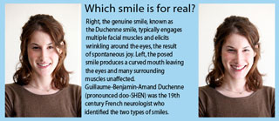
Smile

Slide 23
Pan Am Smile
Duchenne smile

Slide 24
Pan Am Smile

Slide 25
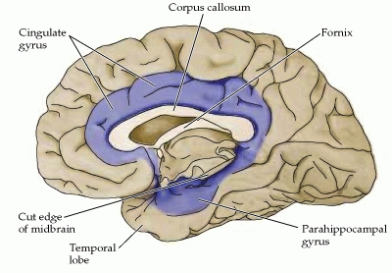
Duchenne smile

Slide 26
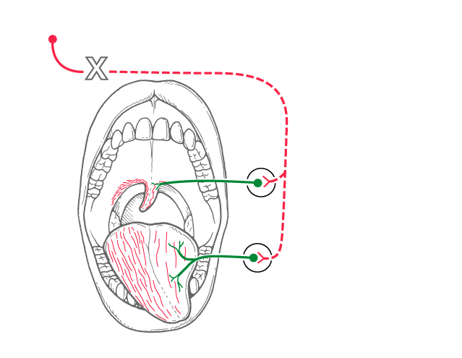
Corticonuclear Fibers
Vagus X
Nucleus ambiguus
Hypoglossal nucleus
Text Fig. 25-15

Slide 27
Corticonuclear Fibers
Nucleus ambiguus
Hypoglossal nucleus
Text Fig. 25-15

Slide 28
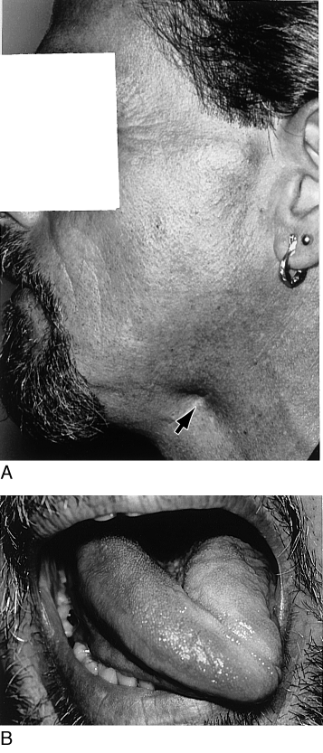
Lesion of the Hypoglossal Nerve
Text Fig. 25-16

Slide 29
Accessory Nerve CN XI
*
*
*
*
*
*

Slide 30
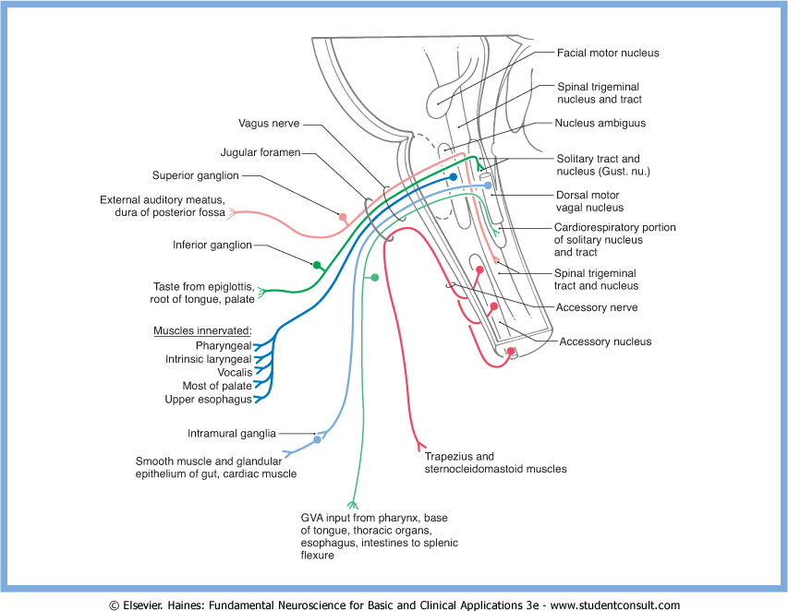
Accessory Nerve CN XI
Motor neurons in the cervical spinal cord
Trapezius & sternocleidomastoid
muscles

Slide 31
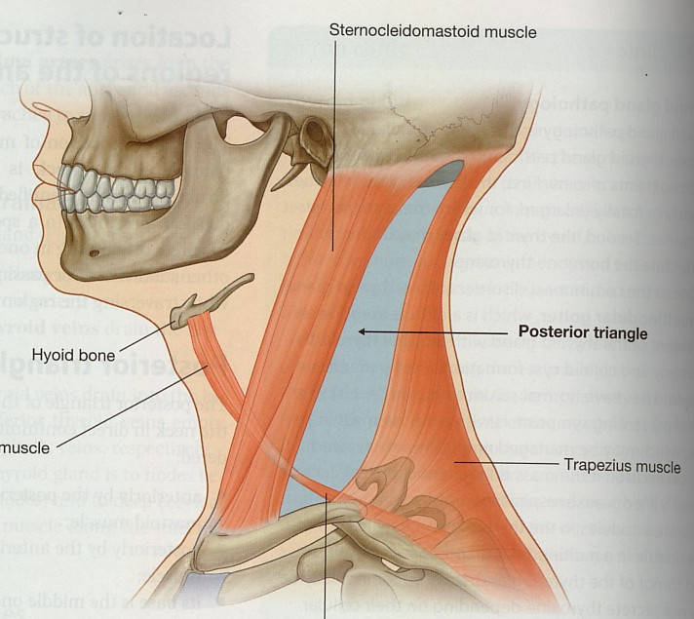
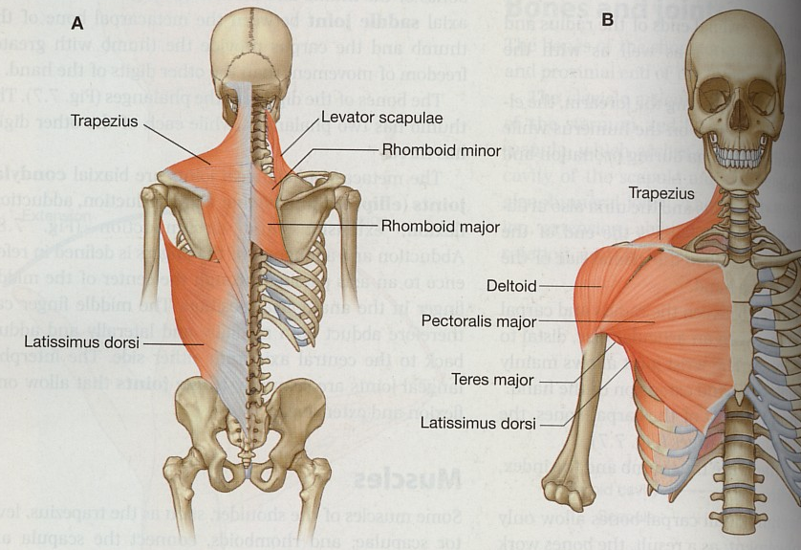
Sternocleidomastoid
Trapezius
Gray’s Anatomy for students: Figs. 8.171 page 920, 7.9 page 614
The sternocleidomastoid will tilt the head towards the shoulder on the same side,
Thereby, rotating the head to turn the face to the opposite direction

Slide 32
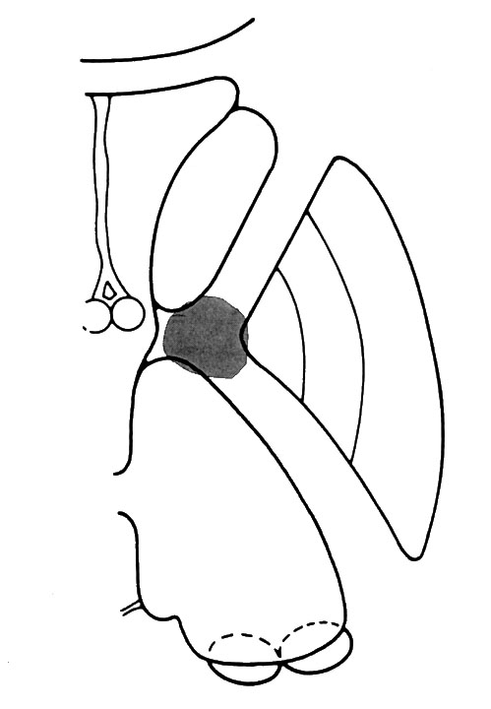
Case Study

Slide 33
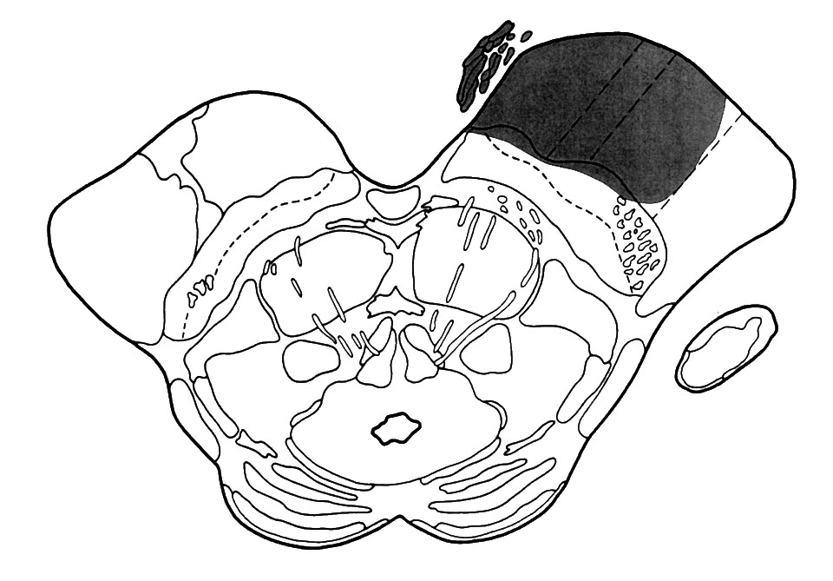
Case Study

Slide 34
Brainstem Syndromes Involving Corticospinal Fibers and Cranial Nerves

Slide 35
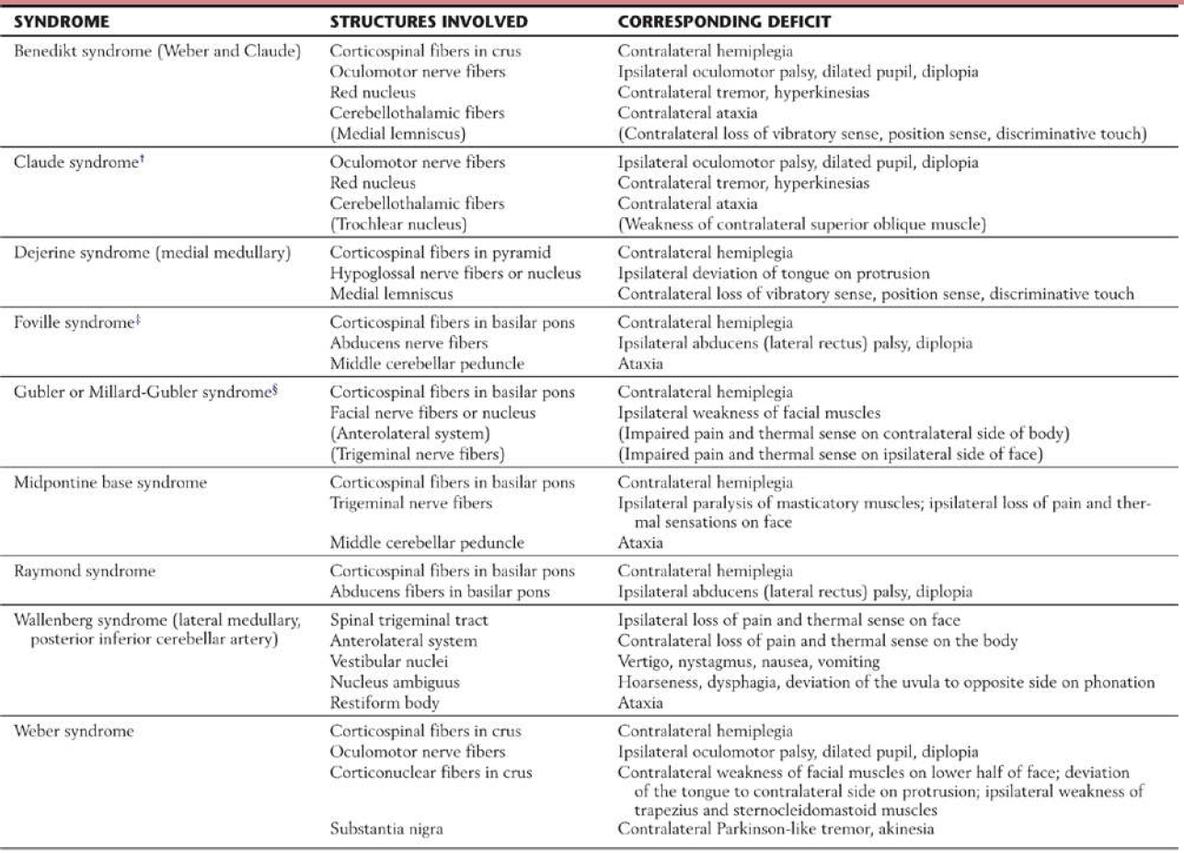
Table 25-1

Slide 36
The Uncus and Uncal Herniation

Slide 37
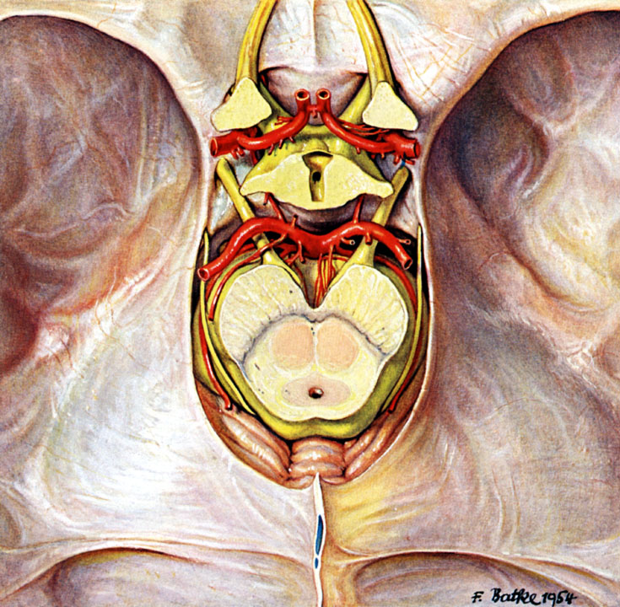
Uncus
Pernkopf Anatomy, Urban & Schwarzenberg, Munich, 1989, Figure 202

Slide 38
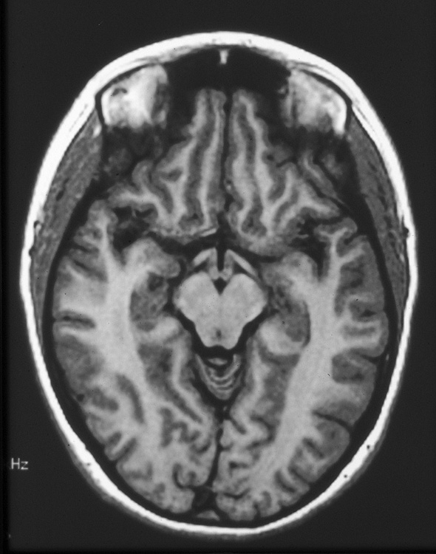
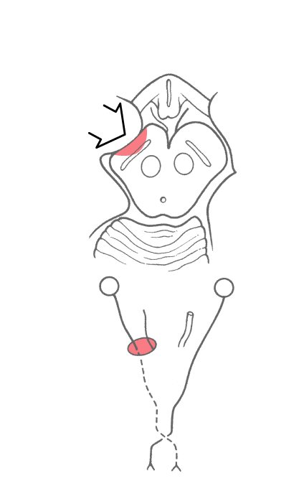
The Uncus and Uncal Herniation
Text Fig. 25-17
Atlas Fig. 5-14

Slide 39
Third Nerve Palsy
Eye “down and out”

Slide 40
Corticonuclear Fibers in the Crus Cerebri
Face
FP fibers
UE
LE
POT fibers
Atlas Fig. 5-24
Atlas Fig. 5-24

Slide 41
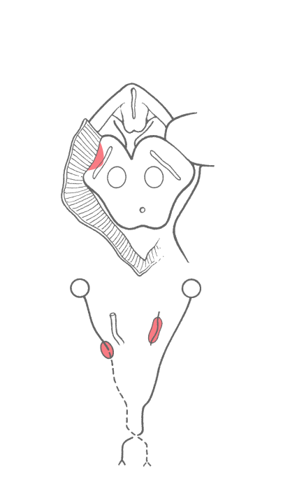
The Kernohan Syndrome
Atlas Fig. 5-23
Text Fig. 25-18

Slide 42
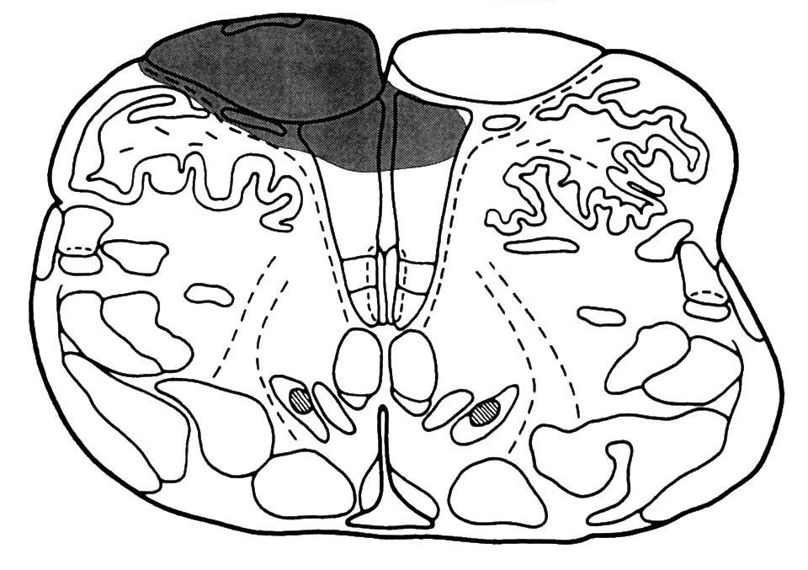
Case Study 21

Slide 43
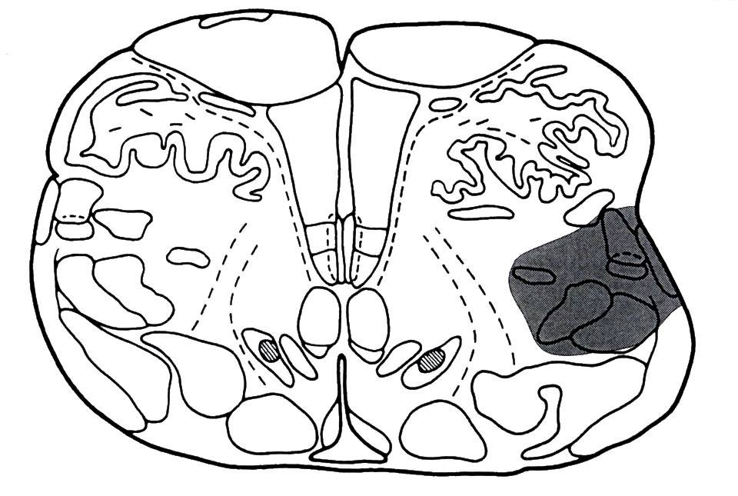
Case Study 18

Slide 44
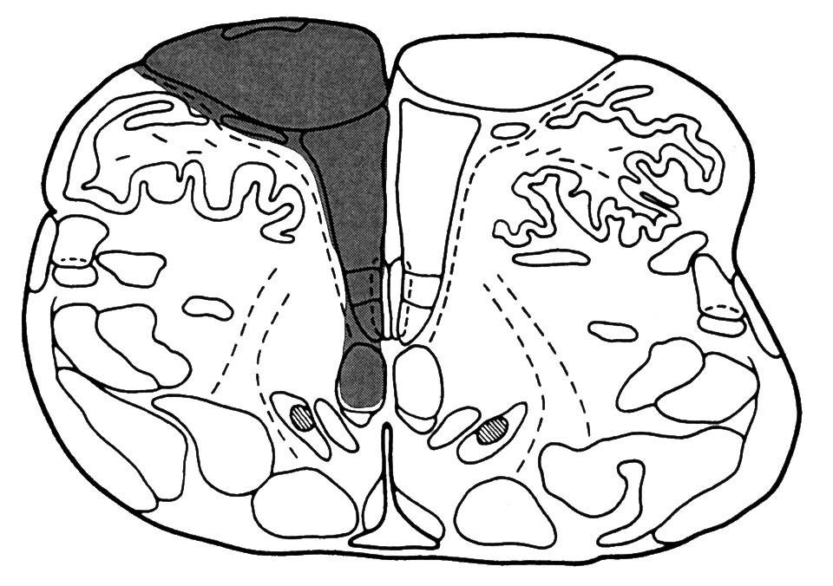
Case Study 20

Slide 46
Thank you

