Slide 1
Feras Hawari, MD, FCCP
Director, Cancer Control Office
Chief, Pulmonary and Critical Care
Director, Respiratory Therapy Service
King Hussein Cancer Center
Regional Director, Global Bridges Eastern Mediterranean
Asthma/COPD Pharmacology

Slide 2
Asthma: chronic disease characterized by recurrent attacks of shortness of breath and wheezing
Chronic bronchitis: (clinical) the presence of a chronic productive cough for 3 months for 2 consecutive years
Emphysema: (pathological) an abnormal, permanent enlargement of the air spaces distal to the terminal bronchioles, accompanied by destruction of their walls and without obvious fibrosis

Slide 4
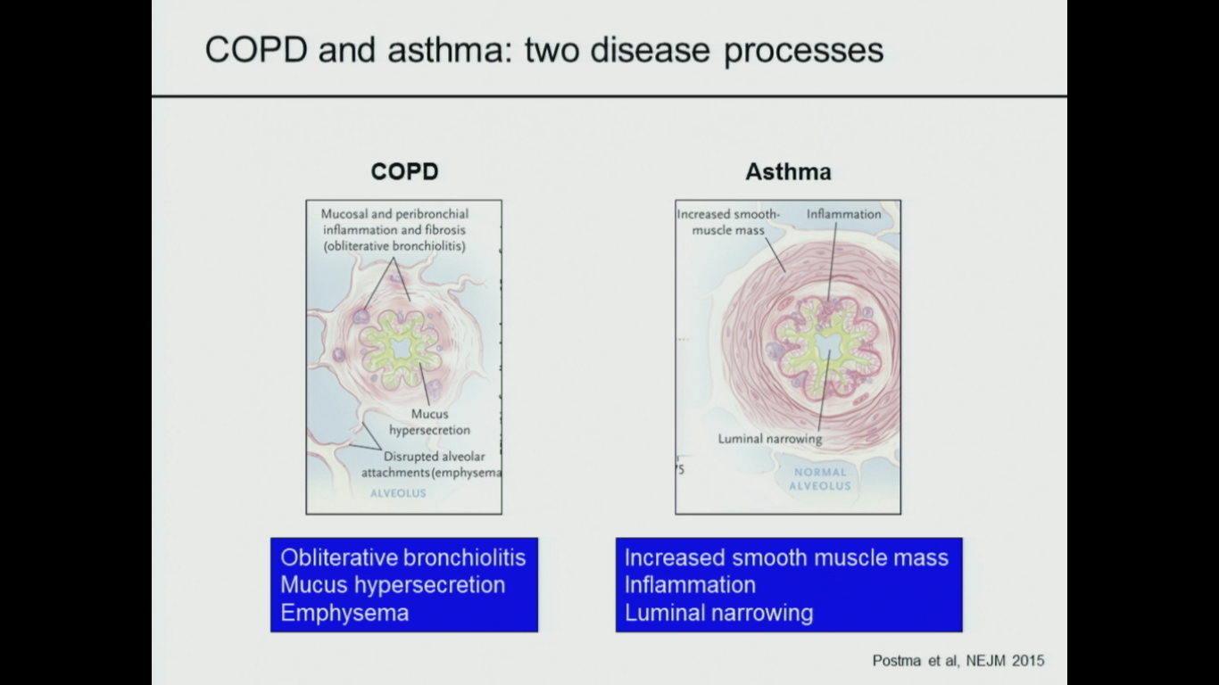

Slide 5
Asthma

Slide 6
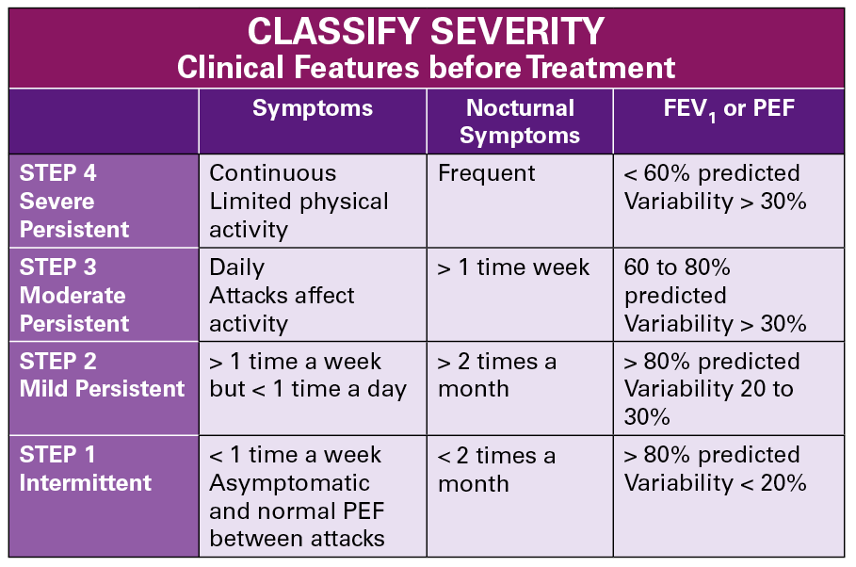

Slide 7
Goals for treating asthma
Avoid troublesome symptoms night and day
Use little or no reliever medication
Have productive, physically active lives
Have (near) normal lung function
Avoid serious attacks

Slide 8

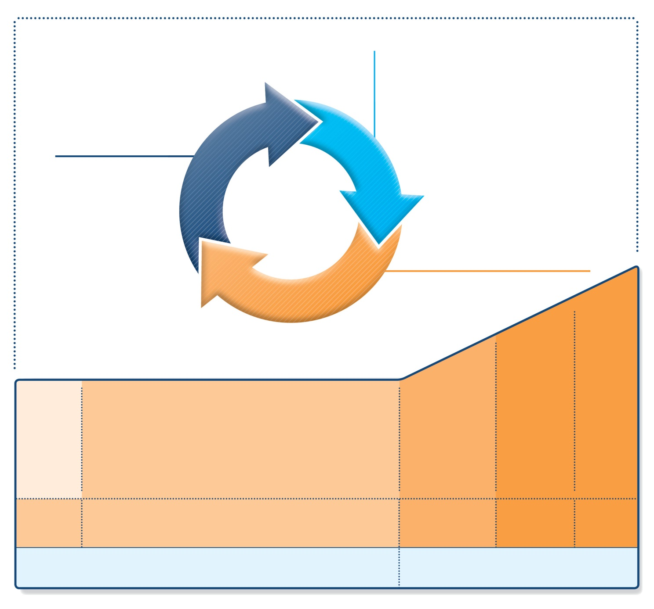

Stepwise management - pharmacotherapy
Diagnosis
Symptom control & risk factors
(including lung function)
Inhaler technique & adherence
Patient preference
ASSESS
REVIEW RESPONSE
Symptoms
Exacerbations
Side-effects
Patient satisfaction
Lung function
ADJUST TREATMENT
Asthma medications
Non-pharmacological strategies
Treat modifiable risk factors
UPDATED 2017
STEP 5
*
Not for children <12 years
**For children 6-11 years, the preferred Step 3 treatment is medium dose ICS
#For patients prescribed BDP/formoterol or BUD/ formoterol maintenance and reliever therapy
 Tiotropium by mist inhaler is an add-on treatment for patients ≥12 years with a history of exacerbations
STEP 4
STEP 1
STEP 2
STEP 3
Refer for add-on treatment
e.g.
tiotropium,* anti-IgE,
anti-IL5*
PREFERRED
CONTROLLER
CHOICE
Med/high
ICS/LABA
Low dose ICS
Low dose
ICS/LABA**
Other
controller
options
Consider low dose ICS
Leukotriene receptor antagonists (LTRA)
Low dose theophylline*
Med/high dose ICS
Low dose ICS+LTRA
(or + theoph*)
Add tiotropium*
High dose ICS
+ LTRA
(or + theoph*)
Add low
dose OCS
RELIEVER
As-needed short-acting beta²-agonist (SABA)
As-needed SABA or
low dose ICS/formoterol#
GINA 2017, Box 3-5 (2/8) (upper part)

Slide 9
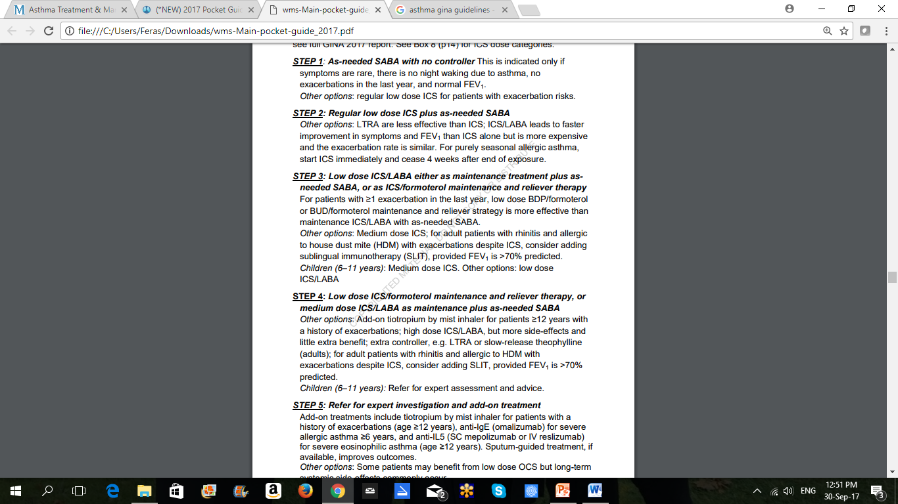

Slide 10
Reviewing response and adjusting treatment
How often should asthma be reviewed?
  1-3 months after treatment started, then every 3-12 months
  During pregnancy, every 4-6 weeks
  After an exacerbation, within 1 week
Stepping up asthma treatment
  Sustained step-up, for at least 2-3 months if asthma poorly controlled
    Important: first check for common causes (symptoms not due to asthma, incorrect inhaler technique, poor adherence)
  Short-term step-up, for 1-2 weeks, e.g. with viral infection or allergen
    May be initiated by patient with written asthma action plan
  Day-to-day adjustment
    For patients prescribed low-dose ICS/formoterol maintenance and reliever regimen*
Stepping down asthma treatment
  Consider step-down after good control maintained for 3 months
  Find each patient’s minimum effective dose, that controls both symptoms and exacerbations
*Approved only for low dose beclometasone/formoterol and low dose budesonide/formoterol
GINA 2017

Slide 11
General principles for stepping down controller treatment
To find the lowest dose that controls symptoms and exacerbations, and minimizes the risk of side-effects
When to consider stepping down
  When symptoms have been well controlled and lung function stable for
  ≥3 months
  No respiratory infection, patient not travelling, not pregnant
Prepare for step-down
  Record the level of symptom control and consider risk factors
  Make sure the patient has a written asthma action plan
  Book a follow-up visit in 1-3 months
Step down through available formulations
  Stepping down ICS doses by 25–50% at 3 month intervals is feasible and safe for most patients (Hagan et al, Allergy 2014)
Stopping ICS is not recommended in adults with asthma because of risk of exacerbations (Rank et al, JACI 2013)
GINA 2017, Box 3-7

Slide 12
Check adherence with asthma medications
Poor adherence:
  Is very common: 50% of adults and children do not take controller medications as prescribed
  Contributes to uncontrolled asthma symptoms and risk of exacerbations and asthma-related death
Contributory factors
  Unintentional (e.g. forgetfulness, cost, confusion) and/or
  Intentional (e.g. no perceived need, fear of side-effects, cultural issues, cost)
How to identify patients with low adherence:
  Ask an empathic question, e.g. “Do you find it easier to remember your medication in the morning or the evening?”, or
  “Would you say you are taking it 3 days a week, or less, or more?”
  Check prescription date, label date and dose counter
  Ask patient about their beliefs and concerns about the medication
GINA 2017, Box 3-12

Slide 13
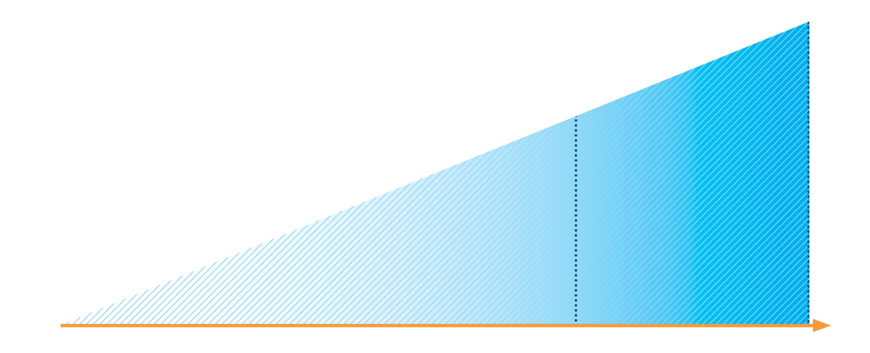
Written asthma action plans
Effective asthma self-management education requires:
• Self-monitoring of symptoms and/or lung function
• Written asthma action plan
• Regular medical review
If PEF or FEV1
<60% best, or not
improving after
48 hours
Continue reliever
Continue controller
Add prednisolone
40–50 mg/day
Contact doctor
All patients
Increase reliever
Early increase in
controller as below
Review response
EARLY OR MILD
LATE OR SEVERE
GINA 2017, Box 4-2 (1/2)

Slide 14
Written asthma action plans – medication options
Increase inhaled reliever
  Increase frequency as needed
  Adding spacer for pMDI may be helpful
Early and rapid increase in inhaled controller
  Up to maximum ICS of 2000mcg BDP/day or equivalent
  Options depend on usual controller medication and type of LABA
  See GINA 2017 report Box 4-2 for details
Add oral corticosteroids if needed
  Adults: prednisolone 1mg/kg/day up to 50mg, usually 5-7 days
  Children: 1-2mg/kg/day up to 40mg, usually 3-5 days
  Morning dosing preferred to reduce side-effects
  Tapering not needed if taken for less than 2 weeks
  Remember to advise patients about common side-effects (sleep disturbance, increased appetite, reflux, mood changes)
UPDATED 2017
GINA 2017, Box 4-2 (2/2)

Slide 15
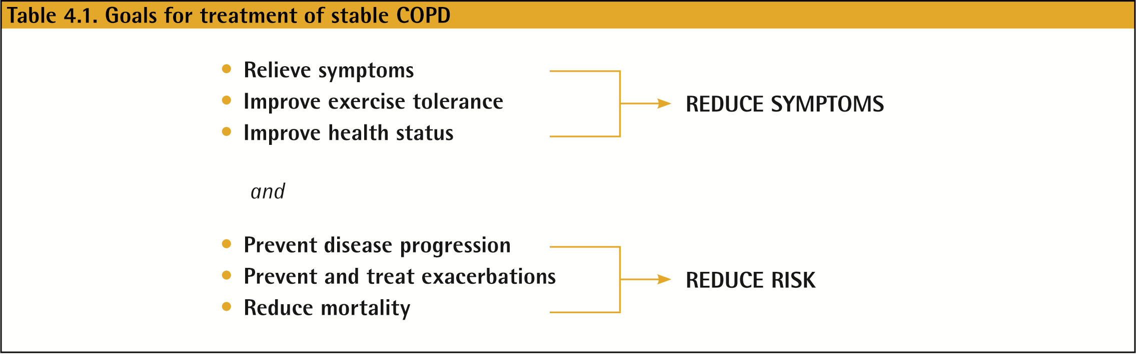
Management of Stable COPD
Once COPD has been diagnosed, effective management should be based on an individualized assessment to reduce both current symptoms and future risks of exacerbations.
© 2017 Global Initiative for Chronic Obstructive Lung Disease

Slide 16
Symptoms of COPD
  Chronic and progressive dyspnea
  Cough
  Sputum production
  Wheezing and chest tightness
  Others: including fatigue, weight loss, anorexia, syncope, rib fractures, ankle swelling, depression, anxiety.
© 2017 Global Initiative for Chronic Obstructive Lung Disease

Slide 17
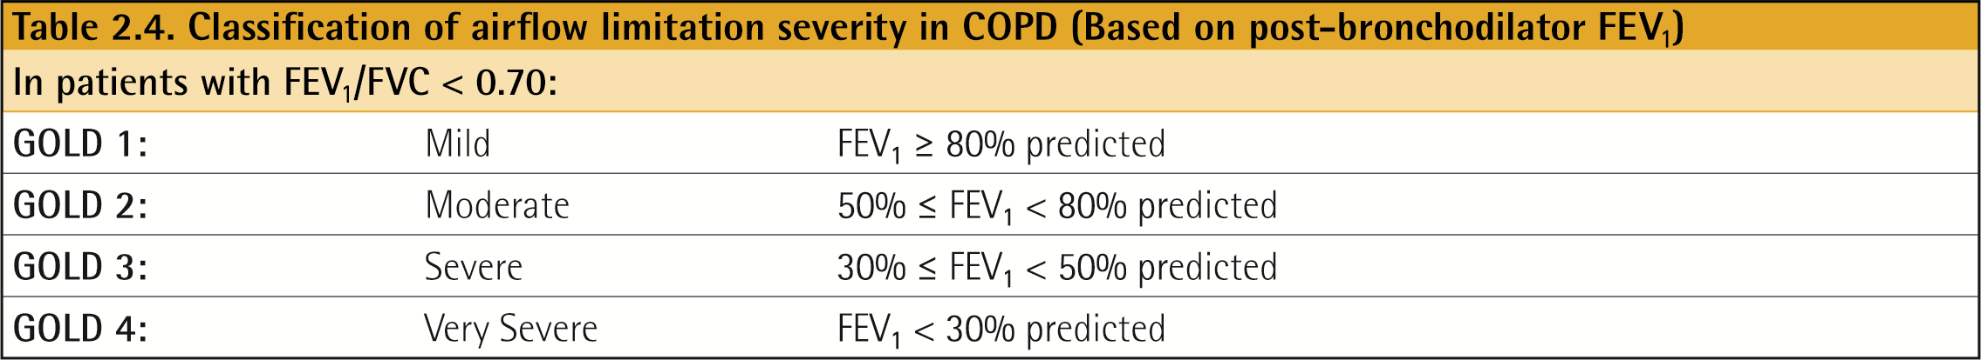
Classification of severity of airflow limitation
© 2017 Global Initiative for Chronic Obstructive Lung Disease

Slide 18
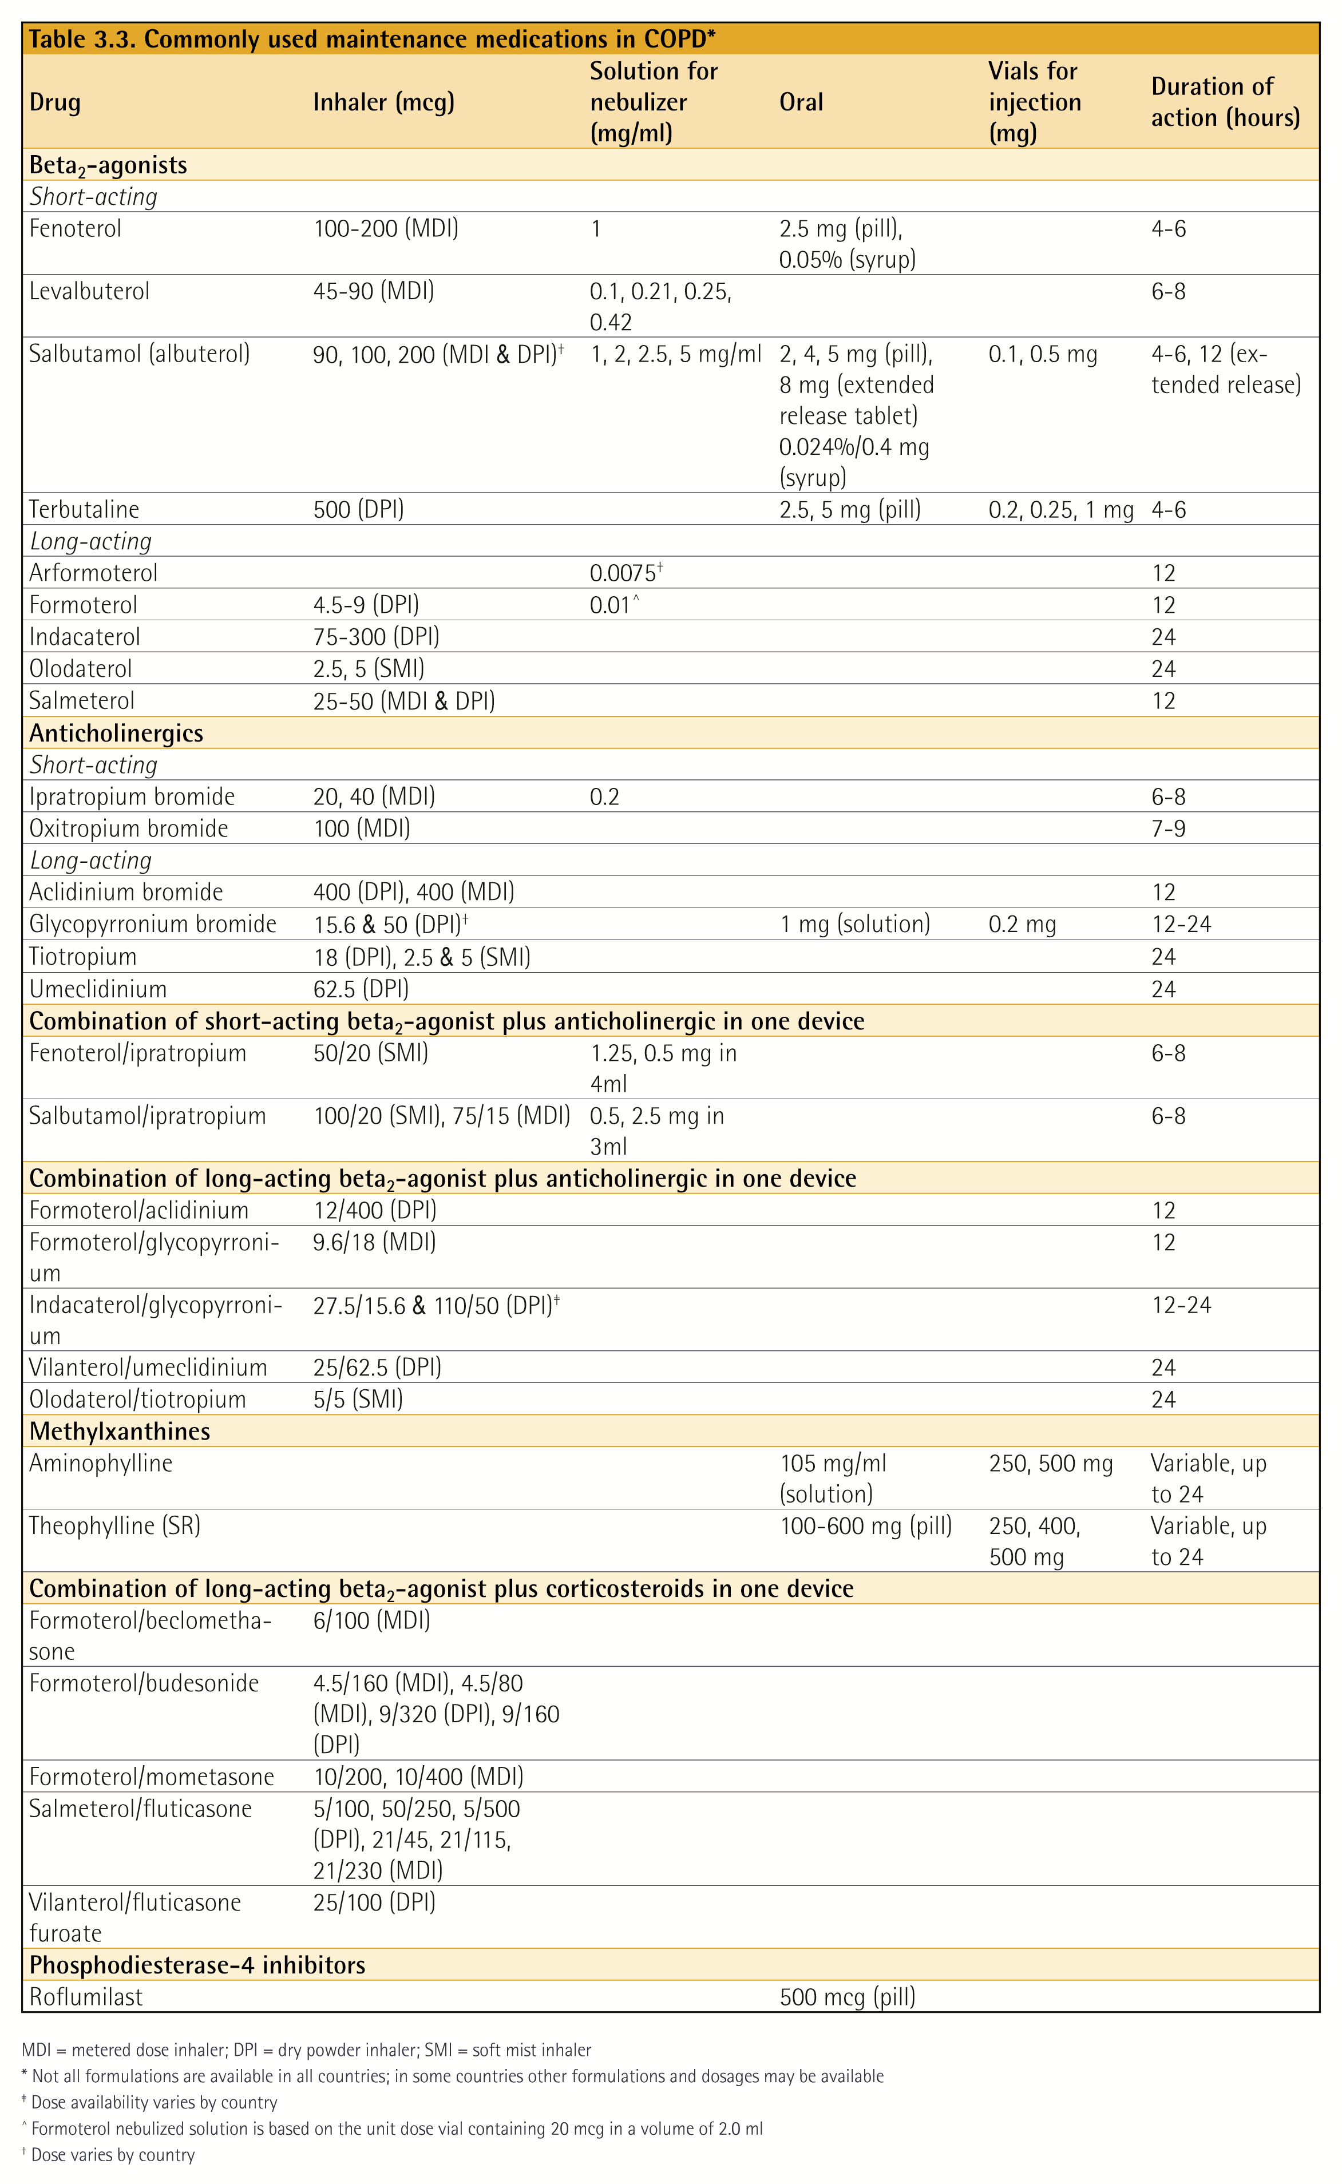
© 2017 Global Initiative for Chronic Obstructive Lung Disease

Slide 19
© 2017 Global Initiative for Chronic Obstructive Lung Disease

Slide 20
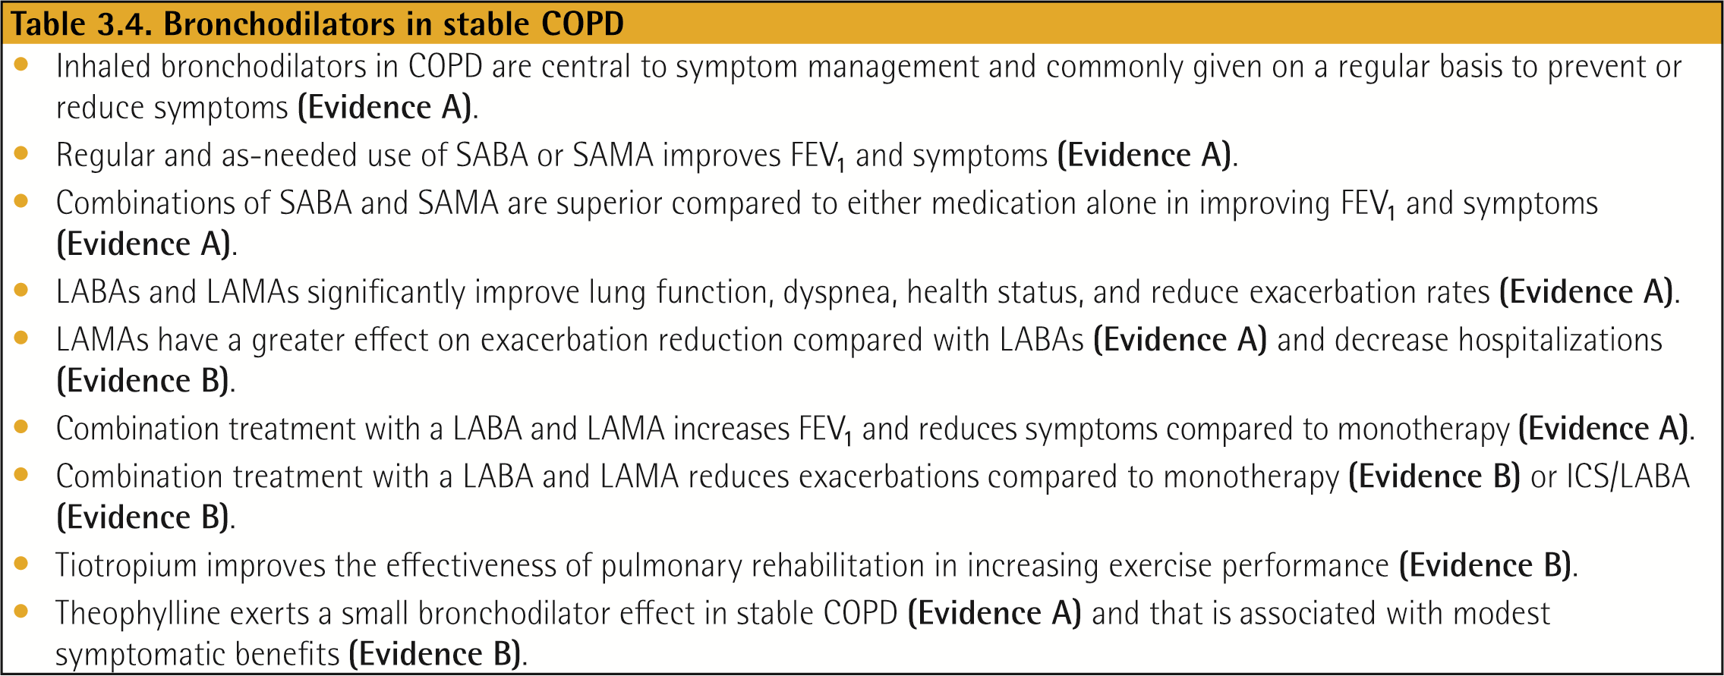
© 2017 Global Initiative for Chronic Obstructive Lung Disease

Slide 21
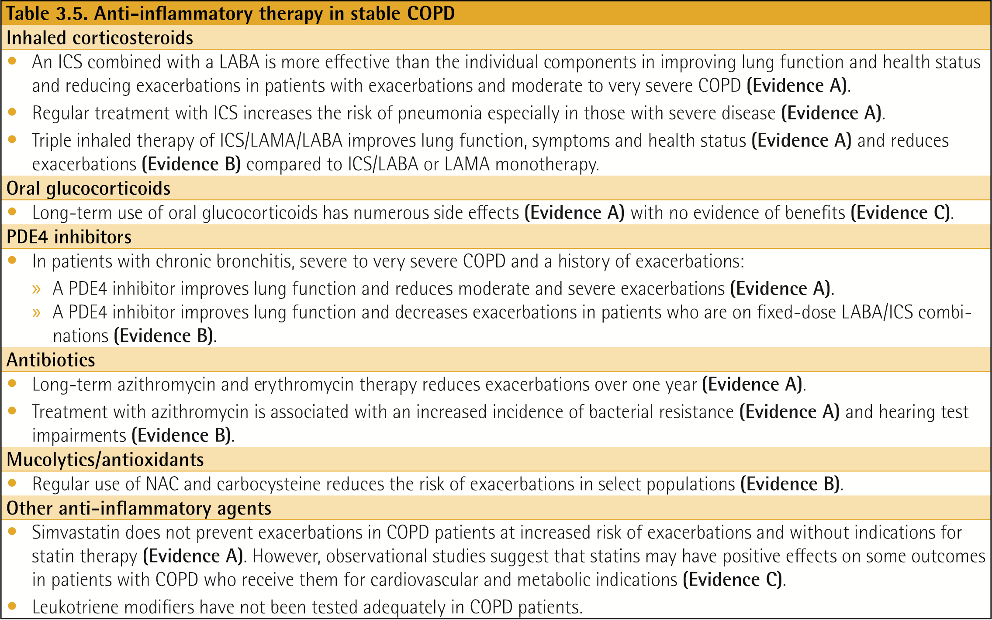
Anti-inflammatory Therapy in Stable COPD
© 2017 Global Initiative for Chronic Obstructive Lung Disease

Slide 22
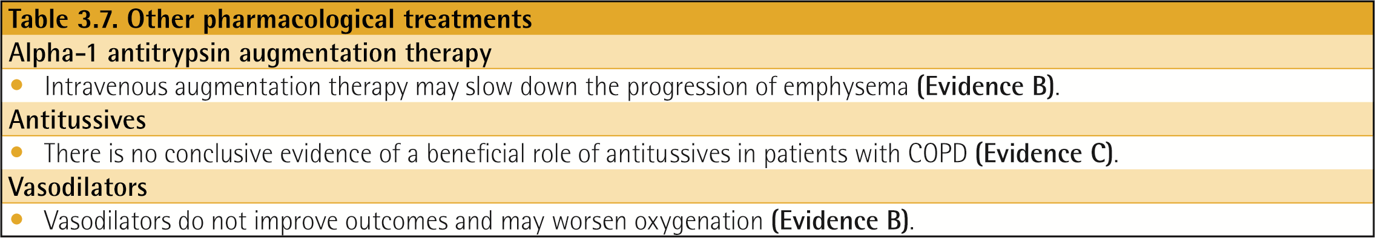
© 2017 Global Initiative for Chronic Obstructive Lung Disease

Slide 23
Treatment of Stable COPD
Pharmacologic therapies can reduce symptoms, and the risk and severity of exacerbations, as well as improve health status and exercise tolerance.
Most of the drugs are inhaled so proper inhaler technique is of high relevance.
© 2017 Global Initiative for Chronic Obstructive Lung Disease

Slide 24
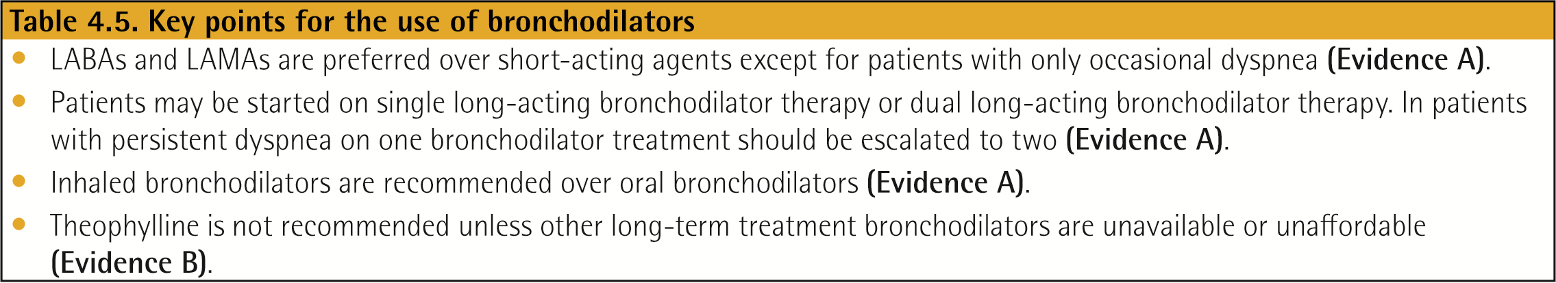
Treatment of Stable COPD
© 2017 Global Initiative for Chronic Obstructive Lung Disease

Slide 25
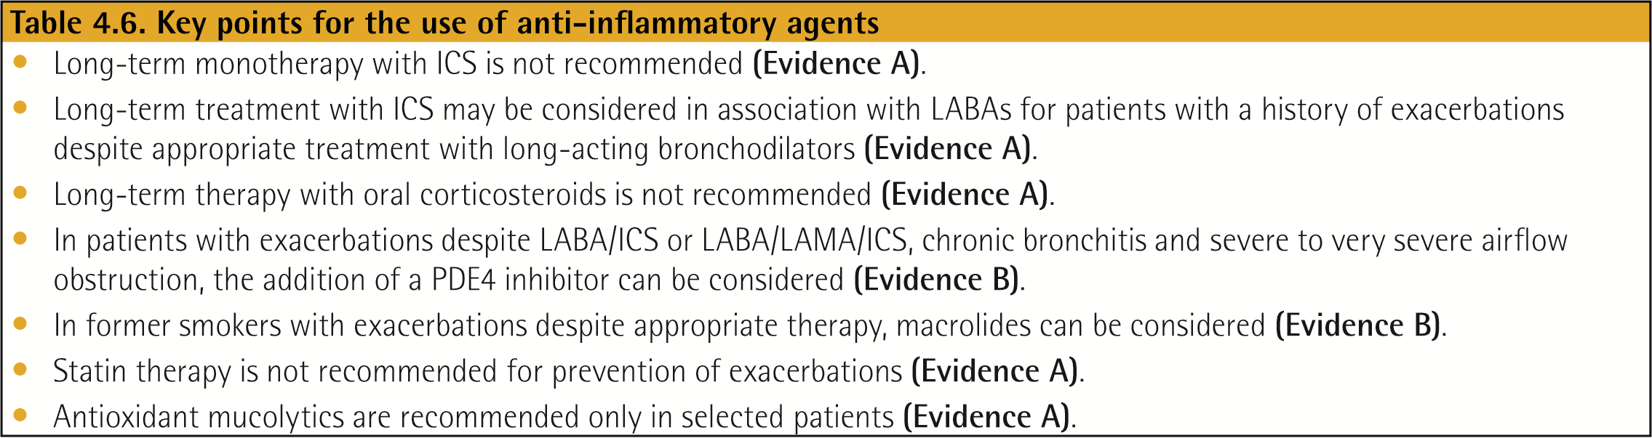

Slide 26
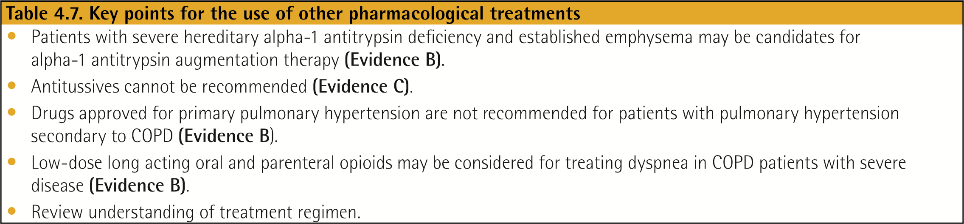
Treatment of Stable COPD
© 2017 Global Initiative for Chronic Obstructive Lung Disease

Slide 27
A proposed model for the initiation, and then subsequent escalation and/or de-escalation of pharmacologic management of COPD according to the individualized assessment of symptoms and exacerbation risk is shown.
© 2017 Global Initiative for Chronic Obstructive Lung Disease

Slide 28
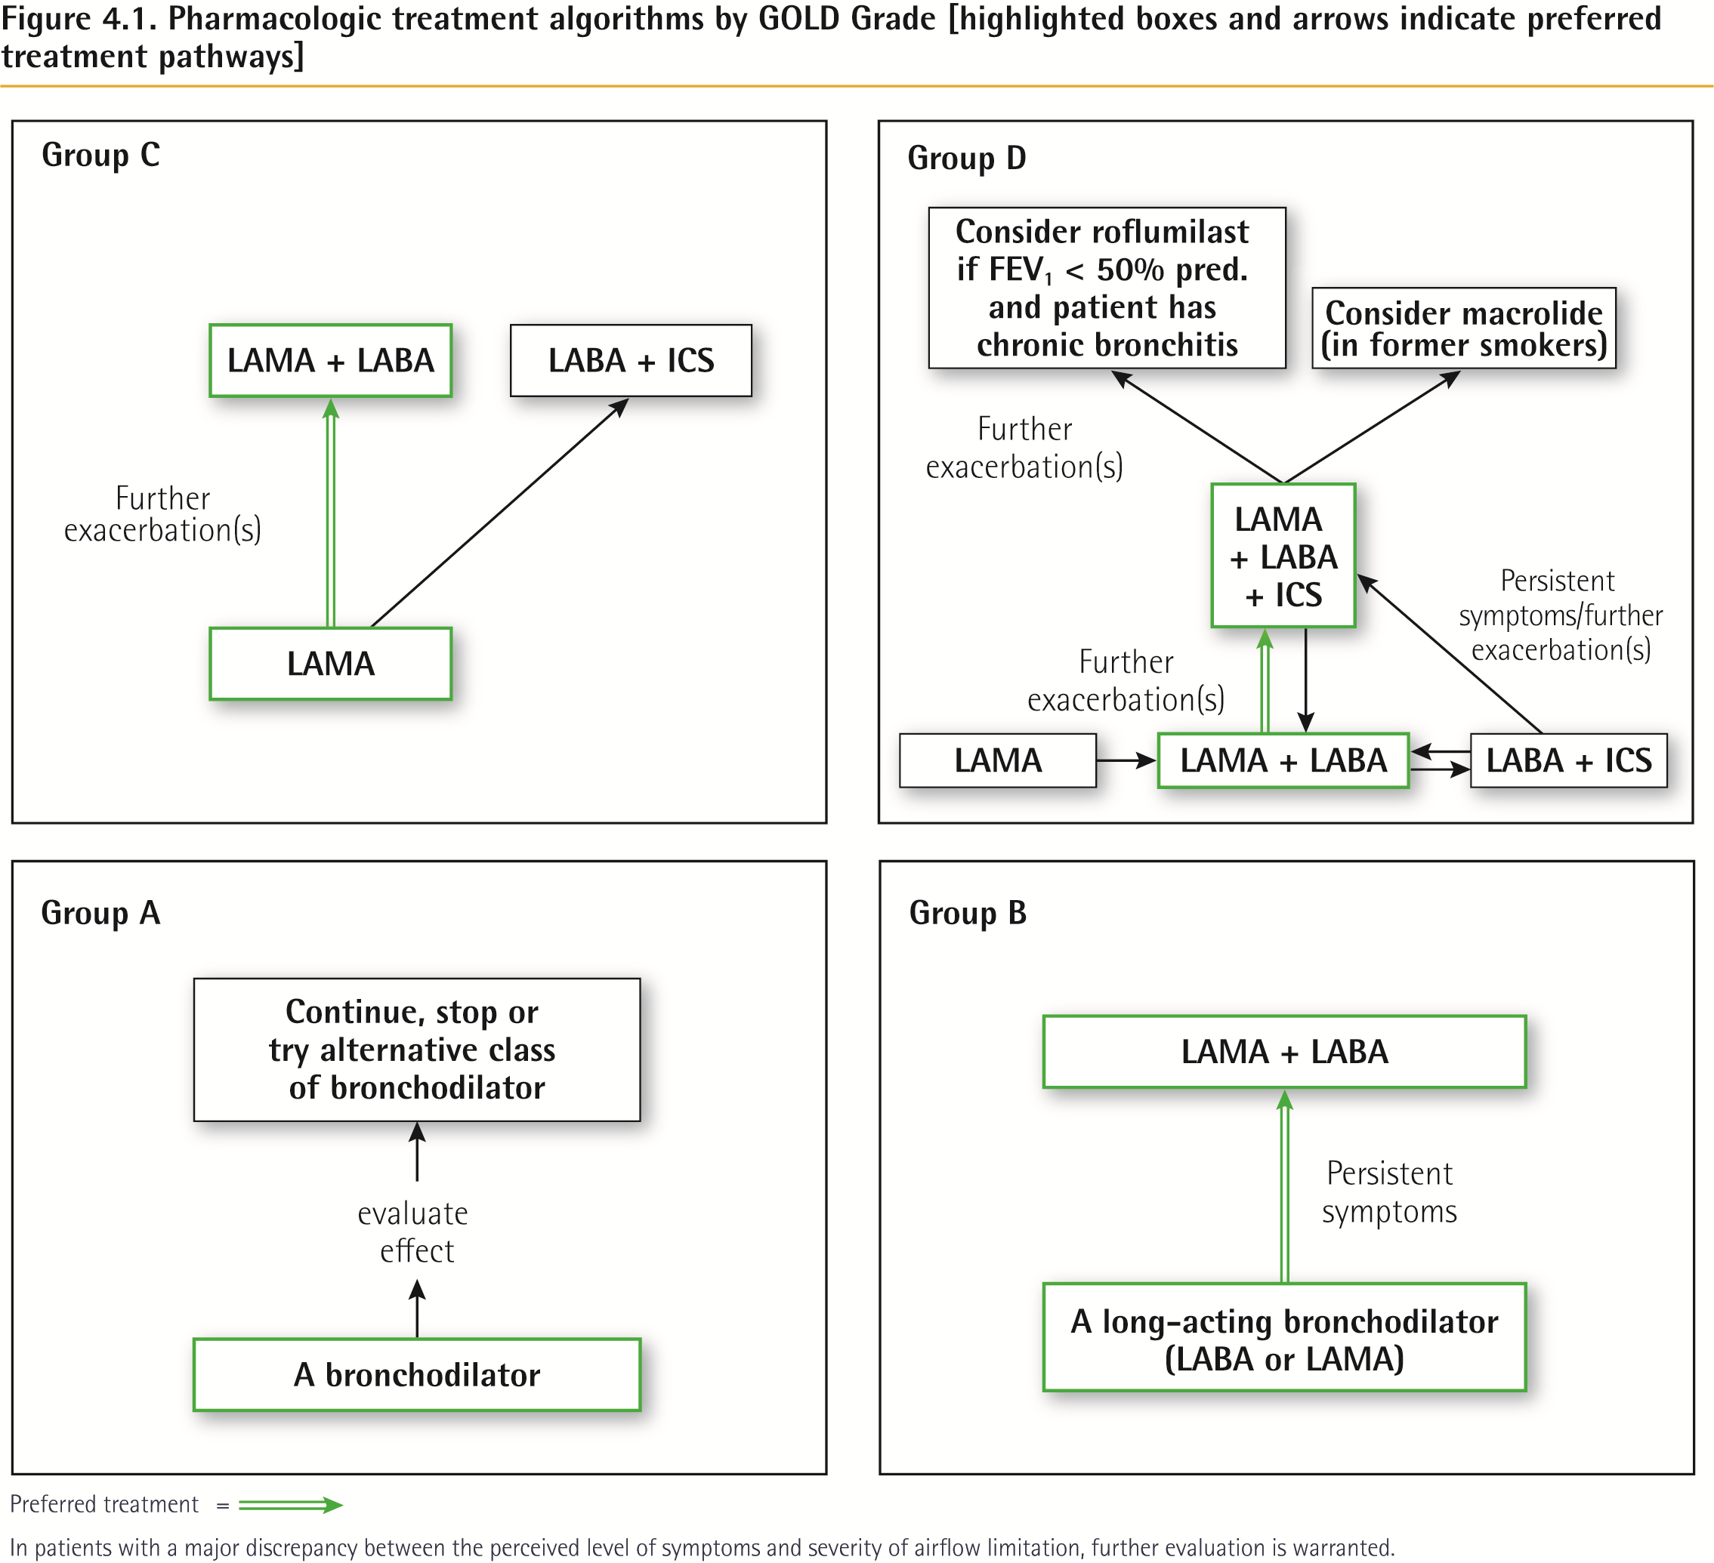
Treatment of Stable COPD
© 2017 Global Initiative for Chronic Obstructive Lung Disease

Slide 29

MILD or MODERATE
Talks in phrases
Prefers sitting to lying
Not agitated
Respiratory rate increased
Accessory muscles not used
Pulse rate 100–120 bpm
O₂ saturation (on air) 90–95%
PEF >50% predicted or best
SEVERE
Talks in words
Sits hunched forwards
Agitated
Respiratory rate >30/min
Accessory muscles being used
Pulse rate >120 bpm
O₂ saturation (on air) < 90%
PEF ≤50% predicted or best
Short-acting beta₂-agonists
Consider ipratropium bromide
Controlled O₂ to maintain
saturation 93–95% (children 94-98%)
Oral corticosteroids
Short-acting beta₂-agonists
Ipratropium bromide
Controlled O₂ to maintain
saturation 93–95% (children 94-98%)
Oral or IV corticosteroids
Consider IV magnesium
Consider high dose ICS
GINA 2017, Box 4-4 (3/4)

Slide 30
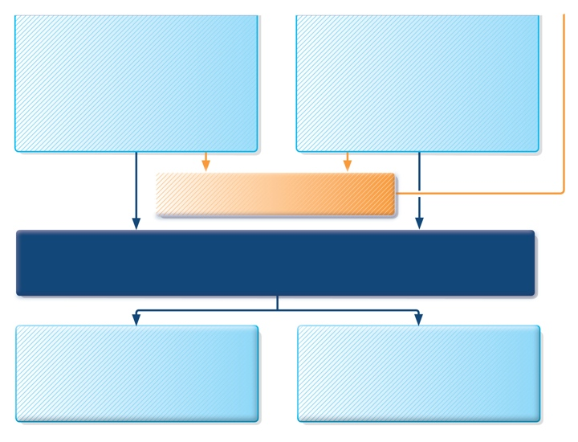
Short-acting beta₂-agonists
Consider ipratropium bromide
Controlled O₂ to maintain
saturation 93–95% (children 94-98%)
Oral corticosteroids
Short-acting beta₂-agonists
Ipratropium bromide
Controlled O₂ to maintain
saturation 93–95% (children 94-98%)
Oral or IV corticosteroids
Consider IV magnesium
Consider high dose ICS
If continuing deterioration, treat as
severe and re-assess for ICU
ASSESS CLINICAL PROGRESS FREQUENTLY
MEASURE LUNG FUNCTION
in all patients one hour after initial treatment
FEV₁ or PEF 60-80% of predicted or personal best and symptoms improved
MODERATE
Consider for discharge planning
FEV₁ or PEF <60% of predicted or
personal best,or lack of clinical response
SEVERE
Continue treatment as above
and reassess frequently
GINA 2017, Box 4-4 (4/4)

Slide 31
β₂ agonists

Slide 32
Distribution of B1/B2 receptors
Organ | B1 | B2
Heart | + inotropic and chronotropic
Vessels |  | Vasodilation
Bronchi |  | Bronchodilation
Uterus |  | Tocolysis
Skeletal musceles |  | Tremor
Fat tissue | Lipolysis (B3)
Carb metabilisim |  | Glycogenolysis

Slide 33
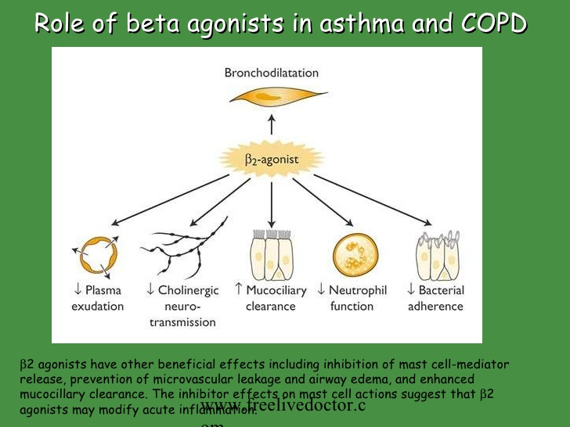

Slide 34
Effects of β₂ agonists on tracheobronchial tree
Bronchodilation: smooth muscle relaxation
Inhibition of mediators release from mast cells, eosinophils and basophiles
Increase mucociliary transport via increasing cilia motion frequency
Decrease capillaries permeability, decrease mucous membrane edema caused by inflammatory mediators
Stimulation of epithelial cells to enhance the secretion of Cl and H2O into the bronchi

Slide 35
Adverse effects of β₂ agonists
Tremor: skeletal muscles, the most frequent dose-limiting side effect: Start low, try another type.
Tachycardia
Metabolic changes:
  Increase: insulin level, lactate, pyruvate and ketones
  Decrease: serum levels of K+, Ca++, Mg++
Anxiety, insomnia, confusion
Headache
Paradoxical bronchospasm
Allergic reactions

Slide 36
Types of β₂ agonists
Short-acting β₂ agonists:
  Salbutamol, Levosalbutamol, terbutaline
Long Acting:
  Formoterol, Salmeterol
Ultra-long-acting β₂ agonists:
  Indacaterol, Vilanterol

Slide 37
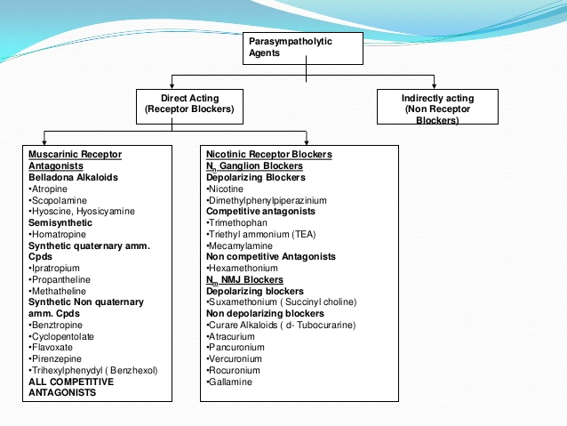

Slide 38
Parasympatholytics (Anticholinergic)

Slide 39
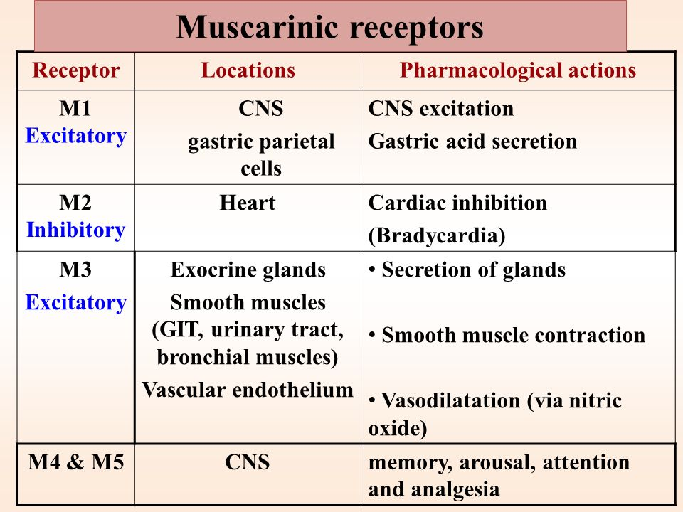

Slide 40
Parasympatholytics (Anticholinergic)
Ipratropium bromide: Atrovent
Oxitropium bromide: Oxivent
Tiotropium bromide: Spiriva, slower onset of action with longer duration
Parasympatolytics in combination with β₂ agonists:
  Ipratropiumbromid+ salbutamol-Combivent

Slide 42
Inhalational anticholinergics
All contain a quaternary ammonium (limited systemic absorption and penetration of the blood–brain barrier)
Ipratropium, tiotropium, and aclidinium are structurally related to atropine, while oxitropium is a congener of scopolamine
Minimal effects on mucociliary clearance of the airway (no inspissation of viscid material and worsening)

Slide 43
Ipratropium
10%–30% of inhaled ipratropium is deposited in the lungs
Only 2% of the swallowed part may be absorbed systemically
The majority of the systemically absorbed ipratropium and its metabolites are excreted renally

Slide 44
Tiotropium
The systemically absorbed tiotropium is mainly eliminated by the urinary tract
The renal clearance of tiotropium exceeds the creatinine clearance, which suggests the presence of active secretion into kidney tubules
Renal impairment may affect its elimination and its safety profile

Slide 45
Tiotropium
Available in a dry powder inhaler (DPI)
Patients with moderate to severe renal impairment (creatinine clearance < 50 mL/min) who are on tiotropium should be monitored closely for evidence of anticholinergic side effects

Slide 46
Tiotropium Effects
Improved lung function
Reduced lung hyperinflation
Improved exercise capacity
Reduced COPD exacerbations
Improved quality of life
In long-term studies, ipratropium and tiotropium did not reduce lung function decline

Slide 47
Side Effects
Dry mouth is the commonest
Blurred vision
Sore throat
Rhinorrhea
Constipation
Nausea

Slide 48
Aclidinium
Metabolized rapidly by plasma esterases, resulting in a very low maximum plasma concentration and thus low systemic exposure
Eliminated as its metabolite in urine (close to two-thirds of a dose) and in feces (close to one-third of a dose)
Dose adjustment is not needed
Residence time of aclidinium in the muscarinic acetylcholine M2 receptor is short and may explain the favorable cardiovascular profile

Slide 49
Cardiovascular: arrhythmias (including supraventricular tachycardia and atrial fibrillation), angina, nonspecific chest pain, and edema. (not substantiated in the RCTs of tiotropium)

Slide 50
Pulmonary
Rhinitis, epistaxis, sinusitis, pharyngitis, laryngitis, throat irritation, cough, and upper respiratory tract infections
In 0.3% of cases, acute paradoxical bronchospasm can be seen as an idiosyncratic reaction with anticholinergic use
Patients who are highly allergic to milk proteins are advised to avoid using tiotropium DPI because of trace amounts of milk protein in the lactose filler

Slide 51
Gastrointestinal
Among the most frequently reported
Dry mouth : (common)
Dysgeusia, also known as parageusia, is a distortion of the sense of taste
Stomatitis, abdominal pain, constipation, dyspepsia, nausea, vomiting, dysphagia, and paralytic ileus

Slide 52
Genitourinary
Urinary difficulty, urinary retention, and urinary tract infection
Increased risk of urinary retention with tiotropium compared with placebo
Use with caution in patients with prostatic hypertrophy or bladder outlet obstruction.

Slide 53
Ophthalmic
Blurred vision
Elevated intraocular pressure, acute or worsening narrow-angle glaucoma, and cataracts
Patients with preexisting narrow-angle glaucoma need to be monitored closely when started on these agents.
Acute anisocoria in patients with loose-fitting nebulizer masks (resulting from the unequal exposure of the eyes to the anticholinergic medication and subsequent development of unilateral mydriasis) can last more than 24 hours with tiotropium

Slide 54
Inhaled Corticosteroids

Slide 58
Notes:
Corticosteroids may regulate gene expression in several ways. Glucocorticoids
enter the cell to bind to glucocorticoid receptors in the cytoplasm that translocate to the
nucleus. GR homodimers bind to glucocorticoid-response elements (GRE) in the promoter
region of steroid-sensitive genes, which may encode anti-inflammatory proteins. Less
commonly, GR homodimers interact with negative GREs to suppress genes, particularly
those linked to side effects of corticosteroids. Nuclear GR also interact with coactivator
molecules, such as CREB-binding protein (CBP), which is activated by proinflammatory
transcription factors, such as nuclear factor-κB (NF-κB), thus switching off the
inflammatory genes that are activated by these transcription factors. Other abbreviations:
SLPI: secretory leukoprotease inhibitor; MKP-1: mitogen-activated kinase phosphatase-1;
IκB-α: inhibitor of NF-κB; GILZ: glucocorticoid-induced leucine zipper protein; POMC:
proopiomelanocortin; CRH: corticotrophin releasing factor.

Slide 59
Notes:
Corticosteroid suppression of activated inflammatory genes. Inflammatory genes
are activated by inflammatory stimuli, such as interleukin-1β (IL-1β) or tumour necrosis
factor-α (TNF-α), resulting in activation of IKK2 (inhibitor of I-κB kinase-2), which
activates the transcription factor nuclear factor κB (NF-κB). A dimer of p50 and p65 NF-
κB proteins translocates to the nucleus and binds to specific κB recognition sites and also
to coactivators, such as CREB-binding protein (CBP) or p300/CBP-activating factor
(pCAF), which have intrinsic histone acetyltransferase (HAT) activity. This results in
acetylation of core histone H4, resulting in increased expression of genes encoding
multiple inflammatory proteins. Glucocorticoid receptors (GR) after activation by
glucocorticoids translocate to the nucleus and bind to coactivators to inhibit HAT activity
directly and recruiting histone deacetylase-2 (HDAC2), which reverses histone acetylation
leading in suppression of these activated inflammatory genes.
There

Slide 60
Mechanism of steroid resistance in COPD, smoking asthma and severe asthma
Notes:
Mechanism of corticosteroid resistance in COPD, smoking asthma and severe
asthma. Stimulation of mild asthmatic alveolar macrophages activates nuclear factor-κB
(NF-κB) and other transcription factors to switch on histone acetyltransferase leading to
histone acetylation and subsequently to transcription of genes encoding inflammatory
proteins, such as tumour necrosis factor-α (TNF-α), interleukin-8 (IL-8) and granulocytemacrophage
colony stimulating factor (GM-CSF). Corticosteroids reverse this by binding
to glucocorticoid receptors (GR) and recruiting histone deacetylase-2 (HDAC2). This
reverses the histone acetylation induced by NF-κB and switches off the activated
inflammatory genes. In COPD patients and smoking asthmatics cigarette smoke generates
oxidative stress (acting through the formation of peroxynitrite) and in severe asthma and
COPD intense inflammation generates oxidative stress to impair the activity of HDAC2.
This amplifies the inflammatory response to NF-κB activation, but also reduces the antiinflammatory
effect of corticosteroids, as HDAC2 is now unable to reverse histone
acetylation.

Slide 61
Notes:
Interaction between corticosteroids and long-acting β2-agonists (LABA).
Corticosteroids have anti-inflammatory effects but also increase the numbers of β2-
receptors, whereas β2-agonists, as well as inducing direct bronchodilatation, act on
glucocorticoid receptors to increase the anti-inflammatory effects of corticosteroids.

Slide 63
ICS in Athma
First-line therapy in any patient who needs to use a β2-agonist inhaler more than two to three times a week
Reduces symptoms and β2-agonist inhaler usage and improves lung function.
Many patients became completely asymptomatic
Reduces exacerbation by around 40% over a three year period
Effects of ICS take on hyperresponsiveness need several months to reach a plateau, the reduction in asthma symptoms occurs much more rapidly and reduced inflammation is seen within hours
The treatment of choice in nocturnal asthma
Reduced asthma mortality

Slide 64
ICS in COPD
Patients with COPD have a poor response to corticosteroids
High doses of ICS have consistently been shown a reduction (20–25%) in exacerbations in patients with severe disease and this is the main clinical indication for their use
ICS failed to reduce the progression in COPD (measured by annual fall in FEV1)
Have not been found to reduce mortality (low HDAC2)

Slide 66
Leukotrienes antagonists
Leukotrienes are proinflammatory mediators derived from arachidonic acid that contribute to the pathogenesis of asthma. The cysteinyl leukotrienes (CysLTs), LTC4, LTD4, and LTE4, mediate pro-asthmatic effects such as sustained bronchoconstriction, mucus secretion and airway edema

Slide 67
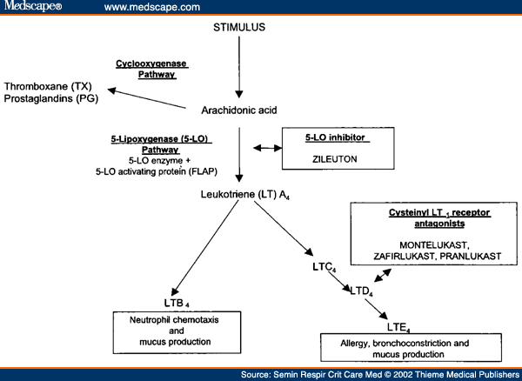

Slide 68
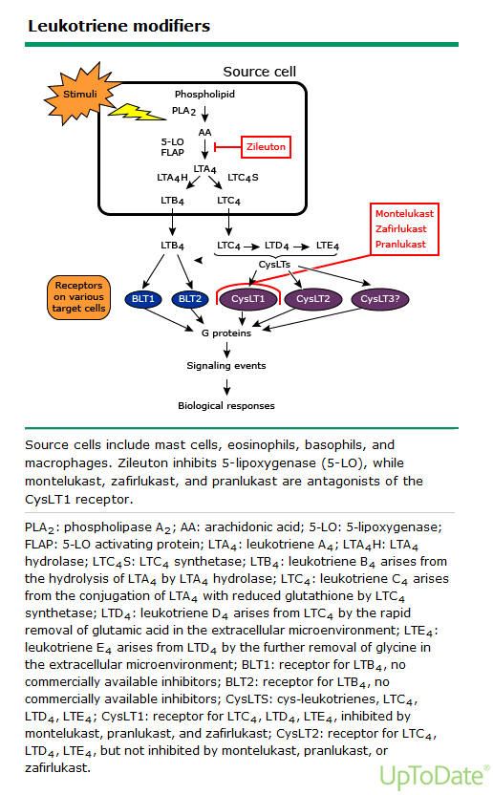

Slide 69
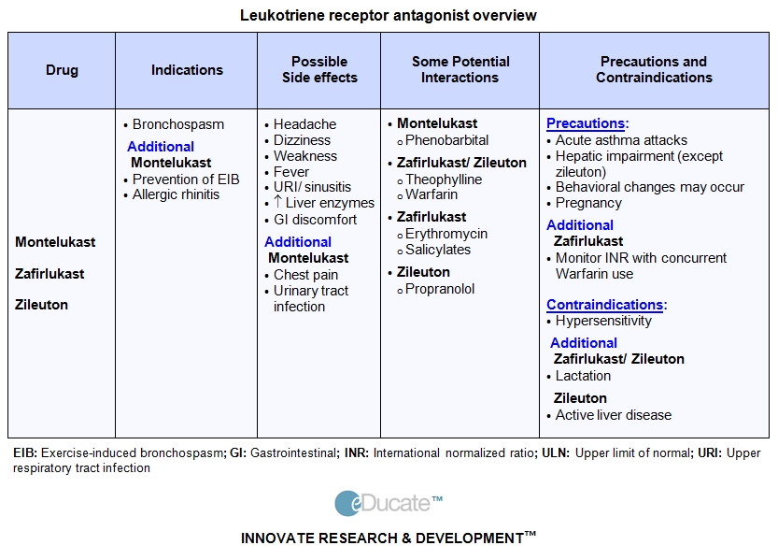

Slide 70
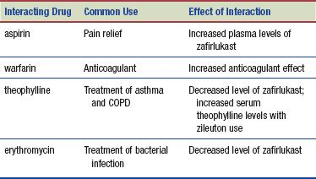

Slide 71
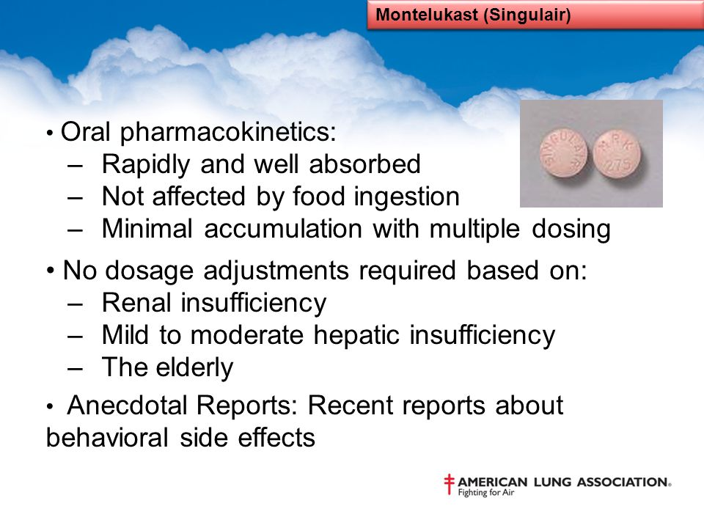

Slide 72
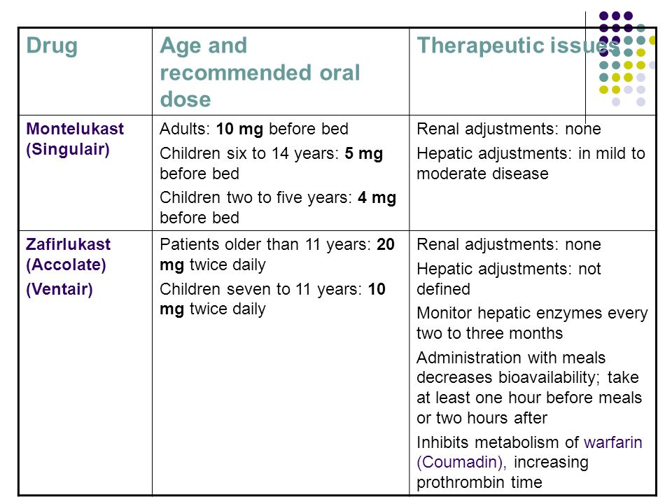

Slide 73
Use of antileukotriene agents
Aspirin induced asthma
Exercise induced asthma
More effective in children than adults
Smoking

Slide 74
Adverse effects
≤2%
Zileuton, Zafirlukast or Montelukast: anaphylaxis, angioedema, dizziness, dyspepsia, muscle weakness, and elevated transaminases
Headache (23-25%), dyspepsia (8%), myalgias (7%), leukopenia (1-3%), elevated transaminases (2-5%), sleep disorders (<1%), and behavior changes (<1%)
  Use in patients with a history of liver disease or substantial alcohol consumption should be avoided
  Monitor ALT monthly for the first three months, every two to three months for the rest of the first year, and periodically thereafter
  Should be discontinued if ALT is ≥3 times normal

Slide 75
Eosinophilic granulomatosis with polyangiitis
Churg-Strauss-like syndrome develops as a rare complication in steroid-dependent asthmatics treated with antileukotriene agents
Occurs following tapering of the oral glucocorticoid dose
EGPA may be unmasked by glucocorticoid withdrawal, rather than being caused by the drugs themselves

Slide 76
Xanthines

Slide 77
Theophylline mechanism of action
Competitive nonselective phosphodiesterase inhibitor:
  Raises intracellular cAMP
  Activates protein kinase
  Inhibits TNF alpha
  Inhibits leukotriene synthesis
Nonselective adenosine receptor antagonist:
  Antagonizing A1, A2, and A3 receptors almost (cardiac effects)
Inhibit TGF beta-mediated conversion of pulmonary fibroblasts into myofibroblasts in COPD and asthma via cAMP-PKA pathway and suppresses COL1 mRNA, which codes for the protein collagen

Slide 78
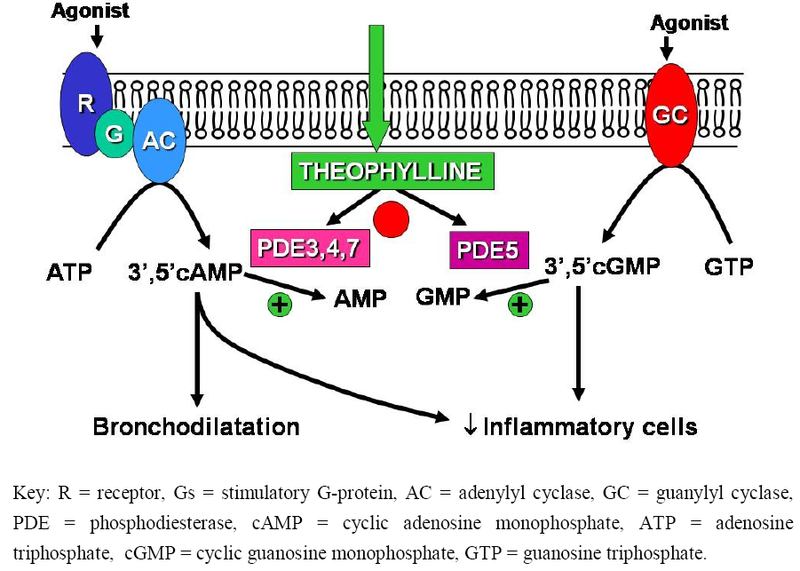
BarnesPJ. Pharmaceuticals2010, 3(3), 725-747

Slide 79
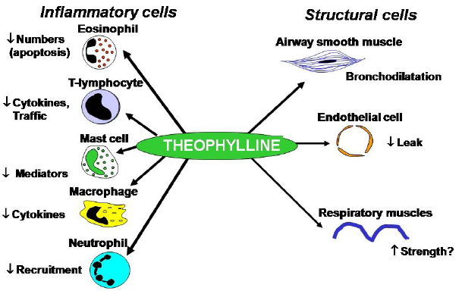

Slide 80
Xanthines Effects
Pulmonary:
  bronchodilation
  Increase mucociliary transport
  Decrease bronchial reactivity
  Inhibition of mediator releasing
  Suppression of inflammation
  Decrease pulmonary hypertension
  Suppression of pulmonary vessels permeability

Slide 81
Xanthines Effects
Extrapulmonary:
  Increase diaphragm contractility
  Heart and vessels(increase BP, dilation of coronary arteries, positive inotropic effect)
  CNS stimulation
  Diuresis (increase renal blood flow)
  Increase gastric secretion
  Suppression of uterus contractions
  Stimulation of respiratory center

Slide 82
Xanthines (Theophylline/Aminophylline)
More in COPD than in Asthma
Advanced cases with less response to all other meds
IV form in acute exacerbation of COPD
Uncontrolled nocturnal symptoms
Monitor serum levels

Slide 83
Non Pharmacological interaction with Xanthines
Decreased metabolism (toxicity)
  Elderly
  Arterial hypoxemia(PaO2 6 kPa, 45 mm Hg)
  Respiratory acidosis
  Heart failure
  Liver cirrhosis
  Viral infections
Increased metabolism (lower efficacy)
  Tobacco smoking

Slide 84
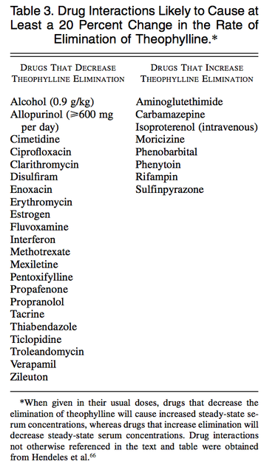

Slide 85
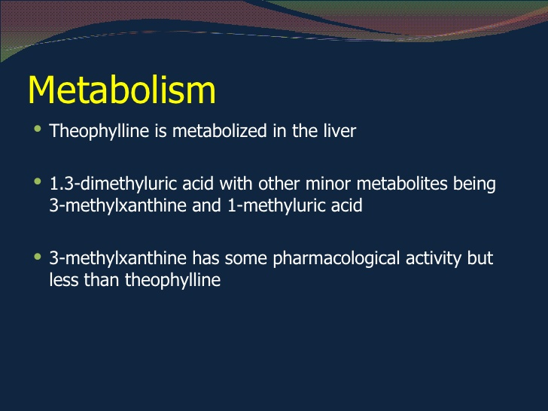

Slide 86
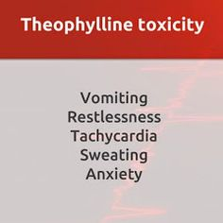
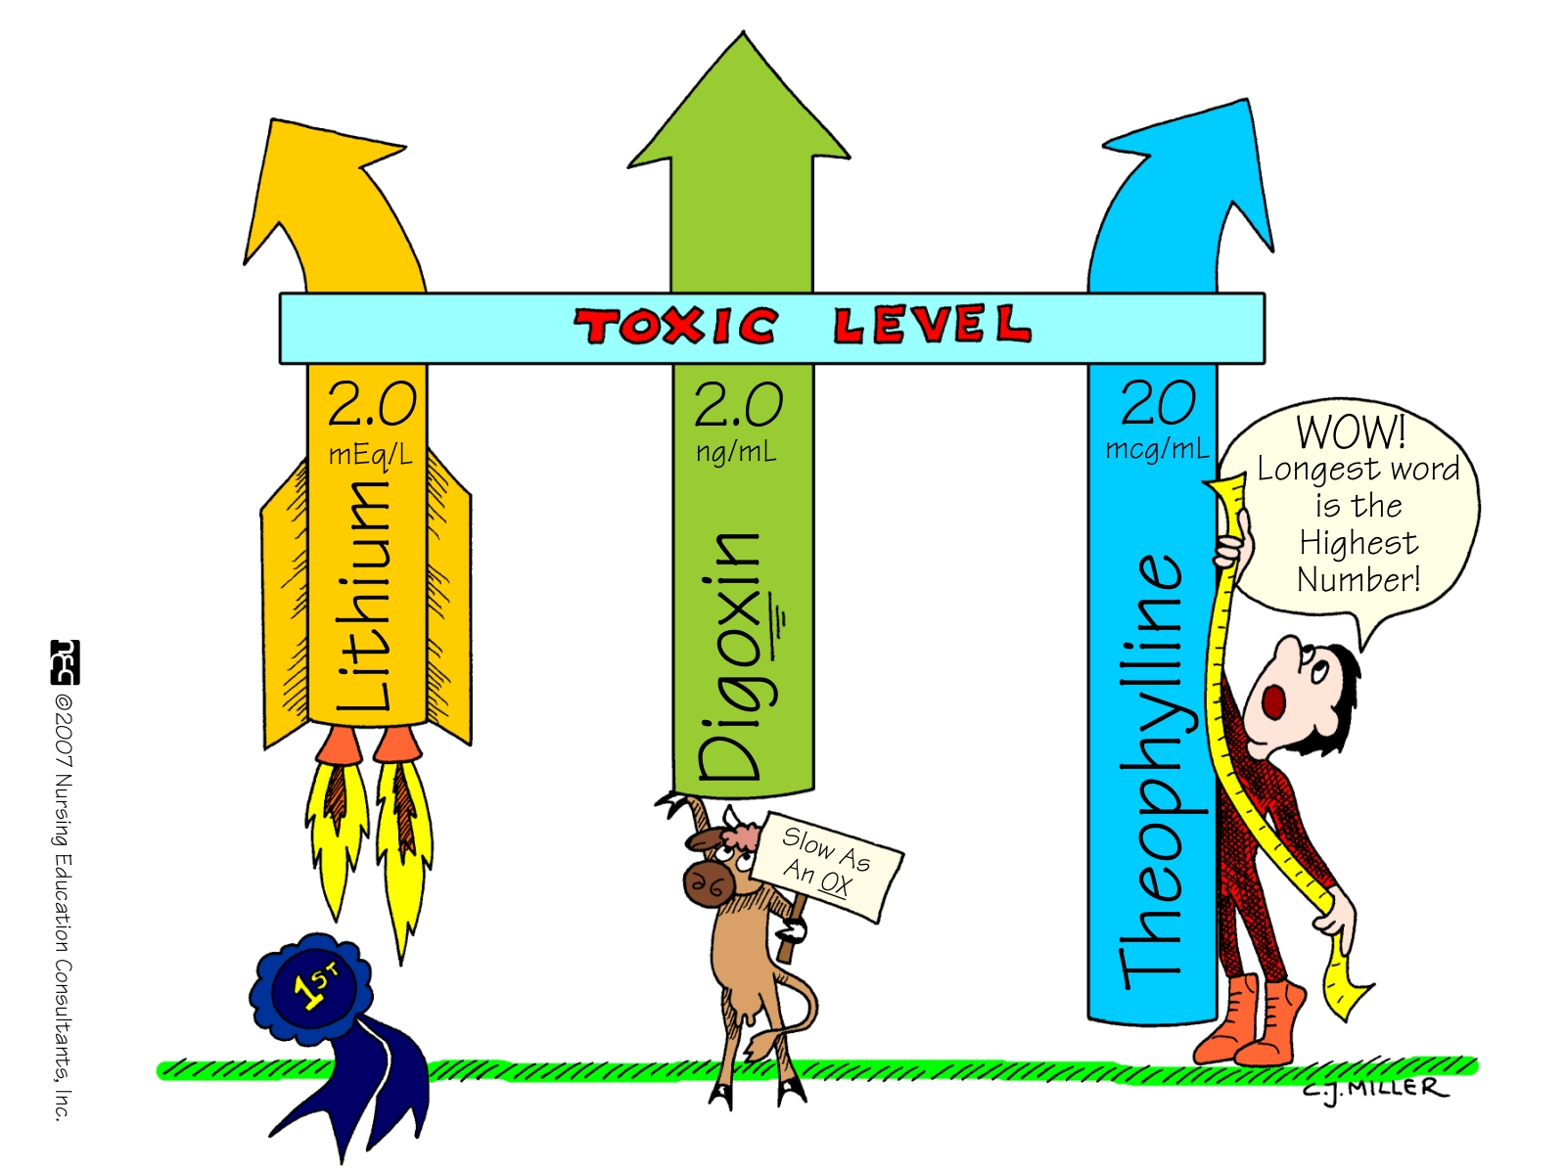

Slide 87
Cromoglycates
inhibits the release of mediators, such as histamine and leukotrienes, from mast cells
  For preventive use
  Weak anti-inflammatory effect
  No prevention of remodeling
  Full action after 4-6 weeks (except nedocromil)
  Dosage 4 x daily
  No decrease of mortality
  AE: irritation

Slide 88
Monoclonal Antibody Therapy
Omalizumab:
  IgG antibody against the Fc component of the IgE
  Given by subcutaneous injection every 2-4 weeks
  moderate-to-severe persistent asthma
  Positive skin test result or in vitro reactivity to a perennial aeroallergen
  Symptoms are inadequately controlled with inhaled corticosteroids
  IgE levels between 30 and 700 IU
  Should not weigh more than 150 kg

Slide 89
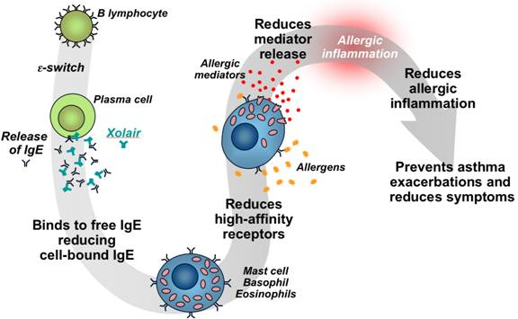

Slide 90
Phosphodiesterase-4 (PDE-4) inhibition

Slide 91
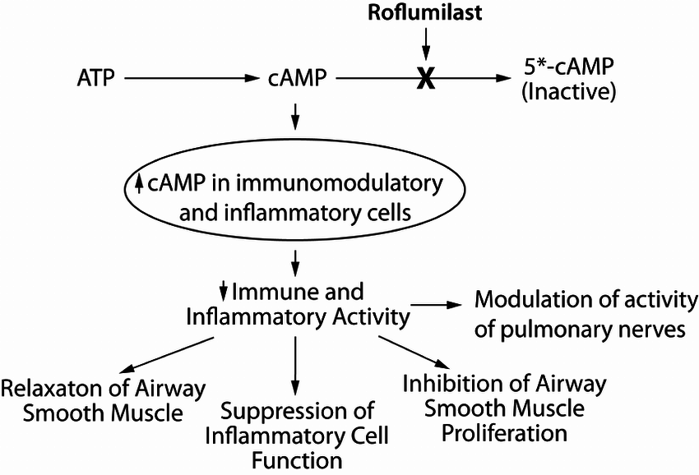
Block the degradative action of phosphodiesterase 4 (PDE4) on cAMP.

Slide 92
Roflumilast may further reduce the risk of COPD exacerbations
Benefit appears modest
Limited to COPD patients with continued exacerbations despite maximally tolerated inhaled therapies

Slide 93
Others
Mucoactive agents:
  N-acetylcysteine (NAC): mucolytic agents designed to sever disulfide bonds of mucoproteins and DNA, possibly leading to reduced mucus viscosity
  Oral expectorants: guaifenesin
Others: antibiotics, vaccination, nutrition

Slide 94
Acute Exacerbation
Nebulizers
Systemic steroids
Heliox: 80:20
Intubation

Slide 95
Evidence Supporting Prevention & Maintenance Therapy
Smoking cessation is key
The effectiveness and safety of e-cigarettes as a smoking cessation aid is uncertain at present
Pharmacologic therapy can reduce COPD symptoms, reduce the frequency and severity of exacerbations, and improve health status and exercise tolerance
Each pharmacologic treatment regimen should be individualized and guided by the severity of symptoms, risk of exacerbations, side-effects, comorbidities, drug availability and cost, and the patient’s response, preference and ability to use various drug delivery devices.
Inhaler technique needs to be assessed regularly.
© 2017 Global Initiative for Chronic Obstructive Lung Disease

Slide 96
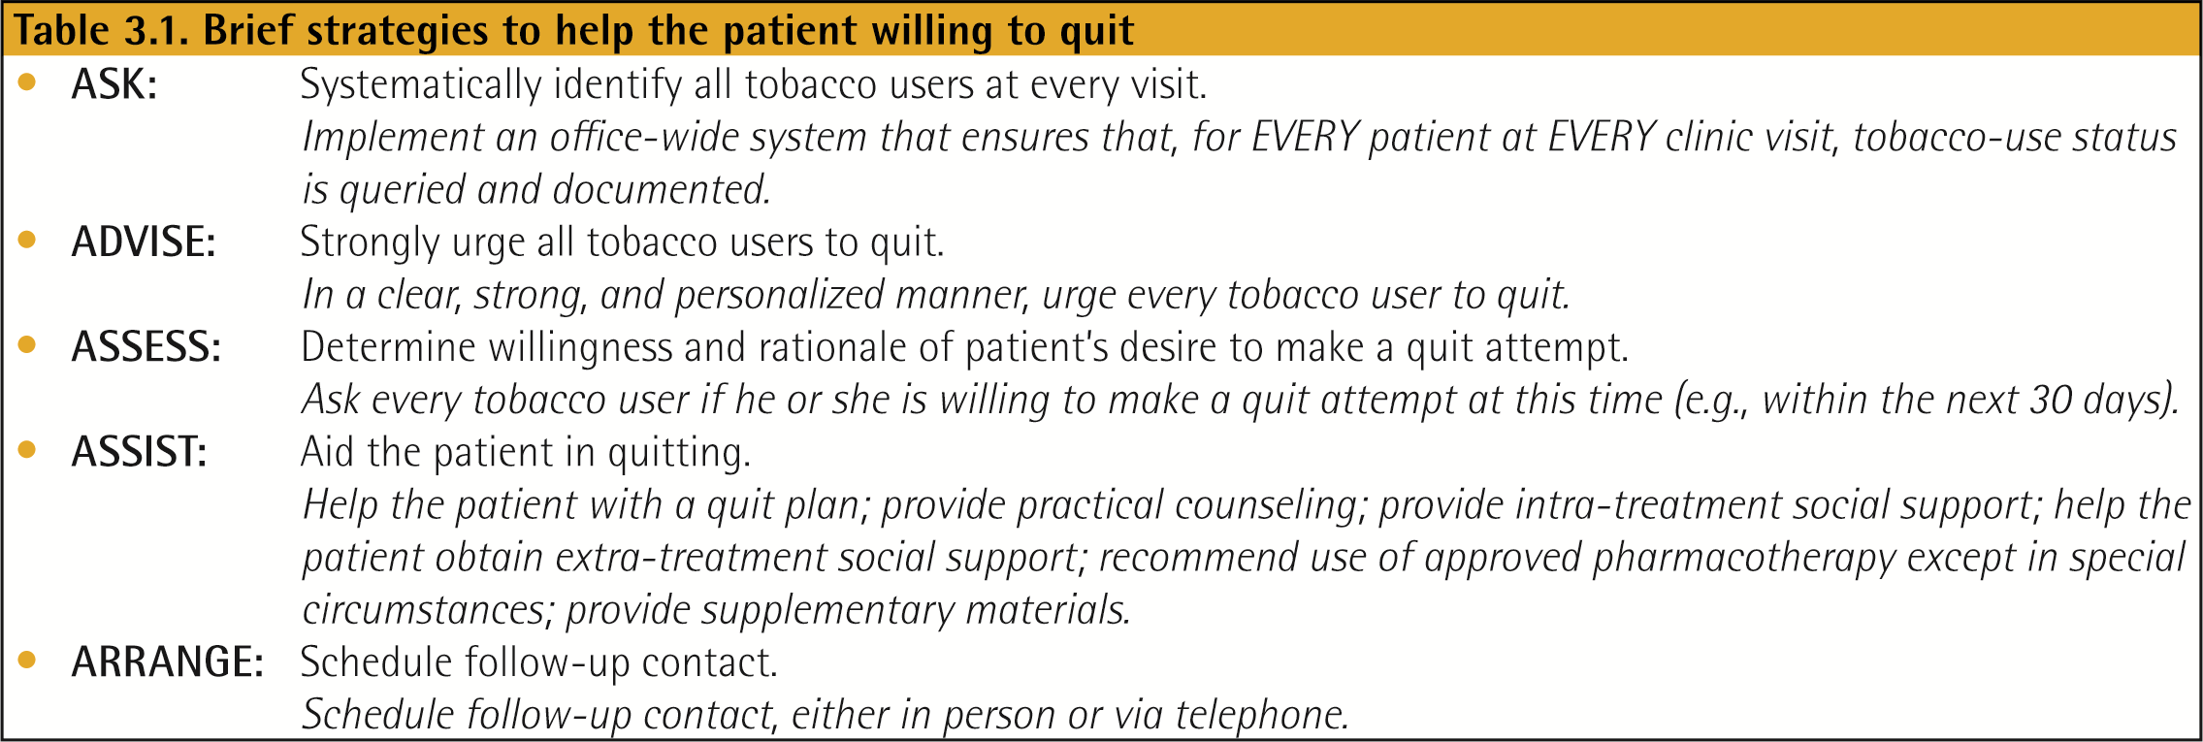
Smoking Cessation
Smoking cessation has the greatest capacity to influence the natural history of COPD.
If effective resources and time are dedicated to smoking cessation, long-term quit success rates of up to 25% can be achieved.
© 2017 Global Initiative for Chronic Obstructive Lung Disease

Slide 97
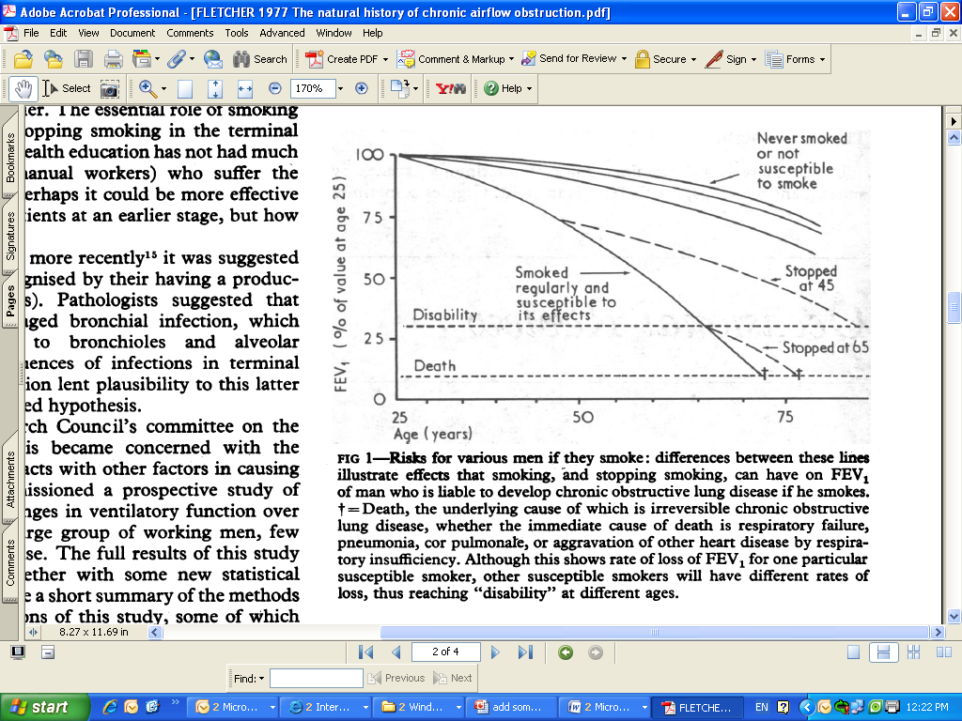
Health consequences of smoking and tobacco use - Lung function decline with smoking
Source: Fletcher C and Peto R. The natural history of chronic airflow obstruction. BMJ 1977; 1:1645-1648.

Slide 98
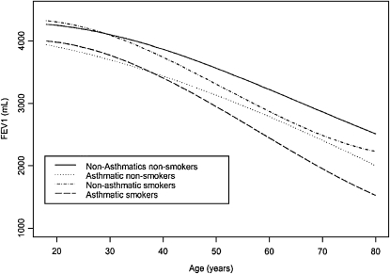
Decline of FEV₁ over the span of adult life in male participants in the Busselton Health Study derived from linear mixed effects models. Decline in lung function in the Busselton Health Study: the effects of asthma and cigarette smoking. Am J Respir Crit Care Med 2005;171:109– 114.
Notes:
Males, taller subjects, smokers, and subjects with asthma had greater declines in FEV1 with age. Smoking and asthma had additive but not multiplicative effects on decline. Thus, asthma is associated with reduced lung function at the beginning of adult life as well as an increased rate of decline during adult life.

Slide 99
General approach to pharmacotherapy
Think of pharmacotherapies as two types, best used together (ACCP)
  Controller meds – stabilize central nicotinic receptor abnormalities
    Nicotine patches
    Bupropion
    Varenicline
  Reliever meds – relieve breakthrough symptoms and acute cravings
    Short-acting nicotine replacement
Notes:
ACCP toolkit (for TDT)

Slide 100
First-line treatments
Nicotine replacement therapy (NRT)
  Skin patch (long-acting)
  Gum (short-acting)
  Oral inhaler (short-acting)*
  Nasal spray (short-acting)*
  Lozenge (short-acting)
Varenicline (Chantix/Champix)*
  α4ß2 receptor partial agonist
Bupropion (Zyban, Wellbutrin)*
  Antidepressant
*Prescription medication
Notes:
Bupropion:
“Bupropion is an atypical antidepressant structurally similar to diethylpropion, an appetite suppressant. The mechanism of the antidepressant effect of bupropion is not fully understood, but bupropion inhibits reuptake of dopamine, noradrenaline, and serotonin in the central nervous system, is a non-competitive nicotine receptor antagonist, and at high concentrations inhibits the firing of noradrenergic neurons in the locus caeruleus. It is not clear which of these effects accounts for the antismoking activity of the drug, but inhibition of the reductions in levels of dopamine and noradrenaline levels in the central nervous system that occur in nicotine withdrawal is likely to be important. The antismoking effect of bupropion does not seem to be related to the antidepressant effect as bupropion is equally effective as a smoking cessation therapy in smokers with and without depression.”
From
ABC of smoking cessation - Bupropion and other non-nicotine pharmacotherapies. E Rody. BMJ VOLUME 328 28 FEBRUARY 2004

Slide 101
NRT relative to cigarettes
Notes:
Patches provide a slow and consistent release of nicotine
Nasal spray mimics most closely the cigarette in form of nicotine release
For references, see MD Consult (“NICOTINE REPLACEMENT THERAPY”, from Primary Care: Clinics in Office Practice - Volume 26, Issue 3 (September 1999)

Slide 102
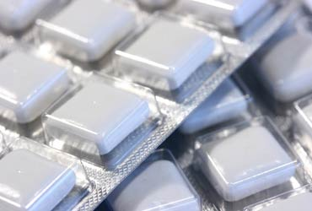
NRT (gum)*
Proper use is to “chew and park”
Available in 2 mg and 4 mg doses
  Heavy smokers (25 or more cigarettes/day)** – 4 mg size
Frequency
  Week 1-6: 1 piece every 1-2 hours (10-15 pieces/d)
  Week 7-9: 1 piece every 2-4 hours
  Week 10-12: 1 piece every 4-8 hours
Notes:
Hurt et al, Review
Micromedex
Pubmed
** Alternative definition: Patients who smoke first cigarette >30 minutes after waking versus < 30 minutes after waking

Slide 103
Bupropion
Monocyclic antidepressant - inhibits reuptake of norepinephrine and dopamine
  May inhibit nicotinic ACH receptor function but precise mechanism of action as smoking aid not clear
  May attenuate weight gain in abstinent smokers
    May be good for smokers worried about weight
  Good for smokers with a history of depression
Bupropion appears to be equally effective and of similar efficacy to NRT

Slide 104
Side effects
Common side effects can include: insomnia, dry mouth, changes in the taste of food, anxiety, agitation, difficulty concentrating, tremors, headaches, nausea, depression
There is a risk of about 1 in 1000 of seizures associated with bupropion use
Suicide risk reported but no causal association concluded.
Notes:
avoid bedtime doses of Zyban (boots)
Data show that bupropion SR and nicotine replacement therapies, in particular 4-mg nicotine gum and 4-mg nicotine lozenge, delay—but do not prevent—weight gain. (US guidelines)

Slide 105
Precautions: drug interactions
Drugs which require metabolic activation by CYP2D6 in order to be effective (e.g. tamoxifen) may have lower efficacy
Caution advised when bupropion is co-administered with medicinal products which
  induce its metabolism (e.g. carbamazepine, phenytoin, ritonavir, efavirenz ) or
  Inhibit its metabolism (e.g. valproate)
Notes:
Bupropion is metabolised to its major active metabolite hydroxybupropion primarily by the cytochrome P450 CYP2B6.

Slide 106
Contraindications
Bupropion is contraindicated in patients with CNS disorders (seizures)
  And in situations that increase seizure risk (e.g. abrupt alcohol withdrawal, bulimia)
Severe hepatic cirrhosis
Bipolar disorder history
Notes:
MAOIs – antidepressants particularly for atypical depression. The early MAOIs inhibited monoamine oxidase irreversibly, i.e they permanently deactivate it, and the enzyme cannot function until it has been replaced by the body, which can take about two weeks. A few newer MAOIs (eg mocolbemide) are reversible (they detach from enzyme and allow latter to return to function)
Note about avoiding in increased seizure risk situations from medsafe website and from Bupropion leaflet
Micromedex
Dosage in Hepatic Insufficiency
A) Bupropion Hydrobromide
1) Mild To Moderate Impairment
a) In patients with mild to moderate hepatic cirrhosis, a reduced dose and frequency
should be considered [67].
2) Severe Impairment
a) Bupropion should be used with extreme caution in patients with severe hepatic
cirrhosis due to accumulation of the active metabolites of bupropion. A dose not
exceeding 174 mg every other day should be used [67].

Slide 107
varenicline

Slide 108
Varenicline
A nicotinic acetylcholine receptor (α4ß2 receptor) partial agonist. On binding to receptors in the brain:
  Symptoms of craving and withdrawal are alleviated because varenicline acts as an agonist and induces dopamine release
  Nicotine binding prevented thereby reducing the rewarding and reinforcing effects of smoking.

Slide 109
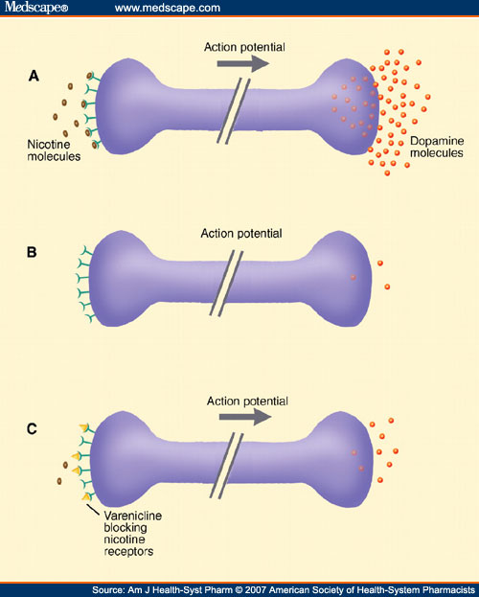
Varenicline
Notes:
“Varenicline's mechanism of action. (A) Nicotine from cigarettes stimulates the production of high levels of dopamine in terminal synapse in the nucleus accumbens. (B) No nicotine present, which induces a state of nicotine withdrawal. (C) Varenicline blocks the nicotine-receptor sites and partially agonizes the receptors, stimulating moderate levels of dopamine in the terminal synapse in the nucleus accumbens. Illustration by Marie Dauenheimer, CMI.” From American Journal of Health-System Pharmacy. 2007;64(13):1381-1384

Slide 110
Varenicline dosage
First visit | Counsel on reducing cigarette intake gradually over week and set target quit date. Medication should be started one week before TQD.
Week 1: days 1 to 3 | 0.5 mg once daily
Week 1: days 4 to 7 | 0.5 mg twice daily
Week 2 (TQD) to week 12* | 1.0 mg twice daily
Further treatment** | 1.0 mg twice daily
* In some patients, dose tapering at the end of treatment may be needed
** ”For patients who have successfully stopped smoking at the end of 12 weeks, an additional course of 12 weeks’ treatment with CHANTIX is recommended to further increase the likelihood of long-term abstinence” (Varenicline product label)

Slide 111
Side effects
Most common side effect is nausea (varenicline binds with moderate affinity at the serotonin receptor)
  Mild to moderate (often transient)
  Dose-dependant, reaching 30% in higher doses
Other common side effects can include GI disturbances (e.g. constipation, flatulence), sleep disturbances, strange dreams or nightmares, headaches
Cardiovascular side effects higher than in placebo but frequency of their occurrence is low (1.06%)*
* Singh S, Loke YK, Spangler JG, Furberg CD. Risk of serious adverse cardiovascular events associated with varenicline: a systematic review and meta-analysis. CMAJ. 2011 Sep 6;183(12):1359-66
Notes:
severe renal impairment (creatinine clearance <30 mL/min)
19% - sleep disturbances, bad dreams

Slide 112
Precautions
Suicidal ideation reported after use
  Observe patient
For patients with severe renal impairment (creatinine clearance <30 mL/min)
  Starting dose of 0.5 mg QD recommended, titrated as needed to a maximum dose of 0.5 mg BID.
For end-stage renal disease (hemodialysis), a maximum dose of 0.5 mg QD may be administered
  No dosage adjustments for hepatic impairment
Varenicline is an FDA pregnancy Class C agent and has not been studied in breastfeeding subjects.
Notes:
severe renal impairment (creatinine clearance <30 mL/min)
19% - sleep disturbances, bad dreams
“CHANTIX should be used during pregnancy only if the potential benefit justifies the potential risk to the
Fetus”

Slide 113
There are currently no known drug interactions with varenicline

Slide 114

Thank you!

