Slide 1
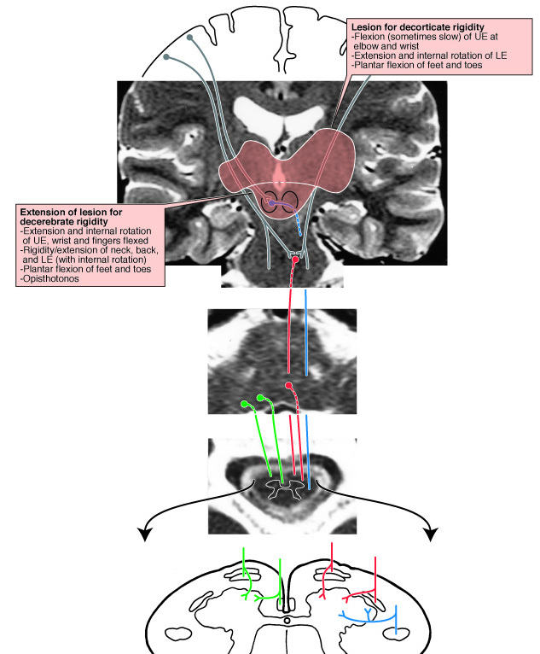
Decorticate and
Decerebrate
Rigidity
Atlas Fig. 8-19B

Slide 2
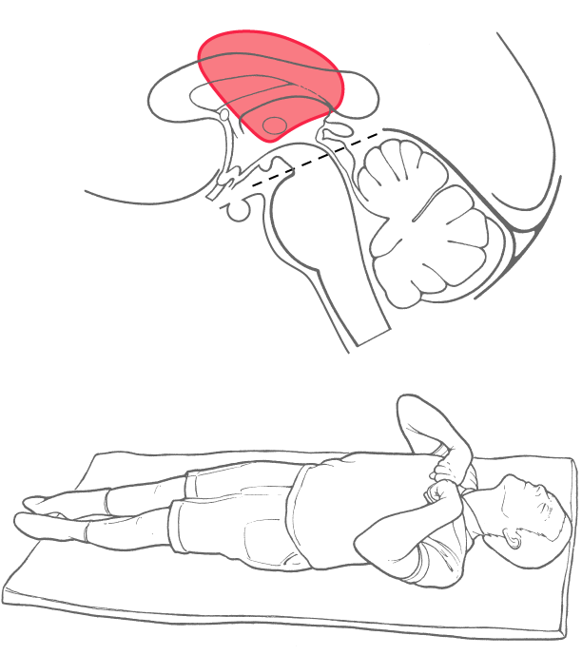
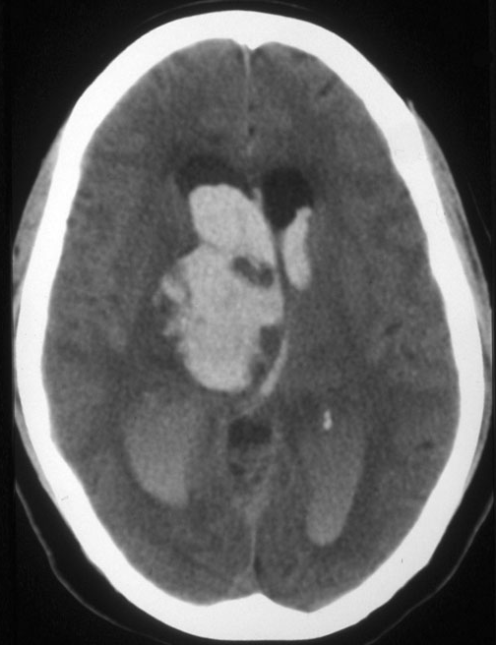
Decorticate
Text Fig. 24-15

Slide 3
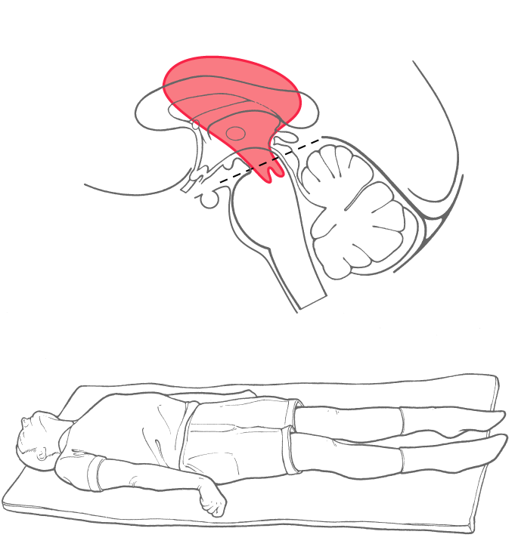
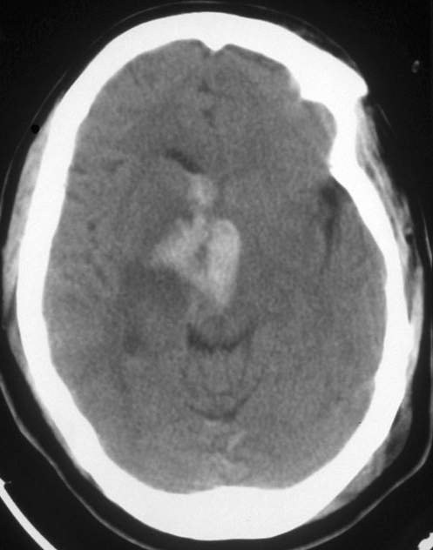
Decerebrate
Text Fig 24-13

Slide 4
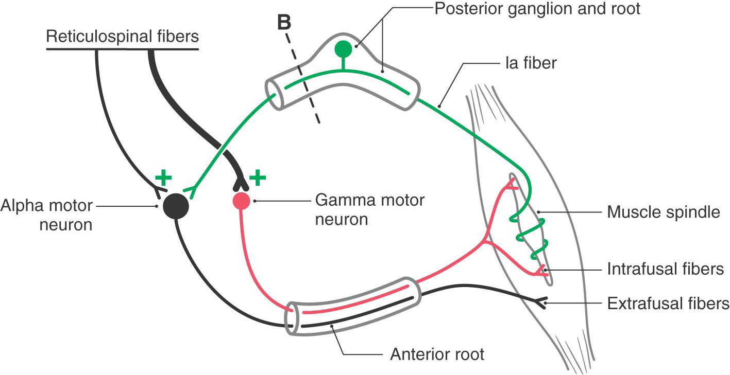

Slide 5
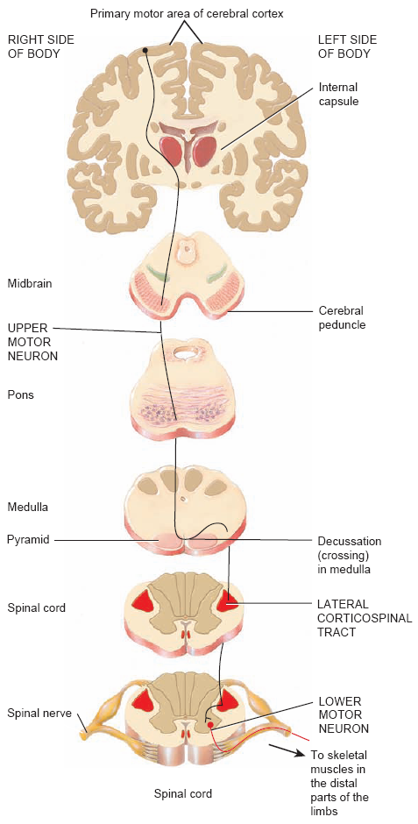
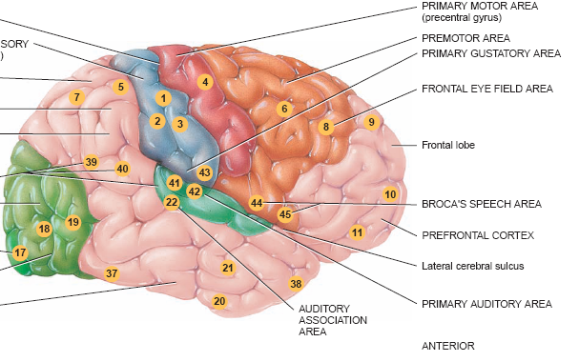
Corticospinal pathway

Slide 6
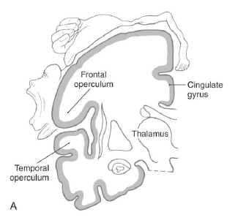
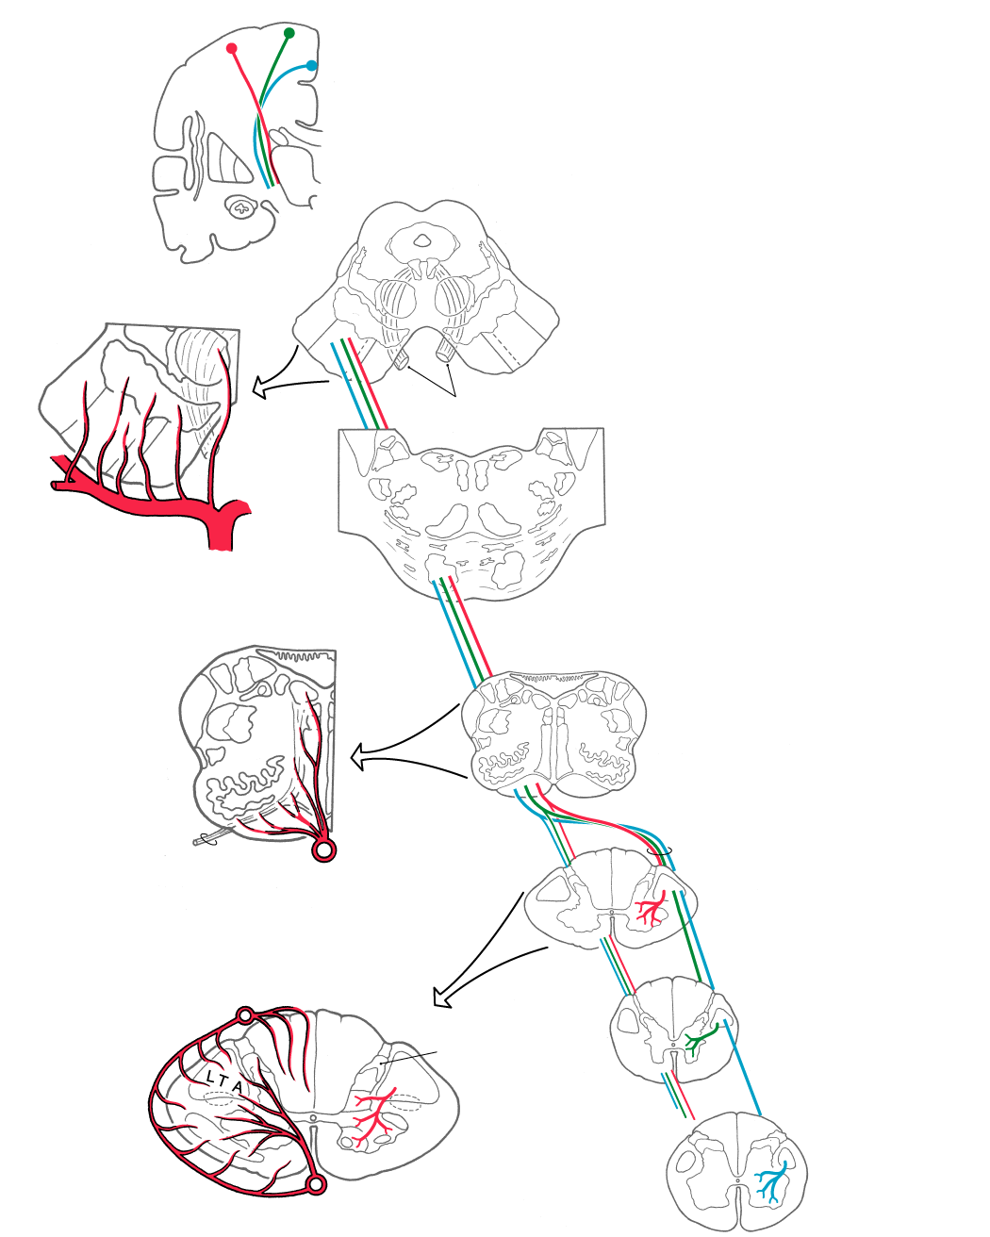
Corticospinal Fibers:
-Somatotopy,
-Laterality,
-Trajectory
FP
Face
UE
LE
POT
Atlas Fig. 5-24
Text Fig. 25-6, see also Atlas Figs. 8-13, 8-14A and 8-14B

Slide 7
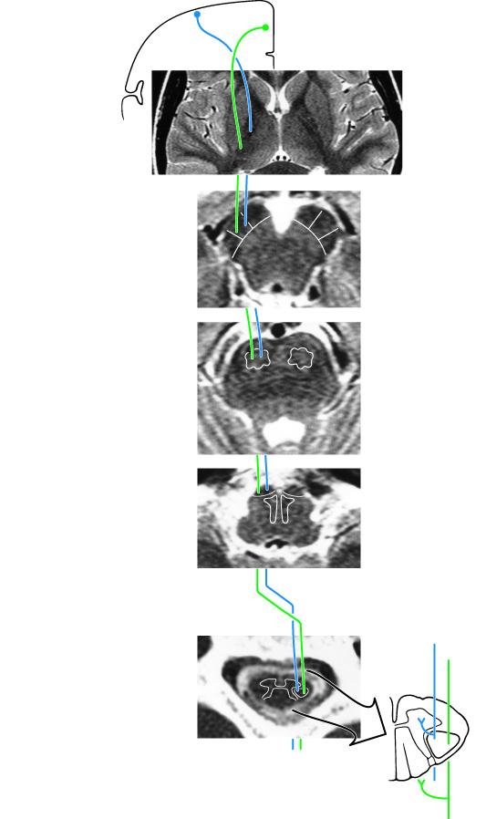
Corticospinal Fibers In MRI:
Atlas Fig. 8-14A

Slide 8
Corticospinal Fibers In MRI:
Atlas Fig. 8-14A

Slide 9
R
L
R
L
Py
MotDec
LCSp
= Lower extremity
= Upper extremity

Slide 10
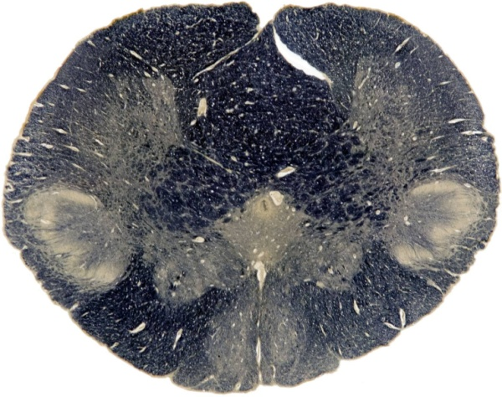
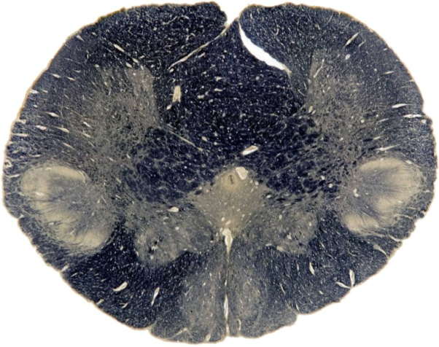
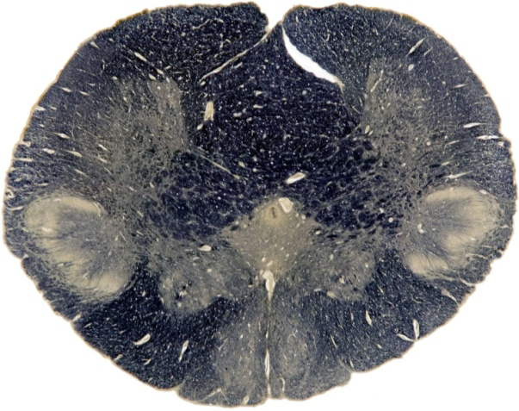
R
L
R
L
Py
Rostral level
MotDec
LCSp
Caudal level
= Lower extremity
= Upper extremity

Slide 11
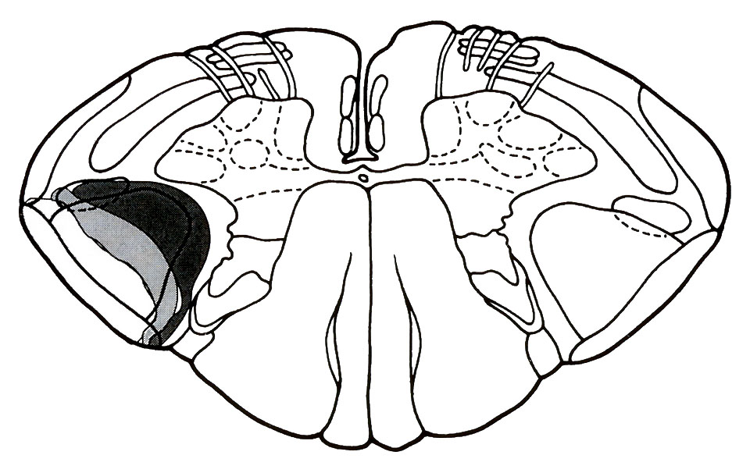
Expanding Extramedullary Lesion

Slide 12
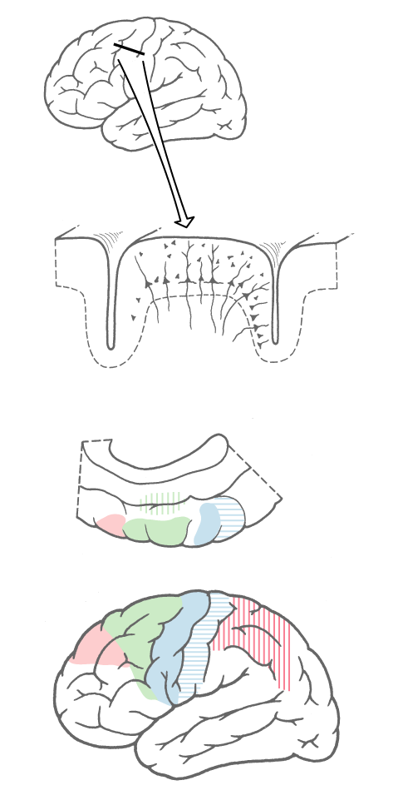
The Motor Cortex

Slide 13
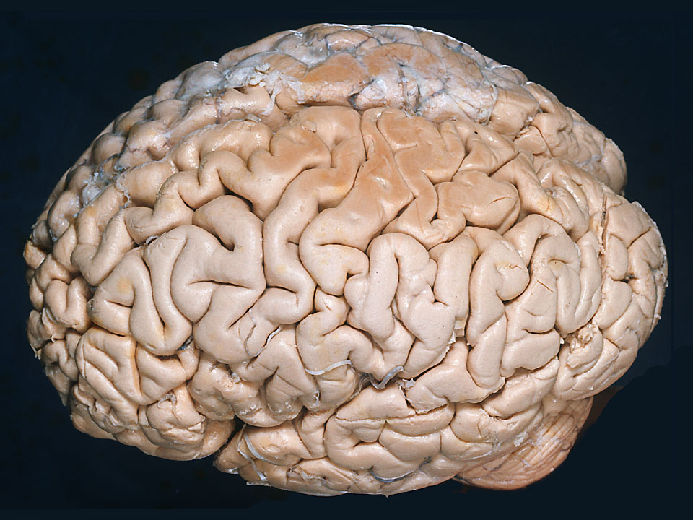
The Primary Somatomotor Cortex
Hip
T
UE
H
F
see Atlas Fig. 2-11

Slide 14
40%
60%

Slide 15
Motor areas in the cerebral cortex

Slide 16
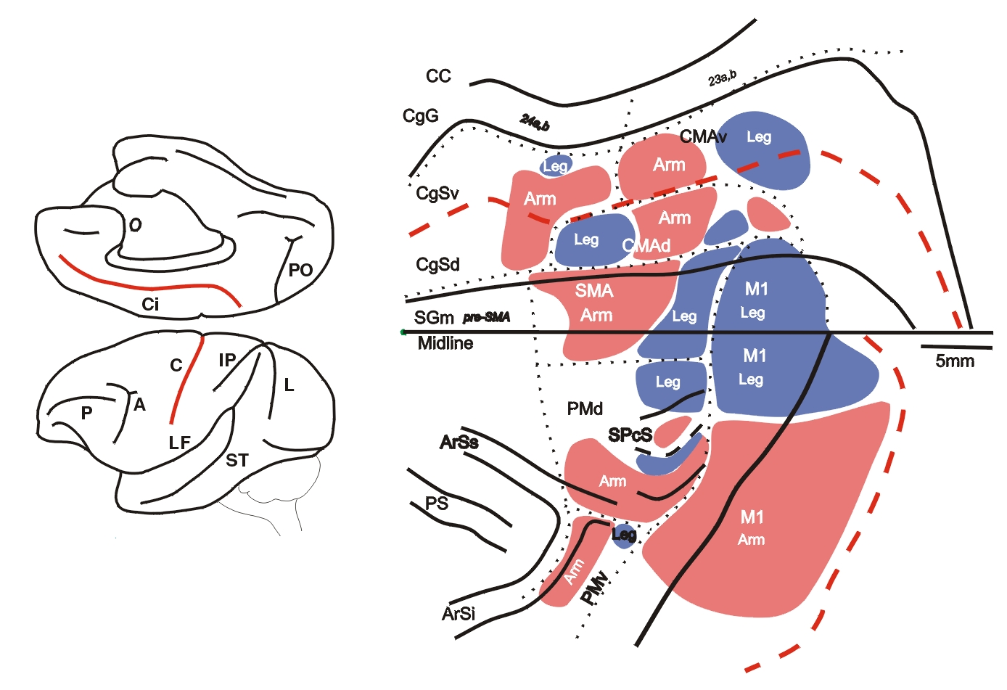
CMAv
Ci
CMAr
CMAd
C
adapted from Strick, PL and Dum, RP,
The Corticospinal System, in
Handbook of Physiology, Oxford, 1996.

Slide 17
Ci
C
The several cortical motor
areas are connected with each
other.

Slide 18
Ci
C
Each cortical motor area
projects to spinal cord
(anterior horn or interneurons)
to cervical
spinal cord

Slide 19
Supplementary
Motor Area
Ci
C
“Preparation for movement,
Coordination of two hands”

Slide 20
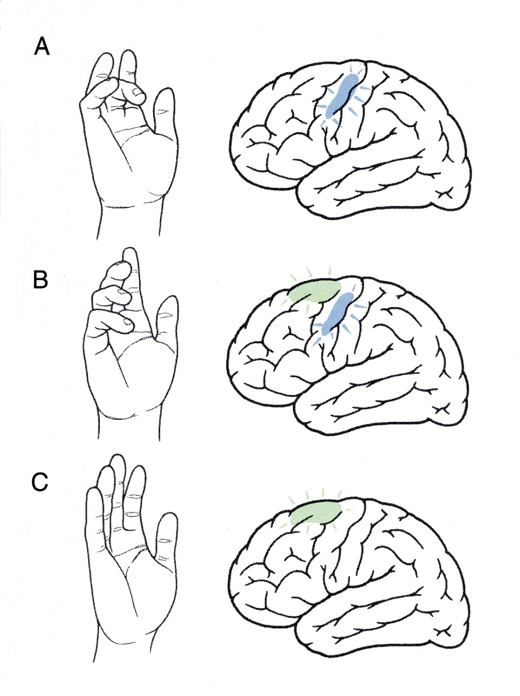
Move one finger
repetitively
Execute complex
learned pattern
of finger
movements
Imagine complex
learned pattern
of finger
movements
SUPPLEMENTARY MOTOR AREA
Haines Figure 25-15

Slide 21
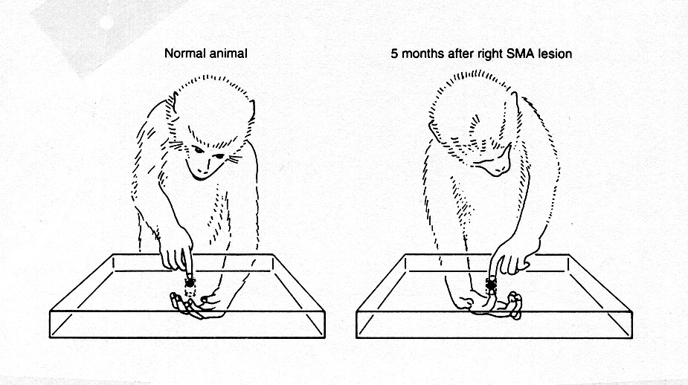
Effect of damage in the Supplementary Motor Area:
difficulty in using two hands together

Slide 22
Dorsal Premotor
Cortex
Ci
C
“Complex movements,
Preparation for movement”

Slide 23
Ventral Premotor
Cortex
Ci
C
“Hand-eye coordination”

Slide 24
Ventral Premotor
Cortex
Ci
C
“Hand-eye coordination”
+
mirror motor neurons

Slide 25
Posterior Parietal Cortex (5+7)
&
Cingulate Motor Cortex

Slide 26
Posterior Parietal Cortex (5+7)
&
Cingulate Motor Cortex
Vs
Limbic
Prefrontal (9 + 46)
&
Posterior Parietal Cortex (5+7)

Slide 27
pathways from the cerebral cortex to the spinal cord
3.

Slide 28
Ci
C
to cervical
spinal cord

Slide 29
Ci
S1, & parietal
C
to cervical
spinal cord

Slide 30
Corticospinal Fibers:
-Somatotopy,
-Laterality,
-Trajectory
FP
Face
UE
LE
POT
Atlas Fig. 5-24
Text Fig. 25-6, see also Atlas Figs. 8-13, 8-14A and 8-14B

Slide 31
Pyramidotomy

Slide 32
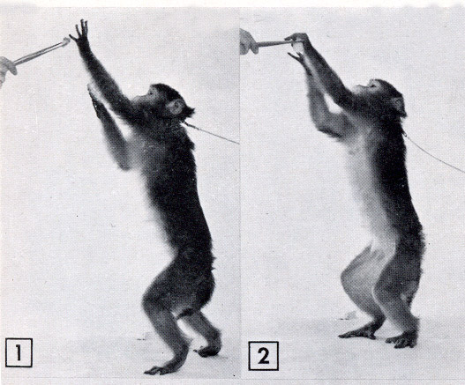
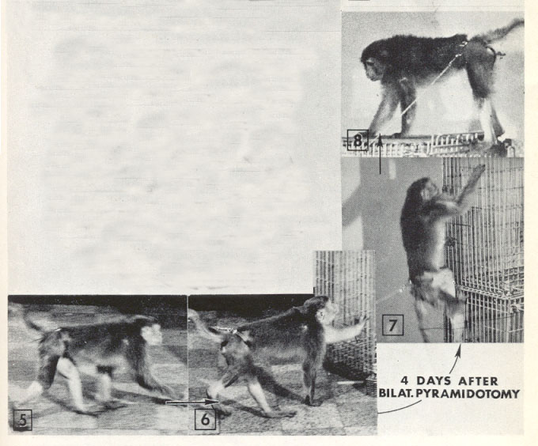

Slide 33
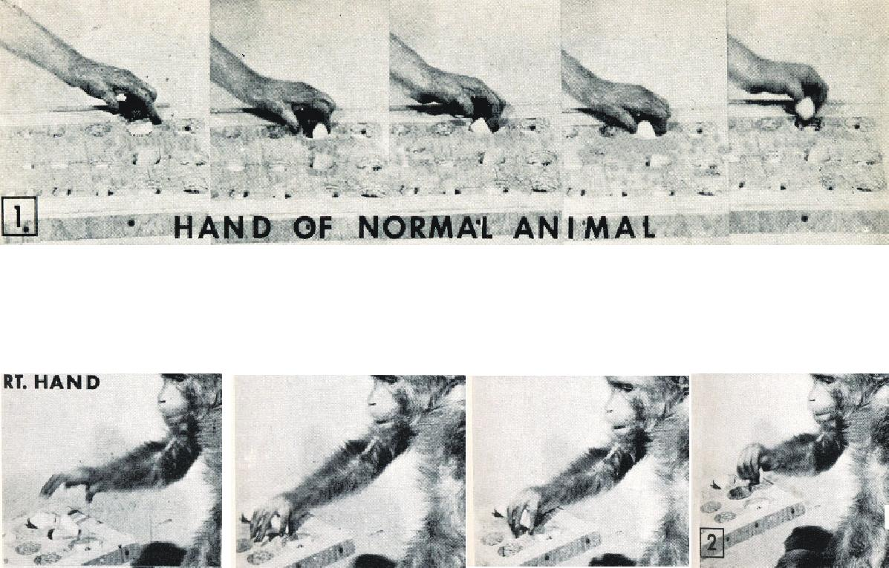
5 months after pyramidal tract lesion:

Slide 34
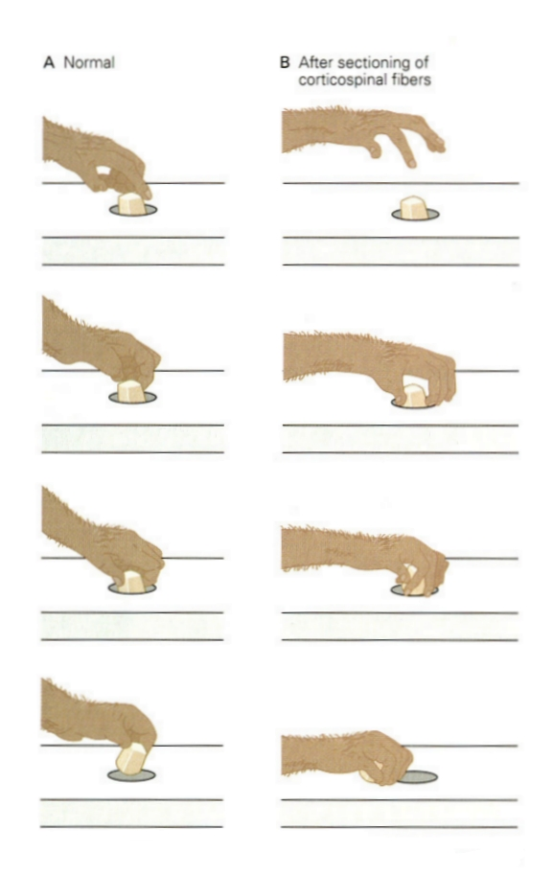

Slide 35
Hemiparesis versus Hemiplegia

Slide 36
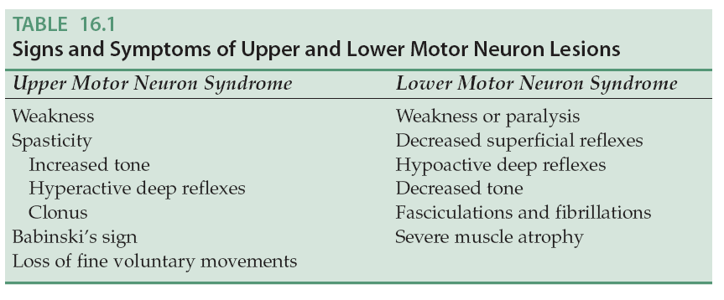

Slide 37
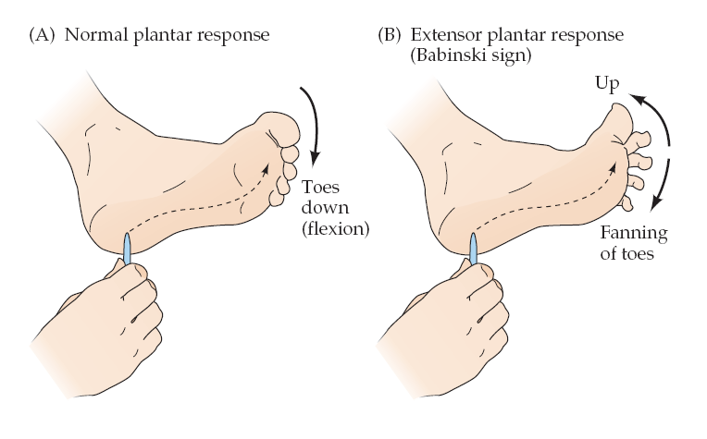

Slide 38
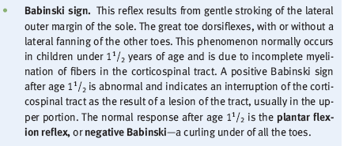

Slide 39
Corticospinal Fibers:
-Somatotopy,
-Laterality,
-Trajectory
Text Fig. 25-6, see also Atlas Figs. 8-13, 8-14A and 8-14B

Slide 40
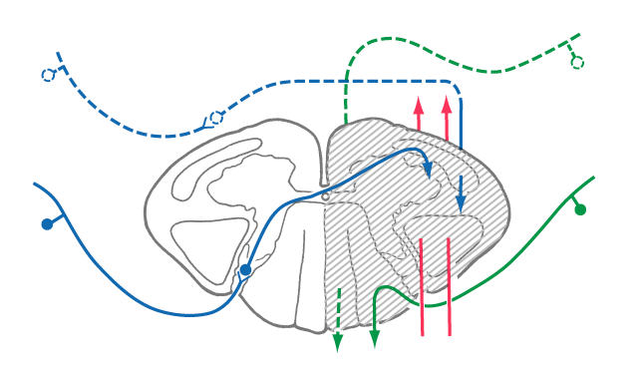
The Brown-Sequard Syndrome

