Slide 1
Motor system

Slide 2
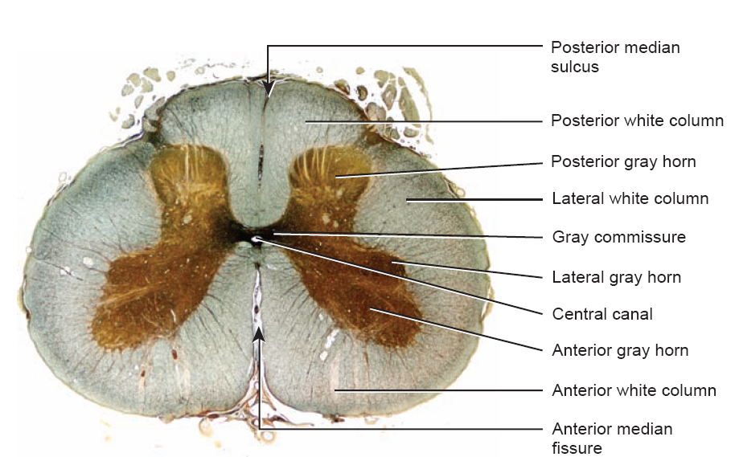

Slide 3
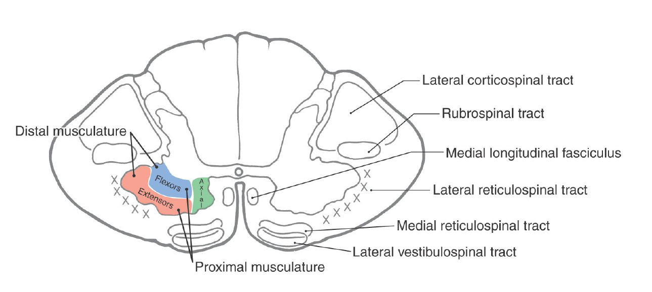

Slide 4
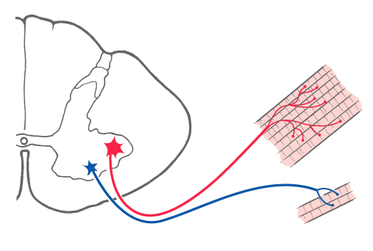
Motor Units – Large Versus Small
Text Fig. 24-3

Slide 5
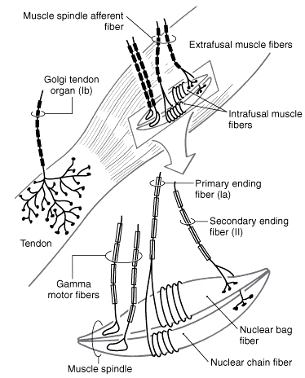
Major receptors involved in spinal cord reflexes: muscle spindle and golgi tendon organ
Text Fig. 17-1
Muscle spindle sense change and rate of change in muscle length
Golgi tendon organ sense the force of muscle contraction (tension)
Notes:
5

Slide 6
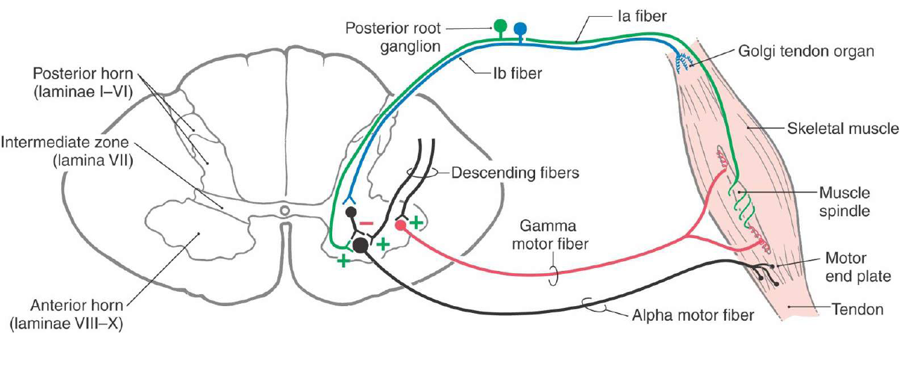

Slide 7
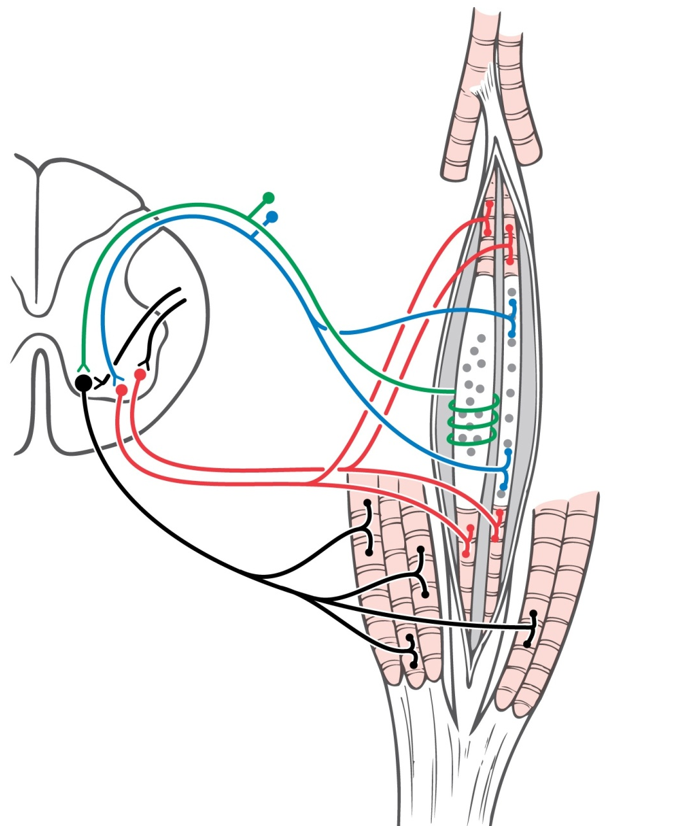
The Muscle Spindle
Nuclear bag fiber (Annulosprial
ending)
Nuclei arranged in cluster
Dynamic/Static
-Primary, Ia, 80-120 msec (12-20)
-Rate of change in length (dynamic)
versus only Change in length
not rate (static)
-Dynamic bag fibers to Dynamic
gamma motor neurons (sensitivity)
-Static bag fibers to Static gamma
motor neurons (length)
Nuclear chain fiber (Flower-spray
ending)
Nuclei arranged in single row
-Secondary, II, 35-70 msec (6-10)
- Change in length only, not rate
of change
See Text Fig. 24-4

Slide 8
The Muscle Spindle When Activated

Slide 10
Spinal cord Reflexes

Slide 11
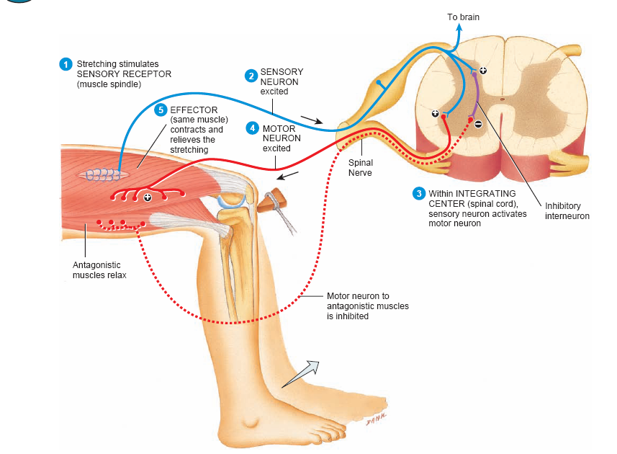
Muscle stretch reflex

Slide 12
Muscle stretch reflex / Reciprocal inhibition

Slide 13
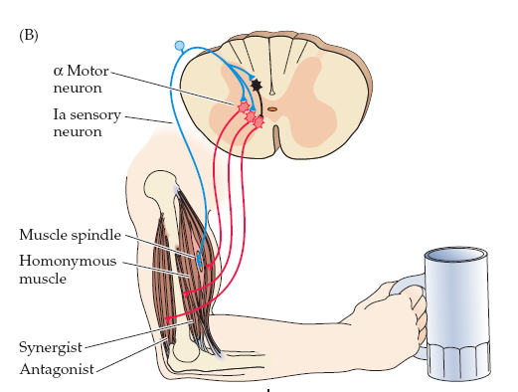

Slide 14
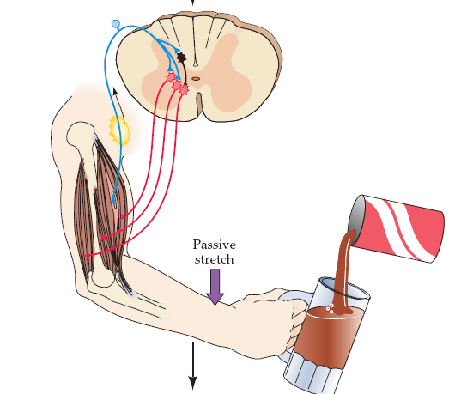

Slide 15
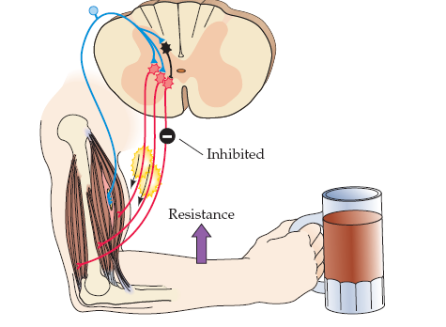

Slide 16
Tendon reflex
(autogenic inhibition)

Slide 17
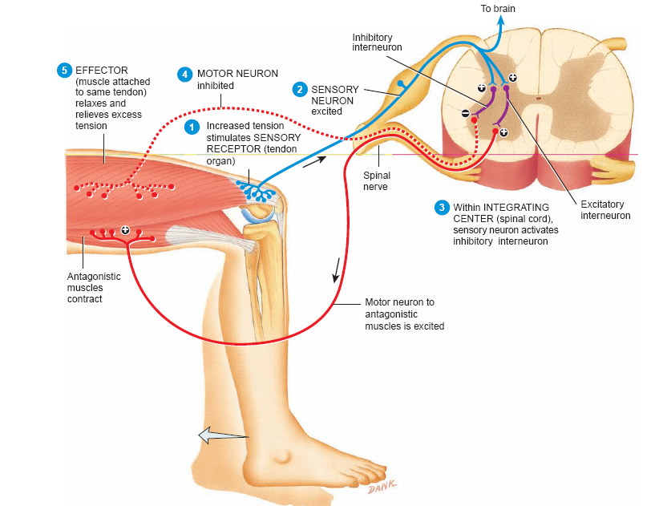
Tendon reflex
(autogenic inhibition)

Slide 18
Flexor (withdrawal ) reflex
(nociceptive reflex)

Slide 19
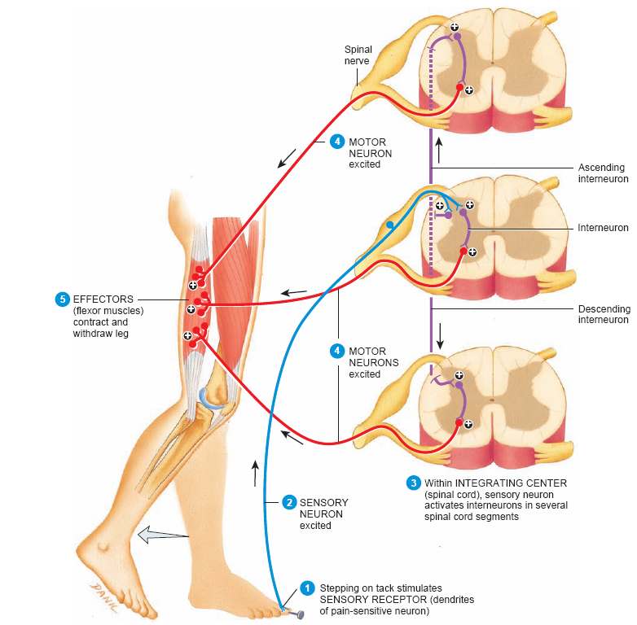
Flexor (withdrawal ) reflex
(nociceptive reflex)

Slide 20
Text Fig. 9-11
Crossed Extension Reflex

Slide 21
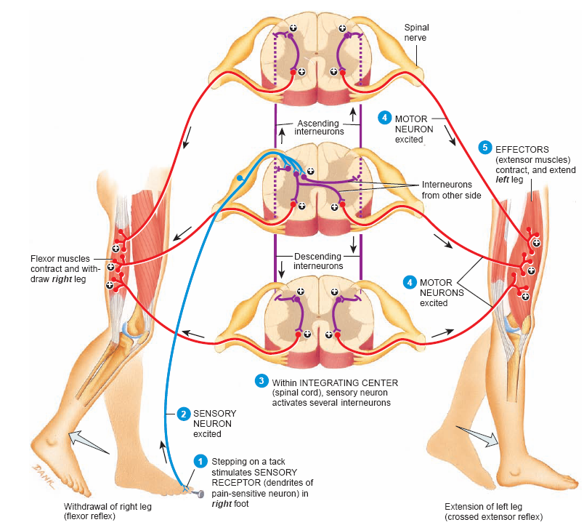
Text Fig. 9-11
Crossed Extension Reflex

Slide 22
Brainstem motor function Extra-pyramidal System,

Slide 23
Extra-pyramidal System
Definition: Tracts other than corticospinal tract are known as Extra-pyramidal tract.

Slide 24
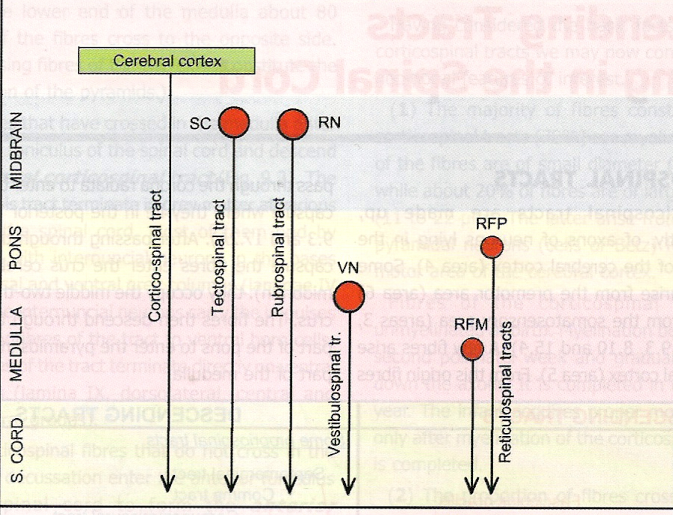

Slide 25
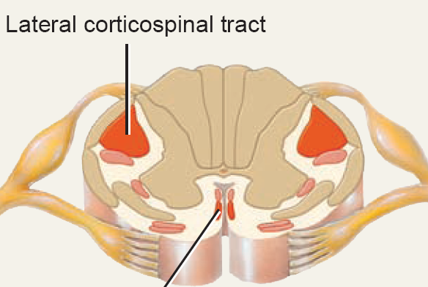
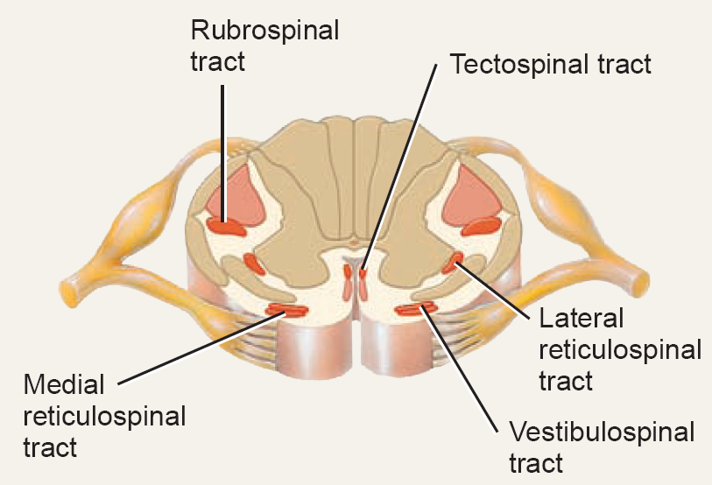

Slide 26
Reticulospinal Tract
The reticular formation in the brainstem. It contains many different nuclear groups.
Pontine and medullary nuclei projects to the anterior horn of the spinal cord.
Functions: is responsible for regulating muscle tone and maintain posture.

Slide 27
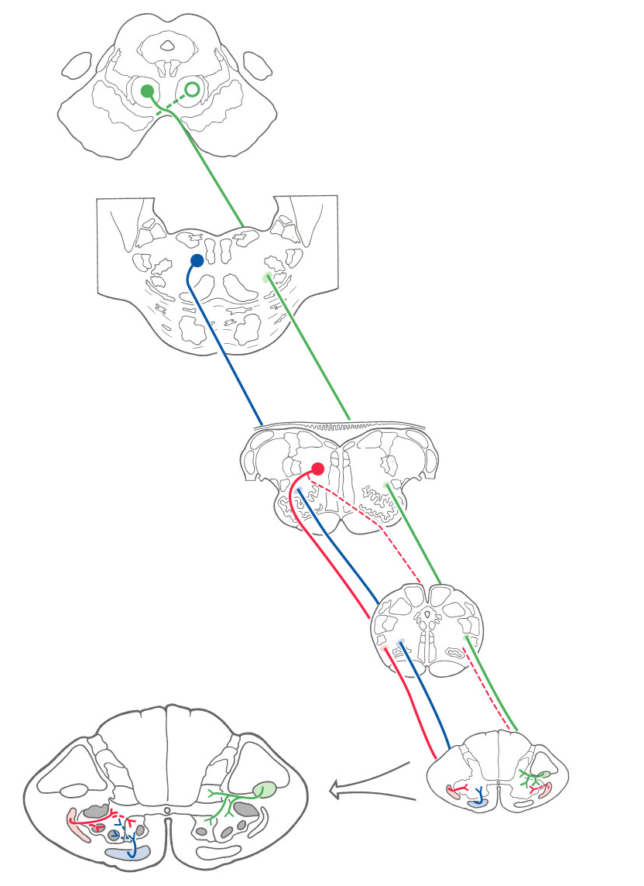
Rubrospinal Fibers:
Reticulospinal Fibers:
-Medial
-Lateral

Slide 28
Vestibulospinal tract
vestibular apparatus & vestibular nuclei
Spinal motor neuron
Innervating axial & postural muscles (trunk muscles)
Function : maintain Posture & balance “head &eye” and balance reflexes

Slide 29
Rubrospinal Fibers:
Reticulospinal Fibers:
-Medial
-Lateral

Slide 30
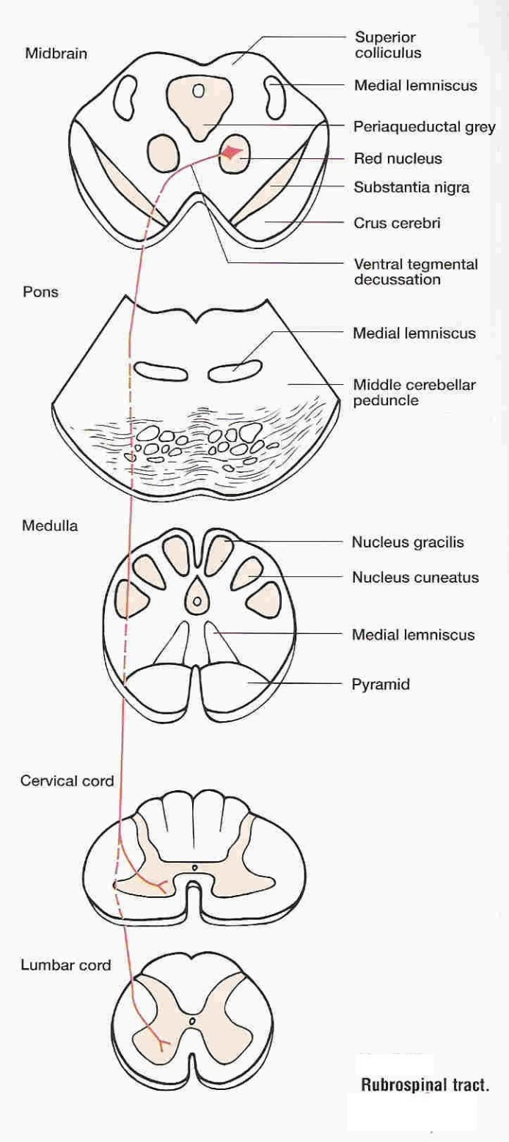
Rubrospinal tract
Red Nucleus in Midbrain
Pass down through Pons & Medulla
Ends in ant. Horn of spinal cord
Control motor neurons
Functions. Control Distal muscle of limbs “especially upper limb”

Slide 31
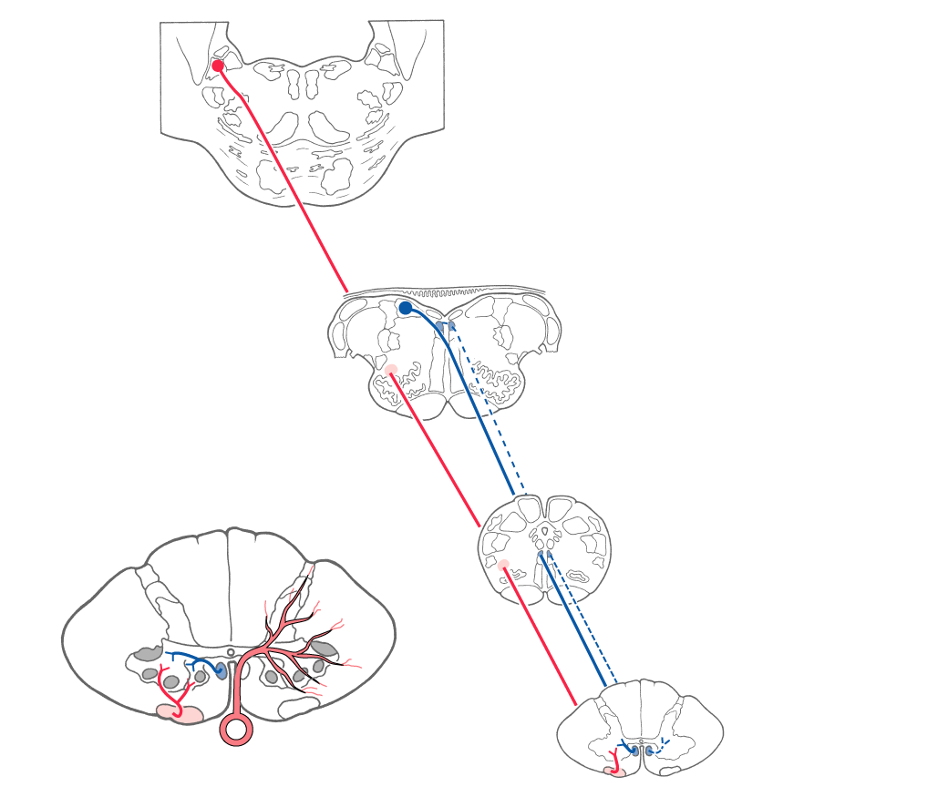
Vestibulospinal Fibers:
-Lateral
-Medial
Text Fig. 24-7, see also Atlas Figs, 8-18, 19A and 19B

Slide 32
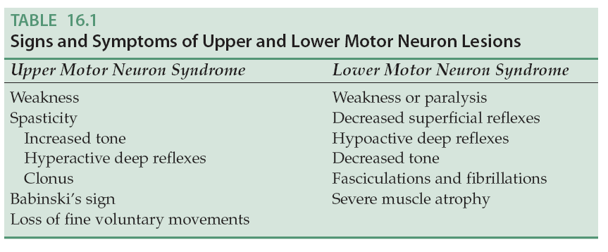

Slide 33
