Slide 1
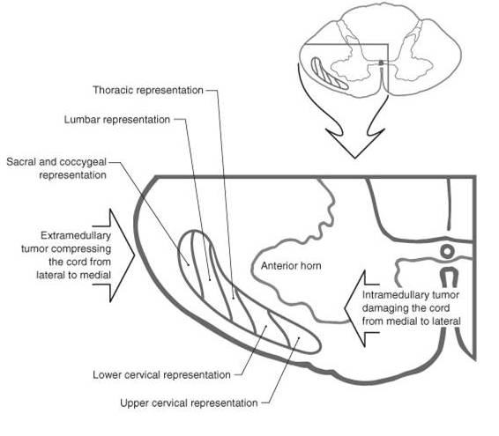
Text Fig. 18-8

Slide 2
Dermatomes

Slide 3
Dermatomes

Slide 4
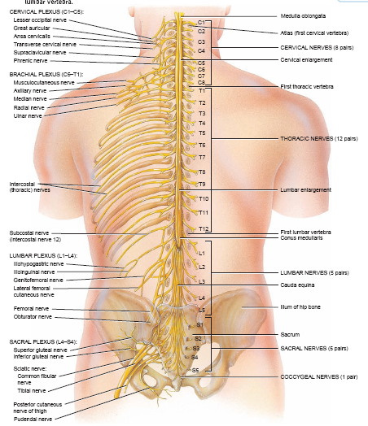

Slide 5
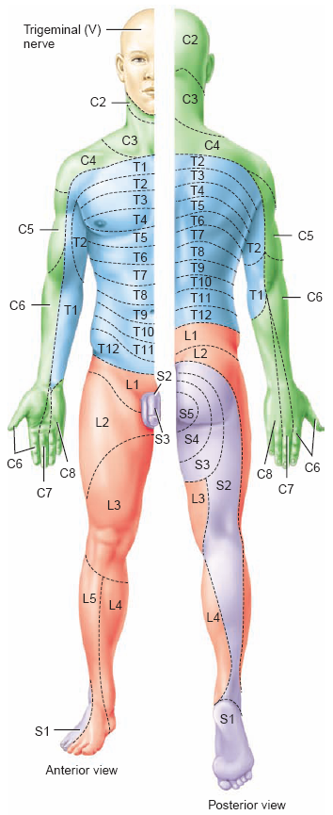
Dermatomes

Slide 6
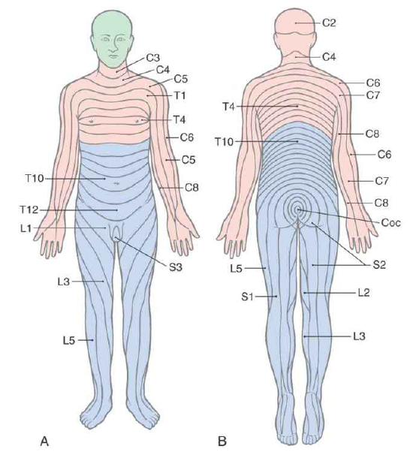
Dermatomes

Slide 7
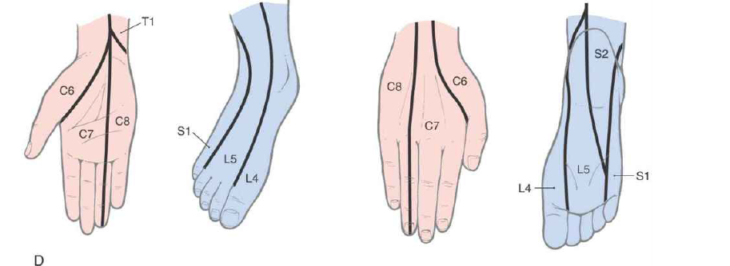
Dermatomes

Slide 8
Dermatomes
Shoulder (C5-C6)
Hand (C6-C8): 6= thumb the, 7= index finger, 8= small finger
Nipple (T4),
Umbilicus (T10),
Inguinal region (T12-L1),
Along the pelvic rim L1
knee (L3, L4),
The big toe (L4-L5)
The genitalia and anus (S4 and S5)

Slide 9
Visceral sensory & referred pain

Slide 10
Syringomyelia and the
ALS
Spinal cord
Hemisection and
the ALS

Slide 11
Visceral sensory & referred pain

Slide 12
Visceral sensory & referred pain

Slide 13
Visceral sensory & referred pain

Slide 14
Referred pain
right
Left
liver

Slide 15
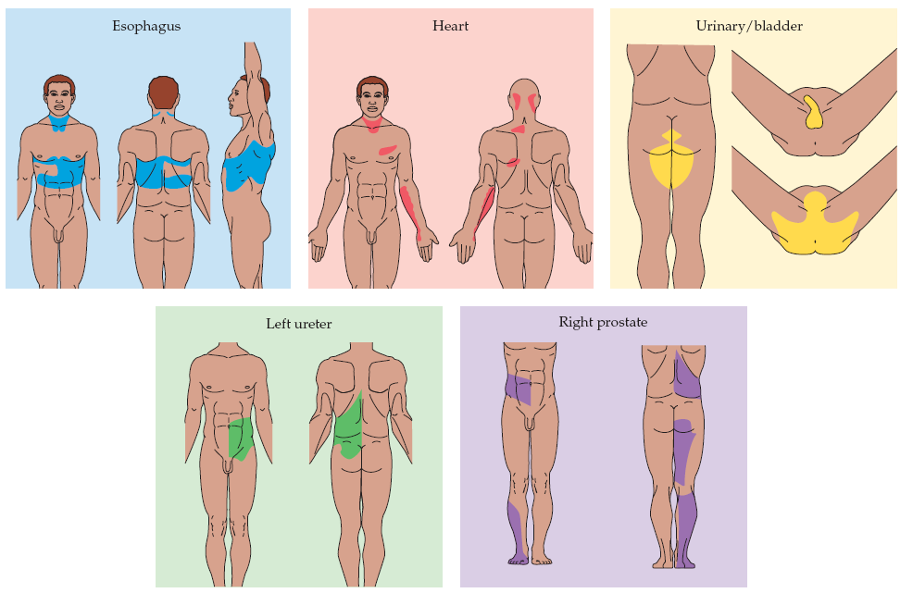
Visceral sensory & referred pain

Slide 16
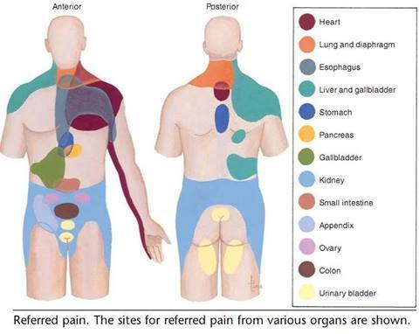
Visceral sensory & referred pain

Slide 17
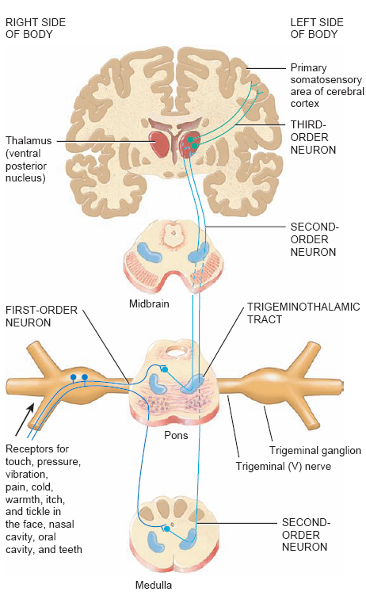
(Trigeminal system)
Carry all the sensation modalities from the face to the brain

Slide 18
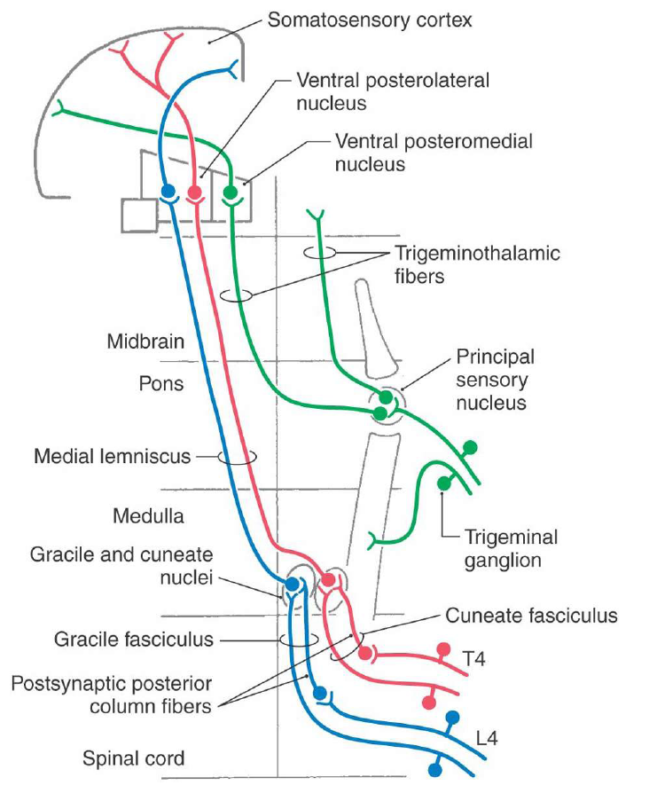

Slide 19
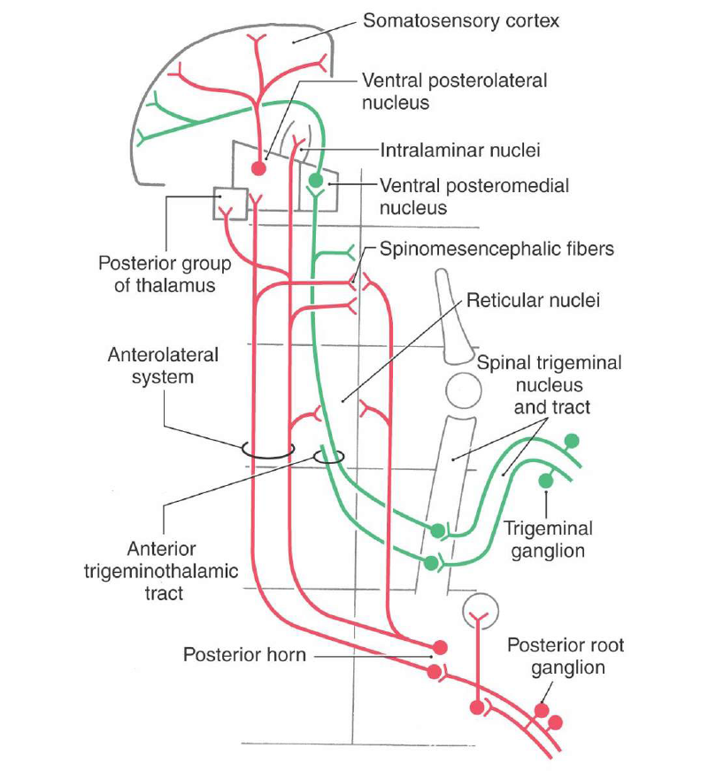

Slide 20
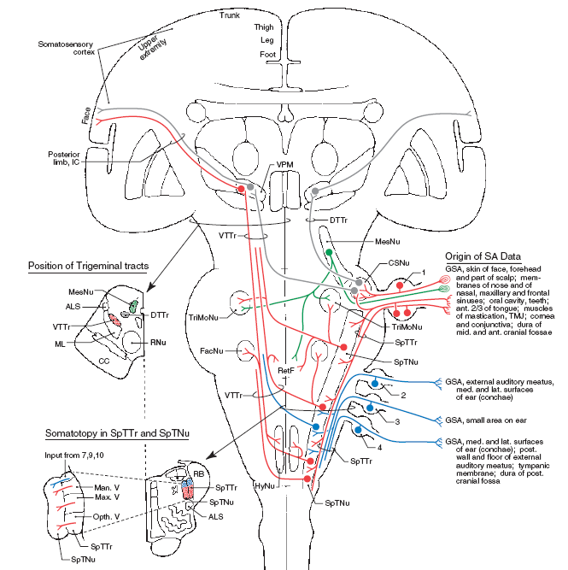

Slide 21
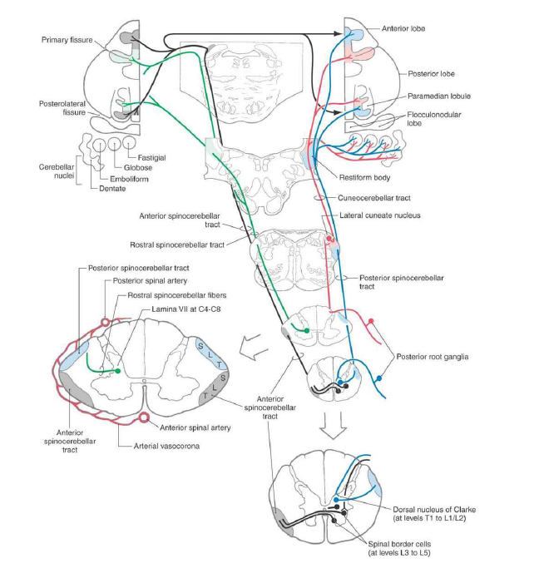
Posterior Spinocerebellar Tract
Cuneocerebellar Tract
Anterior Spinocerebellar Tract
Rostral Spinocerebellar Tract

Slide 22
TERMINOLOGIE
TERM | DESCRIPTION
ALLODYNIA | PERCEPTION OF NON-NOXIOUS STIMULUS AS PAIN
ANALGESIA | ABSENCE OF PAIN PERCEPTION
ANESTHESIA | ABSENCE OF ALL SENSATIONS
ANESTHESIA DOLOROSA | PAIN IN AN AREA THAT LACKS SENSATION
DYSESTHESIA | UNPLEASANT SENSATION WITH OR WITHOUT STIMULUS
HYPOALGESIA | DIMINISHED RESPONSE TO NOXIOUS STIMULUS
HYPERALGESIA | INCREASED RESPONSE TO NOXIOUS STIMULUS
HYPERASTHESIA | INCREASED RESPONSE TO MILD STIMULUS
HYPOASTHESIA | REDUCED CUTANEOUS SENSATION
NEURALGIA | PAIN IN THE DISTRIBUTION OF A NERVE
PARASTHESIA | ABNORMAL SENSATION PERCEIVED WITHOUT AN APPARENT STIMULUS
RADICULOPATHY | FUNCTIONAL ABNORMALITY OF NERVE ROOTS

