Slide 1
Antero-lateral system (ALS)

Slide 2
Sensations modalities
Fast
Slow
2-point discrimination
Vibration
Prorioception
Temperature
Crud touch (itch & rub)
Pain
Antero-lateral system (ALS)
Other name: Spinothalamic pathway

Slide 3
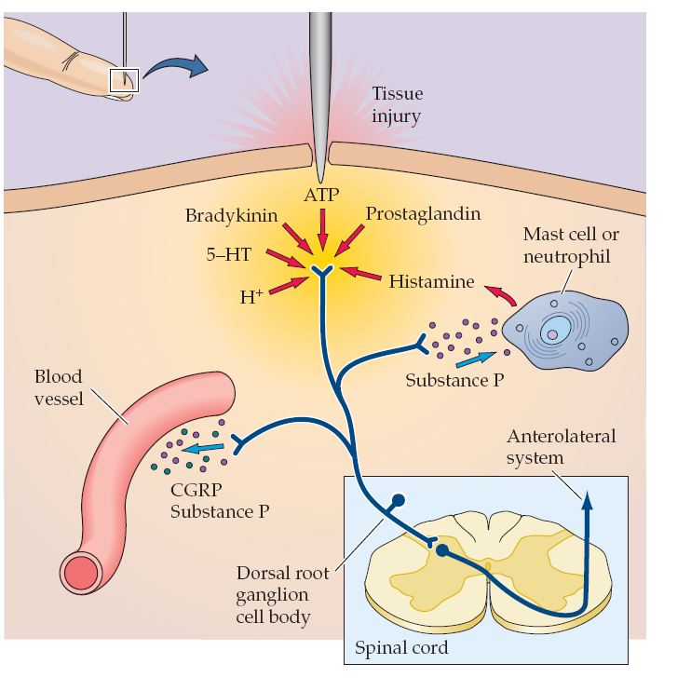

Slide 4
sensitization
hyperalgesia

Slide 5
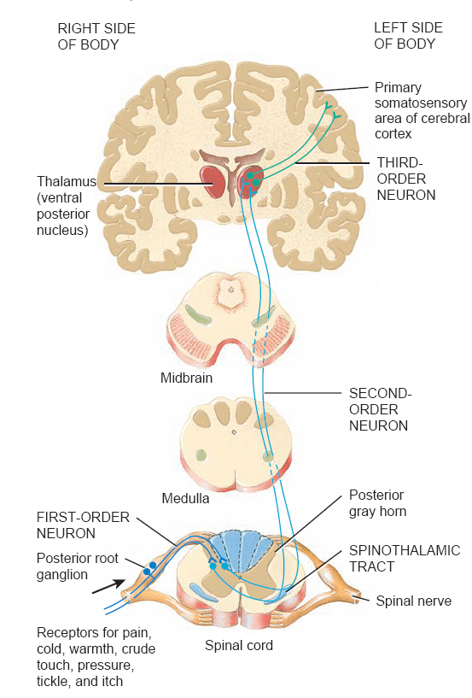

Slide 6
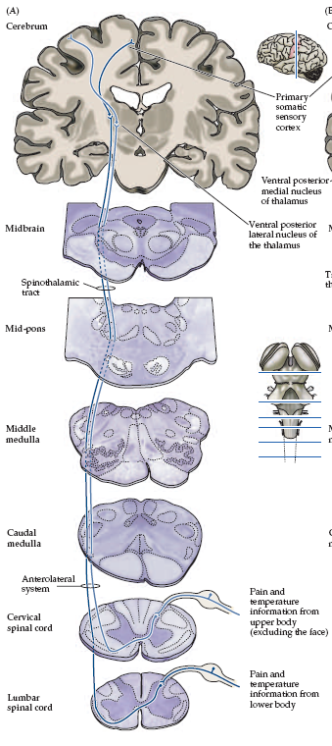

Slide 7
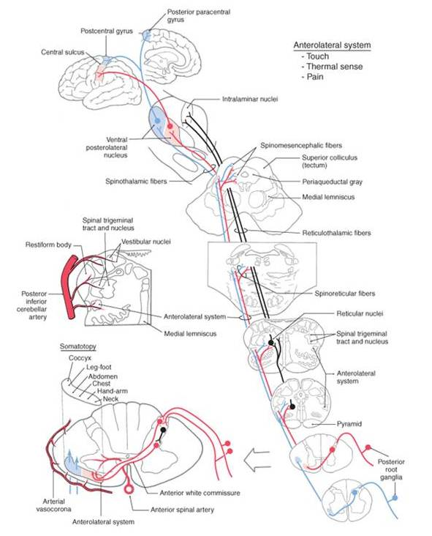
Text Fig. 18-9

Slide 8
Syringomyelia and the
ALS
Spinal cord
Hemisection and
the ALS

Slide 9
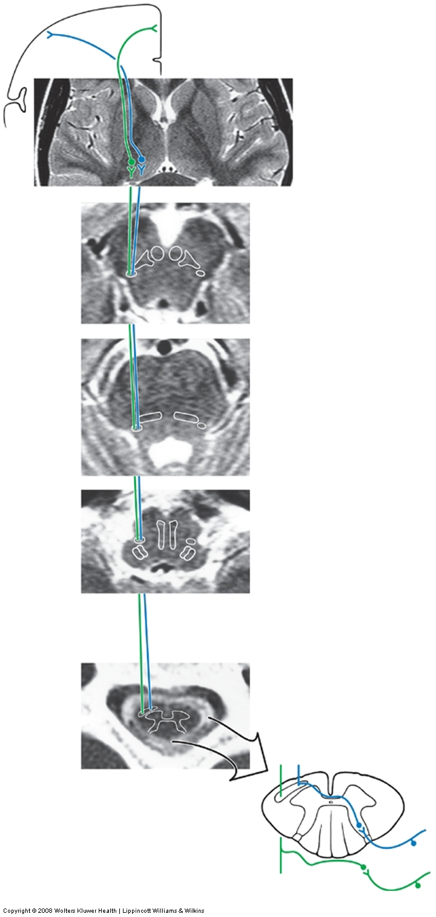
The ALS in the Spinal Cord, Medulla and Pons
Atlas Fig. 8-7A

Slide 10
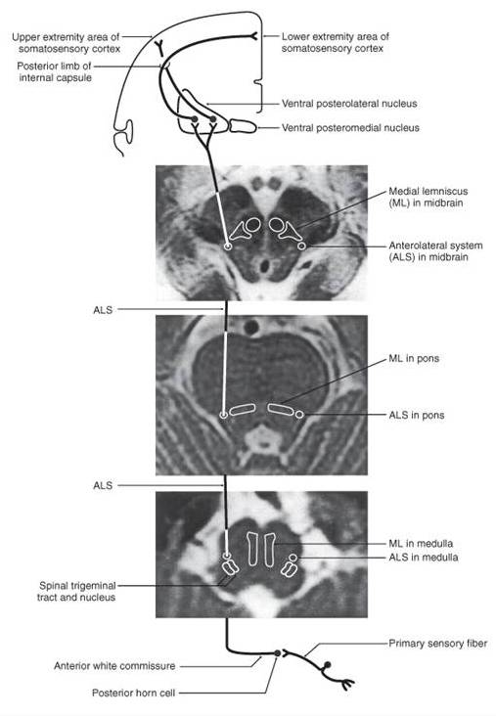
Text Fig. 18-11

Slide 11
The ALS in the Midbrain, Thalamus and
Cerebral Hemisphere
Atlas Fig. 8-7A

Slide 12
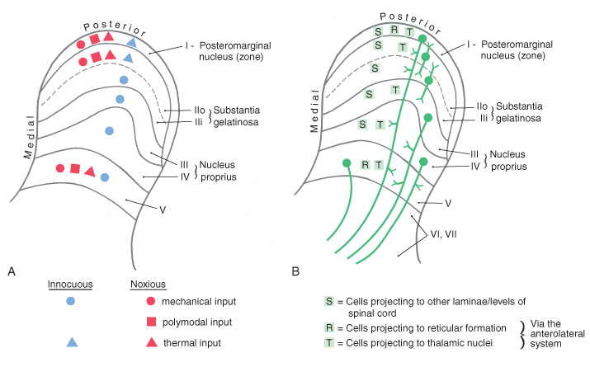
Text Fig. 18-7

Slide 13
ASCENDING PATHWAYS
ANTEROLATERAL System
SPINOTHALAMIC TRACT
originating neurones in laminae I, V, VI, IX
Neospinothalamic tract
project to VPL, VPM
synapse and project to somatosensory cortex
Paleospinothalamic tract
from deeper laminae
to thalamus (other nuclei) , midbrain, pontine and medullary reticular formation (Spinoreticular tract), periaqueductal grey (Spinomesencephalic tract), and hypothalmus (Spinohypothalamic tract)

Slide 14
ASCENDING PATHWAYS
Spinoreticular tract
projects to medullary and pontine reticular formation
involved in motivational and affective responses to pain
ascend medially to spinothalamic tract
Spinomesencephalic tract
project to caudal midbrain areas including periaqueductal gray
Spinohypothalamic tract

Slide 15
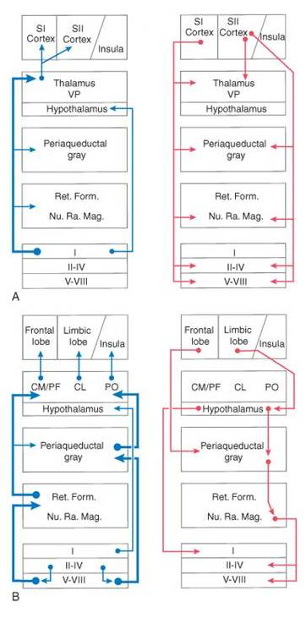
Text Fig. 18-19

Slide 16
Phantom limb
Deafferentation pain
Thalamic syndrom

Slide 17
deafferentation pain
posterior root entry zone) procedure

Slide 18
deafferentation pain
anterolateral cordotomy
Vs
posterior root entry zone) procedure

Slide 19
Spinocervicothalamic pathway

Slide 20
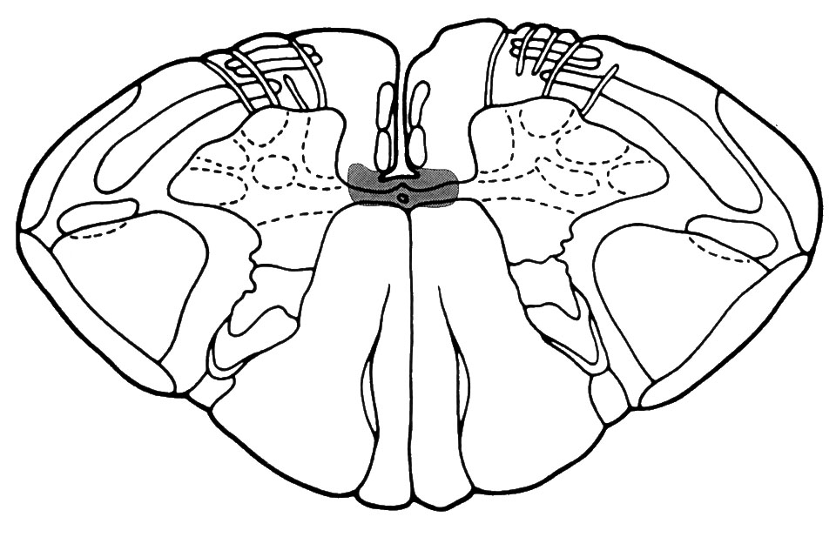
Case Study

Slide 21
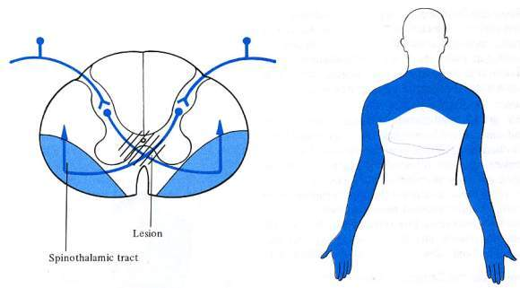
Syringomyelia

Slide 22
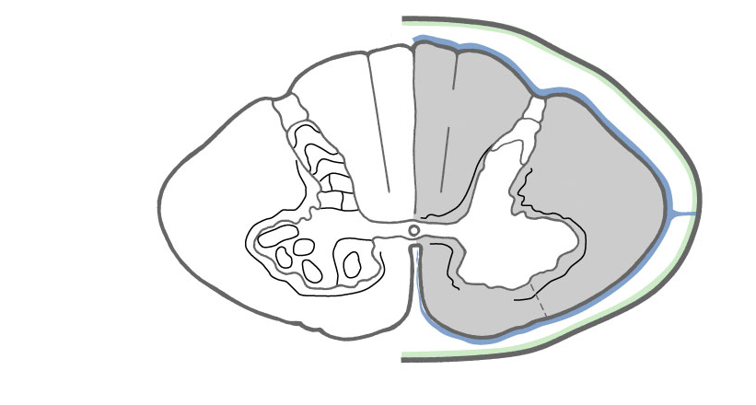
C5
C6
C7
Midline

Slide 23
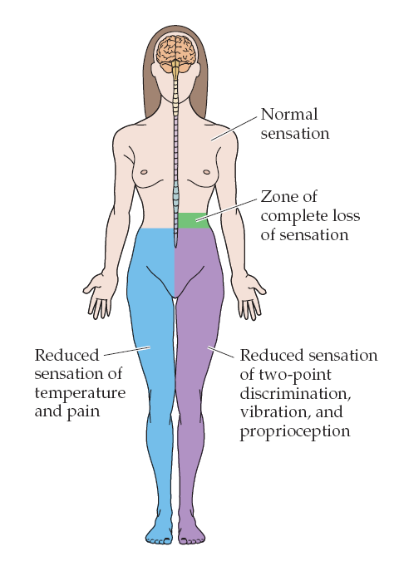

Slide 24
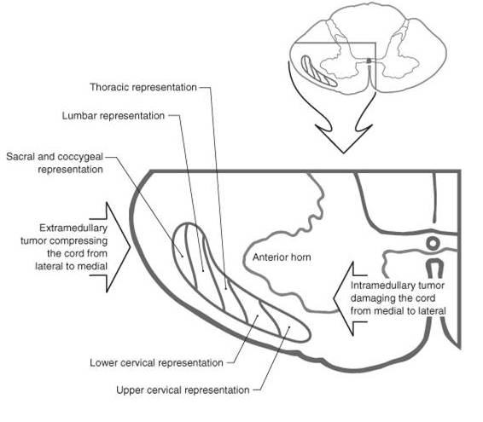

Slide 25
Dermatomes

Slide 26
Dermatomes

Slide 27
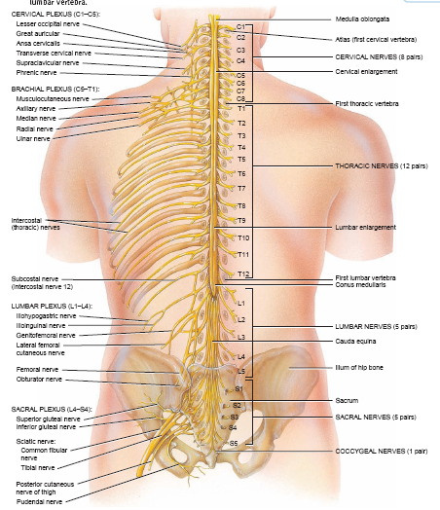

Slide 28
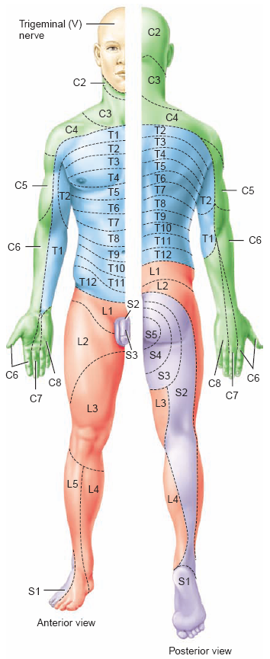
Dermatomes

Slide 29
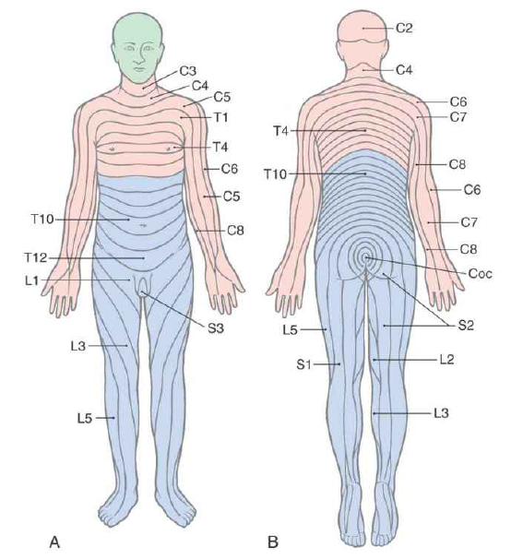
Dermatomes

Slide 30
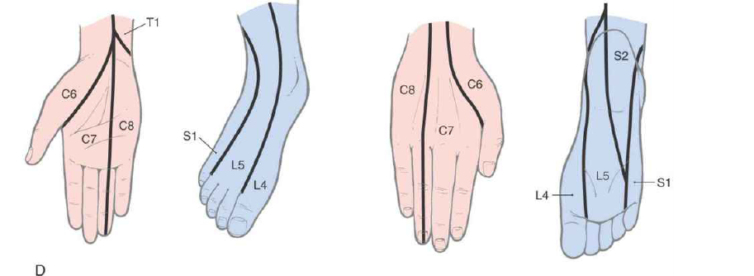
Dermatomes

Slide 31
Dermatomes
Shoulder (C5-C6)
Hand (C6-C8): 6= thumb the, 7= index finger, 8= small finger
Nipple (T4),
Umbilicus (T10),
Inguinal region (T12-L1),
Along the pelvic rim L1
knee (L3, L4),
The big toe (L4-L5)
The genitalia and anus (S4 and S5)

Slide 32
Visceral sensory & referred pain

Slide 33
Visceral sensory & referred pain

Slide 34
Visceral sensory & referred pain

Slide 35
Visceral sensory & referred pain

Slide 36
Referred pain
right
Left
liver

Slide 37
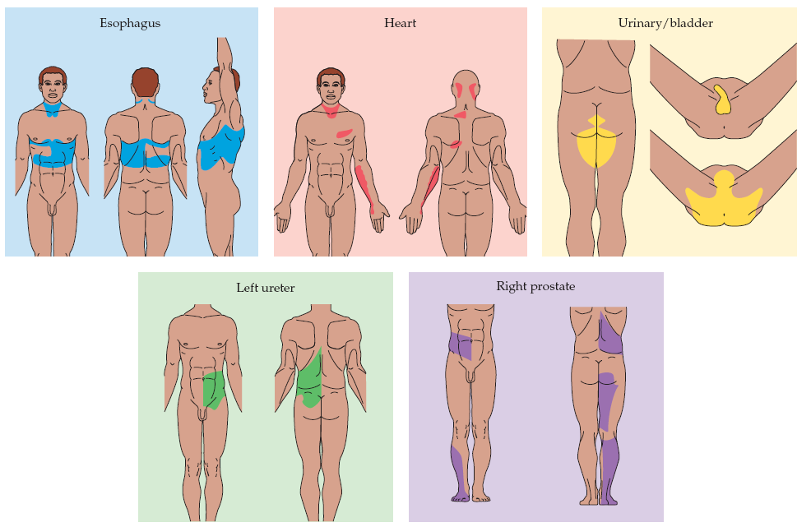
Visceral sensory & referred pain

Slide 38
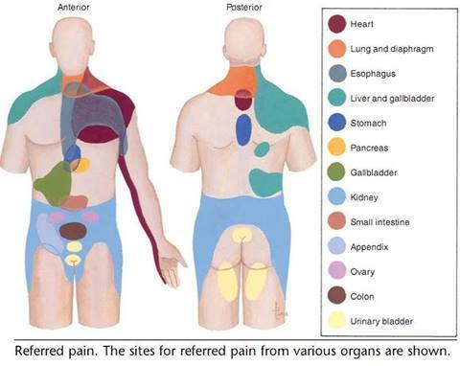
Visceral sensory & referred pain

Slide 39
TERMINOLOGIE
TERM | DESCRIPTION
ALLODYNIA | PERCEPTION OF NON-NOXIOUS STIMULUS AS PAIN
ANALGESIA | ABSENCE OF PAIN PERCEPTION
ANESTHESIA | ABSENCE OF ALL SENSATIONS
ANESTHESIA DOLOROSA | PAIN IN AN AREA THAT LACKS SENSATION
DYSESTHESIA | UNPLEASANT SENSATION WITH OR WITHOUT STIMULUS
HYPOALGESIA | DIMINISHED RESPONSE TO NOXIOUS STIMULUS
HYPERALGESIA | INCREASED RESPONSE TO NOXIOUS STIMULUS
HYPERASTHESIA | INCREASED RESPONSE TO MILD STIMULUS
HYPOASTHESIA | REDUCED CUTANEOUS SENSATION
NEURALGIA | PAIN IN THE DISTRIBUTION OF A NERVE
PARASTHESIA | ABNORMAL SENSATION PERCEIVED WITHOUT AN APPARENT STIMULUS
RADICULOPATHY | FUNCTIONAL ABNORMALITY OF NERVE ROOTS

