Slide 1
Physiology of the sensory system

Slide 2
Two-point discrimination
Number receptors / area
(receptive field of the receptor )

Slide 3
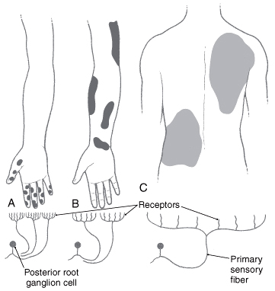
Text Fig. 17-3
Smaller the receptive fields, greater the density of receptors. This relationship allows for greater discrimination in sensory inputs.

Slide 4
Two-point discrimination
Number receptors / area
Pathway arrangement

Slide 5
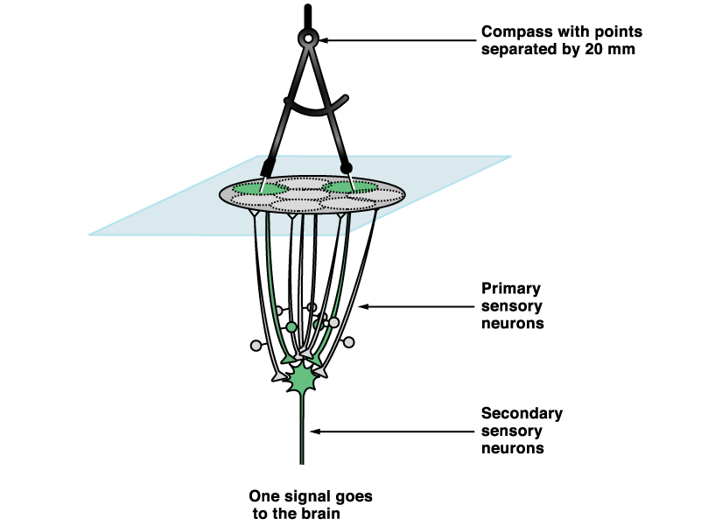
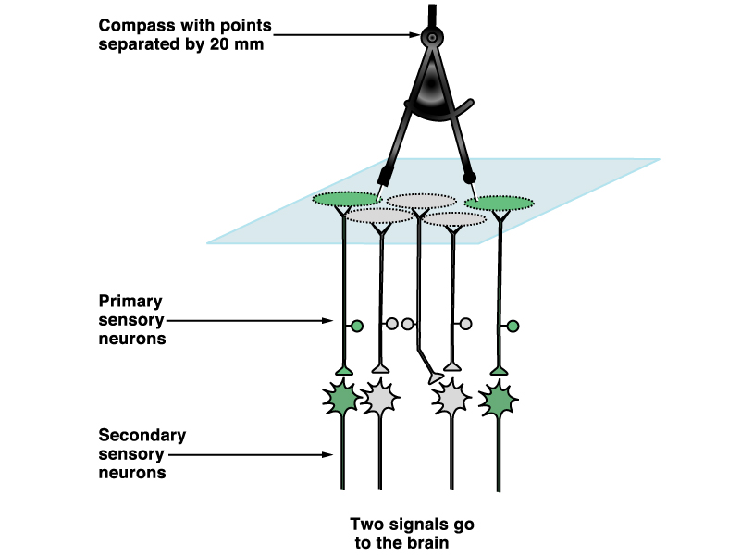

Slide 6
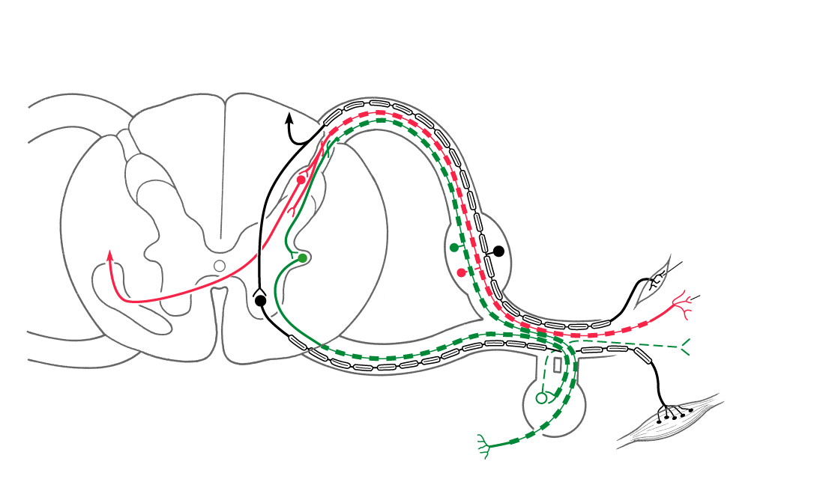
The Spinal Nerve
Text Fig. 9-6, Anatomical Orientation

Slide 7
Sensations modalities
Fast
Slow
2-point discrimination
Vibration
Prorioception
Crud touch (itch & rub)
Temperature
Pain
Posterior Column-Medial lemniscus
Pathway
(PCML)

Slide 8
Sensations modalities
Fast
Slow
2-point discrimination
Vibration
Prorioception
Temperature
Crud touch (itch & rub)
Pain
Antero-lateral system (ALS)
Other name: Spinothalamic pathway

Slide 9
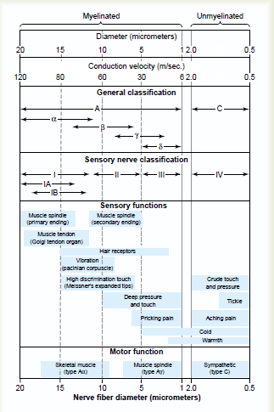

Slide 10
The Spinal Nerve
Text Fig. 9-6, Anatomical Orientation

Slide 11
Posterior Column-Medial lemniscus Pathway (PCML)

Slide 12
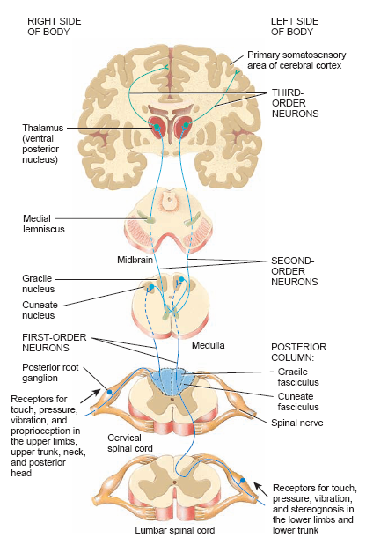

Slide 13
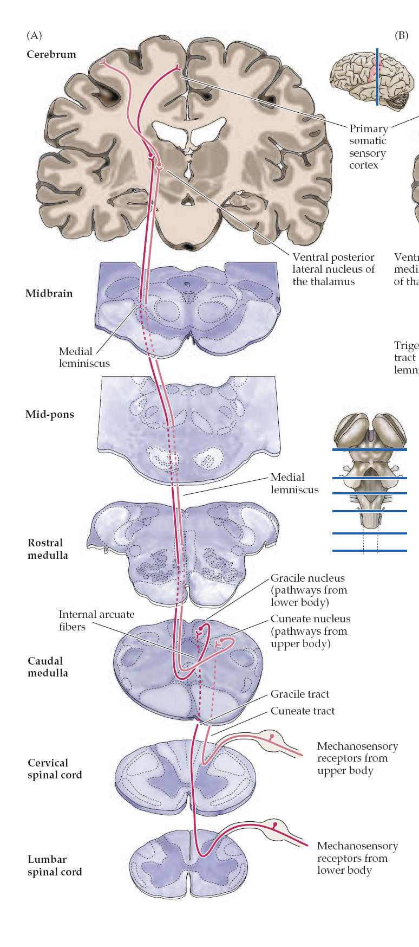
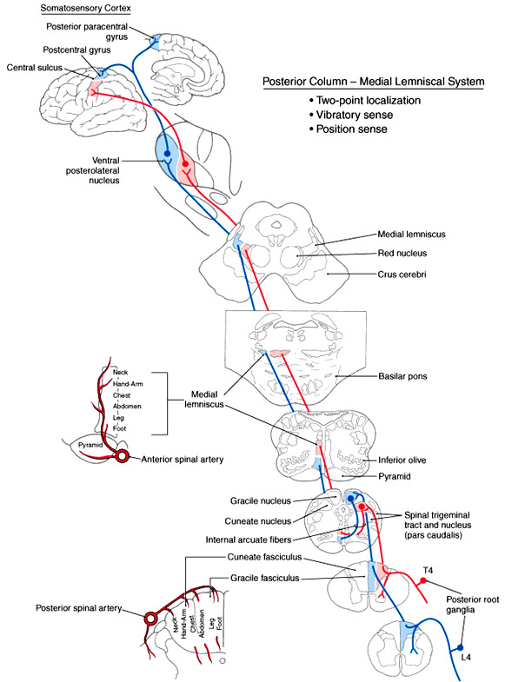

Slide 15
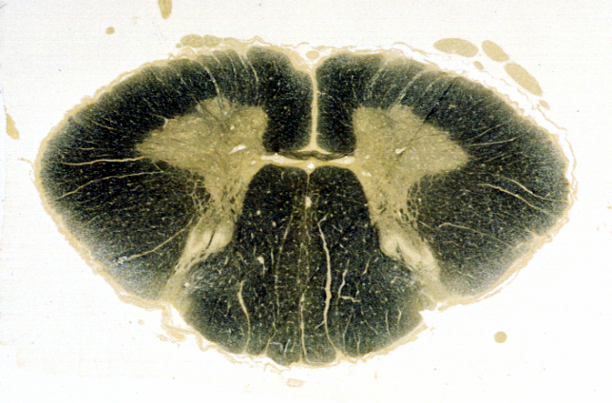
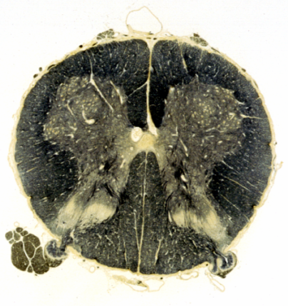
Ascending and Descending Tracts of the Spinal Cord
Cervical
Extremity (UE)
Thoracic
Lumbar
Extremity (LE)

Slide 16
PCML Pathway

Slide 17
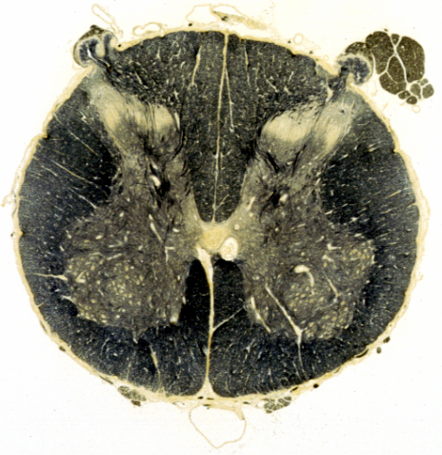
PCML Pathway

Slide 18
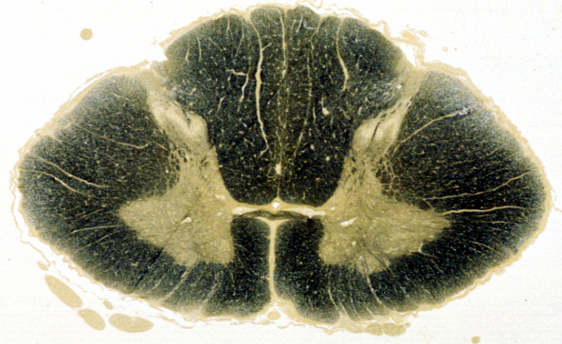
PCML Pathway

Slide 19
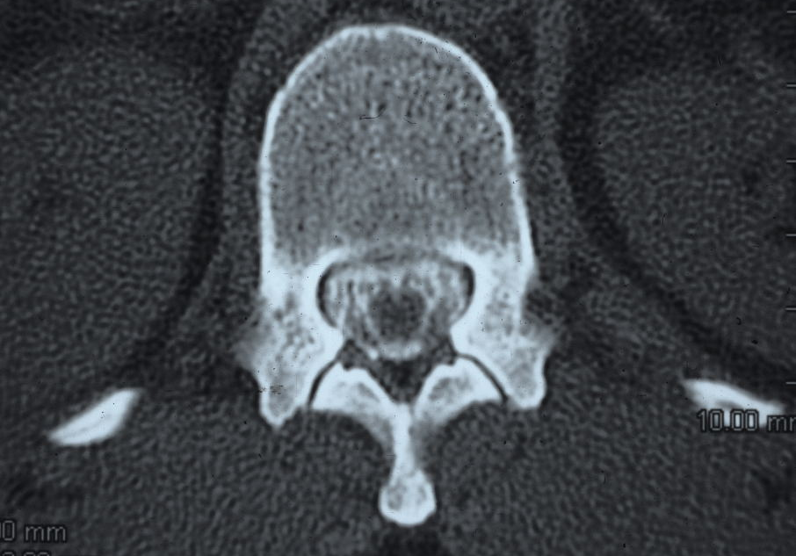
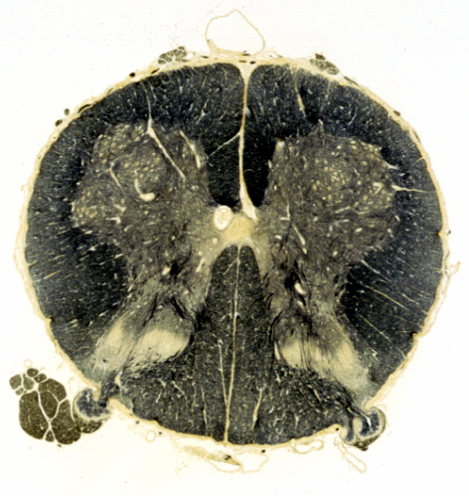
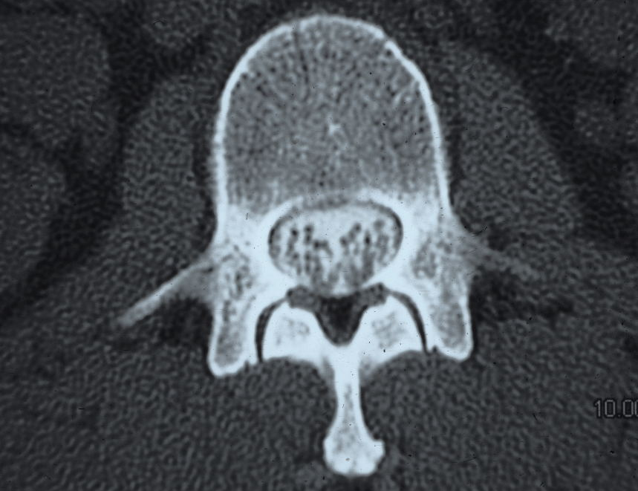
Lumbar Levels

Slide 20
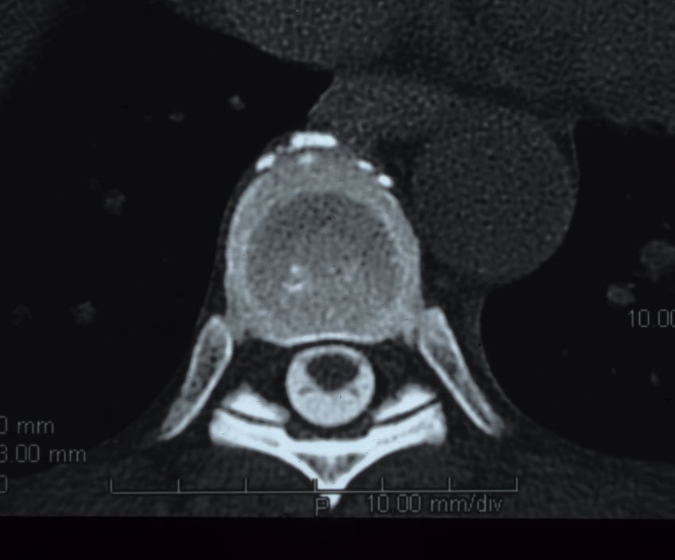
Thoracic Levels

Slide 21
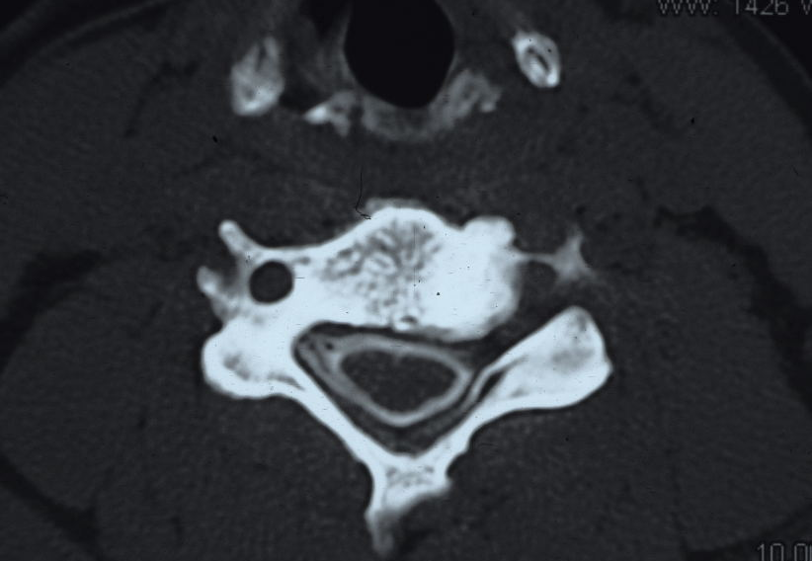
Cervical Levels

Slide 22
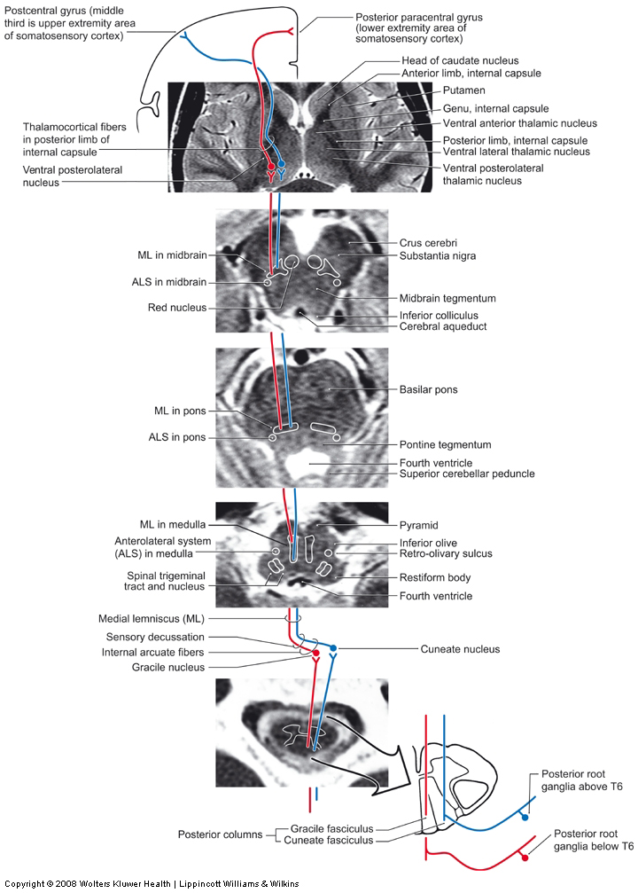
MRI of PCML

Slide 23
Somatotopic organization of (PCML)

Slide 24
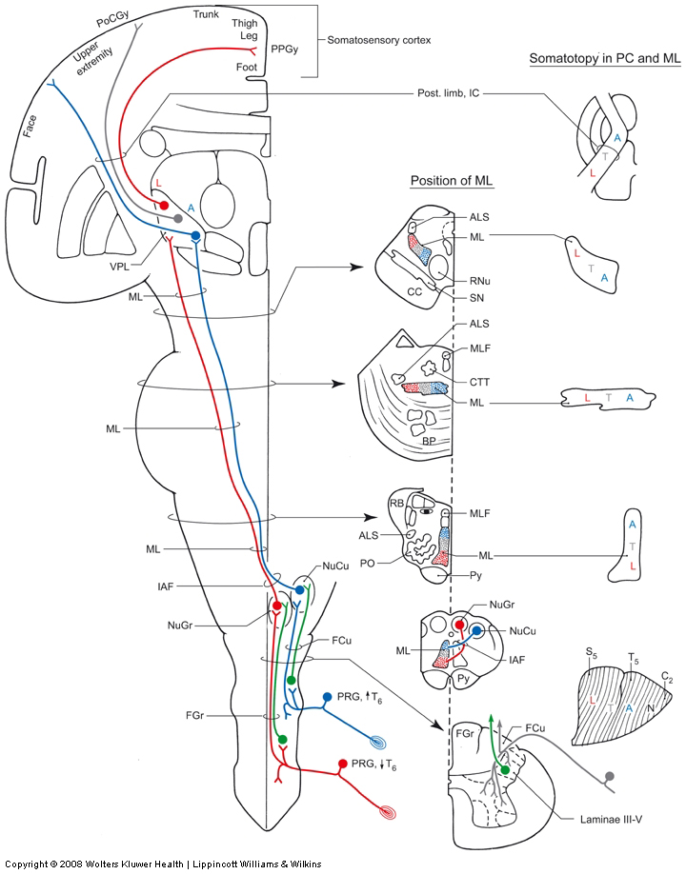

Slide 25
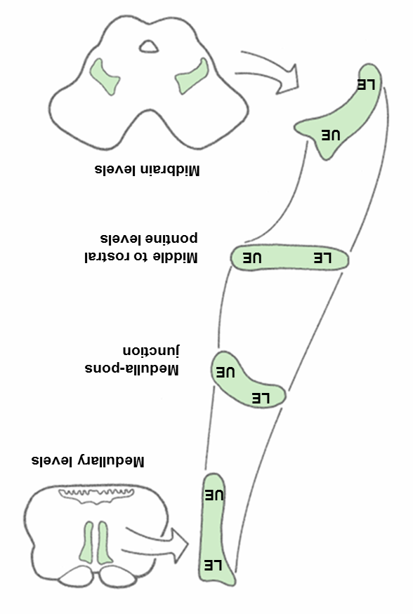

Slide 26
PCML Function
2-point discrimination
Vibration
Prorioception
STEREOGNOSIS
GRAPHESTHESIA
Help in movement and Wight recognition

Slide 27
PCML lesion associated symptoms
Loss of 2-point discrimination sensation
loss of Vibration sensation
Loss Prorioception sensation
ASTEREOGNOSIS / STEREOGNOSIA
AGRAPHESTHESIA
ABAROGNOSIS
SENSORY ATAXIA

Slide 28
PCML lesion associated symptoms
Loss of 2-point discrimination sensation
loss of Vibration sensation
Loss Prorioception sensation
ASTEREOGNOSIS / STEREOGNOSIA
AGRAPHESTHESIA
ABAROGNOSIS
SENSORY ATAXIA

Slide 29
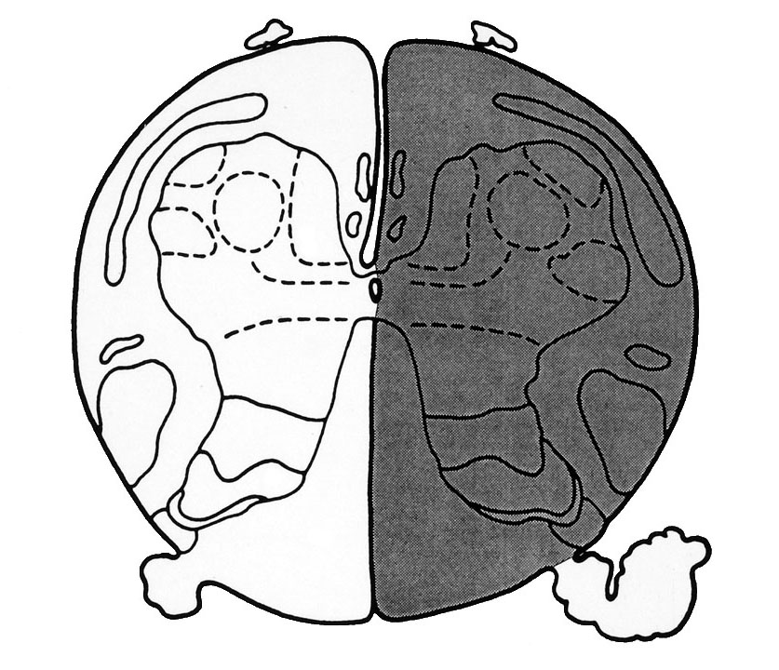
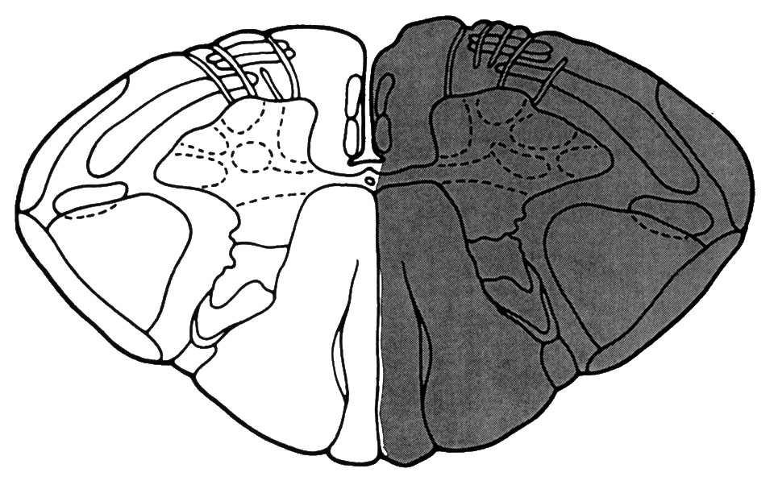
Case Study

Slide 30
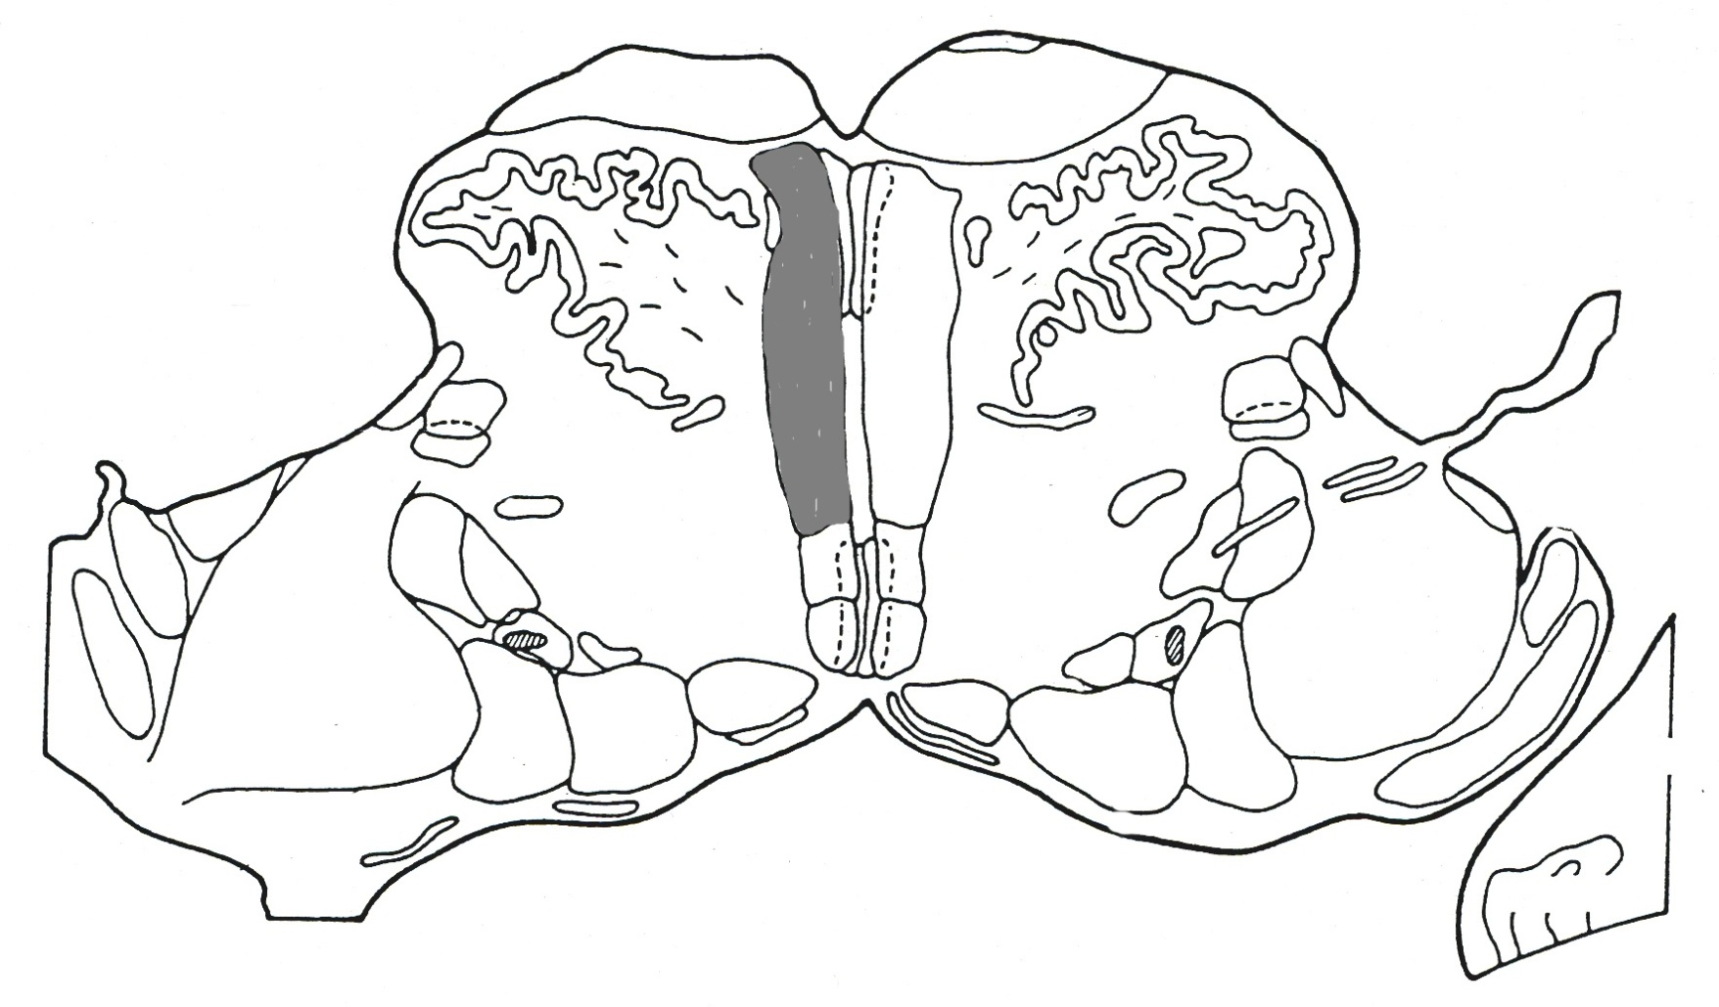
Case Study

Slide 31
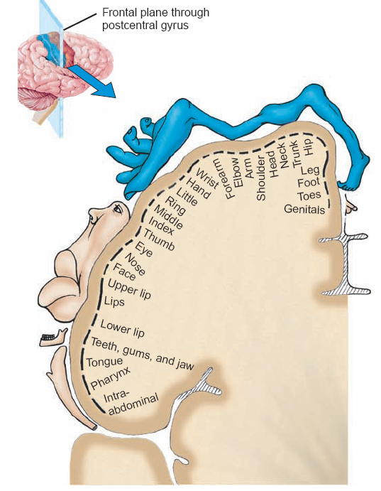

Slide 32
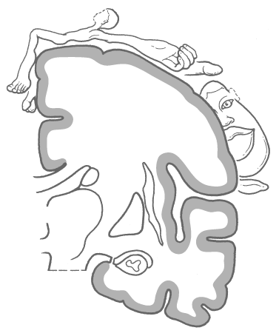
Relationship Between Receptive Fields
and Cortical Representation
Text Fig. 17-3
Text Fig. 17-12
Smaller the receptive fields, greater the density of receptors. This relationship allows for greater discrimination in sensory inputs.
Inverse relationship in the cortex. Smaller the receptive fields larger the cortical area Larger the receptive fields smaller the cortical area

Slide 33
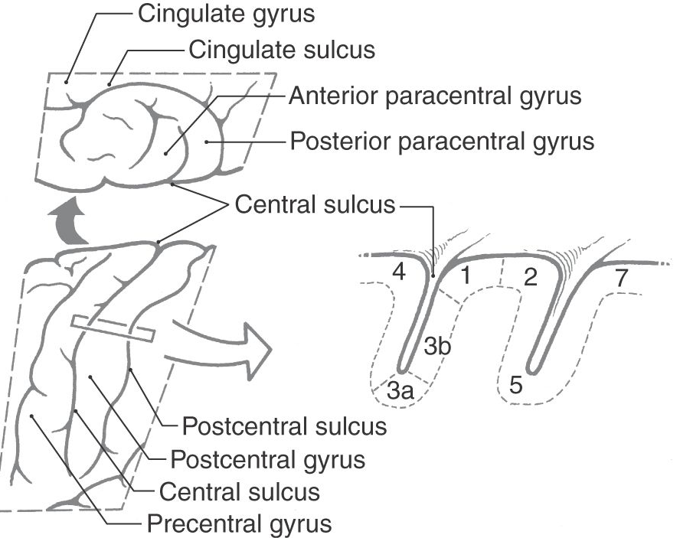

Slide 34
Stocking-glove sensory loss
tabes dorsalis

