Slide 1
The Vestibular System

Slide 2
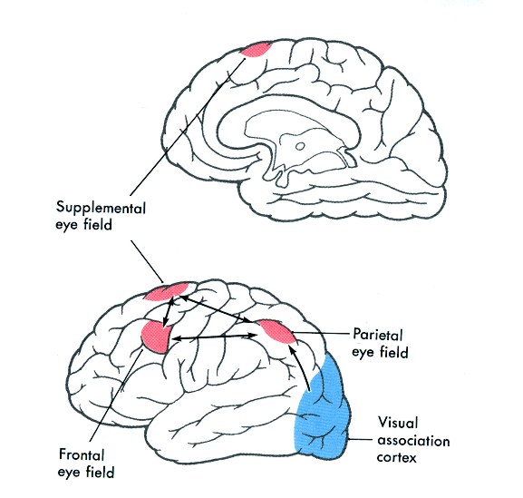
Fig. 28-13

Slide 3
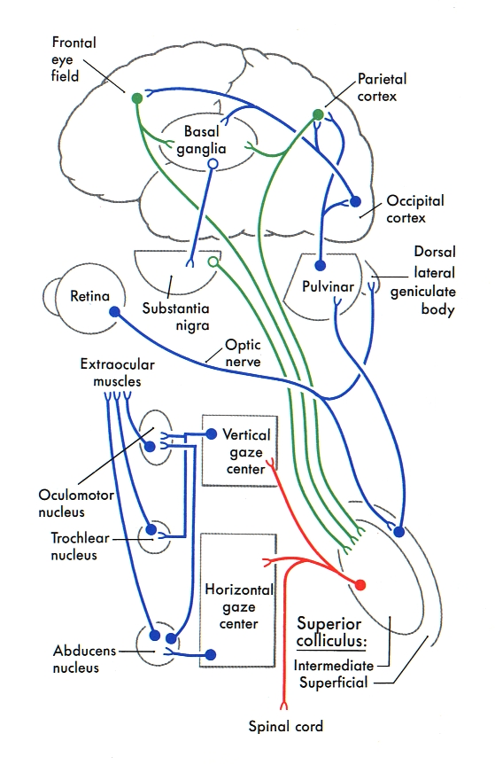
Basic pathway
for controlling
saccadic eye
movements

Slide 4
MLF

Slide 5
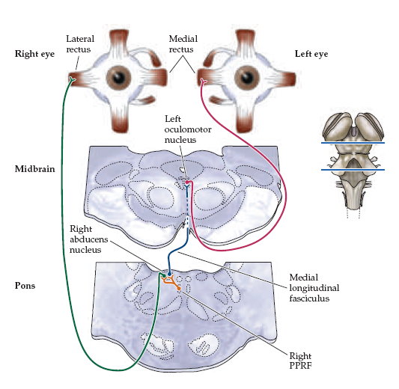

Slide 6
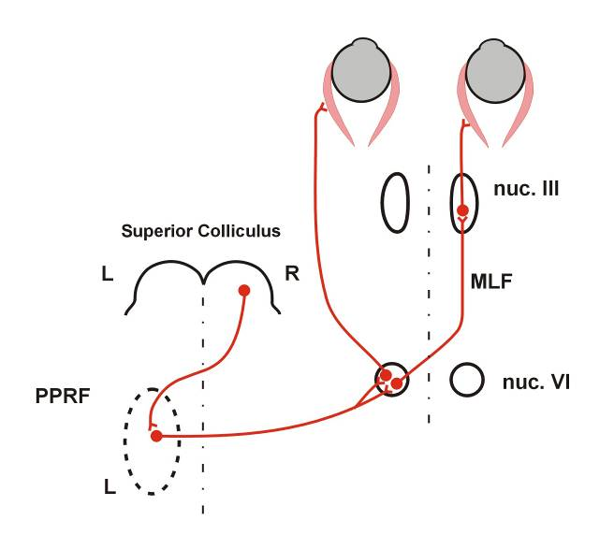
L
R
L
R

Slide 7
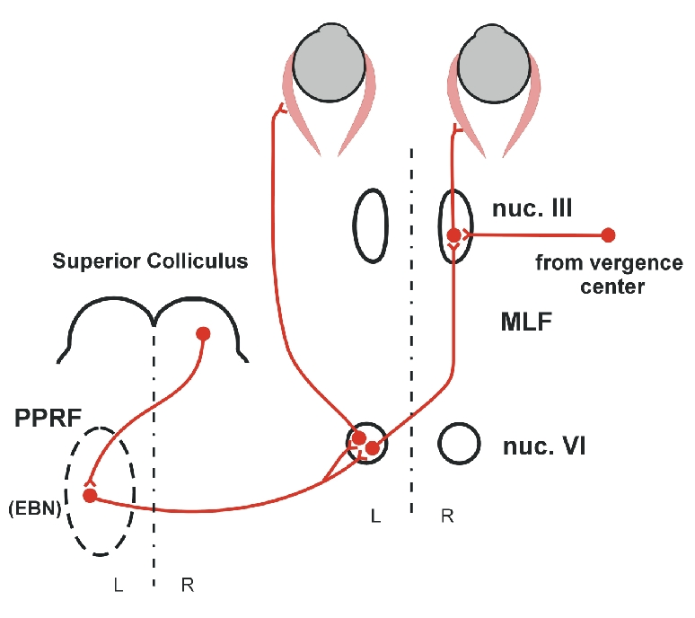
L
R
Disconjugate
eye
movements
Conjugate
eye
movements

Slide 8
L
R
X
Disconjugate
eye
movements
Conjugate
eye
movements
Internuclear Ophthalmoplegia

Slide 9
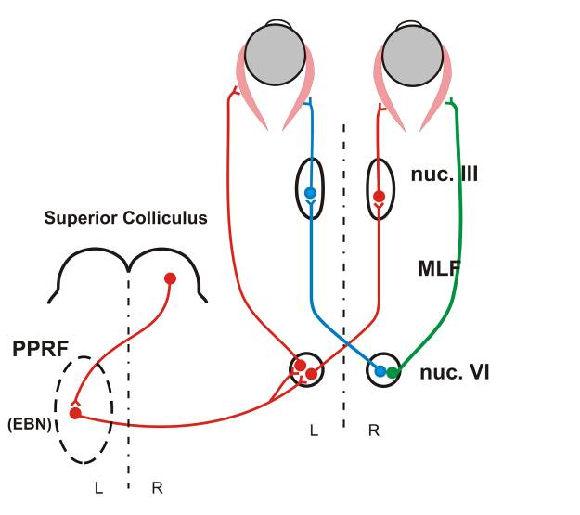
L
R
ONE-AND-A-HALF SYNDROME

