Slide 1
Venous Thromboembolism Update
By Maisa Mansour, MD
Jordan University
Faculty of medicine
Pulmonary medicine
6/2/2017

Slide 2
Pulmonary Embolism General introduction
A pulmonary artery embolism is defined as a partial or complete occlusion of a pulmonary arterial branch.
Approximately 70% of cases are caused by pelvic or leg veins thromboses .
Deep vein thrombosis and PE are different presentations of the same underlying pathophysiological event, venous thromboembolism (VTE).
Dtsch Arztebl Int. Aug 2010; 107(34-35): 589–595

Slide 3
PE
Pulmonary Embolism has been recognized as the third most common cardiovascular disorder in industrialized countries.
About 79% of patients who present with PE will have concomitant DVT, conversely , only 50% of those with DVT will have PE.

Slide 4
Most thrombi originate from soleal veins of the calf, at sites of decreased blood flow.
Majority of these calf thrombi resolve spontaneously.
But 20% to 30% of DVTs propagate to popliteal, femoral or iliac veins.
Additional 10% to 20% of all DVTs occur in proximal veins without prior calf DVT
Iliofemoral thrombosis appear to be the source of most clinically apparent PEs.

Slide 6
Epidemiology
PE is a major cause of death in the United States, with estimated annual incidence of VTE about one episode per 1000 patients.
As many as 3 million people die each year from acute PE.
•>400,000 diagnoses of PE are missed in the United States annually.
•Most deaths from PE are due to failure to diagnose rather than failure to treat adequately.

Slide 7
Epidemiology
Mortality is 30% if untreated, and 8% if treated.
In 25% of PE, the initial manifestation is death.

Slide 8
Risk Factors
Virchow’s triad
Stasis
Venous injury/endothelial damage
Hypercoagulability
Most patients have several of these…

Slide 9
Risk Factors
Inherited
Congenital or hereditary hypercoagulable state.
Factor V leiden (activated protein C resistance ) .
Prothrombin gene mutation ( G20210A mutation ).
Low protein C, protein S, antithrombin III
Family history of VTE
Acquired
Age
--smoking
Obesity
immobility
Malignancy
Antiphospholipid antibody syndrome [venous and arterial]
Hyperhomocysteinemia [venous and arterial]
Oral contraceptive pills or hormone replacement therapy.
Trauma, surgery, hospitalization
Infection
Long haul air travel
Electronic leads, indwelling catheters

Slide 10
Acute PE: Pathophysiology
Gas exchange abnormalities
Right to left shunt
Leads to…
Hypoxemia
Increased A–a gradient.
V/Q mismatch.
Increased dead space
Respiratory alkalosis from hyperventilation
Often a sign of increased dead space and impaired minute ventilation
may suggest massive PE

Slide 11
The term hypercoagulability refers to abnormal fibrinolytic system pathways
Or
aquired and congenital deficiencies of functional abnormalities that predispose the patient to VTE.

Slide 12
Acute PE: Pathophysiology
Hemodynamic abnormalities
Depends on size of embolus
Increased vascular resistance/RV afterload
May cause RV dilation, then, FAILURE

Slide 13
Diagnosis Symptoms and Signs
Symptoms
Dyspnea
Chest pain (pleuritic)
Apprehension
Cough
Hemoptysis
Syncope
Palpitations
Wheezing
Leg pain
Leg swelling
Signs
Tachycardia
Tachypnea
hypoxemia
Accentuated S2
Fever
Diaphoresis
Signs of DVT
Cardiac murmur
Jugular venous distention
Cyanosis
Hypotension

Slide 14
The diagnostic pathway of acute PE is guided by 2 principles:
1 - accurate and fast identification of patients who have PE is critical because PE is a potentially fatal condition and anticoagulation is associated with the risk of major bleeding.
2 - A false diagnosis thus exposes patients to unnecessary risk of death from PE or of bleeding, which can also be fatal.

Slide 15
Diagnostic Approach of PE
Suspicion of PE.
Clinical probability.
Non Diagnostic but are Helpful tests.
Diagnostic Tests
Severity of PE

Slide 16
Clinical Probability
Low Probability
Intermediate
High Probability

Slide 17
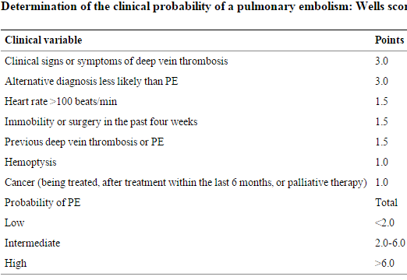
Dtsch Arztebl Int. Aug 2010; 107(34-35): 589–595.

Slide 18
.
Diagnostic strategy
starts with:
The assessment of clinical probability.
Then
2. Either D-dimer testing or CTPA: safe and effective management strategy for patients with a suspected first or recurrent acute PE
Strict adherence to this algorithm which has been validated in many high-quality trials evaluating well
over 5000 consecutive patients, will limit the number of unnecessary imaging tests by 20% to 30%, with an associated reduction in health care costs and complications.

Slide 19
Diagnosis Laboratory Evaluation
D-dimer
Non specific measure of fibrinolysis
High sensitivity (positive in presence of dz)
High negative predictive value (dz is absent when test is negative) in the outpatient setting
Useful in outpatient setting/emergency room, not an inpatient test for ruling out PE

Slide 20
Diagnosis Chest XR
CXR
Most often normal
May show collapse, consolidation, small pleural effusion, elevated diaphragm.

Slide 21
Diagnosis V/Q scans
Old standard
Currently reserved for
Renal impairment
IV contrast allergies
Pregnancy

Slide 22
Diagnosis CT scan – New Standard
Data suggests CT is as accurate as invasive angiography (gold standard)
Negative predictive value of 99%
Quiroz et al, JAMA 2005

Slide 23
What is CT with PE protocol?
Spiral CT
Larger dose of Contrast
Rapid rate of contrast
Effective dose at pulmonary CT angiography, without significant loss of objective or subjective image quality.

Slide 24
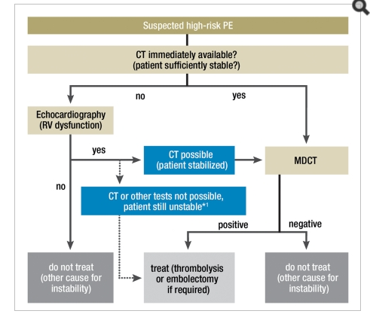
Dtsch Arztebl Int. Aug 2010; 107(34-35): 589–595

Slide 26
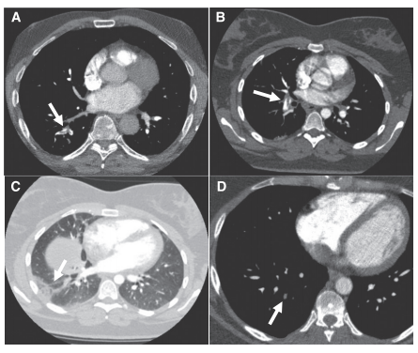

Slide 27
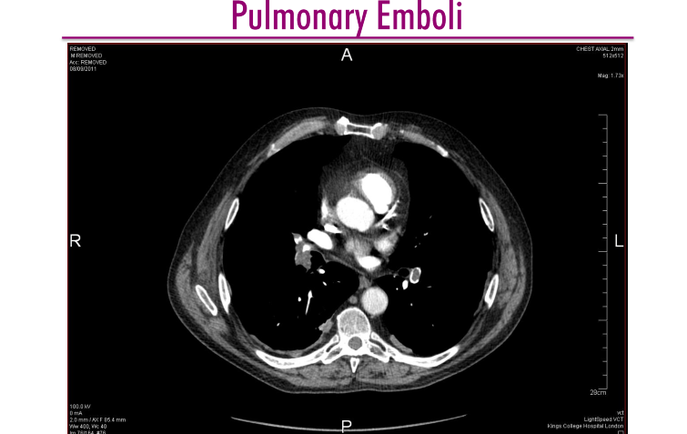

Slide 28
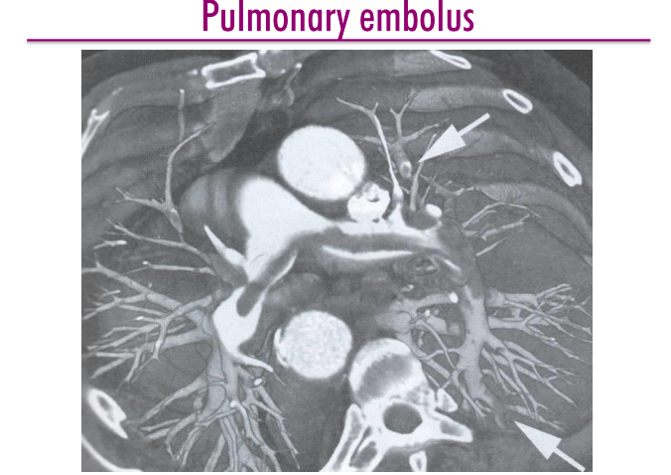

Slide 29
ECHO for Risk Stratification
Insensitive for diagnosis but can risk stratify in patients with known PE
In normotensive patients RV dysfunction is an independent risk factor for early death

Slide 30
Risk stratification algorithm
Hemodynamically stable/no shock
Unstable/shock
BNP BNP (RV on CT)
Troponin troponin
(RV on CT)
ECHO
No RV dysfunction RV dysfunction
anticoagulation
Fibrinolysis, embolectomy

Slide 31
Severity of PE

Slide 32
Classification according to severity
High Risk
- Hemodynamically Unstable with SBP<90 mmHg or drop in SBP>45mmHg IN 15 minutes.
- Early mortality is 15%.
Non High Risk ( According to RVD and Myocardial injury)
- Intermediate Risk
- Low Risk
Eur Heart J. 2008;29(18):2276–2315

Slide 35
Intermediate Risk
Mortality 3-15%.
Diagnosed when you have one of:
- Markers of RVD which includes:
1. RVD or hypokinesia or RV load by ECHO.
2. Dilated RV by Spiral CT.
3. Elevated BNP
4. High RV Pressure
- Marker of myocardial Injury (High Troponin I or T)
Eur Heart J. 2008;29(18):2276–2315.

Slide 36
Low Risk
Mortality < 1%
When all markers of RVD and Myocardial injury all are found to be negative.
Eur Heart J. 2008;29(18):2276–2315.

Slide 37
Treatment Goals
Prevent Death
Restore Hemodynamic Stability.
Prevent Recurrence
Prevent Post Thrombotic Syndrome.

Slide 38
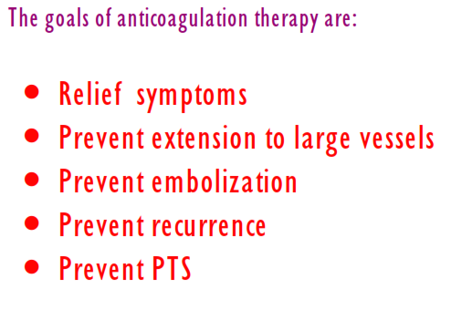

Slide 42
Treatment of Haemodynamically stable patient with VTE
When patients present with acute VTE they should be started on:
1-parenteral anticoagulation therapy with IV unfractionated heparin (UFH)
2-or subcutaneous low molecular weight Heparin.
3- or the Pentasaccharide Fondaparinux

Slide 43
Oral Warfarin therapy can be initiated on the first day of treatment .
Then treatment with both agents continued for at least 5 days and until the INR stays in the therapeutic range of 2 – 3 for 2 consecutive days ( at which time the heparin and Fondaparinux can be discontinued )

Slide 45
DOAC
Many recent studies showed the efficacy and safety of the direct oral anticoagulants .
(DOAC) includes:
- Dabigatran: oral direct Thrombin inhibitor
- Rivaroxaban and Apixaban : oral direct factor Xa
inhibitor.

Slide 46
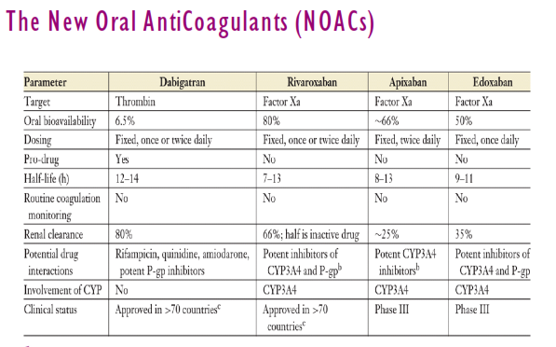

Slide 47
DOAC
DOAC may eventually replace heparin and VKA for both prevention and treatment of VTE in the near future.

Slide 48
DOAC
The current guidelines do not recommend use of these agents over Warfarin or other VKA secondary to the lack of long term safety data.

Slide 49
What is the role of the new oral agents in the management of acute PE?
Currently Rivaroxaban ( Xarelto ) can be considered an option for the acute management of haemodynamically stable patients with PE within its product license.( in 2012 it was FDA approved for treatment and prevention of VTE)

Slide 50
What is the role of the new oral agents in the management of acute PE?
Dabigatran (Pradaxa) was initially approved by FDA in 2010 to reduce the risk of stroke and systemic embolism in patients with non- valvular AF.
Then in 2014 Pradaxa was FDA approved for treatment and prevention of PE and DVT.

Slide 52
What is the main disatvantage?
No Antidote
?????

Slide 53
DOAC
In 2015 FDA approved Praxbind ( idarucizumab) specific reversal agent for Pradaxa (Dabigatran ).

Slide 54
To whom shouldn’t be given?
Patients with:
Severe renal failure with e GFR<30.
High Liver Enzymes.
Non compliant patients.
Concomitant AF caused by Valvular Heart Disease.

Slide 55
Management of massive PE
Definition of massive PE ( PE guidelines from the AHA 2011):
Acute PE with sustained hypotension ( systolic BP < 90 mmHg for at least 15 minutes or requiring inotropic support , not due to a cause other than PE , such as arrhythmia , hypovolemia, sepsis, or LV dysfunction) ,pulselessness, or persistent profound bradycardia ( HR <40 bpm with signs or symptoms of shock).

Slide 56
Management of massive PE.
Definition of submassive PE ( PE guidelines from AHA 2011 ) :
Acute PE without systemic hypotension ( systolic BP > 90 mmHg ) but with either;
- RV dysfunction by Echo, CT , high BNP, high N-terminal pro BNP, ECG.
- myocardial necrosis ( high troponin I, or troponin T)

Slide 57
So
The definition of massive PE is based on hemodynamic considerations rather than anatomical ones.
Although anatomically massive emboli are more likely to be associated with hemodynamic compromise , NOT all anatomically massive emboli lead to circulatory insufficiency .

Slide 58
Irrespective to the degree of vascular obstruction, patients with PE who present with shock have a mortality rate of 30% , regardless of the type of intervention.
Murray & Nadel’s

Slide 59
Thrombolytic therapy
STILL …..Controversial.??????????

Slide 60
Thrombolytic therapy
Is approved for the treatment of proximal DVT and massive PE.
They dissolve thrombi by activating plasminogen into plasmin.
STK ,urokinase, and tPA are approved in the USA.

Slide 61
Thrombolytic therapy
In DVT it is associated with decreased pain and swelling and decreased incidence of postphlebitic syndrome.
In PE they produce more rapid resolution of intravascular abnormalities,.
However, no proven effect on mortality has yet been demonstrated.

Slide 62
Suggestive approach in sub massive PE
In sub massive PE Thrombolysis would not routinely administered.
PESI score and the presence or absence of single or multiple poor prognostic factors should be balanced against factors associated with increased risk of bleeding (including age) in identifying suitable candidates for thrombolysis.
Thorax. Feb 2014; 69(2): 174–180

Slide 63
What is the risk of thrombolysis?
Major bleeding occurred in >50% of patients receiving thrombolysis within 1 week of surgery and in 20% of patients thrombolysed 1–2 weeks postoperatively.
American College of Chest Physicians (ACCP) guidelines suggest that recent surgery (excluding recent brain or spinal surgery or trauma) is a relative contraindication and that the bleeding risk reduces significantly 2 weeks after surgery.

Slide 64
A patient with an acute cerebral infarct is found to have an acute PE: what should I do regards anticoagulation?
To anticoagulate all patients with a cerebral infarct and PE.
In patients with PE with a primary haemorrhagic stroke or recent significant haemorrhagic transformation consider inferior vena cava (IVC) filter insertion and delayed anticoagulation.

Slide 65
Which patients in an arrest or peri-arrest situation should I consider thrombolysing in the absence of definitive radiological evidence of PE?
Thrombolysis should be administered in the peri-arrest or arrest situation when PE is either known or suspected.

Slide 66
Surgical Alternative of Thrombolytics
No comparative data exist to guide primary management of massive PE in the presence of a strong contraindication to systemic thrombolysis.
Management is dependent on local availability of cardiothoracic surgery and catheter-based therapy.

Slide 67
Management of a pregnant patient with significant PE?
Therapeutic LMWH is the anticoagulant of choice in pregnancy.
Systemic thrombolysis should be administered for massive PE in pregnancy;
However if bleeding risk is high (eg, in the peripartum period) then surgical or mechanical methods are suggested, depending on local availability.

Slide 68
Thank You

