Slide 1
Ovarian Pathology

Slide 2
POLYCYSTIC OVARIES (also called Stein-Leventhal syndrome).
oligomenorrhea, hirsutism, infertility, and obesity
usually in girls after menarche
secondary to excessive production of androgens by multiple cystic follicles in the ovaries (unclear causes).
Pathogenesis: excessive production of androgens; high concentrations of LH, and low concentrations of FSH.

Slide 3
The ovaries are enlarged, gray-white with a smooth outer cortex, and are studded with subcortical cysts 0.5 to 1.5 cm in diameter.
Histologically, there is a thickened, fibrotic outer surface, overlying cysts lined by granulosa cells with a hypertrophic and hyperplastic luteinized theca interna, with absence of corpora lutea

Slide 4
Ovarian Neoplastic Diseases
5th most common cancer in women.
5th leading cause of cancer death in women.

Slide 5
Origin of ovarian tumors
three cell types that make up the normal ovary:
1-The surface (coelomic) covering epithelium
2- The germ cells
3- The sex cord/stromal cells.
Each of these cell types gives rise to a variety of tumors

Slide 6
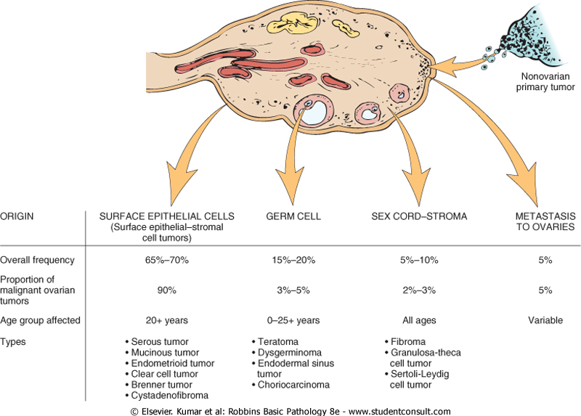
Ovarian Neoplasms

Slide 7
Pathogenesis-familial cases
Several risk factors for epithelial ovarian cancers have been recognized. Two of the most important are nulliparity and family history.
prolonged use of oral contraceptives may reduce the risk.
Only 5%-10% of ovarian cancers are familial, the molecular pathogenesis of these cancers involve specific genes :
mutations in the BRCA genes 1 and 2.
The average lifetime risk for ovarian cancer →30% in BRCA1 carriers. The risk in BRCA2 carriers is lower.

Slide 8
Pathogenesis- sporadic cases
Mutations in BRCA genes mutations are seen in only 8% to 10% of sporadic ovarian cancers. Thus, there must be other molecular pathways for ovarian neoplasms.
HER2/NEU is overexpressed in 35% of ovarian cancers (poor prognosis).
K-RAS protein is overexpressed in up to 30% of tumors, mostly mucinous cystadenocarcinomas.
p53 is mutated in about 50% of all ovarian cancers

Slide 9
SURFACE EPITHELIAL TUMORS
derived from coelomic mesothelium that covers the surface of the ovary.
Benign lesions are usually cystic (cystadenoma) or can have an accompanying stromal component (cystadenofibroma).
Malignant tumors may be cystic (cystadenocarcinoma) or solid (carcinoma).

Slide 10
SURFACE EPITHELIAL TUMORS-types
Serous
Mucinous
Endometrioid
Clear cell
Brenner
cystadenofibroma

Slide 11
borderline surface epithelial tumors
The surface epithelial tumors also have an intermediate, borderline category currently referred to as tumors of low malignant potential. These seem to be low-grade cancers with limited invasive potential. Thus, they have a better prognosis than the fully malignant ovarian carcinomas.

Slide 12
1- Serous Tumors
the most frequent ovarian tumors.
60% benign, 15% borderline, and 25% malignant.
Benign serous lesions →30 and 40 years
malignant serous tumors →45 and 65 years of age.
Combined, borderline and malignant serous tumors are the most common malignant ovarian tumors and account for about 60% of all ovarian cancers.
Mutations in BRAF and K-RAS are common in borderline tumors and low grade cancers.
High-grade serous carcinomas→ mutations in p53 and BRCA1.

Slide 13
Morphology
Benign serous tumors:
large cystic structures, (30 to 40 cm in diameter).
May be bilateral.
The serosa is smooth and glistening.
usually filled with a clear serous fluid
characterized by a single layer of tall columnar epithelium. Some of the cells are ciliated.

Slide 14
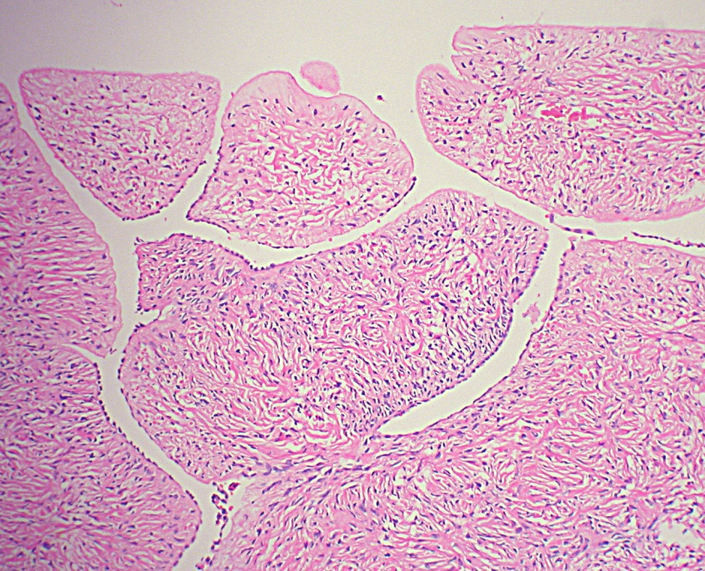
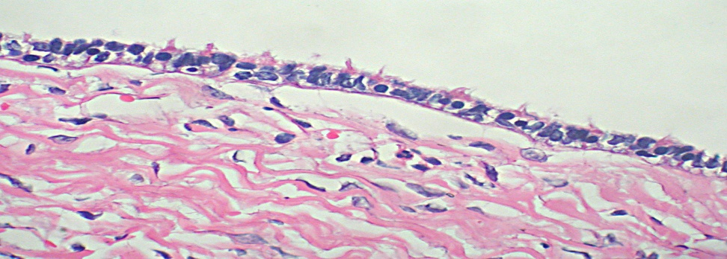
Benign serous tumors:

Slide 15
Morphology
Borderline serous tumors:
more complex architecture
mild cytologic atypia
but no stromal invasion.
However, they might be associated with peritoneal implants

Slide 16
Borderline serous tumors:

Slide 17
Borderline serous tumors:

Slide 18
Morphology
Malignant serous carcinoma: Anaplasia of the lining cells and invasion of the stroma.
Note: Psammoma bodies (concentrically laminated calcified concretions) are common in the tips of papillae of all serous tumors in general.

Slide 19
Prognosis of serous tumors:
Benign and borderline tumors: excellent outcome (borderline tumors →100% survival, and even with peritoneal metastases it is nearly 75%, ).
Malignant invasive serous tumors → prognosis is poor and depends on the stage of the disease at the time of diagnosis.

Slide 20
2- Mucinous ovarian tumors
these tumors consists of mucin-secreting cells.
Only 10% of mucinous tumors are malignant(cystadenocarcinomas),
while 10% are of low malignant potential (borderline),
and 80% are benign.

Slide 21
2- Mucinous ovarian tumors
Morphology
they are large and multilocular.
psammoma bodies are not found
The cysts are lined by mucin secreting cells with abundant vaculated cytoplasm
Depending on the architectural complexity, these tumors are classified to benign, borederline or malignant

Slide 22
2- Mucinous ovarian tumors
The prognosis of mucinous cystadenocarcinoma is somewhat better than that for the serous counterpart, but the stage is the major determinant of treatment success.

Slide 23
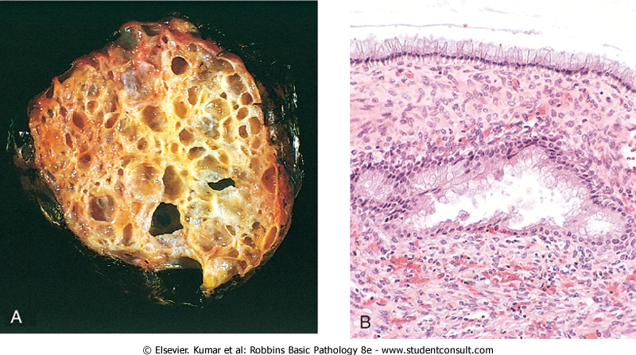
Mucinous ovarian tumors

Slide 24
3- Ovarian Endometrioid Carcinoma
Microscopically they are similar to those of the endometrium, within the linings of cystic spaces.
endometrioid tumors are usually malignant.
bilateral in about 30% of cases
15% to 30% of women with these ovarian tumors have a concomitant endometrial carcinoma.
Many have mutations in the PTEN tumor suppressor gene

Slide 25
Germ cell tumors

Slide 26
Germ cell tumors
Benign (Mature) Cystic Teratomas: differentiation of totipotential germ cells into mature tissues of all three germ cell layers
Most are discovered in young women incidentally on abdominal scans
90% are unilateral
Grossly: often filled with sebaceous secretion and hair; bone and cartilage; epithelium, or teeth.

Slide 27
In 1% of cases→ there is malignant transformation of one of the tissue elements.
May undergo torsion (10% to 15% of cases), producing an acute surgical emergency

Slide 28
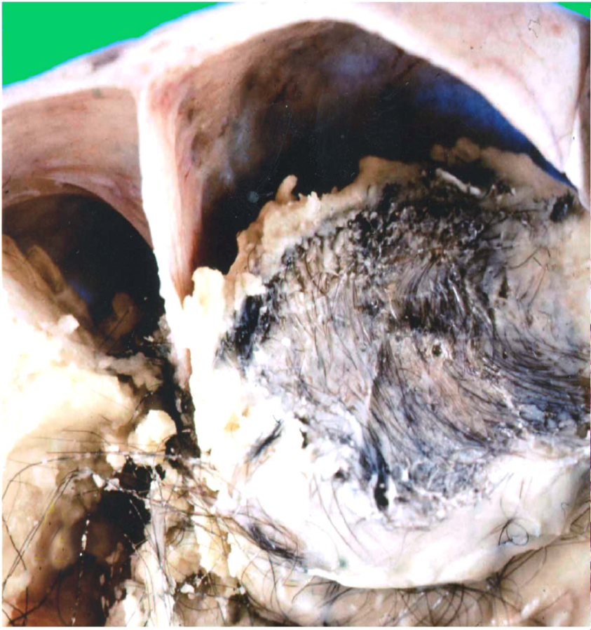
Benign (Mature) Cystic Teratomas

Slide 29
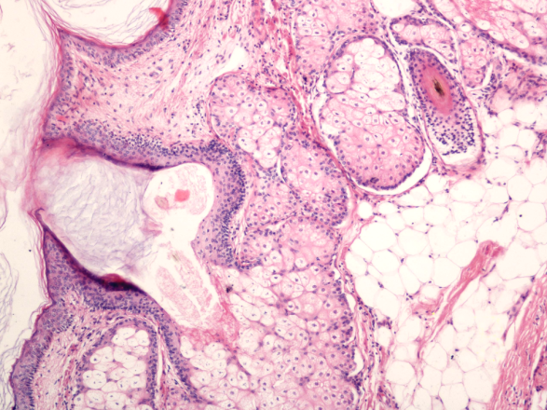
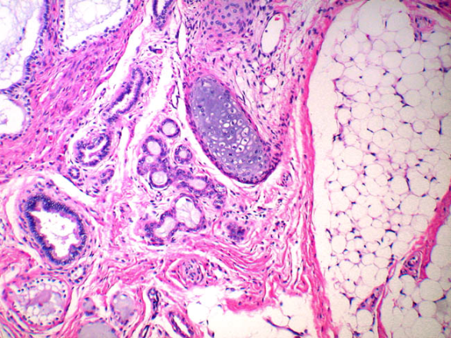
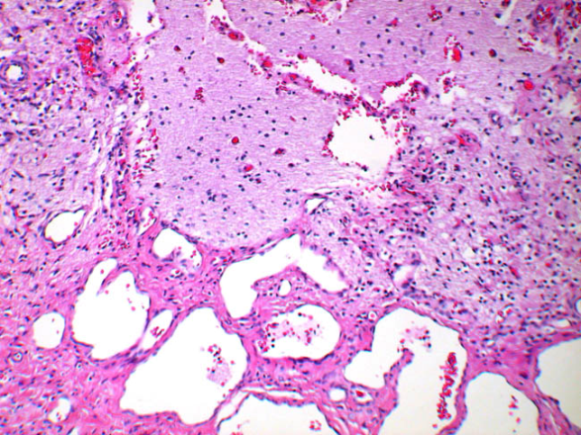
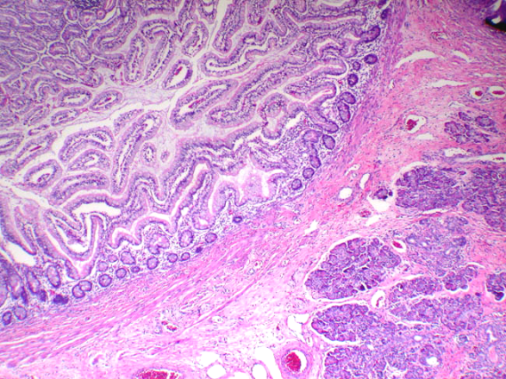
Benign (Mature) Cystic Teratomas

Slide 30
Other germ cell tumors

Slide 31
Germ-Cell Origin | Peak incidence | location | Morphology | Behavior
Dysgerminoma | Second to third decades Occur with gonadal dysgenesis | 80% to 90% unilateral | Counterpart of testicular seminoma. Solid large to small gray masses. Sheets or cords of large cleared cells separated by scant fibrous strands. Stroma may contain lymphocytes and occasional granuloma. | All malignant but only one-third aggressive and spread; all radiosensitive with 80% cure.
Choriocarcinoma | First three decades of life | Unilateral | Identical to placental tumor. Often small, hemorrhagic focus with two types of epithelium; cytotrophoblast and syncytiotrophoblast. | Metastasizes early and widely. Primary focus may disintegrate, leaving only "mets." In contrast to placental tumors, ovarian primaries are resistant to chemotherapy.
Metastases to Ovary | Older ages | Mostly bilateral | Usually solid gray-white masses as large as 20cm in diameter. Anaplastic tumor cells, cords, glands, dispersed through fibrous background. Cells may be "signet-ring" mucin-secreting. | Primaries are gastrointestinal tract (Krukenberg tumors), breast, and lung.

Slide 32
Sex cord-stromal tumors

Slide 33
Sex Cord Tumors | Peak incidence | location | Morphology | Behavior
Granulosa-thecal cell | Most postmenopausal but at any age | Unilateral | May be tiny or large, gray to yellow (with cystic spaces). Composed of mixture of cuboidal granulosa cells in cords, sheets, or strands and spindled or plump lipid-laden thecal cells. Granulosal elements may recapitulate ovarian follicle as Call-Exner bodies. | May elaborate large amounts of estrogen (from thecal elements) and so may promote endometrial or breast carcinoma. Granulosal element may be malignant (5% to 25%).
Thecoma-fibroma | Any age | Unilateral | Solid gray fibrous cells to yellow (lipid-laden) plump thecal cells. | Most hormonally inactive. Few elaborate estrogens. About 40%, for obscure reasons, produce ascites and hydrothorax (Meigs syndrome). Rarely malignant.
Sertoli-Leydig cell | All ages | Unilateral | Usually small, gray to yellow-brown, and solid. Recaps development of testis with tubules, or cords and plump pink Sertoli cells. | Many masculinizing or defeminizing. Rarely malignant.

Slide 34
Clinical Correlations for All Ovarian Tumors
All ovarian neoplasms are clinical challenges, because they produce no symptoms or signs until they are well advanced.
The clinical presentation of all ovarian tumors is similar despite their great morphologic diversity
they cause local pressure symptoms (e.g., pain, gastrointestinal complaints, urinary frequency), sometimes they become twisted on their pedicles (torsion), producing severe abdominal pain mimicking an "acute abdomen."
often cause ascites; espicially Fibromas and malignant serous tumors.
Functioning ovarian tumors often come to attention because of the hormones they induce (Estrogens or androgens).

