Slide 1
Pathology of the lower female genital tract
Vulvar Diseases:
Can be divided to non-neoplastic and neoplastic diseases.
The neoplastic diseases are much less common. Of those, squamous cell carcinoma is the most common.

Slide 2
Non-neoplastic vulvar diseases
Licken sclerosus
Lichen Simplex Chronicus
Condylomas

Slide 3
Neoplastic vulvar diseases
Vulvar Intraepithelial Neoplasia
Carcinoma of the Vulva: Squamous Cell Carcinoma; adenocarcinomas, melanomas, or basal cell carcinomas

Slide 4
Licken sclerosus
most common in postmenopausal women.
smooth, white plaques; skin is thinned out and resembles paper.
Microscopically: thinning of the epidermis and disappearance of rete pegs, hydropic degeneration of the basal cells
The pathogenesis: is uncertain, (?)autoimmune reaction
lichen sclerosus is not pre-malignant by itself

Slide 5
Lichen sclerosus
Lichen simplex
chronicus

Slide 6
Lichen Simplex Chronicus
end result of many inflammatory conditions
an area of leukoplakia.
Microscopically: epithelial thickening and significant surface hyperkeratosis. The hyperplastic epithelial changes show no atypia.
There is generally no increased predisposition to cancer, but suspiciously, lichen simplex chronicus is often present at the margins of adjacent cancer of the vulva.

Slide 7
Condylomas and Low-Grade Vulvar Intraepithelial Neoplasia (VIN)
Condylomas are anogenital warts (HPV infection, esp. HPV type 6 and HPV type11 )
perinuclear cytoplasmic vacuolization (koilocytosis) with nuclear pleomorphism.
The types of HPV isolated from the cancers differ from those most often found in condylomas.
Vulvar condylomas are not precancerous

Slide 8
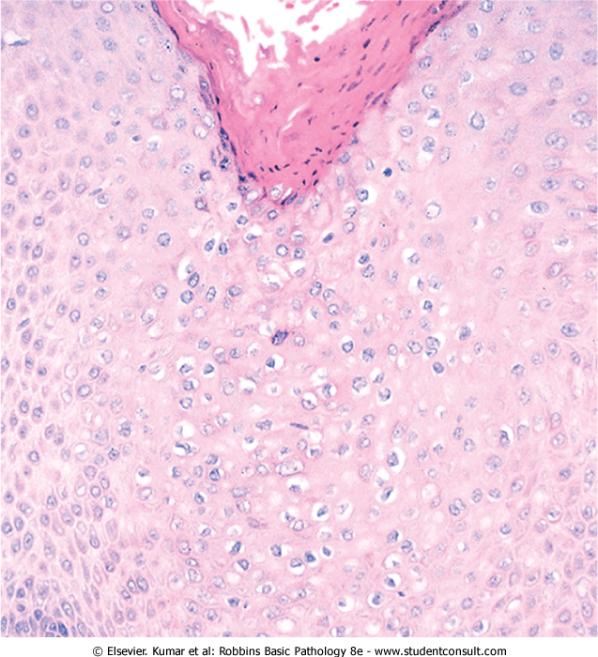
Condyloma acuminatum
koilocytes

Slide 9
High-Grade Vulvar Intraepithelial Neoplasia and Carcinoma of the Vulva
high grade VIN= VIN II or VIN III (carcinoma in situ).
It may be found in multiple foci, or it may coexist with an invasive lesion.
VIN may be present for many years, perhaps decades before progression to cancer.
genetic, immunologic, or environmental influences (e.g., cigarette smoking or superinfection with new strains of HPV) determine the course.

Slide 10
Carcinoma of the Vulva
3% of all genital tract cancers in women.
mostly in women older than age 60.
90% →squamous cell carcinomas; the remainder are: adenocarcinomas, melanomas, or basal cell carcinomas.
Squamous cell carcinoma SCC: there are two biologic forms of vulvar SCC.

Slide 11
First type of SCC (basaloid or poorly differentiated SCC):
most common 75% to 90%
relatively younger patients
HPV-related, especially type 16 & 18
in many cases other lesions related to HPV infection are seen in vagina and cervix.
Poorly differentiated cells

Slide 12
The second form of SCC (well-differentiated SCC):
older women 60-70s.
Not HPV-related
Less common
well to moderately differentiated
No known premalignant lesion
May be found adjacent to lichen simplex or sclerosus

Slide 13
Vaginal pathologic diseases
Inflammatory Vaginal Diseases
Vaginitis: common; usually transient; produces a vaginal discharge (leukorrhea).
A large variety of organisms including bacteria, fungi, and parasites.
predisposing conditions: diabetes, systemic antibiotics, abortion or pregnancy, or compromised immune function.
Frequent causes are bacteria, Candida albicans and Trichomonas vaginalis.

Slide 14
Vaginal Neoplastic Diseases
Sarcoma botryoides (embryonal rhabdomyosarcoma):
Rare sarcoma of skeletal muscle differentiation
Mostly in infants and children <5 years.
soft polypoid masses (grape-like).
Primitive cells (rhabdomyoblasts)

Slide 15
Cervical pathology
Cervical carcinoma
Used to be the most frequent cancer in women around the world.
But, since the introduction of the Papanicolaou (Pap) smear 50 years ago, the incidence of cervical cancer has dropped.

Slide 16
Detection of prinvasive lesions by the Pap smear at an early stage, permits discovery of these lesions when curative treatment is possible.
The Pap smear remains the most successful cancer screening test ever developed because it helped reducing cervical cancer mortality by as much as 99%, ranking it 13th in cancer deaths for women.

Slide 17
Cervical cancer
The most common cervical carcinomas are SCC(75%), followed by adenocarcinomas and adenosquamous carcinomas (20%), and small-cell neuroendocrine carcinomas (<5%).
The SCC are increasingly appearing in younger women, now with a peak incidence at about 45 years, almost 10 to 15 years after detection of their precursors: cervical intraepithelial neoplasia (CIN).

Slide 18
Cervical intraepithelial neoplasia
On the basis of histology, precancerous changes are graded as follows (depending on the extent of involvement):
*CIN I: Mild dysplasia (<third of full epithelial thickness)
*CIN II: Moderate dysplasia (up to 2/3 of full epithelial thickness)
*CIN III: Severe dysplasia in full epithelial thickness (carcinoma in situ)

Slide 19
Dysplasia = increased N/C ratio, nuclear enlargement,
hyperchromasia, and abnormal nuclear membranes

Slide 20
Pap smear pictures
Normal
CIN I
CIN II
CIN III

Slide 21
Epidemiology and Pathogenesis
The peak age incidence of CIN is about 30 years, whereas that of invasive carcinoma is about 45 years.
HPV can be detected by molecular methods in nearly all precancerous lesions and invasive neoplasms.
high-risk HPV types, including 16, 18, 45, and 31, account for the majority of cervical carcinomas

Slide 22
HPV 16 and 18 usually integrate into the host genome and express large amounts of E6 and E7 proteins, which block or inactivate tumor suppressor genes p53 and RB, respectively.
The recently introduced HPV vaccine used in USA and Europe is very effective in preventing HPV infections and hence cervical cancers.

Slide 23
Clinical Aspects Of Cervical Cancers
Symptomatic tumors can cause:
unexpected vaginal bleeding
leukorrhea
dyspareunia
dysuria

Slide 24
Detection of precursors by cytologic examination (pap smear) and their eradication by laser vaporization or cone biopsy is the most effective method of cancer prevention.
Mortality is most strongly related to tumor extent (stage), with 5-year survivals as follows: stage 0 (preinvasive)→ 100%; stage 1→ 90%; stage 2→82%; stage 3→ 35%; and stage 4→ 10%.
Radiotherapy and Chemotherapy may improve survival in advanced cases.

