Slide 1
Pathology of The Breast

Slide 2
Lesions of female breast are much more common than lesions of male breast
Most of these lesions are benign
Breast cancer is 2nd most common cause of cancer deaths in women, following carcinoma of the lung.
The clinical significance of the benign conditions:
1- possible clinical confusion with malignancy
2- association of certain variants with breast carcinoma.

Slide 3
Breast diseases

Slide 4
Fibrocystic changes
are the most common cause of breast "lumps
exaggeration and distortion of the cyclic breast changes that occur normally in the menstrual cycle.
HRT and OCPs do not increase the incidence of these alterations; (OCPs may decrease the risk).
arise during reproductive period of life
Very common (at autopsy in 60% to 80% of women)

Slide 5
TUMORS OF THE BREAST

Slide 6
1- Fibroadenoma
The most common benign neoplasm of the female breast.
increase in estrogen activity
Most in third decade of life.
a discrete, solitary, freely movable nodule, (1 to 10 cm).
usually easily "shelled out“ surgically.
may enlarge late in the menstrual cycle and during pregnancy.
After menopause they usually regress and calcify.

Slide 7
Fibroadenoma
Cytogenetic studies ➔ stromal cells are monoclonal and so represent the neoplastic element of these tumors (the neoplastic stromal cells secrete growth factors that induce proliferation of epithelial cells).
Fibroadenomas almost never become malignant.

Slide 8
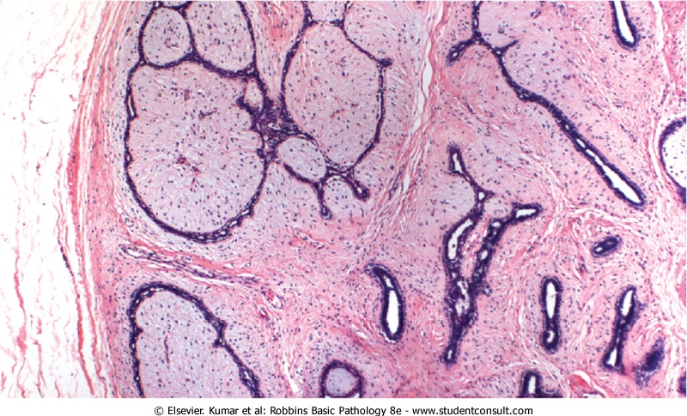
Fibroadenoma

Slide 9
Phyllodes Tumor
much less common than fibroadenomas
arise from the periductal stroma and not from preexisting fibroadenomas.
leaflike clefts and slits➔ they have been designated phyllodes (Greek for "leaflike")
Most (70% )are benign and tend to remain localized and cured by excision.
The most worrying change➔ the appearance of increased stromal cellularity with anaplasia and high mitotic activity, accompanied by rapid increase in size, usually with invasion of adjacent breast tissue = malignant phyllodes.
Malignant lesions may recur
15% of cases→ metastasize to distant sites.

Slide 10
Carcinoma of the Breast
the most common cancer in females
ranking second only to lung cancer as a cause of cancer death in women.
75% of women with breast cancer are older than age 50.
Only 5% are younger than the age of 40.

Slide 11
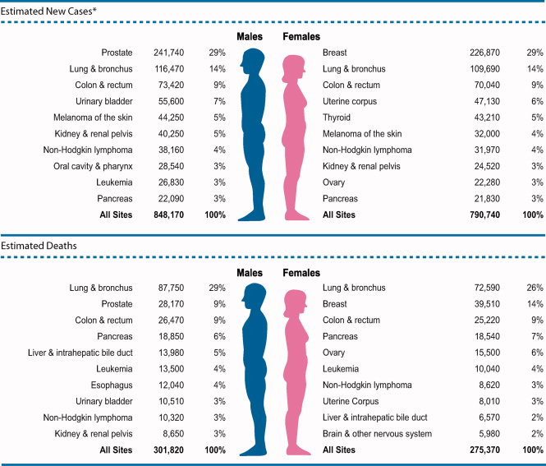
CA: A Cancer Journal for Clinicians Volume 62, Issue 1, pages 10-29, 4 JAN 2012 DOI: 10.3322/caac.20138 http://onlinelibrary.wiley.com/doi/10.3322/caac.20138/full#fig1
Notes:
Ten Leading Cancer Types for the Estimated New Cancer Cases and Deaths by Sex, United States, 2012.*Estimates are rounded to the nearest 10 and exclude basal and squamous cell skin cancers and in situ carcinoma except urinary bladder.
© This slide is made available for non-commercial use only. Please note that permission may be required for re-use of images in which the copyright is owned by a third party.

Slide 12
Pathogenesis
(1)Genetic Changes
well-established familial syndromes
-sporadic breast cancer:
e.g. overexpression of the HER2/NEU proto-oncogene (30% of cases)
(2)Hormonal Influences
increased exposure to estrogen
(3)Environmental Variables

Slide 13
Factor | Relative Risk
Well-Established Influences
Geographic factors | Varies in different areas
Age | Increases after age 30yr
Family history
First-degree relative with breast cancer | 1.2-3.0
Premenopausal | 3.1
Premenopausal and bilateral | 8.5-9.0
Postmenopausal | 1.5
Postmenopausal and bilateral | 4.0-5.4
Menstrual history
Age at menarche <12yr | 1.3
Age at menopause >55yr | 1.5-2.0
Pregnancy
First live birth from ages 25 to 29yr | 1.5
First live birth after age 30yr | 1.9
First live birth after age 35yr | 2.0-3.0
Nulliparous | 3.0
Benign breast disease
Proliferative disease without atypia | 1.6
Proliferative disease with atypical hyperplasia | >2.0
Lobular carcinoma in situ | 6.9-12.0
Less Well-Established Influences
Exogenous estrogens
Oral contraceptives
Obesity
High-fat diet
Alcohol consumption
Cigarette smoking

Slide 14
Major Risk Factors
Age.
Genetics and Family History:
50% of women with hereditary breast cancer have mutations in gene BRCA1; 30% have mutations in BRCA2 .
other genetic diseases may be associated with breast cancer
Prolonged exposure to exogenous estrogens postmenopausally (HRT)
Ionizing radiation, in early life years

Slide 15
Morphology of breast cancer
About 4% of cases→ bilateral primary tumors or sequential lesions in the same breast.
- The locations of the tumors within the breast are:
Upper outer quadrant 50% (most common)
Central portion 20%
Lower outer quadrant 10%
Upper inner quadrant 10%
Lower inner quadrant 10%

Slide 16
Breast cancers are classified into:
Noninvasive (confined by a basement membrane and do not invade into stroma or lymphovascular channels), include:
Ductal carcinoma in situ (DCIS)
Lobular carcinoma in situ (LCIS)
Invasive (infiltrating)
Invasive ductal carcinoma – NOS (most common type)
Invasive lobular carcinoma
Medullary carcinoma
Colloid (mucinous) carcinoma
Tubular carcinoma
Other types

Slide 17
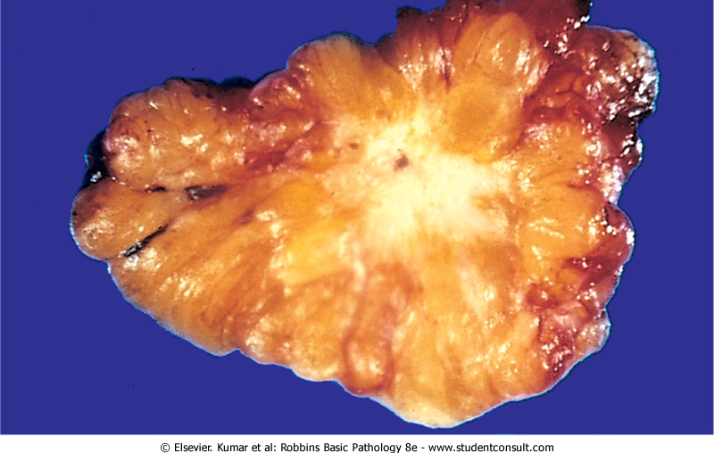

Slide 18
Ductal carcinoma in-situ DCIS
ranges from low nuclear grade to pleomorphic (high nuclear grade).
comedo subtype: high-grade nuclei with extensive central necrosis. (The name derives from the toothpaste-like necrotic tissue).
Calcifications are frequently associated→screening by mammography
The prognosis : excellent (97% long-term survival after simple mastectomy)
Current treatment strategies: surgery and radiation, tamoxifen
Significance: adjacent invasive CA; become invasive if untreated

Slide 19
Comedo DCIS

Slide 20
Invasive ductal carcinoma
Also called Carcinomas "not otherwise specified"
70% to 80% of all
Precancerous lesion: usually DCIS
Clinical presentation: a mammographic density; a hard, palpable mass. Advanced cancers may cause retraction of the nipple, or fixation to the chest wall.
Receptor profile: 2/3 express ER or PR; 1/3 overexpresses HER2/NEU.

Slide 21
Invasive ductal carcinoma

Slide 22
Invasive lobular carcinoma
These tumors comprise fewer than 20% of all breast carcinomas.
Precancerous lesion. 2/3 adjacent LCIS.
multicentric and bilateral (10% to 20%).
Clinical presentation. Most present as palpable masses or mammographic densities
Almost all of these carcinomas express hormone receptors, but HER2/NEU overexpression is very rare or absent.

Slide 23
Medullary carcinoma
is a rare subtype 1% of cases.
Microscopically: large anaplastic cells with pushing, well-circumscribed borders. With a pronounced lymphoplasmacytic infiltrate.
Precancerous lesions. usually absent
increased frequency in women with BRCA1 mutations,.
Receptor profile. lack hormone receptors and do not overexpress HER2/NEU.

Slide 24
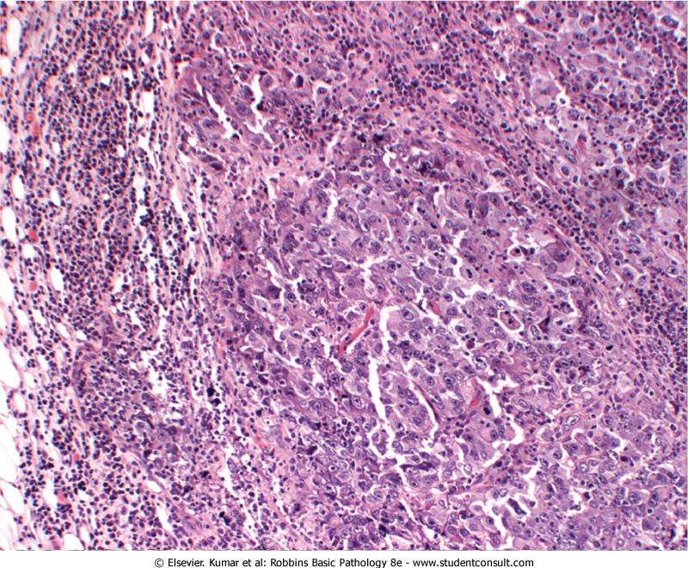

Slide 25
Colloid (mucinous) carcinoma
a rare subtype.
Microscopic picture. The tumor cells produce abundant quantities of extracellular mucin that dissects into the surrounding stroma. Grossly the tumors are usually soft and gelatinous.
Most express hormone receptors (ER,PR), and rare examples may overexpress HER2/NEU.

Slide 26
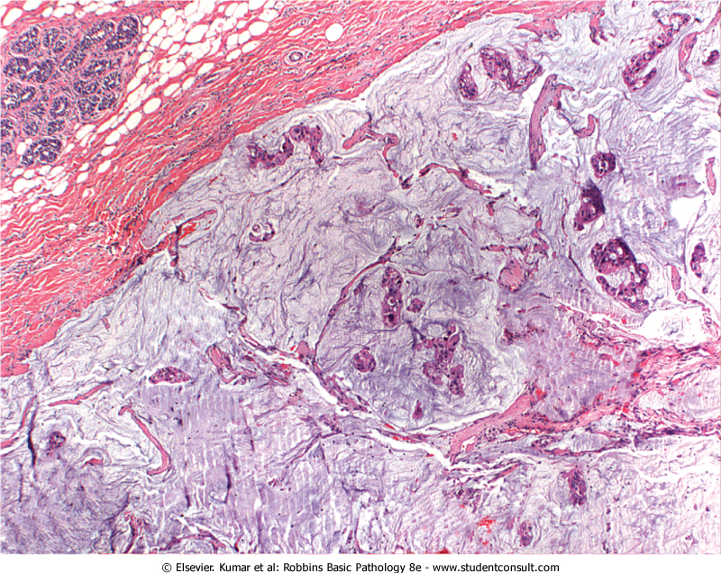

Slide 27
Tubular carcinomas
10% of invasive carcinomas smaller than 1 cm found with mammographic screening.
Clinical presentation. irregular mammographic densities.
Microscopically, well-formed tubules with low-grade nuclei.
Lymph node metastases are rare, and prognosis is excellent.
Virtually all tubular carcinomas express hormone receptors, but overexpression of HER2/NEU is uncommon.

Slide 28
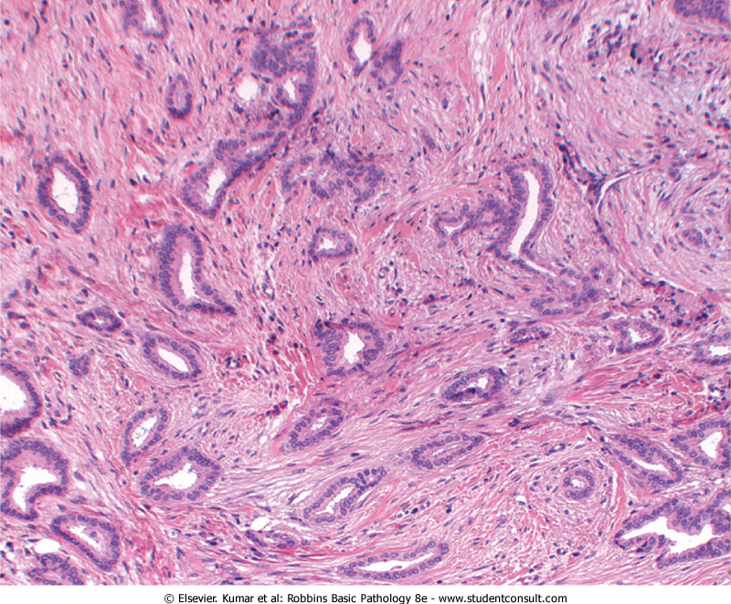

Slide 29
Features Common to All Invasive Cancers
Fixation: adherent to the pectoral muscles or deep fascia of the chest wall
retraction or dimpling of the skin or nipple: adherence to the overlying skin
peau d'orange (orange peel): Involvement of the lymphatic pathways cause localized lymphedema, the skin becomes thickened around exaggerated hair follicles

Slide 30
Spread of Breast Cancer
through lymphatic and hematogenous channels.
Favored mets are the lungs, skeleton, liver, and adrenals and (less commonly) the brain, spleen, and pituitary.
Metastases may appear many years after apparent therapeutic control of the primary lesion
SCREENING :
mammographic screening
Magnetic resonance imaging MRI

Slide 31
Prognosis
1- The size.
2- Lymph node involvement and the number of lymph nodes involved by metastases.
3- Distant metastases.
4- grade
5- The histologic type of carcinoma
6- The presence or absence of estrogen or progesterone receptors.
7- The proliferative rate of the cancer.
8- Aneuploidy. worse prognosis.
9- Overexpression of HER2/NEU
the importance of evaluating HER2/NEU is to predict response to a monoclonal antibody ("Herceptin") against the gene product.

Slide 32
Male breast pathology
Gynecomastia
Enlargement of the male breast
due to absolute or relative estrogen excesses.
According to cause, divided into:
1- pathologic gynecomastia: cirrhosis of the liver; Klinefelter syndrome; estrogen-secreting tumors; estrogen therapy; digitalis therapy.
2- Physiologic gynecomastia: puberty and extreme old age.

Slide 33
Carcinoma of the male breast
male: female breast cancer →1: 125.
advanced age.
Because of the scant amount of breast substance in the male, the tumor rapidly infiltrates the overlying skin and underlying thoracic wall.
Unfortunately, almost 1/2 have spread to regional lymph nodes and more distant sites by the time they are discovered.

