Slide 1
Urinary Tract Tumors
2%-3% of all cancers in adults.
The most common malignant tumor of the kidney is renal cell carcinoma.
followed in frequency by nephroblastoma (Wilms tumor) and by primary tumors of the calyces and pelvis.
Tumors of the lower urinary tract are about twice as common as renal cell carcinomas.

Slide 2
Renal Cell Carcinoma (RCC)
are derived from the renal tubular epithelium.
located predominantly in the cortex.
2%-3% of all cancers in adults.
80%-85% of all primary malignant tumors of the kidney.
30,000 cases per year.
40% of patients die of the disease.
6th-7th decades.
M:F 2:1

Slide 3
Predisposing factors
1- smoking
2- hypertension
3- obesity
4- occupational exposure to cadmium.
Smokers who are exposed to cadmium have a particularly high incidence of renal cell carcinomas.
5- chronic dialysis & acquired polycystic disease
-The risk of developing renal cell cancer is increased 30-fold

Slide 4
New classification based on the molecular origins of these tumors
1-Clear Cell Carcinomas
2-Papillary Renal Cell Carcinomas
3-Chromophobe Renal Carcinomas

Slide 5
1-Clear Cell Carcinomas
are the most common type
(70%- 80% of RCC).
Histologically, they are made up of cells with clear or granular cytoplasm.
Forms of clear cell renal carcinoma:
1-Sporadic
2-Familial
3-in association with von Hippel-Lindau (VHL) disease

Slide 6
VHL disease
VHL gene is tumor suppressor gene involved in limiting the angiogenic response to hypoxia; thus, its absence may lead to increased angiogenesis and tumor growth
is autosomal dominant and is characterized by predisposition to a variety of neoplasms:
1- hemangioblastomas of the cerebellum and retinal angiomas.
2- bilateral renal cysts
3- bilateral & multiple clear cell carcinomas (40%-60% of individuals).
4- Pheochromocytoma

Slide 7
Those with VHL syndrome inherit a germ-line mutation of the VHL gene on chromosome 3p25 and lose the second allele by somatic mutation.
The VHL gene is also involved in the majority of sporadic clear cell carcinomas (60%).
homozygous loss of the VHL gene seems to be the common underlying molecular abnormality in both sporadic and familial forms of clear cell carcinomas

Slide 8
2-Papillary Renal Cell Carcinomas
10% to 15% of all renal cancers.
show a papillary growth pattern.
are frequently multifocal and bilateral and appear as early-stage tumors.
familial and sporadic forms.
papillary renal cancers have no abnormality of chromosome 3.

Slide 9
The gene involved in papillary renal cell cancers is the MET proto-oncogene, located on chromosome 7q31.
The MET gene is a tyrosine kinase receptor for the growth factor called hepatocyte growth factor (HGF).
increased gene dosage of the MET gene due to duplications of chromosome 7 seems to spur abnormal growth in the proximal tubular epithelial cell precursors of papillary carcinomas.

Slide 10
familial cases:
trisomy of chromosome 7
activating mutations of the MET gene.
sporadic cases:
duplication or trisomy of chromosome 7
but there is no mutation of the MET gene.
chromosomal translocation involving chromosome 8q24 close to the c-MYC gene, is also associated with some cases of papillary carcinoma

Slide 11
3-Chromophobe Renal Carcinomas
the least common (5% of all RCC).
They arise from intercalated cells of collecting ducts.
the tumor cells stain more darkly (i.e., they are less clear) than cells in clear cell carcinomas.
These tumors are unique in having multiple losses of entire chromosomes, including chromosomes 1, 2, 6, 10, 13, 17, and 21.
they show extreme hypodiploidy.
Because of multiple losses, the "critical hit" has not been determined.
chromophobe renal cancers have a good prognosis.

Slide 12
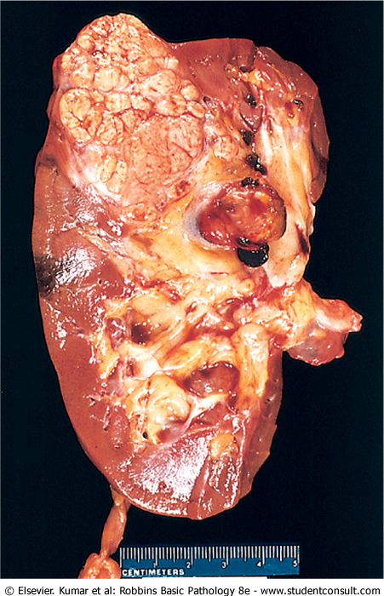
Renal cell carcinoma: typical cross-section of yellowish, spherical neoplasm in one pole of the kidney.
Note the tumor in the dilated, thrombosed renal vein.

Slide 13
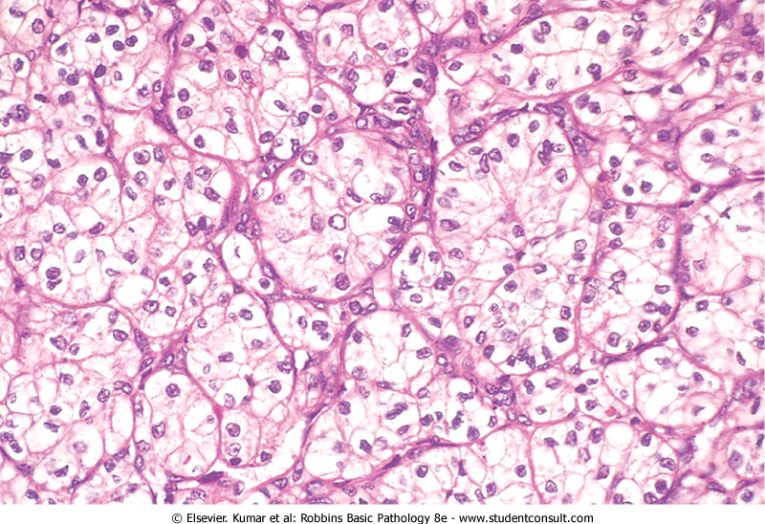
Renal cell carcinoma High-power detail of the clear cell pattern

Slide 14
Clinical Course
1-the most frequent presenting manifestation is hematuria( in more than 50% of cases).
Macroscopic hematuria tends to be intermittent and fleeting superimposed on a steady microscopic hematuria.
2-Less commonly the tumor may present flank pain and a palpable mass. The characteristic triad of :
painless hematuria
a palpable abdominal mass
dull flank pain
3-Fever
4-Polycythemia ( 5% to 10% of cases): It results from elaboration of erythropoietin by the renal tumor.

Slide 15
Paraneoplastic syndromes:
1-hypercalcemia
2-Hypertension
3-Cushing syndrome
4-feminization or masculinization
The prevalent locations for metastases are the lungs and the bones.
may invade the renal vein and grow within this vessel, sometimes extending as far as the inferior vena cava and even into the right side of the heart.

Slide 16
Wilms Tumor
it is the 3rd most common solid organ cancer in children < age of 10 years.
contain cells and tissue components all derived from the mesoderm.
may arise sporadically or familial (susceptibility to tumorigenesis inherited as an autosomal dominant trait).
Mutations involve WT1and 2 genes.
The tumor shows attempts to form primitive glomerular and tubular structures

Slide 17
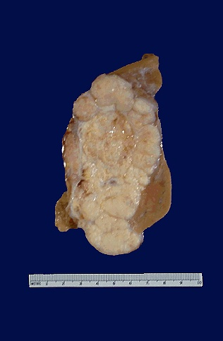
Wilm's tumor of the kidney

Slide 18
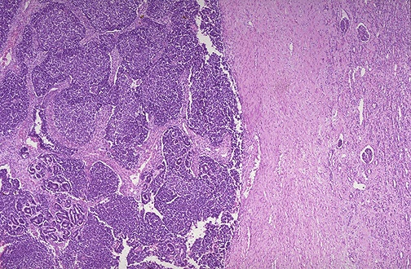
Wilm's tumor nests and sheets of dark blue cells at the left with compressed normal renal parenchyma at the right.

Slide 19
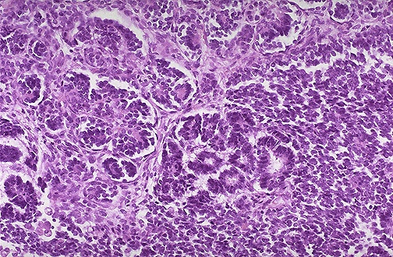
The tumor shows attempts to form primitive glomerular and tubular structures

Slide 20
Papillary urothelial carcinoma of ureter & renal pelvis
5% to 10% of primary renal tumors.
Painless hematuria is the most characteristic feature of these lesions.
Depending on critical location they produce pain in the costovertebral angle as hydronephrosis develops.

Slide 21
Infiltration of the walls of the pelvis, calyces, and renal vein worsens the prognosis.
Despite removal of the tumor by nephrectomy, fewer than 50% of patients survive for 5 years.
Cancer of the ureter is fortunately the rarest of the tumors of the collecting system.
The 5-year survival rate is less than 10%.

Slide 22
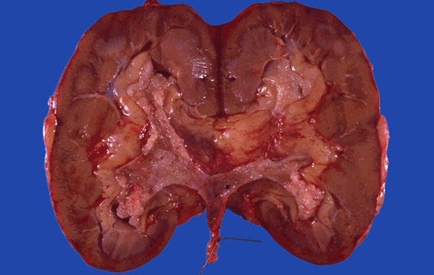
The cut surfaces of the kidney demonstrate normal cortex and medulla, but the calyces show focal papillary tumor masses of transitional cell carcinoma.

Slide 23
Benign Nephrosclerosis
Definition: renal changes in benign hypertension
It is always associated with hyaline arteriolosclerosis.
mild benign nephrosclerosis is present at autopsy in many persons > 60 years of age.
The frequency and severity of the lesions are increased when hypertension or diabetes mellitus are present.

Slide 24
Pathogenesis
many renal diseases cause hypertension which in turn is associated with benign nephrosclerosis.
often seen superimposed on other primary kidney diseases.

Slide 25
Morphology
the kidneys are symmetrically atrophic, each weighing 110 to 130 gm, with a surface of diffuse, fine granularity that resembles grain leather.
the basic change is a homogeneous, pink hyaline thickening of the walls of small arteries and arterioles = hyaline arteriolosclerosis.

Slide 26
This leads to decrease in vessel lumina with loss of underlying cellular detail → markedly decreased blood flow through the affected vessels → produces ischemia in the organ
All structures of the kidney show ischemic atrophy→
glomerular tufts may become globally sclerosed.
Diffuse tubular atrophy and interstitial fibrosis are present

Slide 27
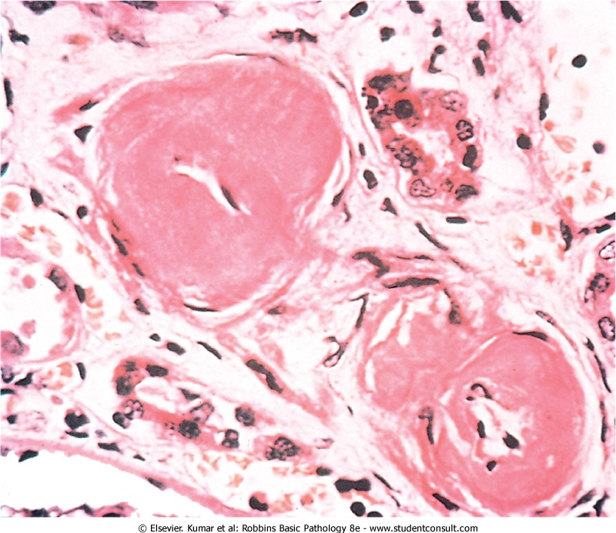
Benign nephrosclerosis. Arterioles with hyaline deposition, marked thickening of the walls and a narrowed lumen.

Slide 28
Clinical Course
rarely causes severe damage to the kidney except in susceptible populations, such as African Americans.
all persons with this lesion usually show some functional impairment, such as loss of concentrating ability or a variably diminished GFR.
A mild degree of proteinuria.

Slide 29
Malignant Hypertension and Malignant Nephrosclerosis
only 5% of HTN cases.
It may arise de novo or it may appear suddenly in a person who had mild hypertension.
Pathogenesis
vascular damage to the kidneys.
injury to the arteriolar walls.
The result is increased permeability of the small vessels to fibrinogen and other plasma proteins, endothelial injury, and platelet deposition.

Slide 30
fibrinoid necrosis of arterioles and small arteries and intravascular thrombosis.
The consequences of the markedly elevated blood pressure on the blood vessels throughout the body are known as malignant arteriolosclerosis, and the renal disorder is referred to as malignant nephrosclerosis.

Slide 31
Mitogenic factors from platelets (e.g., PDGF) and plasma cause intimal smooth hyperplasia of vessels, resulting in the hyperplastic arteriolosclerosis typical of malignant hypertension and of morphologically similar thrombotic microangiopathies
The kidneys become markedly ischemic.
Renin-angiotensin system is stimulated.
angiotensin II causes intrarenal vasoconstriction → renal ischemia → renin secretion.
Aldosterone levels are also elevated → salt retention →↑Bp

Slide 32
Morphology
The kidney is normal-slightly shrunken
pinpoint petechial hemorrhages on the cortical surface from rupture of arterioles or glomerular capillaries giving the kidney a peculiar, flea-bitten appearance.
fibrinoid necrosis of the arterioles .
In the interlobular arteries and larger arterioles, proliferation of intimal cells produces an onion-skin appearance .
This lesion, called hyperplastic arteriolosclerosis, causes marked narrowing of arterioles and small arteries to the point of total obliteration.
Necrosis may also involve glomeruli with microthrombi within the glomeruli as well as necrotic arterioles

Slide 33
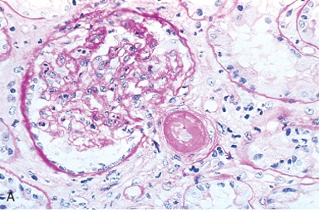
Malignant hypertension. Fibrinoid necrosis of afferent arteriole (PAS stain).

Slide 34
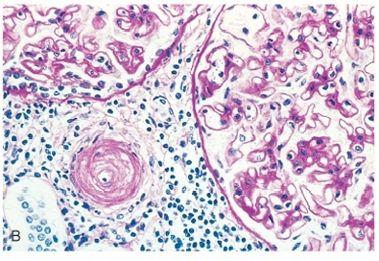
Malignant hypertension Hyperplastic arteriolosclerosis (onion-skin lesion).

Slide 35
Clinical Course
malignant hypertension is characterized by :
1-diastolic pressures > 120 mm Hg,
2-papilledema
3-encephalopathy
4-cardiovascular abnormalities
5-renal failure

Slide 36
increased intracranial pressure➔ headache, nausea, vomiting, and visual impairment, particularly the development of scotomas, or spots before the eyes.
marked proteinuria and microscopic or macroscopic hematuria
The syndrome is a true medical emergency that requires prompt and aggressive antihypertensive therapy before irreversible renal lesions develop.
About 50% of patients survive at least 5 years.
90% of deaths are caused by uremia.
10% by cerebral hemorrhage or cardiac failure

