Slide 1
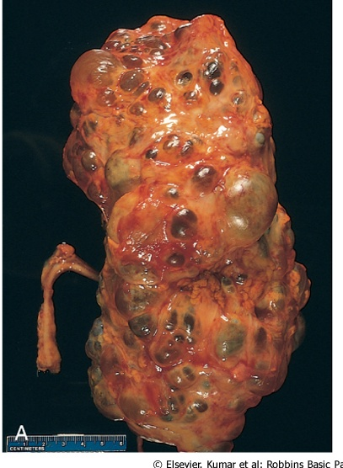
CYSTIC DISEASES OF THE
KIDNEY

Slide 2
Types
1-Simple Cysts
2-Dialysis-associated acquired cysts
3-Autosomal Dominant (Adult) Polycystic Kidney Disease
4-Autosomal Recessive (Childhood) Polycystic Kidney Disease
5-Medullary Cystic Disease

Slide 3
1-Simple Cysts
Multiple or single cystic spaces that vary widely in diameter ( 1-5 cm in diameter ) filled with clear fluid.
usually confined to the cortex.
common post-mortem finding that has no clinical significance.
The main importance of cysts lies in their differentiation from kidney tumors when they are discovered either incidentally or because of hemorrhage and pain

Slide 4
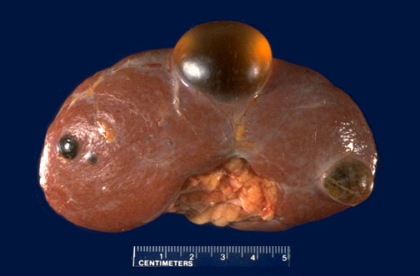
Simple renal Cysts

Slide 5
2-Dialysis-associated acquired cysts
occur in the kidneys of patients with end-stage renal disease who have undergone prolonged dialysis.
They are present in both cortex and medulla and may bleed causing hematuria.
renal carcinomas may arise in the walls of these cysts.

Slide 6
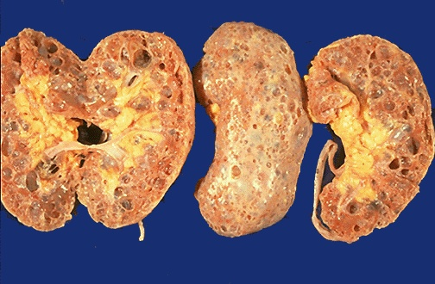
Cystic change associated with chronic renal dialysis.

Slide 7
3-Autosomal Dominant (Adult) Polycystic Kidney Disease
Characterized by multiple expanding cysts of both kidneys that ultimately destroy the intervening parenchyma.
Incidence (1: 500-1000) persons
Accounts for 10% of cases of chronic renal failure.
It can be caused by inheritance of one of at least 2 autosomal dominant genes of very high penetrance.
(1)- PKD1 on the short arm of chromosome 16
- In 85-90% of families
-This gene encodes a large and complex cell membrane-associated protein called polycystin-1

Slide 8
(2)- PKD2 gene (10-15% of cases) on chromosome 4:
encodes polycystin 2.
Polycystin 2 is thought to function as a calcium-permeable membrane channel.
polycystins 1 and 2 are believed to act together by forming heterodimers.
mutation in either gene gives rise to essentially the same phenotype although patients with PKD2 mutations have a slower rate of disease progression as compared with patients with PKD1 mutations.

Slide 9
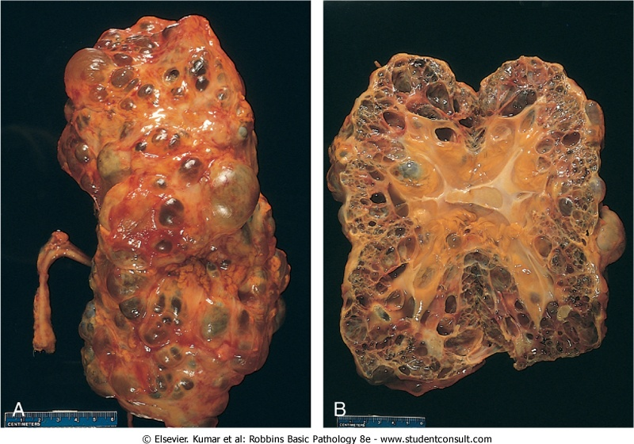

Slide 10
Clinical presentation
asymptomatic until the 4th decade by which time the kidneys are quite large although small cysts start to develop in adolescence.
The most common presenting complaint is flank pain or a heavy dragging sensation.
Acute distention of a cyst either by intracystic hemorrhage or by obstruction may cause excruciating pain.
palpation of an abdominal mass.
Intermittent gross hematuria commonly occurs.
hemorrhage.

Slide 11
Complications
1-hypertension (75% ).
2-urinary infection.
3-Saccular aneurysms of the circle of Willis are present in 10% to 30% of patients (subarachnoid hemorrhage ).
4-end-stage renal failure occurs at about age 50 .

Slide 12
4-Autosomal Recessive (Childhood) Polycystic Kidney Disease
autosomal recessive inheritance.
1:20,000 live births.
Perinatal, neonatal, infantile, and juvenile subcategories have been defined, depending on time of presentation and the presence of associated hepatic lesions.
Mutations in PKHD1 gene coding for a putative membrane receptor protein called fibrocystin, localized to chromosome 6p.
Fibrocystin may be involved in the function of cilia in tubular epithelial cells .

Slide 13
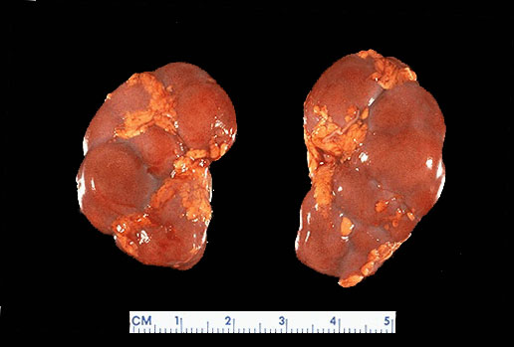
Normal term infant kidneys

Slide 14
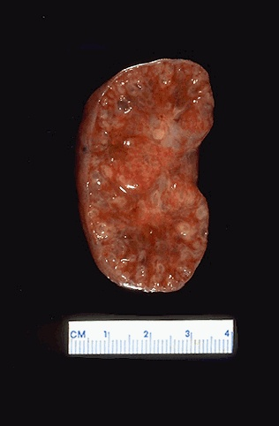
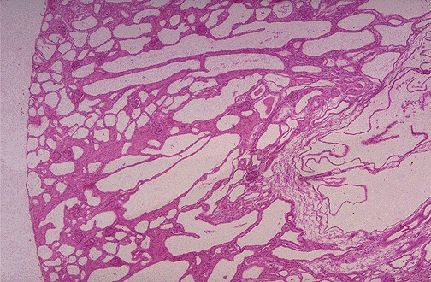
Cysts are fairly small but uniformly distributed throughout the parenchyma so that the disease is usually symmetrical in appearance with both kidneys markedly enlarged.

Slide 15
5-Medullary Cystic Disease
There are 2 major types of medullary cystic disease:
1-medullary sponge kidney
a relatively common and usually innocuous condition.
2-nephronophthisis-medullary cystic disease complex
is almost always associated with renal dysfunction.
usually begins in childhood.
4 variants of this disease complex are recognized on the basis of the time of onset: infantile; juvenile (most common); adolescent; adult

Slide 16
Clinical features
polyuria and polydipsia a consequence of diminished tubular function.
Progression to end-stage renal disease ensues over a 5-10-year period.
The disease is difficult to diagnose, since there are no serologic markers and the cysts may be too small to be seen with radiologic imaging.
cysts may not be apparent on renal biopsy if the cortico-medullary junction is not well sampled.
A positive family history and unexplained chronic renal failure in young patients should lead to suspicion of medullary cystic disease.

Slide 17
URINARY OUTFLOW OBSTRUCTION

Slide 18
Renal Stones (Urolithiasis)
Calculus formation at any level in the urinary collecting system.
Most common arise in the kidney.
(1%) of all autopsies.
Symptomatic urolithiasis is more common in men than in women.
Familial tendency toward stone formation

Slide 19
Stones are unilateral in about 80% of patients.
Common sites of formation are renal pelvis and calyces and the bladder.
They tend to be small (average diameter 2-3 mm) and may be smooth or jagged.
Progressive precipitation of salts leads to the development of branching structures known as staghorn calculi.
These massive stones are usually composed of magnesium ammonium phosphate.

Slide 20
Pathogenesis
Renal stones are composed of:
1-calcium oxalate or calcium oxalate mixed with calcium phosphate(80%) .
2-10% are composed of magnesium ammonium phosphate.
3-6%-9% are either uric acid or cystine stones
In all cases there is an organic matrix of mucoprotein that makes up about 2.5% of the stone by weight.

Slide 21
Causes of Renal Stones
1-increased urine concentration of the stone's constituents so that it exceeds their solubility in urine (supersaturation).
50% of patients who develop calcium stones have hypercalciuria that is not associated with hypercalcemia.
Types of Hypercalciuria:
A. absorptive hypercalciuria.
B. renal hypercalciuria due to primary renal defect of calcium reabsorption.
In 5% to 10% of persons there is hypercalcemia and consequent hypercalciuria.

Slide 22
2-The presence of a nidus
Urates provide a nidus for calcium deposition.
Desquamated epithelial cells

Slide 23
3-urine pH
High urine pH favors crystallization of calcium phosphate and stone formation.
Magnesium ammonium phosphate (struvite) stones almost always occur with a persistently alkaline urine due to UTIs.
Uric acid stones formed in acidic urine (under pH 5.5).
Cystine stones are more likely to form when the urine is relatively acidic.

Slide 24
4-infections
The urea-splitting bacteria such as Proteus vulgaris and the staphylococci predispose the person to urolithiasis.

Slide 25
5-lack of substances that normally inhibit mineral precipitation.
Inhibitors of crystal formation in urine include Tamm-Horsfall protein, osteopontin, pyrophosphate, mucopolysaccharides, diphosphonates, and a glycoprotein called nephrocalcin
No deficiency of any of these substances has been consistently demonstrated in individuals with urolithiasis.

Slide 26
Hydronephrosis

Slide 27
Hydronephrosis
Refers to dilation of the renal pelvis and calyces, with accompanying atrophy of the parenchyma.
The obstruction may be sudden or insidious and it may occur at any level of the urinary tract from the urethra to the renal pelvis.
The most common causes are as follows:

Slide 28
1-Congenital:
Atresia of the urethra
Valve formations in either ureter or urethra
Aberrant renal artery compressing the ureter
Renal ptosis with torsion or kinking of the ureter

Slide 29
2-Acquired:
Foreign bodies: Calculi, necrotic apillae
Tumors: Benign prostatic hyperplasia,
carcinoma of the prostate,
bladder tumors (papilloma and carcinoma),
contiguous malignant disease (retroperitoneal
lymphoma, carcinoma of the cervix or uterus
Inflammation: Prostatitis, ureteritis, urethritis, retroperitoneal fibrosis
Neurogenic: Spinal cord damage with paralysis of the bladder
Normal pregnancy: Mild and reversible

Slide 30
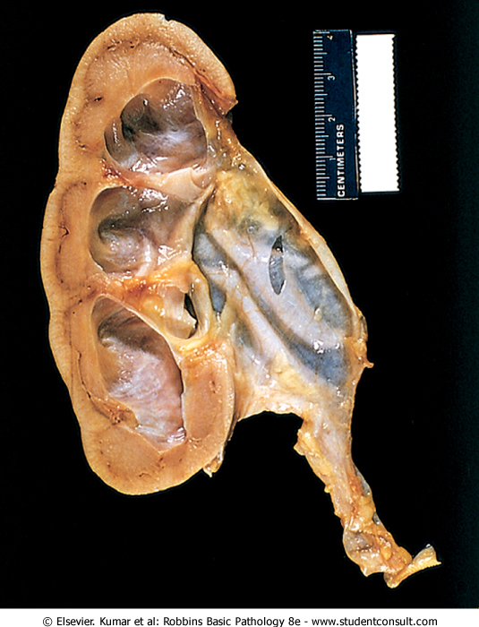
Hydronephrosis of the kidney, with marked dilation of the pelvis and calyces and thinning of renal parenchyma.

Slide 31
DISEASES AFFECTING TUBULES AND INTERSTITIUM
Dr. Nisreen Abu Shahin
Assistant professor, consultant of Pathology
University of Jordan

Slide 32
Tubulointerstitial Nephritis
Causes :
1- bacterial infection.
2- drugs.
3- metabolic disorders such as hypokalemia.
4- physical injury such as irradiation.
5- viral infections.
6- immune reactions.
TIN is divided into :
1-acute
2-chronic

Slide 33
Infectious : Acute Pyelonephritis
a common suppurative inflammation of the kidney and the renal pelvis.
bacterial infection.
important manifestation of (UTI) :
1- lower UT (cystitis, prostatitis, urethritis).
2- upper UT(pyelonephritis).
3- both.

Slide 34
Pathogenesis
The principal causative organisms are :
1- Escherichia coli >is the most common .
2- Proteus.
3- Klebsiella.
4- Enterobacter.
5- Pseudomonas.
6- Staphylococci and Streptococcus faecalis (uncommon).

Slide 35
Routes of infection
1-hematogenous (seeding of the kidneys by bacteria in septicemia or infective endocarditis)
2-ascending infection (most common): from the lower urinary tract

Slide 37
bladder urine is sterile and remains so as a result of:
1- the antimicrobial properties of the bladder mucosa.
2- the flushing action associated with periodic voiding of urine.
The first step is adhesion of bacteria to mucosal surfaces → colonization of the distal urethra → bladder by expansive growth of the colonies and by moving against the flow of urine.

Slide 38
Predisposing factors
1-urethral instrumentation, including catheterization and cystoscopy
2-female sex because of the close proximity of the urethra to the rectum
3-trauma to the urethra
4-outflow obstruction or bladder dysfunction (benign prostatic hyperplasia; uterine prolapse; neurogenic bladder dysfunction

Slide 39
5-Pregnancy.
4% to 6% of pregnant women develop bacteriuria sometime during pregnancy and
20% -40% of these eventually develop UTI.
6-UTI is increased in diabetes because of the increased susceptibility to infection.
7-vesicoureteral reflux

Slide 40
Vesicoureteral reflux
An incompetent vesicoureteral orifice allows the reflux of bladder urine into the ureters &allows bacteria to ascend the ureter into the pelvis.
- present in 20% to 40% of young children with UTI
1- congenital defect that results in incompetence of the ureterovesical valve.
2-acquired in spinal cord injury and with neurogenic bladder dysfunction secondary to diabetes

Slide 41
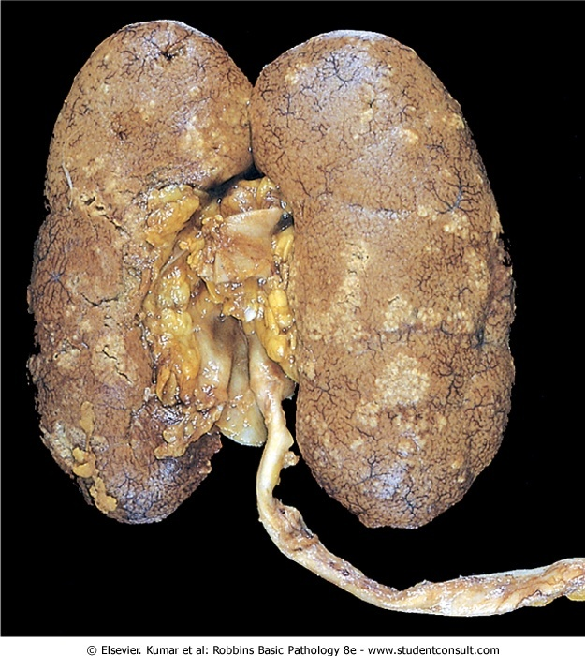
Acute pyelonephritis.
The cortical surface is studded with focal pale abscesses

Slide 42
Drug-Induced Interstitial Nephritis
Two forms of TIN caused by drugs are :
1-Acute Drug-Induced Interstitial
Nephritis
2-Analgesic Nephropathy
Acute TIN
1-most frequently occurs with synthetic penicillins (methicillin, ampicillin)
2- other synthetic antibiotics (rifampin), diuretics (thiazides)
3- nonsteroidal anti-inflammatory agents
4-other drugs (phenindione, cimetidine

Slide 43
Pathogenesis
Many features of the disease suggest an immune mechanism.
Clinical evidence of hypersensitivity is not dose related.
Serum IgE levels are increased in some persons suggesting type I hypersensitivity.
The mononuclear or granulomatous infiltrate, together with positive skin tests to drugs, suggests a T cell-mediated (type IV) hypersensitivity reaction.

Slide 44
Morphology
the interstitium shows pronounced edema and infiltration by mononuclear cells, lymphocytes and macrophages .
Eosinophils and neutrophils may be present, often in large numbers.
With some drugs (e.g., methicillin, thiazides, rifampin), interstitial non-necrotizing granulomas with giant cells may be seen.
The glomeruli are normal except in some cases caused by nonsteroidal anti-inflammatory agents.

Slide 45
Clinical course
The disease begins about 15 days (range 2-40 days) after exposure to the drug.
It is characterized by fever, eosinophilia & rash in about 25% of persons, and renal abnormalities.
Renal findings include hematuria, minimal or no proteinuria, and leukocyturia (sometimes including eosinophils).

Slide 46
A rising serum creatinine or acute renal failure with oliguria develops in about 50% of cases, particularly in older patients.
It is important to recognize drug-induced renal failure, because withdrawal of the offending drug is followed by recovery although it may take several months for renal function to return to normal

Slide 47
Analgesic Nephropathy: chronic drug-induced
Consumption large quantities of analgesics may cause chronic interstitial nephritis often associated with renal papillary necrosis.
ingestion of single types of analgesics or, most commonly people who develop this nephropathy consume mixtures containing some combination of phenacetin, aspirin, acetaminophen, caffeine, and codeine for long periods.
Aspirin and acetaminophen are common causes
While they can cause renal disease in apparently healthy individuals preexisting renal disease seems to be a necessary precursor to analgesic-induced renal failure

Slide 48
Pathogenesis
not entirely clear.
Papillary necrosis is the initial event, and the interstitial nephritis in the overlying renal parenchyma is a secondary phenomenon.
covalent binding and oxidative damage→ Acetaminophen
inhibition of prostaglandin synthesis→ aspirin

Slide 49
Morphology
The papillae show coagulative necrosis
dystrophic calcification may occur in the necrotic areas.
tubular atrophy, interstitial scarring, and inflammation.
The small vessels in the papillae and urinary tract submucosa exhibit characteristic PAS-positive basement membrane thickening.

Slide 50
Clinical Course
Chronic renal failure, hypertension, and anemia.
The anemia results in part from damage to red cells by phenacetin metabolites.
A complication of analgesic abuse is the increased incidence of transitional-cell carcinoma of the renal pelvis or bladder in persons who survive the renal failure.

Slide 51
Acute Tubular Necrosis (ATN)
ATN is a clinicopathologic entity characterized morphologically by damaged tubular epithelial cells and clinically by acute suppression of renal function.
It is the most common cause of acute renal failure.
In acute renal failure, urine flow falls within 24 hours to less than 400 mL/day (oliguria).

Slide 52
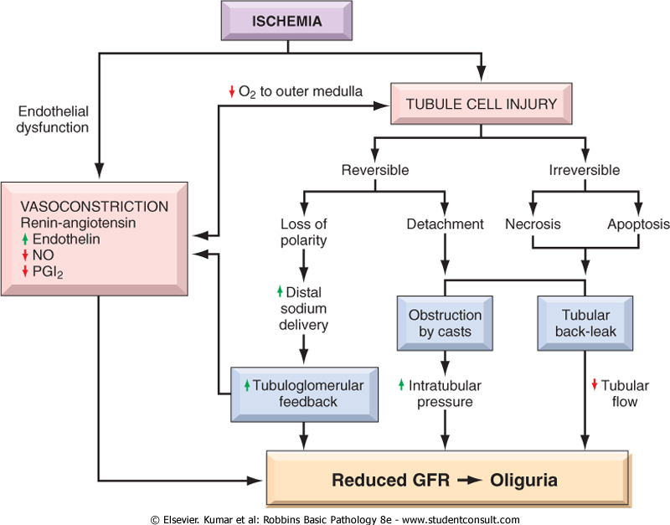
ATN: pathogenesis

Slide 53
ATN is a reversible renal lesion.
predisposing clinical settings:
Types:
1- ischemic ATN : most common variant
is associated with shock that result from either:
1- severe trauma.
2- acute pancreatitis.
3- septicemia.
4- mismatched blood transfusions and other hemolytic crises, as well as myoglobinuria.

Slide 54
2- nephrotoxic ATN
poisons including heavy metals (e.g., mercury)
organic solvents (e.g., carbon tetrachloride)
drugs such as gentamicin and other antibiotics, and radiographic contrast agents.

