Slide 1
Pathology of the Fallopian tubes
Inflammations (Salpingitis)
almost always bacterial in origin.
Chlamydia, Mycoplasma , coliforms, (postpartum) strept. and staph. are now the major offenders.
fever, lower abdominal or pelvic pain, and pelvic masses when the tubes become distended with exudate.

Slide 2
Inflammations (Salpingitis)
Complications:
Adherence of tube to ovary → tubo-ovarian abscess.
more serious→ adhesions of the tubal plicae, and increasing the risk of tubal ectopic pregnancy.
Damage or obstruction of the tubal lumina may produce permanent sterility

Slide 4
Tubal malignancies
Currently, primary adenocarcinomas of the fallopian tubes are considered rare.
The most common is serous carcinoma.
fallopian tube carcinomas are increased in women with BRCA mutations ( In studies of prophylactic oophorectomies:10% →occult foci of malignancy usually in the fimbria).
Because the lumen and fimbria of the fallopian tube have access to the peritoneal cavity, fallopian tube carcinomas frequently involve the omentum and peritoneal cavity at time of presentation.

Slide 5
ECTOPIC PREGNANCY
is implantation of the fertilized ovum in any site other than the normal uterine location.
Incidence: 1% of pregnancies.
In 90% of these cases →fallopian tubes
other sites: ovaries, abdominal cavity
Predisposing factors: tubal obstruction (50% either due to chronic inflammatory changes in the oviduct; tumors; and endometriosis); IUCD..
In 50% of tubal pregnancies, no anatomic cause can be demonstrated.
Early: normal early development of the embryo, with the formation of placental tissue, the amniotic sac, and decidual changes
Later: the placenta eventually burrows through the wall, causing intratubal hematoma (hematosalpinx), intraperitoneal hemorrhage.
Rupture of an ectopic pregnancy may be catastrophic, with the sudden onset of intense abdominal pain and signs of an acute abdomen, often followed by shock. Prompt surgical intervention is necessary.

Slide 6
Trophoblastic diseases

Slide 7
Hydatidiform Mole: Complete and Partial
Are 2 forms of abnormal gestational processes. The two patterns result from abnormal fertilization:
in a complete mole an empty egg is fertilized by two spermatozoa (or a diploid sperm), yielding a diploid karyotype composed of entirely paternal genes
In a partial mole a normal egg is fertilized by two spermatozoa (or a diploid sperm), resulting in a triploid karyotype with a predominance of paternal genes

Slide 8
Hydatidiform Mole: Complete and Partial
Morphology: cystically dilated chorionic villi (grapelike structures); villi are covered by varying amounts of mildly to highly atypical chorionic epithelium.

Slide 9
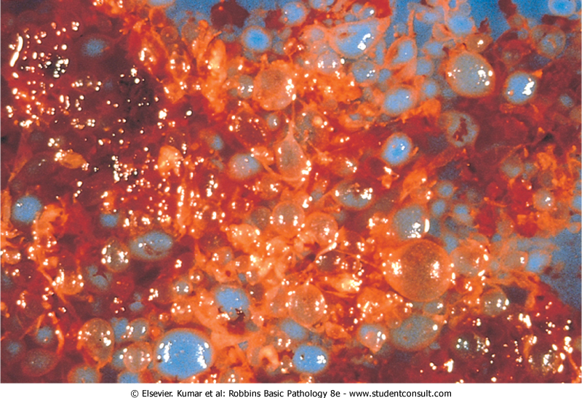
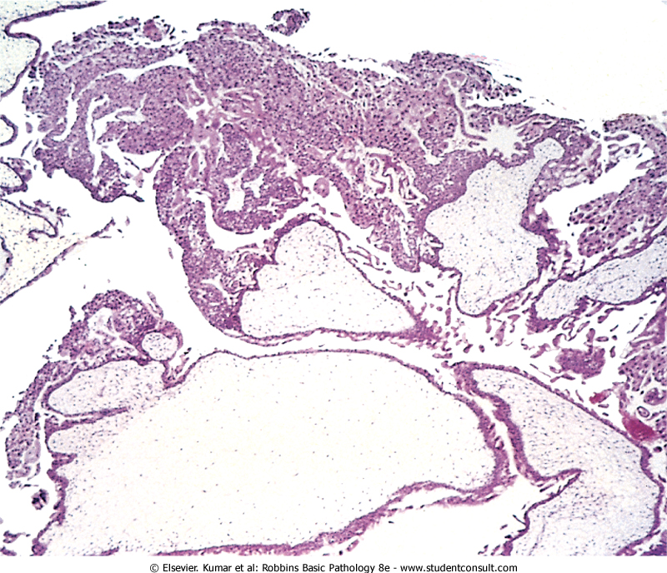

Slide 10
complete hydatidiform mole→ does not permit embryogenesis = never contains fetal parts, and the chorionic epithelial cells are diploid (46,XX or, uncommonly, 46,XY).
partial hydatidiform mole → compatible with early embryo formation and may contains fetal parts, has some normal chorionic villi, and is almost always triploid (e.g., 69,XXY).

Slide 11
Feature | Complete Mole | Partial Mole
Karyotype | 46,XX (46,XY) | Triploid (69,XXY)
Villous edema | All villi | Some villi
Trophoblast proliferation | Diffuse; circumferential | Focal; slight
Atypia | Often present | Absent
Serum hCG | Elevated | Less elevated
hCG in tissue | ++++ | +
Behavior | 2% choriocarcinoma | Rare choriocarcinoma

Slide 12
incidence → 1 to 1.5 per 2000 pregnancies in the US and other Western countries.
For unknown reasons there is a much higher incidence in Asian countries.
Moles are most common before maternal age 20 years and after age 40 years

Slide 13
a previous history of molar pregnancy increases the risk in subsequent pregnancies.
Early monitoring of pregnancies by ultrasound → early diagnosis of hydatidiform mole.
Clinically: Elevations of hCG in the maternal blood and absence of fetal parts or fetal heart sounds are typical.

Slide 14
Prognosis:
complete moles:
80% to 90% → no recurrence after curettage
10% → invasive mole (invades myometrium)
2% to 3% → choriocarcinoma.
Partial moles:
better prognosis and rarely give rise to choriocarcinomas.

Slide 15
Choriocarcinoma
This very aggressive malignant tumor arises either from gestational chorionic epithelium or, from totipotential cells within the gonads.
rare in the Western hemisphere (1 in 30,000 pregnancies). They are much more common in Asian and African countries, reaching a frequency of 1 in 2000 pregnancies.

Slide 16
The risk is somewhat greater before age 20 and is significantly elevated after age 40.
50% of choriocarcinomas arise in complete hyaditidiform moles; 25% arise after an abortion, and most of the rest in normal pregnancy.

Slide 17
the more abnormal the conception, the greater is the risk of developing gestational choriocarcinoma.
Clinically: bloody, brownish discharge accompanied by a very high titer of hCG, in blood and urine.

Slide 18
Choriocarcinoma- Morphology
Grossly: very hemorrhagic, necrotic masses within the myometrium and into vessels of uterus.
Sometime, the primary lesion may self-destruct, and only the metastases are present.
Microscopically: In contrast to hydatidiform moles and invasive moles, chorionic villi are not formed; instead, the tumor is purely epithelial, composed of anaplastic cuboidal cytotrophoblast and syncytiotrophoblast.

Slide 19
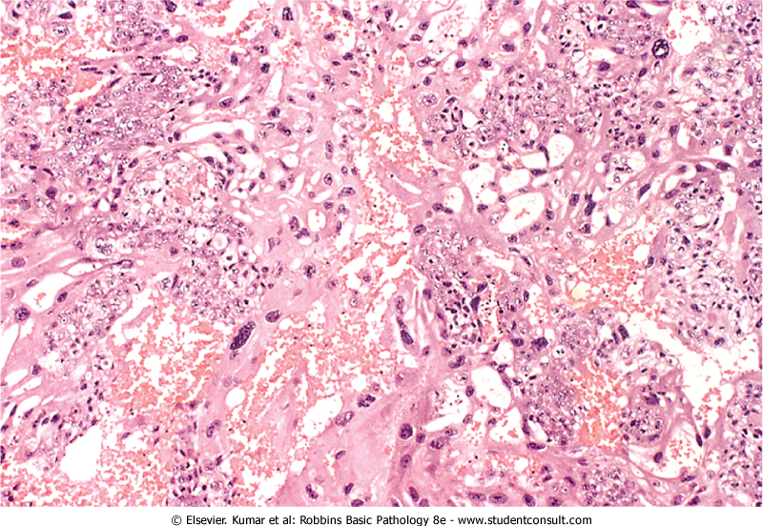

Slide 20
Prognosis
By the time discovered, there is usually widespread dissemination via the blood, most often to the lungs (50%), vagina (30% to 40%), brain, liver, and kidneys.
Lymphatic invasion is uncommon
Despite the extreme aggressiveness of these neoplasms, which made them nearly uniformly fatal in the past, current chemotherapy has achieved remarkable results.
By contrast, there is relatively poor response to chemotherapy in choriocarcinomas that arise in the gonads (ovary or testis).

