Slide 1
Thyroid Disorders
Hussam AlHawari, MD, FACE, ECNU
Consultant Endocrinologist
Assistant Professor of Medicine
Department of Internal Medicine
Faculty of Medicine
University of Jordan

Slide 2
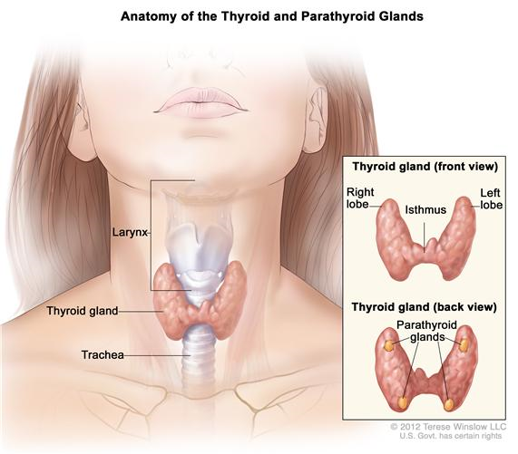
Introduction
The thyroid is one of the largest of the endocrine organs, weighing approximately 15 to 20 g.
It has a tremendous
potential for growth
→ termed a goiter,
can weigh many
hundreds of grams.

Slide 3
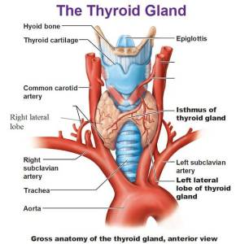
The normal thyroid is made up of two lobes joined by a thin band of tissue, the isthmus.
Two pairs of vessels constitute the major arterial blood supply, the superior thyroid artery, arising from the
external carotid artery,
and the inferior thyroid
artery, arising from the
subclavian artery.

Slide 4
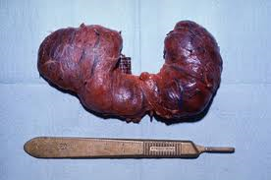
Estimates of thyroid blood flow range from 4 to 6 mL/min/g, well in excess of the blood flow to the kidney (3 mL/min/g). In diffuse toxic goiter due to Graves' disease,
blood flow may
exceed 1 L/min and
be associated with
an audible bruit or
even a palpable thrill.

Slide 5
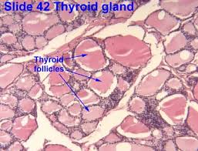
The gland is composed of closely packed spherical units termed follicles, which are invested with a rich capillary network. The interior of the follicle is filled with the clear proteinaceous colloid that normally is the major constituent of the total thyroid mass.
On cross section, thyroid tissue appears as closely
packed ring-shaped structures
consisting of a single layer of
thyroid cells surrounding a
lumen.

Slide 6
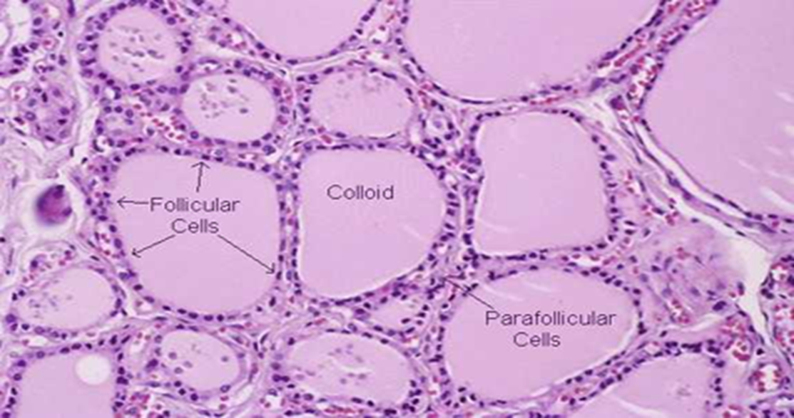
The thyroid also contains para-follicular cells, or C cells, that are the source of calcitonin.
The C cells undergo hyperplasia early in the syndrome of familial medullary carcinoma of the thyroid (MEN2) and give rise to this tumor in both its familial and its sporadic forms

Slide 7
(A) Normal thyroid gland. (B) Normal thyroid follicles. (C) Parafollicular cells. Calcitonin immunostain.

Slide 8
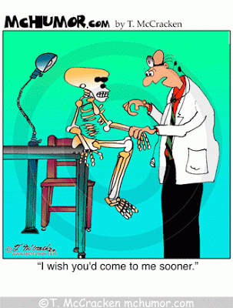
Laboratory/Radiologic assessment of thyroid Status
Goal is to assess the functional and anatomic status.
Laboratory determinations will confirm whether there is an excess, normal, or insufficient supply of thyroid hormone to
verify the inferences
from the clinical
history and physical
examination.

Slide 9
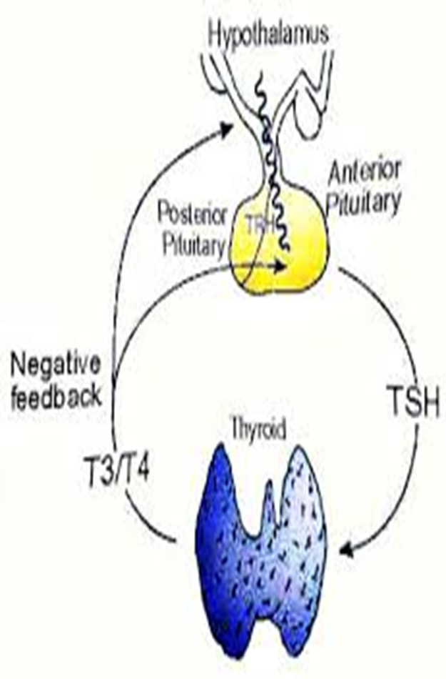
Laboratory/radiologic tests can be divided into four major categories:
(1) Those that assess the state of the hypothalamic-pituitary-thyroid axis.
(2) Tests that reflect the impact of thyroid hormone on tissues.

Slide 10
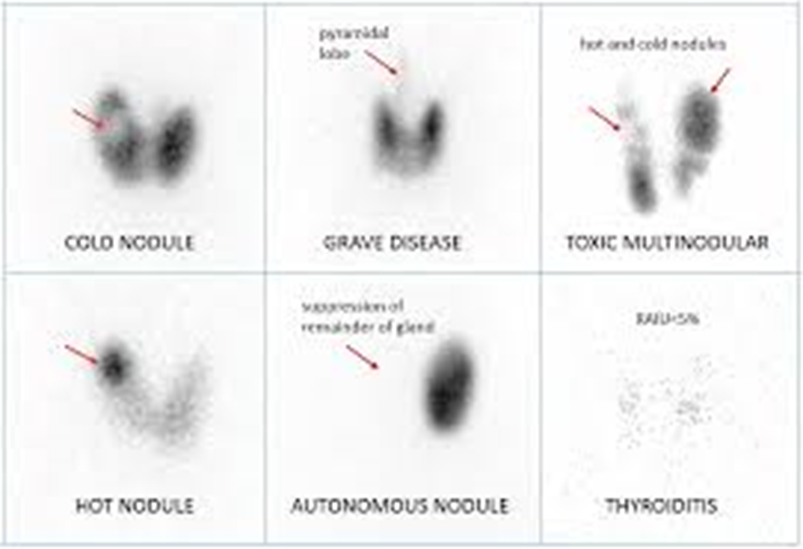
(3) Tests for the presence of autoimmune thyroid disease.
(4) Tests that provide information about thyroidal iodine metabolism. The use of iodine and other isotopes for scintiscanning.

Slide 12
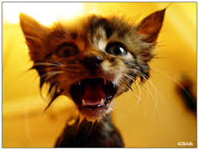
THYROTOXICOSIS

Slide 13
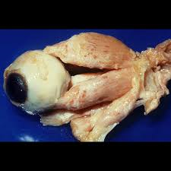
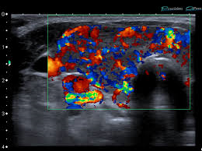

Slide 14
Causes of Thyrotoxicosis
Disorders with increased Iodine uptake:
Graves’ disease
Toxic MNG/adenoma
Inherited non-immune hyperthyroidism
Hyperthyroidism due to thyrotropin secretion (TSH-oma).
HCG-induced hyperthyroidism – Associated with pregnancy or Trophoblastic Tumors

Slide 15
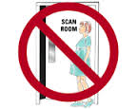
DO NOT DO THYROID UPTAKE AND SCAN DURING PREGNANCY.

Slide 16
Disorders with decreased Iodine uptake:
Sub-acute thyroiditis.
Iatrogenic thyrotoxicosis
Strauma ovarii
Metastatic thyroid carcinoma

Slide 19
Treatment?
In cases of Graves’ disease, toxic MNG or adenoma:
Anti-thyroid medications, i.e carbimazole
I131 treatment
Surgery
Temporary beta blockers for symptoms control.
In cases of subacute thyroiditis → Temporary beta blockers, NSAID’s and/or steroids for symptoms control.

Slide 20
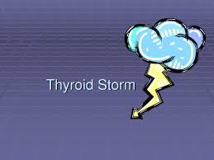
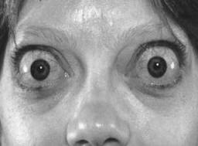
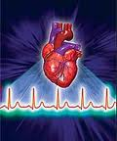
THYROID STORM/THYROID CRISES
An acute, life-threatening,
hypermetabolic state induced
by excessive release of
thyroid hormones.
Presentation: Fever,
tachycardia, HTN , and
neurological and GI
abnormalities.

Slide 21
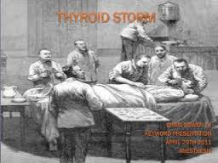
Rapid diagnosis and aggressive treatment are critical.
Diagnosis is primarily clinical
Management: Supportive measures, Propylthiouracil and Beta blockers.

Slide 22
Case#1
All of the following etiologies of thyrotoxicosis can cause increased thyroid iodine uptake except:
Graves’ disease
Toxic Multi-nodular goiter
Hyperthyroidism due to thyrotropin secretion (TSH-oma).
Iatrogenic thyrotoxicosis

Slide 23
Graves’ disease
Toxic Multi-nodular goiter
Hyperthyroidism due to thyrotropin secretion (TSH-oma).
Iatrogenic thyrotoxicosis

Slide 24
Case#2
22 y/o female with no known medical problems, presented to endocrinology clinic for further evaluation of a newly diagnosed thyrotoxicosis which was confirmed per repeat labs, on PE she was noted to have a mild bilateral exophthalmus. The most likely cause of her thyrotoxicosis is:
Graves’ Disease
Toxic MNG
Iatrogenic thyrotoxicosis
TSH-oma

Slide 25
Graves’ Disease
Toxic MNG
Iatrogenic thyrotoxicosis
TSH-oma

Slide 26
Case#3
18 y/o pregnant female, currently 26+ weeks pregnant, presented with thyrotoxicosis, exam showed a 4 cm palpable right thyroid nodule, labs with suppressed TSH and high Free T4. The best next step in management is:
Proceed with thyroid uptake and scan.
Start her on low dose methimazole, repeat thyroid labs after 4 weeks.
Proceed with empiric I131 treatment.
Proceed with right thyroid nodule FNA

Slide 27
Proceed with thyroid uptake and scan.
Start her on low dose methimazole, repeat thyroid labs after 4 weeks.
Proceed with empiric I131 treatment.
Proceed with right thyroid nodule FNA

Slide 28
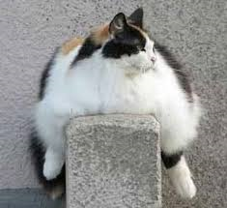
Hypothyroidism

Slide 29
Typical appearance with moderately severe primary hypothyroidism or myxedema

Slide 30
Causes of hypothyroidism
Hashimoto’s thyroiditis.
Post total thyroidectomy.
Post I131 treatment
Congenital, i.e Thyroid agenesis or dysplasia,
Medications, i.e Lithium and Amiodarone.
Iodine deficiency
Central hypothyroidism
Thyroid infiltration, i.e Riedel’s struma, amyloidosis, and hemochromatosis

Slide 32
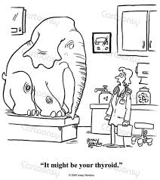
Treatment
Levothyroxine replacement.
No need for additional T3 replacement.
In older people with history of CAD, start with a low dose and then titrate dose up slowly.

Slide 33
Myxedema coma/Myxedema crises
An uncommon but a life-threatening form of untreated hypothyroidism with physiological decompensation.
The condition occurs in patients with long-standing, untreated hypothyroidism and is usually precipitated by a secondary insult, such as climate-induced hypothermia, infection, or another systemic condition, or drug therapy.

Slide 34
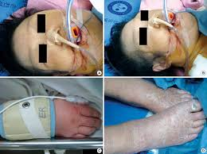
Patients with myxedema coma have changes in their mental status, including lethargy, stupor, delirium, or coma.
Treatment:
Supportive measures
IV levothyroxine
In light of the possibility
of adrenal insufficiency,
stress steroid
replacement after a
cortisol level is obtained.

Slide 35
Case#4
85 y/o man with known history of CAD s/p CABG one year ago, current weight is 70 kg, he was found to have primary hypothyroidism per recent routine labs, TSH was 18.0, Free T4 was slightly low, unremarkable thyroid exam, no previous TFTs were available for comparison. The best next step in management is:
Start levothyroxine 25 mcg daily
Start levothyroxine 100 mcg daily
Do not start levothyroxine and repeat TFTs after 4-6 weeks
Proceed with thyroid ultrasound before making decision on treatment

Slide 36
Start levothyroxine 25 mcg daily
Start levothyroxine 125 mcg daily
Do not start levothyroxine and repeat TFTs after 4-6 weeks
Proceed with thyroid ultrasound before making decision on treatment

Slide 37
NONTOXIC DIFFUSE AND NODULAR GOITER AND THYROID NEOPLASIA

Slide 38
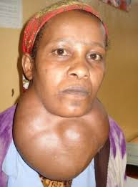
NONTOXIC GOITER: DIFFUSE AND NODULAR
Nontoxic goiter may be defined as any thyroid enlargement characterized by uniform or selective growth of thyroid tissue that is not associated with overt hyperthyroidism or hypothyroidism and that does not result from inflammation or neoplasia.
A thyroid nodule is defined as a discrete lesion within the thyroid gland that is due to an abnormal focal growth of thyroid cells.
Risk factors:
Familial
Iodine deficiency
Smoking
Alcohol
Older age
Female sex
Hx of uterine fibroids

Slide 39
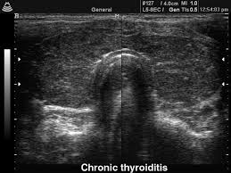
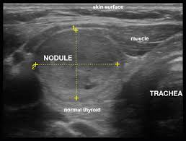
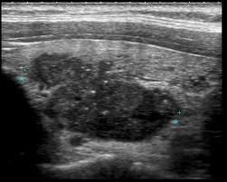

Slide 40
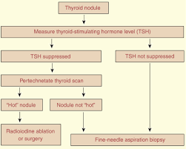
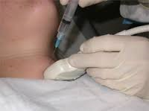
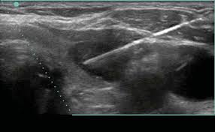

Slide 41
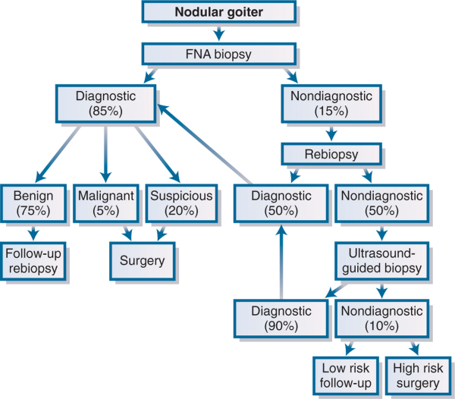

Slide 42
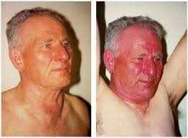
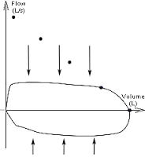
Indications for thyroid surgery
Malignancy
Indeterminate and/or repeatedly nondiagnostic FNA results
Cosmetic, mostly in females
Obstructive symptoms

Slide 43
Case#5
70 y/o man with history of colon cancer, presented with incidentally found 4 cm right thyroid nodule per carotid duppler. The best next step in management is:
Check TSH
Proceed with CT neck
Proceed with right thyroid nodule FNA
PET/CT scan

Slide 44
Check TSH
Proceed with CT neck
Proceed with right thyroid nodule FNA
PET/CT scan

Slide 45
Case#6
25 y/o man, presented to thyroid clinic as consultation for a 6x5cm right solitary thyroid nodule confirmed per recent outside thyroid ultrasound. He has a positive Pemberton sign per exam. TSH was normal. Best next step in management is:
Thyroid uptake and scan
Repeat thyroid US after 3-6 months
Thyroid nodule FNA
Right hemithyroidectomy

Slide 46
Thyroid uptake and scan
Repeat thyroid US after 3-6 months
Thyroid nodule FNA
Right hemithyroidectomy

Slide 47
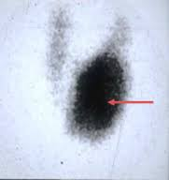
Case#7
36 y/o female presented with palpable left thyroid nodule and hyperthyroidism, thyroid scan was as shown in the figure. The best next step in management:
Start Methimazole
Left thyroid nodule FNA
No treatment but repeat thyroid US and scan after 6 months
Total thyroidectomy

Slide 48
Start Methimazole
Left thyroid nodule FNA
No treatment but repeat thyroid US and scan after 6 months
Total thyroidectomy

Slide 49
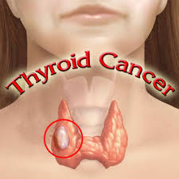
Thyroid cancer
The National Cancer
Institute indicates that thyroid
cancer is the most common
type of endocrine-related
cancer and estimates 60,220
new cases in 2013.
Thyroid cancer represents
approximately 3.6% of all new cancer cases.

Slide 50
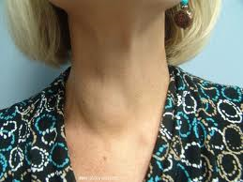
Although a diagnosis of thyroid
or any type of cancer is
frightening, the vast majority of
thyroid cancers is highly treatable
and in most cases curable with
surgery and other treatments.
Thyroid cancer is generally first
suspected by a lump or nodule
in the thyroid gland.

Slide 51
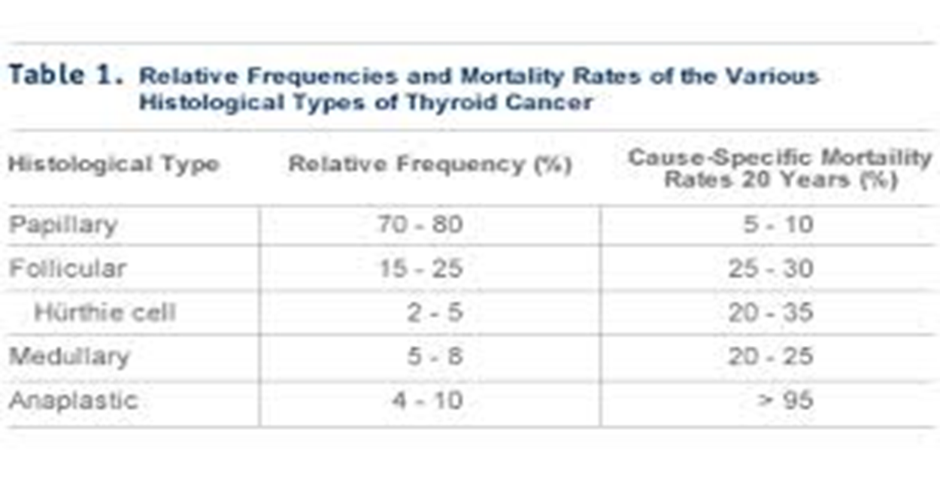

Slide 52
1. Papillary Thyroid Cancer
Most common type of thyroid cancer: 70% to 80% of all thyroid cancers are papillary thyroid cancer
Commonly diagnosed between the ages of 30 and 50
Females are affected 3 times more often than males
Usually not aggressive
May spread, but usually not beyond the neck

Slide 53
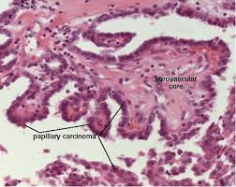
Papillary cells resemble finger-like projections
Tumor development can be related to radiation exposure, such as radiation treatments for acne or adenoid problems as a child

Slide 54
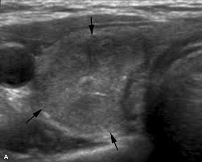
2. Follicular Thyroid Cancer
Makes up about 10% to15% of all thyroid cancers
Often diagnosed between the ages of 40 and 60
Females are affected 3 times more often than males
Cancer cells may invade
blood vessels and travel
to other body parts such
as bone or lung tissues

Slide 55
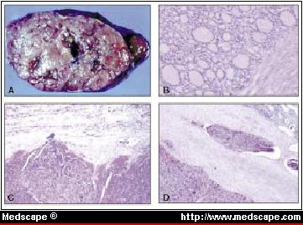
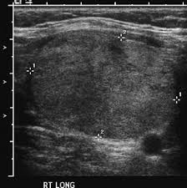
Follicular cells are sphere-shaped
Can be more aggressive in older patients
(A) Follicular adenoma with variegated gross appearance. (B) Follicular adenoma. The periphery of the tumor is surrounded by a fibrous capsule. (C) Follicular adenoma with indentation of the inner aspect of the tumor capsule. (D) Follicular carcinoma with vascular invasion with tumor attachment to the endothelium.

Slide 56
3. Medullary Thyroid Cancer
Makes up about 5 % to 10% of all thyroid cancers
More likely to run in families and associated with other endocrine disorders
Develops from the C Cells or parafolicullar cells that produce calcitonin
An elevated calcitonin level can indicate cancer

Slide 57
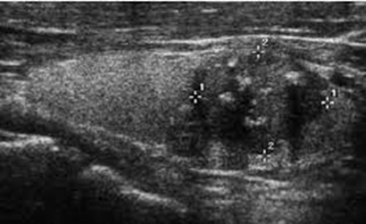
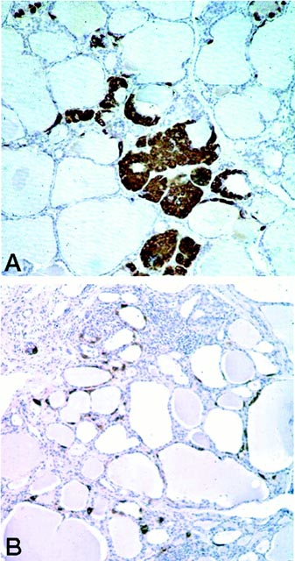
Often diagnosed between the ages of 40 and 50
Females and males are equally affected
Forms of medullary thyroid cancer include sporadic (not inherited), MEN 2A and MEN 2B, and familial (genetic, but not linked to other MEN-related endocrine tumors)

Slide 58
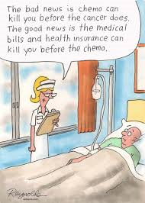
4. Anaplastic Thyroid Cancer
Very rare—affects fewer than 5% of thyroid cancer patients
Usually occurs in
patients older than
65 years
Females are affected
more often than males

Slide 59
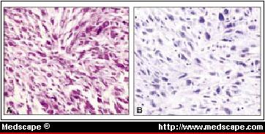
Anaplastic means the cells lose normal structure and organization →Aggressive and invasive
Least responsive to treatment
Undifferentiated (anaplastic) carcinoma. (A) Spindle cells in storiform growth pattern. (B) Prominent hyperchromatism and atypia of tumor cells

Slide 60
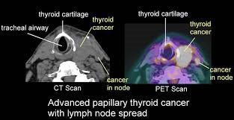
Diagnostic tests
1. Imaging studies (thyroid ultrasound, CT neck, PET scan).

Slide 61
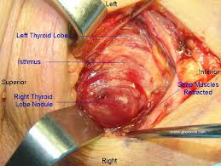
2. The gold standard is thyroid FNA or surgery.

Slide 62
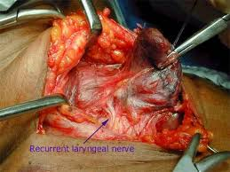
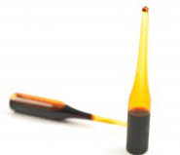
Treatment
1. Surgery (total, subtotal or hemi-thyroidectomy)→ Need an experienced thyroid surgeon.
2. I131 ablation

Slide 63
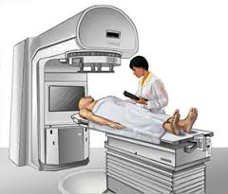
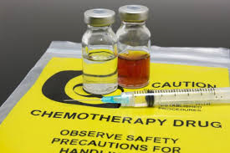
3. External beam radiation
4. Chemotherapy

Slide 64
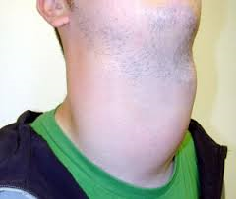
Secondary thyroid tumors
Thyroid lymphoma
Metastasis (Kidney, Lung, Bone, Melanoma)

Slide 65
Case#8
The thyroid cancer type with the worst prognosis is:
Papillary
Follicular
Medullary in the settings of MEN syndrome
Anaplastic

Slide 66
Papillary
Follicular
Medullary in the settings of MEN syndrome
Anaplastic

Slide 67
Williams Textbook of Endocrinology
Medscape.com
UpToDate.com

