Slide 1
Thyroid and Antithyroid Drugs
Munir Gharaibeh, MD, PhD, MHPE
Faculty of Medicine
Summer 2015

Slide 2
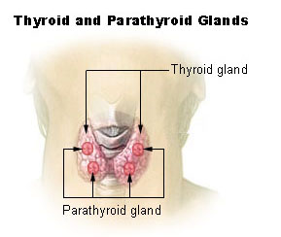
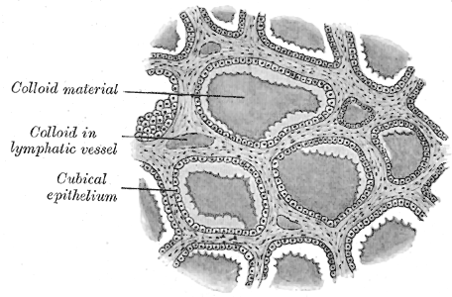
Anatomy and histology of the thyroid gland
Located in the neck at the level of the 5th cervical vertebra (C5).
Composed of epithelial cells which specialize in the absorption of iodine and, of course, secretion of thyroid hormones.
Follicles surround a protein core, the colloid, where thyroglobulin ( a substrate in thyroid hormone synthesis) and thyroid hormones are stored.
(Follicular Cells)

Slide 3
Thyroid Hormones
3 hormones
Thyroxin (3,5,3’,5’-tetraiodothyronine) or (T₄)
Triiodothyronine (T₃)
Calcitonin
T₃ and T₄ are iodine containing amino acid derivatives.
Every tissue in the body is affected by thyroid hormones.
There are no discrete target tissue.

Slide 4
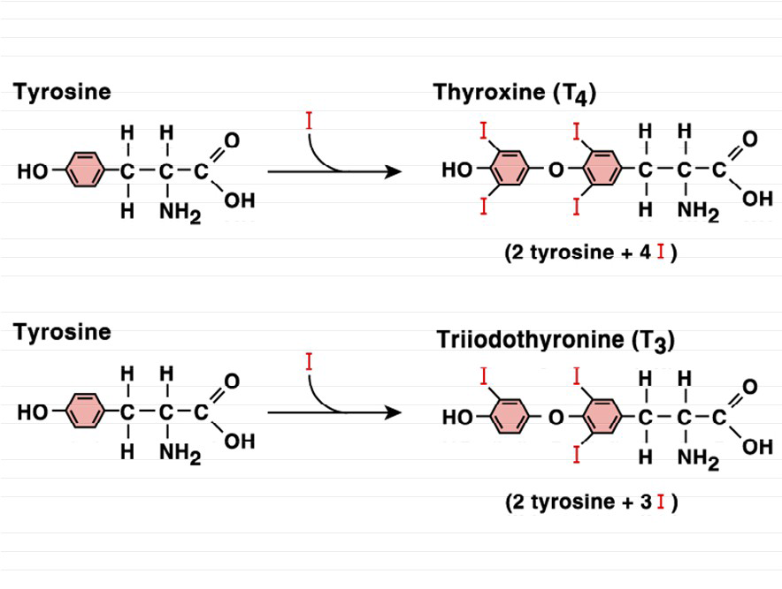
Thyroxin Synthesis

Slide 5
Iodide
Needed for synthesis of thyroid hormones
Sources:
Iodized salt, Iodated bread, and dairy products
Daily requirement: 75 micrograms.
Thyroid peroxidase enzyme
Lysosomal enzymes hydrolyze thyroglobulin.
Most of released T4 is converted peripherally to T3 by deiodinase enzyme
Thyroid hormones travel in blood bound to a specific thyroxine binding globulin (TBG)

Slide 6
Physiological Actions
Normalize growth and development, body temperature, and energy levels.
Influence the metabolism of proteins, carbohydrates, and lipids.
Constant circulating concentrations of T₃ and T₄ are required for their proper effect.
Calcitonin is important in the regulation of calcium metabolism

Slide 7
Effects of Thyroid Hormones on Metabolism
THs serve as a nuclear transcription factor, regulating gene expression in targeted cells to increase metabolism.
Increase size and number of mitochondria in the cell.
Synthesize cytochromes which feed into the electron transfer chain of cellular respiration, stimulating metabolism through increasing ATP production.
Increase ATPase concentration.
Increase K⁺ and Na⁺ concentrations in the cell.
Increase BMR to maintain electrochemical gradient in the cell.
Stimulate carbohydrate metabolism and lipolysis.
Affect protein synthesis.
Increase the body sensitivity to cathecholamines.

Slide 8
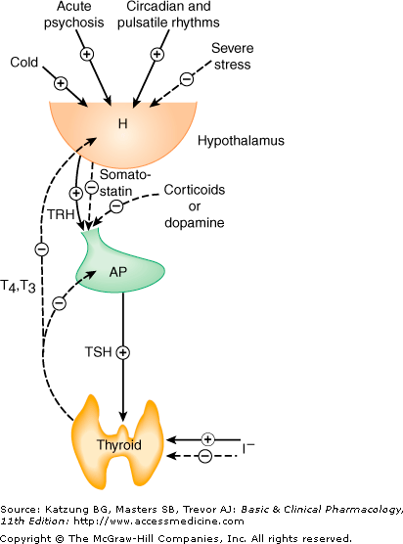
The hypothalamic-pituitary-thyroid axis

Slide 9
The Wolff–Chaikoff Effect
This is a reduction in thyroid hormone levels caused by ingestion of large amounts of iodine.
Small amounts of iodide are necessary for hormone production, but large amounts inhibit T3 and T4 production and release.
It is an autoregulatory phenomenon that inhibits organification (oxidation of iodide) in the thyroid gland, the formation of thyroid hormones inside the thyroid follicle, and the release of thyroid hormones into the bloodstream

Slide 10
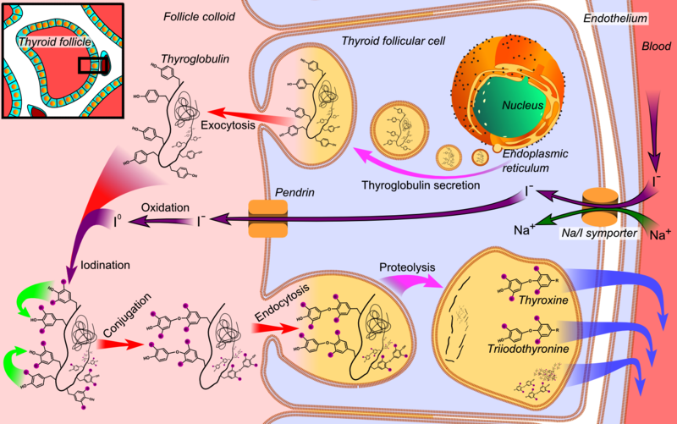
Synthesis of thyroid hormones
Notes:
Thyroglobulin is synthesized in the rough endoplasmic reticulum and follows the secretory pathway to enter the colloid in the lumen of the thyroid follicle by exocytosis. - Meanwhile, a sodium-iodide (Na/I) symporter pumps iodide (I⁻) actively into the cell, which previously has crossed the endothelium by largely unknown mechanisms. - This iodide enters the follicular lumen from the cytoplasm by the transporter pendrin, in a purportedly passive manner.^{[24]} - In the colloid, iodide (I⁻) is oxidized to iodine (I⁰) by an enzyme called thyroid peroxidase. - Iodine (I⁰) is very reactive and iodinates the thyroglobulin at tyrosyl residues in its protein chain (in total containing approximately 120 tyrosyl residues). - In conjugation, adjacent tyrosyl residues are paired together. - The entire complex re-enters the follicular cell by endocytosis. - Proteolysis by various proteases liberates thyroxine and triiodothyronine molecules, which enter the blood by largely unknown mechanisms

Slide 11
Synthesis of Thyroid Hormones
Follicular cells transport Iodide across the cell.
These cells secrete precursor protein thyroglobulin into the follicular lumen.
An enzyme thyroperoxidase (TPO) catalyzes the conversion of iodide (I₂) to iodine (I-) using H₂O₂ as a cofactor.
TPO then catalyzes the addition of iodine to the C-3 and C-5 position of a tyrosine residue of thyroglobulin.
Two iodinated tyrosine rings condense to form thyroxine, or T4, with four iodine substituents.
Triiodothyronine, or T3, with three iodine substituents, accounts for about 10% of thyroid hormone

Slide 12
Thyroid Agents
These are used as supplements in the treatment of hypothyroidism:
Levothyroxine (T4) (Eltroxin)
Liothyronine (T3)
Liotrix (a 4:1 ratio of T4: T3)
Disiccated Natural Thyroid(T3 and T4).

Slide 13
Antithyroid Agents
These are used in the treatment of hyperthyroidism:
Radioactive iodine (¹³¹I) sodium
Methimazole
Potassium iodide: Oral solution, tablets
Propylthiouracil
Thyrotropin.

Slide 14
Hypothyroidism
A syndrome resulting from deficiency of thyroid hormones and is manifested largely by a reversible slowing down of all body functions.
In infants and children, there is striking retardation of growth and development that results in growth and mental retardation, which could be irreversible(Cretinism).

Slide 15
Hypothyroidism
In Children → Cretinism
In adults → Myxedema
Causes:
Surgical removal of thyroid
Thyroiditis (Hashimoto’s)
Inflammatory disease causing atrophy of thyroid.
Infectious; transient; postpartum;
Severe deficiency or excess of iodine
Severe deficiency of one or more of the synthesis enzymes
Severe pituitary or hypothalamic dysfunction
Drug induced…

Slide 16
Hypothyroidism
Causes lethargy and weight gain, among other symptoms.
Primary hypothyroidism is typically caused by Hashimoto’s Disease, an auto-immune disorder in which the thyroid is destroyed by antibodies.
Impaired hypothalamus and pituitary function, typically due to a tumor, can inhibit the secretion of TSH, causing secondary hypothyroidism.
A diet insufficient in iodine causes hypothyroidism as well.

Slide 17
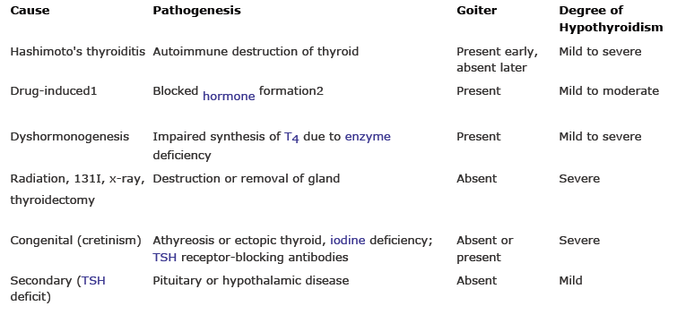
The etiology and pathogenesis of hypothyroidism

Slide 18
Treatment of Hypothyroidism
Hormone replacement therapy.
Thyroxine can be administered orally with a bioavailability ranging from 48%-80%.
Levothyroxine—Synthetic T4
Liothyronine—Synthetic T3
Liotrix—Combination of synthetic T4 and T3 in a ratio of 4:1.
Desiccated natural thyroid hormone—derived from pigs, contains T4 and T3.

Slide 19
Treatment of hypothyroidism
Dosage specific to individual and is determined by their TSH serum levels.
Because thyroid hormones increase heart rate, T4, the inactive form, is typically administered to older patients who have an increased risk for heart attack.
Synthetic T3 is reserved for younger patients, who do not have a history of heart problems and individuals non-responsive to T4 treatment.
Some patients are inefficient in the conversion of T4 to T3, making combination drugs like Liotrix and desiccated thyroid ideal treatment options.
Dosage for individuals suffering from secondary hypothyroidism is determined by the amount of free T4 and T3 circulating in their system.
Administering too high of a dosage leads to hyperthyroid symptoms.

Slide 20
Hyperthyroidism
Symptoms include fatigue, weight loss, rapid heart beat, anxiety, swollen eyes, and sensitivity to hot temperatures.
Causes:
Grave’s disease, an autoimmune disorder in which antibodies serve as agonists to the TSH receptors on the thyroid’s surface, causing thyroid growth and activation of hormone synthesis and secretion.
Thyroid tumors which cause the uncontrolled synthesis and secretion of thyroid hormones.
Thyroiditis, inflammation of the thyroid typically caused by infection.

Slide 21
Treatment of Hyperthyroidism
Anti-thyroid drugs(Thiourea derivatives orThionamides):
Propylthiouracil
Methimazole
Carbamizole
Interfere with oxidation, iodination, and coupling reactions.
Inhibit thyroid hormone synthesis by irreversibly binding to TPO inhibiting its ability to break down iodine (I₂→I⁻) and covalently attach it to the tyrosine residue of thyroglobulin.
Side effects:
Allergy, Hepatic dysfunction, Agranulocytosis, Teratogenicity.
Disadvantages:
Prolonged Rx, Delayed onset of action (12-18 hrs), Side effects, - High relapse rate.

Slide 22
Treatment of Hyperthyroidism
Anti-thyroid drugs.
Iodide (K+ or Na+):
Solution and oral tab.
↓ oxidation ↓ release of T4, T3 ?↓ uptake
Can cause allergy.
Widely used before thyroid surgeries to ↓ vascularity of the thyroid gland
Beta Blockers
Radioactive Iodine
Thyroidectomy

Slide 23
Treatment of Hyperthyroidism
Anti-thyroid drugs.
Iodide (K+ or Na+):
Beta Blockers:
Only control the symptoms.
Radioactive Iodine
Thyroidectomy

Slide 24
Treatment of Hyperthyroidism
Anti-thyroid drugs.
Iodide (K+ or Na+)
Beta Blockers:
Radioactive Iodine:
Higher remission rates , 10% will fail first treatment and require a second dose of 131I.
Cause hypothyroidism, dose dependent
Contraindications: pregnancy (absolute), ophthalmopathy (relative) , may cause or worsen this condition.
Side effects: Pulmonary fibrosis, Teratogenicity
Thyroidectomy

Slide 25
Potential drug interactions in Thyroid treatment
Drugs that reduce thyroid hormone production
Lithium
Iodine-containing medications
Amiodarone
Drugs that reduce thyroid hormone absorption
Sucralfate
Ferrous sulfate
Cholestyramine
Colestipol
Aluminum-containing antacids
Calcium products
Drugs that increase metabolism of thyroxine
Rifampin
Phenobarbital
Carbamazepine
Warfarin
Oral hypoglycemic agents
Drugs that displace thyroid hormone from protein binding
Furosemide
Mefenamic acid
Salicylates

