Slide 1
Pyloric Stenosis (HPS)
Congenital Hypertrophic, Infantile hypertrophic,

Slide 2
Clinical features
One of the most common surgical conditions in the first few weeks of life, in the western world.
There are racial variations, being rare in blacks, Chinese and Indians.

Slide 3
Clinical features
Palpable 'tumor' in right upper quadrant best felt from left during test feed
Visible peristalsis often seen
M:F 4-6:1
Incidence is 3/1000 live birth

Slide 4
Clinical features
Genetic factor seem to be positive with increased incidence in infants born to mothers and fathers who had the disease as infants
Risk to son if affected mother = 20%
Risk to daughter if affected mother = 7%
Risk to son if affected father = 5%
Risk to daughter if affected father = 2%

Slide 5
Clinical features
Clinical features: age 3-6 weeks, progressive, persistent, projectile nonbilious vomiting,
Associated with good appetite, chronic dehydration , loss of weight, constipation and gastritis with hematemesis.
Olive sign. An enlarged pylorus is palpable.
Succution splash.

Slide 6
Pathophysiology
Diffuse hypertrophy and hyperplasia of the smooth muscle of the antrum of the stomach and pylorus proper narrow the channel, which then become easily obstructed.
Gastritis, hematemesis and dehydration
Hypokalemic, hypochloremic, metabolic alkalosis.

Slide 7
Etiology
Unknown, many theories, multifactorial, with proven genetic x-linked factor as well as uncertain environmental factors.
Failure of relaxation of the pyloric musculature.
Abnormal ganglion innervation.
Deregulation of VIP and nitric oxide.

Slide 8
Etiology
Regardless of mechanism, it is a predictable process, occurring several weeks after birth and resolving after transitory muscle hypertrophy, even when not treated with myotomy.

Slide 9
Diagnosis
Clinical features in 80-90%,
gastric peristalsis,
palpation of an olive like mass in the right Para umbilical region.
Ba. swallow and meal, (string sign),
U/S doughnut sign,
serum electrolytes, blood PH.

Slide 10
Differential Diagnosis All causes of vomiting
Over feeding,
Pylorospasm,
GER,
Delayed gastric emptying,
Duodenal stenosis,
Duplication and
Systemic diseases,
Metabolic disorders,
Inborn error of metabolism,
CNS lesions and
Sepsis.

Slide 11
Fluid and Electrolytes disturbances and kidney response:
Vomiting of CL rich fluid , result is hypochlremic, hypokalemic metabolic alkalosis .
Initial response of the kidney is to maintain blood PH, by excreting alkaline urine.
This with loss of Na and K results in increased resorption of H ion by the renal tubules.

Slide 12
Fluid and Electrolytes disturbances and kidney response:
With continued vomiting leads to volume depletion- the response of the kidney- is to expand the ECV.
There is increased resorption of NA and marked loss of K (Aldosterone mediated).
Hypokalemia leads to excretion of H ion that gives rise to paradoxical aciduria.

Slide 13
Treatment
Correct dehydration over a 24 - 72 hour period
Ramstedt's pyloromyotomy
Need to try and avoid mucosal perforation
Feeding re-established within 12-24 hours of surgery

Slide 14
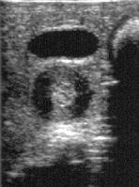

Slide 15
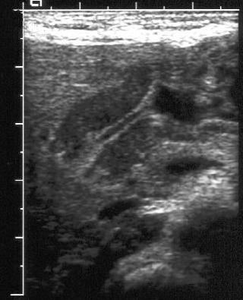

Slide 16
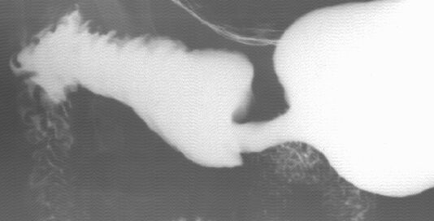

Slide 17
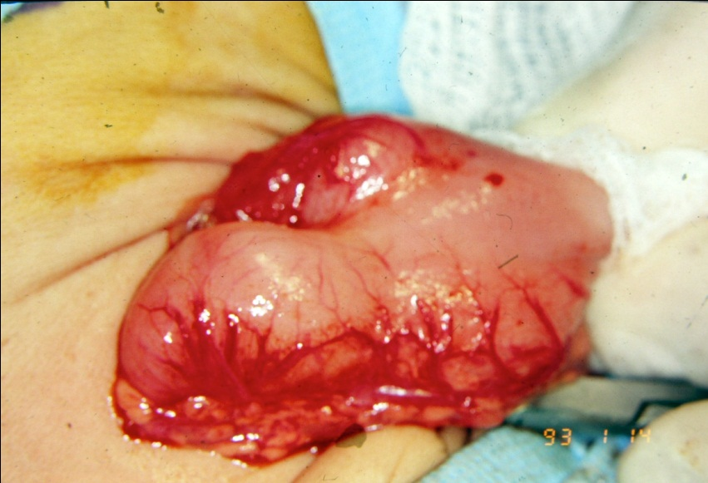

Slide 18
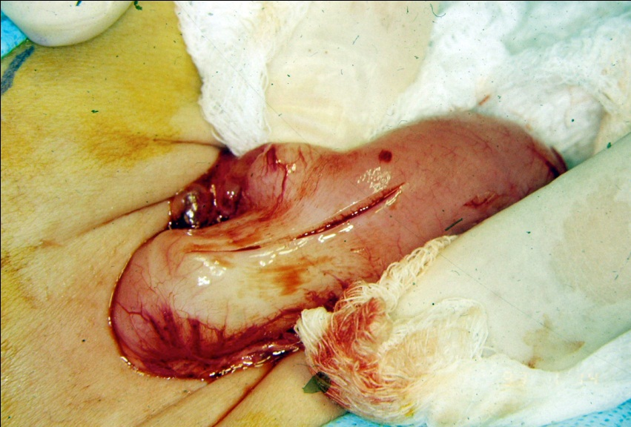

Slide 19
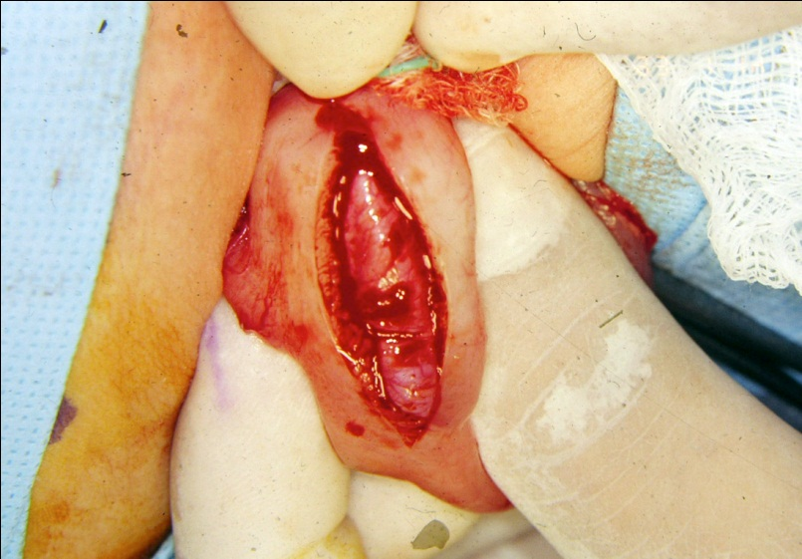

Slide 20
Intussusception

Slide 21
definition
Invagination of a proximal segment of bowel into an adjacent distal segment.
correlation with adenovirus infections
postulated that swollen Peyer’s patches in the ileum may stimulate intestinal peristalsis in an attempt to extrude the mass, thus causing an intussusception

Slide 22
incidence
2-4/1000.
There is no racial or geographic variation.
M:F 3:2.
seasonal incidence has peaks in spring and autumn

Slide 23
Clinical features
In a previously healthy infant.
Two groups:
(idiopathic) 5months-3years,
(secondary) Above 3yrs(surgical lead point).
Is the commonest cause of intestinal obstruction in the age 5months-3yrs.

Slide 24
Clinical features
Begins proximal to the ileocecal region
Prodromal febrile illness related to GIT,
Sudden onset,
Abdominal colic,
Vomiting, lethargy,
Currant jelly stools,
abdominal mass (50%),abdominal distention,
sepsis, shock.

Slide 25
Etiology
Idiopathic.
secondary:
Henoch-Schonlein purpura,
Cystic fibrosis,
Hematologic dyscrasias, and
Post operative period.

Slide 26
Pathophysiology
Mucosal ischemia leads to slough of mucosa and blood and mucous (currant jelly stools).
If untreated, the process progresses to trans mural gangrene and perforation of the leading edge of the intussusception.

Slide 27
Diagnosis
Clinical features.
Plain abdominal x-ray, Picture of intestinal obstruction specially in advanced cases.
US (target, pseudo kidney sign).
Ba. Enema, diagnostic as well as therapeutic.

Slide 28
Diff. Diagnosis
Acute abdomen, any GI condition associated with vomiting and rectal bleeding.

Slide 29
Management
That of intestinal obstruction
Conservative:
hydrostatic reduction
Gas reduction.(pneumatic)

Slide 30
Operative: indications
Peritonitis,
sepsis,
failure of conservative treatment,
recurrence,
presence of leading point.

Slide 31
Surgery
Manual reduction,
Look for leading point,
Resection if:
Unable to reduce the intussusception,
Gangrenous bowel,
Presence of leading point.

Slide 33
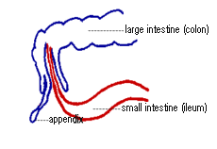

Slide 35
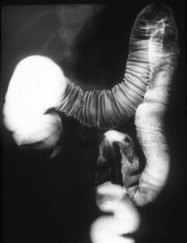

Slide 37
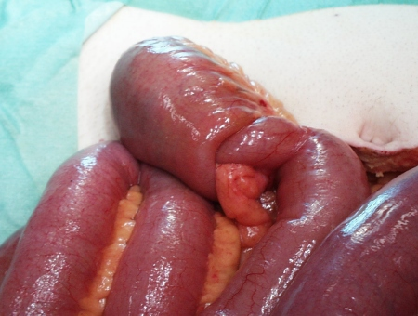

Slide 38
