Slide 1
Blood Supply of pancreas
Arteries
The splenic.a
The superior pancreaticoduodenal .a
Inferior pancreaticoduodenal arteries.a
Veins
The corresponding veins drain into the portal system.

Slide 2
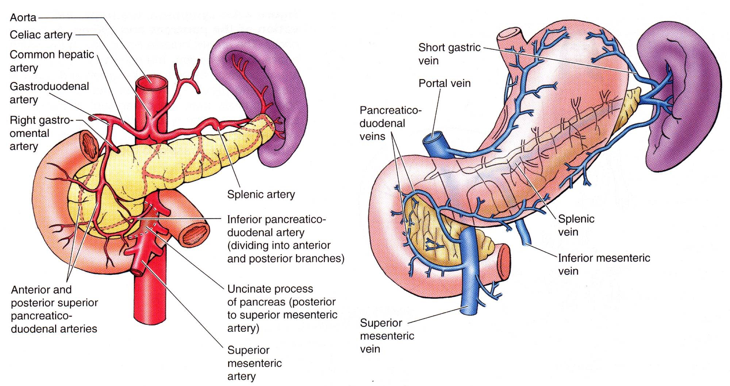
Blood Supply of pancreas

Slide 3
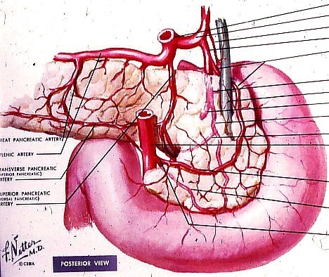
pancreaticoduodenal artery and its branches

Slide 4
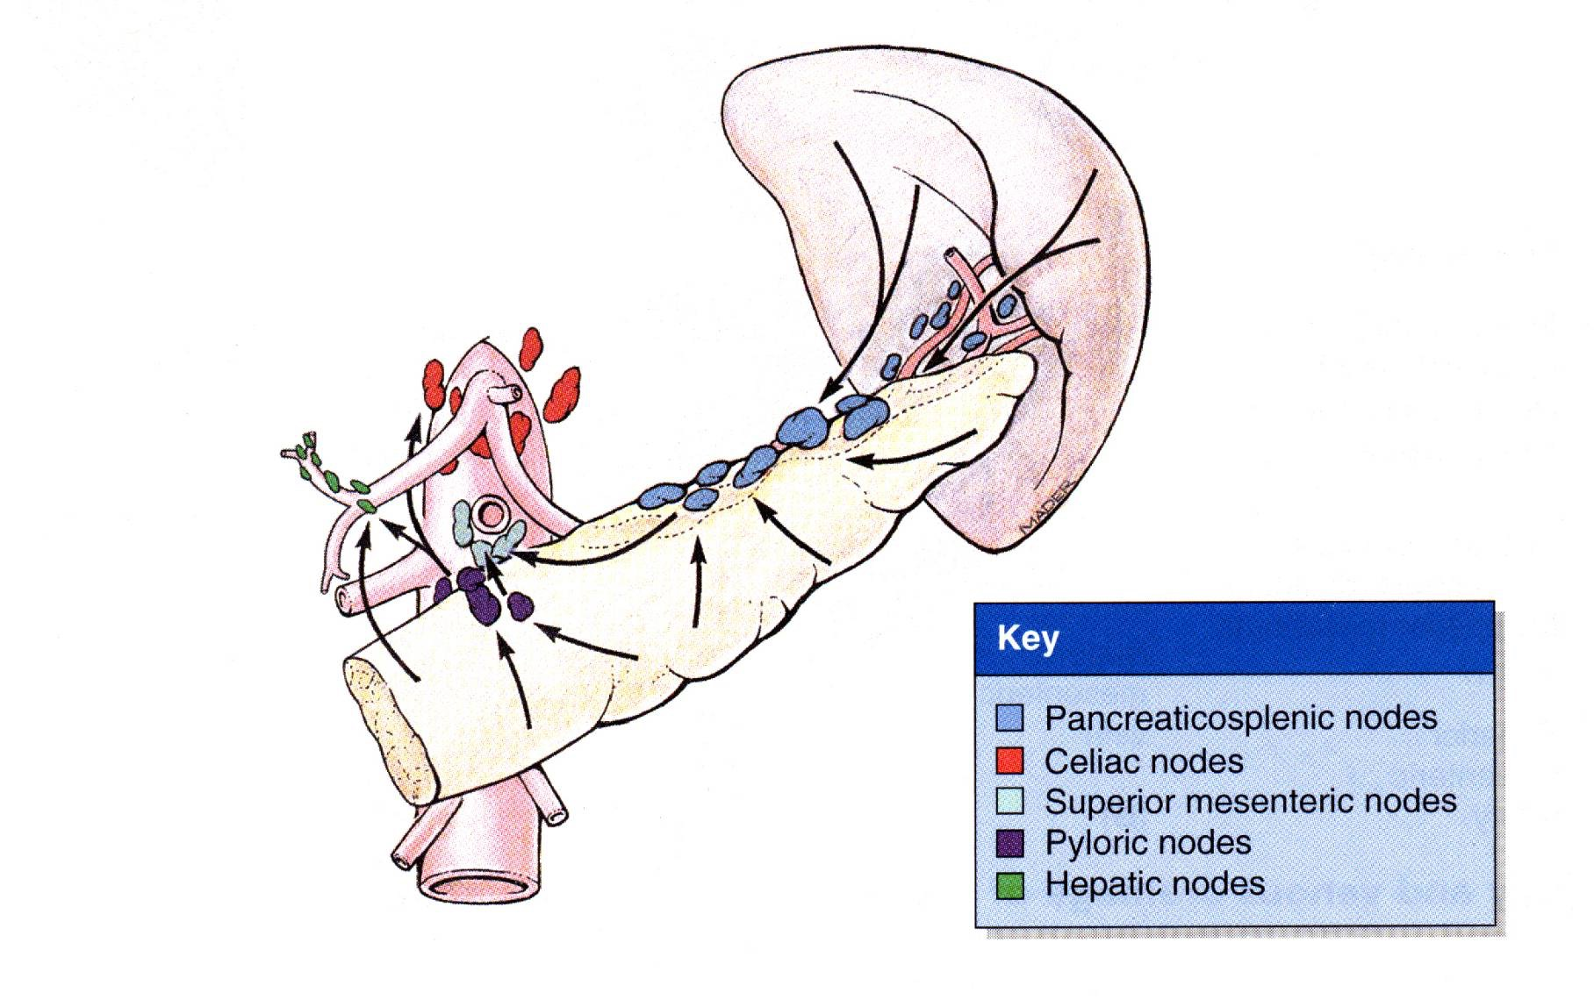
Lymphatic drainage of pancreas
Lymph nodes are situated along the arteries that supply the gland.
The efferent vessels ultimately drain into the celiac and superior mesenteric lymph nodes.

Slide 5
Nerve Supply
Sympathetic and parasympathetic chain
Parasympathetic = vagus nerve

Slide 6
Congenital defects of pancreas
Annular Pancreas (pancreas encircles duodenum) (rare)
Ectopic Pancreas (very common)= Outside the gastrointestinal tract

Slide 7
Clinical Notes
Cancer head of pancreas → Obstruction jaundices
Cancer body of pancreas → pressure→ I.V.C & portal vein
Acute pancreatitis= inflammation of pancreas

Slide 8
Spleen

Slide 9
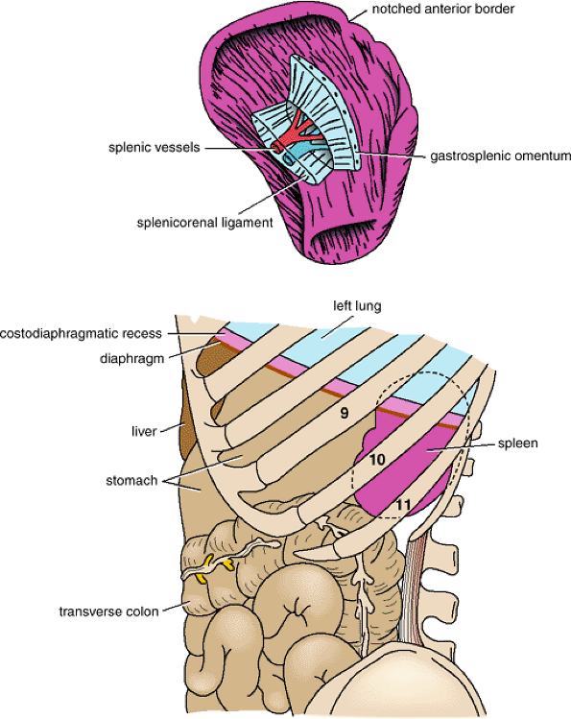
Spleen
Location and Description
it is reddish & oval shaped
the largest single mass of lymphoid tissue in the body.
and
has a notched anterior border.
location:
Lt hypochondrium
It lies just beneath the left half of the diaphragm
under the 9th, 10th, and 11th ribs.
Its long axis parallel to the 10th rib
Medial end is 4 cm away from mid line post
Lat.end is in left mid axillary line

Slide 10
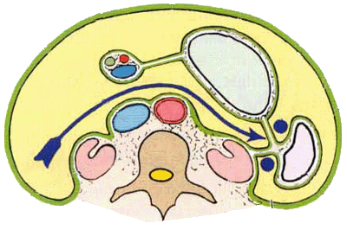
Spleen
Peritoneum
The spleen is completely covered with peritoneum → intraperitoneal organ
Two ligaments
1- the gastrosplenic omentum (ligament)→ between the spleen & the greater curvature of the stomach (carrying the short gastric and left gastroepiploic vessels)
2- splenicorenal ligament→ between spleen & kidney (carrying the splenic vessels and the tail of the pancreas).

Slide 11
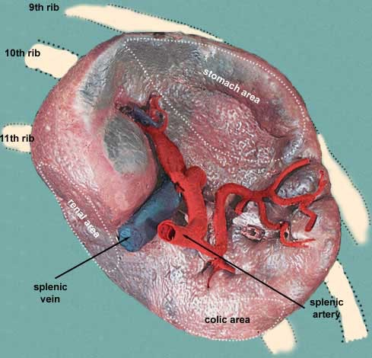
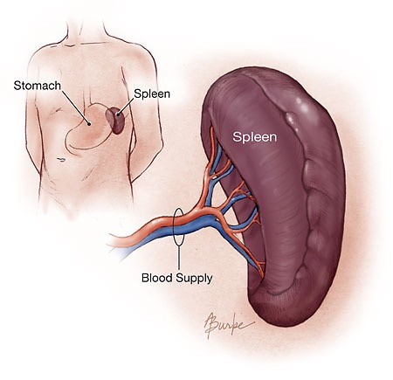
Spleen......cont
Size
1 inch thick
3 inch broad
5 inch long
Weight
7 ounce
Shape → variable
2 ends
2 borders
2 surfaces
Notched
- Due to lobulation in embryo

Slide 12
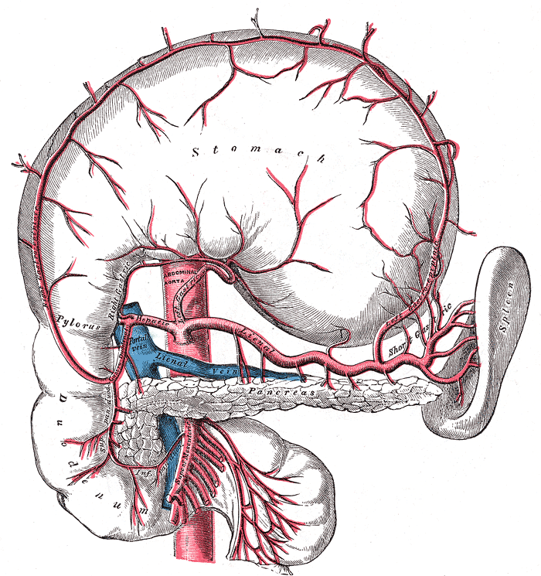
Surfaces of spleen
2 surfaces
- Diaphragmatic surface
- Visceral surface
1- Diaphragmatic surface
- Has Post- lat.relation
- Convex
- Smooth
Diaphragm separates it from
- Pleura & lung
- Ribs 9,10 ,11

Slide 14
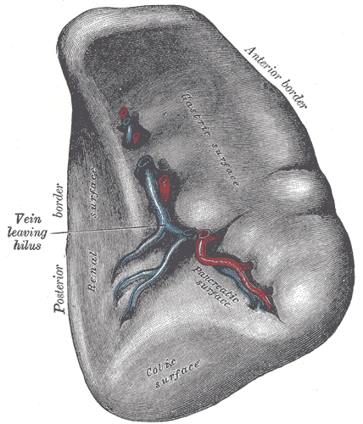
Spleen…..cont
2- Visceral surface
Has Ant- med. Relations
It is divided by a ridge into
1- An anterior or gastric
2- A posterior or renal portion.
Lower extremity has
Colic surface
Pancreatic surface

Slide 15
Spleen……cont
Gastric surface
- Extends forward, upward, and medialward
- Broad and concave
- Related to stomach
Renal surface
Directed medialward and downward.
It is somewhat flattened
- Related to Lt.kidney

Slide 16
Spleen…..cont
The lower extremity or colic surface
It is flat
Triangular in shape
Rests upon the left flexure of the colon and the phrenicocolic ligament, and is generally in contact with the tail of the pancreas (pancreatic surface)

Slide 17
Spleen….cont
Hilum of spleen
- Splenic . A→ ant
- Splenic . v → post
- Tail of pancreas

Slide 18
Spleen..cont
Borders of spleen
1- sup. Border
It is free
Sharp
Thin
Often notched(sup.notch), especially below
It separates the diaphragmatic surface from the gastric surface

Slide 19
Spleen……cont
2- inferior border
More rounded and blunter
Separates the renal from the diaphragmatic surface;
It corresponds to the lower border of the eleventh rib
- lies between the diaphragm and left kidney.

Slide 20
Spleen….cont
Intermediate margin is the ridge which separates the renal and gastric surfaces.
Internal border separates the diaphragmatic from the colic surface.

Slide 21
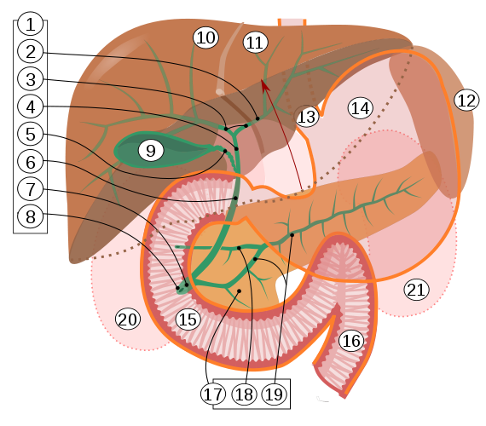
Spleen…cont
2 Ends
Med.end→ sup & back
4cm away from mid line post
Lat.end→ in left mid axillary line

Slide 22
Blood Supply
The large splenic artery is the largest branch of the celiac artery.
It has a tortuous course
It runs along the upper border of the pancreas
The splenic artery then divides into about six branches, which enter the spleen at the hilum

Slide 23
Blood Supply of Spleen
Veins
The splenic vein leaves the hilum and runs behind the tail and the body of the pancreas.
- Behind the neck of the pancreas, the splenic vein joins the superior mesenteric vein to form the portal vein.

Slide 24
Lymphatic Drainage of spleen
The lymph vessels emerge from the hilum and pass through a few lymph nodes along the course of the splenic artery and then drain into the celiac nodes.

Slide 25
Nerve Supply of Spleen
The nerves accompany the splenic artery and are derived from the celiac plexus.

