Slide 1
Anatomy
Of The leg

Slide 2
Skin of the Leg
Cutaneous Nerves
1-Anteromedially:
The saphenous nerve, a branch of the femoral nerve supplies the skin on the anteromedial surface of the leg
2- Anterolaterally:
Upper part
The lateral cutaneous nerve of the calf, a branch of the common peroneal nerve supplies the skin on the upper part of the lateral surface of the leg
Lower part
The superficial peroneal nerve, a terminal branch of the common peroneal nerve
supplies the skin of the lower part of the anterolateral surface of the leg

Slide 3
Posteriorly:
The posterior cutaneous nerve of the thigh descends on the back of the thigh In the popliteal fossa, it supplies the skin over the popliteal fossa and the upper part of the back of the leg
The lateral cutaneous nerve of the calf, a branch of the common peroneal nerve supplies the skin on
the upper part of the posterolateral surface of the leg
The sural nerve,
a branch of the tibial nerve supplies the skin on the lower part of the posterolateral surface of the leg
The saphenous nerve, a branch of the femoral nerve gives off branches that supply the skin on the posteromedial surface of the leg

Slide 4
Fascial Compartments of the Leg

Slide 5
The deep fascia of the leg forms Two intermuscular septa (anterior and posterior) which are attached to the fibula
These, together with the interosseous membrane divide the leg into:
Fascial Compartments of the Leg
Three compartments;
Anterior
Lateral
Posterior
(in the posterior compartment, a superficial and deep transverse septum further divide the posterior compartment into layers of superficial and deep muscles)
Each having its own muscles, blood supply, and nerve supply.

Slide 6
Retinacula of the Ankle
The retinacula are thickenings of the deep fascia that keep the long tendons around the ankle joint in position and act as pulleys.
Superior Extensor Retinaculum
Inferior Extensor Retinaculum
The inferior extensor retinaculum is a Y-shaped band located in front of the ankle joint.

Slide 7
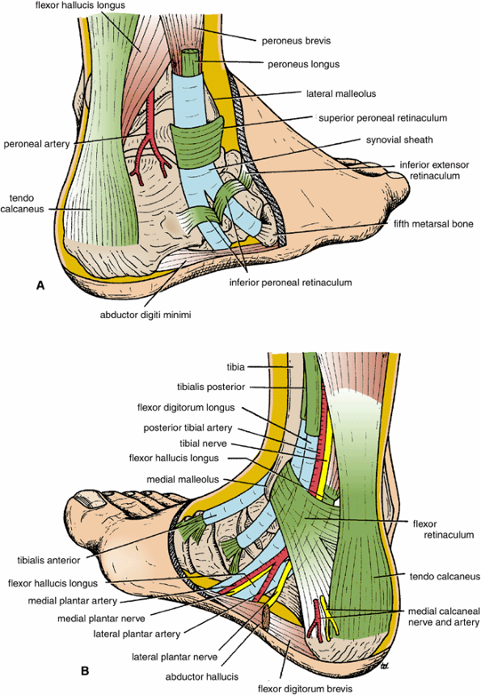
Superior Peroneal Retinaculum
Flexor Retinaculum
The flexor retinaculum extends from the medial malleolus downward and backward to be attached to the medial surface of the calcaneum

Slide 8
Contents of the Anterior Fascial Compartment of the Leg
Muscles:
The tibialis anterior
Extensor digitorum longus
Extensor hallucis longus
Peroneus tertius
Blood supply: Anterior tibial artery
Nerve supply: Deep peroneal nerve

Slide 9
All the muscles of the anterior compartment of the leg originate from
Lateral surface of the shaft of tibia (tibialis anterior) or
The anterior surface of shaft of fibula (extensor surface) the remaining three muscles
Insertion?
The main actions of these muscles are
Extension of the foot at the ankle joint (dorsiflextion) to raise the toes up (in other words
to stand up on the heels)
In addition any muscle that got (tibialis) in its name will invert the foot at subtalar and transverse tarsal joints
while any muscle got (peroneus) in its name will
Everts foot at subtalar and transverse tarsal joints
Nerve supply of all the muscles of the anterior compartment of the leg:
deep peroneal nerve

Slide 10
3)V
2)H
FROM MEDIAL TO LATERAL
In front of the medial malleolus
4)N
Tom has very nice dogs and pigs
Tibialis
H
allucis
VESSELS
Nerve
Digitorum
Peroneus
1)T
5)D
Deep peroneal nerve
6)P
Anterior tibial artery
Peroneus tertius

Slide 11
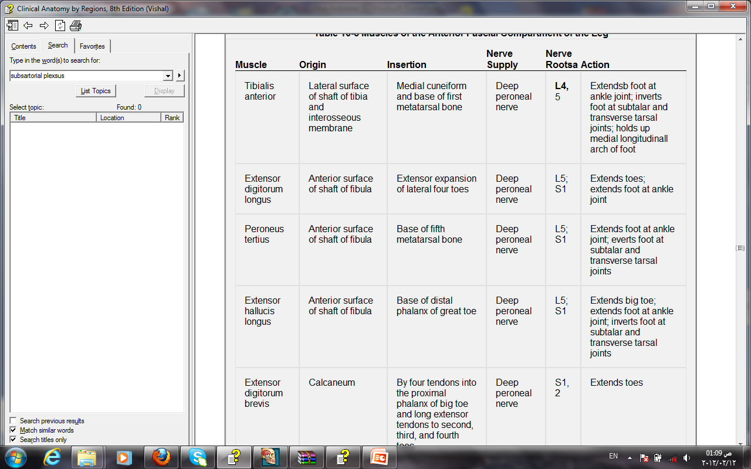

Slide 12
Contents of the Lateral Fascial Compartment of the Leg
Muscles:
Peroneus longus:
Origin: from the lateral surface of shaft of fibula
Insertion: Base of first metatarsal and the medial cuneiform bone (passes through a groove in the Cuboid bone.
peroneus brevis:
Origin: Lateral surface of shaft of fibula
Insertion: Base of fifth metatarsal bone
Blood supply: Branches from the peroneal artery (branch from posterior tibial artery)
Nerve supply: Superficial peroneal nerve
Actions: both flex the foot at the ankle joint
Evert the foot at the subtalar and transverse tarsal joints

Slide 13
Contents of the Posterior Fascial Compartment of the Leg
The transverse septa of the leg divides the muscles of the posterior compartment
into superficial and deep groups
Deep group of muscles
Popliteus
Flexor digitorum longus
Flexor hallucis longus
Tibialis posterior
Superficial group of muscles
Gastrocnemius
Plantaris
Soleus
Blood supply: Posterior tibial artery
Nerve supply: Tibial nerve

Slide 14
Superficial group of muscles
Gastrocnemius
Origin: Lateral head from lateral condyle of femur
Medial head from above medial condyle
Insertion: Via tendo calcaneus into posterior
surface of calcaneum
Nerve supply: Tibial nerve
Actions: Plantar flexes foot at ankle joint
Flexes knee joint
Plantaris
This muscle some times is absent
Nerve supply: Tibial nerve
Soleus
Origin: Shafts of tibia and fibula
Insertion: Via tendo calcaneus into posterior surface of calcaneum
Nerve supply: Tibial nerve
Actions: Together with gastrocnemius and plantaris is powerful plantar flexor of ankle joint; provides main propulsive force in walking and running

Slide 15
Deep group of muscles
Popliteus
Flexor digitorum longus
Flexor hallucis longus
Tibialis posterior

Slide 16
Origin
Insertion
Nerve
Actions

Slide 17
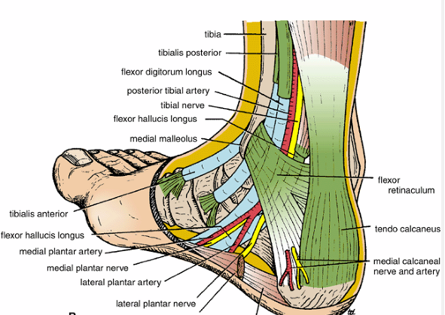
Behind the medial malleolus
1)T
2)D
Tom does very nice hats
3)V
Tibialis
D
igitorum
VESSELS
Nerve
H
allucis
4)N
5)H
Tibial nerve
Tibialis posterior
Flexor hallucis
Posterior tibial artery
Flexor digitorum

Slide 18
Anatomy of the foot

Slide 20
The plantar aponeurosis
Is a triangular thickening of the deep fascia
Its apex is attached to the medial and lateral tubercles of the calcaneum.
The base of the aponeurosis divides into five slips that pass into the toes

Slide 21
Muscles of the Sole of the Foot
The muscles of the sole are conveniently described in four
layers from the inferior layer superiorly.
First layer:
1- Abductor hallucis
2- Flexor digitorum brevis
3-Abductor digiti minimi

Slide 22
Second layer:
1-Quadratus plantae,
2-Lumbricals
3-Flexor digitorum longus tendon,
4- Flexor hallucis longus tendon

Slide 23
Third layer:
1-Flexor hallucis brevis
2-Adductor hallucis
3- Flexor digiti minimi brevis

Slide 24
Fourth layer:
1- Interossei
2- peroneus longus tendon
3- tibialis posterior tendon
.
Unlike the small muscles of the hand, the sole muscles have few delicate functions and are chiefly concerned with supporting the arches of the foot. Although their names would suggest control of individual toes, this function is rarely used in most people

Slide 25
Arteries of the Sole of the Foot
Medial Plantar Artery
The medial plantar artery is the smaller
of the terminal branches of the posterior tibial artery
It ends by supplying the medial side of the big toe
Lateral Plantar Artery
The lateral plantar artery is the larger of the terminal branches of the posterior tibial artery
forms the plantar arch
at the proximal end of the first intermetatarsal space joins the dorsalis pedis artery

Slide 26
Dorsalis Pedis Artery (the Dorsal Artery of the Foot)
On entering the sole between the two heads of the first dorsal interosseous muscle, the dorsalis pedis artery immediately joins the lateral plantar artery

Slide 27
Nerves of the Sole of the Foot
Medial Plantar Nerve
The medial plantar nerve
is a terminal branch of the tibial nerve
Cutaneous branches: Plantar digital nerves run to the sides of the medial three and a half toes. The nerves extend onto the dorsum and supply the nail beds and the tips of the toes
Remember it is similar to the median nerve
Lateral Plantar Nerve
The lateral plantar nerve is a terminal branch of the tibial nerve

Slide 28
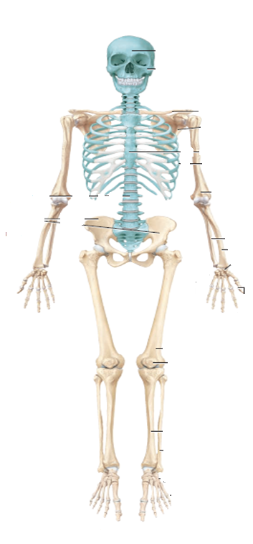
Arches of the Foot
body weight
100%
The bones of the foot are arranged in two arches that are held in position
by ligaments and tendons
The arches provide an ideal distribution of body weight over the soft and hard tissues of the foot
50%
On the right side
50%
On the left side
Normally, the ball of the foot
carries about 40% of the weight and the heel carries about 60%.
Usually, the arches are fully developed by age 12 or 13.
20%
30%
The ball of the foot
The heel

Slide 29
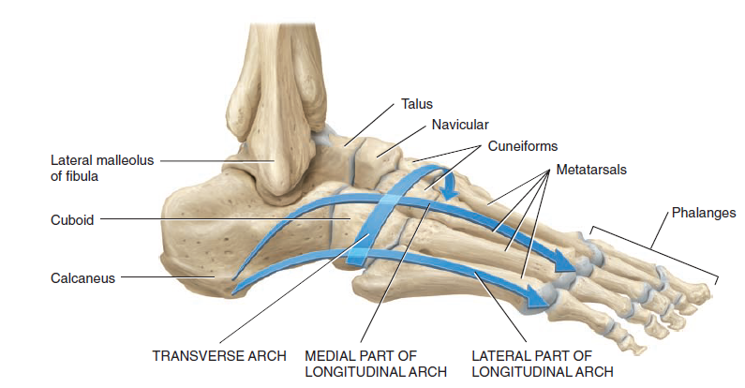
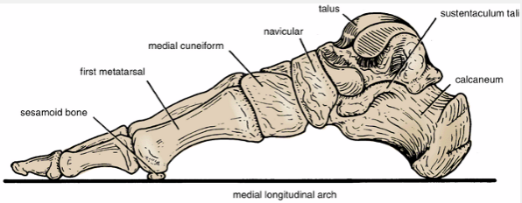
A- longitudinal archs
1-The medial Longitudinal arch
2-The lateral longitudinal arch
B-The transverse arch
1
2
3
1-The medial Longitudinal arch
Made of:
a-Calcaneus
b-Talus
c-Navicular,
d-The three cuneiforms,
e- The heads of the three medial metatarsals.

Slide 30
The Arches of the Foot
A segmented structure can hold up weight only if it is built in the form of an arch.
The foot has three such arches:
1-The medial longitudinal
2-Lateral longitudinal
3-Transverse arches
In the young child, the foot appears to be flat because of the presence of a large amount of subcutaneous fat on the sole of the foot.
1-The medial longitudinal
Consists of :
1-The calcaneum,
2-The talus,
3- The navicular bone,
4-The three cuneiform bones,
5- The first three metatarsal bones

Slide 31
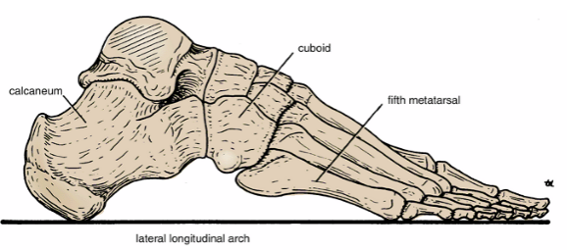
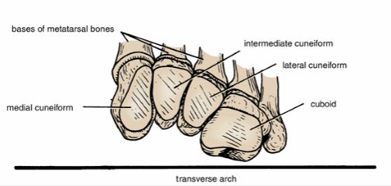
2-Lateral longitudinal arch:
Consists of:
1- The calcaneum,
2-The cuboid
3-The fourth and fifth metatarsal bones
3-Transverse arch:
Consists of :
1-The bases of the metatarsal bones
2-The cuboid
3- The three cuneiform bones

Slide 32
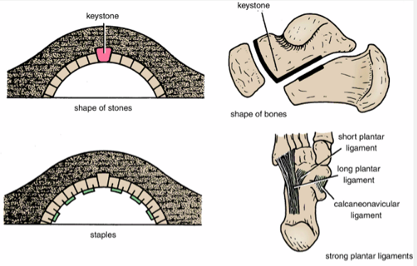
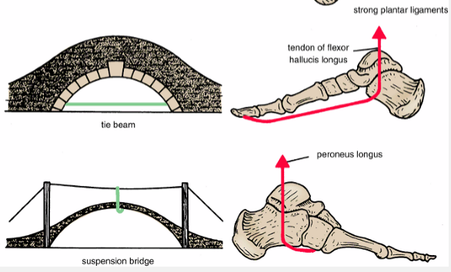
Mechanisms of Arch Support
Examination of the design of any stone bridge reveals the following engineering methods used for its support
The shape of the stones: the stones are wedge shaped
The inferior edges of the stones are tied together: This is accomplished by binding their lower edges together with metal staples
The use of the tie beams: a tie beam connecting the ends effectively prevents separation of the pillars and consequent sagging of the arch
A suspension bridge: multiple supports suspending the arch from a cable above the level of the bridge

Slide 33
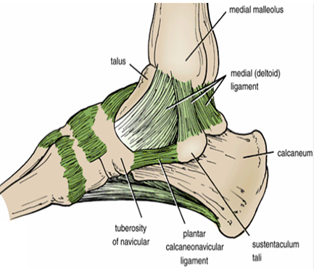
Maintenance of the Medial Longitudinal Arch
1-Shape of the bones:
for example, the sustentaculum tali holds up the talus
The rounded head of the talus is the keystone in the center of the arch
2-The inferior edges of the bones are tied together by the plantar ligaments
The most important ligament is the plantar calcaneonavicular ligament
(spring ligament)
3-Tying the ends of the arch together are the plantar aponeurosis, and short muscles of the foot for example, the abductor hallucis, the flexor hallucis longus
4-Suspending the arch from above are the tibialis anterior and posterior and the medial ligament of the ankle joint

Slide 34
Maintenance of the Lateral Longitudinal Arch
1-Shape of the bones: Minimal shaping of the distal end of the calcaneum and the proximal end of the cuboid.
The cuboid is the keystone.
2-The inferior edges of the bones are tied together by the long and short plantar ligaments
3-Tying the ends of the arch together , FOR EXAMPLE, the plantar aponeurosis
4-Suspending the arch from above are the peroneus longus and the brevis
Maintenance of the Transverse Arch
1-Shape of the bones: The marked wedge shaping of the cuneiform bones and the bases of the metatarsal bones
2-The inferior edges of the bones are tied together by the deep transverse ligaments, the strong plantar ligaments
3-Tying the ends of the arch together is the peroneus longus tendon.
4-Suspending the arch from above are the peroneus longus tendon and the peroneus brevis

Slide 35
Flat foot
Is a condition in which the medial longitudinal arch is depressed or collapsed.
As a result,
1-The forefoot is displaced laterally everted.
2-The head of the talus is no longer supported
3-The body weight forces it downward and medially between the calcaneum and the navicular bone.
The causes of flat foot are both congenital and acquired
When a person wears high-heeled shoes, however, the distribution
of weight changes so that the ball of the foot may carry up to 80%
and the heel 20%. As a result, the fat pads at the ball of the foot are damaged,
joint pain develops, and structural changes in bones may occur.

