Slide 2
Gluteal region
Skin and fascia of the gluteal region

Slide 3
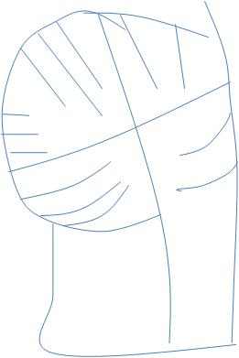
A) Skin of the Buttock (Gluteal region)
2-The upper lateral quadrant
Supplied by
Anterior primary rami of
1-The upper medial quadrant
Supplied by
L1
L2
L3
Lateral cutaneous branch of iliohypogastric nerve
Lateral cutaneous nerve of the subcostal nerve T12
Posterior primary rami of
S1
S2
S3
4-The lower lateral quadrant
Supplied by
Anterior primary rami of
3-The lower medial quadrant
Supplied by
Anterior primary rami of
Branches from lateral cutaneous nerves of the thigh
Branches from posterior cutaneous nerve of the thigh
Cutaneous Innervation of the gluteal region

Slide 4
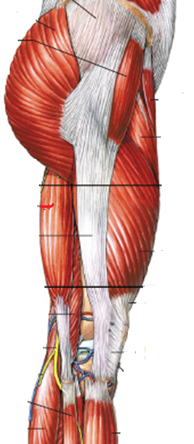
B) Fascia of the Buttock (Gluteal region)
1- Superficial fascia; is thick especially in women . It contributes to the prominence of the buttock.
2- Deep fascia; contentious with the deep fascia of the thigh (fascia lata).
Is a strong fibrous sheet that surrounds the whole of the thigh like a tight trousers.
Thin on its medial side while it is getting thicker on its lateral side to form the iliotibial tract.
Fascia lata
Iliotibial tract
Is a strong wide band (thickening of the deep fascia (fascia lata)) on the lateral side of the thigh) attached above to the tubercle of ilium and below to the lateral condyle of tibia.
Receives the insertion of tensor fascia latae and GM muscles.

Slide 5
Muscles of the gluteal region

Slide 6
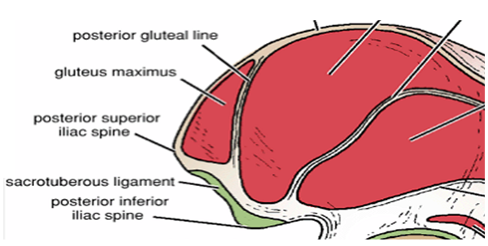
Gluteus maximus
Origin:
1- Ilium ( area behind the posterior gluteal line)
2- Back of sacrum and coccyx
3- Back of sacrotuberous ligament
Insertion
1- The superficial three –fourths are inserted into the iliotibial tract
2- The lower deep part is inserted into the gluteal tuberosity of femur

Slide 7
Actions
1- Extends thigh, some lateral rotation (main extensor of the hip joint)
2-Plays an important role in climbing upstairs and cycling
3- Supports the Extended knee joint through Iliotibial tract
Innervation - Inferior gluteal nerve, L5;S1,2

Slide 8
A- Bony structures
STRUCTURES UNDER THE COVER OF GLUTEUS MAXIMUS MUSCLE
1-Greater trochanter and bursa
2-Gluteal tuberosity
3-Ischial tuberosity and bursa
B- Ligaments
1- Sacrotuberous ligament
2- Scrospinous ligament
C- Muscles
1- Gluteus medius and minimus
2-Short Lateral rotator muscles (6)
3- origin of the hamstring muscles
D- Vessels
1- Superior gluteal vessels
2- inferior gluteal vessels
3- Internal pudendal vessels
E- Nerves
1- Superior and inferior gluteal nerve
2- Sciatic nerve
3- Pudendal nerve
4- Posterior cutaneous nerve of the thigh
5- Nerve to obturator internus
6- Nerve to quadratus femoris

Slide 9
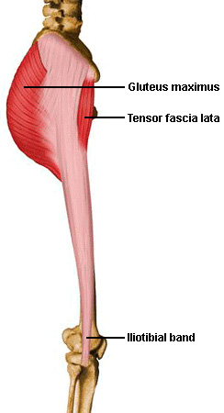
Tensor fasciae latae
Origin
Iliac crest
Insertion
Iliotibial tract
Action
Assist gluteus maximus in extending the knee joint
Nerve supply
Superior gluteal nerve L4,5

Slide 10
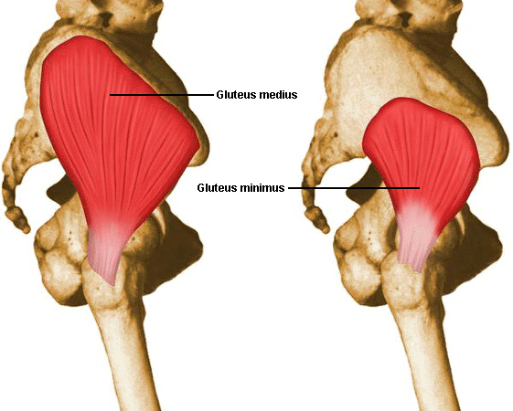
Gluteus medius
Gluteus minimus
Origin
Ilium ?
Insertion
Greater trochanter of femur
Actions
1-Abduction (main abductor of the hip joint)
2-Medial rotation (anterior fibers)
3-Both muscle contract reflexly on each side alternatively during walking to prevent tilting of the pelvis to the unsupported side
Innervation
Superior gluteal nerve

Slide 11
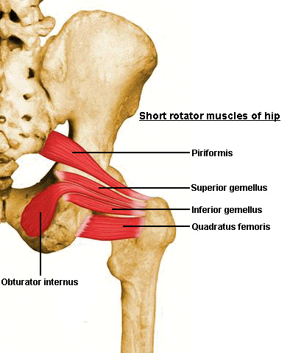
Short Lateral rotator muscles
1-Piriformis
2-Quadratus femoris
3-Obturator internus
4-Superior gemellus
5-Obturator externus
6-Inferior gemellus

Slide 12
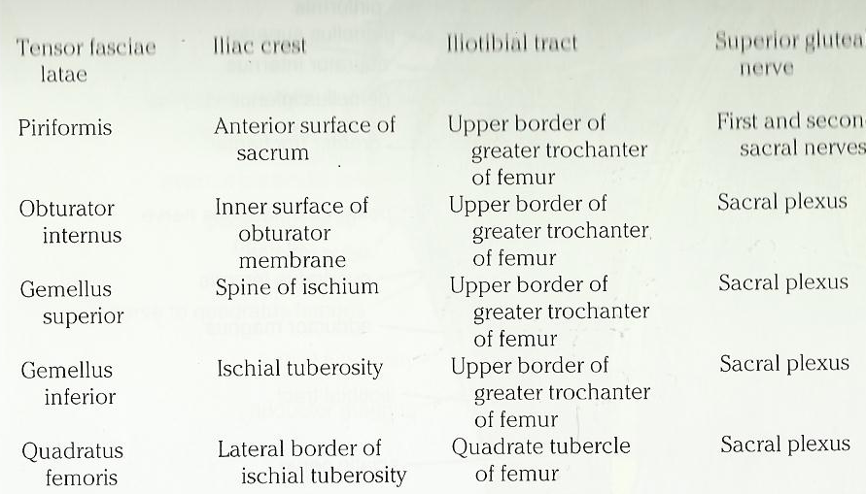
Read these muscles from this slide which can be found on page (566) Snell 8th edition
Short lateral rotator muscles of the hip joint
They have common function; lateral rotation of the thigh at hip joint.
Muscle
Origin
Insertion
Nerve supply

Slide 13
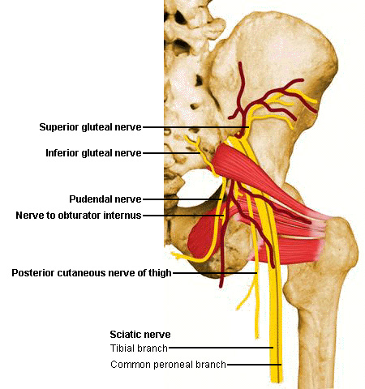
A) Structures passing through the greater sciatic foramen:
1- Piriformis: fills the foramen almost completely leaving some structures to pass either above or below it.
Structures passing above Piriformis muscle:
1- Superior gluteal nerve and vessels
Structures passing below Piriformis muscle:
1-inferior gluteal nerve
2-inferior gluteal vessels
3-sciatic nerve
4-posterior cutaneous nerve of the thigh
5-nerve to quadratus femoris
6-pudendal nerve
7-internal pudendal vessels
9-nerve to obturator internus
B) Structures passing through the lesser sciatic foramen:
1- tendon of obturator internus
2-pudendal nerve
3-internal pudendal vessels
4-nerve to obturator internus

Slide 14
Superior Gluteal Nerve (L4, 5 and S1)
a branch of the sacral plexus
leaves the pelvis through the greater sciatic foramen above the piriformis
It divides into superior and inferior branches
The superior branch supplies the gluteus medius muscle
The inferior branch supplies the gluteus medius, minimus muscles and ends by supplying the tensor fasciae latae muscle.
Inferior Gluteal Nerve
(L5, S1, S2)
a branch of the sacral plexus, leaves the pelvis through the greater sciatic foramen below the piriformis
It supplies the gluteus maximus muscle

Slide 15
Arteries of the Gluteal Region
1-Superior Gluteal Artery
is a branch from the internal iliac artery
enters the gluteal region through the greater sciatic foramen above the piriformis
It divides into superficial and deep branches.
The superficial branch supplies the gluteus maximus muscle
The deep branch supplies the glutei medius and minimus.
Read only
2-Inferior Gluteal Artery
is a branch of the internal iliac artery
enters the gluteal region through the greater sciatic foramen, below the piriformis
It divides into numerous branches that are distributed throughout the gluteal region.
Read only

Slide 16
Branches from the internal iliac artery (superior and inferior gluteal arteries) anastomosis
With branches from the femoral artery to form
1-The Trochanteric Anastomosis
2-The Cruciate Anastomosis
The trochanteric anastomosis :
provides the main blood supply to THE HEAD OF THE FEMUR
The nutrient arteries pass along the femoral neck beneath the capsule
The following arteries take part in the anastomosis:
A) The superior gluteal artery, the inferior gluteal artery and the obturator artery (from the internal iliac artery)
B) The medial femoral circumflex artery, and the lateral femoral circumflex artery (from the femoral artery)
The Cruciate Anastomosis
The cruciate anastomosis is situated at the level of the lesser trochanter of the femur and, together with the trochanteric anastomosis, provides a connection between the internal iliac and the femoral arteries

Slide 17
The muscles of the gluteal region are acting on the hip joint
as different functional groups
Gluteus maximus
Acts as the main extensor of the hip joint
Gluteus medius and minimus
They act as the main abductors of the hip joint while
their anterior fibers act as medial rotators on the hip joint
Short Lateral rotator muscles
They act as lateral rotators on the hip joint
The muscles of the gluteal region, therefore, extend, abduct and rotate the hip joint
medially and laterally
Leaving adduction and flexion to other groups of muscles, which ? Why?

Slide 18
Injury to the superior gluteal nerve
On one side causes Lurching gait
Both sides Waddling gait
The test indicates ‘a defect in
the osseo-muscular stability
of the hip joint’
Positive Trendelenburg’s test
Note
Other conditions also my cause lurching and waddling gates such as:
Clinical Notes
Gluteus Medius and Minimus and Poliomyelitis
The gluteus medius and minimus muscles may be paralyzed when poliomyelitis involves the lower lumbar and sacral segments of the spinal cord.
They are supplied by the superior gluteal nerve (L4 and 5 and S1)
Paralysis of these muscles seriously interferes with the ability of the patient to tilt the pelvis when walking.

Slide 19
Trendelenburg’s test
The stability of the hip in the standing position depends on two factors:
1- The strength of the surrounding muscles
2-The integrity of the lever system of
the femoral neck and head within the intact hip joint
When standing on
one leg, the abductors of the hip on this side (gluteus medius and minimus
and tensor fasciae latae) maintain fixation at the hip joint
If, however, there is any defect in these muscles or lever mechanism
of the hip joint, the weight of the body in these circumstances forces
the pelvis to tilt downwards on the opposite side.
The positive Trendelenburg test is seen if:
A- The hip abductors are paralysed (e.g. poliomyelitis)
B-Congenital dislocation of the hip
C-The head of the femur has been destroyed by disease or
removed operatively (pseudarthrosis),
D-There is an un-united fracture of the femoral neck
E-There is a very severe degree of coxa vara

Slide 20
Clinical Notes
The great thickness of gluteus maximus muscle makes it ideal for intramuscular injections.
To avoid injury to the underlying sciatic nerve, the injection should be given well forward on
the upper outer quadrant of the buttock.

Slide 21
However, the upper lateral quadrant, most likely to be made by the
Gluteus medius muscle rather than the gluteus maximus muscle .
The gluteus maximus covers the posterior part only of the
Gluteus medius while the anterior part (which makes the upper lateral quadrant)
is covered by skin and fascia only
Therefore, the intramuscular injection will be injected into the gluteus medius muscle rather than gluteus maximus muscle

