Slide 2
Adductor canal
(Subsartorial)
or
Hunter’s canal
John Hunter described the exposure and ligation of the femoral
artery in this canal for aneurysm of the popliteal artery; this method has
the advantage that the artery at this site is healthy and will not tear when
tied, as may happen if ligation is attempted immediately above the
aneurysm.

Slide 3
Adductor (Subsartorial) Canal
anterior
is an intermuscular cleft situated on the medial aspect of the middle third of the thigh beneath the sartorius muscle
It commences above at the apex of the femoral triangle and ends below at the opening in the adductor magnus.
In cross section it is triangular,
having
1-Anteromedial wall
2-Posterior wall
3-Lateral wall
Transverse section through the middle of the right thigh as seen from above

Slide 4
The Anteriomediall wall is formed by:
The sartorius muscle and fascia.
anterior
The lateral wall is formed by:
The vastus medialis
medial
lateral
The posterior wall is formed by:
The adductor longus and magnus
posterior

Slide 5
The adductor canal contains
1-The terminal part of the femoral artery
2-The femoral vein
3-The saphenous nerve
4-The terminal part of the obturator nerve
5-The deep lymph vessels
Subsartorial plexus of nerves:
Located on the fascia under the sartorius muscle and is formed by branches from
1-Medial cutaneous nerve of the thigh, Saphenous nerve and The anterior division of obturator nerve

Slide 6
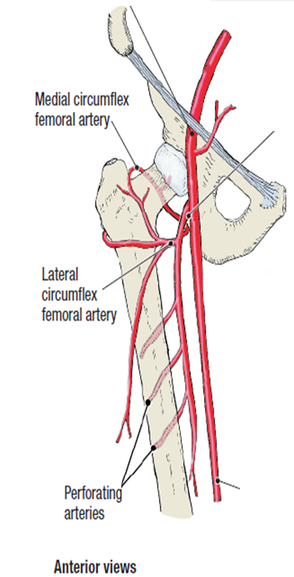
2-It lies midway between the anterior superior iliac spine and the symphysis pubis
The femoral artery
1- It enters the thigh from behind the inguinal ligament as a continuation of the external iliac artery.
(midinguinal point)

Slide 7
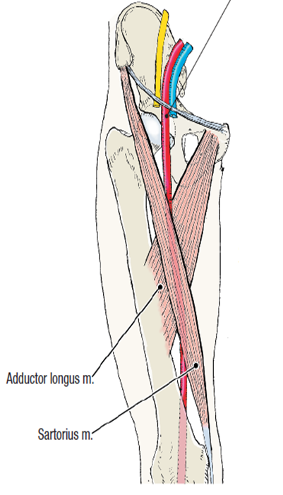
3-As the femoral artery descends downwards, its upper half lies superficial
in the femoral triangle
(what does this mean?)
See next slides
while in the lower half it lies deep in the subsartorial (adductor) canal

Slide 8
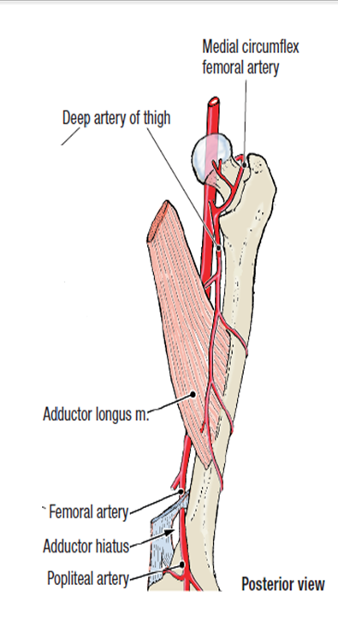
4- The femoral artery then descends almost vertically toward the adductor tubercle of the femur and ends at the opening (Adductor hiatus) in the adductor magnus muscle by entering the popliteal space as THE POPLITEAL ARTERY

Slide 9
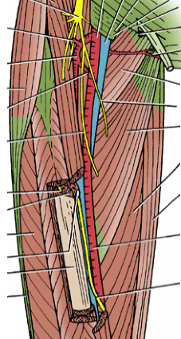
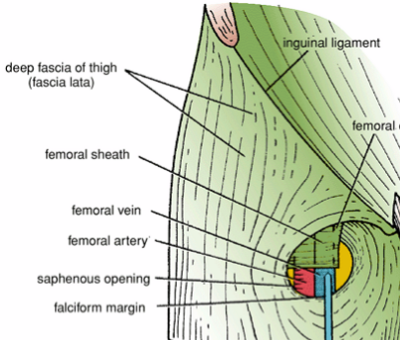
In the upper part of its course, femoral artery lies in the femoral triangle (superficial)
1- Exposed to injuries
2- Good approach for taking femoral pulse
Anteriorly : (in the femoral triangle)
The femoral artery is covered by skin and fascia
Its upper part (1.5 inch) is covered by the anterior wall
Of the femoral sheath and crossed by
the femoral branch of genito-femoral
nerve
Its lower part is crossed
by the saphenous Nerve

Slide 10
Medially: the femoral vein lies medial to the artery in the upper part of the femoral triangle, then it lies posteromedial and finally posterior to the artery at the apex of the femoral triangle
Laterally:
The femoral nerve and
Its branches.
Posteriorly:
1-Psoas major muscle, which separates it from the hip joint

Slide 11
Because the femoral artery lies in the femoral triangle (superficial)
The following procedure can be done
Read only
Femoral Artery Catheterization
1-Fine catheter can be inserted into the femoral artery as it descends through the femoral triangle. 2-The catheter is guided under fluoroscopic view along the external and common iliac arteries into the aorta.
3-The catheter can then be passed into the inferior mesenteric, superior mesenteric, celiac, or renal arteries.
4-Contrast medium can then be injected into the artery under examination and a permanent record obtained by taking a radiograph.
Femoral Vein Catheterization
1-Femoral vein catheterization is used when rapid access to a large vein is needed.
2-The femoral vein has a constant relationship to the medial side of the femoral artery just below the inguinal ligament and is easily cannulated.
3- Because of the high incidence of thrombosis with the possibility of fatal pulmonary embolism, the catheter should be removed once the patient is stabilized.
Anatomy of the Procedure
1-The skin of the thigh below the inguinal ligament is supplied by the genitofemoral nerve; this nerve is blocked with a local anesthetic.
2-The femoral pulse is palpated midway between the anterior superior iliac spine and the symphysis pubis, and the femoral vein lies immediately medial to it.
3-At a site about two fingerbreadths below the inguinal ligament, the needle is inserted into the femoral vein.

Slide 12
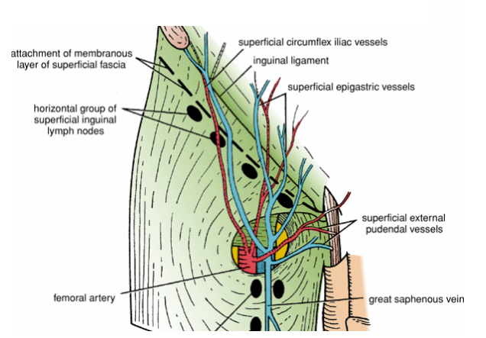
6- Branches of the femoral artery
THREE superficial branches and TWO deep branch
I-Superficial branches
1-The superficial circumflex iliac artery
2-The superficial epigastric artery
3-The superficial external pudendal
In the femoral triangle
They supply cutaneous regions of the upper thigh, lower abdomen, and perineum.

Slide 13
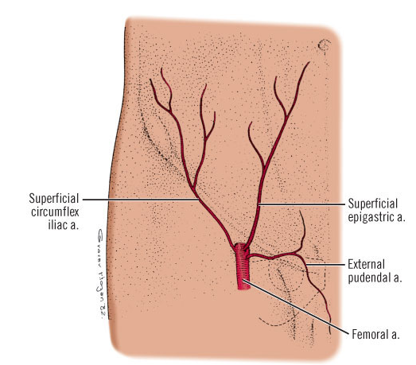

Slide 14
II- DEEP BRANCHES
1-The deep external pudendal artery
2-The profunda femoris artery (Deep artery of thigh)
arises from the lateral side of the femoral artery about
(4 cm) below the inguinal ligament
it gives off:
A)
B) The medial femoral circumflex artery
lateral femoral circumflex artery
C) Perforating arteries .

Slide 15
A) lateral femoral circumflex artery: Normally originates proximally from the lateral side of the profunda femoris artery , but may arise directly from the femoral artery
Read only
It divides into three terminal branches:
1-ascending branch, supplies the neck and head of the femur;
Read only
2-descending branch: connects with a branch of the popliteal artery near the knee
Profunda femoris artery
Read only
3-transverse branch: anastomoses with branches from the medial femoral circumflex artery, the inferior gluteal artery, and the first perforating artery to form the cruciate anastomosis around the hip.

Slide 16
B) The medial circumflex femoral artery
normally originates proximally from the posteromedial aspect of the profunda femoris artery but may originate from the femoral artery
It gives off :
profunda femoris artery
Read only
a) Acetabular branch: which enters the hip joint through the acetabular notch and anastomoses with the acetabular branch of the obturator artery.
Read only
b) Ascending branch: shears in the trochonteric anastomosis
c) Transverse branch: shears in the cruciate anastomosis
C) Perforating arteries .
The profunda femoris artery gives off perforating branches.
The first three arteries arise as branches
of the profunda femoris artery, while the fourth one is
the termination of the profunda femoris artery

Slide 18
Read only
In the lower part of its course,
the femoral artery passes behind the sartorius ( deep) muscle in the subsartorial canal (adductor canal).
Relations of the femoral artery
In the subsartorial canal
Anteriomedially:
Skin and fascia
Sartorius muscle and fibrous roof
of the canal
Saphenous nerve which crosses from
lateral to medial
Anterolaterally:
vastus medialis
Nerve to vastus medialis
Posteriorly:
femoral vein

Slide 19
Branches of the femoral artery in the adductor canal
It gives off only one branch
The descending genicular artery
Other arteries that shear in the blood
Supply of the lower limb
Obturator Artery
The obturator artery is a branch of the internal iliac artery
It passes forward on the lateral wall of the pelvis and accompanies the obturator nerve
It gives off muscular branches and an articular branch to the hip joint

