Slide 2
The front of the thigh

Slide 3
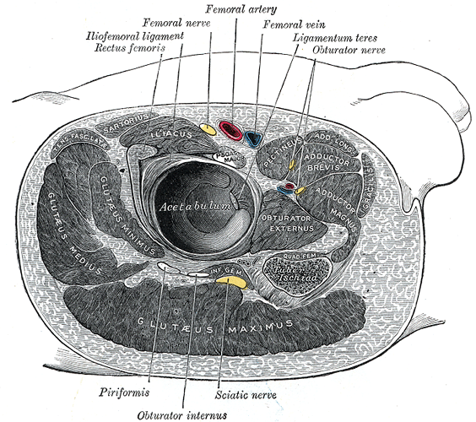
Femoral triangle (Scarpa’s triangle)
Why do need it?
Is a triangular depressed area located in the upper part of the medial aspect of the thigh immediately below the inguinal ligament.
Is it deep or superficial?
Is it a 3D space?

Slide 4
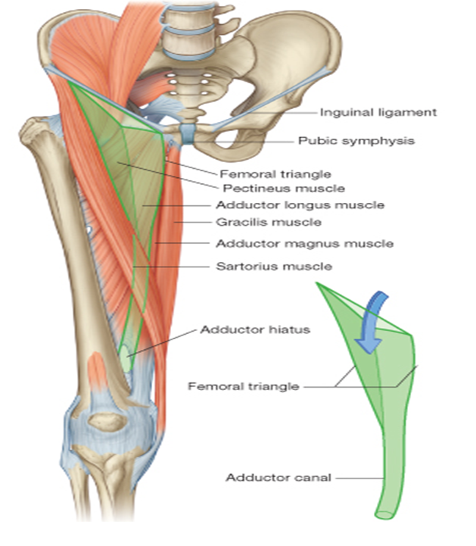
Boundaries
Superiorly:
The inguinal ligament
(the base of the triangle)
Medially:
The medial border of adductor longus muscle
Laterally:
The medial border of sartorius muscle
The apex: directed downwards and is formed by the meeting point of
Sartorius and adductor longus muscles
Floor: gutter shaped
from lateral to medial is made by
The iliopsoas muscle
The pectineus muscle
The adductor longus

Slide 5
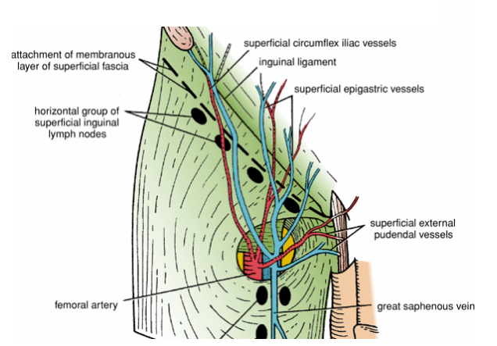
Roof :
Formed by
1- skin
2- superficial fascia which contains:
A-superficial inguinal lymph nodes
B-femoral branch of the genitofemoral nerve
C- branches of ilioinguinal nerve
D-superficial branches of the femoral artery and corresponding veins
E- terminal part of the great saphenous vien
3- deep fascia containing the Saphenous opining
You should know this by know!!!

Slide 6
Contents of the femoral triangle
1-Terminal part of the femoral nerve and its branches.
2- The femoral sheath!!!
3- The femoral artery and its branches.
4- The femoral vein and its tributaries.
5- Deep inguinal lymph nodes
6- femoral branch of genitofemoral nerve
7- lateral cutaneous nerve of the thigh

Slide 7
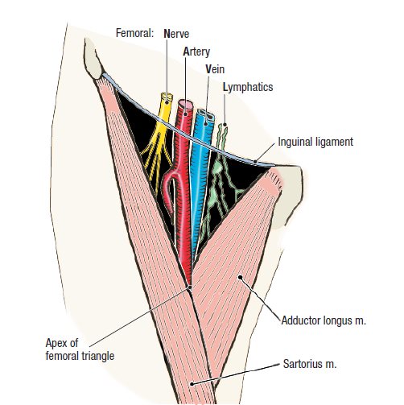

Slide 8
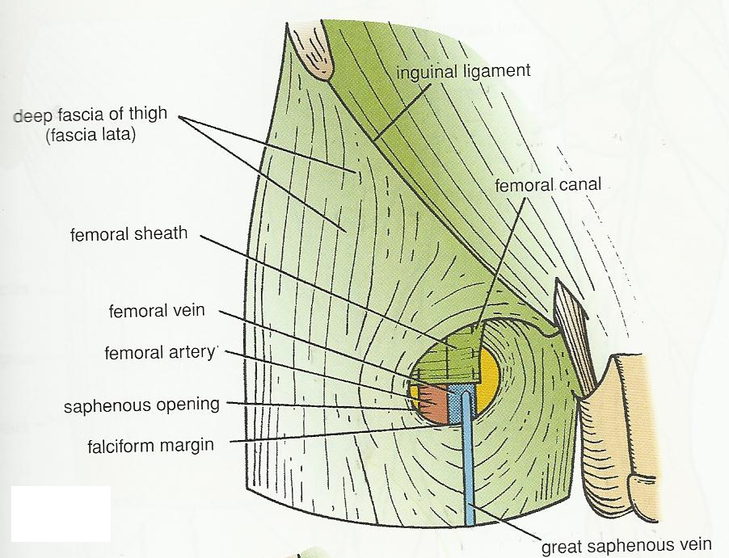
The femoral sheath
Is a funnel-shaped sleeve of fascia surrounded the femoral artery , vein and the associated lymphatic vessels in the femoral triangle for 2.5 cm below the inguinal ligament.
The femoral sheath is formed by a downwards
extension of the abdominal fascia.
Anterior wall: fascia transversalis
Posterior wall: fascia iliaca
Two Anterio-posterior septa divide the sheath into 3 compartments:

Slide 9
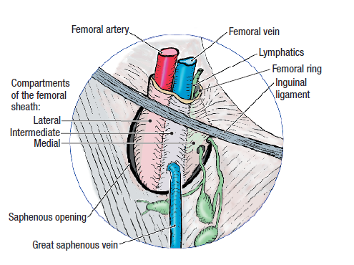
1-Lateral compartment (arterial)
occupied by the femoral artery and femoral branch of the genitofemoral nerve
2-Intermediate compartment (venous)
occupied by the femoral vein
3-Medial compartment (lymphatic) occupied by the lymph vessels
(also Called
femoral canal
?

Slide 10
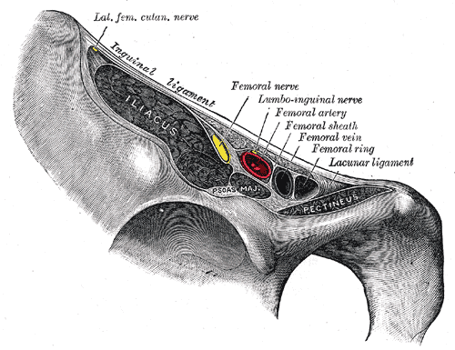
Femoral canal
Is the small medial compartment for the lymph vessels. 1.3 cm In length. just admits the tip of the little finger.
Its upper opening is called the femoral ring.
The femoral septum (is a condensation of extraperitoneal tissue), closes the ring.
Note: the femoral ring is wider in femals because of their wider pelvis and therefore, femoral hernia is commoner in femals than in males

Slide 11
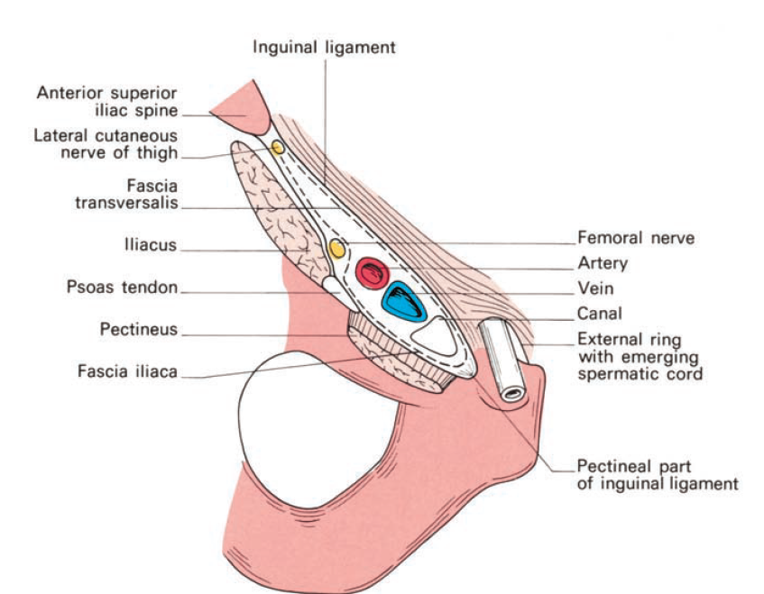
The canal contains:
1-a plug of fat
2-a constant lymph node—the node of
the femoral canal or Cloquet’s gland.
3-all the efferent lymph vessels from the deep inguinal lymph nodes
The canal has two functions: first, as a dead space for expansion of the
distended femoral vein and, second, as a lymphatic pathway from the
lower limb to the external iliac nodes

Slide 12
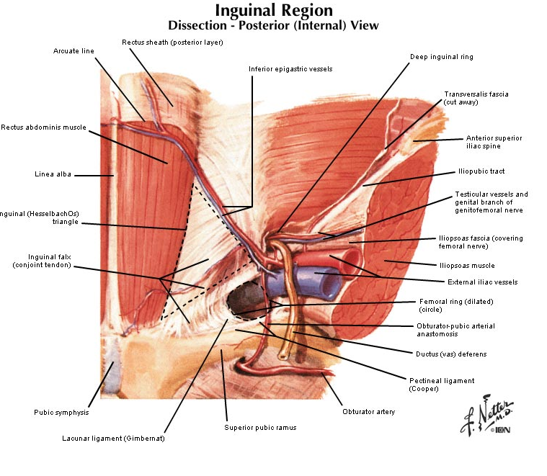
The boundaries of the femoral canal (ring) are:
Anteriorly:the inguinal ligament
Medially: the sharp free edge of the pectineal part of the inguinal ligament,termed the lacunar ligament (Gimbernat’s ligament)
Posteriorly — the pectineal ligament
(of Astley Cooper), which is the
thickened periosteum along the pectineal border of the superior pubic
ramus and which continues medially with the pectineal part of the inguinal
ligament.
laterally—the femoral vein

Slide 13
lacunar ligament (Gimbernat’s ligament)

Slide 14
The part of the femoral sheath that forms the femoral canal is not adherent to the walls of the small lymph vessels; it is this site that forms
a potentially weak area in the abdomen.
A protrusion of peritoneum could be forced down the femoral canal, pushing the femoral septum. Such a condition is known as a femoral hernia.
The lower end of the canal is normally closed by the adherence of its medial wall to the tunica adventitia of the femoral vein.

Slide 15
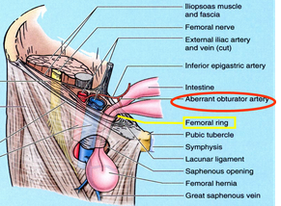

Slide 16
A protrusion of abdominal parietal peritoneum down
through the
femoral canal to form hernial sac
Femoral hernia
In femoral hernia
The neck of the hernial sac is located
below and lateral
to the pubic tubercle
While in the inguinal hernia
The neck of the hernial sac is located
above and medial
to the pubic tubercle

Slide 17
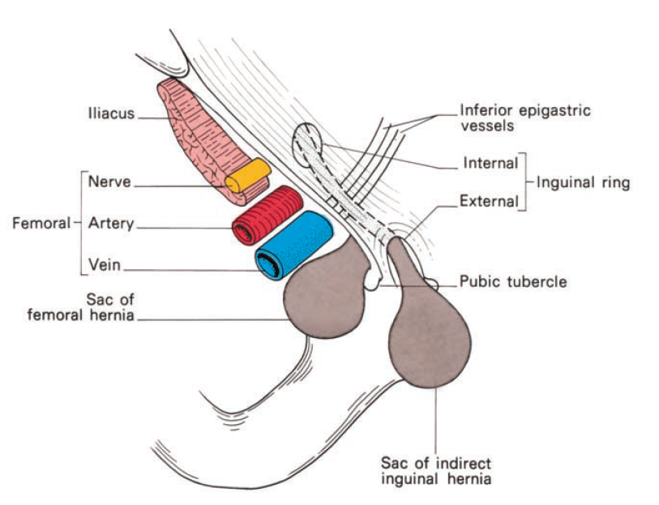
NECK
OF HERNIAL SAC, CAN YOU SEE THE DIFFERENCE BETWEEN THE TWO?POSITION, SHAPE

Slide 18
As the hernia sac enlarges, it emerges through the saphenous opening
then turns upwards along the pathway presented by the superficial epigastric
and superficial circumflex iliac vessels so that it may come to project
above the inguinal ligament.
There should not, however, be any difficulty
in differentiating between an irreducible femoral and inguinal hernia; the
neck of the former must always lie below and lateral to the pubic tubercle
whereas the sac of the latter extends above and medial to this landmark

Slide 19
The neck of the femoral canal is narrow and bears a particular sharp
medial border; for this reason, irreducibility and strangulation occur
more commonly at this site than at any other. In order to enlarge the
opening of the canal at operation on a strangulated case, this sharp edge
of Gimbernat’s lacunar ligament may require incision;
there is a slight risk
of damage to the abnormal obturator artery in this manoeuvre and it is
safer to enlarge the opening by making several small nicks into the ligament.
The safe alternative is to divide the inguinal ligament, which can then
be repaired.

Slide 20
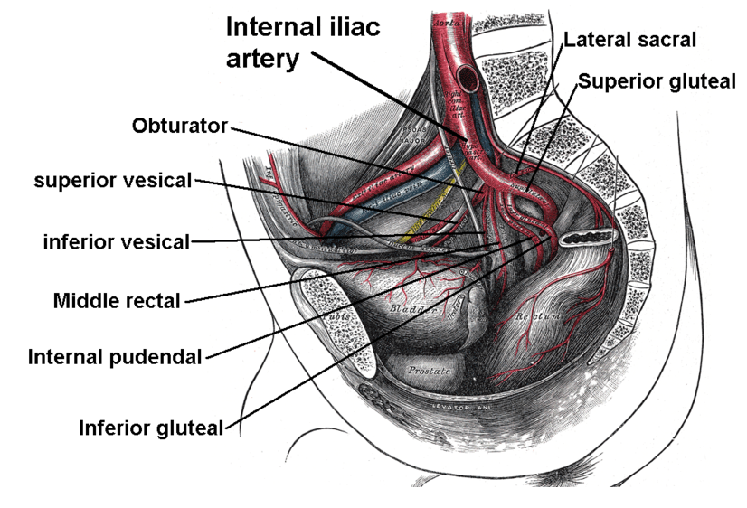
Note.
the obturator artery.
Obturator Artery
The obturator artery is a branch of the internal iliac artery
It passes forward on the lateral wall of the pelvis and accompanies the obturator nerve

Slide 21
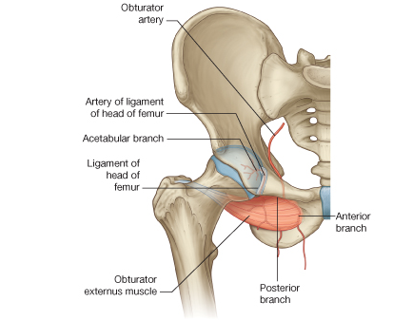
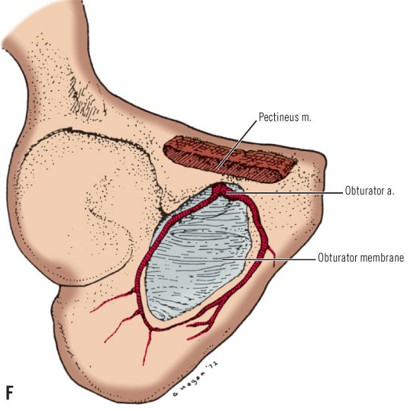
It gives off muscular branches and an articular branch to the hip joint

Slide 22
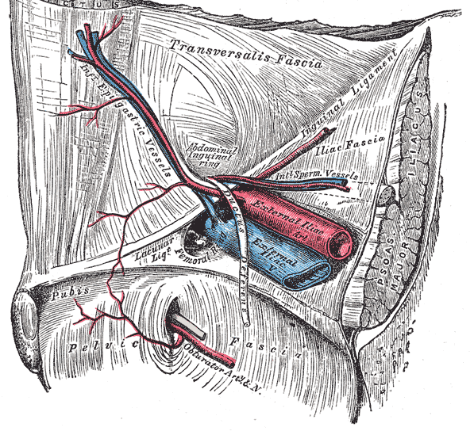
Note.
Normally there is an anastomosis between the pubic branch of the
inferior epigastric artery and the pubic branch of the obturator artery.
A view from inside the abdomen

Slide 23
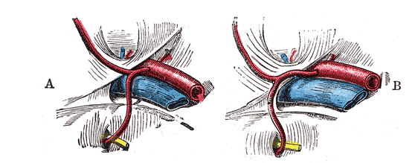
Occasionally
the obturator artery is entirely replaced by this branch from the
inferior epigastric—the abnormal obturator artery.;
This aberrant vessel usually passes laterally to the femoral canal and is out of harm’s way
rarely, it passes behind Gimbernat’s ligament and it is then in surgical danger.

