Slide 1
Lecture 3: Protein sorting (Golgi apparatus and vesicular transport)
Dr. Mamoun Ahram
Faculty of Medicine
Second year, Second semester, 2014-2014
Principles of Genetics and Molecular Biology

Slide 2
Functions of Golgi
Further protein processing and modification
Protein sorting
Synthesis of glycolipids and sphingomyelin

Slide 3
Structure of the Golgi
, endosomes

Slide 4
Processing of N-linked oligosaccharides in Golgi

Slide 5
O-linked glycosylation
Proteins can also be modified by the addition of carbohydrates to the side chains of acceptor serine and threonine residues.
The serine or threonine is usually linked directly to N-acetylgalactosamine, to which other sugars can then be added.
In some cases, these sugars are further modified by the addition of sulfate groups.

Slide 6
Lipid and Polysaccharide Metabolism in the Golgi
Transfer of phosphorylcholine group is from phosphatidylcholine to ceramide.
Sphingomyelin is synthesized on the lumenal surface.
Addition of sugar residues.
Glucose is added to ceramide on the cytosolic side and glucosylceramide then apparently flips and additional carbohydrates are added on the lumenal side of the membrane
Ceramide is synthesized in the ER

Slide 7
Protein Sorting and Export
In contrast to the ER, all of the proteins retained within the Golgi complex are associated with the Golgi membrane rather than being soluble proteins within the lumen
Protein packaging mediated by cargo receptor
processing in Immature secretory vesicles
Regulated secretion after siganling from specialized vesicles
Continuous, unregulated secretion

Slide 8
Transport to the plasma membrane of polarized cells
This is accomplished by the selective packaging of proteins into transport vesicles from the trans Golgi or recycling endosomes.
Targeting is determined by special sequences (basolatera) or sugar modification (apical)

Slide 9
Processing of lumenal lysosomal proteins
Addition of N-acetylglucosamine phosphates
Removal of N-acetylglucosamine
The enzyme recognizes a signal patch (a three-dimensional structural determinant) not a sequence.

Slide 10
Transport of lysosomal proteins
Lumenal lysosomal proteins marked by mannose-6-phosphates bind to a mannose-6-phospahte receptor.
The complexes are packaged into transport vesicles destined for late endosome, which mature into lysosomes.
lysosomal membrane proteins are targeted by sequences in their cytoplasmic tails, rather than by mannose-6-phosphates.

Slide 11
The mechanism of vesicular transport

Slide 12
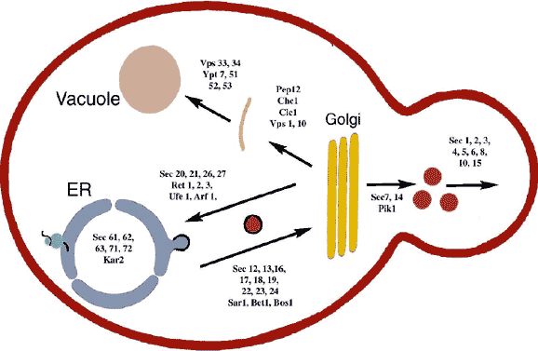
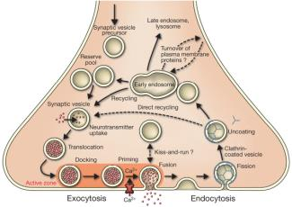
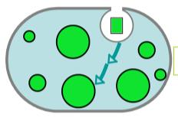
How have we understood the mechanism?
Isolation of yeast mutants that are defective in protein transport and sorting (sec mutants)
The role of Sec61 as translocation channel in the ER
Reconstitution of vesicular transport in cell-free systems
Biochemical analysis of synaptic vesicles
Tracing the path of GFP fusion proteins
Proteomics analysis

Slide 13
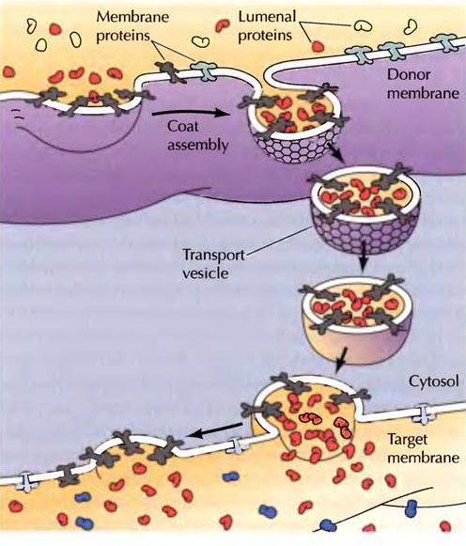
Formation and fusion of a transport vesicle
Vesicular transport
Coat disassembly
Vesicular docking & fusion

Slide 14
Coat proteins

Slide 15
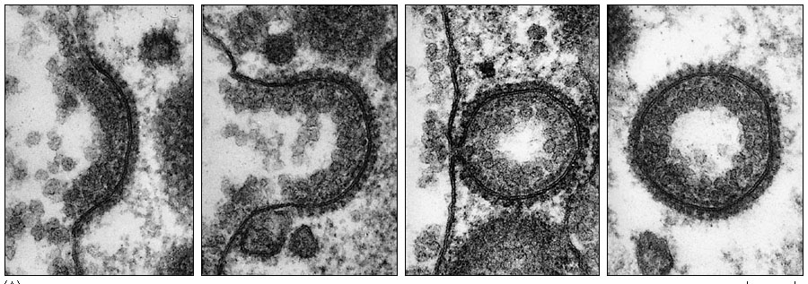
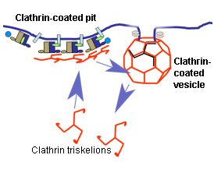
Formation of clathrin-coated vesicles

Slide 16
Role of ARF1
Activation of Arf1 by GEF
Recruitment of AP1 (not shown) and clathrin
Formation of Arf1-clathrin-receptor-cargo complex
Formation of vesicle
Budding and transport of vesicle
Inactivation and of Arf1 and disassembly of coat
Vesicle fusion

Slide 17
Players of vesicle fusion
The formation v-SNAREs-t-SNAREs complexes on the leads to membrane fusion.
GTP-binding Rab proteins function in several steps of vesicle trafficking.
Different combinations of Rab proteins mark different organelles and transport vesicles
Effector proteins allow for specific interaction

Slide 18
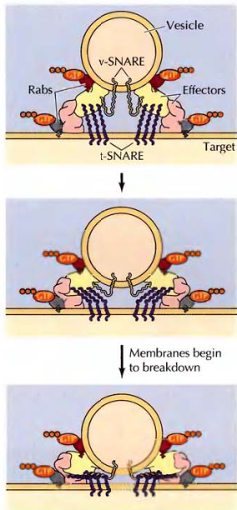
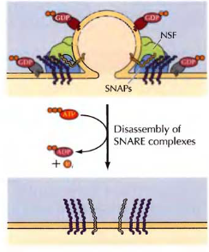
The mechanism of fusion
Closer vesicle-target
Interaction of effector proteins
Fusion
Tethering,
hydrolysis of GTP, SNARE interactions
Disassembly of SNARE complex

Slide 19
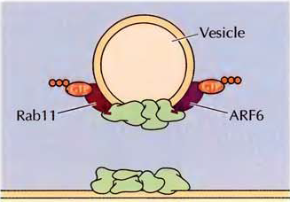
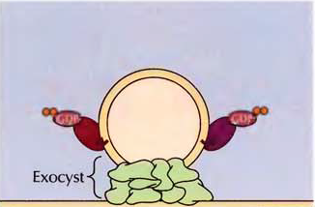
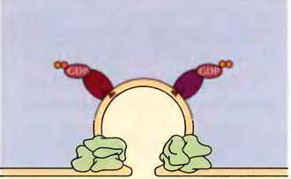
Exocytosis

Slide 20
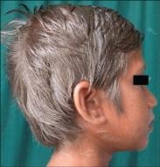
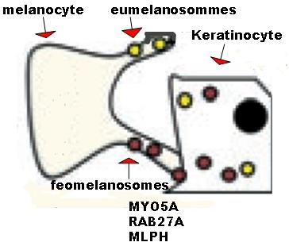
Griscelli syndrome (GS)
A rare genetic condition
Type GS: GS1, GS2, GS3
Mutations in MYO5A, RAB27A and MLPH genes that encode the MyoVA-Rab27a-Mlph protein complex that function in melanosome transport and fusion.
Pigmentary dilution of the skin, silver-grey hair, melanin clumps within hair shafts
Mature melanosomes accumulatte in the centre of melanocytes

Slide 21
Lysosomes

Slide 22
Structure
Lysosomes are membrane-enclosed organelles that contain various enzymes that break down all types of biological macromolecules.
Lysosomes degrade material taken up from outside and inside the cell.

Slide 23
Lysosomal enzymes
Lysosomes contain ~50 different acid hydrolases.
The enzymes are active at the acidic pH (about 5) that is maintained within lysosomes.
Levels of Protection:
Containment
Inactive if released
A proton pump maintains lysosomal pH.

Slide 24
Lysosomal storage diseases
Glycolipidoses (sphingolipidoses)
Oligosaccharidoses
Mucopolysaccharidoses: deficiencies in lysosomal hydrolases of glycosaminoglycans (heparan, keratan and dermatan sulfates, chondroitin sulfates.
They are chronic progressively debilitating disorders that lead to severe psychomotor retardation and premature death.

Slide 25
Glucocerebroside
Glucocerebroside is a glycosphingolipids (a monosaccharide attached directly to a ceramide unit (a lipid)
It is a byproduct of the normal recycling of red blood cells during, which are phagocytosed by macrophages, degraded and their contents recycled to make new cells.

Slide 26
Types
Three types according to severity and nervous system involvement
Type I: (least severe, most common) the nervous system is not involved; spleen and liver enlargement, development of bone lesions
Types II and III (more severe, much rarer): the only cells affected in Gaucher's disease are macrophages
Because macrophages function is to eliminate aged and damaged cells by phagocytosis by continually ingesting large amounts of lipids to be degraded in lysosomes

Slide 27
Gaucher disease, type I (acid glucocerebrosidase deficiency)
Caused by mutation in the gene encoding acid-beta glucosidase, or glucocerebrosidase, which catalyzes the hydrolysis of glucocerebroside to glucose and ceramide.

Slide 28
Gaucher disease, type I (glucocerebrosidase deficiency-acid)
Gaucher's disease is the most common of the lysosomal storage diseases, which are caused by a failure of lysosomes to degrade substances that they normally break down
The resulting accumulation of nondegraded compounds leads to an increase in the size and number of lysosomes within the cell

Slide 29
Carbohydrate metabolism

Slide 30
Oligosaccharidoses
No. | Type | Defective enzyme | Organ affected | Glycogen in the affected organ | Clinical features
0 |  | glycogen synthase-2 | Liver |  | hypoglycemia, early death, hyperketonia
I | Von Gierke disease | Glucose 6-phosphatase or transport system | Liver and kidney | Increased amount; normal structure. | Massive enlargement of the liver. Failure to thrive. Severe hypoglycemia, ketosis, hyperuricemia, hyperlipemia.
II | Pompe disease | α-1,4-Glucosidase (lysosomal) | All organs | Massive increase in amount; normal structure. | Cardiorespiratory failure causes death, usually before age 2.
III | Cori disease | Amylo-1,6-glucosidase (debranching enzyme) | Muscle and liver | Increased amount; short outer branches. | Like type I, but milder course.
IV | Andersen disease | Branching enzyme | Liver and spleen | Normal amount; very long outer branches. | Progressive cirrhosis of the liver. Liver failure causes death, usually before age 2.
V | McArdle disease | Phosphorylase | Muscle | Moderately increased amount; normal structure. | Limited ability to perform strenuous exercise because of painful muscle cramps. Otherwise patient is normal and well developed.
VI | Hers disease | Phosphorylase | Liver | Increased amount. | Like type I, but milder course.
VII | Tarui Disease | Phosphofructokinase | Muscle | Increased amount; normal structure. | Like type V.
VIII |  | Phosphorylase kinase | Liver | Increased amount; normal structure. | Mild liver enlargement. Mild hypoglycemia.
IX |  | phosphorylase kinase, β-subunit | liver, leukocytes, muscle |  | like VI
 | Fanconi-Bickel, hepatorenal glycogenosis | glucose transporter-2 (GLUT-2) | liver | failure to thrive, hepatomegaly, rickets, proximal renal tubular dysfunction

Slide 31
Pompe disease (type II)
Lysosomes become engorged with glycogen because they lack α-1,4-glucosidase, a hydrolytic enzyme confined to these organelles
Glycogen structure is normal, but its amount is excessive

Slide 32
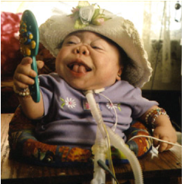
I-cell disease
Lack of targeting of lysosomal enzymes from Golgi
A deficiency in tagging enzyme
Features: severe psychomotor retardation that rapidly progresses leading to death between 5 and 8 years of age.

Slide 33
Treatment

Slide 34
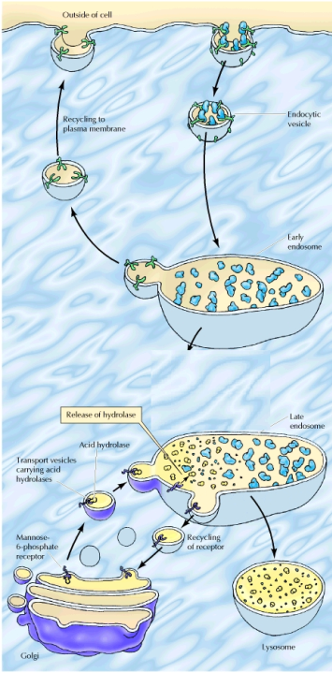
Endocytosis
Molecules are taken up from outside the cell in endocytic vesicles, which fuse with early endosomes.
Membrane receptors are recycled via recyling endosomes.
Early endosomes mature into late endosomes.
Transport vesicles carrying acid hydrolases from the Golgi fuse with late endosomes, which mature into lysosomes.
The acid hydrolases dissociate from the mannose-6-phosphate receptor and the receptors are recycled to the Golgi.
Recycling endosomes
Maturation
Maturation
or fusion

Slide 35
Chloroquine
Anti-malarial agent
In the parasite’s vaculoe, hemoglobin is digested and heme is modified by heme polymerase.
If heme is not modified, it is toxic to the parasite.
Chloroquine inhibits the enzyme.
It is a weak base that becomes charged at acidic pH
It crosses membranes into the malarial digestive vacuole.

Slide 36
Phagocytosis and autophagy

