Slide 1
Base of the Skull
The interior of the base of the skull is
divided into three cranial fossae:
1-Anterior
The anterior cranial fossa is separated from
the middle cranial fossa
By
The lesser wing of the sphenoid
2-Middle
The middle cranial fossa is separated from
the posterior cranial fossa
By
The petrous part of the temporal bone
3-Posterior

Slide 2
Anterior Cranial Fossa
Contains the frontal lobes of
the cerebral hemispheres
It is bounded
Anteriorly: by the inner surface of the
frontal bone
In the midline: a crest galli for the
attachment of the falx cerebri.
Posteriorly :the lesser wing of the
sphenoid bone
Note: The medial end of the lesser wing of the sphenoid forms
The anterior clinoid process
gives attachment to the
Tentorium cerebelli.
The floor of the fossa is formed by:
Laterally :orbital plates of the frontal bone
Medially: by the cribriform plate of the
ethmoid
The crista galli is a sharp upward projection of the ethmoid bone in the midline for the attachment of
The falx cerebri.

Slide 3
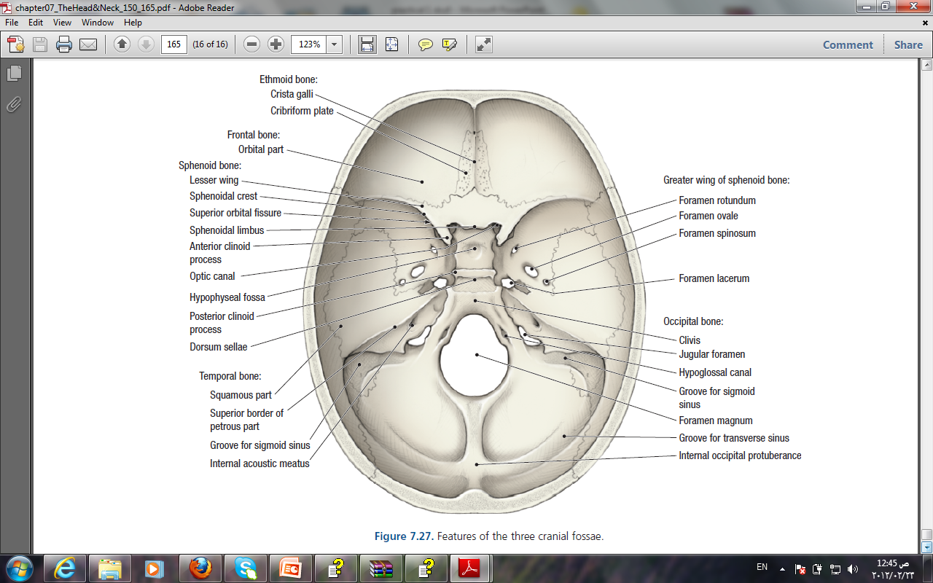
Middle Cranial Fossa
formed by:
the body of the sphenoid
It is bounded
Anteriorly by: the lesser wings of the sphenoid
Posteriorly by :the superior borders of the petrous parts of the temporal bones
Laterally :
the squamous parts of the temporal bones, the greater wings of the sphenoid,
and the parietal bones.
The floor of each lateral part of the middle cranial fossa is formed by the greater wing of the sphenoid and the squamous and petrous parts of the temporal bone.

Slide 4
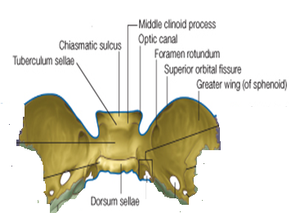
The sphenoid bone
resembles a bat having a centrally placed body with greater and lesser wings that are outstretched on each side
1-The body of the sphenoid :contains the
sphenoid air sinuses
2-The optic canal transmits
A- The optic nerve
B-The ophthalmic artery
3-The superior orbital fissure
is a slitlike opening between
the lesser and greater wings
of the sphenoid transmits:
Lacrimal
Frontal
Trochlear
Superior division of Oculomotor nerve
Nasociliary
Inferior division of oculomotor nerve
Abducent nerves
together with the superior ophthalmic vein.
Live
Free
To
See
No
Insult
At all

Slide 5
4-The foramen rotundum
situated behind the medial end of the superior
orbital fissure
Transmits the maxillary nerve.
5-The foramen ovale
lies posterolateral to the foramen rotundum
Transmits the mandibular nerve
the lesser petrosal nerve
6-The small foramen spinosum
lies posterolateral to the foramen ovale
The foramen transmits
The middle meningeal artery
7-Foramen lacerum
lies between the apex of the petrous part of the temporal bone and the sphenoid bone
in life is filled by cartilage and fibrous tissue, and only small blood vessels pass through this tissue from the cranial cavity to the neck.
9- Meckl’s cave:
impression on the apex of the petrous part of the temporal bone for the trigeminal ganglion
8-The carotid canal
Transmits: The internal carotid artery

Slide 6
10-The median part of the middle cranial fossa is formed by:
the body of the sphenoid bone
In front of it is
The sulcus chiasmatis
which is related to the optic chiasma
and leads laterally
To
THE OPTIC CANAL
On the superior aspect of the body is a depression called
The sella turcica
which CONTAIN
THE PITUITARY GLAND
The sella turcica is bounded posteriorly by a square plate of bone called
THE DORSUM SELLAE
The superior angles of the dorsum sellae have
two tuberclescalled
The posterior clinoid processes
which give attachment to the fixed margin of
The tentorium cerebelli.

Slide 7
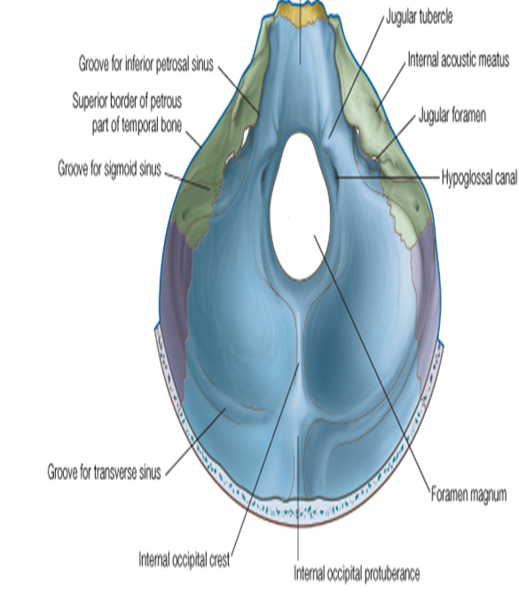
Posterior Cranial Fossa
Contains the parts of the hindbrain:
The cerebellum, Pons, and Medulla oblongata
Is bounded by:
Anteriorly: the petrous part of the temporal bone
Posteriorly : the internal surface of the
squamous part of the occipital bone
The floor is formed by:Parts of the occipital bone
The mastoid part of the temporal bone
The roof is formed by:
a fold of dura
THE TENTORIUM CEREBELLI
which intervenes between the cerebellum below And
the occipital lobes of the cerebral hemispheres above

Slide 8
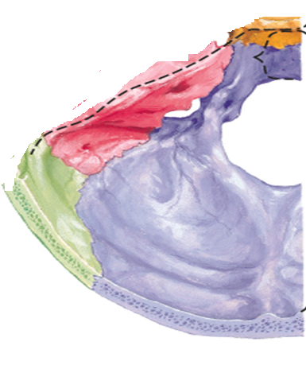
1-The internal acoustic meatus
pierces the posterior surface of the petrous part of the temporal bone.
It transmits:
A- THE VESTIBULOCOCHLEAR NERVE
B- THE FACIAL NERVE.
2-The internal occipital protuberance
attached to it the small falx cerebelli
3- Groove for the transverse sinus:
On each side of the internal occipital protuberance
4-the sigmoid sinus
4-the sigmoid sinus

Slide 9
5-The foramen magnum
occupies the central area of the floor
Transmits
A- The medulla oblongata and its surrounding meninges
B- The ascending spinal parts of the accessory nerves
C-The two vertebral arteries
6-The hypoglossal canal
is situated above the anterolateral boundary of the foramen magnum
Transmits the hypoglossal nerve
7-The jugular foramen
It transmits the following structures:
from before backward:
A-The inferior petrosal sinus
B-The 9th, 10th, and 11th cranial nerves
C- The large sigmoid sinus
D-The inferior petrosal sinus
E-The sigmoid sinus turns down through the foramen
to become the internal jugular vein

Slide 10
Inferior View of the Skull
1-The hard palate whic is made of:
A-The palatal processes of the
maxillae
B-The horizontal plates of the
palatine bones
2-Incisive fossa and foramen
3-The greater and lesser palatine
foramina
4-The choanae (posterior nasal apertures).
5-The vomer
6-Medial and lateral pterygoid plates
of the sphenoid bone

Slide 11
The greater wing of the sphenoid is pierced by the large
7-foramen ovale
8-foramen spinosum
9-The spine of the sphenoid LOCATED Posterolateral to the foramen spinosum is
10-The mandibular fossa of the temporal bone and the articular tubercle form the upper articular surfaces for the temporomandibular joint.
11-Tympanic plate of the temporal bone
12-The styloid process of the temporal bone
13-The opening of the carotid canal
14- Foramen lacerum
15-the external auditory meatus

Slide 12
16- The stylomastoid foramen
In the interval between the styloid and mastoid processe
17-jugular foramen
18-Hypoglossal canal
Superior to the occipital condyle
for transmission of the hypoglossal nerve
19-The basilar part of the occipital bone
20-The occipital condyles
21-The external occipital protuberance.
22- The superior nuchal lines :posterior to the foramen magnum in the midline

