Slide 1
The Skull
The skull is composed of several separate bones (22 bones) united at immobile joints called sutures.
The connective tissue between the bones is called a sutural ligament
Only one moveable bone, the mandible which is united to the skull by the mobile
Temporomandibular Joint
The bones of the skull can be divided into:
1- Bones of the cranium (contain the brain)
2- Bones of the face
The skull bones are made up of
External and internal tables of compact bone separated by a layer of spongy bone called the diploic bones
The bones are covered on the outer and inner surfaces with periosteum.
The upper part of the cranium is The vault
The base of the skull is the lowest part of the cranium

Slide 2
The cranium consists of the following bones
two of which are paired :
Frontal bone: 1
Parietal bones: 2
Occipital bone: 1
Temporal bones: 2
Sphenoid bone: 1
Ethmoid bone: 1
B)The facial bones consist of the following
two of which are single:
Zygomatic bones: 2
Maxillae: 2
Nasal bones: 2
Lacrimal bones: 2
Vomer: 1
Palatine bones: 2
Inferior conchae: 2
Mandible: 1

Slide 3
Norma Frontalis
It is the anterior aspect of the skull
Made of three parts
1-Upper part: Forehead; made of the frontal bone
2-Middle part: contains 3 caviteis;2 orbital & 1 nasal
3-Lower part: formed by the upper & lower jaws

Slide 4
1- Frontal eminence: the most prominent areas on either side of the forehead
2-The superciliary arches :Elevated ridges above the medial parts of the sup. Orbital margins
3-supraorbital notch, or foramen: located on junction
between the medial 1/3 and the lateral 2/3. transmits the supraorbital n. & vessels
4-Glabela:an area above the root of the nose Between the 2 superciliary arches
5-Nasion:a point where the frontonasal & interanasal sutures meet
6-The nasal bones: form the roof of the nose

Slide 5
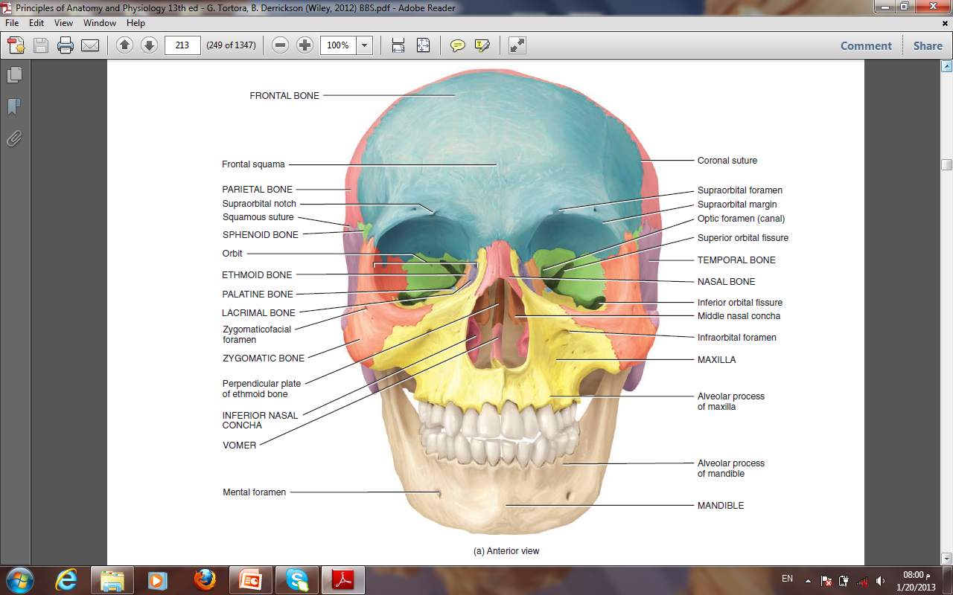
7-The zygomatic bones has:
a-Frontal processes: articulates with frontal bone
b-Temporal processes: articulates with zygomatic process of the temporal bone to form the zygomatic arch
c- maxillary processes: articulates with the maxillary bone
d- orbital plate: shears in the formation of the floor and lateral wall of the orbit
a-Frontal processes:
b-Temporal processes:
d- orbital plate
The zygomatic bone
c- maxillary processes
The orbital margins are bounded by:
A-The frontal bone :superiorly
B-The zygomatic bone :laterally
C- The maxilla: inferiorly
D-The processes of the maxilla and frontal bone :medially

Slide 6
Norma lateralis
The parietal bones form the sides and roof of the cranium.
The skull is completed at the side by the
1-Squamous part of the occipital bone
2-Parts of the temporal bone
The squamous
Tympanic
Mastoid process
Styloid process
3-Zygomatic process
4- The greater wing of the sphenoid
Note the position of the external auditory meatus.
The ramus and body of the mandible lie inferiorly.
.

Slide 7
Identify
the superior and inferior temporal lines, which begin as a single line from the posterior margin of the zygomatic process of the frontal bone and diverge as they arch backward.
The upper temporal line gives attachment for the temporal fascia
The lower temporal line is for the attachment of temporalis muscle
The supramastoid crest
The zygomatic arch: formed of the temporal process of
The zygomatic process of temporal bone and the zygomatic process of temporal bone (its lower border And inner surface give attachment to the masseter muscle

Slide 8
Pterion: is an area located on the floor of the temporal fossa
Where 4 bones meet at an H-shaped structure
The 4 bones are
1-freontal
2- parietal
3-squamous part of temporal bone
4-greater wing of sphenoid
The pterion is the thinnest part of the lateral wall of the skull. it overlies the anterior division of
The middle meningeal artery and vein
Epidural bleeding

Slide 9
The temporal fossa lies below the inferior temporal line
The zygomatic arch divides the lateral side of the Skull into
The temporal fossa & The infratemporal fossa
The infratemporal fossa
lies below the infratemporal crest on the greater wing of the sphenoid

Slide 10
The temporal fossa
Boundries
Above and behind: the superior temporal line
Below: The zygomatic arch
Anteriorly: the frontal process of zygomatic bone
Infratemporal fossa
Anterior wall: back of the maxilla
Medial wall: lateral pterygoid plate
Roof: infratemporal surface of the greater wing Of sphenoid bone
Lateral wall: ramus of mandible
Communications
Temporal fossa: through the gap deep to the zygomatic arch
Orbit: through the inferior orbital fissure
Pterygo-polatine fossa : through the pterygo-maxillary fissure

Slide 11
The pterygomaxillary fissure is a vertical fissure that lies within the fossa between the pterygoid process of the sphenoid bone and back of the maxilla. It leads medially into the pterygopalatine fossa.
The inferior orbital fissure
is a horizontal fissure between the greater wing of the sphenoid bone and the maxilla.
It leads forward into the orbit.

Slide 12
The pterygopalatine fossa
Is a small space behind and below the orbital cavity.
It communicates
laterally :with the infratemporal fossa through the pterygomaxillary fissure
Medially: with the nasal cavity through the sphenopalatine foramen
superiorly :with the skull through the foramen rotundum
anteriorly :with the orbit through the inferior orbital fissure

Slide 13
Superior View of the Skull (Norma Verticalis)
Anteriorly
the frontal bone articulates with the two parietal bones
AT THE CORONAL SUTURE
The two parietal bones articulate in the midline
AT THE SAGITTAL SUTURE
lambdoid sutures

Slide 15
Posterior View of the Skull
Above
The posterior parts of the two
Parietal bones with the intervening sagittal suture
Below,
the parietal bones articulate with the squamous part of the occipital bone
at the lambdoid suture.
On each side the occipital bone articulates with the temporal bone.
In the midline of the occipital bone is a roughened elevation called
The external occipital protuberance
which gives attachment to muscles and the ligamentum nuchae
On either side of the protuberance the superior nuchal lines extend laterally toward the temporal bone.

