Slide 1
Superior View of the Skull (Norma Verticalis)
Anteriorly
the frontal bone articulates with the two parietal bones
AT THE CORONAL SUTURE
The two parietal bones articulate in the midline
AT THE SAGITTAL SUTURE
lambdoid sutures

Slide 2
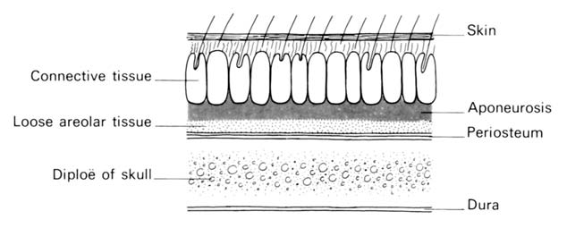
To assist one in memorizing the names of the five layers of the scalp, use each letter of the word SCALP to denote the layer of the scalp.
S—skin
C—connective tissue
A—aponeurosis
L—loose connective tissue
P—periosteum.

Slide 3
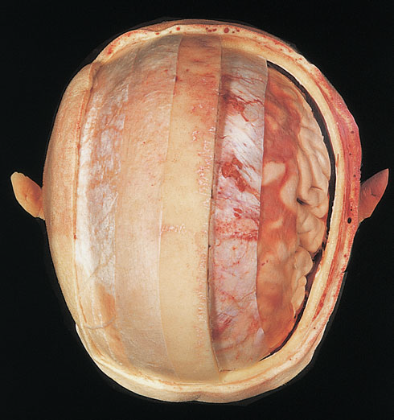
S—skin
C—connective tissue
A—aponeurosis
L—loose connective tissue
P—periosteum.
S—skin
C—connective tissue
A—aponeurosi
L—loose connective tissue
P—periosteum

Slide 4
The Scalp
The scalp consists of FIVE LAYERS
S-skin
C-connective tissue (dense)
A-aponeurotic layer
L-loose connective tissue
P-pericranium
The first three of which are intimately
bound together and move as a unit
1-Skin
is thick contains hair and contains
numerous sebaceous glands
Remember that scalp is the common site
for sebaceous cyst

Slide 5
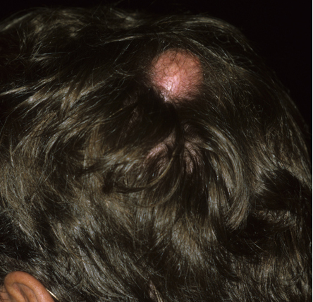
Sebaceous cyst

Slide 6
2-Connective tissue
Made of fibrous fascia and septa
which unite the skin to the underlying aponeurosis of the occipitofrontalis muscle
Contains
numerous arteries and veins!!!
It is often difficult to stop the bleeding of a scalp wound because
the arterial walls
are attached to fibrous septa
in the subcutaneous tissue
and are unable to contract or retract to allow blood clotting to take place
Local pressure applied to the scalp is the only satisfactory method of stopping the bleeding

Slide 7
3-Aponeurosis (epicranial),
is a thin, tendinous sheet that unites the occipital and frontal bellies
of the occipitofrontalis muscle
Epicranail aponeurosis
The lateral margins of the aponeurosis are attached to the temporal fascia.
The subaponeurotic space is the potential space beneath the epicranial aponeurosis.
It is limited in front and behind by the origins of the occipitofrontalis muscle, and it extends laterally as far as the attachment of the aponeurosis to the temporal fascia
The tension of the epicranial aponeurosis, produced by the tone of the occipitofrontalis muscles, is important in all deep wounds of the scalp. If the aponeurosis has been divided, the wound will gape open. For satisfactory healing to take place, the opening in the aponeurosis must be closed with sutures

Slide 8
The subaponeurotic space
Is under the aponeurosis of occipitofrontalis muscle

Slide 9
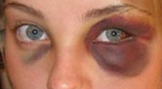
4-Loose areolar tissue
Also called the dangerous area
Of the scalp
Occupies the subaponeurotic space and extends anteriorly to the eyelids Therefore, any blood collection in this layer may extend to the root of the nose and the eyelids causing Black eye
Black eyes …..think of head trauma

Slide 11
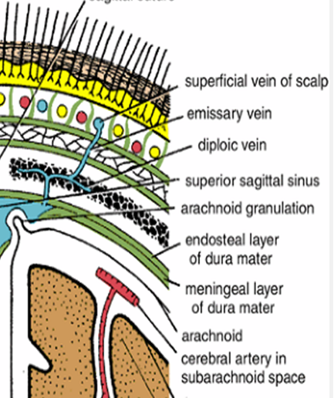
Made of loose areolar tissue which contains important emissary veins.
The emissary veins are
valveless and connect
The superficial veins of the scalp
with the diploic veins of the skull bones
Causing Osteomyelitis
Infected blood in the diploic veins may travel by the emissary veins farther into the venous sinuses and produce venous sinus thrombosis

Slide 12
5-Pericranium
is the periosteum covering the outer surface of the skull bones.
The sutures between individual skull bones, the periosteum on the outer surface of the bones becomes continuous with the periosteum on the inner surface of the skull bones . THEREFORE if there is any fluid collection beneath the pericranium (Cephalhaematoma) it will take the shape of the related bone

Slide 13
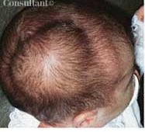
Read only
A right parietal cephalhematoma was first noted on this 2-week-old girl 2 days after her birth. Caused by bleeding under the outer periosteum of a newborn's skull bone, usually the parietal bone, swelling becomes evident by day 2 or 3 after delivery.
The swelling is confined to the involved bone and does not extend beyond the suture lines or the midline of the skull
Treatment with needle aspiration is contraindicated because of the possibility of introducing an infection

Slide 14
Muscles of the Scalp
Occipitofrontalis
The origin
Insertion
nerve supply
action
The frontal bellies of the occipitofrontalis can raise the eyebrows in expressions of surprise or horror.

