Slide 1
Pelvic mesocolon
Begins:
begins as a continuation of the descending colon Lt side of pelvic brim(inlet of pelvic)
Parts of the pelvic mesocolon
  Sigmoid colon
  Rectum
  Upper part of the anal canal

Slide 2
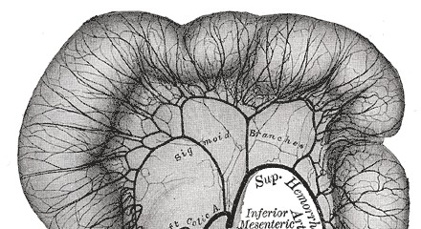
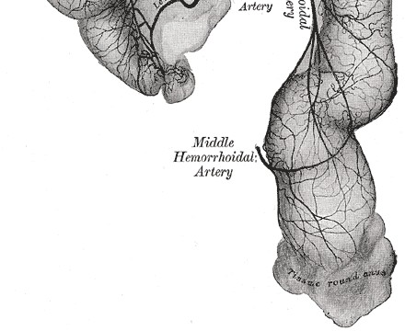
Sigmoid Colon
Location and Description
The sigmoid colon is 10 - 15 in. (25 to 38 cm)long
It is a part of large intestine in pelvic cavity
Begin: Lt. side of the pelvic brim(inlet of the pelvis)
End: it becomes continuous with the rectum in front of the third sacral vertebra( mid of the sacrum).
Parts:
Lateral limb� contains lower Lt. colic artery
-Medial limb� contains sup.Rectal artery
Free margin� curved to Rt. of mid line
- Root � has an inverted V shape attachment

Slide 3
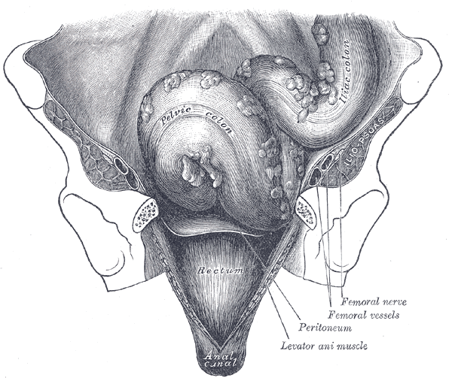
Pelvic colon……cont
The sigmoid colon is mobile and hangs down into the pelvic cavity in the form of a loop.
It is attached to the posterior pelvic wall by the fan-shaped sigmoid mesocolon.
Attachment of the root of mesocolon
At middle piece of sacrum
Bifurcation of Lt.common iliac artery
Middle of Lt.Ext.iliac artery
The appendices epiploicae (omental appendages) are very long in the sigmoid colon

Slide 4
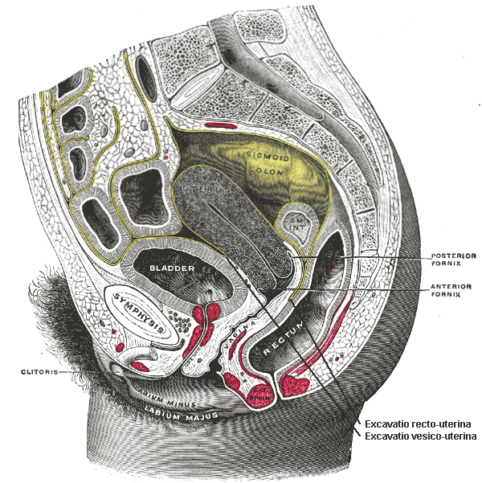
Relations of sigmoid c
Left
Lt.Ext. iliac vesseles
Lat.wall of pelvis
Vas defferance or ovary
Right
Small intestines
Superior
Coils of small intestine
Inferior
In mal: urinary blabber
In femal : uterus
olon

Slide 5
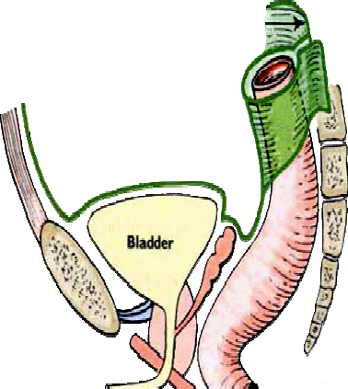
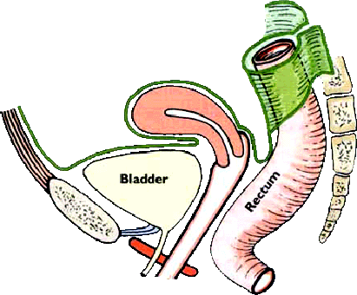
Relations of sigmoid colon
Posteriorly:
- The rectum
the sacrum.
the lower coils of the terminal part of the ileum
Sacral plexus
Lt.periformis muscle
Lt. external iliac vessels
Lt.Ureter
Lt. internal common iliac artery
The sigmoid colon usually occupies the rectovesical pouch in males and the rectouterine pouch in females

Slide 6
Blood Supply of sigmoid colon
Arteries
- Sigmoid branches of the inferior mesenteric artery.
The most superior sigmoid artery anastomoses with the descending branch of the left colic artery.
Veins
The veins drain �the inferior mesenteric vein� the portal venous system.

Slide 7
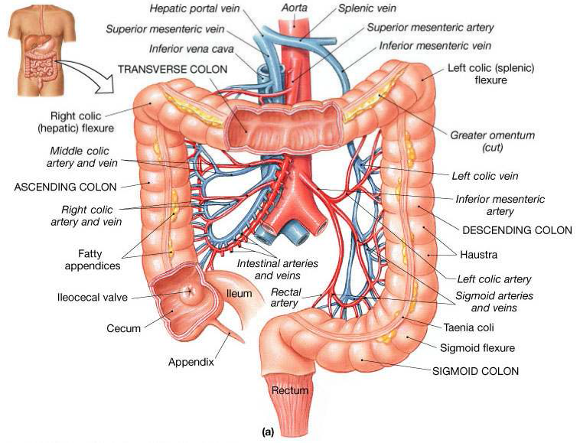
Blood supply for sigmoid colon

Slide 8
Lymph Drainage of sigmoid colon
The lymph drains into nodes along the course of the sigmoid arteries �the inferior mesenteric nodes.

Slide 9
Nerve Supply of sigmoid colon
The sympathetic and parasympathetic nerves from the inferior hypogastric plexuses
The parasympathetic supply is derived from the pelvic splanchnic nerves

Slide 10
Rectum
Location and Description
The rectum is about 5 in. (13 cm) long
begins in front of the third sacral vertebra as a continuation of the sigmoid colon.
ends in front of the tip of the coccyx by piercing the pelvic diaphragm and becoming continuous with the anal canal.
The lower part of the rectum is dilated to form the rectal ampulla.
The rectum deviates to the left, but it quickly returns to the median plane
On lateral view, the rectum follows the anterior concavity of the sacrum before bending downward and backward at its junction with the anal canal
The puborectalis portion of the levator ani muscles forms a sling at the junction of the rectum with the anal canal and pulls this part of the bowel forward, producing the anorectal angle.

Slide 11
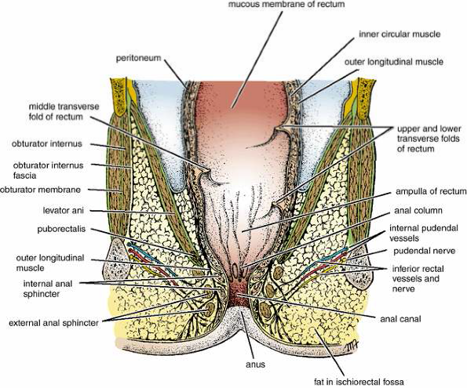
Rectum

Slide 12
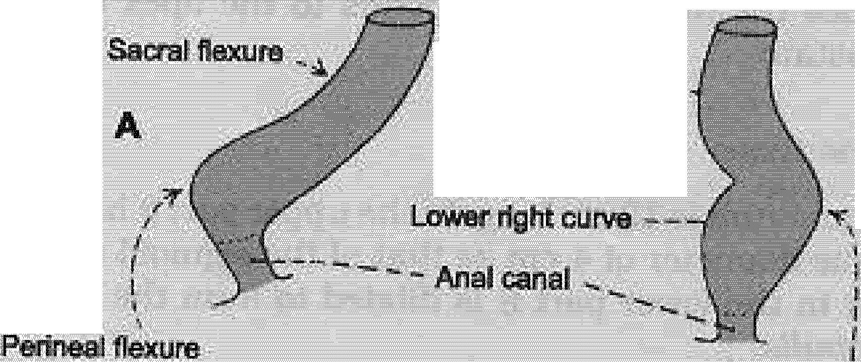

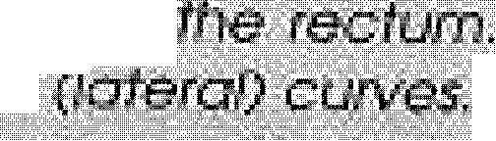


"U,P..n..,a.,f.,FII&r".n"""" t.c," u", r" ve"""
...
'" B"
Fig, 33./Z: t;tmJDtUI /)f
:;ICJ

Slide 13
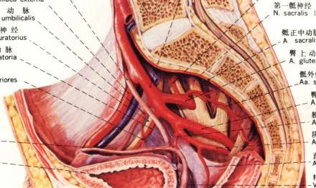
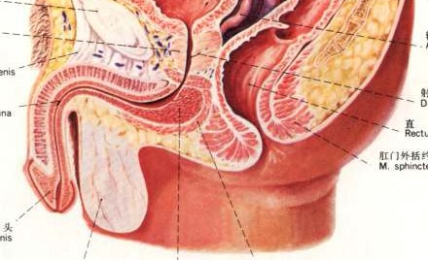
Sacral flexure
Perineal flexure

Slide 14
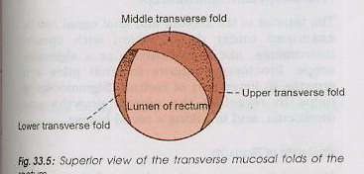

anterior
Right left
posterior
Mucosal folds: the transverse or horizontal folds or Houston’valve: upper fold projects from right, middle fold projects from anterior and right wall, lowest fold projects from left wall.

Slide 15
rectum……cont
The peritoneum
first third �covers the anterior and lateral surfaces
middle third � only the anterior surface of the
the lower third �devoid of peritoneum .

Slide 16
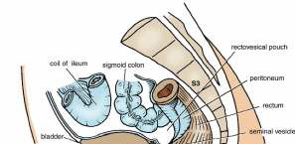
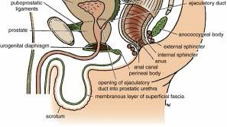
Relations of rectum
Posteriorly:
The rectum is in contact with the sacrum and coccyx
the piriformis muscle
Coccygeus muscle
levatores ani muscle
the sacral plexus
the sympathetic trunks.
Anteriorly:
1- In the male
the upper two thirds of the rectum
It is covered by peritoneum
It is related to the sigmoid colon and coils of ileum that occupy the rectovesical pouch.
The lower third of the rectum
It is devoid of peritoneum
It is related to the posterior surface of the bladder
to the termination of the vas deferens
the seminal vesicles on each side
and to the prostate

Slide 17
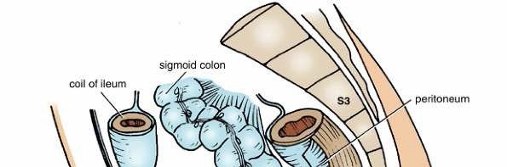
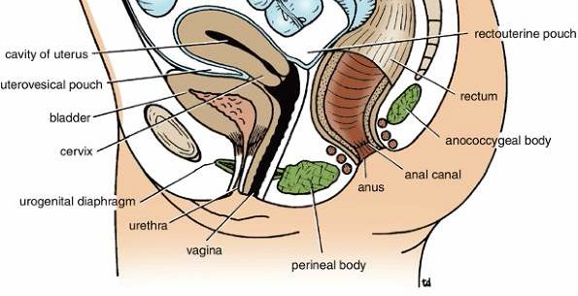
Relations of rectum….cont
Anteriorly:
2- In the female
the upper two thirds of the rectum
It is covered by peritoneum
It is related to the sigmoid colon and coils of ileum that occupy the rectouterine pouch (pouch of Douglas).
The lower third of the rectum
It is devoid of peritoneum
It is related to the posterior surface of the vagina.

Slide 18
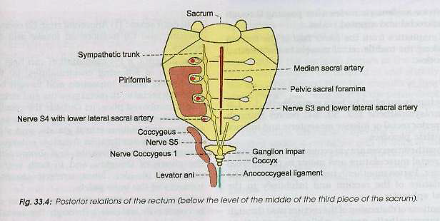

Slide 19
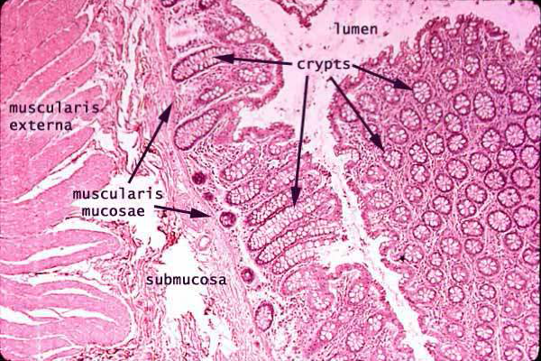
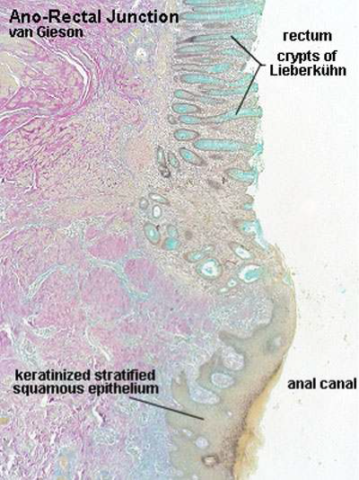
Histology of rectum

Slide 20
Histology of the rectum
The muscular coat of the rectum is arranged in
outer longitudinal of smooth muscle
inner circular layers of smooth muscle
- The three taenia coli of the sigmoid colon however, come together so that the longitudinal fibers form a broad band on the anterior and posterior surfaces of the rectum � No taenia coli
- transverse folds of the rectum (semicircular permanent folds) �The mucous membrane of the rectum+ the circular muscle layer

Slide 21
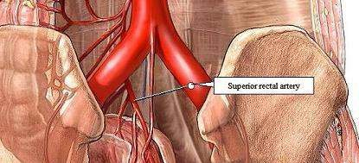
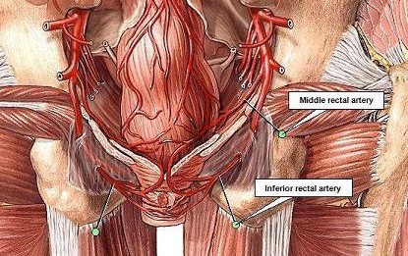
Blood Supply of rectum
Arteries
The superior, middle, and inferior rectal arteries �supply the rectum.
1- The superior rectal artery
It is a direct continuation of the inferior mesenteric artery and is the chief artery supplying the mucous membrane.
It enters the pelvis by descending in the root of the sigmoid mesocolon and divides into right and left branches, which pierce the muscular coat and supply the mucous membrane.
They anastomose with one another and with the middle and inferior rectal arteries.

Slide 22
Blood supply of rectum
2- The middle rectal artery
-It is a small branch of the internal iliac artery
- It is distributed mainly to the muscular coat.
3- The inferior rectal artery
It is a branch of the internal pudendal artery in the perineum.
It anastomoses with the middle rectal artery at the anorectal junction.

Slide 23
Blood supply of rectum
Veins
The veins of the rectum correspond to the arteries.
The superior rectal vein is a tributary of the portal circulation and drains into the inferior mesenteric vein.
The middle rectal vein� the internal vein
inferior rectal vein� internal pudendal veins
- The union between the rectal veins forms an important portal systemic anastomosis .

Slide 24
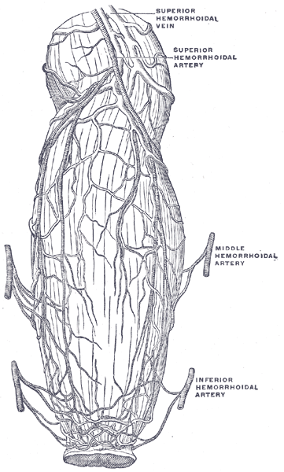
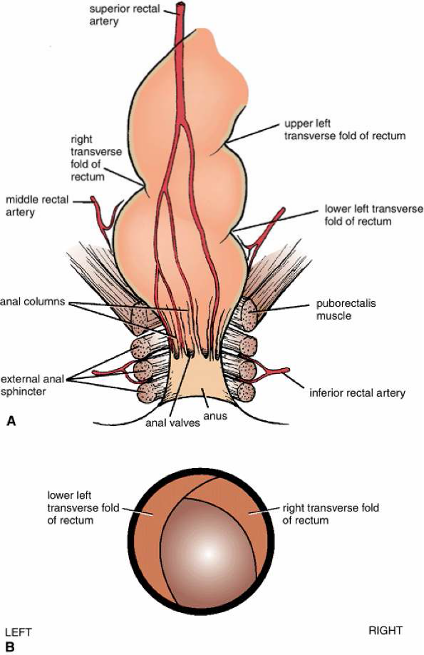
Blood supply of rectum

Slide 25
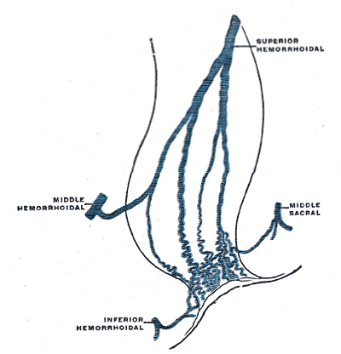
The hemorrhoidal plexus (or
rectal venous plexus)
surrounds the rectum, and communicates in front with the vesical venous plexus in the male, and the uterovaginal plexus in the female.
A free communication between the portal and systemic venous systems is established through the hemorrhoidal plexus.

Slide 26
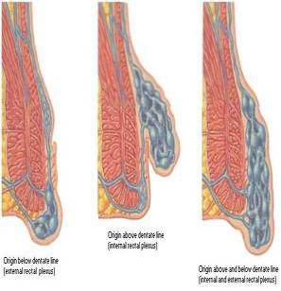
Rectal plexus & Hemorrhoids

Slide 27
Lymph Drainage of rectum
the upper part drain �into the pararectal nodes � then into inferior mesenteric nodes.
the lower part follow the middle rectal artery� to the internal iliac nodes.

Slide 28
Nerve Supply of rectum
The nerve supply is from the sympathetic and parasympathetic nerves from the inferior hypogastric plexuses.
The rectum is sensitive only to stretch.

Slide 29
Anal canal

Slide 30
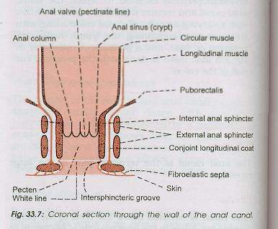
The anal canal
It is the terminal part of the large intestine.
-It is situated below the level of the pelvic diaphragm and lies in anal triangle of perineum.
-The anal canal is 3.8cm long
It extends from the anorectal junction to the anus.
-The anorectal junction Is marked by the forward convexity of the perineal
flexure of the rectum, the anus is the surface opening of the anal canal, situated about 4cm below and in front of the tip of the coccyx in the cleft between two buttocks.

Slide 31
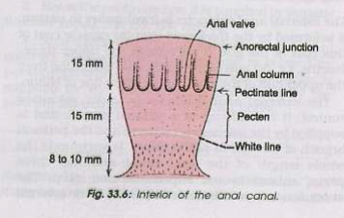
Anorectal ring:
this is a muscular ring presentat at the anorectal junction.
It is formed by the fusion of the puborectalis, deep external sphincter and the internal sphincter, which can be felt on rectal examination .

Slide 32
Interior of the anal canal shows many features and can be divided into three parts :
1- upper part is lined by mucous membrane, & is of endodermal origin. The mucous membrane shows 6 to 10 vertical folds,
these folds are called the anal columns of Morgagni
.

Slide 33
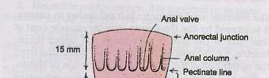
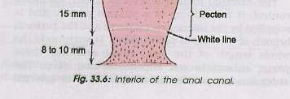
The lower ends of the anal columns are united to Each other by short semilunar folds of mucous membrane, these folds are called the anal valves . Above each valve there is a depression in the mucosa which is called the anal sinus, the anal valves together form a transverse line that runs all round the anal canal .this is pectinate line.

Slide 34
2- The middle part of anal canal
- It is termed as transitional zone or pecten, it is also lined by mucous membrane.
-The mucosa has a bluish appearance because of a dense venous plexus that lies beneath.
- The lower limit of the pecten often has a whitish appearance because of which it is referred to as the white line or Hilton’s line, is situated at the level the interval between the subcutaneous part of external anal sphincter and the lower border of internal anal sphincter.
3- Lower cutaneous part
is about 8mm long and is lined by true skin containing sweat and sebaceous glands.

Slide 35
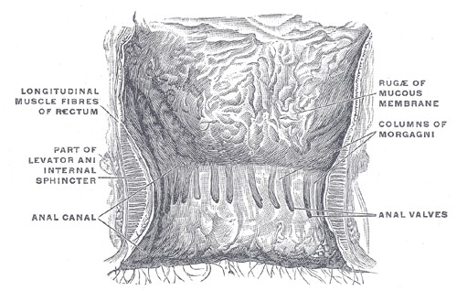
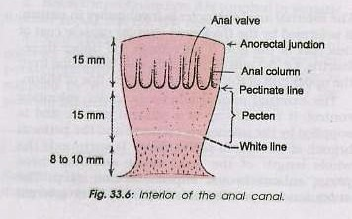
White line
A landmark for the intermuscular border between internal and external anal sphincter muscles.
This line represents the transition point from non-keratinized stratified squamous epithelium to keratinized stratified squamous epithelium in the anus.

Slide 36
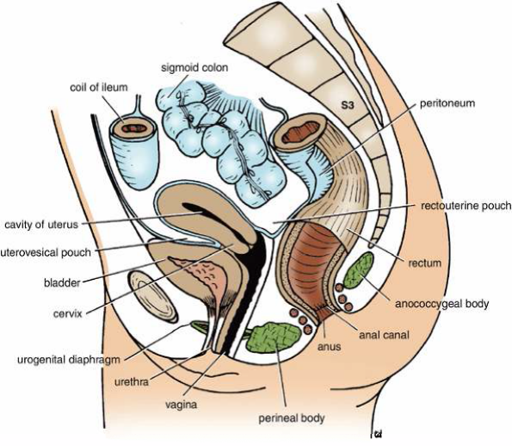
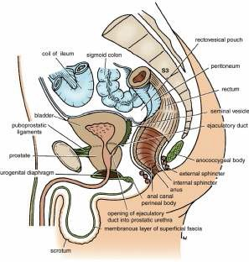
Relations of anal canal Anteriorly
In male
perineal body
membranous urethra
bulb of penis
In female
lower end of the vagina
Posteriorly
anococcygeal ligaent
tip of the coccyx
laterally
ischiorectal fossae.

Slide 37
Musculature of the anal canal:
internal anal sphincter is involuntary in nature, It is formed by the thickened circular muscle coat of this part of the gut.
the external anal sphincter is under voluntary control.
& has three parts: subcutaneous ,superficial and deep parts.
subcutaneous part lies below the level of internal sphincter and surrounds the lower part of the anal canal. The superficial part is elliptical in shape and arises from the terminal segment of the coccyx and anococcygeal ligament, the fibres surround the lower part of the internal sphincter and are inserted into the perineal body. The deep part surrounds the upper part of the internal sphincter and is fused with the puborectalis.

Slide 38
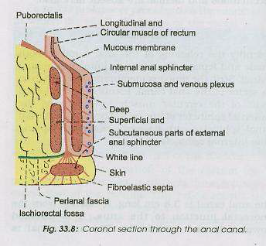

Slide 39
Blood supply of anal canal
Arterial supply:
the part of the anal canal above the Pectinate line is supplied by the superior rectal artery
the part below the pectinate line is supplied by the inferior rectal artery.

Slide 40
Venous drainage:
internal rectal venous plexus drains into superior rectal vein
the lower part of the external rectal venous plexus is drained by inferior rectal vein into the internal pudendal vein
the middle part by the middle rectal vein into the internal iliac vein
upper part by the superior rectal vein into the inferior mesenteric vein.
The anal vein are arranged radially around the anal margin. They communicate with the internal rectal plexus and with the inferior rectal vein.

Slide 41
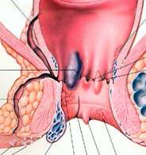
Anal Hemorrhoids
Internal hemorrhoids
External hemorrhoids

Slide 42
What Are Hemorrhoids?
The term hemorrhoids refers to a condition in which the veins around the anus or lower rectum are swollen and inflamed.
Hemorrhoids may result from 1- straining to move stool.
2- Other contributing factors include pregnancy, aging, chronic constipation or diarrhea, and anal intercourse.
Two types
Hemorrhoids are both inside and above the anus (internal)
Under the skin around the anus (external).
Hemorrhoids (piles) arise from congestion of internal and/or external venous plexuses around the anal canal

Slide 43


Internal hemorrhoids (piles)occur higher up in the anal canal, out of sight. Bleeding is the most common symptom of internal hemorrhoids, and often the only one in mild cases.
Varicosities of the sup. Rectal vein
Lies in the anal columns at 3,7,11 o’clock (lithotomy position)

Slide 44


External hemorrhoids are visible-occurring out side the anus. They are basically skin- covered veins that have ballooned and appear blue.
Usually they appear without any symptoms. When inflamed, however, they become red and tender.
Inferior rectal vein
Thrombosis is common

Slide 45
Causes for hemorroids
Congenital weakness of the venous walls
Superior rectal vein is the most dependant and valvless
Chronic constipation and cough
Pregnancies
Portal hypertension
Cancer in the rectum

Slide 46
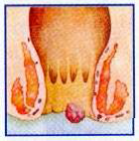
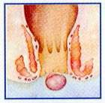
Sometimes, internal hemorrhoids will come through the anal opening when straining to move your bowels. This is called a prolapsed internal hemorrhoid; it is often difficult to ease back into the rectum, and is usually quite painful.
When a blood clot forms inside an external hemorrhoid, it often causes Severe pain. This thrombosed external hemorrhoid can be felt as a firm, tender mass in the anal area, about the size of a pea.

Slide 47


Surgical Classification of Hemorrhoids Hemorrhoids (piles) arise from congestion of internal and/or external venous plexuses around the anal canal. They are classified, depending on severity, into four degrees.
First degree hemorrhoids bleed but do not prolapse outside of the anal canal;
second degree prolapse outside of the anal canal, usually upon defecation, but retract spontaneously.
Third degree hemorrhoids require manual placement back inside of the anal canal after prolapsing,
fourth degree hemorrhoids consist of prolapsed tissue that cannot be manually replaced and is usually strangulated or thrombosed.
Symptoms associated with hemorrhoids include pain, bleeding, puritus ani (itching) and mucus discharge.
In IV degree prolapse, the area where the rectal mucous membrane meets the anal skin (the dentate line) is positioned almost outside the anal canal, and the rectal mucous membrane permanently occupies the muscular anal canal

Slide 48
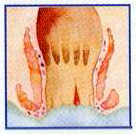
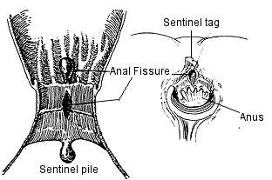
Anal fissure
A thin slit-like tear in the anal tissue, an anal fissure is likely to cause itching, pain, and bleeding during a bowel movement.
An elongated ulcer is formed
It is extremely painful
Its site is in the midline , either posterior or interiorly to the superficial part of the external anal sphincter (no support)

Slide 49
Perianal abscess
Its most common cause the fecal trauma to the anal mucosa, which might spread to the sub mucosa
It’s a complication of the anal fissure
Its located in relation to the ext. anal sphincter
Anal fistula may rise as a result of the spread or inadequate treatment of the anal abcess

Slide 50
PR examination
Finger is in the rectum canal:
In the female the vagina lies anteriorly, while in the male the urinary bladder and the superior vena cava, ampulla vas difference, prostate
The sacrum and the coccyx lies posteriorly, while the ischiolateral fossae lie laterally

Slide 51
Lymphatic drainage of anal canal:
lymph vessels from the part above the pectinate line drain into the internal iliac nodes.
Vessels from the part below the pectinate line drain into superficial inguinal nodes.

Slide 52
Nerve supply of anal canal
above the pectinate line, the anal canal is supplied by autonomic nerves (inferior hypogastric plexus and pelvic splanchnic).
Below the pectinate line , it is supplied by somatic (inferior rectal )nerves. Painful as a result of high sensation
The external sphincter is supplied by inferior rectal Nerve and by branch of the fourth sacral nerve.

Slide 53
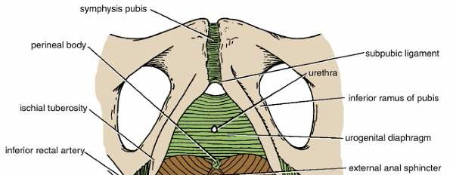
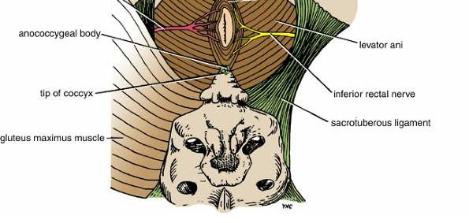
Anal Triangle
The anal triangle is bounded
ant. � perineal membrane
post � by the tip of the coccyx
- on each side� by
the ischial tuberosity
the sacrotuberous ligament, overlapped by the border of the gluteus maximus muscle .
ischiorectal fossa
- in the midline �The anus, or lower opening of the anal canal.

Slide 54
Contents of anal triangule
Some components of the anal triangle include:
Ischioanal fossa
Sacrotuberous ligament
Sacrospinous ligament
Pudendal nerve
Internal pudendal artery and Internal pudendal vein
Anal canal
Muscles
  Sphincter ani externus muscle
  Gluteus maximus muscle
  Obturator internus muscle
  Levator ani muscle
  Coccygeus muscle

Slide 55
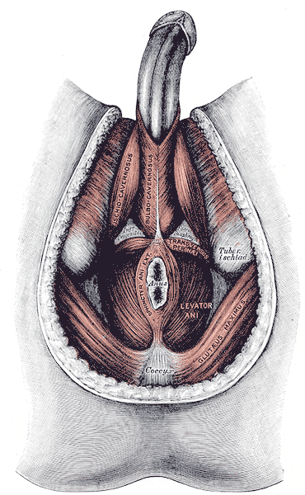
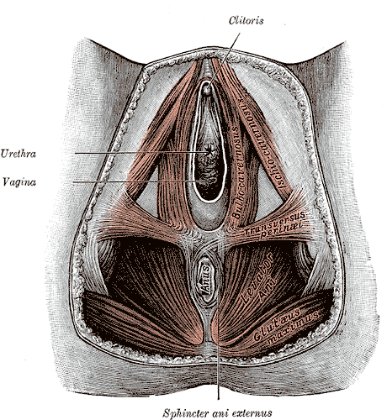
Anal triangule

Slide 56
The skin around the anus is supplied by the
inferior rectal (hemorrhoidal) nerve.

Slide 57
The lymph vessels of the skin drain into the medial group of the superficial inguinal nodes
Lymphatic drainage of anal triangle

Slide 58
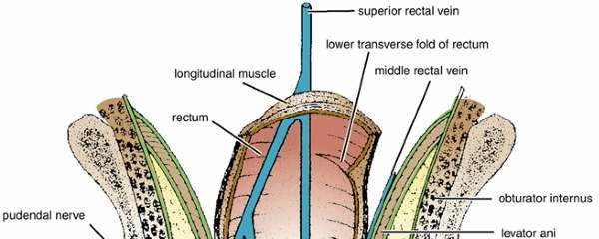
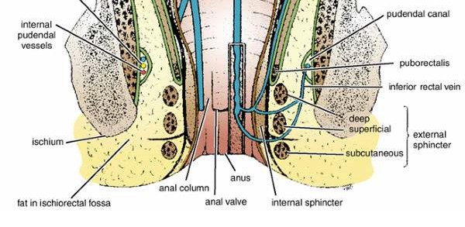
Ischiorectal Fossa
The ischiorectal fossa (ischioanal fossa) is a wedge-shaped space located on each side of the anal canal.
The base of the wedge is superficial and formed by the skin.
The edge of the wedge is formed by the junction of the medial and lateral walls.
The medial wall is formed by the sloping levator ani muscle and the anal canal.
The lateral wall is formed by the lower part of the obturator internus muscle, covered with pelvic fascia.

Slide 59
Contents of Fossa
The ischiorectal fossa is filled with dense fat which supports the anal canal and allows it to distend during defecation.
The pudendal nerve
internal pudendal vessels are embedded in a fascial canal
the pudendal canal, on the lateral wall of the ischiorectal fossa
on the medial side of the ischial tuberosity . The inferior rectal vessels and nerve cross the fossa to reach the anal canal.

Slide 60
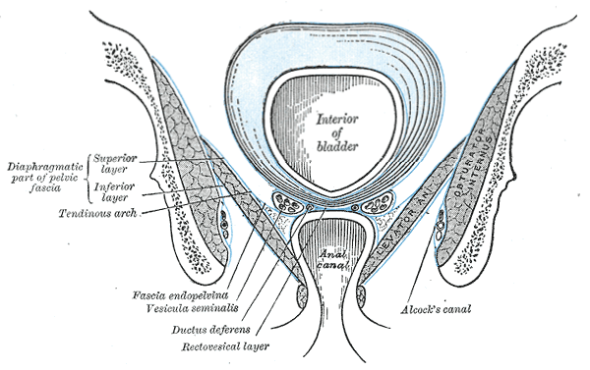
The pudendal canal
Structure
The pudendal canal (also called Alcock's canal) is an anatomical structure in the pelvis formed by the obturator internus fascia
Runs in the lateral wall of the ischiorectal fossa
Ends in the deep perineal pouch
Its contents
Internal pudendal artery
Internal pudendal veins
Pudendal nerve
These vessels and nerve cross the pelvic surface of the obturator internus.

Slide 61
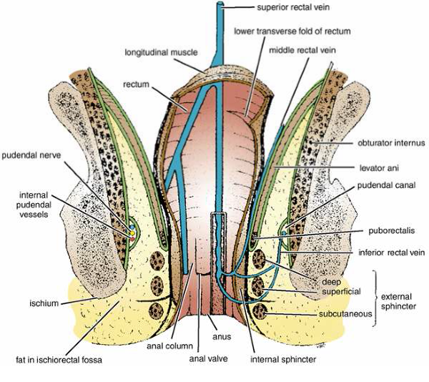
Pudendal canal

Slide 62
Thank you

