Slide 2
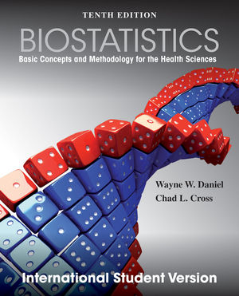
Introduction to Biostatistics Probability Second Semester 2014/2015 Text Book: Basic Concepts and Methodology for the Health Sciences By Wayne W. Daniel, 10 th edition
Dr. Sireen Alkhaldi, BDS, MPH, DrPH
Department of Family and Community Medicine
Faculty of Medicine
The University of Jordan

Slide 3
Chapter 3
Some Basic Probability Concepts
Learning Outcomes:
After studying this chapter, you will be able to:
Understand objective (classical, relative frequency), and subjective probability.
Understand the properties of probability and some probability rules.
Calculate the probability of an event.
Apply Baye’s theorem to screening test results (sensitivity, specificity, and predictive value positive and negative)

Slide 4
Introduction
The theory of probability is a branch of mathematics, but only its fundamental concepts will be discussed here.
This will provide the foundation for statistical inference (to reach a conclusion about a population from a sample drawn from that population).

Slide 5
The Big Picture
Populations and Samples
Population
Parameters
μ, σ, σ²
Sample / Statistics
x, s, s²

Slide 6
Introduction, continued
The concept of probability is frequently encountered in everyday communication.
For example:
a physician may say that a patient has a 50-50 chance of surviving a certain operation.
Another physician may say that she is 95 percent certain that a patient has a particular disease.
A nurse may say that nine times out of ten, a client will break an appointment.

Slide 7
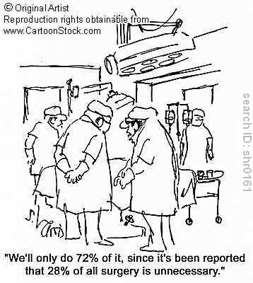
It is
all about how
you interpret the results!

Slide 8
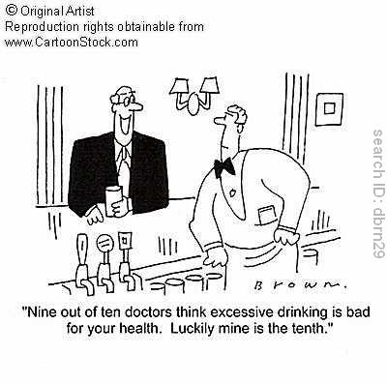

Slide 9
Introduction, continued
Those people have expressed probabilities mostly in terms of percentages (Probabilityx100).
But, it is more convenient to express probabilities as fractions.
Thus, we measure the probability of the occurrence of some event by a number between 0 and 1.
The more likely the event, the closer the number is to one. An event that can't occur has a probability of zero, and an event that is certain to occur has a probability of one.

Slide 10
Two views of Probability
Objective Probability:
Classical
Relative
Subjective Probability

Slide 11
1. Classical Probability :
This theory was developed to solve the problems related to games of chance (rolling the dice or playing cards).
For Example:
If a fair six-sided die is rolled, the probability that a 1 will be observed is 1/6, and is the same for the other five faces.
If a card is picked from a well-shuffled deck of ordinary playing cards, the probability of picking a heart is 13/52.
If a fair six-sided die is tossed, the probability of an even numbered outcome (2, 4, 6) is ½. Three of the six equally likely outcomes have the trait (3/ 6 = ½)

Slide 12
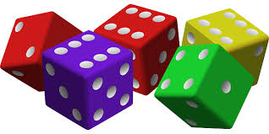
1. Classical Probability
Definition:
If an event can occur in N mutually exclusive and equally likely ways, and if m of these possess a triat, E, the probability of the occurrence of event E is equal to m/ N [probability of E: P(E)= m/N]

Slide 13
2. Relative Frequency Probability:
Definition: If some process is repeated a large number of times, n, and if some resulting event E occurs m times , the relative frequency of occurrence of E , m/n will be approximately equal to probability of E.
Subjective Probability : (personalistic)
This concept does not rely on the repeatability of a process. It applies for events that can happen only once. It depends on personal judgement.
For Example : the probability that a cure for cancer will be discovered within the next 10 years.

Slide 14
Some important symbols
1.Equally likely outcomes: Are the outcomes that have the same chance of occurring.
2. A ∩B : Both A and B occur simultaneously (involves multiplication)
3. A U B : Either A or B occur, or they both occur (involves addition)
2.Mutually exclusive: Two events are mutually exclusive if they cannot occur simultaneously such that A ∩ B =Φ (events do not overlap)
3. The universal Set (S): The set of all possible outcomes.
4. The empty set Φ : Contain no elements.
5. The event ,E : is a set of outcomes in )S( which has a certain characteristic.
6. or A’ denotes the absence of A, that is occurrence of “ not A”.

Slide 15
Elementary Properties of Probability:
1. All events must have a probability greater than or equal to zero.
P(E_{i} ) ≥ 0, i= 1,2,3,……n
2. The probability of all possible events should total to one (exhaustiveness)
P(E₁ )+ P(E₂) +……+P(E_{n} )=1
3. Considering any two mutually exclusive events, the probability of the occurrence of either of them is equal to the sum of their individual probabilities.
P(E_{i} +E_{J} )= P(E_{i} )+ P(E_{J} ) E_{i} ,E_{J} are mutually exclusive

Slide 16
Intersection
A∩B
A
B
S=Sample space (totality of all events)
S

Slide 17
Mutually Exclusive
Implies no intersection
Example: (A∩A^{C}) = Ø by definition
A
B
S=Sample space (totality of all events)
S

Slide 18
Union
AUB
A
B
S=Sample space (totality of all events)
S

Slide 19
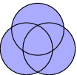
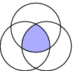
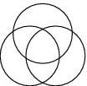
A U B “ A or B ”
A ∩ B “ both A and B”
Intersection
A U B U C “ at least one”
A or B or C
A ∩ B ∩ C “ All”
A and B and C
None

Slide 20
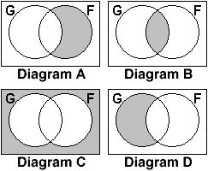
Exercise:
The diagrams below represent a class of children (boys and girls). G is the set of girls and F is the set of children who like Healthy Food.
Girls who like Healthy Food ………. B
Girls who dislike Healthy food ……… D
Boys who like Healthy Food ……… A
Boys who dislike Healthy Food ….…. C

Slide 21
Table 3.4.1 Frequency of family history of mood disorder by the age group among bipolar subjects
Total | Later >18 (L) | Early = 18 (E) | Family history of Mood Disorders
63 | 35 | 28 | Negative(A)
57 | 38 | 19 | Bipolar Disorder(B)
85 | 44 | 41 | Unipolar (C)
113 | 60 | 53 | Unipolar and Bipolar(D)
318 | 177 | 141 | Total
If we pick a person at random from this sample, What is the probability that this person will be 18 years old or younger?

Slide 22
Answer the following questions:
Suppose we pick a person at random from this sample.
The probability that this person will be 18-years old or younger?
The probability that this person has family history of mood orders Unipolar(C)?
The probability that this person has no family history of mood orders Unipolar( )?
The probability that this person is 18-years old or younger or has no family history of mood orders Negative (A)?
The probability that this person is more than18-years old and has family history of mood orders Unipolar and Bipolar(D)?

Slide 23
Calculating the Probability of an Event
In the previous table:
The 318 subjects are the population
Early and Late are mutually exclusive categories
All persons are equally likely to be selected
P (Early)= number of Early subjects/ total number of subjects
= 141 / 318 = 0.4434

Slide 24
Conditional Probability:
P(A\B) is the probability of A assuming that B has happened.
The probability of A given B.
P(A\B)= , P(B)≠ 0 P(B\A)= , P(A)≠ 0
Marginal probability (Unconditional probability)
One of marginal totals is used as nominator (141 / 318)

Slide 25
Conditional Probability
Exercises:
Suppose we pick a person at random and find he is 18 years or younger (E),what is the probability that this person will be one who has no family history of mood disorders (A)? ……... A given E
The 141 Early subjects become denominator
The 28 Early subjects with (A) become the nominator
P(A\E) = 28/141= 0.1986
suppose we pick a person at random and find he has family history of mood (D) what is the probability that this person will be 18 years or younger (E)? …E given D
P (E \ D) = 53/ 113= 0.469
 | Early | Later | total
A | 28 | 35 | 63
B | 19 | 38 | 57
C | 41 | 44 | 85
D | 53 | 60 | 113
total | 141 | 177 | 318

Slide 26
Joint Probability :
If a subject is picked at random from a group of subjects possesses two characteristics at the same time, this is called joint probability. It can be calculated as follows:
Suppose we pick a person at random from the 318 subjects. Find the probability that he will be Early (E) and will be a person who has no family history of mood disorders (A).
The number of subjects who satisfy
both conditions is found first:
P (E ∩ A) = 28/318= 0.0881
 | Early | Later | total
A | 28 | 35 | 63
B | 19 | 38 | 57
C | 41 | 44 | 85
D | 53 | 60 | 113
total | 141 | 177 | 318

Slide 27
Multiplicative Rule:
A probability can be computed from other probabilities.
For any two events A and B
P(A∩B)= P(B) P(A\B) if P (B)≠ 0
P(A∩B)= P(A) P(B\A) if P (A)≠ 0
Where,
P(A): marginal probability of A.
P(B): marginal probability of B.
P(B\A):The conditional probability.
From this equation you can find any one of the three probabilities if the other two are known. This leads to: P (A\B)= P (A∩B)/ P(B)

Slide 28
Independent Events:
If event B has occurred and the probability of A is not affected by the occurrence or nonoccurrence of B, we say that A and b are independent.
1- P(A ∩ B)= P(B) P(A)
2- P(A \ B)= P(A)
3- P(B \ A)= P(B)

Slide 29
Multiplicative Rule:
Example In a certain high school class consisting of 60 girls and 40 boys, it is observed that 24 girls and 16 boys wear eyeglasses . If a student is picked at random from this class ,the probability that the student wears eyeglasses , P(E), is 40/100 or 0.4 .
What is the probability that a student picked at random wears eyeglasses given that the student is a boy?
P (E\B)= P (E∩B)/ P(B) = (16/100)/ (40/100) = 0.4
What is the probability of the joint occurrence
of the events of wearing eye glasses and being a boy?
P(E∩B)= P(B) P(E\B) = (40/ 100)x 0.4= 0.16
If you know that E and B are independent events:
P(E∩B)= P(B) P(E) = (40/ 100)x (40/100)= 0.16
 | Eyegla-sses E | E’ | total
Boy (B) | 16 | 24 | 40
Girl (B’) | 24 | 36 | 60
total | 40 | 60 | 100

Slide 30
The Addition Rule
The addition rule is: P(AUB) = P(A) + P(B) – P (A∩B )
(U is “union” or “or”).
Example: If we pick a person at random from the 318 in the table, what is the probability that this person will be Early age onset (E) OR have no family history of mood disorders (A)
P (E U A) = (141/ 318 ) + (63/ 318) – ( 28/318)
= 0.4434 + 0.1981 - 0.0881 = 0.5534
If A and B are mutually exclusive (disjoint) ,then P (A∩B ) = 0
Then , addition rule is P(A U B)= P(A) + P(B) .
 | Early | Later | total
A | 28 | 35 | 63
B | 19 | 38 | 57
C | 41 | 44 | 85
D | 53 | 60 | 113
total | 141 | 177 | 318

Slide 31
Complementary Rule
P( )= 1 – P(A) where, = complement event (A and are mutually exclusive)
Early onset and Late onset are complementary events because the sum equals 1 ………. [ P (A) + P( ) = 1]
Example
Suppose that of 1200 admission to a general hospital during a certain period of time,750 are private admissions. If we designate these as a set A, then compute P(A) , P( ).

Slide 32
Complementary Events
Solution:
If we designate the 750 as a set A, then
= 1200 – 750 = 450.
P (A) = 750 / 1200 = 0.625
P( ) = 450 / 1200 = 0.375
Also see that: P( ) = 1 – P ( A) = 0.375
0.375 = 1 - 0.625
0.375 = 0.375

Slide 33
Summary of some Probability Rules
P ( A or B)= P ( A ) + P ( B ) – P (A and B).
P ( A or B)= P ( A ) + P ( B ) if A and B are mutually exclusive.
P ( A and B)= P ( A ) . P ( B \ A).
P ( A and B)= P ( A ) . P ( B ) if A and B are independent.

Slide 34
Baye’s Theorem Screening Tests, Sensitivity, and Specificity
Probability laws and concepts are widely applied in health sciences specially for the evaluation of screening tests and diagnostic criteria.
How can we enhance the ability to correctly predict the presence or absence of a particular disease from knowledge of test results (positive or negative) and/ or from the status of presenting symptoms (present of absent)
What is the likelihood of a positive or negative result?
What is the likelihood of the presence or absence of a particular symptom with or without a particular disease?
In screening tests we must be aware that the result is not always right.

Slide 35
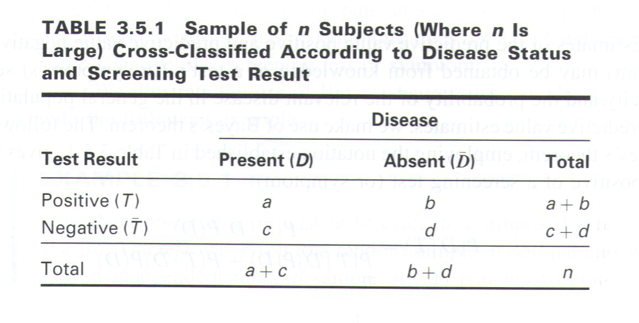

Slide 36
Baye’s theoremScreening tests, Sensitivity and Specificity
Prevalence Rate = (a + c )/ N
A False Positive results when a test indicates a positive status when the true status is negative
A False Negative results when a test indicates a negative status when the true status is positive.
The sensitivity of the test (or symptom) is the probability of positive test result given the presence of the disease. It is equals
P ( T \ D) = a / (a + c)
The specificity of the test (or symptom) is the probability of a negative test result given the absence of the disease. It equals
P ( \ ) = d / (b + d)

Slide 37
Baye’s Theorem, Screening tests
The Predictive value positive of the screening test (or symptom):
the probability that a subject has the disease given that the subject has a positive screening test result
P(D⁺|T⁺) = a / ( a + b) *
The Predictive value Negative of the screening test (or symptom):
the probability that a subject does not have the disease, given that the subject has a negative screening test result
P(D⁻|T⁻) = d / ( c + d) *
* if the prevalence of disease in the general population is the same as the prevalence of disease observed in the study

Slide 38
Example 1
A medical research team wished to evaluate a proposed screening test for Alzheimer’s disease. The test was given to a random sample of 450 patients with Alzheimer’s disease and an independent random sample of 500 patients without symptoms of the disease. The two samples were drawn from populations of subjects who were 65 years or older. The results are as follows.
Test Result | Yes (D) | No ( ) | Total
Positive (T) | 436 | 5 | 441
Negative ( ) | 14 | 495 | 509
Total | 450 | 500 | 950

Slide 39
Example 1: Screening test
Compute the false positive?
P ( \ T ) = 5 / 441 = 0.0113
b) Compute the false negative?
P ( D\ ) = 14 / 509 = 0.0275
c) Compute the sensitivity of the screening test.
d) Compute the specificity of the screening test.
e) Compute the Predictive value +. P V + = ( D \ T )= 436/ 441 = 0.99
d) Compute the Predictive value _. P V - = ( D’\ T’)= 495/ 509 = 0.97

Slide 40
Exercise
Suppose that a certain ophthalmic trait is associated with eye color. Three hundred randomly selected individuals are studied with results as in the table.
Using these data, find:
P (trait)
P (blue eyes and trait)
P (brown eyes/ trait)
 | Eye Color |  |  | Total
 | Blue | Brown | Other
Trait T | 70 | 30 | 20 | 120
T’ | 20 | 110 | 50 | 180
Total | 90 | 140 | 70 | 300

Slide 41
Answers:
 | Eye Color |  |  | Total
 | Blue | Brown | Other
Trait T | 70 | 30 | 20 | 120
T’ | 20 | 110 | 50 | 180
Total | 90 | 140 | 70 | 300
P (trait): 120/ 300 =
2. P (blue eyes and trait)= P(blue\t) P(T)=
=(120/300)/ (70 / 300) = 70/300
3. P (brown eyes\ trait) = P (brown ∩ Trait)/ P (T)
= (30/300)/ (120/300)= 30/120 = 0.1

Slide 42
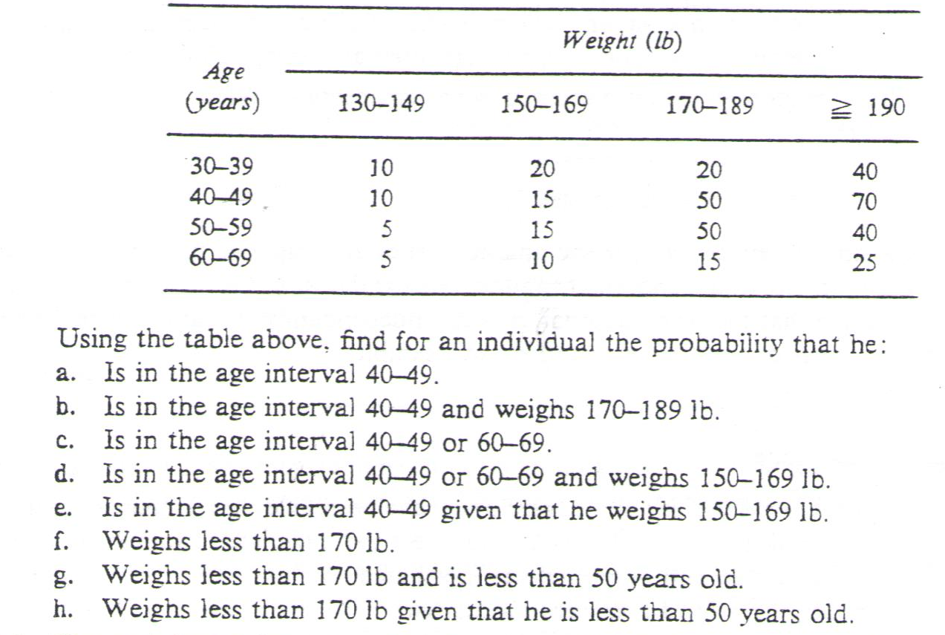
Probabilities…
Example
Marginal
Total
90
145
110
55
Marginal Totals
30
60
135
175
400

Slide 43
Solution
P (is in age interval 40-49)= 145/ 400
P (is in age interval 40-49 and weighs 70-189 lb.)= 50/400= 0.125
P (is in age interval 40-49 or 60-69)=(145/400)+(55/400)= .36+ .138
P (is in age interval 40-49 or 60-69 and weighs 150-169 lb.)=
= 14/400 + 10/400= .035+.025= 0.060
P(is in age interval 40-49 given that he weighs150-169 lb.)= 15/60=.25
P (weighs less than 170 lb. )= (30 + 60)/400= ….
P (weighs less than 170 lb. and is < 50 y old)= (10+20+10+15)/400= …
P (weighs less than 170 lb. given that he is <50 y old)=
= (10+20+10+15) /90+145 = 55/235 =0.234

Slide 44
Screening test example ….
Solution:
Prevalence =30/100= 30 with disease
Sensitivity = 0.9 = 30 x 0.9 = 27 (S\ D)
P ( S\ D’)= 0.2 x 70 = 14
Predictive value + =P(D\S) = 27/ 41= 0.66
 | D | D’
S | 27 | 14 | 41
S’ | 3 | 56 | 59
 | 30 | 70 | 100

