Slide 1
The quadriceps femoris muscle
Vastus intermedius
Origin: Anterior and lateral surfaces of shaft of femur
Insertion: the four heads are attached to the
patella and, via the ligamentum patellae,
to the tibial tuberosity (the real insertion)
Actions: the quadriceps femoris muscle
Extends the leg at knee joint;
flexes thigh at hip joint (only the rectus femoris head).
vastus intermedius
Remember
Ligamentum patellae
Quadriceps femoris is the main extensor of the knee joint
Nerve supply : femoral nerve

Slide 2
Femoral Nerve
is the largest branch of the lumbar plexus (L2, 3, and 4).
It emerges from the lateral border of the psoas muscle
enters the thigh lateral to the femoral artery and the femoral sheath, behind the inguinal ligament.
it terminates by dividing into anterior and posterior divisions.
Anterior Division
The anterior division gives off two cutaneous branches
1- the medial cutaneous nerve of the thigh.
2- the intermediate cutaneous nerve of the thigh
and two muscular branches.
Nerve to sartorius and nerve to pectineus muscles.

Slide 3
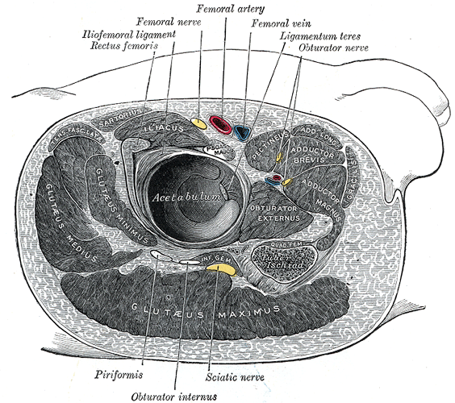

Slide 4
Posterior Division
The posterior division gives off one cutaneous branch
The Saphenous nerve
and muscular branches to the quadriceps muscle.
THE SAPHENOUS NERVE
runs downward and medially.
It emerges between the tendons of sartorius and gracilis
It then runs down in company with the great Saphenous vein.
It passes in front of the medial malleolus and along the medial border of the foot, where it terminates in the region of the ball of the big toe

Slide 5
articular branch
To the hip joint
Why?
is derived from the nerve to the rectus femoris muscle
To the knee joint
are three in number.
the first one is derived from the nerve to the vastus lateralis muscle. Which penetrates the capsule of the joint on its anterior aspect.
The second one which is derived from the nerve to the vastus medialis, can usually descends downward on the surface of this muscle ( to reach the joint the nerve then penetrates the muscular fibers to accompany the articular branch of the highest genicular artery where it pierces the medial side of the articular capsule, and supplies the synovial membrane)
The third branch is derived from the nerve to the vastus intermedius

Slide 6
The saphenous nerve accompanies the femoral artery through the adductor canal, but does not pass through the adductor hiatus with the femoral artery. Rather, the saphenous nerve penetrates directly through connective tissues near the end of the canal to appear between the sartorius and gracilis muscles on the medial side of the knee. Here the saphenous nerve penetrates deep fascia and continues down the medial side of the leg to the foot, and supplies skin on the medial side of the knee, leg, and foot.

Slide 7
Medial fascial compartment
Of the thigh

Slide 8
Why do we need adductors for the hip joint !
Can you think of a bone that can be suitable to provide an origin
for an adductor muscle of the hip joint?
The Pubic bone
Why?
Would you be able to think of a bone that can be a good insertion
FOR the adductor muscles ?
The femur
Why?

Slide 9
Contents of the medial fascial compartment
1-Muscles
GRACILIS
ADDUCTOR LONGUS
ADDUCTOR BREVIS
ADDUCTOR MAGNUS
OBTURATOR EXTERNUS
In the practical sessions
Remember that the adductor muscles are
arranged in three layers in similar way to that of the pages of the book .
The first layer (page) contains: pectineus
and adductor longus
The second layer contains: add. Brevis only
The third layer contains: add. Magnus only
2-Nerve supply: Obturator nerve
3-blood supply: Profunda femoris artery
and obturator artery

Slide 10
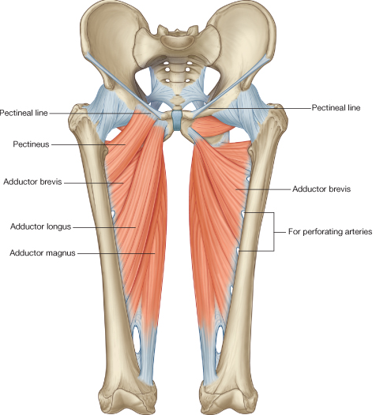
Muscles of the Medial Fascial Compartment of the Thigh
Adductor longus
Origin: Body of pubis, medial to pubic tubercle
Insertion: Posterior surface of shaft of femur (linea aspera)
Nerve supply: Obturator nerve
Actions: Adducts thigh at hip joint
Adductor brevis
Origin: Inferior ramus of pubis
Insertion: Posterior surface of shaft of femur (linea aspera)
Nerve supply: Obturator nerve
Actions: Adducts thigh at hip joint
Adductor magnus(pubic part)
Anterior view
Origin: Ischio-pubic ramus
Insertion: mainly linea aspera, gluteal tuberosity and medial supracondylar line
Notice the adductor hiatus. Which structures pass through it?
Nerve supply: obturator nerve
Actions: Adducts thigh at hip joint

Slide 11
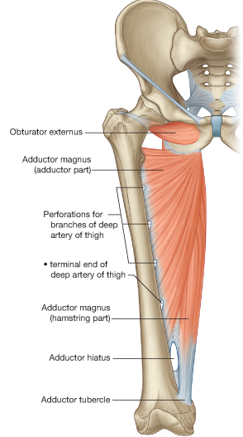
Gracilis muscle
Origin: Inferior ramus of pubis, ramus of ischium
Insertion: Upper part of shaft of tibia on medial surface
(SGS) area
Nerve supply: Obturator nerve
Actions: Adducts thigh at hip joint; flexes leg at knee joint (how?)
pubic part
of
Gracilis
Adductor magnus
Ischial part of

Slide 12
Obturator externus
Origin: Outer surface of obturator membrane and pubic and ischial rami
Insertion: Medial surface of greater trochanter
Nerve supply: Obturator nerve
Action: Laterally rotates thigh at hip joint
One of the short lateral rotator muscles of
the hip joint

Slide 13
Action of the adductor muscles as a group
Adduct the thigh although adduction of the thigh
is not important in the mechanism of walking and standing
2-Because their origin is in front of the hip joint
( in a plane that is in front of the hip joint)
they can flex the thigh at the hip joint
3- Because their origin
is from the medial Side of the hip while their insertion
is on the back of the thigh
They can assist in lateral rotation of the thigh

Slide 14
Obturator Nerve
Arises from the lumbar plexus (L2, 3, and 4) anterior divisions
Emerges on the medial border of the psoas muscle
It divides into anterior and posterior divisions
The anterior division
(Motor) it gives muscular branches to :
Gracilis
Adductor brevis
Adductor longus
and occasionally to the Pectineus.
Sensory
It gives articular branches
to the hip joint
contributes to the subsartorial plexus
supplies the skin on the medial side of the thigh.

Slide 15
The posterior division
It gives muscular branches (MOTOR) to the
Obturator externus
The adductor part of the adductor magnus
and occasionally to The adductor brevis
It supplies the knee joint (SENSORY). Referred pain
Is the pain perceived at a location other than the site of the painful stimulus.
Hilton’s law states that the nerves crossing a joint supply
1-the muscles acting on it
2- the skin over the joint
3- the joint itself.
For example, The hip receives fibres from the femoral, sciatic and obturator nerves. It is important to note that these nerves also supply the knee joint and, for this reason, it is not uncommon for a patient, particularly a child, to complain bitterly of pain in the knee and for the cause of the mischief, the diseased hip, to be overlooked

Slide 16
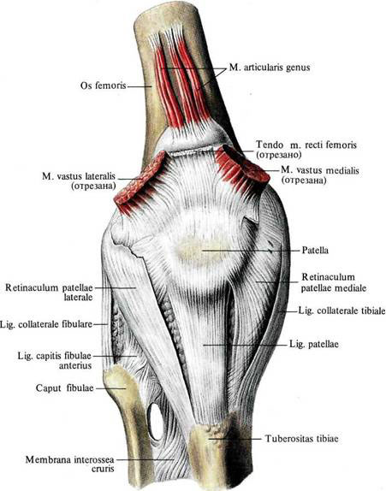

Slide 17
Articularis Genu – Originating from the latin roots “articularis” – pertaining to the joints, and “Genu” – pertaining to or relating to the knee (or knee shaped).
Articularis Genu:
Origin: Anterior surface of distal part of the body of the femur
Insertion: Proximal part of the suprapatellar bursa (an extension of the synovial cavity of the knee joint) and proximal anterior joint capsule of the knee
The articularis genu is a small muscle that may be blended with the vastus intermedius, but is usually distinct from it. This muscle lies deep to the vastus intermedius and rectus femoris and inserts deep to the patella.

