Slide 1
Preoperative Assessment& Evaluation& Pre-medications

Slide 2
Objectives
Determine pt medical status by
(1) Proper history
(2) Physical exam
(3) Indicated Lab. Investigations
(4) Review medical records
(5) Consider if needed further testing or consults to develop anesthesia plan.
Perform proper airways examination
ASA Classification: Perform adequate preoperative psychological & pharmacological preparation for adult and pediatric patients.
Evaluation of patients with known systemic disease
- HTN - DM
-Thyroid disease -Cardiac disease
- Pulmonary disorder.

Slide 3
Objectives
Identify ASA fasting guidelines
Identify patients at risk of peri-op. aspiration
Anti cholinergic premedication
Perioperative corticosteroid coverage
DVT / PE prophylaxis
Antibiotics prophylaxis

Slide 4
History (Know your patient)
Age / Weight/ Type of surgery/ fasting hours
Past history
Focused review of systems
_ Anesthetic Hx : any complications (difficult airways/delayed emergence/PONV) , family hx. (scoline apnea)
_ Surgical / Medical history (DM, HTN , thyroid)
Cardio
CP /Angina/ stent)) IHD
PNDs/ orthopnea) ) CHF
Exercise intolerance
Palpitations
Respiratory
Asthma
COPD
OSA
Recent URTI/LRTI
Cough/ sputum
Smoking
Neuro
Epilepsy
CVA/TIA
Denervation disease

Slide 5
Cont…
Medications (e.g. B-blockers, statins)
Allergy (e.g. penicillin)
GIT
GERD
PUD
Hiatus Hernia
Intestinal obstruction.
Renal
CRF
ARF
On dialysis
Blood disorders
Antiplatelet
Anticoagulation

Slide 6
Physical Examination
Vital signs
General appearance
Cardiac exam
Respiratory exam
Neuro exam
Check rate and rhythm
Auscultate heart sounds
Look for signs of resp. distress
Respiratory rate
Auscultate lung sounds
Mental status
Gross motor/ gross sensory

Slide 7
Airway Examination
(1)Mallampatti classification
It categorizes the ratio of tongue size to the oropahrynx
Has low positive predictive value

Slide 8
Mallampatti Classification
Structures identified when pt seated | class
Tonsilar pillars, uvula , soft & hard palate | 1
Uvula ,soft & hard palate | 2
Base of uvula ,soft & hard palate | 3
Only hard palate is can be seen | 4

Slide 9
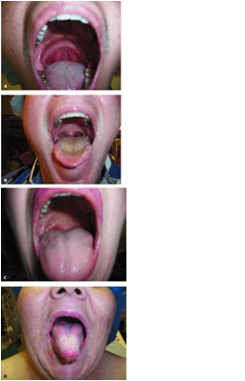

Slide 10
Airway exam
(2) Mouth opening
(3)Teeth ( prominent upper incisors/ loose or mobile)
(4)Palate ( high arched )
(5) Ability to protrude the lower jaw beyond the upper incisors (jaw protrusion)

Slide 11
Airway exam
(6) Neck exam
Look for short or thick neck
Look for neck movements
Look for neck masses tracheal shift

Slide 12
(7) Three distances
# Tyro-mental distance
#Sterno- mental distance
#Interincisor distance
-It describes the distance between the mentum & thyroid notch
-It helps in determining how readily the laryngeal axis will fall in line with
the pharyngeal axis
-It is normally in adults > 6cm
-It describes the distance between the mentum & suprasternal notch
-If this distance less than 12 cm it predicts difficult intubation
-It describes the distance between the upper and lower incisors
-It is normally 4.5 cm

Slide 13
Method of Assessment (L.E.M.O.N )
Look externally
teeth /tongue / face / mouth opening
Evaluate the three distances
interincisor / thyromental / thyrosternal distance
Mallampatti score (3 or 4)
Obstruction (presence of any obstruction like peri-tonsillar abscess , thyroid mass , VC nodule)
Neck mobility
L
E
M
O
N

Slide 14
Lab Investigations
Blood tests
CXR
ECG
PFT

Slide 15
Lab Investigations
Advanced age/ Anemic pt/ Bleeding /chronic disease (kidney liver heart )
CBC
KFT
Sugar
LFT
Coagulation studies
Diabetics/ HTN/ chronic disease / on medications like diuretics , digoxin ,ACEI
Diabetics / HTN/ chronic disease / on steroid
Liver disease / malnourished pt
Bleeding disorder/ Kidney disease/ Liver disease/ pt on anticoagulants

Slide 16
Cont…
CXR
Indicated in patients with respiratory or cardiac disease
Indicated in smokers
Indicated in patients with recent LRTI
ECG
Indicated in patients with respiratory or cardiac disease
Advanced Age ( M: 55y F: 65y )
Any patient with CAD risk factors
(HTN, DM, Hyperlipidemia , exercise intolerance)

Slide 17
Pulmonary Function test
_ Identifying patients at risk, evaluating the risk, and finding modified factors to decrease risk
Guidelines don’t support the routine use of PFT.
Indicated in obstructive lung disorders
Indicated in restrictive lung disorders
(3) Indicated in neuromuscular disorders
_ Includes mainly
Spirometry
ABGs

Slide 18
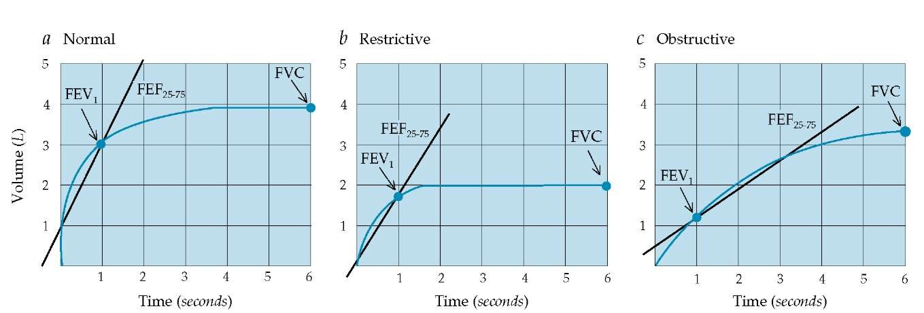
Pulmonary Function test

Slide 19
Major surgery
Defined as highly invasive surgery commonly needs
Blood transfusion
Post op.
ICU
Invasive monitor

Slide 20
ASA classification of physical status
Comment | Health status | Categrory
 | Healthy | ASA 1
Has a well-controlled disease of one body system; cigarette smoking ; mild obesity, pregnancy | Mild systemic disease | ASA 2
Some functional limitation; has a controlled disease of more than one body system or one major system | Severe systemic disease | ASA 3
Has at least one severe disease that is poorly controlled or at end stage; possible risk of death | Severe systemic disease that is constant threat to life | ASA 4
Not expected to survive > 24 hours without surgery; imminent risk of death | Moribund patients who are not expected to survive without the operation | ASA 5
 | A declared brain-dead patient whose organs are being removed for donor purposes | ASA 6

Slide 21
Preoperative preparation in adults
It includes preop. Visit with informative and comforting interview about OR events , anesthesia steps & all patient concerns like fear of death .loss of consciousness which would replace many grams of antidepressants .
Take your time before the operation to earn the trust and confidence of the patient.
premedication to achieve sedation & amnesia in selected pts.
Orally given before 60 min, on the other hand I.V given before few minutes.

Slide 22
Benzodiazepine
They produce anxiolysis, amnesia and sedation.
They have little depression on ventilatory and circulatory systems in premedication doses
Low incidence of toxicity ( wide therapeutic index)
Lack of opioids side effects ( nausea & vomiting)

Slide 23
Midazolam
It is water soluble with rapid metabolism
Onset 1-2 mins
Dose 1-2 mg IV given prior to the trip to OR
Mental function return to normal within 1-4 hours
Better than lorazepam , diazepam Why??
Rapid onset/// Rapid elimination // rapid clearance

Slide 24
Preoperative preparation of pediatrics
Age is the most important aspect when psychological preparation is considered.
A baby younger than 8 months has no separation anxiety so preparation is often directed toward educating the parents.
Toddlers(1-2) & preschool (3-5) will become upset when separated, and its so difficult to explain for them OR events
This age group is good candidate for premedication.
Consider your visit as chance to connect with the child by becoming familiar with his/her toys & games to gain trust .
It may be helpful for the child to have their parents accompany to the OR after explaining events of induction.

Slide 25
Preoperative preparation of pediatrics
The goal is to reduce apprehension, produce sedation & amnesia.
Premedication is not used for children before 8 months.
Preferred route is oral (older children) or rectal (preschool) esp. if there is no IV access.
Avoid IM route as you can.
Premedication use in pediatric patients is controversial ???
(1) Premedication has failure rate of 20 %
(2) Premedication hasn’t proved to reduce psychological outcome
(3) Smooth induction is less likely to produce long lasting psychological problems.

Slide 26
Preoperative preparation of pediatrics
The most commonly used is oral midazolam
Dose 0.5 - 0.75 mg/kg
Cherry flavored with bitter after taste
It produce sedation but not sleep
Onset within 15 minutes
Can be given intranasally

Slide 27
Preoperative preparation of pediatrics
The second commonly used is ketamine
Route include oral rectal & IM
Given 30 minutes before induction
Dose (5-10 mg/kg)
The disadvantage of ketamine use
Copious secretions
Give antisialagogue

Slide 28
Evaluation of patients with known systemic disease
- HTN
- DM
-Thyroid disease
-Cardiac disease
- Pulmonary disorder.

Slide 29
Hypertension
HTN has been divided into three stages
90-99 | 140-159 | Stage 1
100-109 | 160-179 | Stage 2
More than 110 | More than 180 | Stage 3

Slide 30
Hypertension
HTN may be associated with
CAD
ECG changes suggesting chronic ischemia
Uncontrolled BP is associated with increased risk of perioperative myocardial infarction and cardiac arrhythmia mainly A fib

Slide 31
Delay or Don’t delay
Delay the surgery if
If SBP >180
IF DBP >110
Delay esp. if there is end organ damage in heart (CAD or LVH ) or in the kidney (CRI or border line Cr)

Slide 32
Diabetes
DM is a disease of
DM is associated with CAD////…. ECG should be done for all diabetics WHY???
Microvascular
Retinal vessel
Renal arterioles
Neurons
Macrovascular
Brain
Heart
Peripheral vessels

Slide 33
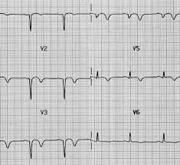
Answer
Because they are at higher risk of silent MI than non diabetics
Seen on ECG as Q waves

Slide 34
Diabetes Evaluation
(1) through HX and exam focusing on end organ damage
(2) compliance to medication
(3) documentation of sugar readings
(4) ECG
(5) KFT , Sugar ,HbA1c

Slide 35
When to delay????
Delay the elective surgery if
No evidence based guidelines dictate when to cancel due to hyperglycemia
Abnormal electrolytes
Pt in DKA or HNKH
RBS > 400- 500
Hba1c out of range (>8-9)

Slide 36
Goals of delay
Why we do focus on preoperative glycemic control????
(1) Reduce infection rate
(2) Improve wound healing
(3) improves postoperative outcomes in term of end organ functions// heart, brain//
(4) decrease length of stay in hospital or ICU
(5) Avoid complicated postoperative course of DKA or metabolic derangement.

Slide 37
Diabetes Perioperative Recommendations
(1)Oral hypoglycemic are held on the day of surgery
(2)Discontinue metformin 48 hours preop.
(3) Continue insulin through the evening before the surgery
(4) Check blood sugar on arrival to holding area
(5) Plan the surgery as the first case on schedule

Slide 38
Cont….
(6) For type 1 DM administer half the dose of long acting and intermediate insulin, but hold rapid acting or short acting insulin
(7) Intraoperative glycemic control is needed and the goal is (110-200)
Mix 100 IU actrapid with 100 cc N/S and titrate your infusion accordingly

Slide 39
Thyroid disease
Look for signs & symptoms of hypothyroidism or hyperthyroidism
Ask about stridor (upper airway obstruction)
Ask about medications and compliance
Look for thyroid masses with possible tracheal shift

Slide 40
Thyroid disease
Why in anesthesia we are concerned about thyroid status???
Hypothyroidism
Hypoventilation
Hypoglycemia
Hypothermia
hyponatremia
Hyperthyroidism
Risk of thyroid storm

Slide 41
Thyroid storm
Hypermetabolic state due to sudden release of T3 or T4 or both.
Clinically manifested with fever agitation tachycardia , shock ,heart failure
Intra operatively there is only
↑B.P
tachycardia
Malignant hyperthemia // thyroid storm

Slide 42
How to differentiate ???
Malignant hyperthermia
Thyroid storm
High end tidal CO2
Low end tidal CO2

Slide 43
Cardiac Evaluation
For
Non-Cardiac Surgery

Slide 44
yes
NO yes
NO
yes
NO
yes
Emergency
OR
Active cardiac condition
Evaluate
Low risk surgery
OR
Good functional capacity
OR

Slide 45
Poor exercise tolerance
The decision now depends on presence of clinical risk factors
No clinical risks
1 or 2
3 or more
OR
???
Evaluate

Slide 46
Active cardiac conditions
Unstable angina
Decompensated heart failure
Significant or new onset arrhythmia
Severe valvular disease
Myocardial infarction in the last one month

Slide 47
Types of Non Cardiac surgery
Low risk surgery( <1% )
Includes superficial , endoscopic , breast surgery
Intermediate risk surgery (1-5 %)
Includes intraperitoneal , intrathoracic , Head& neck, major ortho. surgery
High risk surgery (> 5%)
Includes major vessles :Abdominal Aorta
Carotids

Slide 48
Clinical Risk factors
DM
Renal impairment
CHF
CVA history
IHD history

Slide 49
Respiratory disease
Perioperative complication includes
1-Pneumonia
2-Aspiration
3-Pulmonary Embolism
4-Atelectasis
5-Bronchspasm
6-COPD exacerbation
7-Respiratory failure may need mechanical ventilation

Slide 50
Respiratory disease
These postoperative risks increase with
Upper abdominal surgery// Thoracic surgery
Emergency surgery// duration of surgery
Preexisting diseases COPD // OSA // Asthma //
Smoking

Slide 51
Respiratory disease
To minimize respiratory complications
1- Address preexisting respiratory problems with assessment of - type - severity - reversibility
2- Epidural analgesia
3- DVT prophylaxis
4- Reduce bacterial contamination during endotracheal insertion

Slide 52
Smoking
Studies showed that smoke cessation for at least 4 to 8 weeks was necessary to reduce post operative complications
Airway of smokers showed increased reactivity under GA
Premedicate with B2 agonist bronchodilator at the morning of surgery.

Slide 53
Identify ASA fasting guidelines
Identify patients at risk of peri-op. aspiration
Anti cholinergic premedication
Perioperative corticosteroid coverage
DVT / PE prophylaxis
Antibiotics prophylaxis

Slide 54
ASA Fasting Guidelines
Water , Fruit juice without pulp, | 2 hours | Clear fluid
 |  | Milk
 | 4 hours | Human
 | 6 hours | Infant formula
Fruits , juice with pulp, Vegetables | 6 hours | Light Foods
Fatty meals , meats | 8 hours | Heavy foods

Slide 55
Perioperative Aspiration
H2 blockers
PPI
Prokinetic agents
Antacids

Slide 56
Perioperative Aspiration
ASA members found that the literature is insufficient to support the effect of any of the drug classes on reduction of incidence of emesis & pulmonary aspiration .
Guidelines don’t recommend routine use of them and limit their use for patients at risk .

Slide 57
Perioperative Aspiration
Risk factors:
Anesthesia Factors
Patient Related
Surgery Related
Light anesthesia
Opioid use
Obesity , GERD, Hiatus Hernia, Pregnancy
, Gastro paresis , difficult airway
Emergency surgery , Intestinal obstruction

Slide 58
H2 Blockers
Classes include Cimitidine, Ranitidine (Zantac), Famotidine.
They block histamine receptor ability to induce acid secretion by proton pump.
They reduce gastric fluid volume and acidity
Antacids
Given ½ an hour before induction
Reduce gastric acidity only
PPI
-Omeprazole, the first drug in this class, lansoprazole , esomeprazole .
-Binds to H+ / K+ pump on parietal cell.
-Given 40 mg IV 30 min before surgery .
-Reduce both volume and acidity
Metoclopromide
-Act on dopamine receptors
-Increase gastric motility & LES tone
-Reduce gastric fluid volume only

Slide 59
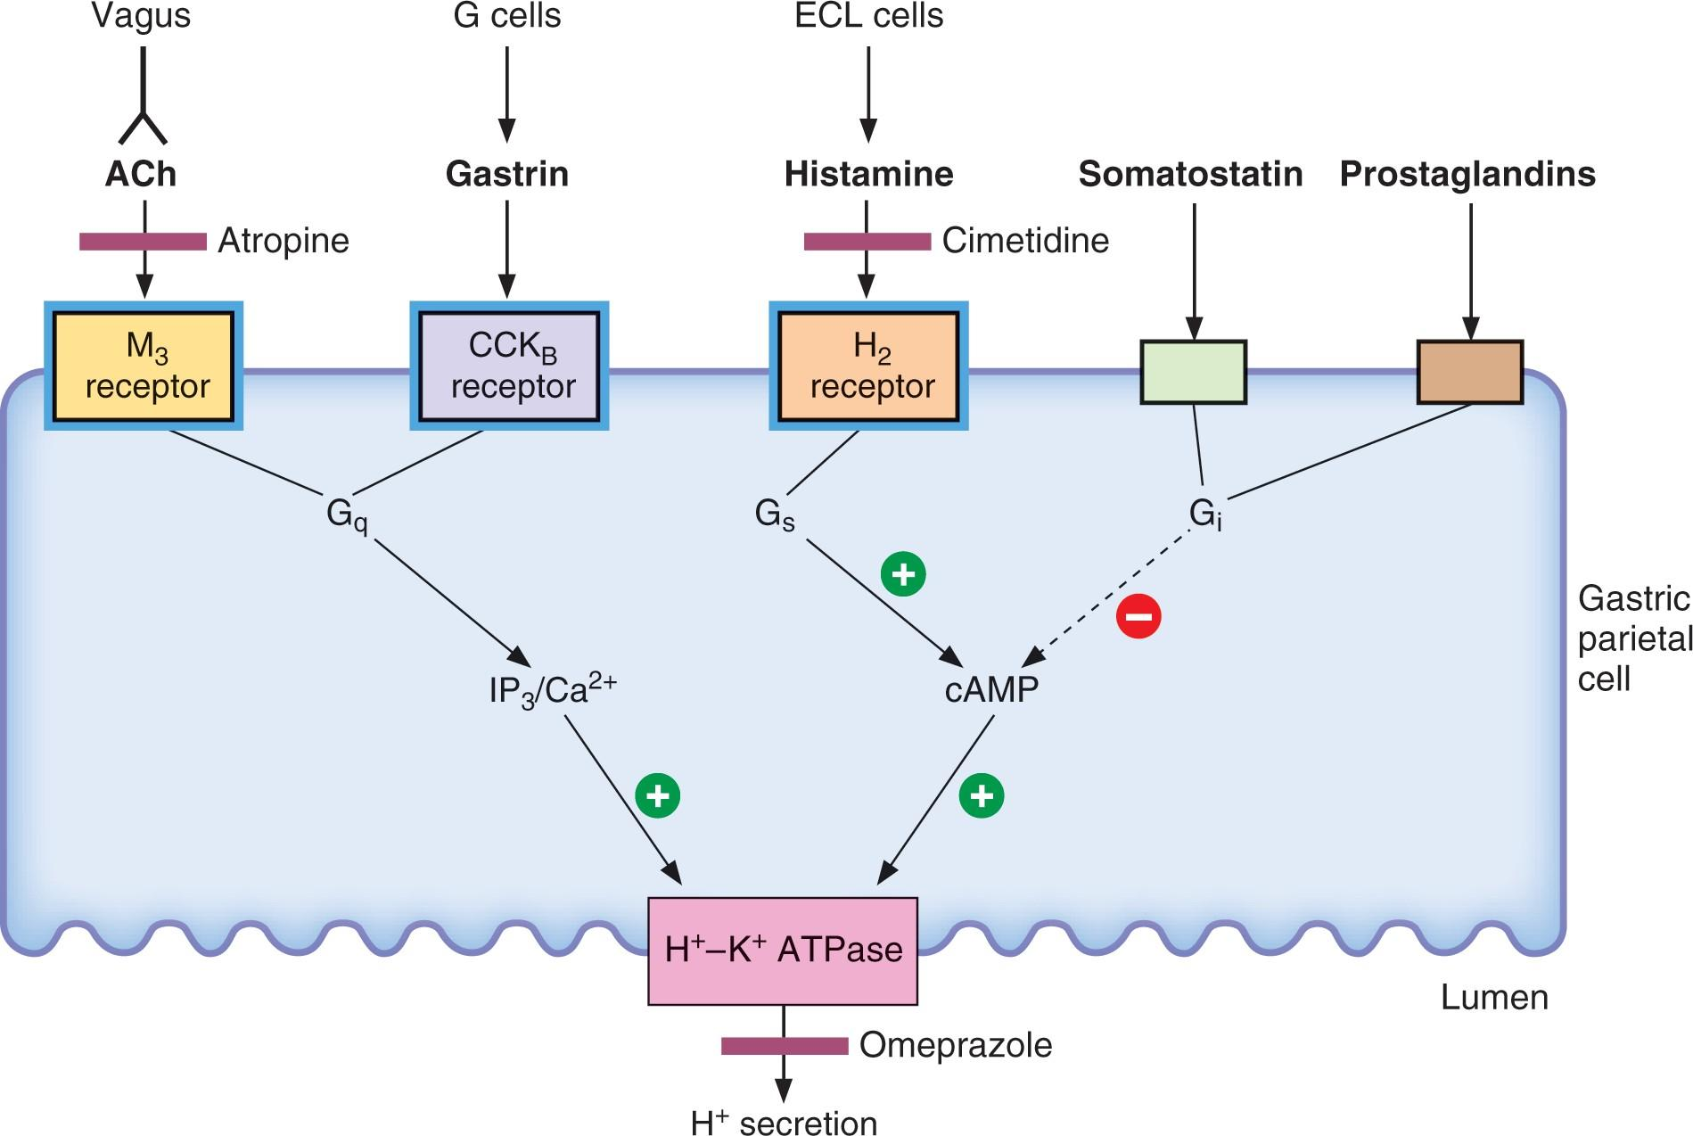

Slide 60
Anticholinergic Premedication
(1) Antisialagogue effects
Was routinely used
Now indicated in awake fiberoptic intubation , intra oral surgeries. Bronchoscope (better visualization+ ???? )
(2) Vagolytic effect
It blocks Ach effect on SA node
Used to prevent reflex bradycadia in
Traction of viscera or extraocular muscles
Carotid sinus stimulation
Repetitive doses of succinylcholine

Slide 61
Cont….
Scopolamine | Glycopyrrolate | Atropine
+ | +++ | + | Antisialagouge
+ | ++ | +++ | Increased HR
+++ | 0 | + | Sedation
Gastric acid secretion & Anticholinergic

Slide 62
Perioperative Steroids
Any patient taking corticosteroids for long period needs preoperative steroid supplement to cover stress of anesthesia & surgery. Esp, with higher doses & longer duration .
Any patient on steroid ttt for at least one month needs coverage WHY ???
Because it is impossible to identify the specific duration or the specific dose at which Adrenocortical suppression

Slide 63
Perioperative steroids
Coverage depends on type of the surgery :
Minor surgery :
On the morning of the dose 1.5 times his oral dose
No need for IV
(2) Intermediate surgery :
On the morning of the dose 2 times his oral dose
Give hydrocortisone (25mg/ 75mg/ 50 mg)
(3) Major surgery
On the morning of the dose 2 times his oral dose
Give hydrocortisone (50mg/ 100mg/ then 100 mg Q 8 hours for 1 day)

Slide 64
DVT / PE Prophylaxis
Stasis
CHF
Immobility
Varicose veins
Preganancy
Hypercoagulable states
Protein C,S def.
Factor V leiden
OCP use
Malignancy
Endothelial injury
Long bone #
Pelvic & ortho surgery
Major surgeries
Sepsis

Slide 65
DVT /PE Prophylaxis
Unfractionated heparin (UH)
UH given 5000 IU SC should be given within two hours of operation
And then every 8 hours is probably more effective at preventing VTE with similar risk of major bleeding
Low molecular weight heparin (LMWH)
Start dosing the night before surgery with no other preoperative dosing to decrease the risk of operative bleeding
Dose depends on weight 1mg/kg once daily .

Slide 66
Antibiotics Prophylaxis
Antibiotics should be given in coordination with the surgeon in - contaminated
clean contaminated
Other indications
Prevention of infective endocarditis
Prevention of infection in immunocompromised pt.
Best time for administration is within 60 minutes before the surgery.
Two exceptions for this rule
(1)Vanco before 2 hours
(2) Tourniquet prior to inflation
Re-dosing concept in long surgeries ( Cefazolin given every 4 hours)

Slide 67
The End

