Slide 1
Posterior abdominal wall

Slide 2
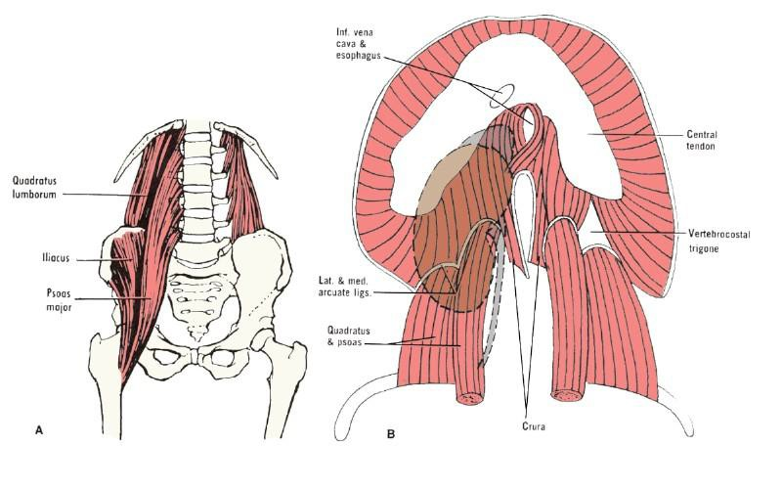
Posterior abdominal wall
Structures of post.
Abdominal wall:
5 lumbar vertebra & their intervertebral disc
12th ribs
Upper part of bony pelvis
Muscles
  psoas major
  psoas minor
  Quadratus lumborum
Aponeurosis of transversus abdominis muscles iliacus muscle lie in the
iliac fossa

Slide 3
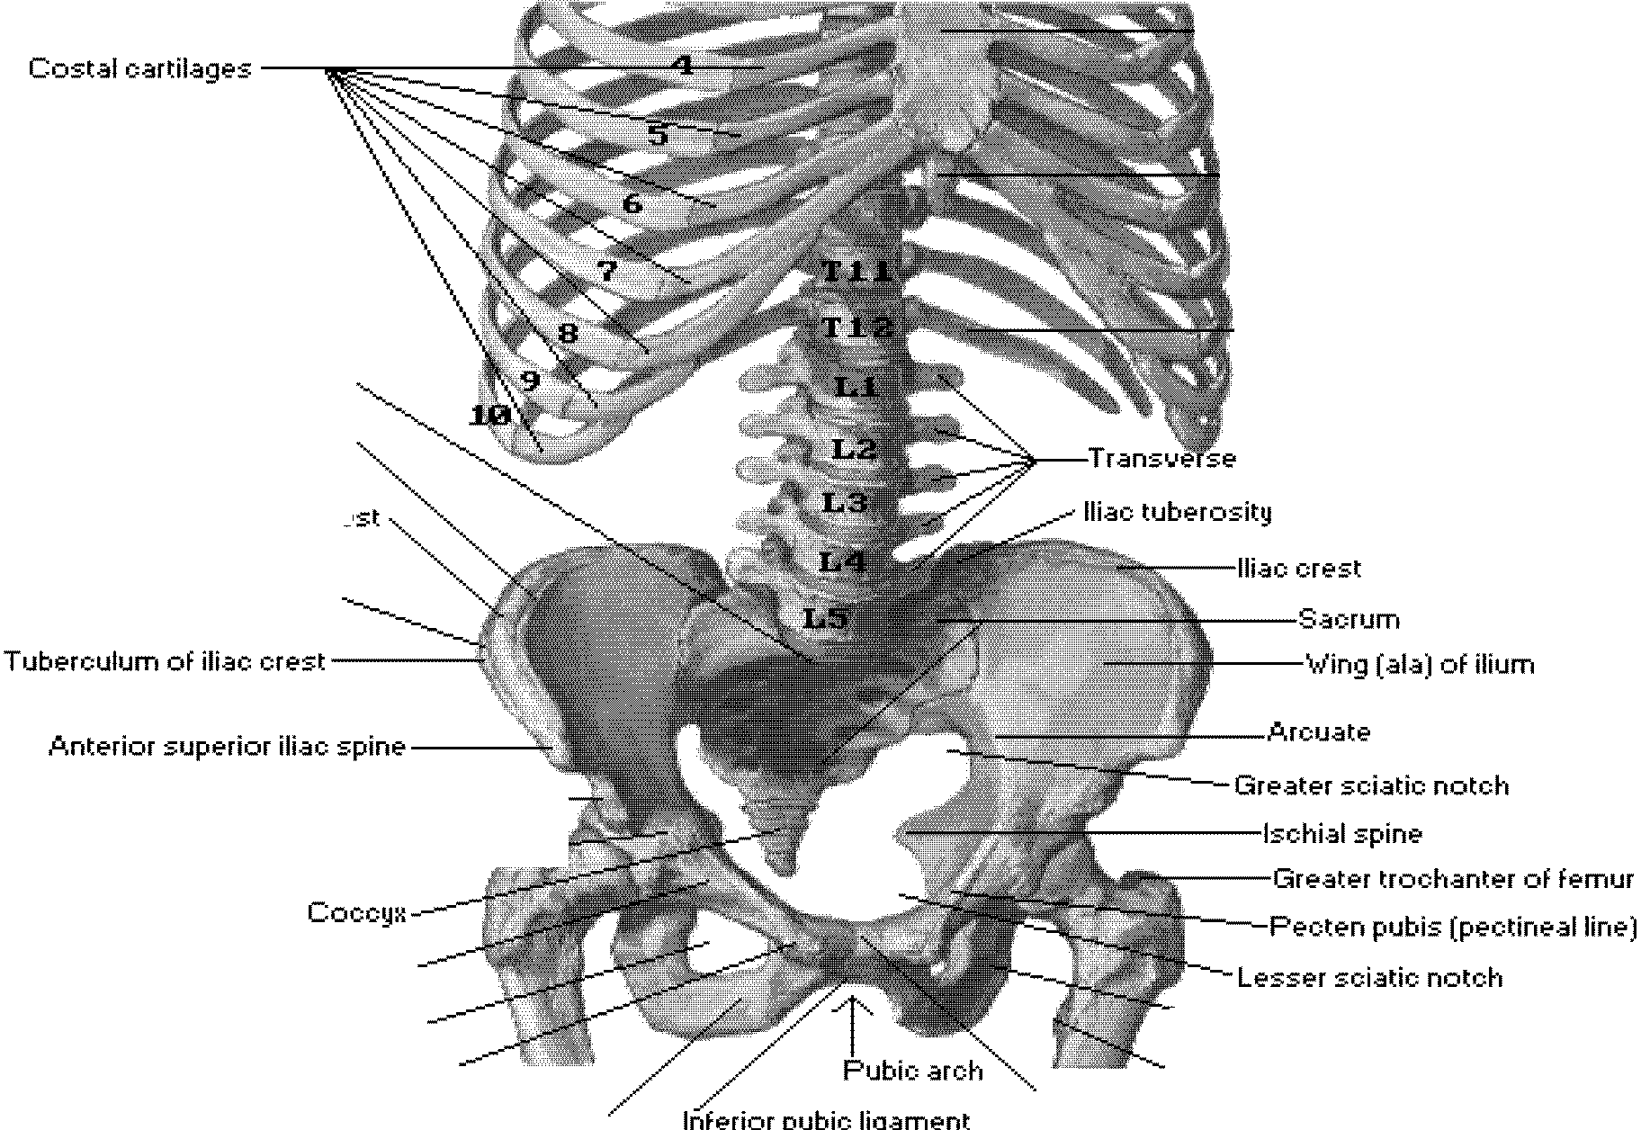

Bony Framewot·k of Abdomen
----Body of ste-rnum
----Xiphoid proce-ss
'----·12th rib Saoral promontory
Inne-r lip of iliac cre-st
proce-sse-s of lumbar •Je-rte-br ae-
Inte-rme-diate- zone- of iliac cre-st
Oute-r lip of iliac cre-st·
line-
Ante-rior infe-rior iliac spine-----­ lliopubio e-mine-nce- .....--::::;::-;
Supe-rior pubic ramus
Obturator for ame-n
Pubic tube-role­
Infe-rior pubic ramus
-l ;c •ial tube-rosity
Le-sse-r tr•::oohante-r of fe-mur Pubic symphysis

Slide 4
Muscles of post.abdominal wall
Psoas major
Origin: body & transverse process of lumbar vertebra & intervertebral disc
Ins :Lesser trochanter of femur
N.S: nerve plexus(T12,L1,L2.L3)
Action: flexion of hip & thigh
Quadratus lumborum
Origin: Iliolumbar lig.& iliac crest
Ins: 12th rib
N.S: nerve plexus(T12,L1,L2.L3
Action: fix or depresses 12th rib during respiration & lateral
flexion of the trunk
Iliacus muscle
Origin: iliac fossa
Ins: Lesser trochanter of femur
N.S: femoral nerve
Action: Lateral flexion of hip &
thigh for lying position

Slide 5
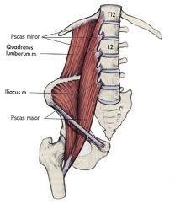
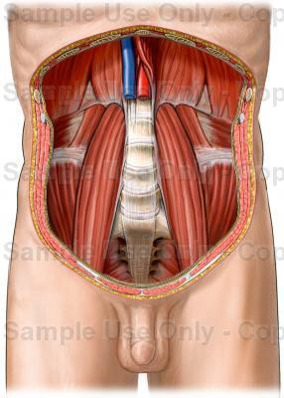

Slide 6
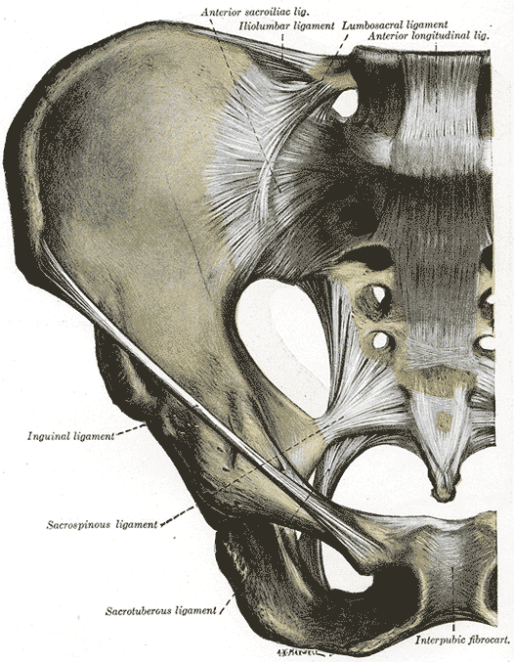
Iliolumbar ligament
The Iliolumbar ligament is a strong ligament passing from the tip of the transverse process of the fifth lumbar vertebra to the posterior part 1/3 of the inner lip of the iliac crest

Slide 7
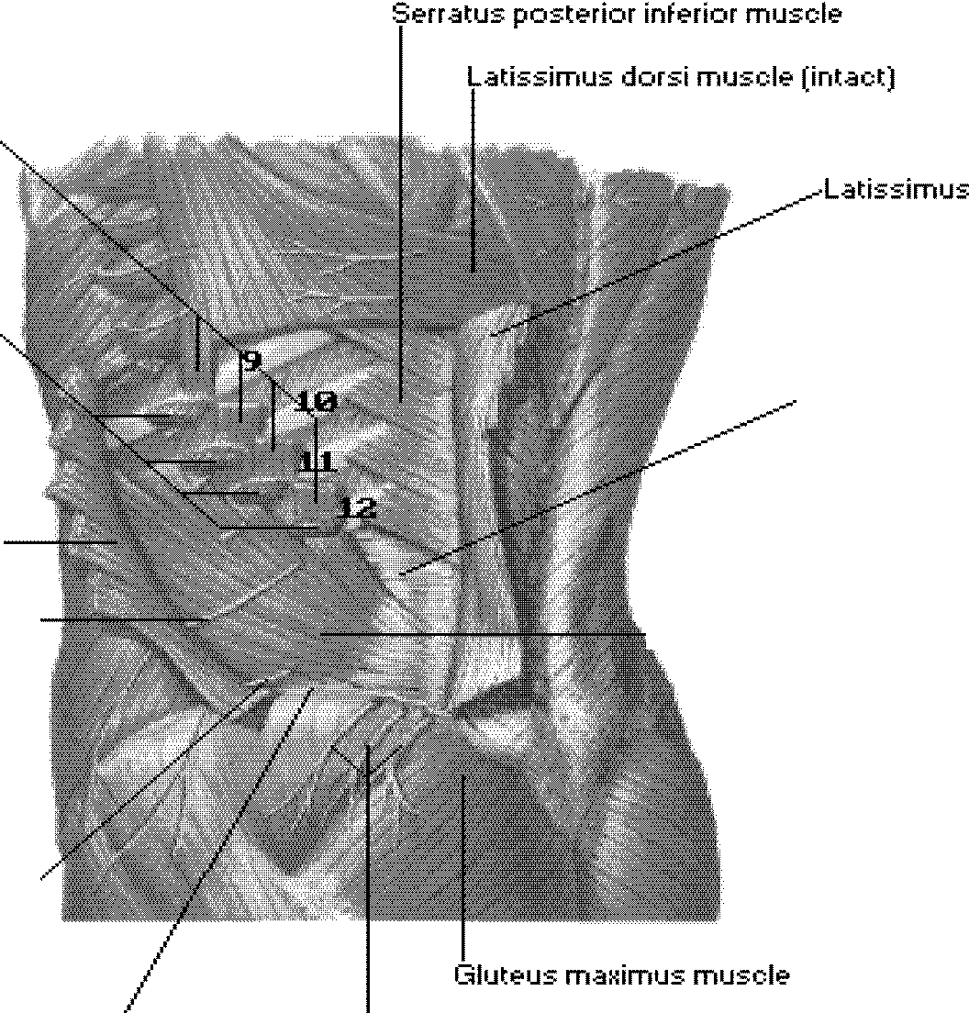

Posterolateral Abdominal Wall [Continued]
Digit.ations of costal origin of latissimus dorsi muscle
Digit.ations of costal origin of e tern.al oblique muscle
dorsi muscle (cut .and turned back)
Tendon of origin of tr .ans11ersus
.abdominis muscle
E tern.al oblique muscle
·cut .and turned b.ac ,
Later.al cutaneous br.anch of subcostal ner11e (11entr.al ramus of T12) -------,
----h'rte•rn< l oblique muscle
Later .al cutaneous br.anch of iliohypogastric ner11e (L1)
Suoer·ior cluneal ner11es (later.al cutaneous br.anches of posterior (dorsal) r.ami of L1, 2, 3 spinal ner11es)
Iliac crest

Slide 8
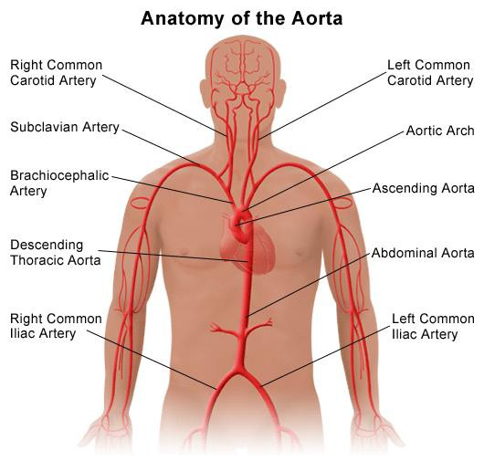
Arteries on the Posterior Abdominal Wall
Aorta
Location and Description
The aorta enters the abdomen through the aortic opening of the diaphragm in front of the 12th thoracic vertebra .
It descends behind the peritoneum on the anterior surface of the bodies of the lumbar vertebrae.
End: At the level of the fourth lumbar vertebra, it divides into two common iliac
arteries . Relation Ant:
Pancreas
3rd part of d.d
Coils of small intestine
- Crossed by Lt.renal vein
On its right side :
The inferior vena cava
The cisterna chyli
- The beginning of the azygos vein.
On its left side
- The left sympathetic trunk.

Slide 9
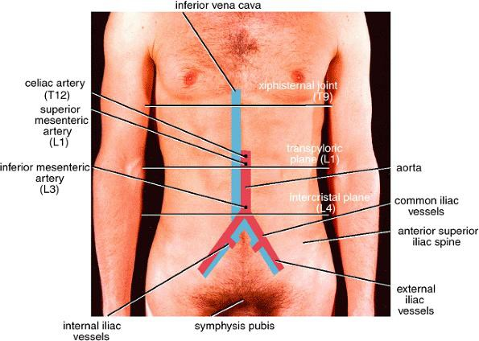
Branches of abd. Aorta
Single branches:
3 front & I back
Front:
  The celiac artery
  Superior mesenteric artery
- Inferior mesenteric artery
Back:
Median sacral artery

Slide 10
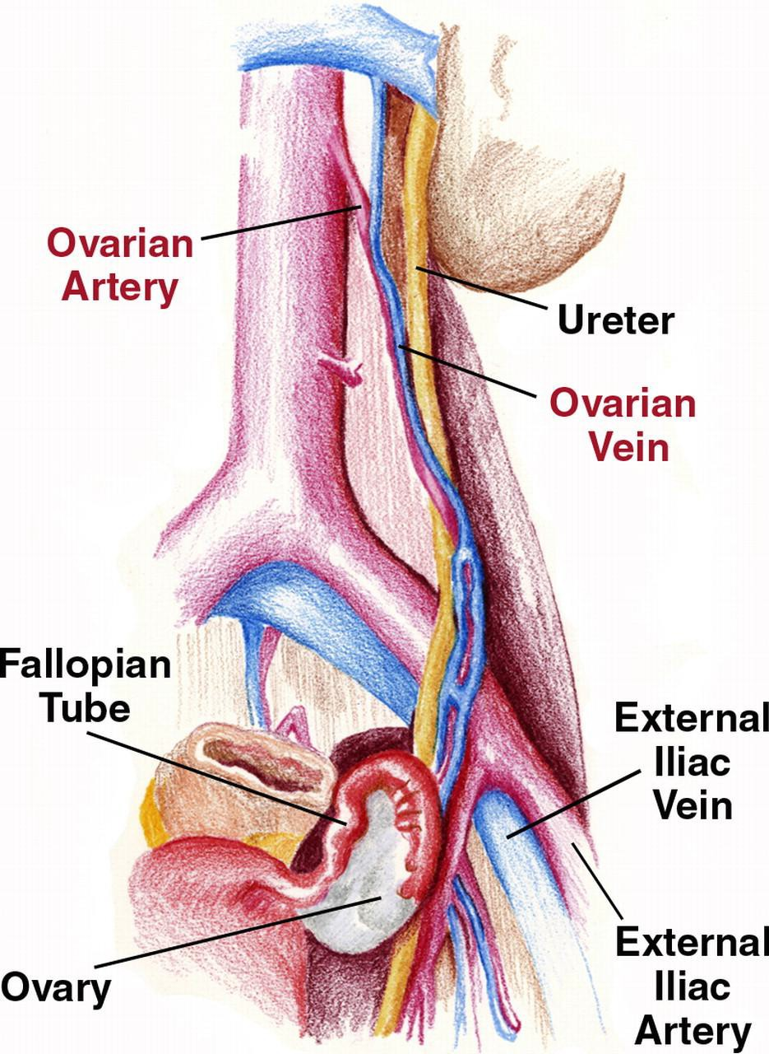
Abdominal Aorta……cont
Pairs branches: 1 front, 4back & 3 side of aorta
1 front →testicular or ovarian artery at level L2
4 back → lumbar arteies
3 side of aorta →
  Inferior phrenic . a
  Middle suprarenal .
a
  Renal . a

Slide 11
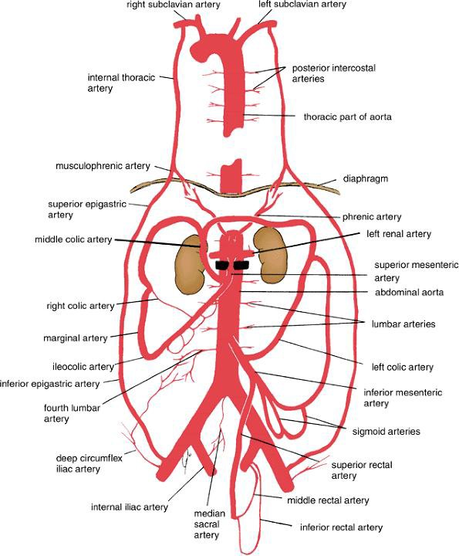

Slide 12
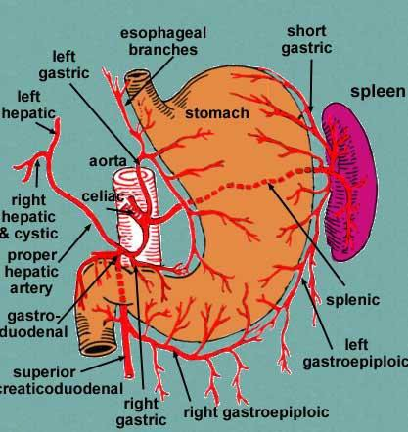
Abdominal aorta…cont
Celiac Artery at level L1
•
The celiac artery or trunk is very short and arises
from the commencement of the abdominal aorta
at the level of the 12th thoracic vertebra. It is
surrounded by the celiac plexus and lies behind the lesser sac of peritoneum.
It has three terminal branches: 1- The left gastric
- The small left gastric artery runs to the cardiac end of
the stomach, gives off a few esophageal
branches, then turns to the right along the lesser
curvature of the stomach. It anastomosis with the
right gastric artery
2- Splenic Artery
Pancreatic branches
The left gastroepiploic artery
The short gastric arteries → fundus
3- hepatic arteries
The right gastric artery arises from the hepatic
artery at the upper border of the pylorus and runs
to the left in the lesser omentum along the lesser
curvature of the stomach. It anastomosis with the left gastric artery .
•
The gastroduodenal artery :
- It divides into the right gastroepiploic artery
that runs along the greater curvature of the
stomach between the layers of the greater
omentum and the superior
pancreaticoduodenal artery that descends
between the second part of the duodenum and
the head of the pancreas .
The right and left hepatic arteries enter the
porta hepatis. The right hepatic artery usually
gives off the cystic artery, which runs to the neck of the gallbladder

Slide 13
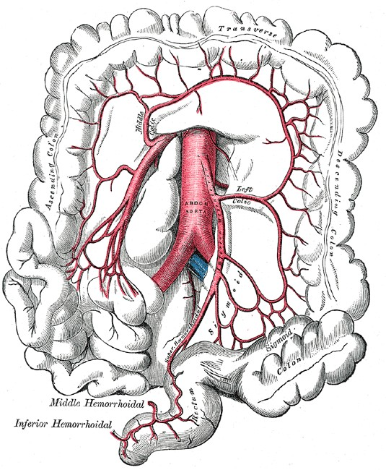
Abdominal aorta……cont
Superior mesenteric Artery at level L 2
The inferior pancreaticoduodenal artery
The middle colic artery runs forward in the transverse mesocolon to supply the transverse colon and divides into right and left branches.
The right colic artery is often a branch of the ileocolic artery. It passes to the right to supply the ascending colon and divides into ascending and descending branches.
The ileocolic artery passes downward and to the right. It gives rise to a superior branch that anastomoses with the right colic artery and an inferior branch that anastomoses with the end of the superior mesenteric artery. The inferior branch gives rise to the anterior and posterior Cecal arteries; the appendicular artery is a branch of the posterior Cecal artery .
The jejunal and ileal branches are 12 to 15 in number and arise from the left side of the superior mesenteric artery . Each artery divides into two vessels, which unite with adjacent branches to form a series of arcades. Branches from the arcades divide and unite to form a second, third, and fourth series of arcades. Fewer arcades supply the jejunum than supply the ileum. From the terminal arcades, small straight vessels supply the intestine

Slide 14
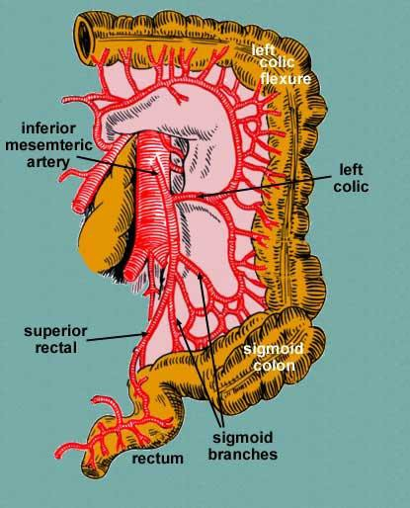
Abdominal aorta….cont
Inferior Mesenteric Artery at
level L3
Branches
The left colic artery runs upward
and to the left and supplies the
distal third of the transverse colon,
the left colic flexure, and the upper
part of the descending colon. It
divides into ascending and descending branches.
The sigmoid arteries are two or
three in number and supply the descending and sigmoid colon.
The superior rectal artery is a
continuation of the inferior
mesenteric artery as it crosses the
left common iliac artery. It
descends into the pelvis behind
the rectum. The artery supplies the
rectum and upper half of the anal
canal and anastomoses with the
middle rectal and inferior rectal arteries

Slide 15
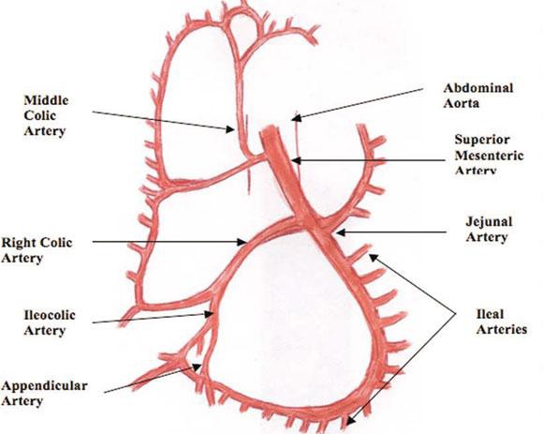
Marginal Artery
The anastomosis of the colic arteries around the concave margin of the large intestine forms a single arterial trunk called the marginal artery. This begins at the ileocecal junction, where it anastomoses with the ileal branches of the superior mesenteric artery, and it ends where it anastomoses less freely with the superior rectal artery

Slide 17
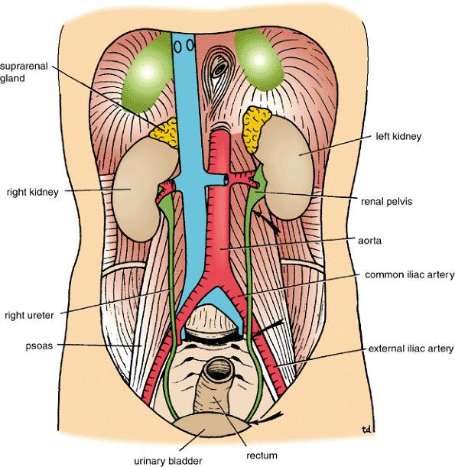
Common Iliac Arteries
The right and left common iliac arteries are the terminal branches of the abdominal aorta. They arise at the level of the fourth lumbar vertebra and run downward and laterally along
At medial border of the psoas
muscle .
Each artery ends in front of the sacroiliac joint by dividing into the external and internal iliac arteries.
At the bifurcation, the common iliac artery on each side is crossed anteriorly by the ureter .

Slide 18
External Iliac
Artery
runs along the medial border of the psoas,
following the pelvic brim .
It gives off the inferior epigastric and deep circumflex iliac branches .
The artery enters the thigh by passing under the inguinal ligament to become the femoral artery.

Slide 19
Branches of Ex. iliac artery
1- The inferior epigastric
- artery arises just above the inguinal ligament.
- It passes upward and medially along the medial margin of the deep inguinal ring and enters the rectus sheath behind the rectus abdominis muscle.
2- The deep circumflex iliac - artery arises close to the inferior epigastric artery
.
- It ascends laterally to the anterior superior iliac spine and the iliac crest, supplying the muscles of the anterior abdominal wall.

Slide 20
Internal Iliac Artery
The internal iliac artery passes down into the pelvis in front of the sacroiliac joint
Posterior Iliolumbar artery
Posterior Lateral sacral arteries
Posterior Superior gluteal artery - greater sciatic foramen
Anterior Obturator artery (occasionally from
inferior epigastric artery) - obturator canal
Anterior Inferior gluteal artery - greater
sciatic foramen
Anterior Umbilical artery superior vesical artery (usually, but sometimes it branches directly from anterior trunk) medial umbilical ligament
Anterior Uterine artery (females) or deferential artery (males) superior and vaginal branches uterus, vas deferens
Anterior Vaginal artery (females, can also arise from uterine artery) - vagina
Anterior inferior vesical artery - urinary bladder
Anterior Middle rectal artery - rectum
Anterior Internal pudendal artery

Slide 21
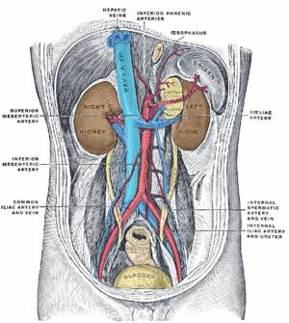
Veins on the Posterior Abdominal Wall
Inferior Vena Cava
- Location and Description
The inferior vena cava conveys most
of the blood from the body below the
diaphragm to the right atrium of the heart.
It is formed by the union of the
common iliac veins behind the right
common iliac artery at the level of the fifth lumbar vertebra .
It ascends on the right side of the
aorta, pierces the central tendon of the diaphragm
Ascends then separated from the aorta
by Rt .crus of the diaphragm
Ends at the level of the eighth thoracic
vertebra, and drains into the right atrium of the heart.
The right sympathetic trunk lies behind
its right margin and the right ureter lies
close to its right border. The entrance
into the lesser sac separates the
inferior vena cava from the portal vein .

Slide 22
Relations of I.V.C
Anterior
Coils of small intestine
3rd part & 1st part of d.d
Head of pancreas & C.B.D
Related to foramen of Winslow
Portal vein
Lies in deep groove of liver

Slide 23
Tributaries of I.V.C
The inferior vena cava has the following tributaries
Two anterior visceral tributaries: the hepatic veins
Three lateral visceral tributaries: the right suprarenal vein (the left vein drains into the left renal vein), renal veins, and right testicular or ovarian vein (the left vein drains into the left renal vein)
Five lateral abdominal wall tributaries: the
inferior phrenic vein and four lumbar veins
Three veins of origin: two common iliac veins
and the median sacral vein

Slide 24
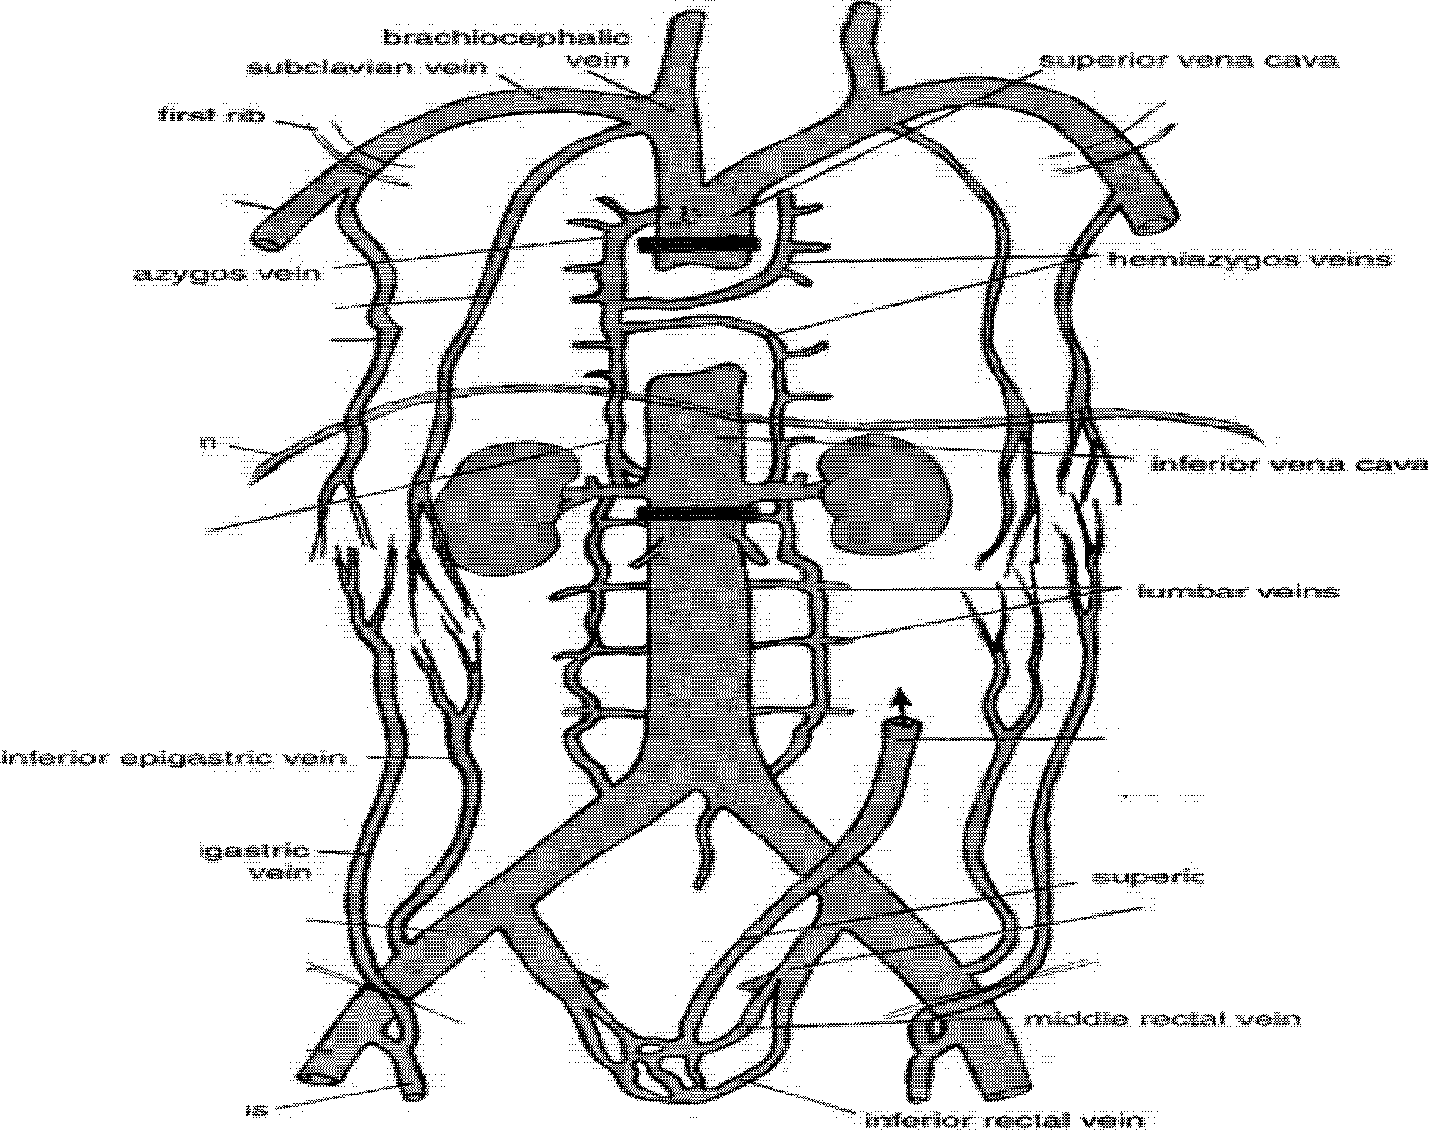

&Jdilary vein
internal thoracic vein lateral thoracic vein
a ;,carld,ing lumbar
vein
inferier mesenteric
vein
vein
to
rectal vein internal iliac vein
external iliac vein---
femoral vein ---
vein

Slide 25
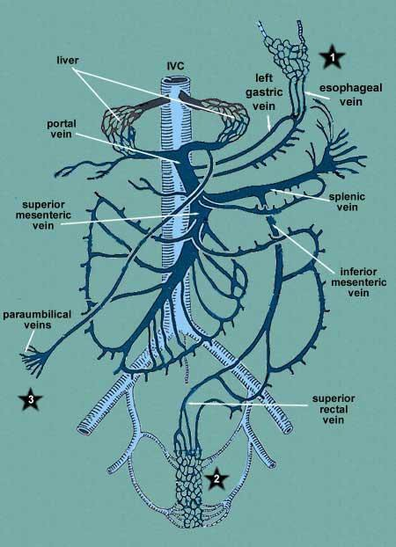
Inferior Mesenteric Vein
The inferior mesenteric vein is a tributary of the portal circulation. It begins halfway down the anal canal as the superior rectal vein . It passes up the posterior abdominal wall on the left side of the inferior mesenteric artery and the duodenojejunal flexure and joins the splenic vein behind the pancreas. It receives tributaries that correspond to the branches of the artery.
The splenic vein
It is a tributary of the portal circulation. It begins at the hilum of the spleen by the union of several veins and is then joined by the short gastric and the left gastroepiploic veins. It passes to the right within the splenicorenal ligament and runs behind the pancreas. It joins the superior mesenteric vein behind the neck of the pancreas to form the portal vein. It is joined by veins from the pancreas and the inferior mesenteric vein.
Superior Mesenteric Vein
The superior mesenteric vein is a tributary of the portal circulation. It begins at the ileocecal junction and runs upward on the posterior abdominal wall within the root of the mesentery of the small intestine and on the right side of the superior mesenteric artery. It passes in front of the third part of the duodenum and behind the neck of the pancreas, where it joins the splenic vein to form the portal vein. It receives tributaries that correspond to the branches of the superior mesenteric artery and also receives the inferior pancreaticoduodenal vein and the right gastroepiploic vein .

Slide 26
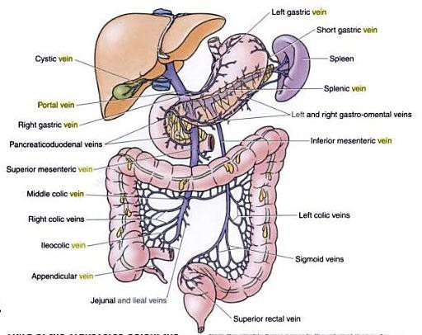
Portal Vein
The portal vein drains blood from
the abdominal part of the
gastrointestinal tract from the lower
third of the esophagus to halfway
down the anal canal; it also drains
blood from the spleen, pancreas,
and gallbladder.
The portal vein enters the liver and
breaks up into sinusoids, from
which blood passes into the hepatic
veins that join the inferior vena cava.
It is about 2 in. (5 cm) long and is
formed behind the neck of the
pancreas by the union of the
superior mesenteric and splenic veins.
It ascends to the right, behind the
first part of the duodenum, and
enters the lesser omentum .
It then runs upward in front of the
opening into the lesser sac to the
porta hepatis, where it divides into right and left terminal branches
The portal circulation begins as a
capillary plexus in the organs it
drains and ends by emptying its
blood into sinusoids within the liver.

Slide 27
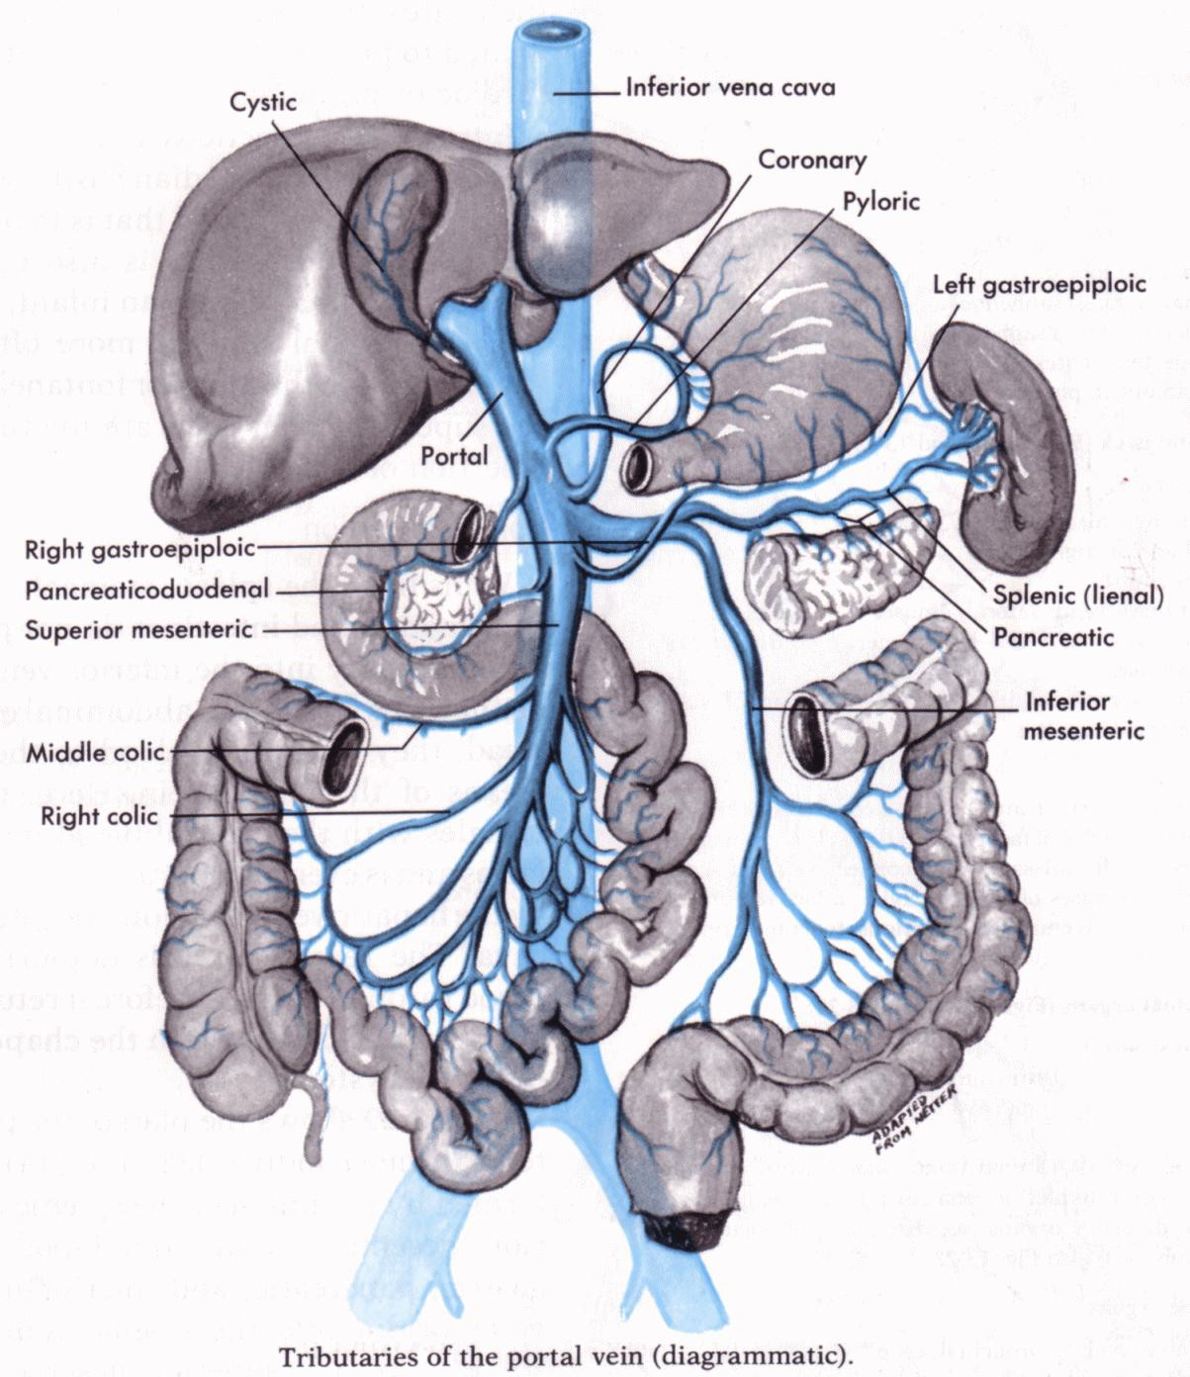
.
Tributaries of the Portal Vein
The tributaries of the portal vein are the
splenic vein, superior mesenteric vein, left
gastric vein, right gastric vein, and cystic veins.
Splenic vein: This vein leaves the hilum of
the spleen and passes to the right in the
splenicorenal ligament. It unites with the
superior mesenteric vein behind the neck of
the pancreas to form the portal vein . It
receives the short gastric, left gastroepiploic, inferior mesenteric, and pancreatic veins.
Inferior mesenteric vein: This vein ascends
on the posterior abdominal wall and joins the
splenic vein behind the body of the pancreas.
It receives the superior rectal veins, the
sigmoid veins, and the left colic vein.
Superior mesenteric vein: This vein
ascends in the root of the mesentery of the
small intestine. It passes in front of the third
part of the duodenum and joins the splenic
vein behind the neck of the pancreas . It
receives the jejunal, ileal, ileocolic, right colic,
middle colic, inferior pancreaticoduodenal, and right gastroepiploic veins.
Left gastric vein: This vein drains the left
portion of the lesser curvature of the stomach
and the distal part of the esophagus. It opens directly into the portal vein
Right gastric vein: This vein drains the right
portion of the lesser curvature of the stomach and drains directly into the portal vein .
Cystic veins: These veins either drain the
gallbladder directly into the liver or join the portal vein.

Slide 28
Portal circulation
1!n eric:«'
--";--- ve cava
lige:n1enr os*".....,
eeophageat vetn
mtt gaslrffie ij,fQWl;

Slide 29
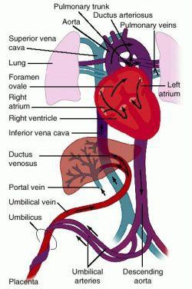
Portal systemic anastomosis
A porta caval anastomosis
(also known as portal systemic
anastomosis or portal caval
system) is a specific type of
anastomosis that occurs
between the veins of portal
circulation and those of systemic
circulation.
The lower end of esophagus is
one of the important sites for the
portosystemic anastomosis . In
portal hypertension as in the
case of cirrhosis of liver the
anastomosis opens and forms
venous dilatation called esophageal varices.
Their rupture causes severe and
dangerous haematesis (hematemesis).

Slide 30
Portal systemic anastomosis……cont
Causes
Liver diseases → Cirrhosis, fibrosis ( bilharzial)
Valvular diseases of the heart
Congenital patent

Slide 31
Portal systemic anastomosis
Region | Name of clinical condition | Portal circulation | Systemic circulation
Esophageal | Esophageal varices | Esophageal branch of left gastric vein | Esophageal branches of Azygos vein
Rectal | Hemorrhoids | Superior rectal vein | Middle rectal veins and inferior rectal veins
Paraumbilical | Caput medusae | Paraumbilical veins | Superficial epigastric vein
Retroperitoneal | (no clinical name) | Right colic vein, middle colic vein, left colic vein | Renal vein, suprarenal vein, paravertebral vein, and gonadal vein
Intrahepatic | Patent ductus venosus | Left branch of portal vein | Inferior vena cava

Slide 32
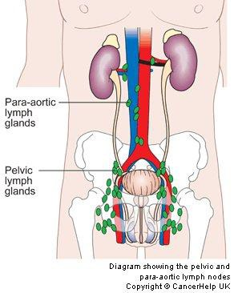
Lymphatics on the Posterior Abdominal Wall
Lymph Nodes
•
The lymph nodes are closely related to the
aorta and form a preaortic and a right and left lateral aortic (Para-aortic or lumbar) chain .
The preaortic lymph nodes
lie around the origins of the celiac, superior
mesenteric, and inferior mesenteric arteries and
are referred to as the celiac, superior
mesenteric, and inferior mesenteric lymph nodes, respectively.
They drain the lymph from the gastrointestinal
tract, extending from the lower one third of the
esophagus to halfway down the anal canal, and
from the spleen, pancreas, gallbladder, and greater part of the liver.
The efferent lymph vessels form the large
intestinal trunk.
The lateral aortic (para-aortic or lumbar) lymph nodes
drain lymph from the kidneys and suprarenals;
from the testes in the male and from the
ovaries, uterine tubes, and fundus of the uterus
in the female; from the deep lymph vessels of
the abdominal walls; and from the common iliac nodes.
The efferent lymph vessels form the right and left lumbar trunk
The thoracic duct commences in the abdomen
as an elongated lymph sac, the cisterna chyli.
This lies just below the diaphragm in front of the
first two lumbar vertebrae and on the right side of the aorta .

Slide 33
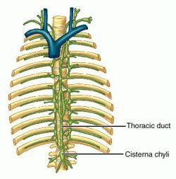
The cisterna chyli
The right and left lumbar trunks under the diaphragm on the side of the aorta
Receives lymph from
  The intestinal trunk
  Some small lymph vessels that descend from the lower part of the thorax.
- Rt & Lt vessels from lower thorax

Slide 34
