Slide 2
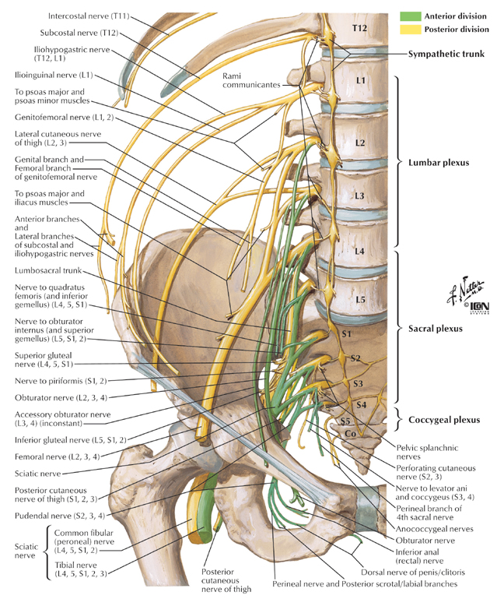
Nerves on the Posterior Abdominal Wall
Lumbar Plexus
The lumbar plexus, which is one of the main nervous pathways supplying the lower limb, is formed in the psoas muscle from the anterior rami of the upper four lumbar nerves .
The anterior rami receive gray rami communicates from the sympathetic trunk,
The upper two only give off white rami communicates to the sympathetic trunk.
The branches of the plexus emerge from the lateral and medial borders of the muscle and from its anterior surface.
The iliohypogastric nerve, ilioinguinal nerve, lateral cutaneous nerve of the thigh, and femoral nerve emerge from the lateral border of the psoas, in that order from above downward .
The iliohypogastric and ilioinguinal nerves (L1) enter the lateral and anterior abdominal walls

Slide 3
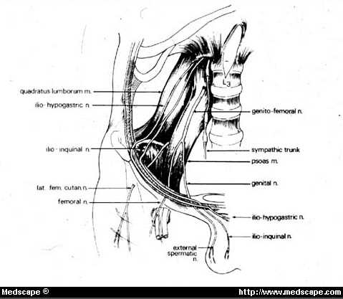
Nerves on the Posterior Abdominal Wall
The iliohypogastric nerve
- supplies the skin of the lower part of the anterior abdominal wall,
The ilioinguinal nerve
- passes through the inguinal canal to supply the skin of the groin and the scrotum or labium majus.
The lateral cutaneous nerve of the thig
Crosses the iliac fossa in front of the iliacus muscle and enters the thigh behind the lateral end of the inguinal ligament .
- It supplies the skin over the lateral surface of the thigh.

Slide 4
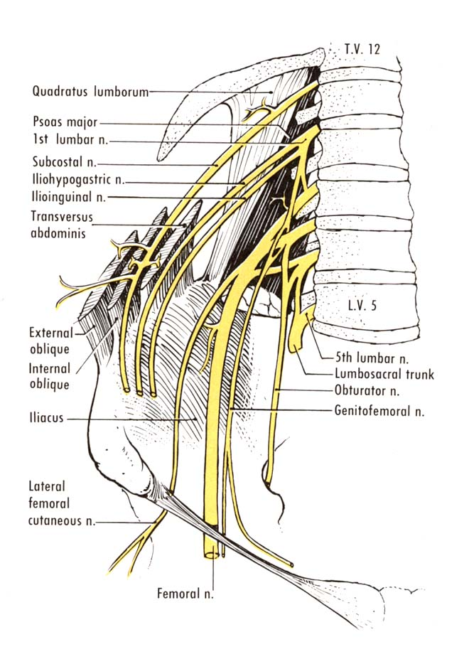
Lumber plexus…….cont
The femoral nerve (L2, 3, and 4)
It is the largest branch of the lumbar plexus.
It runs downward and laterally between the psoas and the iliacus muscles and enters the thigh behind the inguinal ligament and lateral to the femoral vessels and the femoral sheath.
In the abdomen it supplies the iliacus muscle.

Slide 5
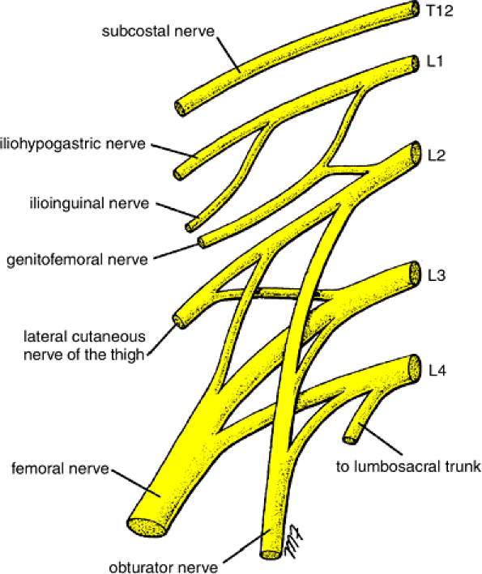

Slide 6
Lumber plexus……cont
The Obturator nerve and the fourth lumbar root of the lumbosacral trunk
Emerge from the medial border of the psoas at the brim of the pelvis.
The Obturator nerve (L2, 3, and 4) crosses the pelvic brim in front of the sacroiliac joint and behind the common iliac vessels.
It leaves the pelvis by passing through the Obturator foramen into the thigh.
The fourth lumbar root of the lumbosacral trunk takes part in the formation of the sacral plexus . It descends anterior to the ala of the sacrum and joins the first sacral nerve.

Slide 7
Lumber plexus…….cont
The genitofemoral nerve (L1 and 2)
Emerges on the anterior surface of the psoas.
It runs downward in front of the muscle and divides into :
1- A genital branch, which enters the spermatic cord and supplies the Cremasteric muscle
2- A femoral branch, which supplies a small area of the skin of the thigh.
Cremasteric reflex
It is the nervous pathway , in which stimulation of the skin of the thigh in the male results in reflex contraction of the cremaster muscle and the drawing upward of the testis within the scrotum.
Cremasteric reflex may be absent with: testicular torsion, upper and lower motor neuron disorders, as well as a spine injury of L1-L2. It can also occur if the ilioinguinal nerve is accidentally cut during a hernia repair

Slide 8
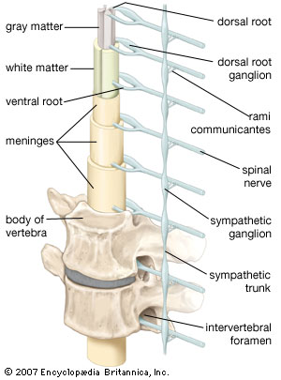
Sympathetic Trunk (Abdominal Part)
The abdominal part of the sympathetic trunk is continuous above with the thoracic and below with the pelvic parts of the sympathetic trunk.
It runs downward along the medial border of the psoas muscle on the bodies of the lumbar vertebrae .
It enters the abdomen from behind the medial arcuate ligament and gains entrance to the pelvis below by passing behind the common iliac vessels.
The right sympathetic trunk lies behind the right border of the inferior vena cava; the left sympathetic trunk lies close to the left border of the aorta.
The sympathetic trunk possesses four or five segmentaly arranged ganglia, the first and second often being fused together.

Slide 9
Sympathetic trunk....Abdominal part
Branches
White rami
- communicantes join the first two ganglia to the first two lumbar spinal nerves.
- A white ramus contains Preganglionic nerve fibers and afferent sensory nerve fibers.
Gray rami
communicantes join each ganglion to a corresponding lumbar spinal nerve.
A gray ramus contains postganglionic nerve fibers distributed to blood vessels, sweet gland and skin

Slide 10
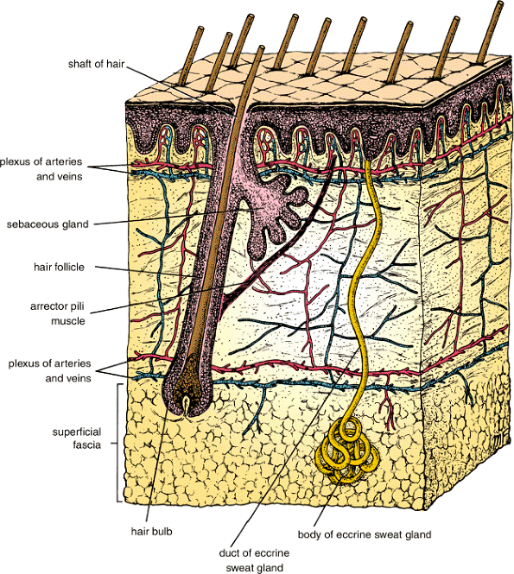
Sympathetic…….Abdominal part
Post gangilionic fibers……..cont
Distributed through the branches of the spinal nerves to the blood vessels, sweat glands, and arrector pili muscles of the skin.
Fibers pass medially to the sympathetic plexuses on the abdominal aorta and its branches. (These plexuses also receive fibers from splanchnic nerves and the vagus.)
Fibers pass downward and medially in front of the common iliac vessels into the pelvis, where, together with branches from sympathetic nerves in front of the aorta, they form a large bundle of fibers called the superior hypogastric plexus.
Notes:
10

Slide 11
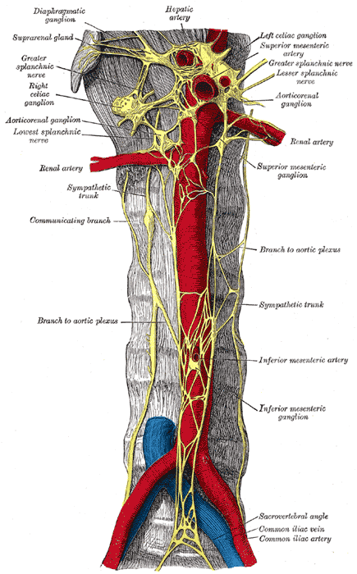
Aortic Plexuses
Preganglionic and postganglionic sympathetic fibers
Preganglionic parasympathetic fibers, and visceral afferent fibers form a plexus of Nerves, the aortic plexus, around the abdominal part of the aorta .
Regional concentrations of this plexus around the origins of the celiac, renal arteries
Superior mesenteric→ celiac plexus
Inferior mesenteric plexus→ Renal plexus
1- The celiac plexus consists mainly of two celiac ganglia connected together by a large network of fibers that surrounds the origin of the celiac artery.
The ganglia receive the greater and lesser splanchnic nerves (Preganglionic sympathetic fibers).
Postganglionic branches accompany the branches of the celiac artery and follow them to their distribution.
Parasympathetic vagal fibers also accompany the branches of the artery.
2- The renal plexuses are smaller than the celiac plexus. They are distributed along the branches of the corresponding arteries. The inferior mesenteric plexus is similar but receives parasympathetic fibers from the sacral parasympathetic.

Slide 12
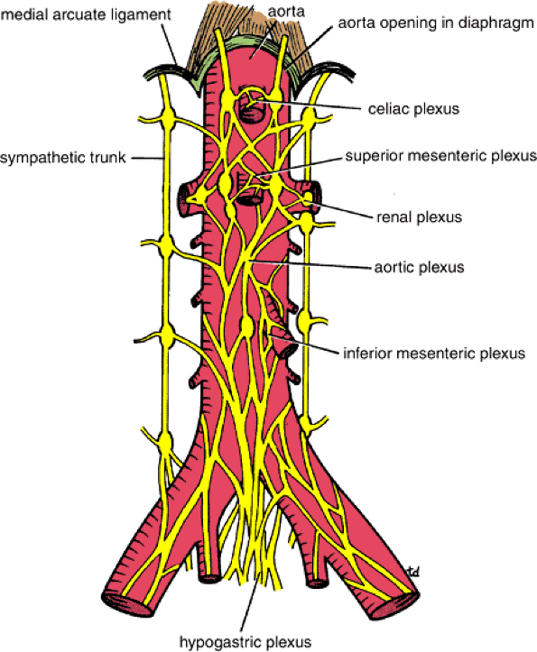

Slide 13
Sympathetic chain

Slide 14
Sympathetic chain

Slide 15
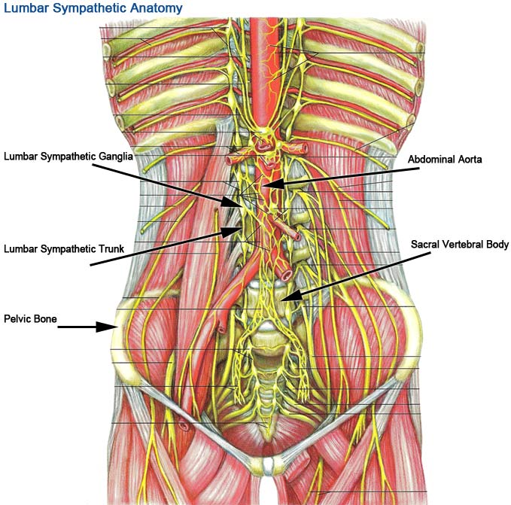
Sympathetic chain
2 chains extend from level of atlas till coccyx
Number of ganglia (in pairs )
- C = 3
- Th. = 10 -12 (11)
- L = 4
- S = 4
- Coccygeal = 1(ganglion impar)

Slide 16
Sympathetic chain….cont
Pregangilonic fibers:
Origin: sympathetic nucleus present in lat. Horn cell of thoracic and upper 2 lumber region of spinal cord = 14
Leave the spinal cord throw the ant. Root and then leave the spinal nerve as white rami to join the symp.chain ( 14 white rami )
Preganglionic fibers when it enters the sympathetic chain may :
1- Synapse with cells in the ganglia it enters (e.g. middle.Th.. Segm)
2- Pass up to synapse in higher ganglia (upper Th. Segm → 3 cerv. Segm )
3- Pass down to synapse in lower ganglia ( lower Th & upper 2 lumber go to lumber & sacral ganglia)
4- May not synapse in sympathetic chain & continue as preganglionic fibers to form ( splanchnic nerves)

Slide 17
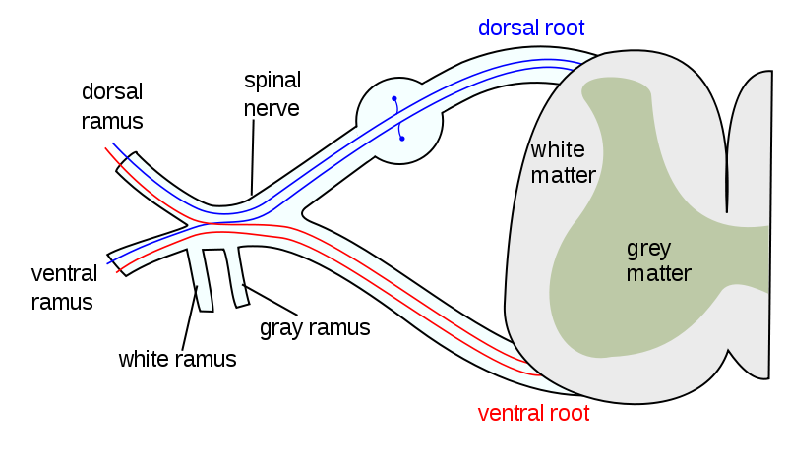
Sympathetic chain

Slide 18
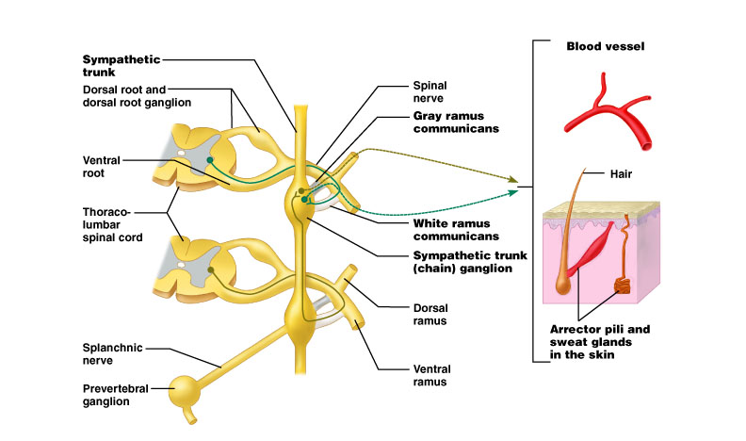
Synapse in chain ganglia at same level or different level
18

Slide 19
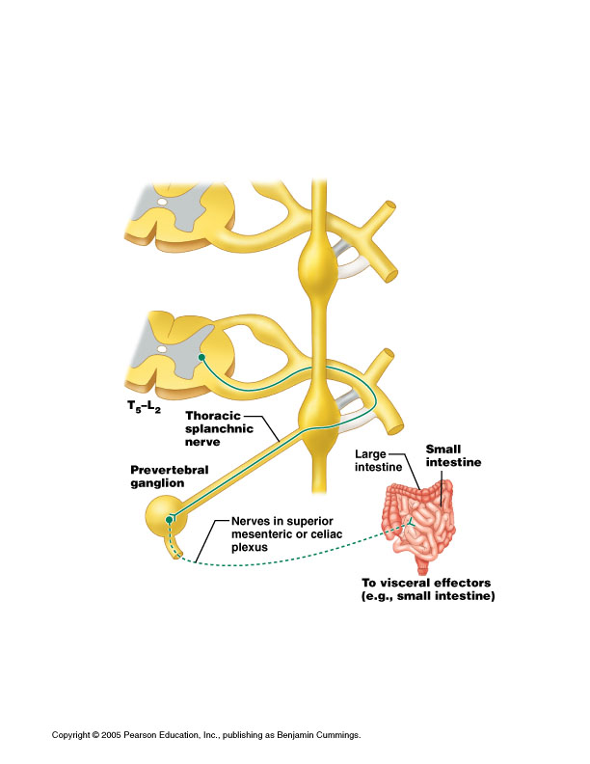
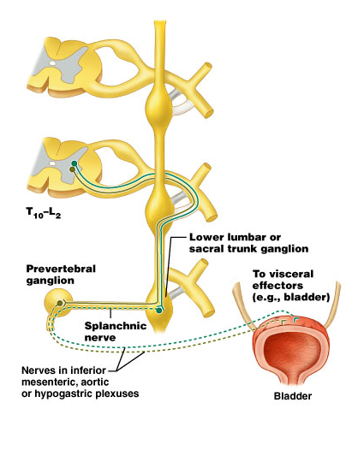
Pass through ganglia and synapse in prevertebral ganglion
19

Slide 20
Sympathetic chain….cont
Nerves which leave the sympathetic chain:
A- gray rami ( 31 post ganglionic fibers join spinal nerves to reach sweat glands, errectore papillae & blood vessels
- S.C.S.G→ lower 4 cranial nerves + upper 4 cervical
- M.C.S.G → 5th , 6th cervical nerves
I.C.S.G → 7th , 8th cervical nerves
Thoracic , lumber, sacral ganglia to corresponding nerves
B- visceral nerves
1- Int, & Ext. carotid nerves from S.C.S.G to corresponding arteries
2- pharyngeal branch : from S.C.S.G to pharyngeal plexus
3- pulmonary nerves : 2nd , 3^{rd&} 4th thoracic ganglia
4- cardiac nerves : 2nd , 3^{rd&} 4th thoracic ganglia + 3 cervical ganglia
5- splanchnic nerves : greater, lesser and lowest splanchnic nerves

Slide 21
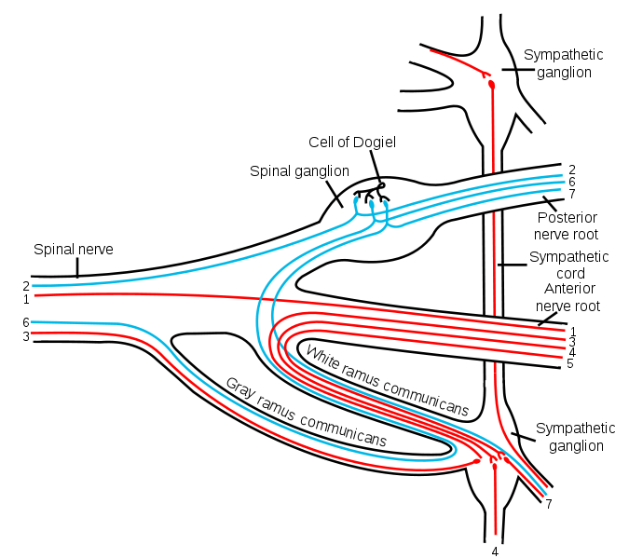
Sympathetic chain

Slide 22
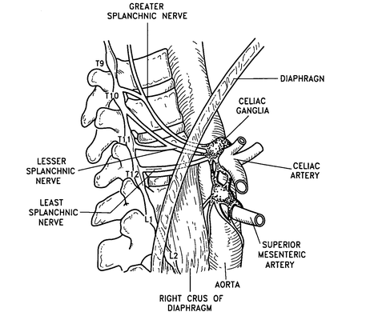
Greater splanchnic nerves:
Arise from ganglia (5-9th ) or 10th
Pierce the cruss of the diaphragm
End in the coeliac ganglia
Post. ganglia fibers follow the branches of coeliac artery to reach the smooth muscle , gland of stomach

Slide 23
Lesser splanchnic nerves:
Arise from the 9th & 10th Th.ganglia
Pierces the cruss of diaphragm
End in the sup. Mesenteric ganglia
Post. Ganglia fibers supply the smooth muscles, glands of small intestine, ascending and transverse parts of colon

Slide 24
Lowest splanchnic nerves:
May be absent, if present arises from the last one or two th.ganglia
Pierces the diaphragm to end in renal plexus

Slide 25
Lumber splanchnic branch
Arise from L1& L2 ganglia
Ends in inferior mesenteric ganglia
Post. Gangilionic fibers go to sigmoid and pelvic colon, other post. Gangilionic fibers form the descending hypogastric plexus to supply bladder, rectum and genetalia
Branches from sacral part of the chain go to pelvic viscera

Slide 26
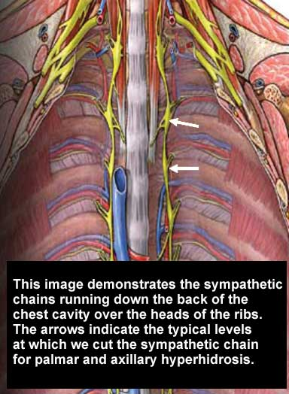
Thoracic sympathetic chain:
Site: enters the thorax in front of neck of 1st rib and leaves it by passing behind the medial arcuate ligament
In the upper part it lies on the necks of the ribs while in the lower part it lies on the side of the bodies of vertebrae
Ganglia: (10 -12 ),1st sometimes fuses with the I.C.S.G →stellate ganglia
Branches:
A- Gray & white rami communicants
B- 2nd ,3rd & 4th ganglia ( cardiac & pulmonary )
C- The upper five ganglia give aortic oesophageal branches
D- Greater, lesser and lowest splanchnic nerves

Slide 27
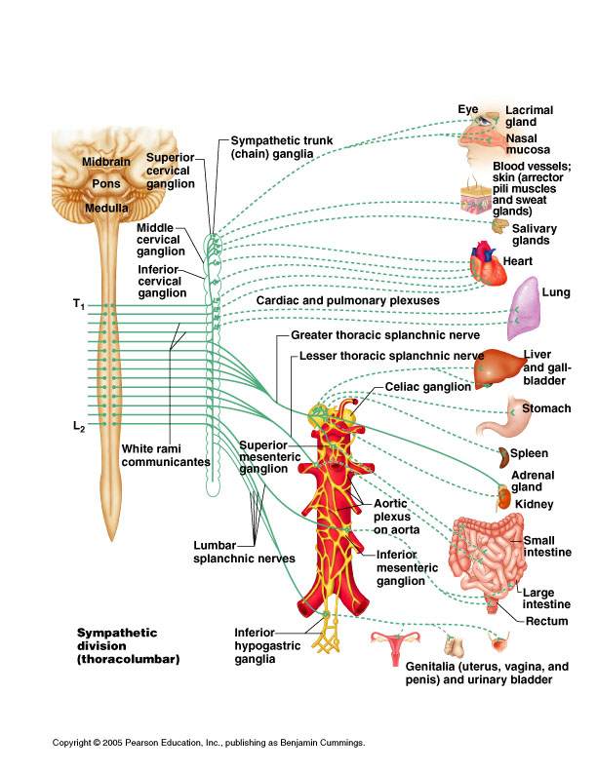
Sympathetic chain
27

Slide 28
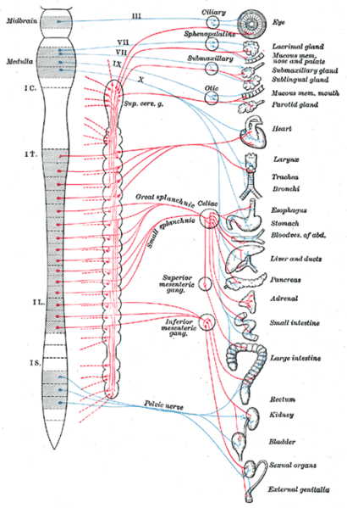
Splanchnic nerve

Slide 29
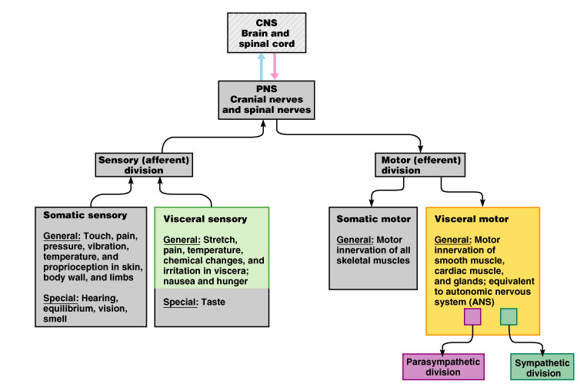
Visceral sensory system
29

Slide 30
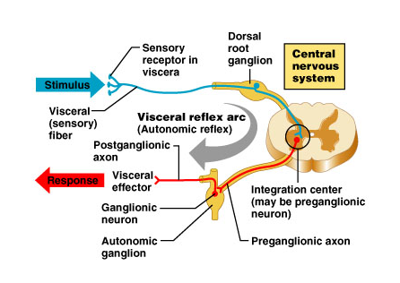
Visceral sensory and autonomic neurons participate in visceral reflex arcs
Many are spinal reflexes such as defecation and micturition
reflexes
Some only
involve peripheral
neurons: spinal
cord not involved
(not shown)*
30
*e.g. “enteric” nervous system: 3 neuron reflex arcs entirely within the wall of the gut

Slide 31
THANK YOU

