Slide 1
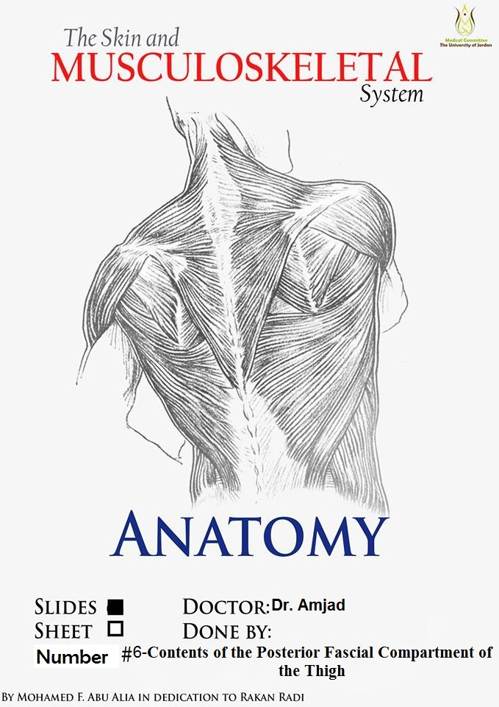

Slide 2
Contents of the Posterior Fascial Compartment of the Thigh

Slide 3
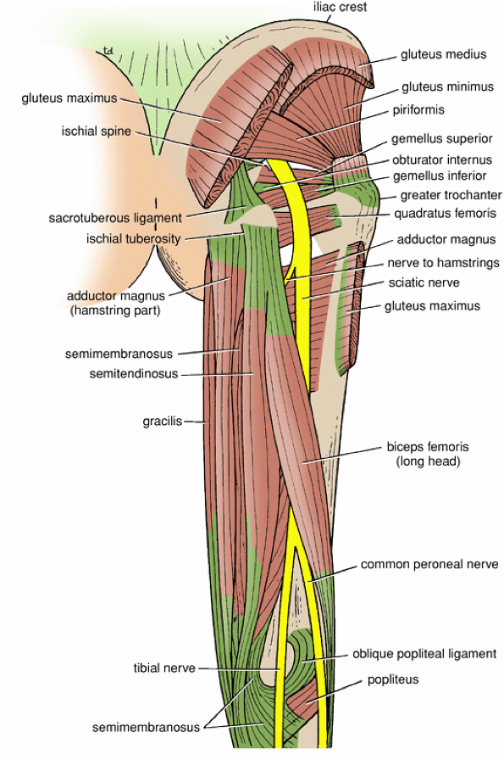
1-Muscles:
Biceps femoris
Semitendinosus
Semimembranosus
a small part of the adductor magnus (hamstring part
or ischial part)
2-Blood supply: Branches of the profunda femoris artery
3-Nerve supply: Sciatic nerve

Slide 4
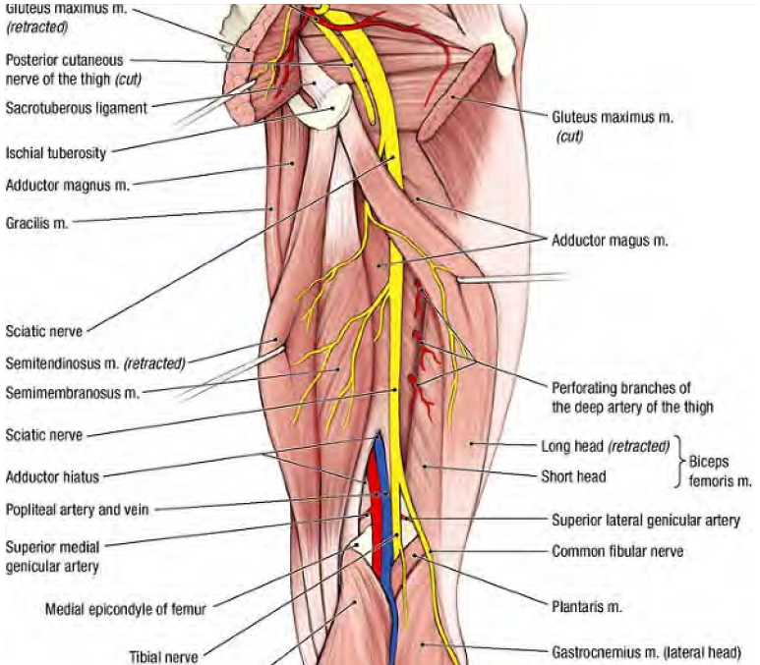
Biceps femoris
Origin: two heads
1-Long head: ischial tuberosity
2-Short head: linea aspera, lateral supracondylar ridge of shaft of femur
Insertion: Head of fibula
Nerve supply:
Long head: tibial portion of sciatic nerve
Short head: common peroneal portion of sciatic nerve
Actions: Flexes and laterally rotates leg at knee joint; long head also extends thigh at hip joint

Slide 5
Semitendinosus
Origin:
Ischial tuberosity
Where?
Insertion:
Upper part of medial surface of shaft of tibia
(SGS area)
Nerve supply: Tibial portion of sciatic nerve
Actions: Flexes and medially rotates leg at knee joint;
extends thigh at hip joint

Slide 6
Semimembranosus
Origin: Ischial tuberosity, where?
Insertion: Medial condyle of tibia
Nerve supply: Tibial portion of sciatic nerve
Actions: Flexes and medially rotates leg at knee joint; extends thigh at hip joint

Slide 7
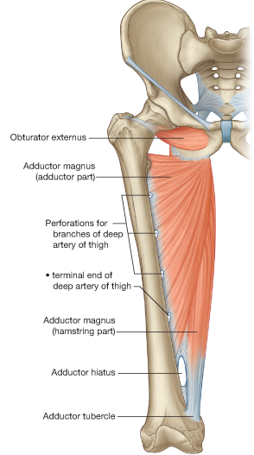
Adductor magnus (hamstring portion)
Or ischial part
Origin: Ischial tuberosity
Insertion: Adductor tubercle of femur
Nerve supply: Tibial portion of sciatic nerve
Actions: Extends thigh at hip joint
Does it flex the knee?

Slide 8
Pay attention to the fact that the muscles of the thigh are designed
To act on the knee joint
For example, quadriceps femoris occupies the anterior compartment of the thigh but its
Main action is to extend the knee joint
The same should be considered for the muscles of the posterior compartment of the thigh
Although they occupy the posterior compartment of the thigh
Their main function is to flex the knee joint
Now think!
Which muscles will rotate the knee joint medially and laterally?
Keep in your mind that when the knee joint is extended medial and lateral rotation is not possible!
The joint said to be locked
Therefore, we need to unlock the extended (locked) knee joint
A small muscle called popliteus unlocks the knee joint by
rotating the femur on the tibia laterally before any flexion of the knee can take place
Now the joint said to be unlocked
Only now when the knee joint is semiflexed
The biceps femoris can act as lateral rotators of the leg
The semimembranousus and semitendinosus can act as medial rotators of the leg

Slide 9
Sciatic Nerve
A terminal branch of the sacral plexus
(L4 and 5; S1, 2, and 3)
Emerges from the pelvis through the lower part
of the greater sciatic foramen below the piriformis muscle
It is the largest nerve in the body and consists of the
tibial and common peroneal nerves bound together with fascia.
Commonly terminates in the middle of the thigh
by dividing into Tibial Nerve
(medial popliteal nerve)
and Common peroneal
(lateral popliteal nerve ALSO CALLED common fibular nerve

Slide 10
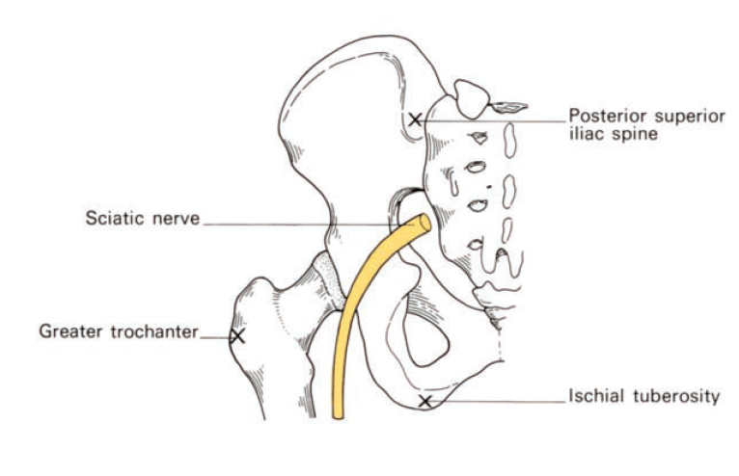
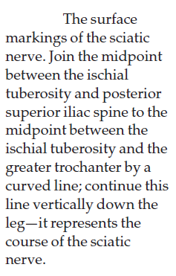

Slide 11
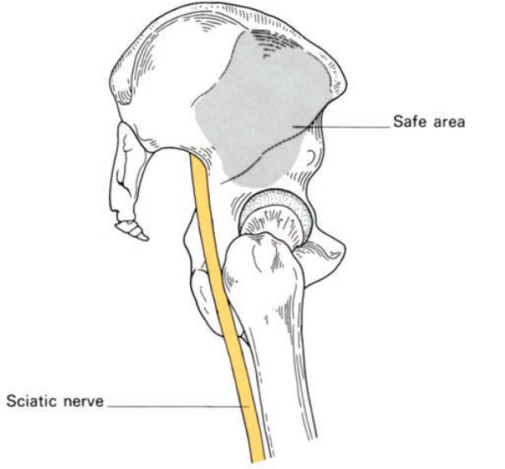
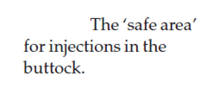
A better surface marking for the ‘safe area’ of buttock injections can be
defined as that area which lies under the outstretched hand when the
thumb and thenar eminence are placed along the iliac crest with the tip of
the thumb touching the anterior superior iliac spine

Slide 12
Posterior Cutaneous Nerve of the Thigh
A branch of the sacral plexus S1,2,3.
Enters the gluteal region through the lower part of the greater sciatic foramen below the piriformis muscle
It passes downward on the posterior surface of the sciatic nerve and runs down the back of the thigh beneath the deep fascia.
In the popliteal fossa it supplies the skin OVER THE BACK OF THE thigh and upper part of the leg.

Slide 13
The popliteal fossa

Slide 14
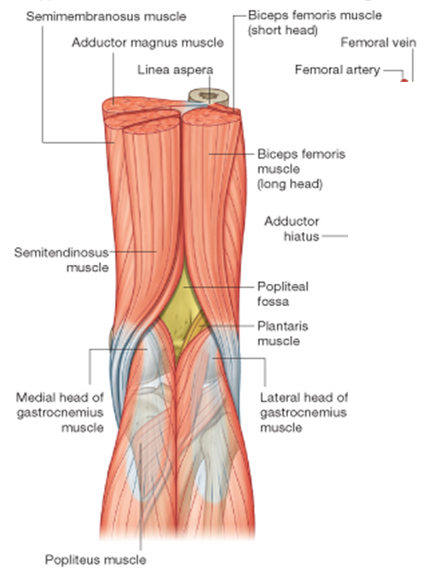
Popliteal Fossa
Is a diamond-shaped intermuscular space situated at the back of the knee
Boundaries
Laterally: (above)
The biceps femoris
(below) The lateral head of the gastrocnemius and Plantaris
Medially:
(above) The semimembranosus and semitendinosus (below) The medial head of the
gastrocnemius

Slide 15
The Floor is formed by
The popliteal surface of the femur,
The posterior surface of the knee joint,
The popliteus muscle.

Slide 16
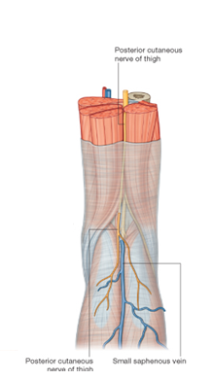
The Roof is formed by
Skin
Superficial fascia
The deep fascia of the thigh.

Slide 18
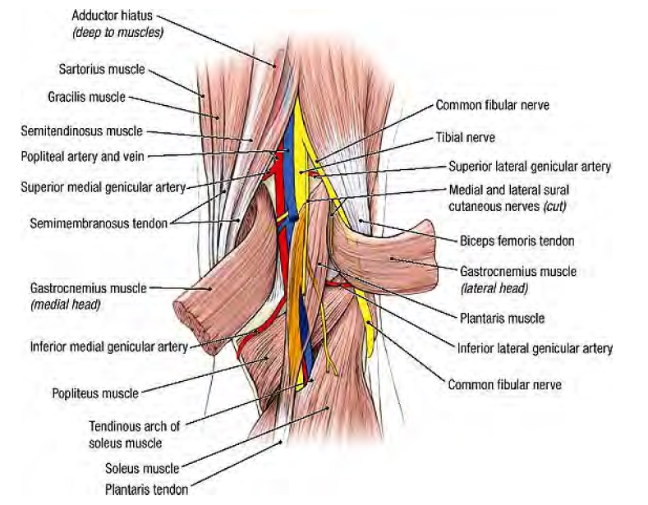
Contents of the popliteal fossa
Popliteal artery and vein
The common peroneal nerve(lateral popliteal nerve)
Tibial nerve(medial popliteal nerve)
The posterior cutaneous nerve of the thigh
The small saphenous vein
Connective tissue, and lymph nodes.

Slide 19
The popliteal artery
Enters the popliteal fossa through the opening in the adductor magnus as a continuation of the femoral artery (the deepest structure in the fossa).
It ends at the level of the lower border of the popliteus muscle by dividing into anterior and posterior tibial arteries
important
AT the middle of the fossa
The popliteal artery is the deepest structure
While the vein is intermediate and the tibial nerve
Is most superficial
Branches
Muscular branches
Articular ( genicular) branches to the knee.

Slide 20
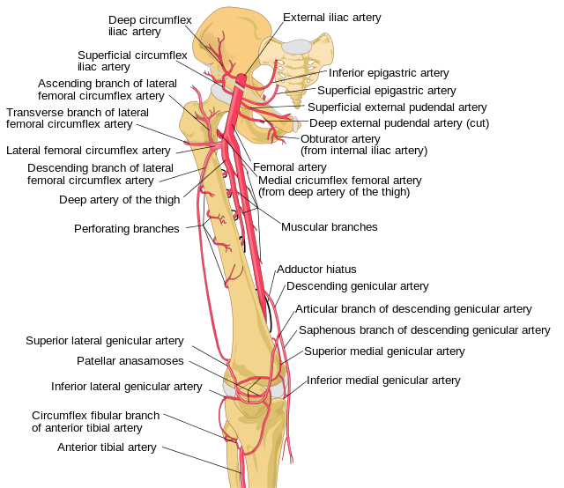
Articular ( genicular)
?
?

Slide 21
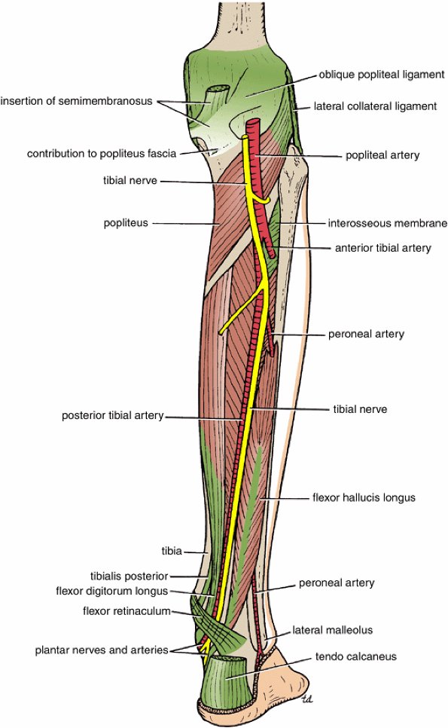
Tibial Nerve
Ventral divisions of L4, 5, S1, 2, 3
Root value
The larger terminal branch of the sciatic nerve
Arises in the lower third of the thigh.
It runs downward through the popliteal fossa
Enters the posterior compartment of the leg by passing beneath the soleus muscle.
Branches
1-Cutaneous:
The sural nerve
descends between the two heads of the gastrocnemius muscle
Supplies the skin of the calf and the back of the leg.
The sural nerve accompanies the small saphenous vein behind the lateral malleolus and is distributed to the skin along the lateral border of the foot and the lateral side of the little toe
2-Muscular: branches supply both heads of the gastrocnemius and the plantaris, soleus, and popliteus
3-Articular: branches supply the knee joint.

Slide 22
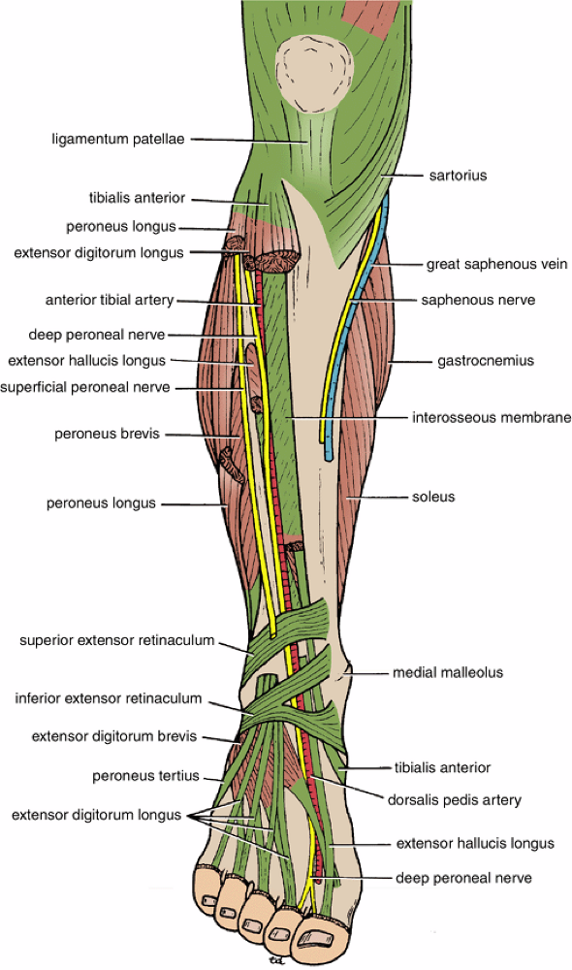
Common Peroneal Nerve
L4, 5, S1, 2
The smaller terminal branch of the sciatic nerve
Arises in the lower third of the thigh.
It runs downward through the popliteal fossa
It leaves the fossa by crossing superficially the lateral head of the gastrocnemius muscle.
It then passes behind the head of the fibula, winds laterally around the neck of the bone (subcutaneous and exposed to injury), pierces the peroneus longus muscle.
Divides into two terminal branches:
The superficial peroneal nerve
The deep peroneal nerve

Slide 23
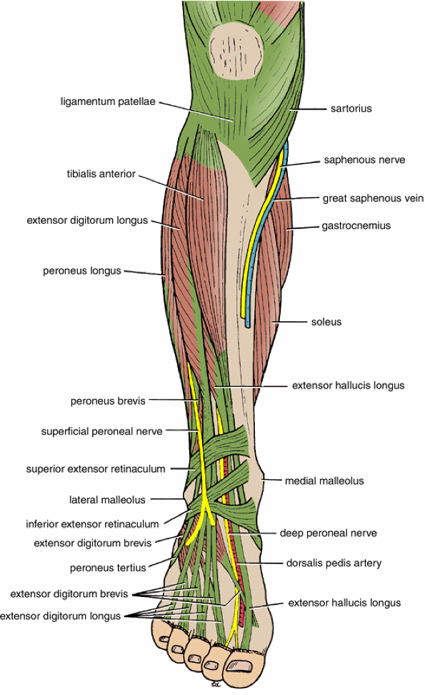
Branches
Cutaneous:
The sural communicating branch
The lateral cutaneous nerve of the calf supplies the skin on the lateral side of the back of the leg
Muscular branch: to the short head of the biceps femoris muscle, which arises high up in the popliteal fossa
Articular: branches to the knee joint
Terminal branches
The superficial peroneal nerve
Also called the musclocutaneous
nerve of the leg,
Supplies two muscles and then becomes
cutaneous where
It supplies the skin over the leg

Slide 24
Small saphenous vein

