Slide 1
Diseases of the endocrine system
Dr Heyam Awad
FRCPath

Slide 2
Lectures will be available on my university website on the same day they are given.
Office hours: Wednesday and Thursday :10-12.
Office: in the hospital.
Email: h_awad@ju.edu.jo

Slide 3
Six lectures
Pituitary gland.
Thyroid gland 1
Thyroid gland 2
Midterm exam
Adrenal gland
Parathyroid gland
Endocrine pancreas & diabetes

Slide 4
Endocrine system diseases general principles
Mass effect.
Disordered hormonal production…. Under or over production
No relation between the above two.
Three conditions can affect all glands:
Hyperplasia, non-neoplastic, can become autonomous
Adenoma: benign neoplasm, functional or nonfunctional
Carcinoma: malignant… infiltrative and potentially metastisizing

Slide 5
Pituitary gland

Slide 6
Anterior versus posterior pituitary

Slide 7
Anterior vs posterior
Histology.. Adenohypophysis vs neurohypophysis; epithelial vs glial cells and neural axons
Embryology: oral mucosa vs neural crest
Hormones secreted: anterior.. TSH, PRL, ACTH, GH, FSH , LH. Posterior: ADH and oxytocin.

Slide 8
Diseases of the anterior pituitary
Mass effect:
*Radiographic abnormalities of sella turcica :sellar expansion, bony erosions.
*Compression of the optic chiasm: visual field abnormalities.
*elevated intracranial pressure: headache, nausea, vomiting.
*seizures.
*Cranial nerve palsies.
*pituitary apoplexy

Slide 9
Pituitary apoplexy
Acute hemorrhage into an adenoma…. Rapid enlargement of the lesion… decreased consciousness.
Neurosurgical emergency…. Can cause sudden death.

Slide 10
Hyperpituitarism
MOST COMMON CAUSE: functional adenoma.
Other causes:
Hyperplasia
Carcinoma
Secretion of pituitary hormones by nonpituitary tumors.
Hypothalamic disorders.

Slide 11
Pituitary adenomas
Functional or nonfunctional.
Functional: usually one cell type and one hormone produced.
Classified according to the hormones they produce.

Slide 12
Types of pituitary adenomas
Prolactinomas.. 20-30%
Null cell adenoma… 20%
ACTH cell adenoma.. 10-15%
Gonadotroph cell adenoma… 10-15%
GH cell adenoma… 5%
Mixed GH/Prolactn adenoma.. 5%
TSH cell adenoma… 1%
Other pleurihormonal… 15%

Slide 13
Pituitary adenomas
10% of intracranial neoplasms.. clinically
Incidental finding in 25% of autopsies.
Peak.. 4th to 6th decades.
Mostly single lesions.
Micro amd macro adenomas acording to size.. Cutoff point: 1cm.

Slide 14
Macroscopic appearance
Gross features of adenomas
The usual adenoma is a well-circumscribed, lesion that if small, is confined by the sella turcica
- In 30% of cases, the adenomas are non-encapsulated and infiltrate adjacent bone,dura and brain.

Slide 15
Pituitary adenoma

Slide 16
Pituitary adenoma

Slide 17
Notes
- This cellular monomorphism and the absence of a significant reticulin network distinguish pituitary adenomas from non-neoplastic anterior pituitary parenchyma
- The functional status of the adenoma cannot be reliably predicted from its histologic appearance.
Adenomas that harbor TP53 mutations demonstrate brisk mitotic activity and are designated atypical adenomas to reinforce their potential for aggressive behavior.

Slide 18
- prolactinomas
Hyperprolactinemia causes:
a. Amenorrhea and galactorrhea,
Loss of libido, and infertility
prolactinomas usually are diagnosed at an earlier stage in women of reproductive age than in other persons

Slide 19
Other causes of hyperprolactinemia
a. Pregnancy, and high-dose estrogen therapy,
b. Dopamine-inhibiting drugs (e.g., reserpine).
c. Any mass in the suprasellar compartment may disturb
the normal inhibitory influence of hypothalamus on prolactin secretion, resulting in hyperprolactinemia-a mechanism known as the stalk effect.

Slide 20
Growth Hormone-Producing (Somatotroph) Adenomas
- May be quite large at time of diagnosis because the clinical manifestations of excessive growth hormone may be subtle,
-- Small amounts of immunoreactive prolactin often are present as well.

Slide 21
clinical manifestations.
If a growth hormone-secreting adenoma occurs before the epiphyses closes: gigantism.
gigantism: generalized increase in body size, with disproportionately long arms and legs.

Slide 23
acromegaly
If elevated levels of growth hormone persist, or develop after closure of the epiphyses, affected persons develop acromegaly, in which:
1. Growth is most conspicuous in soft tissues, skin, and viscera and in the bones of the face, hands, and feet 2. Enlargement of the jaw results in its protrusion
with eparation of the teeth.
3. Enlarged hands and feet with broad, sausage-like fingers

Slide 24
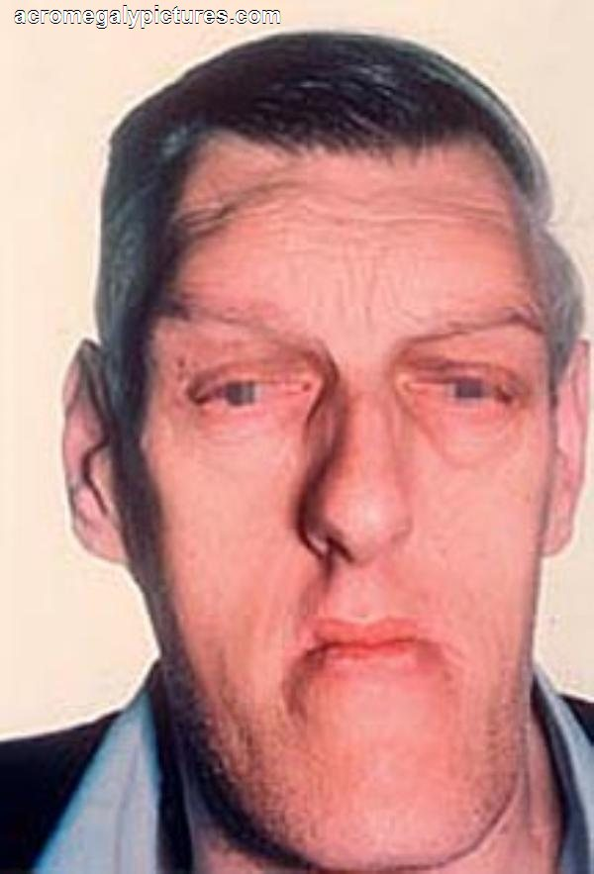
acromegaly

Slide 25
- Corticotroph cell adenomas may be:
*Clinically silent or
*May cause hypercortisolism, manifested clinically as Cushing syndrome
*Large, clinically aggressive corticotroph cell adenomas may develop after surgical removal of the adrenal glands for treatment of Cushing syndrome, this condition is Nelson syndrome.
*Because ACTH is synthesized as part of a larger pro-hormone substance that includes melanocyte-stimulating hormone (MSH), hyperpigmentation may be a feature.

Slide 26
Gonadotroph LH]-producing and FSH adenomas
- Can be difficult to recognize, because they secrete hormones inefficiently, and the secretory products usually do not cause a recognizable clinical syndrome.

Slide 27
Pituitary carcinomas
are exceedingly rare and in addition to local extension beyond the sella turcica, these tumors virtually always demonstrate distant metastases.

Slide 28
Hypopituitarism:
Loss of 75% of anterior pituitary
Causes:
a. Congenital absence(exceedingly rare)
Hypothalamic tumors, associated with posterior pituitary dysfunction.
C . Nonfunctioning pituitary adenomas .. Most common
Ischemic necrosis of the anterior pituitary, e;g Sheehan syndrome.
e. Ablation of the pituitary by surgery or irradiation
f. Inflammatory lesions such as sarcoidosis or tuberculosis
g. Trauma and Metastatic neoplasms involving the pituitary.

Slide 29
Sheehan syndrome, or postpartum necrosis of anterior pituitary, is the most common form of clinically significant ischemic necrosis of the anterior pituitary.
- During pregnancy, the anterior pituitary enlarges considerably, because of an increase in the size and number of prolactin-secreting cells and this physiologic enlargement is not accompanied by an increase in blood supply from the low-pressure portal venous system.
The enlarged gland is thus vulnerable to ischemic injury, especially in women who experience significant hemorrhage and hypotension during the peripartal period

Slide 30
POSTERIOR PITUITARY SYNDROMES.
- Impairment of oxytocin synthesis and release has not
been associated with significant clinical abnormalities.
- The clinically important posterior pituitary syndromes involve ADH.

Slide 31
I. ADH deficiency causes diabetes insipidus, characterized by excessive urination (polyuria) caused by an inability of the kidney to properly resorb water from the urine
- Diabetes insipidus can result from several causes,
a. Head trauma, Neoplasms,
b. Inflammatory disorders and surgical procedures of the hypothalamus and pituitary,
d. The condition may be idiopathic.
Note:- Diabetes insipidus from ADH deficiency is designated as central, to differentiate it from nephrogenic DI

Slide 32
- The clinical manifestations of DI include:
a. The excretion of large volumes of dilute urine with an inappropriately low specific gravity
b. Serum sodium and osmolality are increased as a result of excessive renal loss of free water resulting in thirst and polydipsia
- Patients who can drink water generally can compensate for urinary losses; patients who are obtunded, bedridden, or otherwise limited in their ability to obtain water may develop life threatening dehydration.

Slide 33
develop life-threatening dehydration
- In (SIADH) ADH excess is caused by several extracranial and intracranial disorders.
- This condition leads to resorption of excessive amounts of free water, with resultant hyponatremia.
- The most common causes of SIADH include;
a. The secretion of ectopic ADH by malignant neoplasms ,
b. Non-neoplastic diseases of the lung,
c. local injury to the hypothalamus or neurohypophysis.
- The clinical manifestations of SIADH are dominated by hyponatremia, cerebral edema, and resultant neurologic dysfunction.

