Slide 1
Anti-inflamatory Drugs lecture 1 (slide+sheet) lecture 2 (slide only) Dr. Omar Shaheen computerized by: farah bilal

Slide 2
Injury will cause inflammation, which is a natural response to injury and also a protective one. Then the inflammation will be ended by an anti-inflammatory process.

Slide 3
Types of Inflammation
1- Exogenous: which is caused by outside factors (physical trauma, chemicals & toxins, microbiological)
induce a NON-SELF inflammatory response
2- Endogenous: which is an inappropriate activation of immune system. E.g.: Rheumatoid arthritis.
considered a SELF-RESPONSE for the causative agents are actually normally found in the body. So here the body is fighting itself with an abnormal responses.

Slide 4
Characteristics of inflammation
Pain, fever, etc (palliative)
Tissue repair. (healing)
Destroy invading organisms
Functional disability. (Stop or delay inflammatory process which will slow the process). as a result of the process of inflammation in joints,
[ mainly in large joints, and in some small joints as well, e.g: hand, wrist, elbow joints as well as the spinal cord.]
Joints deformities.
Stiffness.
Twisting of body, if the injury affects the spinal cord.

Slide 5
Healing
Either it’s complete or not complete.
If inflammation process is in progress, pain will continue and disability occurs.
Immune system cannot differentiate between self and nonself-injury.
We usually establish the inflammatory process to help the injured and damaged tissue to repair. If there is for example an invasive pathologic microorganism, then we’ll use anti-microbial agents (anti-inflammatory) to remove it.

Slide 6
You can watch this video before starting with the next slide and it says everything and more.
https://www.youtube.com/watch?v=Yc-9dfem3lM

Slide 7
Rheumatoid arithritis
where the body starts to recognize some agents as antigens, and produces some antibodies against it, what results in a pathological processes, disability, fever, hyperpyrexia (high fever), and pain in joints, with the previously mentioned (stiffness in joints + twisting of body).
it may affect the knee joint.
The knee joint consists of bones, cartilage, endothelial membrane, and synovial fluid inside a synovial cavity [the most common site in which Rheumatic Arthritis occurs].
The synovial fluid –in normal cases -contains main nutrients for cartilage and bone, and maintains healthy articulation and normal movement of joints.-The problem begins when the body, mainly in old people, recognizes some parts of the synovial fluid as foreign bodies and starts to fight them via immune system.

Slide 9
Okay so here we have this joint where the inflammatory attack will take place, and then there will be WBC activation in the synovia.
B-lymphocytes will stimulate:
Autoantibodies because it’s endogenous:
-Rheumatoid factors (Autoantibody used as inflammatory marker in the serum to diagnose the disease accurately)
T-lymphocytes(immune system mediators) will stimulate:
-monocytes and macrophages >> which will secrete pro-inflammatory cytokines and then autacoids (Which are biological factors that have short duration) like cytokines interleukins, and tumor necrotizing factors, which all affect the synovial fluid, membrane, Bone and the cartilage of the joint
Progr-essive tissue injury

Slide 10
Effects of cytokines
Local effects in joints: mainly in the syonvial fluid which nourishes the joint and the covering endothelial plus the cartilage above metaphysis and bones themselves.
Endothelial cells:
infiltration, dilation and increase in number>> redness, hotness, swelling and pain.
Cartlige–chondrocytes :
increase the production of proteolytic enzymes (collagenases, metalloprotinases,..) >> degredation of cartilage >> joint space narrwoin >> restrict the movement>> resulting in stiffness and development of some sort of threads of fibers at night. → the symptoms will start to improve during the day with movement, specially the pain (it will become less sever).
Osteoclasts :
increase its activity >> focal bone erosions (pain) >> dimineralization around joints.
release of Histamine, Kinin, Prostaglandins, Hyaluronidase, and other enzymes along with Cytokines participate in the inflammatory (pathological) reaction in the endothelial membrane, cartilage, and bone, inducing hotness, redness, disability, disruption of movement and more pain.

Slide 11
2- Systemic effects:
Heart
Lungs
Liver: when we take a blood sample we will notice high levels of marker proteins like c-reactive protein and proteolytic enzymes, due to the injury and inflammation in the hepatocytes.

Slide 12
How to TREAT Rheumatic Arthritis?
Until now, there is not one perfect single effective drug to treat this disease and allow the patient to live a normal life without bad side effects, although some new drugs are claiming so. These can be dangerous drugs with fatal consequences.

Slide 13
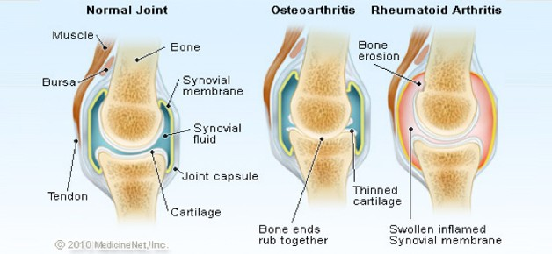
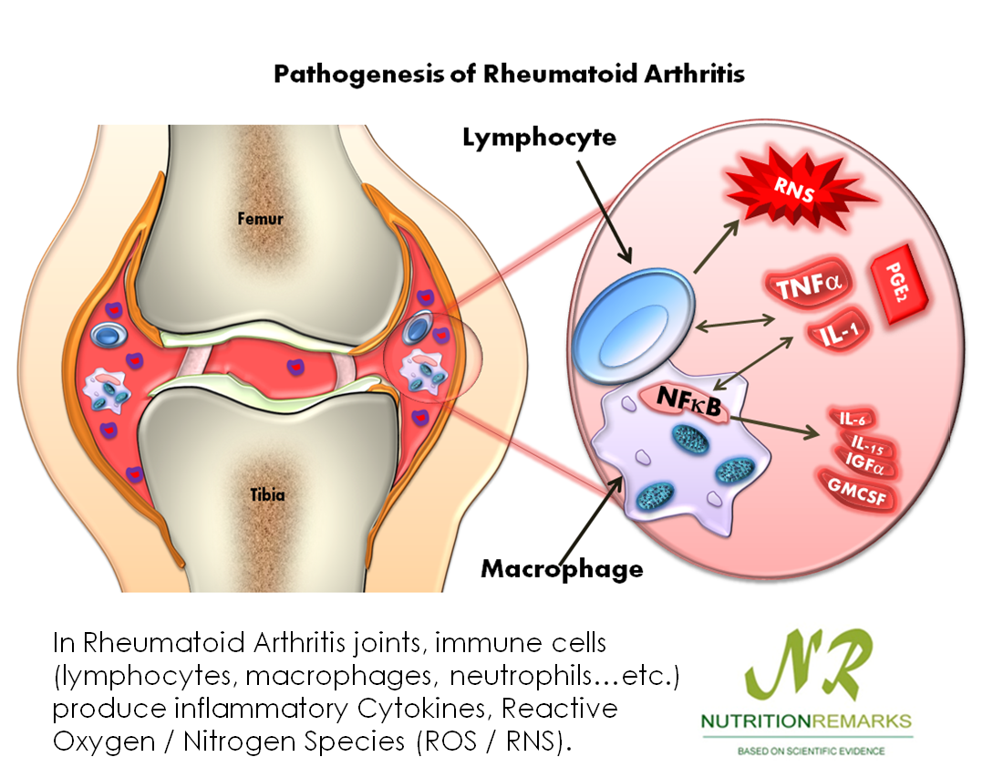
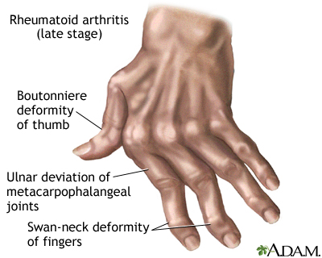

Slide 14
Pharmacological interferance
Objective:
Reduce and modulate inflammatory process by anti-inflamatory agents
Reduce and modulate inflammatory process by immunosuppresants
Analgesics : modulate pain
Healing or at least slowing the progression of the disease, since healing in some cases becomes very difficult to be achieved.

Slide 15
Second Lecture

Slide 16
Anti-inflammatory drugs 2
Salicylates
Paracetamol
Non-selective COX inhibitors (NSAIDs)
Azapropazone
Diclofenac
Etodolac
Fenbuten
Fenoprofen
Flubiprofen
Ibuprofen
Ketoprofen
Meloxicam
Nabmetone
Naproxen
Piraxicam
Salindac
Selective COX2 inhibitors (NSAIDs)
Celecoxib(celebrex)
Rofecoxib (vioxx)

Slide 17
Drugs for arithritis
Abatacept
Adalimumab
Anakinra
Chloroquine
Etanercept
Gold salts
Infliximab
Leflunomide
Methotrexate
D- Penicillamine
Rituximab

Slide 18
Drugs for gout
Allopurinol
Colchicine
Probencid
sulfinpyrazone

Slide 19
prostaglandins
NSAIDs mechanism of action and side effects can be explained by understanding their inhibitory action on prostaglandins synthesis.
Prostaglandins :
Structure: 20 carbon atoms in their structure (eicosanoids) and cylic ring structure.
Belongs to a group of compounds called Autocoids which they’re pharmacologically active compounds.
Characteristics :
Formed locally by the tissues.
Act locally in these tissues (like local hormones).
Produced by many tissues (different than hormones that produced by specific organs).
Rapidly metabolized into inactive products.
Don’t circulate in the body.

