Slide 1
Pathology lecture 3
Thyroid-continued
-A.K

Slide 2
Note: all thyroid related pathologies are more common in women than in men
Sub-acute Granulomatous (de Quervain) Thyroiditis
- Is much less common than Hashimoto disease
- Is most common between the ages of 30 and 50 and,
- More frequently in women than in men.
- Is believed to be caused by a viral infection and a majority of patients have a history of an upper respiratory infection just before the onset of thyroiditis.
Gross- The gland has intact capsule, and may be unilaterally or bilaterally enlarged.

Slide 3
Histologic examination reveals
1. Disruption of thyroid follicles, with extravasation of colloid
leading to a neutrophilic infiltrate, which is replaced by lymphocytes, plasma cells, and macrophages.
2. The extravasated colloid provokes a granulomatous reaction with giant cells that contain fragments of colloid.
What happens exactly is: viral destruction of follicles result in the release of colloid extracellularly; inflammatory reactions with macrophages surrounding the colloid >> granuloma
3. Healing occurs by resolution of inflammation and fibrosis.

Slide 4
Clinical Features :
-Acute onset characterized by neck pain ( with swallowing)
This syndrome is the only thyroid-related disease where the gland is painful
- Fever, malaise, and variable enlargement of the thyroid. (typical syndromes of an infection) there also might be upper respiratory tract symptoms
- Transient hyperthyroidism may occur as a result of disruption of follicles and release of excessive hormones.
- The leukocyte count is increased. >> HIGH WBC like any other viral infection
With progression of disease and gland destruction, a transient hypothyroid phase may ensue.
- The condition typically is self-limited, with most patients returning to a euthyroid state within 6 to 8 weeks

Slide 5
Sub-acute Lymphocytic Thyroiditis :
Also is known as silent or painless thyroiditis;
Less common than other thyroid-related thingies
- And in a subset of patients the onset of disease follows - pregnancy (postpartum thyroiditis). After delivery of first child, were the mother to get the disease, that means there is a higher risk of developing the condition again after her next delivery
- Most likely to be autoimmune because circulating antithyroid antibodies are found in a majority of patients. (actual mechanism not well understood)
It mostly affects middle-aged women, who present with a- painless neck mass or features of thyrotoxicosis
Under the microscope, the main thing we can see is lymphoid aggregates, -ALONE- which distinguishes sub-acute lymphocytic thyroiditis from hashimoto, if we see Hurthle cells with the lymphoid aggregates then = HASHIMOTO

Slide 6
Riedel thyroiditis,:
A rare disorder of unknown etiology, but there is some evidence suggesting it might be AUTOIMMUNE
- Characterized by extensive fibrosis (main problem) involving the thyroid and contiguous structures simulating a thyroid neoplasm. Fibrosis is infiltrative and might go beyond the gland, it fixes the gland to the surrounding tissue. This would make the thyroid gland hard, fixed and immobile, mimicking the features of a malignant tumor
May be associated with idiopathic fibrosis in other parts of the body, such as the retro peritoneum
- The presence of circulating antithyroid antibodies in most patients suggests an autoimmune etiology

Slide 7
The doctor focused on this point a lot: there is no relationship between mass effect and the hormonal status of the gland
Goiter: increase in the size of the gland.
Can be associated with Hyperthyroidism or Hypothyroidism … there is no relationship between size and amount of hormones secreted
Exception; Hashimoto >> hypothyroidism, initially it could be hyperthyroidism but in general it causes hypothyroidism
Graves is also an exception, it is ALWAYS associated with HYPERTHROIDISM

Slide 8
GRAVES DISEASE
The most common cause of endogenous hyperthyroidism with a peak incidence in women between the ages of 20 and 40.
You can not have GRAVES disease without these 4 clinical signs:
HYPERTHYROIDISM.
DIFFUSE,
SYMMETRIC,
And BILATERAL ENLARGEMENT of GLAND
Triad of manifestations:
A. Thyrotoxicosis,. All patients
B. Localized, infiltrative dermopathy ( pretibial myxedema), minority of cases and involves the skin overlying the shins, and manifests as scaly thickening
C. Infiltrative ophthalmopathy with resultant exophthalmos in 40% of patients

Slide 9
Localized dermopathy rarely occurs, infiltrative dermopathy is the presence of mucopolysacchrides forming edema-like appearance of the skin
Exophthalmos is the result of increased volume of the retro-orbital connective tissues by
Marked infiltration of T cells with inflammatory edema
Accumulation of glycosaminoglycans
Increased numbers of adipocytes (fatty infiltration).
These changes (increased tissue) displace the eyeball forward, potentially interfering with the function of the extraocular muscles
Exophthalmos may persist after successful treatment of the thyrotoxicosis, and may result in corneal injury. (ulcer from dry eye)

Slide 10
PATHOGENESIS :- Genetic factors are important in the causation of Graves disease, the incidence is increased in relatives of affected patients, and the concordance rate in
monozygotic twins is 60%.
- A genetic susceptibility is associated with the presence of
HLA-DR3,
- it is characterized by a breakdown in self-tolerance to thyroid autoantigens, and is the production of multiple autoantibodies

Slide 11
Autoantibodies in GRAVES :
1. Thyroid-stimulating immunoglobulin:
An IgG antibody binds to the TSH receptor and mimics the action of TSH, with resultant increased hormones
2. Thyroid growth-stimulating immunoglobulins:
- Directed against the TSH receptor, and have been implicated in the proliferation of follicular epithelium
3. TSH-binding inhibitor immunoglobulins:
- Prevent TSH from binding to its receptor on thyroid cells and in so doing may actually inhibit thyroid cell function, a finding explains why some patients with Graves spontaneously develop episodes of hypothyroidism.

Slide 12
Note: The coexistence of stimulating and inhibiting immunoglobulins in the serum of the same patient may explain why some patients with Graves disease spontaneously develop episodes of hypothyroidism
.Gross: Symmetrical enlargement of the thyroid gland with intact capsule,

Slide 13
On microscopic examination,
a. The follicular cells in untreated cases are tall, and more crowded (more ER produced) and may result in formation of small papillae. (pseupapillae) from TSH-mimicking-antibodies
b. Lymphoid infiltrates, consisting predominantly of T cells, with few B cells and plasma cells are present throughout the interstitium; with formation of germinal centers
Laboratory findings and radiologic findings
- Elevated serum free T₄ and T₃ and depressed serum TSH
- Because of ongoing stimulation of the thyroid follicles radioactive iodine uptake is increased, and radioiodine scans show a diffuse uptake of iodine.

Slide 14
DIFFUSE AND MULTINODULAR GOITER
Common condition in areas with iodine deficiencies
Diffuse: equal spread and distribution
Multinodular: some areas increase in size while other areas do not.
- Enlargement of the thyroid, or goiter, is the most common manifestation of thyroid disease
Mechanism :
The goiters reflect impaired synthesis of thyroid hormone often caused by dietary iodine deficiency and this leads to to a compensatory rise in the serum TSH, which in turn causes hyperplasia of the follicular cells and, ultimately, gross enlargement of the thyroid gland .
The goiter might start as diffuse then become multinodular

Slide 15
Goiters can be endemic or sporadic.
I. Endemic goiter :Occurs in geographic areas where the soil, water, and food supply contain little iodine.
- The term endemic is used when goiters are present in more than 10% of the population in a given region.
- Such conditions are common in mountainous areas of the world, including the Himalayas and the Andes but with increasing availability of iodine supplementation, the frequency and severity of endemic goiter have declined

Slide 16
II. Sporadic goiter : Less common than endemic goiter.
- The condition is more common in females than in males, with a peak incidence in puberty or young adulthood,
when there is an increased physiologic demand for T₄.
- It may be caused by several conditions, including the:
a. Ingestion of substances that interfere with thyroid hormone synthesis , such as excessive calcium and vegetables such as cabbage, cauliflower, sprouts, .
b. Hereditary enzymatic defects that interfere with thyroid hormone synthesis (dyshormonogenetic goiter).
-In most cases, the cause of sporadic goiter is not apparent.

Slide 17
MORPHOLOGY : (depends on the stage)
- Initially, the gland is diffusely and symmetrically enlarged (diffuse goiter) but later on it becomes multinodular goiter.
On microscopic examination,
a. The follicular epithelium may be hyperplastic in the early stages of disease or flattened and cuboidal during periods of involution(cyst formation, regeneration and hemorrhage)
b. Colloid is abundant in the latter periods (colloid goiter).
c. With time, recurrent episodes of hyperplasia and involution produce a more irregular enlargement of thee thyroid, termed multinodular goiter and virtually all long-standing diffuse goiters convert into multinodular goiters.

Slide 18
-The columnar cells are the active cells
-Usually Euthyroid (active)
Picture on the next page shows loads of colloid and large follicles
-Plummer syndrome:
Some nodules might become autonomous, i.e they will stop responding to the negative feedback – when T3 and T4 inhibit the release of TSH – so the hormonal level will not drop to normal, forming a multinodular goiter.

Slide 19
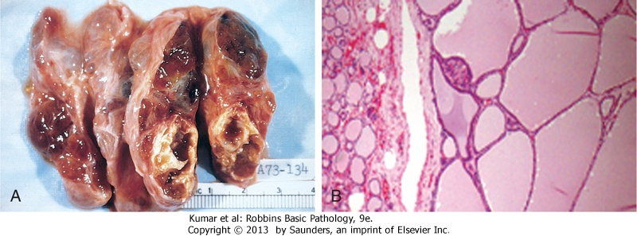
Multinodular Goiter

Slide 20
- Multinodular goiters cause multilobulated, asymmetrically enlarged glands which attain massive size and old lesions often show fibrosis, hemorrhage, calcification
- Multinodular goiters typically are hormonally silent,
- 10% of patients can manifest with thyrotoxicosis due to the development of autonomous nodules producing hormone independent of TSH stimulation and this condition, called toxic multinodular goiter or Plummer syndrome

Slide 21
Clinical Features :
a. The dominant features are mass effects of the goiter
b. may cause airway obstruction, dysphagia, and compression of large vessels in the neck and upper thorax
c. The incidence of malignancy in long-standing multinodular goiters is low (less than 5%) but not zero and concern for malignancy arises with goiters that demonstrate sudden changes in size or associated symptoms ( hoarseness)

Slide 22
Thyroid tumors :
-present as solitary nodules.
(unlike goiters), not every single nodule = malignancy
- the majority of solitary nodules of the thyroid prove to be benign : 90%
a. Follicular adenomas
b. A dominant nodule in multinodular goiter
Simple cysts or foci of thyroiditis
- Carcinomas of the thyroid, are uncommon, accounting for much less than 10% of solitary thyroid nodules.

Slide 23
- Several clinical criteria provide a clue to the nature of a
given thyroid nodule:
a. Solitary nodules, in general, are more likely to be neoplastic than are multiple nodules.
b. Nodules in younger patients are more likely to be neoplastic than are those in older patients.
Nodules in males are more likely to be neoplastic than are those in females.
d. Nodules that take up radioactive iodine in imaging studies (hot nodules) are more likely to be benign than malignant.

Slide 24
Follicular adenomas
Are benign neoplasms derived from follicular epithelium.
Usually called nodules
- solitary.
The tumor is demarcated and compressed the adjacent thyroid parenchyma by a well-defined, intact capsule
-the majority are cold nodules on scanning but might be functional. (causing hyperthyroidism)

Slide 25
.
Microscopic examination of follicular adenoma,
- The cells are arranged in follicles and its variants
Hurthle cell adenoma:
- The neoplastic cells show oxyphil or Hürthle cell change) and its behavior is not different from those of a conventional adenoma.
Atypical adenoma:
- The neoplastic cells exhibit focal nuclear atypia, (endocrine atypia);and these features do not constitute evidence of malignancy

Slide 26
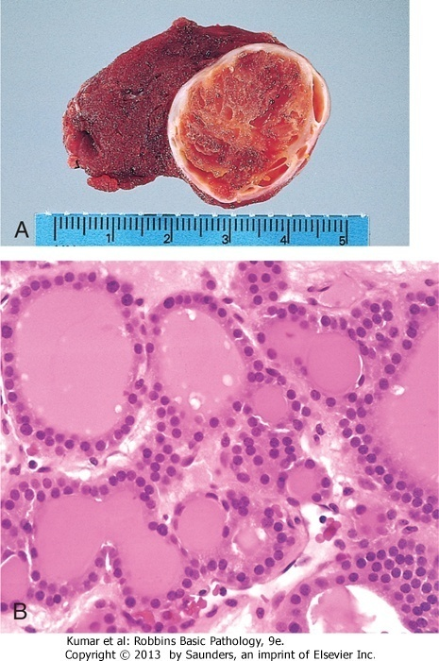
Follicular adenoma
Soft
Well-circumscribed
No infiltration
Surrounded by a capsule
ONLY UNDER THE MICROSCOPE YOU CAN KNOW IF THE TUMOR IS BENIGN OR MALIGNANT
^BY CHECKING IF THERE IS CAPSULE INVASION
Histologiacally you can see endocrine atypia and yet still have a benign tumor

Slide 27
Thyroid adenomas :
Carry an excellent prognosis
and do not recur or metastasize
and are not forerunners to carcinomas (carcinomas do not start as adenomas)
- About 10% of cold nodules prove to be malignant and by contrast, malignancy is rare in hot nodules
Hurthle cell adenoma behaves just like follicular adenoma so we treat it the same way

Slide 28
Carcinomas :
- Accounting for about 1.5% of all cancers
- A female predominance has been noted among patients who develop thyroid carcinoma in the early and middle adult years
-***** cases manifesting in childhood and late adult life are distributed equally between men and women
- The major subtypes of thyroid carcinoma are are
1. Papillary carcinoma ( for more than 85% of cases)(can occur during childhood)
2. Follicular carcinoma (5% to 15% of cases)
3. Anaplastic carcinoma (less than 5% of cases)
4. Medullary carcinoma (5% of cases) (parafollicular cells)
** in extreme ages, both genders are equally at the risk of being affected, (for normal age usually females are affected)

Slide 29
PATHOGENESIS
A. Genetic factors
A. Papillary thyroid carcinomas:
1. rearrangements of RET
- The RET gene is not normally expressed in follicular cells but in papillary cancers, chromosomal rearrangements place the tyrosine kinase domain of RET under the transcriptional control of genes that are constitutively expressed in the thyroid epithelium and the novel fusion proteins so formed are known as RET/PTC and are present in 20% to 40% of papillary thyroid cancers.
-

Slide 30
Genetics of papillary carcinoma/ continued
The frequency of RET/PTC rearrangements is significantly higher in papillary cancers arising after radiation exposure.
2. The second mechanism involves activating point
mutations in BRAF, whose product is an intermediate signaling component in the MAP kinase pathway
Note: RET/PTC rearrangements and BRAF point mutations are not observed in follicular adenomas or carcinomas.

Slide 31
GENETIC FACTORS
B. Follicular thyroid carcinomas:
(most important one) A unique (2;3) translocation presents in one third to one half of follicular carcinomas which creates a fusion gene composed of portions of PAX8, a gene that is important in thyroid development, and the peroxisome proliferator-activated receptor gene (PPARG), whose product is a nuclear receptor implicated in cell differentiation
50% of follicular carcinomas ^

Slide 32
GENETIC FACTORS
C. Anaplastic carcinomas:
Inactivation of TP53, restricted to anaplastic carcinomas and may also relate to their aggressive behavior

Slide 33
GENETIC FACTORS
D. Medullary thyroid carcinomas:
- Arise from the C cells,.
a. Familial medullary thyroid carcinomas occur in multiple endocrine neoplasia type 2 (MEN-2) and are associated with germline RET proto-oncogene mutations . 30%
b. RET mutations are also seen in approximately one half
of nonfamilial (sporadic) medullary thyroid cancers. 70%

Slide 34
B. Environmental Factors.
a. The major risk factor to papillary thyroid cancer is exposure to ionizing radiation, during the first 2 decades of life. (papillary carcinoma risk > other thyroid carcinoma risks)
b. Deficiency of dietary iodine: and by extension, an association with goiter is linked with a higher frequency of follicular carcinomas.

Slide 35
Papillary Carcinoma :
Is the most common form
- accounts for the majority of thyroid carcinomas associated with previous exposure to ionizing radiation.
May occur at any age,
Gross: Either solitary or multifocal lesions (this is an exception from other carcinomas)
Some are well circumscribed and even encapsulated; others infiltrate the adjacent parenchyma and the definitive diagnosis is made by microscopic examination

Slide 36
Microscopically:
The diagnosis of papillary carcinoma is based on nuclear features even in the absence of a papillary architecture.
1. The nuclei of papillary carcinoma cells show:
*this can only be seen in histological sections, not in cytological sections*
a. optically clear nuclei, or "Orphan Annie eye" nuclei , seen on histological but not cytological preparations ( formalin artefact)
b. Have invaginations of the cytoplasm to the nucleus ( pseudoinclusions)
2. papillary architecture is common
3. Concentrically calcified structures(psammoma bodies)
4. Foci of lymphatic permeation by tumor cells are present, but invasion of blood vessels is relatively uncommon
5. Metastases to cervical lymph nodes in half of cases.

Slide 37
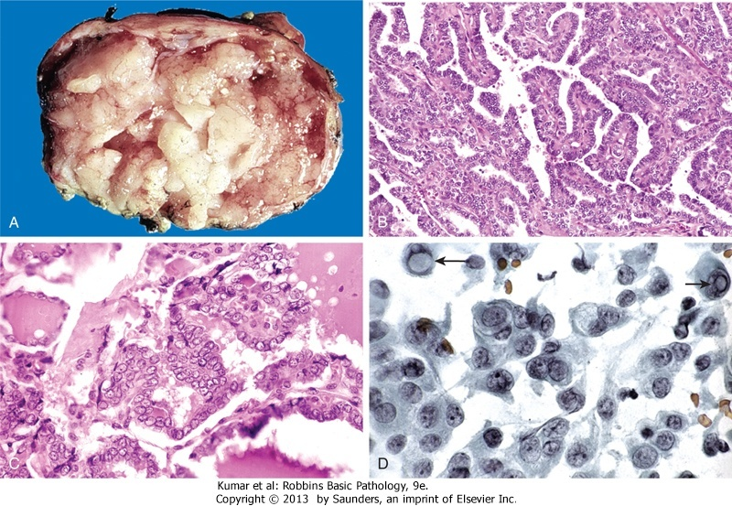
Papillary carcinoma
Well demarcated
-inclusions

Slide 38
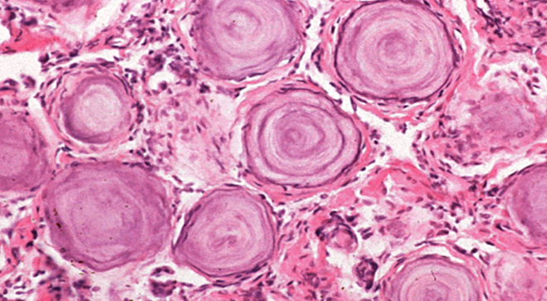
Psammoma bodies
Calcified and concentric tissue arrangements, can be found in other parts of the body in carcinomas

Slide 39
Clinical Features of papillary carcinomas
a. Are nonfunctional tumors (usually cold) manifest as painless masses in the neck, either within the thyroid or as metastasis in a cervical lymph node 50%
b. Are indolent lesions, with 10-year survival rates of 95%.
c. The presence of isolated cervical nodal metastases does not have influence on good prognosis of these lesions.
d. In a minority of patients, hematogenous metastases are present at the time of diagnosis, most commonly to lung.

Slide 40
Follicular Carcinoma :
-- More common in women and in areas with dietary iodine deficiency .
The peak incidence between the ages of 40 and 60 years
On microscopic examination,
- Are composed of fairly uniform cells forming small follicles,
- In other cases, follicular differentiation is less apparent
- It may be
a. widely invasive, infiltrating the thyroid parenchyma and extrathyroidal soft tissues, or
b. Minimally invasive that may be impossible to distinguish from follicular adenomas on gross examination and the .
requires extensive histologic sampling to exclude capsular and/or vascular invasion
Survival rate decreases with metastasis
Blood metastasis >> to bones and common places

Slide 41
Clinical Features
- Manifest most frequently as solitary cold thyroid nodules.
- Tend to metastasize through the bloodstream (hematogenous dissemination) to lungs, bone, and liver.
- Regional nodal metastases are uncommon .
- As many as half of patients with widely invasive carcinomas succumb to their disease within 10 years,
while less than 10% of patients with minimally invasive
follicular carcinomas die within the same time span.

Slide 42
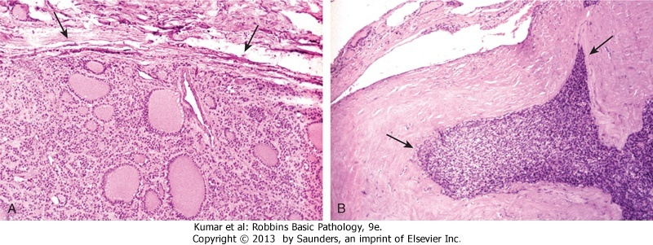
Follicular carcinoma
Capsular invasion

Slide 43
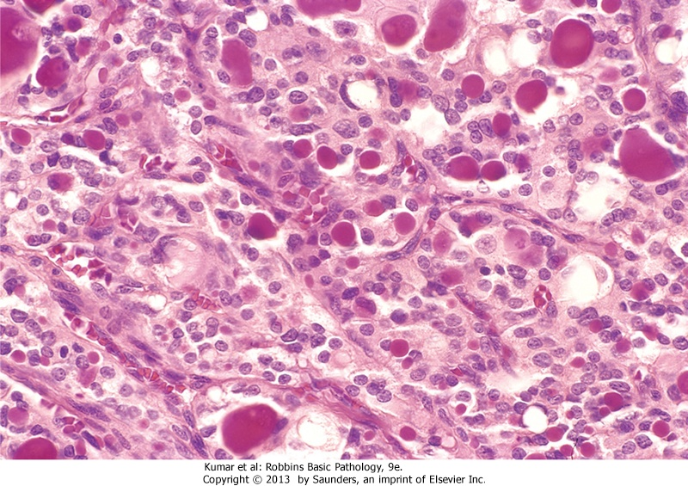

Slide 44
3. Anaplastic Carcinoma
- Are undifferentiated tumors of the thyroid epithelium,
- The mean age of 65 years.
- They are aggressive, with a mortality rate of 100%.
- Approximately a quarter of patients have a past history a well-differentiated carcinoma, and a 1/4th harbor a well-differentiated tumor in the resected specimen.
Metastases to distant sites are common, but death occurs in less than 1 year as a result of aggressive local growth which compromise of vital structures in the neck. (early metastasis)

Slide 45
4. Medullary Carcinoma (from c-cells)
- neuroendocrine neoplasms.
- Secrete calcitonin, the measurement of which plays an important role in the diagnosis and postoperative follow-up evaluation of patients.
- In some cases, the tumor cells elaborate somatostatin, serotonin, and vasoactive intestinal peptide (VIP)
Nodules are cold even if the tumor secrets calcitonin, hot and cold are terms used to describe whether iodine production is present or not.

Slide 46
- Are sporadic in about 70% of cases and the remaining 30% are familial cases
a. Occurring in the setting of MEN syndrome 2A or 2B,
or familial medullary thyroid carcinoma without an associated MEN syndrome
Note: Both familial and sporadic forms demonstrate activating RET mutations.

Slide 47
Cases associated with MEN-2A or MEN-2B show multicentric C cell hyperplasia in the surrounding thyroid parenchyma, a feature usually absent in sporadic lesions.
These foci are believed to represent the precursor lesions from which medullary carcinomas arise.

Slide 48
Clinical Features
- The sporadic cases manifests most often as a mass in the neck, sometimes associated with compression effects such as dysphagia or hoarseness.
- In some instances, the initial manifestations are caused by the secretion of a peptide hormone (e.g., diarrhea caused by the secretion of VIP).

Slide 49
- Screening of the patient's relatives for elevated calcitonin levels or RET mutations permits early detection of tumors in familial cases. Thyroidectomy to prevent cancer
All members of MEN-2 carrying RET mutations are offered prophylactic thyroidectomies to prevent the
development of medullary carcinomas
- Often, the only finding in the resected thyroid of these asymptomatic carriers is the presence of C cell
hyperplasia or small (<1 cm) micromedullary carcinomas.
Recent studies have shown that specific RET mutations correlate with an aggressive behavior in medullary carcinomas.
We monitor calcitonin level for diagnosis and follow-up

Slide 50
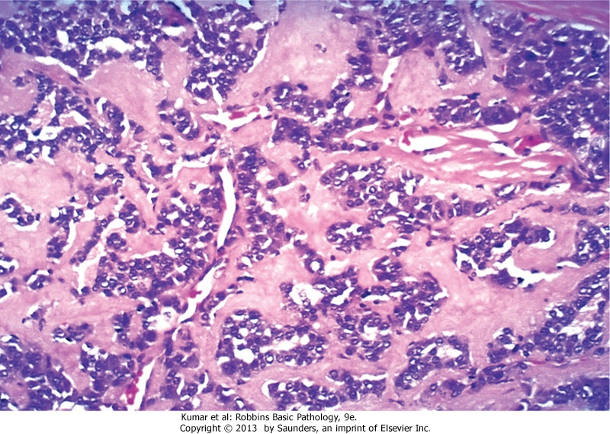
Medullary carcinoma
Amyloid released from calcitonin
All neuroendocrine tumors are small, round, blue cell tumors (blue due to eosinphilia)

