Slide 1
Kidney and Urinary Tract
TEXT read by the doctor is coloured RED
Extra notes are coloured maroon
Some pictures have extra information in the “notes” section so do not forget to read them
The doctor said she will mainly ask about what she reads, the skipped slides should be briefly read in order to fully understand the diseases

Slide 2
CLINICAL MANIFESTATIONS OF RENAL DISEASES
1-Azotemia
refers to an elevation of blood urea nitrogen(BUN) and creatinine levels
It is largely related to a decreased glomerular filtration rate (GFR).
Why do we use those markers for testing renal impairment function? Since they are waste products, and the only way to get rid of them is through the kidney, creatinine increases in a few cases which are mostly due to renal diseases. Creatinine is a waste product from muscles, and urea is from protein metabolism
2-uremia (same lab test results as azotemia)
when azotemia progresses to clinical manifestations and systemic biochemical abnormalities.
Uremia is characterized by: (including the lab tests) but differs by
1- failure of renal excretory function.
2- metabolic and endocrine alterations

Slide 3
Patients are subject to these: (from a case of uremia)
3- 2ry gastrointestinal manifestations (e.g., uremic gastroenteritis).
4- 2ry neuromuscular manifestations (e.g., peripheral neuropathy).
5- 2ry cardiovascular manifestations (e.g., uremic fibrinous pericarditis).

Slide 4
The major renal syndromes we have 7 renal syndromes we need to memorise
1-Acute nephritic syndrome (clinical picture)
Group of disorders leading to glomerular injury , glomerular syndrome characterized by:
1- acute onset .
2- gross hematuria.
3- mild to moderate proteinuria (< 3.5 gm of protein/day in adults) in children we use an equation per kg/body weight
4- azotemia.
5- edema.
6- hypertension.

Slide 5
2-Nephrotic syndrome
it is a glomerular syndrome characterized by: (also from glomerular injury)
1- heavy proteinuria (excretion of >3.5 gm of protein/day in adults) (nephrotic range proteinuria
2- hypoalbuminemia (losing albumin from blood, major plasma protein)
3- severe edema (reduction of colloid osmotic pressure)
4- hyperlipidemia (no protein carriers) –found by lipid profiling
5- lipiduria (lipid in the urine).

Slide 6
Difference between two previous syndromes:
Nephritic syndrome is more severe with a worse prognosis, as there is hypertension and azotemia (not seen in nephrotic!)
Level of injury in nephritic syndrome leads to inflammation which damages the glomerulus, resulting in a vicious circle of reduced GFR > activation of renin-angiotensin system > hypertension
In the nephrotic syndrome the injury is at the level of the podocytes, so the problem here is protein loss > edema, no hypertension
We need to differentiate between them since prognosis and outcome differ, also clinical manifestations differ of course. In nephrotic if we treat proteinuria we can preserve kidney function

Slide 7
3-Asymptomatic hematuria or proteinuria
is usually a manifestation of mild glomerular abnormalities. Incidental finding from urine analysis. Case significant even if mild hematuria or proteinuria, disease might progress if untreated
4-Rapidly progressive glomerulonephritis (not a single disease entity, will be discussed next lecture but doctor read common manifestations
It results in loss of renal function in a few days or weeks suddenly
It is manifested by :
1-microscopic hematuria.
2-dysmorphic red blood cells and red blood cell casts in the urine sediment.
3-mild-moderate proteinuria

Slide 8
5-Acute renal failure
is dominated by oliguria (poor urine output, less than 400ml for adults) or anuria (no urine flow).
recent onset of azotemia.
It can result from any acute failure if any of these fails to function
1-glomerular injury (such as crescentic glomerulonephritis).
2-interstitial injury.
3-vascular injury (such as thrombotic microangiopathy).
4-acute tubular necrosis.

Slide 9
6- Chronic renal failure
It is characterized by prolonged symptoms and signs of uremia. (prolonged = more than 6 weeks)
It is the end result of all chronic renal diseases .
7- Urinary tract infection (discussed later, dr skipped this)
It is characterized by bacteriuria and pyuria (bacteria and leukocytes in the urine).
The infection may be symptomatic or asymptomatic.
Types :
1- pyelonephritis (affection of the
kidney ).
2- cystitis (affection of the bladder).

Slide 10
8-Nephrolithiasis (discussed later, dr skipped this)
Renal stones (meaning of nephrolithiasis)
It is manifested by:
1-renal colic.
2-hematuria.
3-recurrent stone formation.

Slide 11
Glomerular diseases-1
concepts

Slide 12
GLOMERULAR DISEASES doctor jumped to histology picture in slide 15
chronic glomerulonephritis is one of the most common causes of chronic kidney disease in humans.
the glomerulus consists of an anastomosing network of capillaries invested by two layers of epithelium.
The visceral epithelium (podocytes) is an intrinsic part of the capillary wall.
the parietal epithelium lines Bowman space (urinary space), the cavity in which plasma ultrafiltrate first collects.
The glomerular capillary wall is the filtration unit and consists of :
1-A thin layer of fenestrated endothelial cells, each fenestra 70 to 100 nm in diameter.
2-A glomerular basement membrane (GBM).

Slide 13
The capillary basement membrane
consists of :
1- a thick electron-dense central layer (lamina densa)
2- thinner and electron-lucent peripheral layers ( lamina rara interna and lamina rara externa ).
The GBM consists of collagen (mostly type IV), laminin, polyanionic proteoglycans, fibronectin, and several other glycoproteins.
3-The visceral epithelial cells (podocytes), structurally complex cells that possess interdigitating processes embedded in and adherent to the lamina rara externa of the basement membrane.

Slide 14
Adjacent foot processes are separated by 20- to 30-nm-wide filtration slits which are bridged by a thin slit diaphragm composed in large part of nephrin.
4-Supportive cells (mesangial cells) lying between the capillaries.
Basement membrane-like mesangial matrix forms a meshwork through which the mesangial cells are scattered.

Slide 15
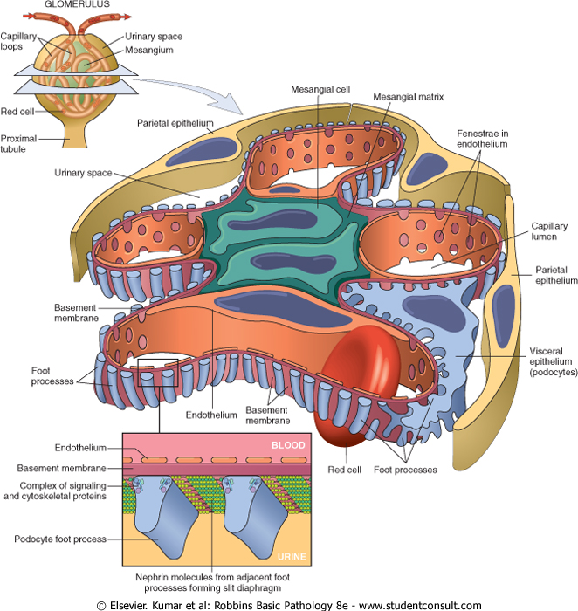
Notes:
Each glomerulus is made of an anastomosing network of capillaries that is enclosed by bowmans capsule, which has 2 layers of epithelia cells, parietal layer and visceral epithelia cells also known as podocytes
In each network we have a center composed of mesangial cells ( specialized stromal cells)
Capillary loops are lined from inside by endothelial cells (orange colour) and from outisde ( glomerular basement membrane and podocytes)
Those 3 make up the glomerular filtration membrane, it is the functional unit of the glomerulus and determines its permeability

Slide 16
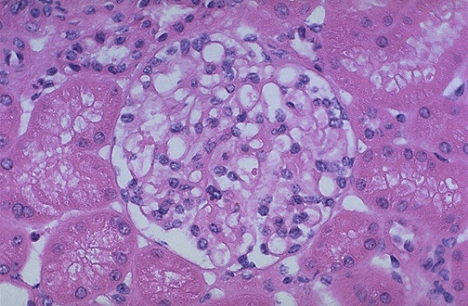
Normal glomerulus by LM.
The glomerular capillary loops are thin and delicate.
Endothelial and mesangial cells are normal in number. The surrounding tubules are normal.
Notes:
This is a large microscopic picture of the normal glomerulus center, normal capillary is patent, capillary basement membrane should be thin
Mesangial part should have normal cellularity ( up to 3 nuclei in each area, anything more > mesangial prolifeation / hypercelluarity )

Slide 17
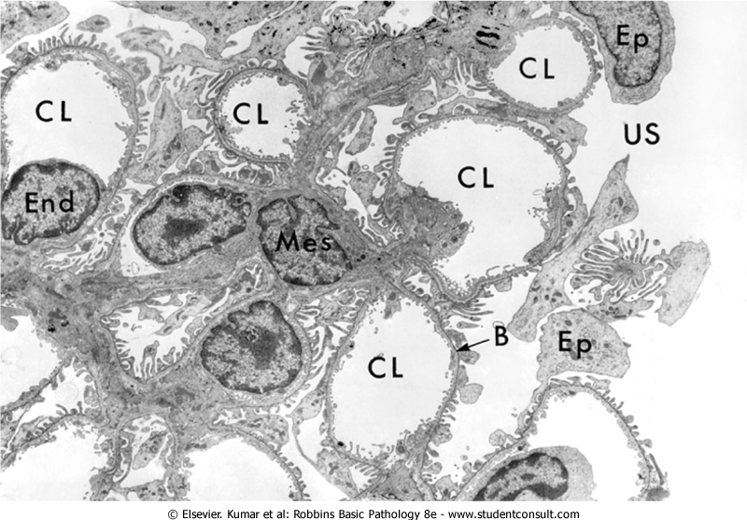
EM-GLOMERULUS
CL-capillary lumen, End-endothelium, US-urinary space, B-basement membrane, Ep-epithelial cell, Mes-mesangial cell, Fp-foot process.
Fp
Notes:
This was taken by an electron microscope, we can tell since it is detailed and the colour (grey-scale)
Notice the podocytes (with projections the dr likes to call eye-lashes, foot processes)

Slide 18
The major characteristics of glomerular filtration
1- an extraordinarily high permeability to water and small solutes (selective permeability)
2- an almost complete impermeability to molecules of the size and molecular charge of albumin (size: 3.6 nm radius; 70,000 kD).
The selective permeability discriminates among protein molecules depending on:
1- their size (the larger the less permeable),
2- their charge (the more cationic the more
permeable).
3-their configuration.
Nephrin and its associated proteins, including podocin, have a crucial role in maintaining the selective permeability of the glomerular filtration barrier.
anionic or large molecules should not be filtered

Slide 19
Pathogenesis of Glomerular Diseases (immune related usually from an antibody assocaited disease ) ~
Antibody-associated
(1) injury resulting from deposition of soluble circulating Ag-Ab complexes in the glomerulus.
(2) injury by Abs reacting in situ within the glomerulus.
)3) Abs directed against glomerular cell components.
1-Nephritis Caused by Circulating Immune Complexes
The antigen is not of glomerular origin.
1- endogenous as in the GN associated with SLE.
2- exogenous as in the GN that follows certain bacterial (streptococcal), viral (hepatitis B), parasitic (Plasmodium falciparum malaria), and spirochetal (Treponema pallidum) infections

Slide 20
antigen-antibody complexes are formed in situ or in the circulation and are then trapped in the glomeruli → activation of complement and the recruitment of leukocytes → injury.
the glomerular lesions usually consist of leukocytic infiltration (exudation) into glomeruli and variable proliferation of endothelial, mesangial, and parietal epithelial cells.
Electron microscopy reveals the immune complexes as electron-dense deposits or clumps that lie at one of three sites: location is important and can be seen in IF too
1-in the mesangium.
2-between the endothelial cells and the GBM
(subendothelial deposits).
3-between the outer surface of the GBM and
the podocytes (subepithelial deposits).

Slide 21
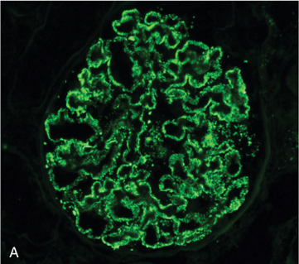
IF-Granular deposition of immune complexes characteristic of circulating and in situ immune complex deposition
Deposits may be located at more than one site.
The presence of Igs and complement in these deposits can be demonstrated by immunofluorescence microscopy.
The pattern of immune complex deposition is helpful in distinguishing various types of GN

Slide 22
2-Nephritis Caused by In Situ Immune Complexes
antibodies in this form of injury react directly with fixed or planted antigens in the glomerulus.
Planted antigens include:
1- DNA.
2- bacterial products
3-large aggregated proteins (e.g., aggregated IgG), which deposit in the mesangium because of their size
4- immune complexes themselves because they continue to have reactive sites for further interactions with free antibody, free antigen, or complement.

Slide 23
3-Anti-Glomerular Basement Membrane (GBM) Antibody Glomerulonephritis
Classic anti-GBM antibody GN (less than 1% of human GN cases).
Abs are directed against fixed antigens in the GBM.
Deposition of these antibodies creates a linear pattern of staining when the bound antibodies are visualized with IF microscopy.
Autoimmune disease results from autoABs against collagen in basement membrane, deposition on IF would be very characteristic feature of disease
Notes:
IF = immunoflorescence

Slide 24
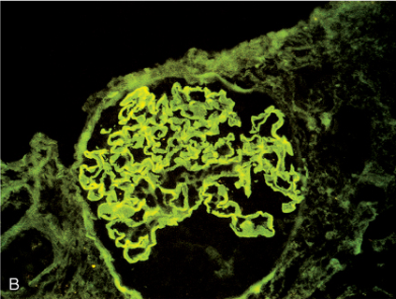
immunofluorescence linear deposition of immune complexes

Slide 25
Glomerular diseases-1
Diseases leading to nephrotic syndrome

Slide 26
The Nephrotic Syndrome
Going back to our nephrotic syndromes, we should not memorize numbers in the upcoming table but we should know which disease is most prevalent for its age group
The nephrotic syndrome refers to a clinical complex that includes the following:
(1) massive proteinuria with daily protein loss in the urine of 3.5 gm or more in adults.
(2) hypoalbuminemia with plasma albumin levels less than 3 gm/dL.
(3) generalized edema
(4) hyperlipidemia and lipiduria.
(5) little or no azotemia, hematuria, or hypertension.

Slide 27
Causes of Nephrotic Syndrome
A-primary glomerular diseases
Prevalence (%) Adults | Prevalence (%) Children | Cause
 |  | Primary Glomerular Disease
30 | 5 | Membranous GN
10 rare for adults | 65 | Minimal-change disease
35 | 10 | Focal segmental glomerulosclerosis
10 | 10 | Membranoproliferative GN
15 | 10 | IgA nephropathy

Slide 28
B-Systemic Diseases with Renal Manifestations: (secondary)
Diabetes mellitus: most important
Amyloidosis
Systemic lupus erythematosus (autoimmune)
drugs (gold, penicillamine, "street heroin")
Infections (malaria, syphilis, hepatitis B, HIV)
Malignancy (carcinoma, melanoma)
Miscellaneous (e.g bee-sting allergy)

Slide 29
Minimal-Change Disease (Lipoid Nephrosis(
This relatively benign disorder. (good prognosis)
The most frequent cause of the nephrotic syndrome in children (ages 1-7 years).
It is characterized by glomeruli that have a normal appearance by LM but show diffuse effacement of podocytes by the EM. (named from this) negative IF
Pathogenesis: still not clear.
Based on some experimental studies, the proteinuria has been attributed to a T-cell derived factor that causes podocyte damage and effacement of foot processes.
neither the nature of such a putative factor nor a causal role of T cells is established in the human disease.
those hypothesis emerged since we treated those patients with immunosuppressants especially corticosteriods and they worked

Slide 30
Morphology
LM
the glomeruli in minimal change disease appear normal. IF negative
The cells of the proximal convoluted tubules are often heavily laden with protein droplets and lipids but this is secondary to tubular reabsorption of the lipoproteins passing through the diseased glomeruli (lipoid nephrosis).
EM diagnostic
the GBM appears normal.
The only obvious glomerular abnormality is the uniform and diffuse effacement of the foot processes of the podocytes .
The cytoplasm of the podocytes thus appears flattened over the external aspect of the GBM obliterating the network of arcades between the podocytes and the GBM.
There are also epithelial cell vacuolization microvillus formation and occasional focal detachments

Slide 31
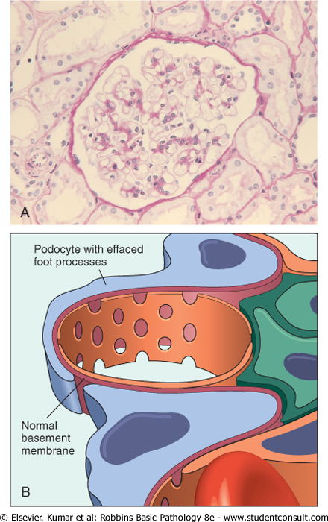
Minimal change disease. A Under the light microscope the PAS-stained glomerulus appears normal, with a delicate basement membrane B Schematic diagram illustrating diffuse effacement of foot processes of podocytes with no immune deposits.

Slide 32
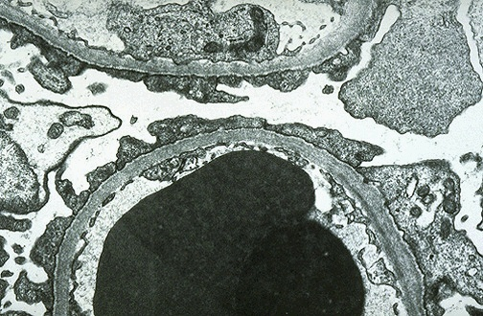
MCD-EM the capillary loop in the lower half contains two electron dense RBC's. Fenestrated endothelium is present and the BM is normal.
The overlying epithelial cell foot processes are fused (arrows).
Notes:
Can’t see foot processes anymore (effacement)
No actual damage to cells

Slide 33
Clinical Course
insidious development of the nephrotic syndrome in an otherwise healthy child. Mostly complains from generalized edema
There is no hypertension. No azemtia
renal function is preserved in most individuals.
selective proteinuria (the protein loss is usually confined to albumin )
The prognosis is good.
When the changes in the podocytes reverse (e.g., in response to corticosteroids) the proteinuria remits
More than 90% of cases respond to a short course of corticosteroid therapy.
proteinuria recurs in more than 2/3 of the initial responders some of whom become steroid dependent
< 5% develop chronic renal failure after 25 years and it is likely that most persons in this subgroup had nephrotic syndrome caused by FSGS not detected by biopsy.
Adults with minimal change disease also respond to steroid therapy but the response is slower and relapses are more common.

Slide 34
Focal and Segmental Glomerulosclerosis
Most common nephrotic syndrome in adults
characterized histologically by sclerosis (scar formation) affecting some but not all glomeruli (focal involvement) and involving only segments of each affected glomerulus.
This histologic picture is often associated with the nephrotic syndrome.
It can occur :
(1)in association with other known conditions as AIDS or heroin abuse (HIV or heroin nephropathy).
(2) as a secondary event in other forms of GN (e.g IgA nephropathy).

Slide 35
(3) as a maladaptation after nephron loss.
(4) in inherited or congenital forms resulting from mutations affecting cytoskeletal or related proteins expressed in podocytes (e.g., nephrin).
(5) as a primary disease( 20% to 30% of all cases of the nephrotic syndrome) .
At least 50% of individuals with FSGS develop end-stage renal failure within 10 years of diagnosis.
Adults do worse than children

Slide 36
IMPORTANT to differentiate between two diseases
FSGS | MCD
+ | - | hematuria
+ | - | hypertension
nonselective | selective | proteinuria
poor | good | response to corticosteroid therapy

Slide 37
Pathogenesis
unknown .
injury to the podocytes is thought to represent the initiating event of primary FSGS.
permeability-increasing factors produced by lymphocytes.
The deposition of hyaline masses in the glomeruli represents the entrapment of plasma proteins and lipids in foci of injury where sclerosis develops.
IgM and complement proteins commonly seen in the lesion are also believed to result from nonspecific entrapment in damaged glomeruli.
The recurrence of proteinuria after renal allografts transplantation sometimes within 24 hours of transplantation supports the idea that a circulating mediator is the cause of the damage to podocytes .
Can be primary or secondary disease, patients present clincally with nephrotic syndrome

Slide 38
Morphology
The disease is "focal" and initially affects only the juxtamedullary glomeruli.
With progression eventually all levels of the cortex are affected.
LM-FSGS is characterized by lesions occurring in some tufts within a glomerulus and sparing of the others ( "segmental").
The affected glomeruli exhibit increased mesangial matrix, obliterated capillary lumens, and deposition of hyaline masses (hyalinosis) and lipid droplets.
progression of the disease leads to global sclerosis of the glomeruli (global sclerosis) with pronounced tubular atrophy and interstitial fibrosis

Slide 39
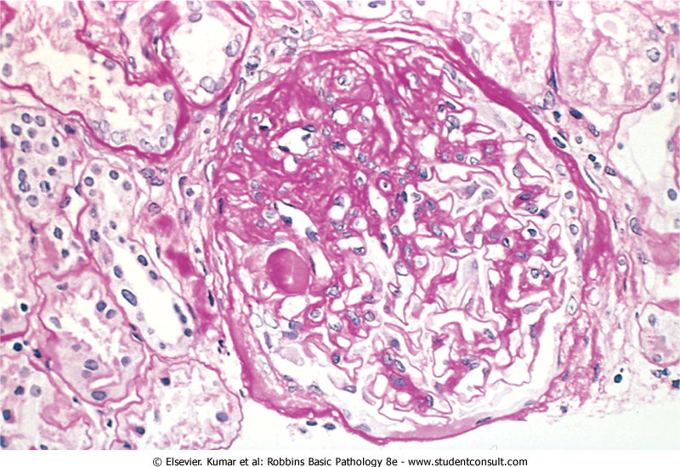
focal and segmental glomerulosclerosis (PAS stain). a mass of scarred, obliterated capillary lumens with accumulations of matrix material
Notes:
Collagen and fibrous tissue stained purple
Look for scar

Slide 40
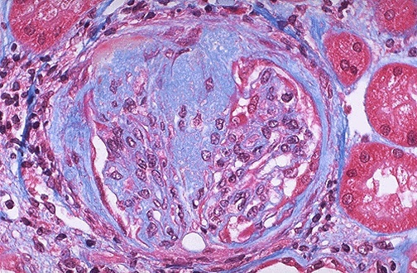
FSGS blue collagen deposition (MT stain).
Notes:
Blue part is the scar

Slide 41
IF microscopy
Negative. Sometimes non-specific trapping of Igs usually IgM, and complement in the areas of hyalinosis.
EM
the podocytes exhibit effacement of foot processes as in MCD.
Clinical Course (different from MCD and worse )
Poor responses to corticosteroid therapy.
about 50% of individuals suffer renal failure after 10 years.

