Slide 1
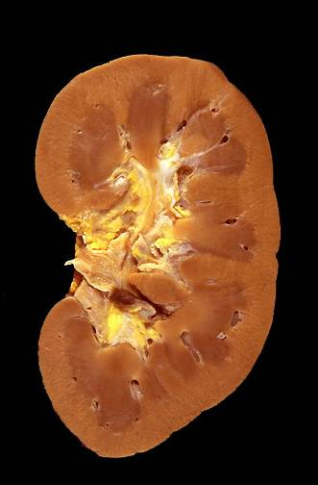
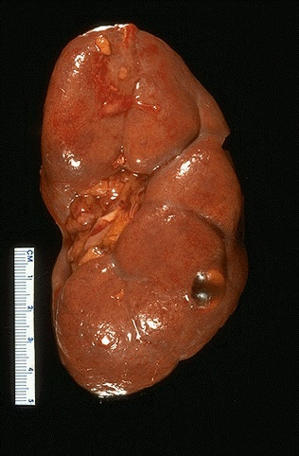
Kidney & Urinary tract

Slide 2
CLINICAL MANIFESTATIONS OF RENAL DISEASES
1-Azotemia
refers to an elevation of blood urea nitrogen(BUN) and creatinine levels
It is largely related to a decreased glomerular filtration rate (GFR).
2-uremia
when azotemia progresses to clinical manifestations and systemic biochemical abnormalities.
Uremia is characterized by:
1- failure of renal excretory function.
2- metabolic and endocrine alterations

Slide 3
3- 2ry gastrointestinal manifestations (e.g., uremic gastroenteritis).
4- 2ry neuromuscular manifestations (e.g., peripheral neuropathy).
5- 2ry cardiovascular manifestations (e.g., uremic fibrinous pericarditis).

Slide 4
The major renal syndromes
1-Acute nephritic syndrome:
it is a glomerular syndrome characterized by:
1- acute onset .
2- gross hematuria.
3- mild to moderate proteinuria (< 3.5 gm of protein/day in adults)
4- azotemia.
5- edema.
6- hypertension.

Slide 5
2-Nephrotic syndrome
it is a glomerular syndrome characterized by:
1- heavy proteinuria (excretion of >3.5 gm of protein/day in adults)
2- hypoalbuminemia
3- severe edema
4- hyperlipidemia
5- lipiduria (lipid in the urine).

Slide 6
3-Asymptomatic hematuria or proteinuria
is usually a manifestation of mild glomerular abnormalities.
4-Rapidly progressive glomerulonephritis
It results in loss of renal function in a few days or weeks
It is manifested by :
1-microscopic hematuria.
2-dysmorphic red blood cells and red blood cell casts in the urine sediment.
3-mild-moderate proteinuria

Slide 7
5-Acute renal failure
is dominated by oliguria or anuria (no urine flow).
recent onset of azotemia.
It can result from :
1-glomerular injury (such as crescentic glomerulonephritis).
2-interstitial injury.
3-vascular injury (such as thrombotic microangiopathy).
4-acute tubular necrosis.

Slide 8
6- Chronic renal failure
It is characterized by prolonged symptoms and signs of uremia.
It is the end result of all chronic renal diseases .
7- Urinary tract infection
It is characterized by bacteriuria and pyuria (bacteria and leukocytes in the urine).
The infection may be symptomatic or asymptomatic.
Types :
1- pyelonephritis (affection of the
kidney ).
2- cystitis (affection of the bladder).

Slide 9
8-Nephrolithiasis
Renal stones.
It is manifested by:
1-renal colic.
2-hematuria.
3-recurrent stone formation.

Slide 10
Glomerular diseases-1
concepts

Slide 11
GLOMERULAR DISEASES
chronic glomerulonephritis is one of the most common causes of chronic kidney disease in humans.
the glomerulus consists of an anastomosing network of capillaries invested by two layers of epithelium.
The visceral epithelium (podocytes) is an intrinsic part of the capillary wall.
the parietal epithelium lines Bowman space (urinary space), the cavity in which plasma ultrafiltrate first collects.
The glomerular capillary wall is the filtration unit and consists of :
1-A thin layer of fenestrated endothelial cells, each fenestra 70 to 100 nm in diameter.
2-A glomerular basement membrane (GBM).

Slide 12
The capillary basement membrane
consists of :
1- a thick electron-dense central layer (lamina densa)
2- thinner and electron-lucent peripheral layers ( lamina rara interna and lamina rara externa ).
The GBM consists of collagen (mostly type IV), laminin, polyanionic proteoglycans, fibronectin, and several other glycoproteins.
3-The visceral epithelial cells (podocytes), structurally complex cells that possess interdigitating processes embedded in and adherent to the lamina rara externa of the basement membrane.

Slide 13
Adjacent foot processes are separated by 20- to 30-nm-wide filtration slits which are bridged by a thin slit diaphragm composed in large part of nephrin.
4-Supportive cells (mesangial cells) lying between the capillaries.
Basement membrane-like mesangial matrix forms a meshwork through which the mesangial cells are scattered.

Slide 14
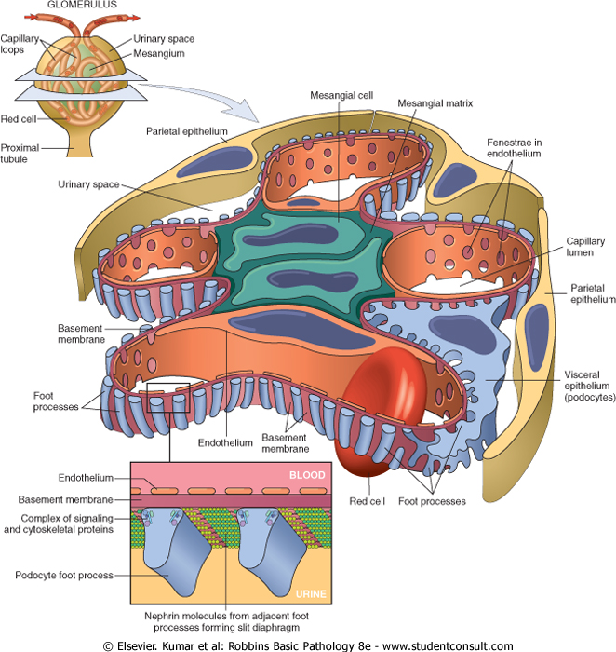

Slide 15
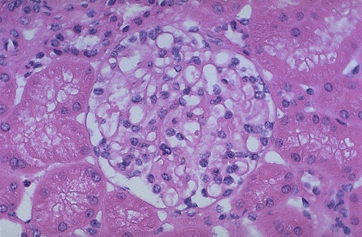
Normal glomerulus by LM.
The glomerular capillary loops are thin and delicate.
Endothelial and mesangial cells are normal in number. The surrounding tubules are normal.

Slide 16
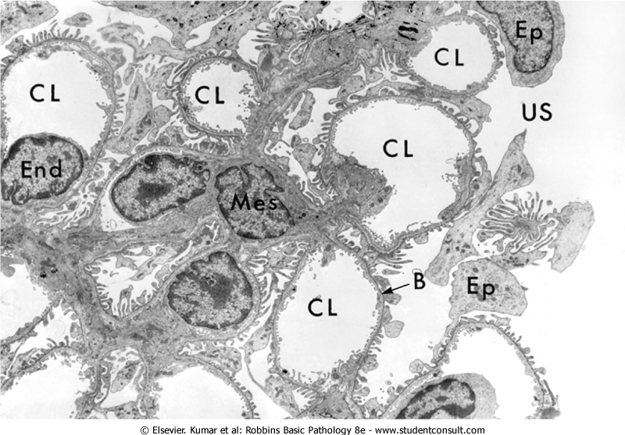
EM-GLOMERULUS
CL-capillary lumen, End-endothelium, US-urinary space, B-basement membrane, Ep-epithelial cell, Mes-mesangial cell, Fp-foot process.
Fp

Slide 17
The major characteristics of glomerular filtration
1- an extraordinarily high permeability to water and small solutes
2- an almost complete impermeability to molecules of the size and molecular charge of albumin (size: 3.6 nm radius; 70,000 kD).
The selective permeability discriminates among protein molecules depending on:
1- their size (the larger the less permeable),
2- their charge (the more cationic the more
permeable).
3-their configuration.
Nephrin and its associated proteins, including podocin, have a crucial role in maintaining the selective permeability of the glomerular filtration barrier.

Slide 18
Pathogenesis of Glomerular Diseases
Antibody-associated
(1) injury resulting from deposition of soluble circulating Ag-Ab complexes in the glomerulus.
(2) injury by Abs reacting in situ within the glomerulus.
)3) Abs directed against glomerular cell components.
1-Nephritis Caused by Circulating Immune Complexes
The antigen is not of glomerular origin.
1- endogenous as in the GN associated with SLE.
2- exogenous as in the GN that follows certain bacterial (streptococcal), viral (hepatitis B), parasitic (Plasmodium falciparum malaria), and spirochetal (Treponema pallidum) infections

Slide 19
antigen-antibody complexes are formed in situ or in the circulation and are then trapped in the glomeruli → activation of complement and the recruitment of leukocytes → injury.
the glomerular lesions usually consist of leukocytic infiltration (exudation) into glomeruli and variable proliferation of endothelial, mesangial, and parietal epithelial cells.
Electron microscopy reveals the immune complexes as electron-dense deposits or clumps that lie at one of three sites:
1-in the mesangium.
2-between the endothelial cells and the GBM
(subendothelial deposits).
3-between the outer surface of the GBM and
the podocytes (subepithelial deposits).

Slide 20
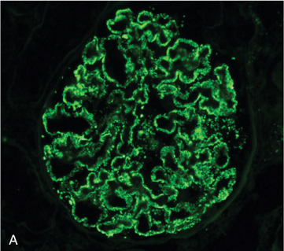
IF-Granular deposition of immune complexes characteristic of circulating and in situ immune complex deposition
Deposits may be located at more than one site.
The presence of Igs and complement in these deposits can be demonstrated by immunofluorescence microscopy.
The pattern of immune complex deposition is helpful in distinguishing various types of GN

Slide 21
2-Nephritis Caused by In Situ Immune Complexes
antibodies in this form of injury react directly with fixed or planted antigens in the glomerulus.
Planted antigens include:
1- DNA.
2- bacterial products
3-large aggregated proteins (e.g., aggregated IgG), which deposit in the mesangium because of their size
4- immune complexes themselves because they continue to have reactive sites for further interactions with free antibody, free antigen, or complement.

Slide 22
3-Anti-Glomerular Basement Membrane (GBM) Antibody Glomerulonephritis
Classic anti-GBM antibody GN (less than 1% of human GN cases).
Abs are directed against fixed antigens in the GBM.
Deposition of these antibodies creates a linear pattern of staining when the bound antibodies are visualized with IF microscopy.

Slide 23
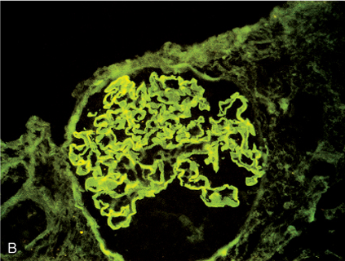
immunofluorescence linear deposition of immune complexes

Slide 24
Glomerular diseases-1
Diseases leading to nephrotic syndrome

Slide 25
The Nephrotic Syndrome
The nephrotic syndrome refers to a clinical complex that includes the following:
(1) massive proteinuria with daily protein loss in the urine of 3.5 gm or more in adults.
(2) hypoalbuminemia with plasma albumin levels less than 3 gm/dL.
(3) generalized edema
(4) hyperlipidemia and lipiduria.
(5) little or no azotemia, hematuria, or hypertension.

Slide 26
Causes of Nephrotic Syndrome
A-primary glomerular diseases
Prevalence (%) Adults | Prevalence (%) Children | Cause
 |  | Primary Glomerular Disease
30 | 5 | Membranous GN
10 | 65 | Minimal-change disease
35 | 10 | Focal segmental glomerulosclerosis
10 | 10 | Membranoproliferative GN
15 | 10 | IgA nephropathy

Slide 27
B-Systemic Diseases with Renal Manifestations:
Diabetes mellitus:
Amyloidosis
Systemic lupus erythematosus
drugs (gold, penicillamine, "street heroin")
Infections (malaria, syphilis, hepatitis B, HIV)
Malignancy (carcinoma, melanoma)
Miscellaneous (e.g bee-sting allergy)

Slide 28
Minimal-Change Disease (Lipoid Nephrosis(
This relatively benign disorder.
The most frequent cause of the nephrotic syndrome in children (ages 1-7 years).
It is characterized by glomeruli that have a normal appearance by LM but show diffuse effacement of podocytes by the EM.
Pathogenesis: still not clear.
Based on some experimental studies, the proteinuria has been attributed to a T-cell derived factor that causes podocyte damage and effacement of foot processes.
neither the nature of such a putative factor nor a causal role of T cells is established in the human disease.

Slide 29
Morphology
LM
the glomeruli in minimal change disease appear normal.
The cells of the proximal convoluted tubules are often heavily laden with protein droplets and lipids but this is secondary to tubular reabsorption of the lipoproteins passing through the diseased glomeruli (lipoid nephrosis).
EM
the GBM appears normal.
The only obvious glomerular abnormality is the uniform and diffuse effacement of the foot processes of the podocytes .
The cytoplasm of the podocytes thus appears flattened over the external aspect of the GBM obliterating the network of arcades between the podocytes and the GBM.
There are also epithelial cell vacuolization microvillus formation and occasional focal detachments

Slide 30
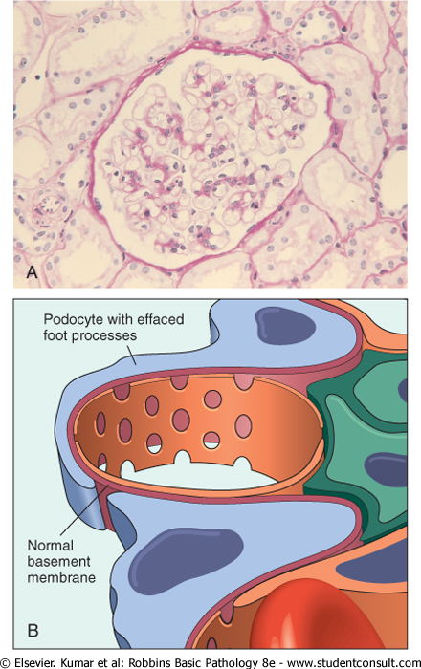
Minimal change disease. A Under the light microscope the PAS-stained glomerulus appears normal, with a delicate basement membrane B Schematic diagram illustrating diffuse effacement of foot processes of podocytes with no immune deposits.

Slide 31
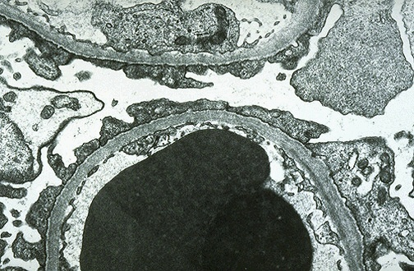
MCD-EM the capillary loop in the lower half contains two electron dense RBC's. Fenestrated endothelium is present and the BM is normal.
The overlying epithelial cell foot processes are fused (arrows).

Slide 32
Clinical Course
insidious development of the nephrotic syndrome in an otherwise healthy child.
There is no hypertension.
renal function is preserved in most individuals.
selective proteinuria (the protein loss is usually confined to albumin )
The prognosis is good.
When the changes in the podocytes reverse (e.g., in response to corticosteroids) the proteinuria remits
More than 90% of cases respond to a short course of corticosteroid therapy.
proteinuria recurs in more than 2/3 of the initial responders some of whom become steroid dependent
< 5% develop chronic renal failure after 25 years and it is likely that most persons in this subgroup had nephrotic syndrome caused by FSGS not detected by biopsy.
Adults with minimal change disease also respond to steroid therapy but the response is slower and relapses are more common.

Slide 34
Focal and Segmental Glomerulosclerosis
characterized histologically by sclerosis affecting some but not all glomeruli (focal involvement) and involving only segments of each affected glomerulus.
This histologic picture is often associated with the nephrotic syndrome.
It can occur :
(1)in association with other known conditions as AIDS or heroin abuse (HIV or heroin nephropathy).
(2) as a secondary event in other forms of GN (e.g IgA nephropathy).

Slide 35
(3) as a maladaptation after nephron loss.
(4) in inherited or congenital forms resulting from mutations affecting cytoskeletal or related proteins expressed in podocytes (e.g., nephrin).
(5) as a primary disease( 20% to 30% of all cases of the nephrotic syndrome) .
At least 50% of individuals with FSGS develop end-stage renal failure within 10 years of diagnosis.
Adults do worse than children

Slide 36
FSGS | MCD
+ | - | hematuria
+ | - | hypertension
nonselective | selective | proteinuria
poor | good | response to corticosteroid therapy

Slide 37
Pathogenesis
unknown .
injury to the podocytes is thought to represent the initiating event of primary FSGS.
permeability-increasing factors produced by lymphocytes.
The deposition of hyaline masses in the glomeruli represents the entrapment of plasma proteins and lipids in foci of injury where sclerosis develops.
IgM and complement proteins commonly seen in the lesion are also believed to result from nonspecific entrapment in damaged glomeruli.
The recurrence of proteinuria after renal allografts transplantation sometimes within 24 hours of transplantation supports the idea that a circulating mediator is the cause of the damage to podocytes .

Slide 38
Morphology
The disease is "focal" and initially affects only the juxtamedullary glomeruli.
With progression eventually all levels of the cortex are affected.
LM-FSGS is characterized by lesions occurring in some tufts within a glomerulus and sparing of the others ( "segmental").
The affected glomeruli exhibit increased mesangial matrix, obliterated capillary lumens, and deposition of hyaline masses (hyalinosis) and lipid droplets.
progression of the disease leads to global sclerosis of the glomeruli (global sclerosis) with pronounced tubular atrophy and interstitial fibrosis

Slide 39
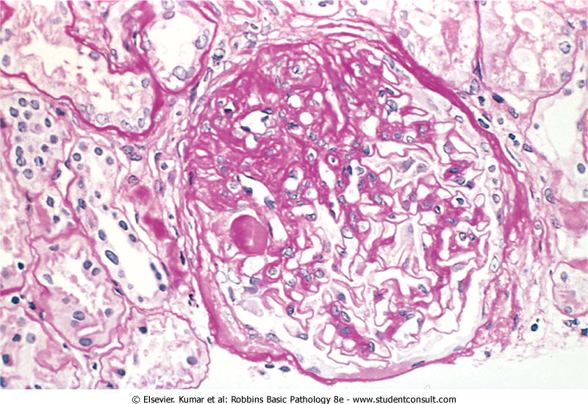
focal and segmental glomerulosclerosis (PAS stain). a mass of scarred, obliterated capillary lumens with accumulations of matrix material

Slide 40
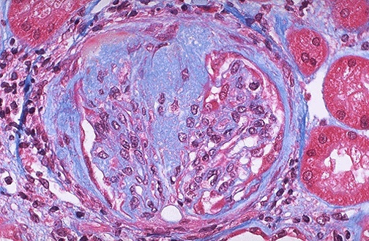
FSGS blue collagen deposition (MT stain).

Slide 41
IF microscopy
Negative. Sometimes non-specific trapping of Igs usually IgM, and complement in the areas of hyalinosis.
EM
the podocytes exhibit effacement of foot processes as in MCD.
Clinical Course
Poor responses to corticosteroid therapy.
about 50% of individuals suffer renal failure after 10 years.

Slide 42
Collapsing glomerulopathy
It is a morphologic variant of FSGS.
It carries a particularly poor prognosis.
It is characterized by collapse of the entire glomerular tuft and podocyte hyperplasia.
It may be :
1-idiopathic .
2-associated with HIV infection.
3-drug-induced toxicities.

Slide 44
Membranous Glomerulonephritis ( MGN)
It is slowly progressive disease.
most common between 30 -50 years of age.
It is characterized morphologically by the presence of subepithelial Ig-containing deposits along the GBM.
Membranous glomerulonephritis :
1-Idiopathic (85% of cases).
2-Secondary

Slide 45
secondary to other disorders including:
(1) infections (HBV, syphilis,schistosomiasis,
malaria).
(2) malignant tumors (carcinoma of the lung
and colon and melanoma).
(3) autoimmune diseases as SLE .
(4) exposure to inorganic salts (gold,
mercury).
(5) drugs (penicillamine, captopril,NSAID).

Slide 46
Pathogenesis
Membranous GN is a form of chronic immune complex nephritis.
circulating complexes of
1- exogenous (e.g., hepatitis B virus) .
2- endogenous (DNA in SLE) antigen .
Morphology
LM
the basic change appears to be diffuse thickening of the GBM .

Slide 47
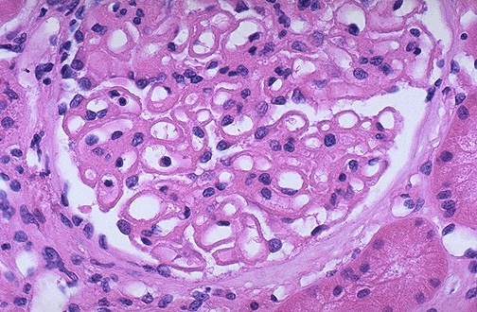
LM- membranous glomerulonephritis in which the capillary loops are thickened and prominent, but the cellularity is not increased

Slide 48
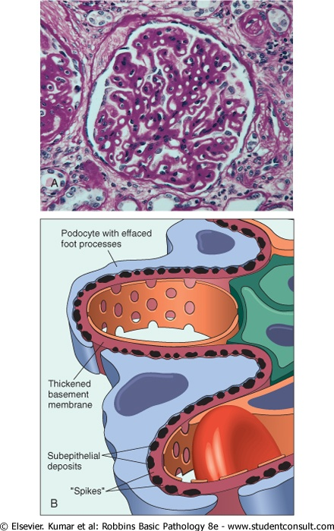
Membranous nephropathy.
A, Diffuse thickening of the glomerular basement membrane.
B, Schematic diagram illustrating subepithelial deposits, effacement of foot processes, and the presence of "spikes" of basement membrane material between the immune deposits.

Slide 49
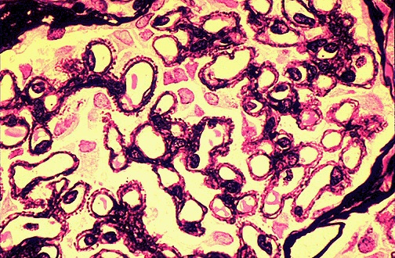
A silver stain of the glomerulus highlights the proteinaceous basement membranes in black. There are characteristic "spikes" seen with membranous glomerulonephritis seen here in which the black basement membrane material appears as projections around the capillary loops.

Slide 50
IF
diffuse granular deposits of immunoglobulins and complement along the GBM .
mainly IgG and complement.
EM
subepithelial deposits → thickening of the GBM and are separated from each other by small, spikelike protrusions of GBM matrix that form in reaction to the deposits ("spike and dome" pattern).
As the disease progresses, these spikes close over the deposits, incorporating them into the GBM.
the podocytes show effacement of foot processes.

Slide 51
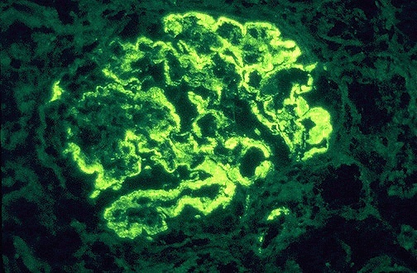
Membranous GN
IF-deposits of mainly IgG and complement collect in the basement membrane and appear in a diffuse granular pattern

Slide 52
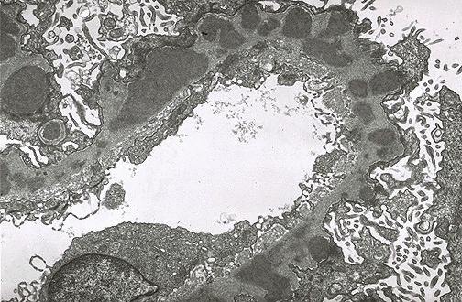
EM-the darker electron dense immune deposits are seen scattered within the thickened basement membrane.

Slide 53
Clinical Course
insidious development of the nephrotic syndrome, usually without antecedent illness.
some individuals with membranous nephropathy may have lesser degrees of proteinuria rather than the full-blown nephrotic syndrome.
the proteinuria is nonselective.
no response to corticosteroid therapy.
Membranous nephropathy follows a variable and often indolent course.
Overall proteinuria persists in over 60% of cases.
~ 40% suffer progressive disease terminating in renal failure after 2 to 20 years.
10%-30% have a more benign course with partial or complete remission of proteinuria.

