Slide 1
Bcl-2 family
There are three classes of Bcl-2 according to their domains and apoptotic effect:
Anti-apoptotic proteins contain four specific domains
Proapoptotic proteins:
Multi-domain
BH3-only domain

Slide 2
How is apoptosis activated upstream?
Normally, BH3-only protein is inactive and the multi-domain proapoptotic protein is inactivated by the anti-apoptotic protein.
Death signals inactivate the anti-apoptotic protein and release the multi-domain proapoptotic protein.

Slide 3
How is cytochrome c released form mitochondria?
Proapoptotic multidomain
Apoptosome
Oligomeric pore

Slide 4
Internal pathway
Stimulation of p53 phosphorylation by ATM/Chk2 signaling results in induced expression of BH3-only proteins.

Slide 5
External signaling (1): pro-survival
Activation of Pi-3 Kinase/AKT signaling inhibits proapoptotic proteins (cell survival)
Absence of signaling results in activation of proapoptotic proteins

Slide 6
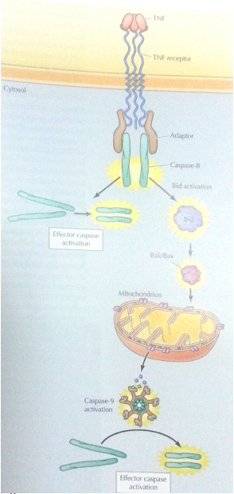
External signaling (2): pro-death
multidomain protein
BH3-only protein

Slide 7
Autophagy
Apoptosis can be caspase-independent, but mediated by autophagy through mTOR signaling.
The dying cell does not go through the same morphological features, but accumulate lysosomes.
Advantages:
When cells lack molecular machinery of apoptosis
It provides cells with an opportunity to repair the damage prior to death

Slide 8
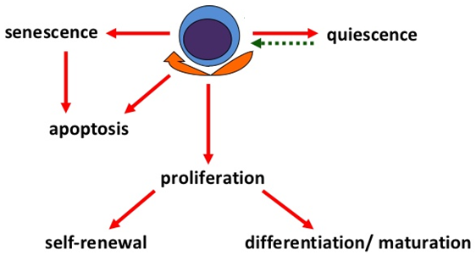
Cell fate
Damaged
cells
Fibroblasts
Endothelial cells
Smooth muscle cells
Epithelial cells
Stem cells

