Slide 1
Parathyroid gland
Dr Heyam Awad
FRCPath

Slide 2
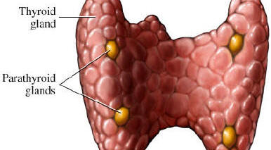
Parathyroid gland

Slide 3
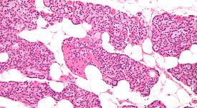
Parathyroid gland

Slide 4
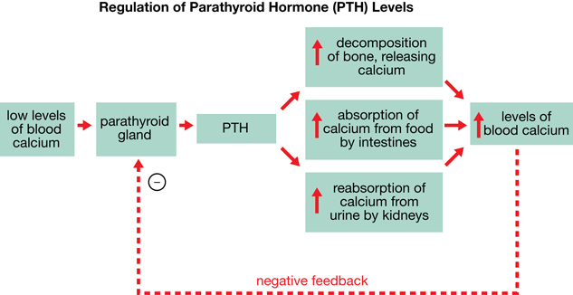
PTH

Slide 5
Diseases of the parathyroid
Hyperparathyroidism
Hypoparathyroidism
Mass lesions

Slide 6
HYPERPARATHYROIDISM :
Primary
b. Secondary
c. tertiary hyperparathyroidism.

Slide 7
Primary Hyperparathyroidism
- Is a common disorder and important cause of hypercalcemia
- Increased detection of cases as a result routine inclusion of serum calcium assays in testing for a variety of clinical conditions

Slide 8
Causes of primary hyperparathyrpoidism:
Parathyroid adenoma (85% to 95%)
2. Primary parathyroid hyperplasia-5% to 10%.
3. Parathyroid carcinoma-(1%)
Majority: sporodic but some familial cases associated with MEN syndromes.

Slide 9
Parathyroid adenoma:
-Most parathyroid adenomas weigh between 0.5 and 5 g.
Encapsulated, soft, solitary.
- A rim of compressed, non-neoplastic tissue, separated by a fibrous capsule, is visible at the edge of the adenoma.
- Cells with pleomorphic nuclei may be seen (endocrine atypia) and must not be taken as a sign of malignancy.
- Mitotic figures are rare with inconspicuous adipose tissue

Slide 10
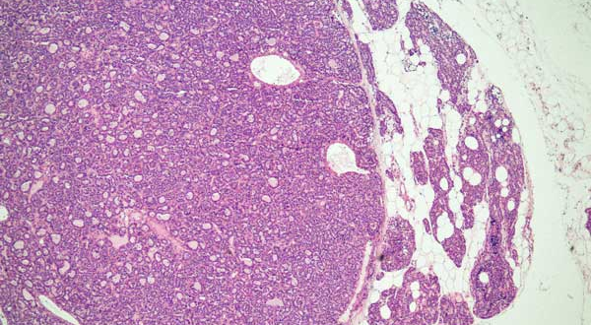
Parathyroid adenoma

Slide 11
Parathyroid hyperplasia
multiglandular process.
The combined weight of all glands rarely exceeds 1.0 g .
stromal fat is inconspicuous within foci of hyperplasia.

Slide 12
Parathyroid carcinomas :
-one gland affected.
-Consist of irregular masses that sometimes exceed 10 g in weight .
- The diagnosis of carcinoma based on cytologic detail is unreliable, and invasion of tissues and metastasis are the only definitive criteria
- Local recurrence occurs in one third of cases,
- More distant dissemination occurs in another third

Slide 13
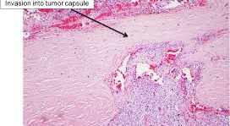
Parathyroid carcinoma

Slide 14
Morphologic changes in other organs in hyperparathyroidism
1. Skeletal changes
Osteitis fibrosa cystica) characterized by
- Increased osteoclastic activity, resulting in erosion of
bone and mobilization of calcium salts.
- In more severe cases the cortex is grossly thinned and the marrow contains increased amounts of fibrous tissue accompanied by foci of hemorrhage and cysts
b. Brown tumors of hyperparathyroidism)
Aggregates of osteoclasts,, and hemorrhage occasionally form masses that may be mistaken for neoplasms

Slide 15
2. Kidney changes in hyperparathyroidism:
a. PTH-induced hypercalcemia favors the formation of
urinary tract stones (nephrolithiasis)
b. Calcification of the renal interstitium (nephrocalcinosis)
3. Metastatic calcification may be seen in the stomach, lungs, myocardium, and blood vessels.

Slide 16
Clinical features of primary hyperparathyroidism
- Primary hyperparathyroidism is a disease of adults and is much more common in women than in men.
- The most common manifestation is an increase in serum calcium and is the most common cause of clinically silent hypercalcemia.
- The most common cause of clinically apparent hypercalcemia in adults is malignancy: paraneoplastic syndromes or bone mets.

Slide 17
Clinical Manifestations :
painful bones,
renal stones,
abdominal groans,
psychic moans.
Abdominal groans:
peptic ulcers,
pancreatitis,
Gallstones
Renal stones

Slide 18
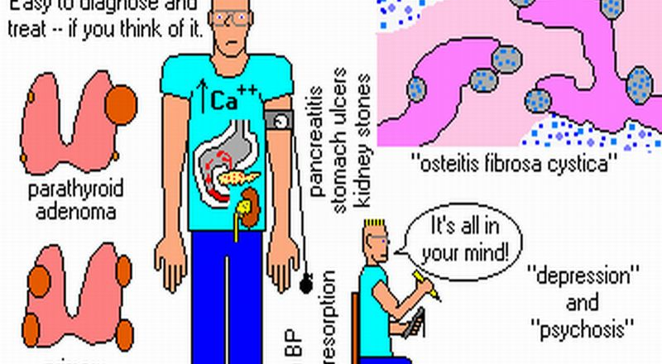

Slide 19
Secondary Hyperparathyroidism –
caused by chronic decreases in the serum calcium level
- Renal failure is the most common cause
Chronic renal insufficiency causes decreased phosphate excretion, which in turn results in hyperphosphatemia. Which depress serum calcium levels and so stimulate parathyroid gland activity
reduced the availability of α₁-hydroxylase enzyme necessary for the synthesis of the active form of vitamin D, which in turn reduces intestinal absorption of calcium

Slide 20
- Clinical Features
Are dominated by those related to chronic renal failure
Bone abnormalities (renal osteodystrophy) are less severe than those seen in primary type
- Serum calcium remains near normal because compensatory increase in PTH levels sustains serum calcium.
Note- In a minority of patients, parathyroid activity may become autonomous and excessive, with resultant hypercalcemia-a process sometimes termed tertiary

Slide 21
HYPOPARATHYROIDISM:
is less common than hyperparathyroidism and the major causes are:.
a. Surgically induced hypoparathyroidism: inadvertent removal of parathyroids during thyroidectomy.
b. Congenital absence: This occurs in conjunction with thymic aplasia (Di George syndrome) and cardiac defects, secondary to deletions on chromosome 22q11.2
c. Autoimmune hypoparathyroidism :This is a hereditary polyglandular deficiency syndrome

Slide 23
MEN syndromes

Slide 24
MULTIPLE ENDOCRINE NEOPLASIA SYNDROMES
- Are a group of inherited diseases resulting in proliferative lesions of multiple endocrine organs.
- Endocrine tumors arising in the context of MEN syndromes have distinctive features that are not shared with their sporadic counterparts:
1. Occur at a younger age than that for sporadic cases.
2. They arise in multiple endocrine organs.
3. Even in one organ, the tumors often are multifocal.
4. Usually are preceded by an asymptomatic stage of endocrine hyperplasia involving the cell of origin of tumor.
5. Are usually more aggressive and recur in a higher proportion of cases than tumors that occur sporadically.

Slide 25
MEN type 1
- Is an autosomal dominant syndrome and the gene (MEN1) is located at 11and is a tumor suppressor gene;.
- Organs most commonly involved are the parathyroid, the pancreas, and the pituitary-the "3 Ps.“

Slide 26
a. Parathyroid: Primary hyperparathyroidism is the most common manifestation of MEN-1 (80% to 95% of patients) .
Abnormalities include both hyperplasia and adenomas.
b. Pituitary: The most frequent pituitary tumor in patients with MEN-1 is a prolactin-secreting macroadenoma.
- In some cases, acromegaly develops in association with somatotropin-secreting tumors

Slide 27
c. Pancreas: Endocrine tumors of the pancreas are the leading cause of death in MEN-1.
- Are aggressive tumors manifest with metastatic disease.
- May find multiple microadenomas" scattered throughoutthe pancreas in conjunction with the dominant lesions
Pancreatic endocrine tumors often are functional
-Hypoglycemia, related to insulinomas, is also common.

Slide 28
MEN 2 syndromes
MEN 2A
MEN 2B
Both : activation mutation of RET proto-oncogene.
AUTOSOMAL DOMINENT.

Slide 29
MEN Type 2A
THYROID, PARATHYROID AND ADRENALS.
Thyroid: Medullary carcinoma of the thyroid develops in virtually all untreated cases, and the tumors usually occur in the first 2 decades of life
b. Adrenal medulla: Pheochromocytomas develop in 50% of the patients; and 10% of these tumors are malignant.
c. Parathyroid: 10% to 20% of patients develop parathyroid hyperplasia resulting in primary hyperparathyroidism

Slide 30
Multiple Endocrine Neoplasia Type 2B
a. Organs commonly involved include the thyroid and the adrenal medulla and the spectrum of thyroid and adrenal medullary disease is similar to that in MEN-2A,
b. Primary hyperparathyroidism does not develop in patients with MEN-2B.
c. Extraendocrine manifestations.

Slide 31
Extraendocrine manifestations.
1. Ganglioneuromas of mucosal sites (gastrointestinal tract, lips, tongue)
a marfanoid habitus, in which overly long bones of the axial skeleton give an appearance resembling that in Marfan syndrome

