Slide 1
Neonatal surgical emergencies
Congenital diaphragmatic hernia (CDH)
Esophageal atresia and tracheoesophageal fistula (EA and TEF)
Abdominal wall defect

Slide 2
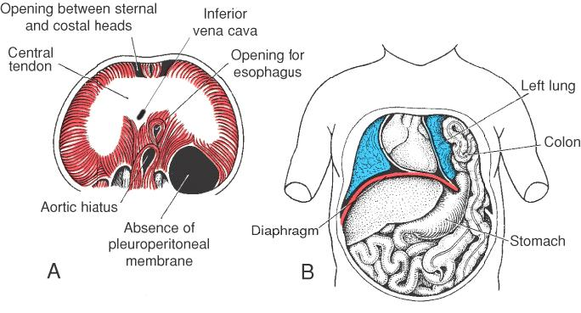
Anatomy

Slide 3
CDH
CDH occurs in 1 of every 2000-4000 live births and accounts for 8% of all major congenital anomalies.
Congenital diaphragmatic hernia (CDH) constitutes a major surgical emergency in the newborn ( not anymore)
Symptoms depend on the degree of herniation; small hernias may initially pass unnoticed, whereas larger ones produce immediate and severe respiratory distress.

Slide 4
CDH Pathophysiology
Pulmonary hypoplasia is thought to result from long-standing intrauterine (embryonic) compression of the lungs by the hernia.
Mortality in babies with CDH is largely confined to those with bilateral pulmonary hypoplasia
The pulmonary vasculature is also affected to a greater degree than the bronchial tree leading to pulmonary hypertension

Slide 5
Pulmonary Hypertension in CDH
A key factor in mortality associated with CDH is development of persistent pulmonary hypertension of the newborn (PPHN).
Affected Infant has poor oxygenation with, in particular, a difference between pre- and postductal arterial oxygen saturation
Echocardiography reveals raised pulmonary vascular resistance and high right ventricular pressures.
Blood flow through the lungs is hampered and blood flows preferentially into the systemic circulation via the ductus arteriosus and foramen ovale (right-to-left shunting )

Slide 6
Pulmonary Hypertension in CDH
Pulmonary hypertension in CDH has two components:
exaggerated, but reversible, pulmonary vasoconstriction
fixed resistance from the hypoplastic vascular bed
In approximately 50% of infants with CDH pulmonary hypertension is transitory and resolves over the first few weeks of life

Slide 7
Differential Diagnosis
Surgical
Cystic adenomatoid malformation(CCAM),lung sequestration, Mediastinal cyst (bronchogenic, neuroenteric cyst, thymic cyst) Pneumatocele
Medical
Neonatal respiratory distress conditions, hyaline membrane disease, RDS, Meconium aspiration, choanal atresia, lobar emphysema, etc.

Slide 8
Diagnosis
prenatal period, U/S features indicative of CDH include:
1-polyhydramnios;
2- an absent or intrathoracic stomach bubble;
3-a mediastinal and cardiac shift away from the side of the herniation; and, rarely,
4- fetal hydrops

Slide 9
Antenatal Diagnosis
Two-dimensional US is used to calculate the ratio of the area of the contralateral fetal lung at the level of the four chamber view of the heart to the fetal head circumference at the level of the lateral ventricles

Slide 10
Antenatal Diagnosis
Measurement of fetal lung to head ratio (LHR) has gained popularity in recent years as a method of determining prognosis
There results of antenatal prognostication by LHR are unfortunately not consistent
More recently the use of MRI as a new method for predicting outcome in antenatally diagnosed CDH
The correlated total fetal lung volume with total fetal body volume to generate a lung volume observed–expected ratio. A ratio below 35% predicted a poor prognosis

Slide 11
Antenatal poor prognostic factors
Bilateral hernia
The position of the liver
Fetal lung–head ratio less than 0.8
Polyhydramnios
Mediastinal shift

Slide 12
Postnatal Diagnosis
Symptoms depend on the degree of herniation; small hernias may initially pass unnoticed, whereas larger ones produce immediate and severe respiratory distress.
Around 50% of babies with a CDH remain undiagnosed until birth.
In neonatal period a tetrad of
Respiratory distress as soon as clamping the umbilical cord
Dextrocardia,
Apparent scaphoid abdomen
Barrel shaped chest

Slide 13
Prognosis
Mortality in babies with CDH is related to pulmonary hypoplasia, persistent fetal circulation (PFC), and associated anomalies
The reported mortality rate is 25-60%; Hidden mortality refers to the death of infants who are so severely affected that they die prior to their transfer to a surgical unit.

Slide 14
Scaphoid abdomen in CDH

Slide 15
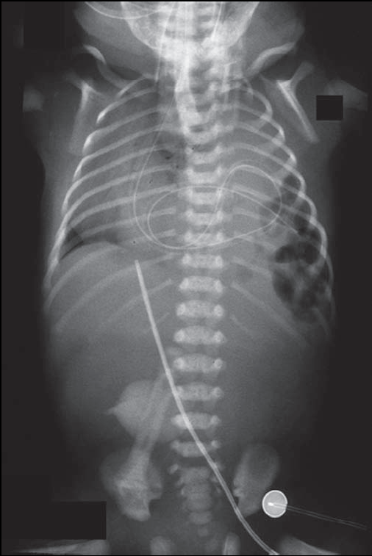
Postnatal Diagnosis
An X-ray reveals the characteristic combination of bowel loops within the chest, lung hypoplasia, mediastinal shift away from the side of the hernia and NG coiled in the chest

Slide 17
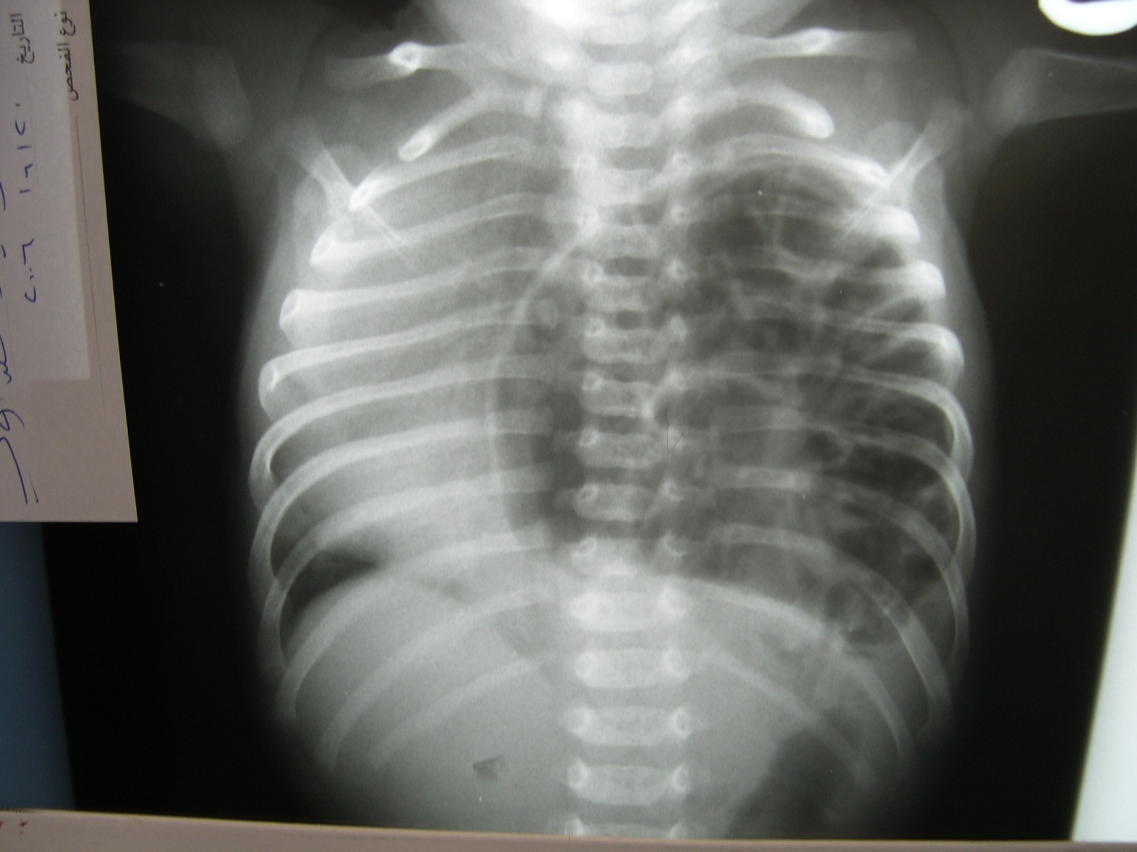

Slide 18
Advanced medical treatments
methods that used as adjunctive treatments if adequate oxygenation cannot be achieved using conventional ventilation:
High-frequency oscillating ventilation (HFOV),
Extracorporeal membrane oxygenation (ECMO),
Inhaled nitric oxide (iNO)

Slide 19
Gentle Ventilation and Permissive Hypercapnia
The infant is intubated but allowed to breath spontaneously and hypercapnia is tolerated (permissive hypercapnia).
High ventilator pressures are avoided with the aim of minimizing iatrogenic/ventilator-induced lung injury.
Permissive hypercarbia is associated with fewer complications notably a reduced incidence of pneumothorax.
Survival rate reaches 76% and if infants with lethal associated anomalies are excluded, survival approaches 100% in some centers

Slide 20
Esophageal Atresia(EA) and Tracheoesophageal Fistula(TEF)

Slide 22
Classification
Anatomical Characteristics
Esophageal atresia with distal TEF-- 87%
Isolated esophageal atresia without TEF-8%
Isolated TEF-4%
Esophageal atresia with proximal TEF-1%
Esophageal atresia with proximal and distal TEF-1%

Slide 23
Pathophysiology
Approximately 17-70% of children with TEFs have associated developmental anomalies. These anomalies include
VATER, VACTERL syndrome

Slide 24
Clinical Features
Esophageal atresia in the fetus should be considered as a cause of maternal polyhydramnios.
Absence of stomach bubble on prenatal ultrasound is another indication of esophageal atresia.
Neonates with esophageal atresia usually develop copious, fine white frothy bubbles of mucus in the mouth and nose.
Secretions recur despite suctioning.

Slide 25
Clinical Features
Infants may develop respiratory distress and episodes of coughing and choking in association with cyanosis.
Symptoms worsen during feeding
The average duration of symptoms from onset to diagnosis is approximately 12 hours.

Slide 27
Clinical Features
Infants may develop rattling respiration and episodes of coughing and choking in association with cyanosis.
Symptoms worsen during feeding in the presence of a TEF.
The symptoms induced by TEFs are cough, aspiration, and fever. The average duration of symptoms from onset to diagnosis is approximately 12 hours.

Slide 28
Diagnosis
Insertion of a nasogastric tube may show coiling in the mediastinum of patients who have concomitant esophageal atresia.
Contrast studies are seldom required to confirm the diagnosis.
These studies have the risk of aspiration pneumonitis and pulmonary injury, and they add minimal information to the diagnostic workup.

Slide 29
Treatment
Surgery ligation and division of fistula when present
Restoring the continuity of the esophagus
This is done as a primary, delayed primary or in a staged procedure

Slide 30
Prognosis
Surgical and perioperative management of congenital TEFs have improved significantly. Survival rates of 100% can be achieved in infants who do not have severe associated congenital anomalies.
Patients may develop morbidities following TEF repair, including tracheomalacia, esophageal dysmotility, gastroesophageal reflux, and dysphagia. Additionally, patients may develop pulmonary problems from recurrent aspiration.

