Slide 1
بسم الله الرحمن الرحيم
الحمد لله رب العالمين والصلاة والسلام على نبينا محمد خاتم الأنبياء وسيد المرسلين وعلى آله وصحبه أجمعين وبعد

Slide 2
NONCOMMUNICABLE DISEASES
Part Two

Slide 3
The Regional Situation
In the WHO Region for the Eastern Mediterranean, Chronic Diseases (CVD, Cancer, Diabetes etc..) account for 52% of all deaths and 47% of the disease burden in EMR during the year 2005
This burden is likely to rise to 60% in the year 2020.
The conventional risk factors may explain 75% of chronic diseases.

Slide 4
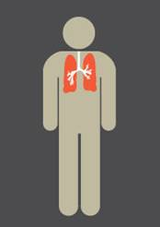
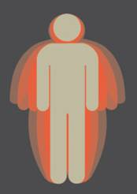
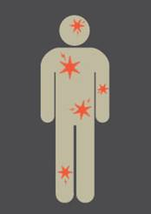
Chronic Diseases result in
percent of deaths
4
52
EMR Adult Population
Cardiovascular
Chronic Respiratory
Disease
Type 2 Diabetes
Cancer

Slide 5
EMR/NCD RISK FACTORS
Smoking 16-65%
Hypertension 12-35%
Diabetes 7-25%
Over weight-obesity 40-70%
Dyslipidemia 30-70%
Physical Inactivity 80-90%

Slide 6
Stepwise data from some EM countries
Country | Year of field work | Diabetes % | Hypertension % | Overweight & Obesity %
Iraq | 2006 | 10.4 | 40.4 | 66.9
Jordan | 2007 | 16 | 25.5 | 67.4
Saudi Arabia | 2005 | 17.9 | 26
Syrian Arab Republic | 2003 | 19.8 | 28.8 | 56.3
Kuwait | 2005 | 16.7 | 24.6 | 81.2
Egypt | 2005 | 16.5 | 33.4 | 76.4
Sudan | 2005 | 19.2 | 23.6 | 53.9

Slide 7
Stepwise data from some EM countries
Country | Year of field work | Hyper-cholestrolemia % | Smoking % | Low physical activity % | Low intake of fresh fruit & vegetables %
Iraq | 2006 | 37.5 | 21.6 | 56.7 | 92.3
Jordan | 2007 | 26.2 | 29 | 5.2 | 14.2
Saudi Arabia | 2005 | 19.3 | 12.9 | 33.8 | 91.6
Syrian Arab Republic | 2003 | 33.5 | 24.7 | 32.9 | 95.7
Kuwait | 2005 | 42 | 15.7 | 91.5 | 89
Egypt | 2005 | 24.2 | 21.8 | 50.4 | 79
Sudan | 2005 | 19.8 | 12 | 86.8 | 1.7/day

Slide 8
Prevalence of Smoking according to STEPwise Survey in EM countries
%

Slide 9
Prevalence of diabetes based on stepwise surveys
Jordan: 12%
Iraq: 10.4%
Syria: 20.5%
Saudi Arabia: 17.9%
Iran: 10.3%
No available data from other EM countries

Slide 10
The Global burden of diabetes
Diabetes accounts for more than 5% of the global deaths, which are mostly due to CVD.
Diabetes is responsible for over one third of end-stage renal disease requiring dialysis.
Amputations are at least 10 times more common in people with diabetes.
A leading cause of blindness and visual impairment. Diabetics are 20 times more likely to develop blindness than nondiabetics.

Slide 11
Notes:
Dr. Ossama AlKhatib

Slide 12
Prevalence of Undiagnosed NCD risk factors in Oman

Slide 13
Cancer IN EMR
In EMR, cancer is the 4th ranked cause of death after cardiovascular diseases, infectious/parasitic diseases and injuries.
Cancer kills each year in the Region, more than HIV/AIDS, tuberculosis and malaria combined.

Slide 14
The global and regional strategic direction
A 2% annual reduction in chronic disease death rates, over and above projected trends to 2015. This goal, if achieved, would result in aversion of 2.3 million deaths in EMR.
This goal was formally endorsed by the ministers of health in 2006 (RC 53).

Slide 15
Regional Strategy for cancer control
The burden of cancer is high in the EM region and is likely to increase fast in the coming years
There is a wide diversity among EM countries in terms of data available, programs, resources and capacities for cancer control. Many countries have already programmes, but at different levels of development.
In almost all countries, cancers are detected late. This means increase in cost and in mortality.
Access to treatment is limited in many countries of the Region
There is limited access to palliative care due to misconception, health providers attitude, legislations and availability.

Slide 16
The Regional Strategy Guide Countries to
Establish the National Cancer Control Committee (NCCC),
Develop and implement the NCCP, which is an integrated set of activities covering:
Primary prevention
Early detection
Diagnosis and treatment
Palliative care
Registries
Research

Slide 17
DPAS regional framework for country action
The Global Strategy on Diet, Physical Activity and Health (DPAS) was adopted by the 57th World Health Assembly (WHA) in 2004 but EM Region only OMAN has a national strategy based on DPAS
Implementing DPAS in the EM Region will lead to a significant reduction in the mortality and morbidity of major NCDs and the NCD risk factors.
The regional framework will support countries to develop culturally sensitive programs for DPAS implementation

Slide 18
Specificity in EM Region
Physical Activity
In most countries it would be considered little out of place even for men are jogging on the side of the road-a normal practice witnessed in European and some Asian countries
A culture of regularly going to the parks or open spaces and gymnasiums to engage in physical activity is not prevalent
Opportunities (jogging tracks, Gyms, etc) for PA are also not available (or scanty) in many countries of the Region
In case of women, in most countries, culturally it is not acceptable that women should resort to any form of physical activity in places where men are also present
Even if women are convinced that regular physical activity is essential for improving quality of life and preventing NCDs, supportive environments to promote physical activity among women rarely exist.

Slide 19
Integration of NCD in PHC
Avoidance of fragmentation of services and provision of services in a comprehensive approach rather than a collection of different diseases
Health promotion, prevention and care services can be provided at the same place.
High percentage of population use PHC(80%).
PHC is more accessible and affordable and hence it has a drive to reach vulnerable populations

Slide 20
Package of essential NCD interventions
For different Setting
Different levels of resources
To cover the complete spectrum of health needs
promotion,
prevention,
acute,
long-term,
rehabilitation,
palliative,

Slide 21
Challenges
Lack of enough national policies for NCD prevention and control
Poor Fundings
Re orientation of the health system from acute to chronic diseases.
Dealing with NCDs is beyond the capacity of the health sector alone. Necessary interventions should come from other sectors, e.g. ministries of industry, commerce, agriculture, justice, etc.

Slide 22
The lack of sufficiently effective, safe, easy to use, and inexpensive medications is another important challenge Lack of financing PHC
Skills of PHC providers
Equipment, medicines
deficiency/ nonexistence of inter sectoral collaboration within Health system

Slide 23
Challenges
Strengthen community participation, and intersectoral action .
Re orientation of the health system
Dealing with NCDs is beyond the capacity of the health sector alone. Necessary interventions should come from other sectors, e.g. ministries of industry, commerce, agriculture, justice, etc.

Slide 24
Conclusions
We Lack of reliable data for advocacy
Resources / funding
Political instability
We need to create supportive environment
We need to focus on training health professional
We Lack of guidelines, tool
We need to change community / society perception

Slide 25
The epidemiologic transition (Omran, 1971)
Change in the balance of disease in a population
from
communicable diseases
to
non-communicable disease

Slide 26
Decline in proportion of total mortality due to infectious diseases England & Wales, 1911-94, by age
Males
Females
1-14
25-44
45-64
65-74
Notes:
Here we see the decline over time in the proportion of mortality at different ages attributable to infections ranging from tuberculosis to diuphtheria, measles and gastro-intestinal infections.
The downward spike in 1918 is because most excess deaths were from pneumonia rather than “influenza”. Rates of pneumonia were much lower than those for infectious diseases either side of the 1918 Spanish flu – making up less than 10% of all deaths among those aged
The sharp decline mid-century is not well understood and is under-researched. The precise role of the introduction and use of anti-biotics is important question.. Mackenbach’s work suggesting that this played a role in the Netherlands at least.
With the decline of infectious diseases life-expectancy in particular becomes more strongly related to the influence of individual behaviours. This is apparent with the widening gap in male to female life-expectancy over the 20th Century which rose from 4 years in 1900 to a peak of just over 6 years in the late 1960s.

Slide 27
Non-communicable diseases as % of all deaths by global region (all ages)
WORLDWIDE | 59%
N.America; W Europe | 88%
China, W Pacific, + some SE Asia | 75%
Latin America + Caribbean | 67%
S E Asia including India | 51%
Sub-Saharan Africa | 21%

Slide 28
Drivers of the epidemiological transition in low and middle income countries
Population ageing
Major socio-economic changes (especially urbanisation)
changes in risk factors such as diet, physical activity, smoking etc.

Slide 29
Global Burden of Disease (GBD) Study

Slide 30
GBD 2001 mortality estimates
107 countries had collected “useable” information on cause of death from registration systems
55 countries (42 in sub Saharan Africa) no information on adult mortality
Estimates based on many assumptions and extrapolations

Slide 31
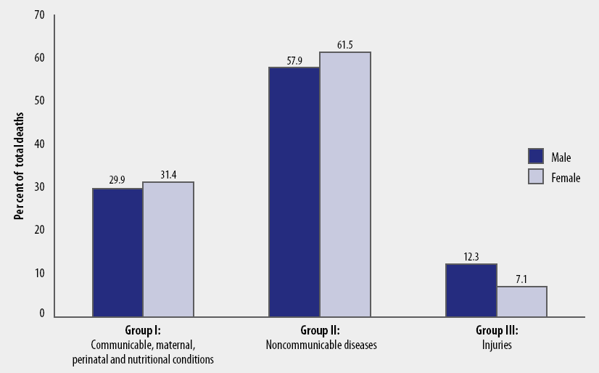
Distribution of deaths in the world by sex, 2004
GBD report 2004 update, 2008

Slide 32
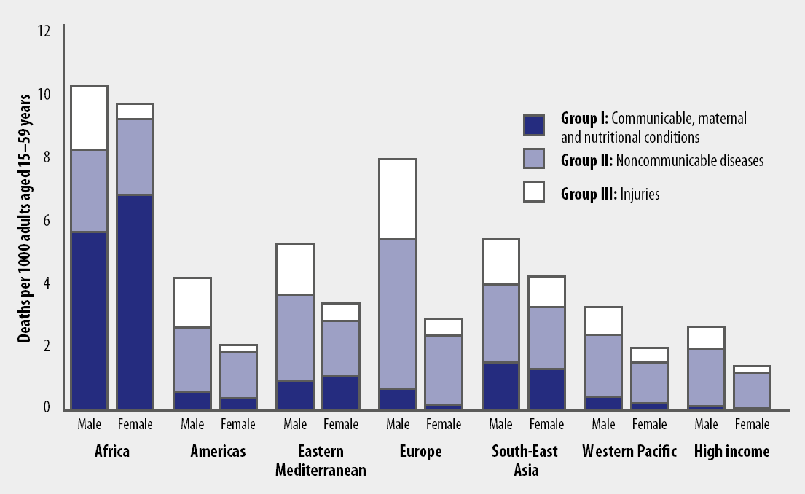
Mortality rates among men and women aged 15–59 years, region and cause-of-death group, 2004
GBD report 2004 update, 2008

Slide 33
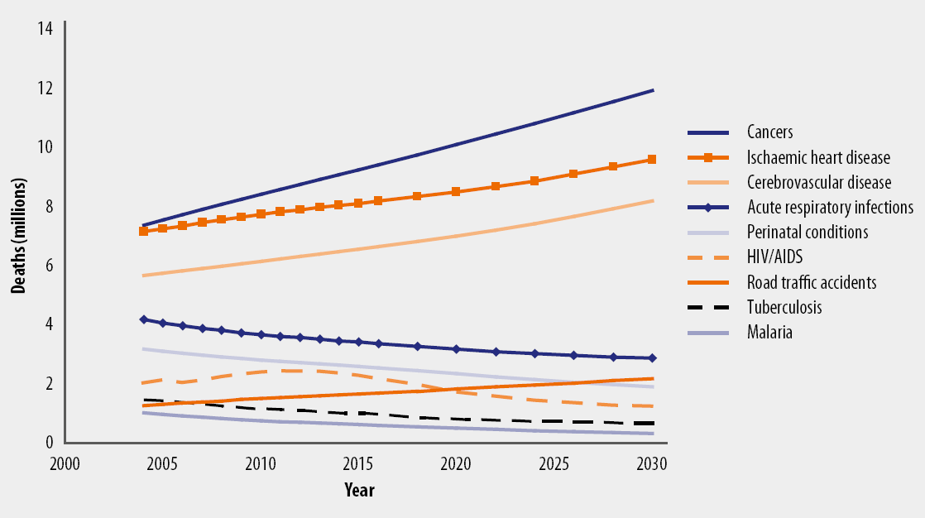
Projected global deaths for selected causes, 2004–2030
GBD report 2004 update, 2008

Slide 34
DALYs in Developing Areas (Disability-adjusted life year)
1990 2020
Infectious Disease NCDs Injury

Slide 35
Trends in Death in Developing Areas
NCDs
Comm. Dis.
Injuries
40
30
Deaths (millions)
20
10
0
1990
2000
2010
2020
Global Burden of Disease

Slide 36
Things are getting worse not better

Slide 37
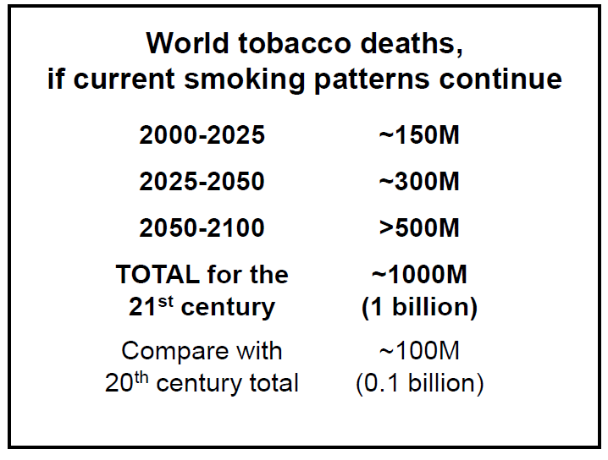

Slide 38
Summary
Non-communicable diseases are now the most common cause of death world wide
Increasing rates in low and middle income countries because of change in lifestyles (urbanisation)
Key risk factors have very large effects
Interventions are effective and can reduce burden
The need to combine results and have large studies

Slide 39
Thank you for your attention!

