Slide 1
بسم الله الرحمن الرحيم
الحمد لله رب العالمين والصلاة والسلام على نبينا محمد خاتم الأنبياء وسيد المرسلين وعلى آله وصحبه أجمعين وبعد

Slide 2
NONCOMMUNICABLE DISEASES
Part One

Slide 3
What are non-communicable diseases?

Slide 4
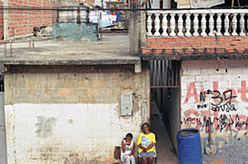
Noncommunicable diseases are the leading killer today and are on the increase.
Nearly 80% of these deaths occurred in low- and middle-income countries.

Slide 5
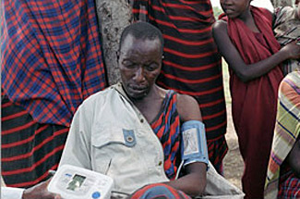
More than nine million of all deaths attributed to noncommunicable diseases (NCDs) occur before the age of 60.
Around the world, NCDs affect women and men almost equally.

Slide 6
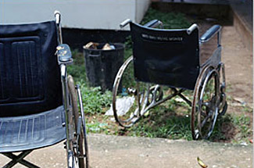
Global status report on noncommunicable diseases (April 2011 the World Health Organization (WHO) )
NCDs are the leading cause of death in the world, responsible for 63% of the 57 million deaths that occurred in 2008.
The majority of these deaths - 36 million - were attributed to cardiovascular diseases and diabetes, cancers and chronic respiratory diseases.

Slide 7
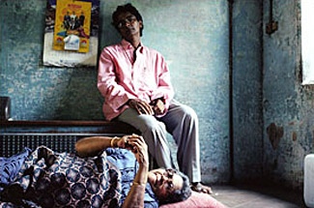
NCDs are largely preventable by means of effective interventions that tackle shared risk factors, namely: tobacco use, unhealthy diet, physical inactivity and harmful use of alcohol.
NCDs are not only a health problem but a development challenge as well.

Slide 8
Global status report on noncommunicable diseases (April 2011 the World Health Organization (WHO) )
The leading causes of NCD deaths in 2008 were: cardiovascular diseases (17 million deaths, or 48% of NCD deaths); cancers (7.6 million, or 21% of NCD deaths); and respiratory diseases, including asthma and chronic obstructive pulmonary disease (COPD), (4.2 million). Diabetes caused an additional 1.3 million deaths.
Behavioural risk factors, including tobacco use, physical inactivity, and unhealthy diet, are responsible for about 80% of coronary heart disease and cerebrovascular disease.

Slide 9
Cardiovascular diseases
Cardiovascular disease is caused by disorders of the heart and blood vessels, and includes coronary heart disease (heart attacks), cerebrovascular disease (stroke), raised blood pressure (hypertension), peripheral artery disease, rheumatic heart disease, congenital heart disease and heart failure.
Although heart attacks and strokes are major killers in all parts of the world, 80% of premature deaths from these causes could be avoided by controlling the main risk factors: tobacco, unhealthy diet and physical inactivity.

Slide 10
Cardiovascular diseases: Facts and figures
Cardiovascular disease (CVD) causes more than half of all deaths across the European Region.
80% of premature heart disease and stroke is preventable.

Slide 11
Cardiovascular diseases: Contributing / Risk factors
A person’s genetic make-up
The foundations of adult health are laid in early life
Socioeconomic group
Mental health
Diet
Overweight and obesity
Inactivity
Tobacco
Alcohol
Diabetes
Globalization and urbanization

Slide 12
Cardiovascular diseases: Prevention
Focusing on a combination of risk factors for cardiovascular disease
Implementing medical screening for individuals at risk
Providing effective and affordable treatment to those who require it

Slide 13
Cardiovascular diseases: Prevention
It has been predicted that mortality from coronary heart disease (CHD) in the United Kingdom could be halved by small changes in cardiovascular risk factors: a 1% decrease in cholesterol in the population could lead to a 2–4% CHD mortality reduction; a 1% reduction in smoking prevalence could lead to 2000 fewer CHD deaths per year; and a 1% reduction in population diastolic blood pressure could prevent around 1500 CHD deaths each year.

Slide 14
80% of the reduction in CHD mortality in Finland during the period of 1972–1992 has been explained by a decline in the major risk factors. Similarly, in Ireland, almost half (48.1%) of the reduction in CHD mortality rates during 1985–2000 among those aged 25–84 years has been attributed to favorable trends in population risk factors. In both countries, the greatest benefits appear to have come from reductions in mean cholesterol concentrations, smoking prevalence and blood pressure levels.

Slide 15
Cardiovascular diseases: Treatment
Effective measures are available for people at high risk. For example, combination drug therapy (such as aspirin, beta blocker, diuretic and statin) can lead to a 75% reduction in myocardial infarction (heart attack) among those at high risk of having one.
But many such interventions are not being implemented, and about half of coronary patients in the world still require more intensive blood pressure management.

Slide 16
Cancer
Cancer is the uncontrolled growth and spread of cells that arises from a change in one single cell. The change may be started by external agents and inherited genetic factors and can affect almost any part of the body. The transformation from a normal cell into a tumour cell is a multistage process where growths often invade surrounding tissue and can metastasize to distant sites.

Slide 17
Cancer: Interaction between a person’s genetic factors and any of three categories of external agents
physical carcinogens, such as ultraviolet and ionizing radiation or asbestos;
chemical carcinogens, such as vinyl chloride, or betnapthylamine (both rated by the International Agency for Research into Cancer as carcinogenic), components of tobacco smoke, aflatoxin (a food contaminant) and arsenic (a drinking-water contaminant); and
biological carcinogens, such as infections from certain viruses, bacteria or parasites.
Most chemicals to which people are exposed in everyday life have not been tested for their long-term impact on human health.

Slide 18
Cancer: the majority of cancer deaths
Lung, breast, colorectal, stomach and liver cancers
In high-income countries, the leading causes of cancer deaths are lung cancer among men and breast cancer among women.
In low- and middle-income countries cancer levels vary according to the prevailing underlying risks. In sub-Saharan Africa, for example, cervical cancer is the leading cause of cancer death among women.

Slide 19
Cancer: risk factors for cancer
tobacco use
unhealthy diet
insufficient physical activity
the harmful use of alcohol
Infections (hepatitis B, hepatitis C (liver cancer), human papillomavirus (HPV; cervical cancer), Helicobacter pylori (stomach cancer)
Radiation
variety of environmental and occupational exposures of varying importance

Slide 20
Cancer: policy
WHO’s approach to cancer has four pillars:
prevention,
early detection,
screening,
treatment
palliative care.

Slide 21
Cancer: policy
At least one third of the 10 million new cases of cancer each year are preventable through reducing tobacco and alcohol use, moderating diet and immunizing against viral hepatitis B.
Early detection and prompt treatment where resources allow can reduce incidence by a further one third.
Effective techniques are sufficiently well established to permit comprehensive palliative care for the remaining more advanced cases.

Slide 22
Cancer: national cancer control programme
WHO has consolidated tools for countries in a framework known as the national cancer control programme, which focuses government attention and services on all facets of the fight.
A national cancer control programme is a public health programme designed to reduce cancer incidence and mortality and improve cancer patients’ quality of life, through the systematic and equitable implementation of evidence-based strategies for prevention, early detection, diagnosis, treatment and palliation, making the best use of available resources.

Slide 23
Chronic respiratory diseases: Quick facts and figures
According to the WHO Global Status Report on NCDs 2010, smoking is estimated to cause about 71% of all lung cancer deaths and 42% of chronic respiratory disease worldwide. Of the six WHO regions, the highest overall prevalence for smoking in 2008 was estimated to be the in the European Region, at nearly 29%.

Slide 24
Chronic respiratory diseases: Quick facts and figures
24
Survey data from 2002–2007 indicate that over half of all children aged 13–15 years in many countries in the European Region are exposed to second-hand tobacco smoke at home. Second-hand smoke causes severe respiratory health problems in children, such as asthma and reduced lung function; and asthma is now the most common chronic disease among children throughout the Region.

Slide 25
Chronic respiratory diseases: Quick facts and figures
According to the latest available data for 1997–2006, over 12% of infant deaths in the world are due to respiratory diseases.
Indoor air pollution from biological agents related to damp and mould increases the risk of respiratory disease in children and adults. Children are particularly susceptible to the health effects of damp, which include respiratory disorders such as irritation of the respiratory tract, allergies and exacerbation of asthma. Damp is often associated with poor housing and social conditions, poor indoor air quality and inadequate housing hygiene.

Slide 26
Chronic respiratory diseases: Quick facts and figures
Increasing evidence suggests that allergic sensitization, which is the most common precursor to the development of asthma, can already occur antenatally. Emphasis on the health, nutrition and environment of the pregnant woman and the unborn child are therefore essential.
Ozone pollution causes breathing difficulties, triggers asthma symptoms, causes lung and heart diseases, and is associated with about 21 000 premature deaths per year in 25 countries in the WHO European Region.

Slide 27
Chronic respiratory diseases: Quick facts and figures
Most countries in the world and the European Region have introduced a wide range of comprehensive policies to reduce and eliminate tobacco smoke. For example, the advertising of cigarettes and the sale of tobacco products to minors have been banned in more than 80% of the countries in the Region. Smoking in restaurants and bars continues to be regulated less strictly, however. Ireland, Turkey and the United Kingdom are the first countries to make public places 100% smoke free.

Slide 28
Diabetes
Diabetes is a chronic disease that occurs when the pancreas does not produce enough insulin (a hormone that regulates blood sugar) or alternatively, when the body cannot effectively use the insulin it produces. The overall risk of dying among people with diabetes is at least double the risk of their peers without diabetes.

Slide 29
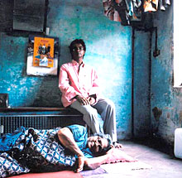
Diabetes: Quick facts and figures
About 347 million people worldwide have diabetes.
There is an emerging global epidemic of diabetes that can be traced back to rapid increases in overweight, obesity and physical inactivity.

Slide 30
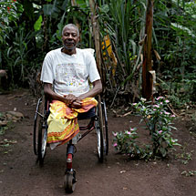
Diabetes: Quick facts and figures
Diabetes is predicted to become the seventh leading cause of death in the world by the year 2030.
Total deaths from diabetes are projected to rise by more than 50% in the next 10 years.

Slide 31
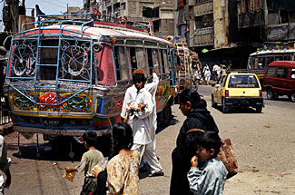
Diabetes: Quick facts and figures
80% of diabetes deaths occur in low- and middle-income countries.
In developed countries most people with diabetes are above the age of retirement, whereas in developing countries those most frequently affected are aged between 35 and 64.

Slide 32
Diabetes: Health implications
Elevated blood sugar is a common effect of uncontrolled
diabetes, and over time can damage the heart, blood
vessels, eyes, kidneys, and nerves.
Some health complications from diabetes include:
Diabetic retinopathy
Diabetic neuropathy
Diabetes is among the leading causes of kidney failure; 10-20% of people with diabetes die of kidney failure.
Diabetes increases the risk of heart disease and stroke; 50% of people with diabetes die of cardiovascular disease (primarily heart disease and stroke).

Slide 33
Diabetes: Prevention
Without urgent action, diabetes-related deaths will increase
by more than 50% in the next 10 years. To help prevent type
2 diabetes and its complications, people should:
Achieve and maintain healthy body weight.
Be physically active - at least 30 minutes of regular, moderate-intensity activity on most days.
Early diagnosis can be accomplished through relatively inexpensive blood testing.
Treatment of diabetes involves lowering blood sugar and the levels of other known risk factors that damage blood vessels.
Tobacco cessation is also important to avoid complications.

Slide 34
Diabetes: Control
People with type 1 diabetes require insulin; people with type 2 diabetes can be treated with oral medication, but may also require insulin.
Blood pressure control
Foot care
Other cost saving interventions include:
Screening and treatment for retinopathy (which causes blindness);
Blood lipid control (to regulate cholesterol levels);
Screening for early signs of diabetes-related kidney disease and treatment.
These measures should be supported by a healthy diet,
regular physical activity, maintaining a normal body weight
and avoiding tobacco use.

Slide 35
Obesity
Obesity is one of the greatest public health challenges of the 21st century. Its prevalence has tripled in many countries of the WHO European Region since the 1980s, and the numbers of those affected continue to rise at an alarming rate, particularly among children.
In addition to causing various physical disabilities and psychological problems, excess weight drastically increases a person’s risk of developing a number of noncommunicable diseases (NCDs), including cardiovascular disease, cancer and diabetes.
The risk of developing more than one of these diseases (co-morbidity) also increases with increasing body weight.

Slide 36
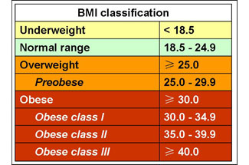
Obesity
Overweight and obesity are defined as "abnormal or excessive fat accumulation that may impair health“
Body mass index (BMI) – the weight in kilograms divided by the square of the height in meters (kg/m2) – is a commonly used index to classify overweight and obesity in adults. WHO defines overweight as a BMI equal to or more than 25, and obesity as a BMI equal to or more than 30.

Slide 37
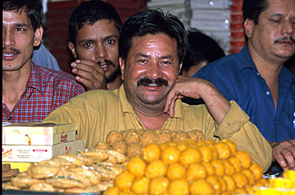
Obesity: Quick facts and figures
More than 1.4 billion adults were overweight in 2008, and more than half a billion obese
In 2008, more than 1.4 billion adults were overweight and more than half a billion were obese. At least 2.8 million people each year die as a result of being overweight or obese. The prevalence of obesity has nearly doubled between 1980 and 2008. Once associated with high-income countries, obesity is now also prevalent in low- and middle-income countries.

Slide 38
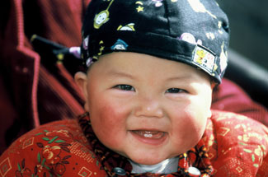
Obesity: Quick facts and figures
Globally, over 40 million preschool children were overweight in 2008
Childhood obesity is one of the most serious public health challenges of the 21st century. Overweight children are likely to become obese adults. They are more likely than non-overweight children to develop diabetes and cardiovascular diseases at a younger age, which in turn are associated with a higher chance of premature death and disability.

Slide 39
Obesity: Quick facts and figures
Overweight and obesity are linked to more deaths worldwide than underweight
65% of the world's population live in a country where overweight and obesity kills more people than underweight. This includes all high-income and middle-income countries. Globally, 44% of diabetes, 23% of ischaemic heart disease and 7–41% of certain cancers are attributable to overweight and obesity.

Slide 40
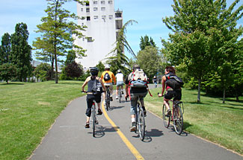
Obesity: Quick facts and figures
Supportive environments and communities are fundamental in shaping people’s choices and preventing obesity
Individual responsibility can only have its full effect where people have access to a healthy lifestyle, and are supported to make healthy choices.
WHO mobilizes the range of stakeholders who have vital roles to play in shaping healthy environments and making healthier diet options affordable and easily accessible.

Slide 41
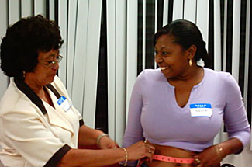
Obesity: Quick facts and figures
The global obesity epidemic requires a population-based multisectoral, multi-disciplinary, and culturally relevant approach
WHO's Action Plan for the Global Strategy for the Prevention and Control of Noncommunicable Diseases provides a roadmap to establish and strengthen initiatives for the surveillance, prevention and management of noncommunicable diseases, including obesity.

Slide 42
Thank you for your attention!

