Slide 1
Introduction to Management and Organizations
Presented by Dr. Sireen Alkhaldi, BDS, MPH, DrPH
Community Medicine Course
Faculty of Medicine, The University of Jordan
First Semester 2014 / 2015

Slide 2
What Is Management?
  Management is what managers do.
  Management is the attainment of organizational goals in an effective and efficient manner through: planning, organizing, leading, and controlling organizational resources.
Managerial Concerns
  Efficiency
    “Doing things right”
      Getting the most output for the least inputs (people, money, …)
  Effectiveness
    “Doing the right things”
      Attaining organizational goals

Slide 3
Why Study Management?
The Value of Studying Management
  The universality of management
    Good management is needed in all types, sizes, and levels of all organizations.
  The reality of work
    Employees in all jobs either manage or are managed.
  Rewards and challenges of being a manager
    Management offers challenging, exciting and creative opportunities for meaningful and fulfilling work.
    Successful managers receive significant monetary rewards for their efforts.

Slide 4
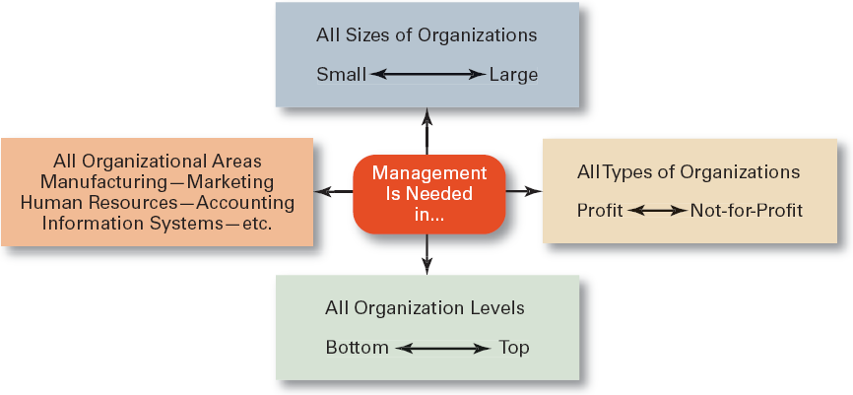
Exhibit 1–11 Universal Need for Management

Slide 5
Who Are Managers?
Manager
  Someone who coordinates and oversees the work of other people so that organizational goals can be accomplished.

Slide 6
Classifying Managers Levels
First-line Managers
  Individuals who manage the work of non-managerial employees (e.g. team leaders, supervisors).
Middle Managers
  Individuals who manage the work of first-line managers. They are in charge of large departments or divisions consisting of several smaller work units (e.g. clinic directors in hospitals and regional manangers).
Top Managers
  Individuals who are responsible for making organization-wide decisions and establishing plans and goals that affect the entire organization. Job titles at this level are: chief executive officer, chief operating officer, president, and vice president.

Slide 7
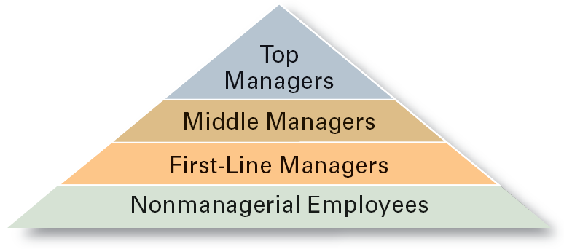
Exhibit 1–1 Managerial Levels

Slide 8
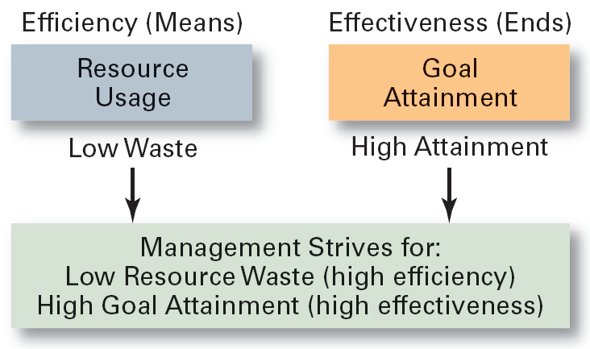
Exhibit 1–2 Effectiveness and Efficiency in Management

Slide 9
The 4 Functions of Management
  Planning
    Defining goals, establishing strategies to achieve goals, developing plans to integrate and coordinate activities.
  Organizing
    Arranging and structuring work to accomplish organizational goals.
  Leading
    Working with and through people to accomplish goals.
  Controlling
    Monitoring, comparing, and correcting work.

Slide 10
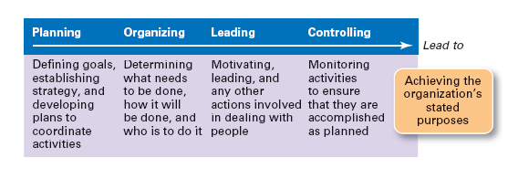
Exhibit 1–3 Management Functions

Slide 11
What Do Managers Do?
Managerial Skills
  Technical skills
    The ability to use Knowledge and proficiency or expertise in a specific field
  Human skills
    The ability to work well with other people (with trust and enthusiasm), and empathize with the emotions and feelings of others (emotional intelligence).
  Conceptual skills
    The ability to think analytically and conceptualize about abstract and complex situations concerning the organization, to solve problems.

Slide 12
Examples of Conceptual skills:
  a manager conducts an analysis of the best way to provide a service
  a manager determines a strategy to reduce patient complaints regarding food service
Examples of Technical skills:
  a manager develops and implements a new incentive compensation program for staff
  a manager designs and implements modifications to a computer-based staffing model
Examples of Human skills:
  a manager counsels an employee whose performance is below expectation
  a manger communicates to subordinates the desired performance level for a service for the next fiscal year

Slide 13
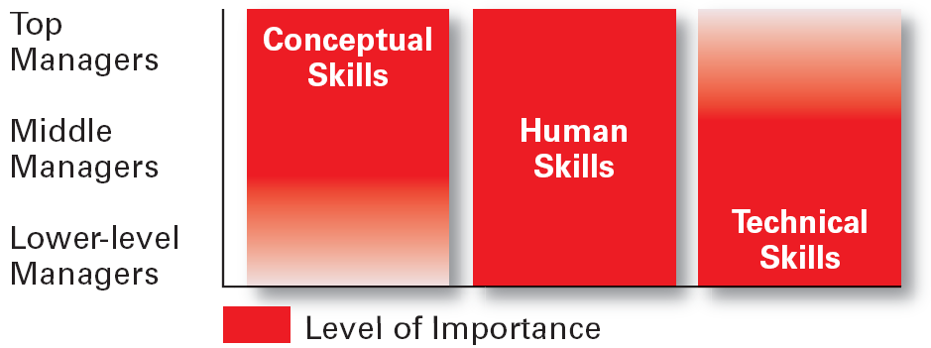
Exhibit 1–5 Skills Needed at Different Management Levels

Slide 14
What Is An Organization?
An Organization Defined
  A deliberate arrangement of people to accomplish some specific purpose, that individuals independently could not accomplish alone.
Common Characteristics of Organizations
  Have a distinct purpose (goal)
  Composed of people
  Have a deliberate structure

Slide 15
What Is An Organization?
In health care, organizations can take a variety of forms:
  For-profit hospitals
  Private physicians’ offices
  Networks of health care specialists
  Community health center

Slide 16
The Purpose of An Organization?
The PURPOSE of an organization is to produce goods and/ or services that satisfy the needs of the customers.
Although many organizations focus on producing services (immunizing infants, testing for diseases, treating illnesses, providing long-term nursing care, etc………), all organizations exist because they contribute something useful to the society.

Slide 17
Social Responsibility
  What is Social Responsibility?
  Management’s social responsibility goes beyond achieving organizational goals and making profits to include protecting and improving society’s welfare.
  Firms have a moral responsibility to larger society to become involved in social, legal, and political issues.
  “To do the right thing”

Slide 18
The Greening of Management (Go Green)
The recognition of the close link between an organization’s decision and activities and its impact on the natural environment.
    Firms should do what is legally required by obeying laws, rules, and regulations willingly and without legal challenge.
  Global environmental problems facing managers:
    Air, water, and soil pollution from toxic wastes
    Global warming from greenhouse gas emissions
    Natural resource depletion

Slide 19
How Organizations Go Green
Legal (of Light Green) Approach
  Firms simply do what is legally required by obeying laws, rules, and regulations willingly and without legal challenge.
Market Approach
  Firms respond to the preferences of their customers for environmentally friendly products.
Stakeholder Approach
  Firms work to meet the environmental demands of multiple stakeholders—employees, suppliers, and the community.
Activist Approach
  Firms look for ways to respect and preserve environment and be actively socially responsible.

Slide 20
Planning
  Planning involves two important aspects
  Setting Goals (also Objectives)
    Desired outcomes for individuals, groups, or entire organizations
    Provide direction and evaluation performance criteria
  Developing Plans
    Documents that outline how goals are to be accomplished
    Describe how resources are to be allocated and establish activity schedules
    As managers plan, they develop both goals and plans.

Slide 21
Characteristics of Well-Designed Goals
Written in terms of outcomes, not actions
  Focuses on the ends, not the means.
Measurable and quantifiable
  Specifically defines how the outcome is to be measured and how much is expected.
Clear as to time frame
  How long before measuring accomplishment.
Challenging but attainable
  Low goals do not motivate.
  High goals motivate if they can be achieved.
Written down
  Focuses, defines, and makes goal visible.
Communicated to all
  Puts everybody “on the same page.”

Slide 22
Strategic Management
The set of managerial decisions
and actions that determines
the long-run performance
of an organization.

Slide 23
Strategic Management
Managers ask such questions as...
What changes and trends are occurring?
Who are our customers?
What products or services should we offer?
How can we offer these products or services most efficiently?

Slide 24
Strategic Management Process
Scan External Environment – National, Global
Identify Strategic Factors – Opportunities, Threats
Implement Strategy via Changes in: Leadership culture, Structure, HR, Information & control systems
Evaluate Current Mission, Goals, Strategies
Formulate Strategy – Corporate, Business, Functional
Define new Mission Goals, Grand Strategy
SWOT
Scan Internal Environment – Core Competence, Synergy, Value Creation
Identify Strategic Factors – Strengths, Weaknesses

